Slide 1
Significance of Cloud Computing to CERN
Giri Fox
Director, Customer Technical Services
@girifox

Slide 2
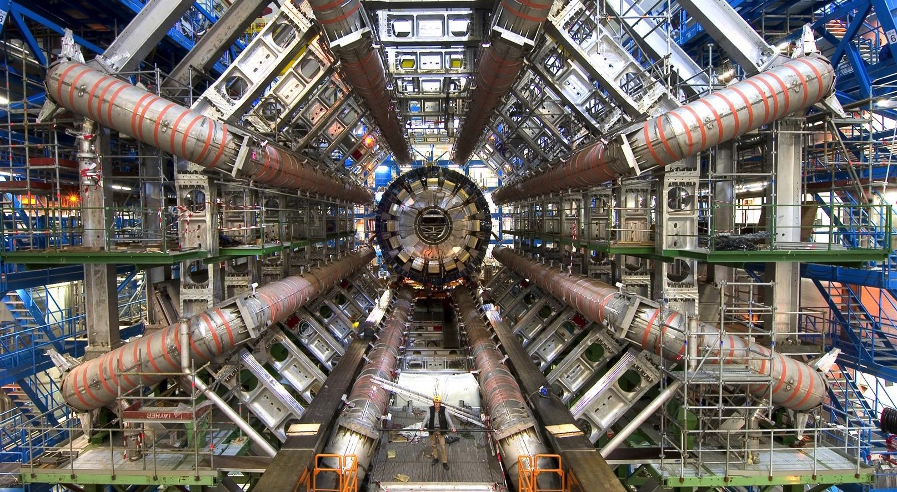

Slide 3
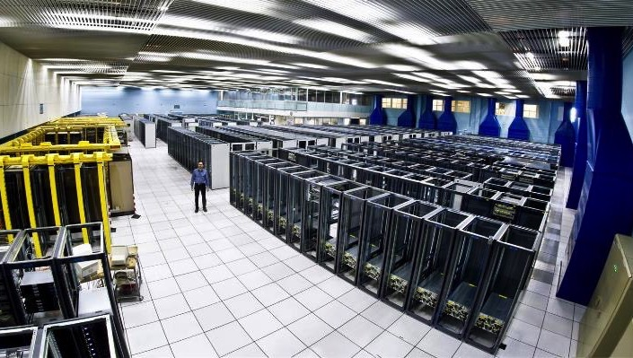
THE CERN MEYRIN
DATA CENTRE
http://goo.gl/maps/K5SoG
Notes:
Recording and analysing the data takes a lot of computing power.
The CERN computer centre was built in the 1970s for mainframes and crays. Now running at 3.5MW of power, it houses 11,000 servers but is at the limit of cooling and electrical power. It is also a tourist attraction with over 80,000 visitors last year!
As you can see, racks are only partially empty in view of the limits on cooling.

Slide 4
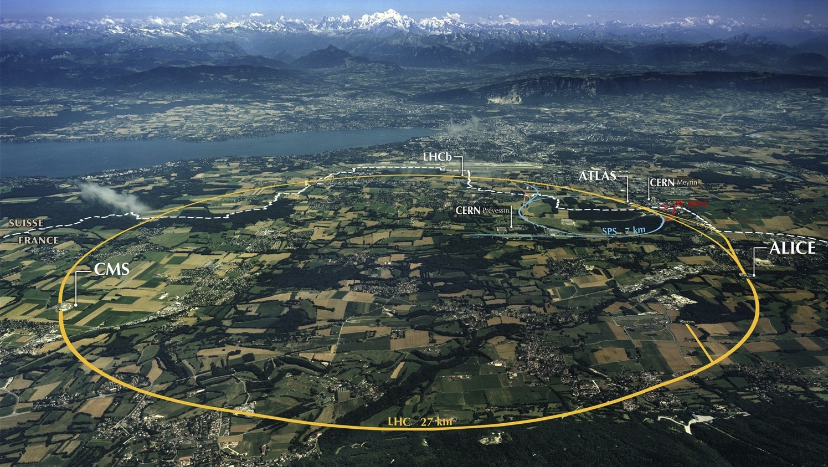

Slide 5
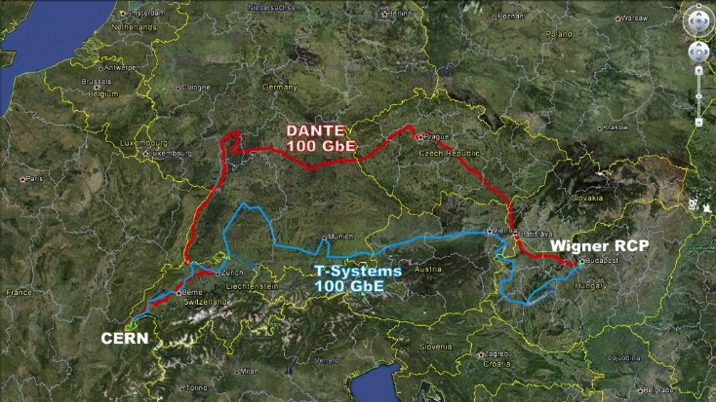

Slide 6
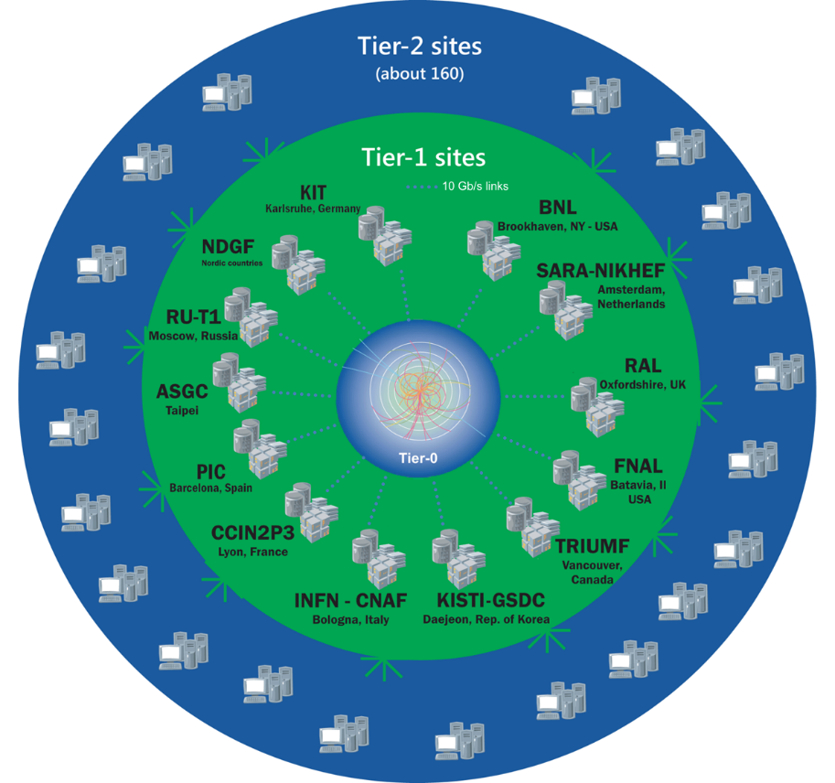

The Worldwide LHC Computing Grid
TIER-0 (CERN):
data recording, reconstruction and distribution
nearly 170 sites,
40 countries
~350’000 cores
TIER-1:
permanent storage,
re-processing,
analysis
500 PB of storage
> 2 million jobs/day
TIER-2:
Simulation,
end-user analysis
10-100 Gb links
Image courtesy of CERN

Slide 7
OpenStack Private Cloud Status
4 OpenStack clouds at CERN
  Largest is ~120,000 cores in ~5,000 servers
  3 other instances with 45,000 cores total
  1,100 active users
Running OpenStack Juno
  3PB Ceph block storage for attached volumes
All non-CERN specific code is contributed back to the community

Slide 8

Federated Clouds
Many Others
on Their Way
Public Cloud such
as Rackspace
NecTAR
Australia
Brookhaven
National Labs
ALICE Trigger
12K cores
CERN Private Cloud
120K cores
IN2P3
Lyon
ATLAS Trigger
28K cores
CMS Trigger
12K cores
Image courtesy of CERN

Slide 9
Prior openlab activity
Developed OpenStack identity federation
  Demo between CERN and Rackspace at the Paris summit

Slide 10
Current openlab activity
Expand federation functionality
Developing workload federation so a CERN researcher can deploy to other clouds
  Images
  Orchestration

Slide 11
Significance
CERN’s computing challenges and collaboration with Rackspace has fostered sustainable innovation
We have fruitful areas where our research interests overlap
Plus, Rackspace staff and customers feel good about our association
Giri Fox
Director, Customer Technical Services
@girifox

