Slide 2


Starting with databases at CERN: RDBMS for beginners
Lorena Lobato Pardavila
CERN IT Department – DB Group

Slide 3

About the speaker
Lorena Lobato Pardavila
Hometown: Vigo(Spain)
Studies
  National Vocational Qualification 4 in Telecommunication System and Computer Science (School Francisco Asorey,2004)
  Bachelor Degree in Computer Science Management (University of Vigo, 2007)
  Master Degree in Computer Science Engineer (University of Vigo,2012)
Career
  Computer System Designer and Analyst(2009-2010, Indra)
  Senior Consultant (2010, Redegal)
  Software Developer (2011-2012, Technical Student PH/ES)
  Replication Technologies Administrator (2012 - Fellow Openlab IT/DB )
Sports lover!
Starting with databases at CERN: RDBMS for beginners – Lorena Lobato Pardavila

Slide 4

Agenda
1.What’s a database?
2.Databases models
3.DBMS
1.Objective
2.Description
3. SQL Functions
4.JOINS
5. Aggregating data
1.Definition
2. Basic Concepts
3.Constraints
4.Data Integrity
Introduction to databases
RDBMS
Structured query language (SQL)
What IT-DB group does?
Questions
Replication Technologies at WLCG - Lorena Lobato Pardavila

Slide 5
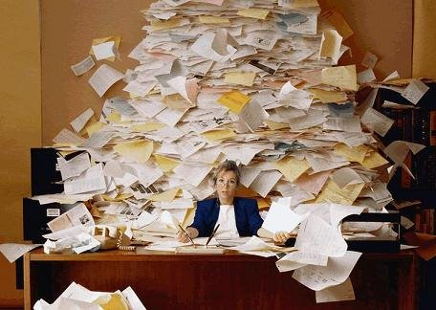
Introduction to Databases
Starting with databases at CERN: RDBMS for beginners – Lorena Lobato Pardavila
Notes:
Organized Collection of Data

Slide 6
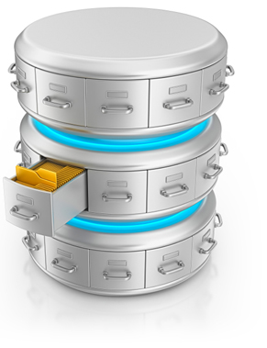
Introduction to Databases
What is a database?
Starting with databases at CERN: RDBMS for beginners – Lorena Lobato Pardavila
Notes:
Organized Collection of Data

Slide 7

Introduction to Databases
Starting with databases at CERN: RDBMS for beginners – Lorena Lobato Pardavila
Notes:
Organized Collection of Data

Slide 8
Introduction to Databases
Database Models: Way of storing and retrieving the data
    Hierarchical
      Data is stored in the form of a tree with one-to-many relationship between entities.
    Network
      Data is stored along with pointers, which specify the relationship between entities.
    Relational
      This stores data in the form of a table.
Starting with databases at CERN: RDBMS for beginners – Lorena Lobato Pardavila

Slide 9
Introduction to Databases
DBMS
      Software tools that enable the management (definition, creation, maintenance and use) of large amounts of interrelated data stored in a computer accessible media.
DBMS features
  Support for large amount of data
  Data sharing, concurrency and locking
  Data security
  Data integrity
  Fault tolerance and recovery
Starting with databases at CERN: RDBMS for beginners – Lorena Lobato Pardavila

Slide 10

Introduction to Databases
Organized collection of data treated as an unit
Purpose: To store and retrieve related information
Oracle Database 12c Production Databases running at CERN
Oracle database consists of
  Data files
  Control files
  Online redo log files
Starting with databases at CERN: RDBMS for beginners – Lorena Lobato Pardavila

Slide 11
RDBMS
      A Relational Database Management System (RDBMS) is a database management system (DBMS) that is based on the relational model as introduced by E. F. Codd.
      Allows application system simply makes a “call” to the RDBMS in order to be used to manage the organization, storage, access, security and integrity of data
Starting with databases at CERN: RDBMS for beginners – Lorena Lobato Pardavila

Slide 12
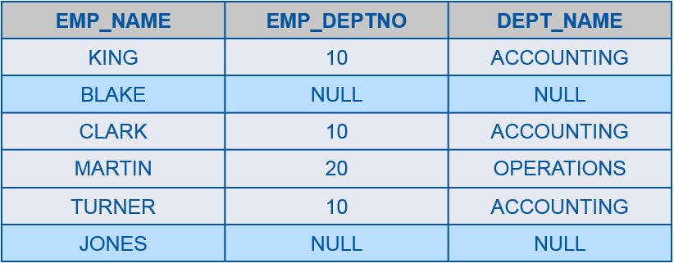
RDBMS
Basic Concepts
      Table: Collection of relates entries and it consists of columns and rows
      Tuple/Row: Each row represents the data of a single entry
      Attribute/Column: A column stores an attribute of the entity
Starting with databases at CERN: RDBMS for beginners – Lorena Lobato Pardavila

Slide 13
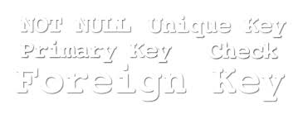
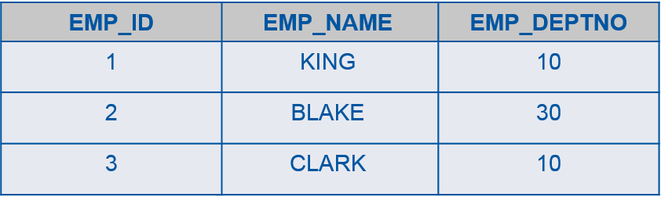
RDBMS
Constraints
  NOT NULL: Ensures that a column cannot have NULL value.
  DEFAULT: Provides a default value for a column when none is specified.
  UNIQUE: Ensures that all values in a column are different.
  PRIMARY KEY: Uniquely identified each rows/records in a database table.
Starting with databases at CERN: RDBMS for beginners – Lorena Lobato Pardavila

Slide 14
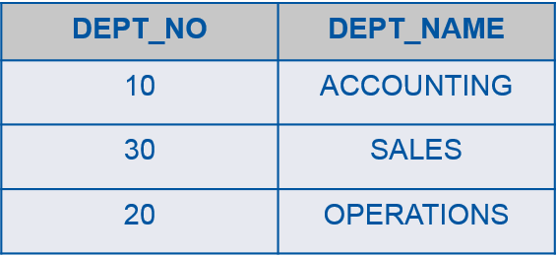
RDBMS
Constraints
  FOREIGN KEY: Uniquely identified a rows/records in any another database table.
  CHECK: The CHECK constraint ensures that all values in a column satisfy certain conditions.
Starting with databases at CERN: RDBMS for beginners – Lorena Lobato Pardavila

Slide 15
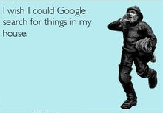

RDBMS
Constraints
  INDEX: Data structure used to create and retrieve data from the database very quickly.
  The general rule is anything that is used to limit the number of results you’re trying to find.
  SELECT * FROM employee WHERE emp_name = ‘Gonzalez’;
  Index creation
Starting with databases at CERN: RDBMS for beginners – Lorena Lobato Pardavila

Slide 16
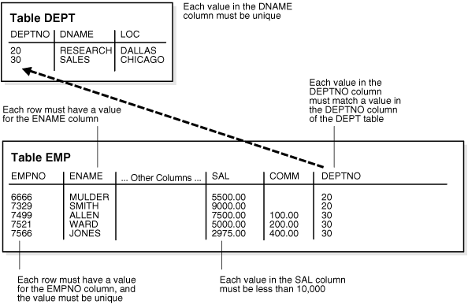
RDBMS
Data Integrity
  Entity Integrity: There are no duplicate rows in a table.
  Domain Integrity: Enforces valid entries for a given column by restricting the type, the format, or the range of values.
  Referential integrity: Rows cannot be deleted, which are used by other records.
  .
Starting with databases at CERN: RDBMS for beginners – Lorena Lobato Pardavila

Slide 17
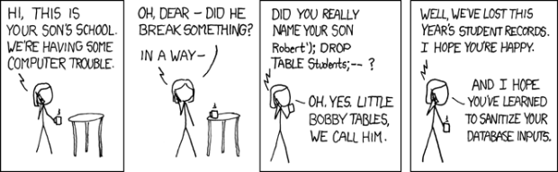
Structured query language (SQL)
Structured Query Language
Official ANSI Standard
Developed by IBM(1970) to support its various relational products
Simple programming language used for accessing and managing data in relational databases
Starting with databases at CERN: RDBMS for beginners – Lorena Lobato Pardavila

Slide 18
Structured query language (SQL)
Objective
  Be able to perform the basic operation of the RDBMS data model
    create, modify the layout of a table
    remove a table from the user schema
    insert data into the table
    retrieve and manipulate data from one or more tables
    update/ delete data in a table
Starting with databases at CERN: RDBMS for beginners – Lorena Lobato Pardavila

Slide 19
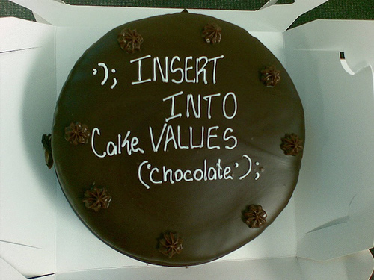
Structured query language (SQL)
Description of available statements
    Data Retrieval
        SELECT
    Data Manipulation Language(DML)
        INSERT, UPDATE and DELETE
    Transaction Control
        COMMIT and ROLLBACK
    Data Definition Language(DDL)
        CREATE,ALTER,DROP,RENAME and TRUNCATE
    Data Control Language(DCL)
        GRANT and REVOKE
Starting with databases at CERN: RDBMS for beginners – Lorena Lobato Pardavila

Slide 20
Structured query language (SQL)
SQL Functions
Oracle provides a set of SQL functions for manipulation of column and constant values
      Numeric
      Character or Text
      Date
      Conversion
      Other
SELECT ROUND (unit_price) FROM product;
SELECT UPPER (product_name) FROM product;
SELECT TO_DATE('02/05/2010','DD/MM/YYYY')
FROM DUAL;
Starting with databases at CERN: RDBMS for beginners – Lorena Lobato Pardavila

Slide 21
Structured query language (SQL)
Types of join
Retrieve data from tables defining a condition for the row association
EQUIJOIN | Values in the two corresponding columns of the different tables must be equal
NON-EQUIJOIN | The relationship between the columns of the different tables must be other than equal
OUTERJOIN (LEFT, RIGHT, FULL) | It returns also the rows that do not satisfy the join condition
SELFJOIN | Joining data in a table to itself
Starting with databases at CERN: RDBMS for beginners – Lorena Lobato Pardavila

Slide 22
Structured query language (SQL)
Equijoin
Retrieve data from tables defining a condition for the row association
SQL> SELECT e.emp_name, e.emp_deptno, d.dept_name
FROM emp e, dept d
WHERE e.emp_deptno = d.deptno
ORDER BY emp_name;
EMP_NAME | EMP_DEPTNO
KING | 10
BLAKE | 30
CLARK | 10
DEPT_NO | DEPT_NAME
10 | ACCOUNTING
30 | SALES
20 | OPERATIONS
EMP_NAME | EMP_DEPTNO | DEPT_NAME
KING | 10 | ACCOUNTING
BLAKE | 30 | SALES
CLARK | 10 | ACCOUNTING
Starting with databases at CERN: RDBMS for beginners – Lorena Lobato Pardavila

Slide 23
Structured query language (SQL)
SQL> SELECT e.emp_name, e.emp_deptno, d.dept_name
FROM emp e, dept d
WHERE e.emp_deptno = d.deptno(+)
ORDER BY emp_name;
Outerjoin
EMP_NAME | EMP_DEPTNO
KING | 10
BLAKE | NULL
CLARK | 10
MARTIN | 20
TURNER | 10
JONES | NULL
DEPT_NO | DEPT_NAME
10 | ACCOUNTING
30 | SALES
20 | OPERATIONS
EMP_NAME | EMP_DEPTNO | DEPT_NAME
KING | 10 | ACCOUNTING
BLAKE | NULL | NULL
CLARK | 10 | ACCOUNTING
MARTIN | 20 | OPERATIONS
TURNER | 10 | ACCOUNTING
JONES | NULL | NULL
Starting with databases at CERN: RDBMS for beginners – Lorena Lobato Pardavila

Slide 24
Structured query language (SQL)
Aggregating data
Data can be grouped and some summary values can be computed
Functions
  AVG, COUNT, MAX, MIN, STDDEV, SUM, VARIANCE
Clauses
  group by - used to define the grouping parameter
  having - used to limit the output of the statement
  SELECT COUNT(*) FROM employees;
  SELECT COUNT(email) FROM employees;
  SELECT COUNT(DISTINCT div_id) FROM employees;
  SELECT SUM(salary) FROM employees;
Starting with databases at CERN: RDBMS for beginners – Lorena Lobato Pardavila

Slide 25

What IT-DB group does?
Three sections IT-DB
    IT-DB-DBB
    IT-DB-DBF (mine! ☺)
    IMS
Several Functions
  Accelerator Database Service
  Backup and Restore Service
  Experiment Database Service
  General Purpose Database Service
Starting with databases at CERN: RDBMS for beginners – Lorena Lobato Pardavila
Notes:
Services
THE FOLLOWING SERVICES ARE UNDER THE RESPONSIBILITY OF THIS TEAM
ServiceResponsibleDescriptionAccelerator Database ServiceIT-DB-DBFThis service provides tailored support for accelerator related database applications.
Backup and Restore ServiceIT-DB-DBBThe CERN IT department provides a centralized service to backup CERN-owned server machines containing critical data in the computer centre.
The IBM Tivoli Storage Manager product (TSM) is currently used to provide this function.
Engineering Database ServiceIT-DBOBSOLETE - Merged with SE = "General Purpose Database Service"
This service provides tailored support for EDMS related database applications.
Experiment Database ServiceIT-DBThis service provides support for Oracle-based services to the Physics community at CERN, in particular for applications related to detector conditions, PVSS, bookkeeping, file transfers, physics production processing, detector construction and calibration, and LHC Computing Grid services (such as the LCG file catalog LFC or the gLite file transfer FTS, the grid monitoring tools and experiments dashboards).
General Purpose Database ServiceIT-DBThis service provides, operates and maintains the backend and middle-tier infrastructure for database applications as well as database expertise for software developers.
General Purpose Databases include the IT and the Engineering databases.

Slide 26
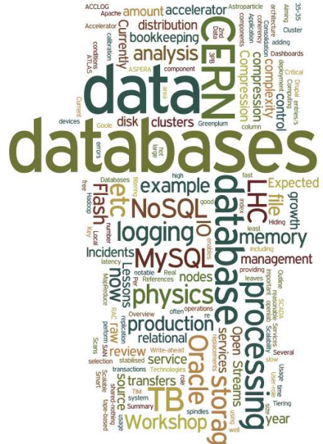
What IT-DB group does?
Openlab
  Database Competence Centre
  Oracle is our sponsor
  Currently 6 Fellows
  Fields involved
      Replication technologies
      Virtualization
      Data analytics
      Java Enterprise Edition
      Monitoring and Oracle 12c
Starting with databases at CERN: RDBMS for beginners – Lorena Lobato Pardavila

Slide 27
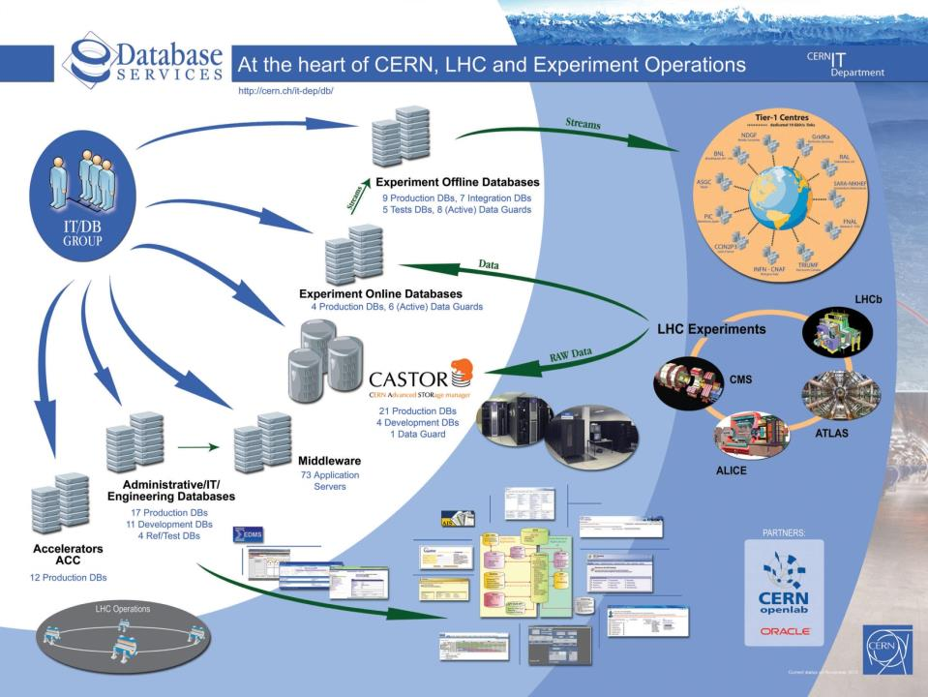
What IT-DB group does?
Starting with databases at CERN: RDBMS for beginners – Lorena Lobato Pardavila

Slide 28

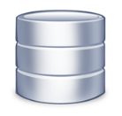



What IT-DB group does?
~100 Oracle databases, most of them RAC
  Mostly NAS storage plus some SAN with ASM
  ~500 TB of data files for production DBs in total
Example of critical production DBs:
  LHC logging database ~200 TB, expected growth up to ~70 TB / year
But also as DBaaS, as single instances
  MySQL Open community databases
  PostgreSQL databases
  Oracle12C
And additional tests setups: Hadoop + Impala, CitusDB
Starting with databases at CERN: RDBMS for beginners – Lorena Lobato Pardavila

Slide 29


Questions?
      Thank you! / Merci! / Спасибо!
      More info: lorena.lobato@cern.ch
Starting with databases at CERN: RDBMS for beginners – Lorena Lobato Pardavila

Slide 31
DEPT_NAME
ACCOUNTING
NULL
ACCOUNTING
OPERATIONS
ACCOUNTING
NULL
Outerjoin
EMP_ID
1
2
3
4
5
6
EMP_NAME | EMP_DEPTNO
KING | 10
SMITH | 20
CLARK | 10
MARTIN | 20
TURNER | 10
WHITE | 30
DEPT_NAME
ACCOUNTING
OPERATIONS
ACCOUNTING
OPERATIONS
ACCOUNTING
SALES
EMP_NAME | EMP_DEPTNO | DEPT_NAME
KING | 10 | ACCOUNTING
BLAKE | NULL | NULL
CLARK | 10 | ACCOUNTING
MARTIN | 20 | OPERATIONS
TURNER | 10 | ACCOUNTING
JONES | NULL | NULL
DEPT_NO | DEPT_NAME
10 | ACCOUNTING
20 | OPERATIONS
30 | SALES
Starting with databases at CERN: RDBMS for beginners – Lorena Lobato Pardavila

