Slide 1
Speeding-up Large-Scale Storage with Non-Volatile Memory
CERN openlab Open Day
10 June 2015
KL Yong
Sergio Ruocco
Data Center Technologies Division

Slide 2
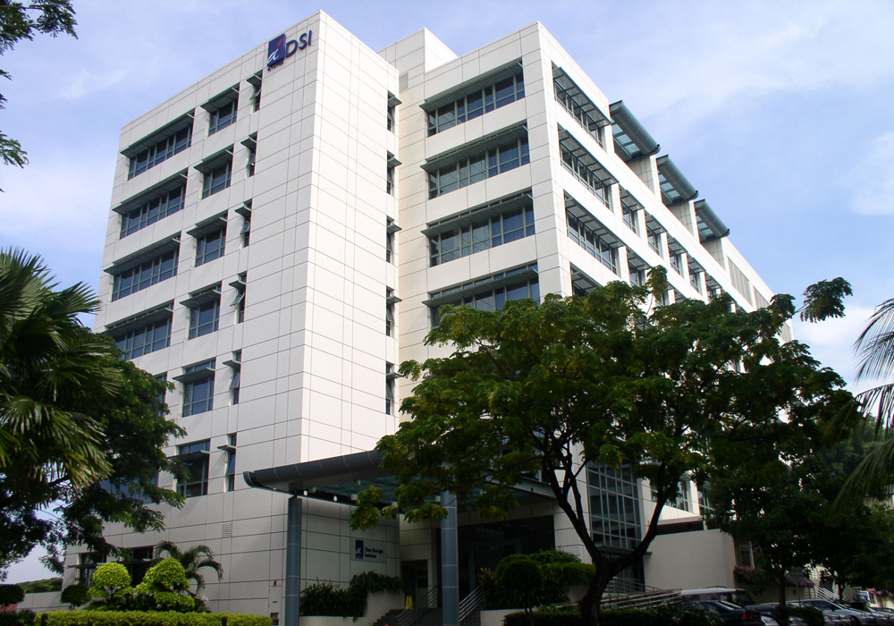
about
DSI
vision
Founded in 1992, DSI’ vision is to be a vital node in a global community of knowledge generation and innovation, nurturing research talents and capabilities for world class R&D in next generation technologies.
mission
To establish Singapore as an R&D center of excellence in data storage technologies.

Slide 3
Core Competencies
HARD DISK DRIVE
TECHNOLOGIES
10Tb/in² areal density technologies
Thin Hybrid HDD (0.5TB 2.5”, 5mm, hybrid HDD)
STT-MRAM
ReRAM
Signal Processing & Error Correction
IC Design
NON-VOLATILE
MEMORIES
NVM System
Active Hybrid Storage System
Big Data Analytics Platform
Data & Storage Security
DATA CENTER TECHNOLOGIES
Nanofabrication
Spintronics
Plasmonics
Photo-Electronics
Metamaterials and Small Particle Physics Research
ADVANCED CONCEPT & NANOFABRICATION TECHNOLOGIES
Notes:
Top to bottom

Slide 4
Massive Data Key Challenge for Data Center
Performance
CAPEX cost for additional IT equipment - servers, networks and storage
Driving the energy costs
Larger footprint and space required
Increasingly challenging and costly to scale and deliver performance
Increasing complexity in operating and managing the data center
Providing data protection and security for massive amount of data
Scalability
Security
Energy Consumption
Space
Manageability

Slide 5
Future Data Center Architecture with Emerging Technologies
Integration of
Hybrid Drive
Active Drive
NVM
Software
Managed
Homomorphic
Security
Hard Disk
Controller
Open
Flow
Magnetic
Media
NVM
Cache
Performance, scalable, secured, energy and cost efficient
Notes:
A total of $13.8M SGD allocated for 7 projects over 3 years,

Slide 6
Next Generation Non Volatile Memory (NVM)
Characteristics of next generation NVM:
+ high speed ~ DRAM like
+ data persistent against power loss
+ byte-addressable (vs 4KB- 512KB blocks)
+ endurance (~DRAM like) >>> Flash
+ no refresh cycles/energy
Technology | Read | Write | Endurance Cycle | Read (V) | Write (V) | Maturity
HDD (15KRPM) | 6000μs | 6000μs | NA | 5V, 12V | 5V,12V | Product
SLC Flash | 25μs | 200μs/1.5ms (Program/Erase) | 10⁵ (1000x for MLC) | 2 | 15 | Product
DRAM | <10ns | <10ns | 10¹⁶ | 1.8 | 2.5 | Product
STT-MRAM | 2-20ns | 2-20ns | 10¹⁵ | 0.7 | + 1 | Advanced Development

Slide 7
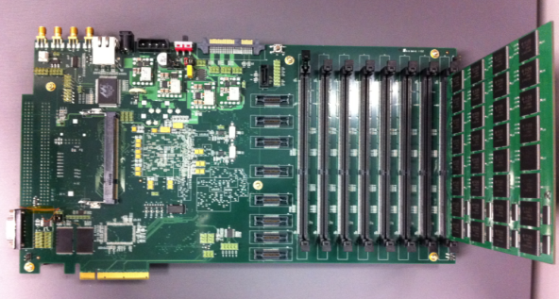
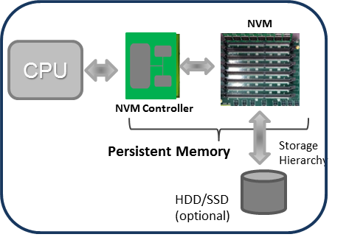
NVM Research in DSI: Device to System
NVM Device
NVM Controller
NVM-based Systems
Materials & Structure
Signal Processing
Process
IC Integration
I/O Flow, Scheduling, Buffering
Wear Leveling
Erasure Coding
FPGA and firmware
NVM File System
System, Memory & Storage Stacks
Programming Model, Language & Toolchains
NVM Systems
Cluster

Slide 8
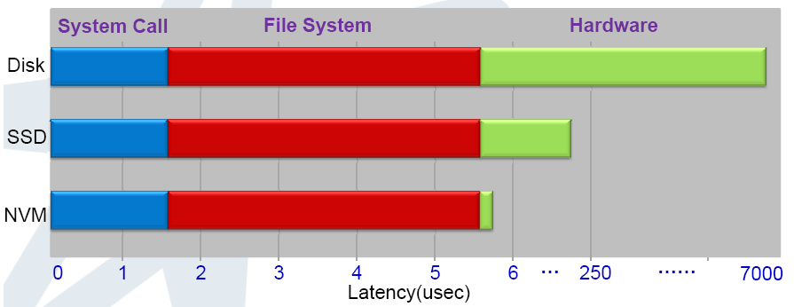
Next Generation Non-Volatile Memory
8msec
50usec
2usec
8000
To fully exploit its performance, the hardware architecture and OS stacks including programming model – applications, languages, compilers/VMs, run-time libraries, middleware,... – must change

Slide 9
NVM Software Programming Model
Application
Application
POSIX
Direct memory
load/store
NVM Programming Primitives & Lib
File System
NVM
New programming model for NVM provides data persistence integrated into the application programs:
Byte-addressable
Load/Storage access without demand paging
Memory performance
Notes:
Programming model and primitives for persistent NVM
NVM software compiler and toolchains
NVM runtime libraries
OS support

Slide 10
CERN EOS NameSpace
9.6M files
93M files
Metadata operations (create, rename, move, delete etc.) are sped-up by in-memory NameSpace, with a growing RAM footprint of 100+ GBs Disk-based logs enable consistent reconstruction of NameSpace to recover after any hw & sw faults
4.4M files
100GB+ RAM
catalog or NameSpace
7.4M files
client 1
68M files
EOS node
client 2
client 100
50+ PB experimental data in 150M+ files across 5 experiments (nodes): ATLAS, CMS, LHCB, ALICE… Node availability critical for the continued operation of thousands of clients
disk-based log
client 1000+

Slide 11
Challenges: Availability and Consistency
Read-only FailOver
One of the challenges is the consistent journaling of metadata updates between memory and disk logs; but also across failures of the NS service, the hardware or power.
Reconstructing a 100GB+ Catalog can take even 10 minutes, disrupting client’s work.
Reconstruction is not IO-bound but CPU-bound because data structures trade-off lookup speed against insert speed.
client 1
client 2
Failed & recovering
client 100
disk-based log
client 1000+

Slide 12
Proposed Solution: EOS Catalog in Non-Volatile Memory
Store the instance of the EOS Catalog in Non-Volatile Memory. NVM-based Catalog is persistent, fault-tolerant, and always consistent. No more slow reconstructions from logs
.
Non-Volatile Memory
client 1
Persistent Catalog
Read-Write Node
client 2
client 100
Volatile memory
client 1000+
Failed & recovering
disk-based log

Slide 13
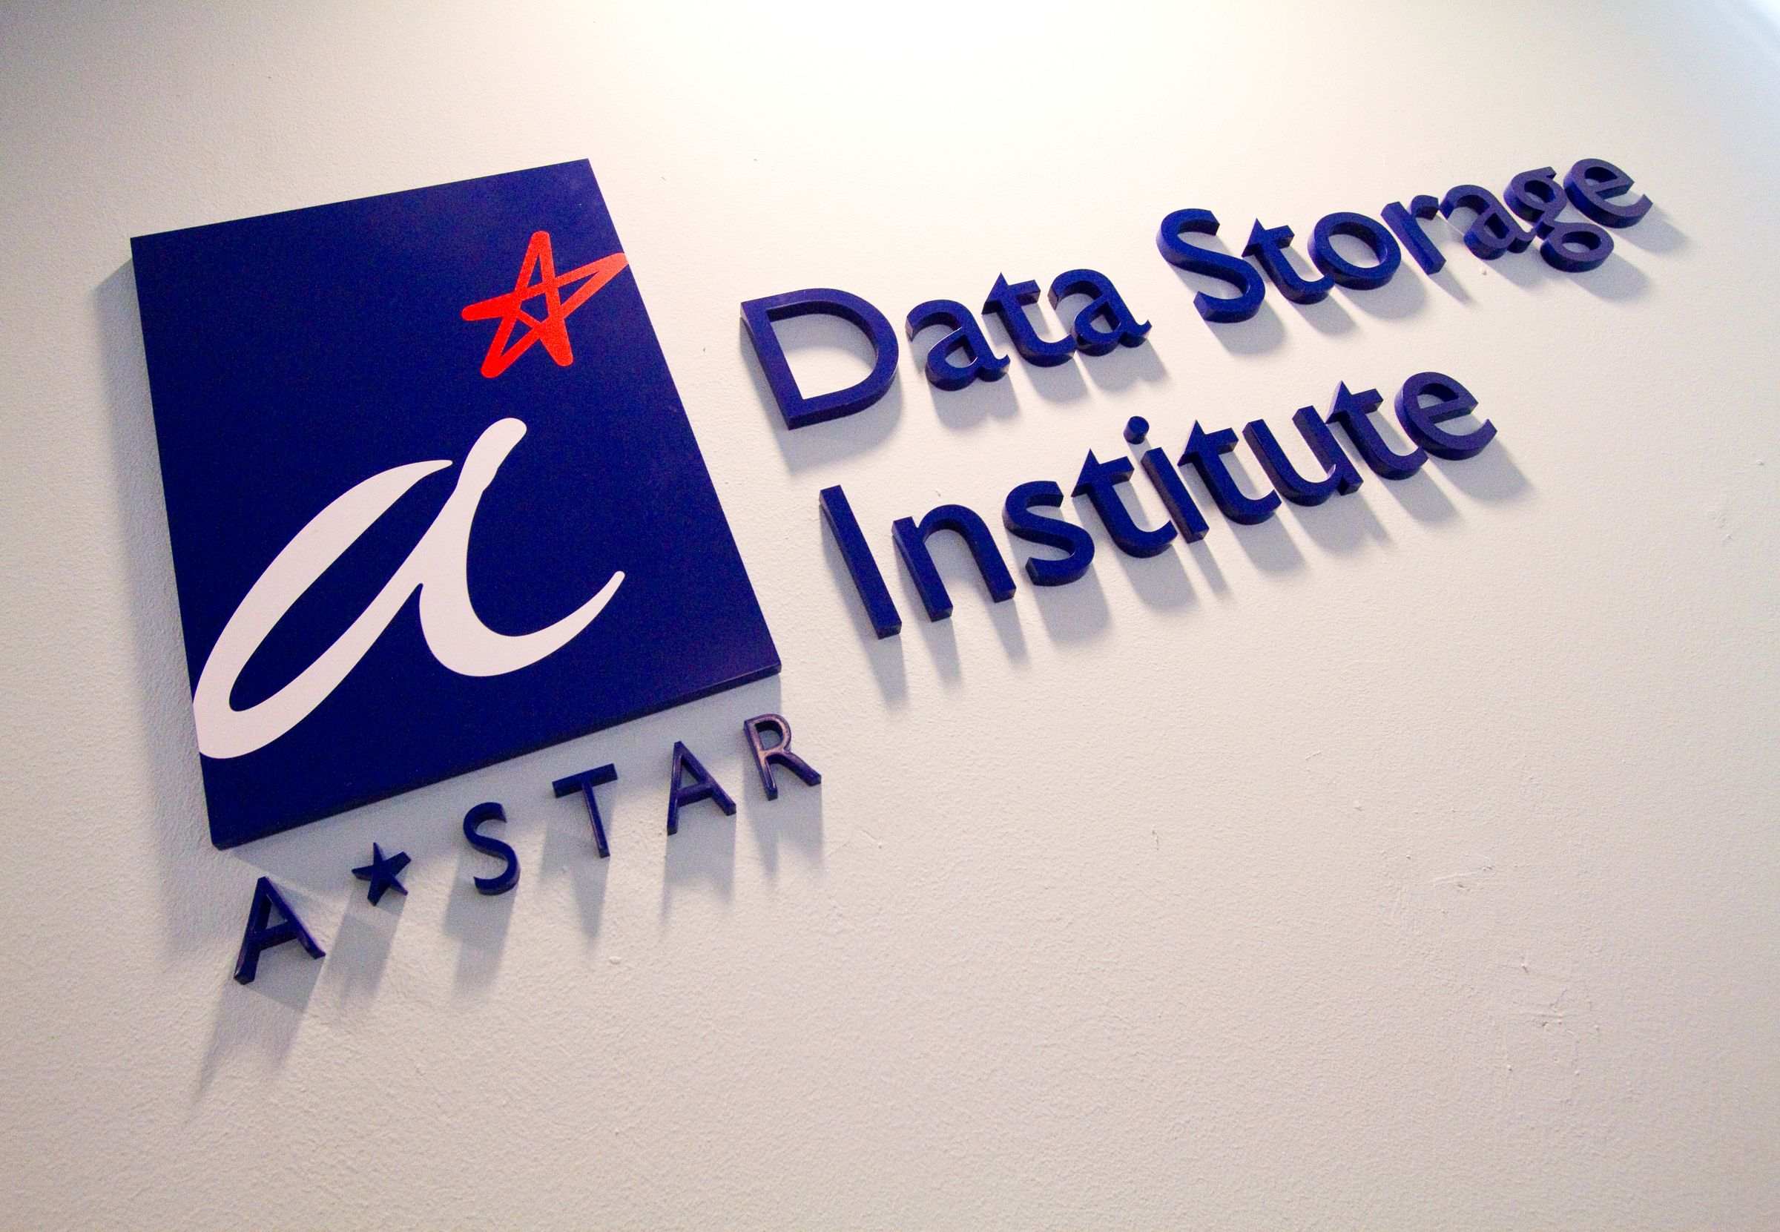
of Enabling
Storage
Technologies

