Slide 1
Optimal Flow Placement in SDN Networks
Mohammad Hanif
June 2015

Slide 2
Legal Disclaimer
All or some of the products detailed in this presentation may still be under development and certain specifications, including but not limited to, release dates, prices, and product features, may change. The products may not function as intended and a production version of the products may never be released. Even if a production version is released, it may be materially different from the pre-release version discussed in this presentation.
NOTHING IN THIS PRESENTATION SHALL BE DEEMED TO CREATE A WARRANTY OF ANY KIND, EITHER EXPRESS OR IMPLIED, STATUTORY OR OTHERWISE, INCLUDING BUT NOT LIMITED TO, ANY IMPLIED WARRANTIES OF MERCHANTABILITY, FITNESS FOR A PARTICULAR PURPOSE, OR NONINFRINGEMENT OF THIRD PARTY RIGHTS WITH RESPECT TO ANY PRODUCTS AND SERVICES REFERENCED HEREIN.
Brocade, the B-wing symbol, DCX, Fabric OS, File Lifecycle Manager, MyView, and StorageX are registered trademarks, and DCFM and SAN Health are trademarks of Brocade Communications Systems, Inc., in the United States and/or in other countries. All other brands, products, or service names are or may be trademarks or service marks of, and are used to identify, products or services of their respective owners.

Slide 3
Agenda
Challenges
Use Cases
Elephant Flow Management
Solution Overview
Highlights
Benefits

Slide 4
Some of the Challenges in today’s Network
Do I have enough bandwidth/capacity in the network?
Are my links running at capacity? Do I need to redirect traffic?
What applications are consuming the most bandwidth?
Can I traffic engineer my network in real-time? When do peaks occur?
Which is the busiest server in my network?
Do I have any bad flows?
Network Intelligence: Identify Network issues and address them in real-time

Slide 5
Flow Optimizer Use Cases
Volumetric Attack Mitigation
Flow Metering
SDN Based Wiretap
Firewall Bypass
Botnet Attack Mitigation
Elephant Flow Management

Slide 6



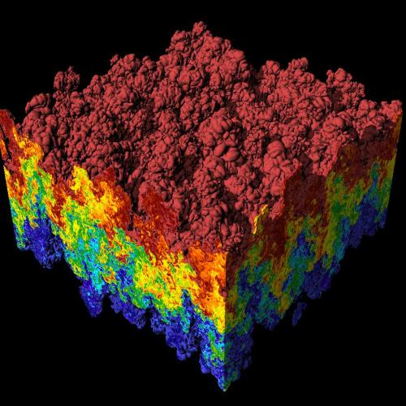
Elephant Flow Management
Dynamic and Programmatic Action for Efficient Network
Programmable / Scheduled via Northbound API
Brocade Flow Optimizer
App
sFlow Collector
Monitor
Flow Policy
matched flow parameters, action
Backup
sFlow samples
for flow
visibility
Scientific Computing
OF rule
WAN / Cloud
OF
Matching
Normal Forwarding
Regular Traffic
Campus / DC
Re-mark
Critical
Re-direct
Dedicated network for Elephants
MLXe
Programmable profile and action for elephant flow
Northbound API for scheduled or on-demand elephant flow management
No impact to regular routing

Slide 7
SDN-based volumetric traffic management
Brocade Application that works with OpenDaylight controller
Avoids network congestion without disrupting the traffic path
Policy based large flow detection and management with fine-grained control
Supports metering, redirection and remark actions for optimal flow management
Dashboard and reports for visibility into traffic flow

Slide 8

Brocade SDN Solution Components
Volumetric Traffic Management
3
Brocade Flow Optimizer
UI
Portal
Brocade Network Devices
  Send sFlow samples
sFlow Collector(s)
  Collect flow sample data
Brocade SDN Application
  Analyzes and manages flows
  Policy-based UI and REST APIs
SDN Controller
  Programs OpenFlow 1.3 rules
  MLXe and ICX (today), VDX (future)
  OpenDaylight or Brocade Vyatta Controller
API
Brocade sFlow Collector
2
4
1

Slide 9



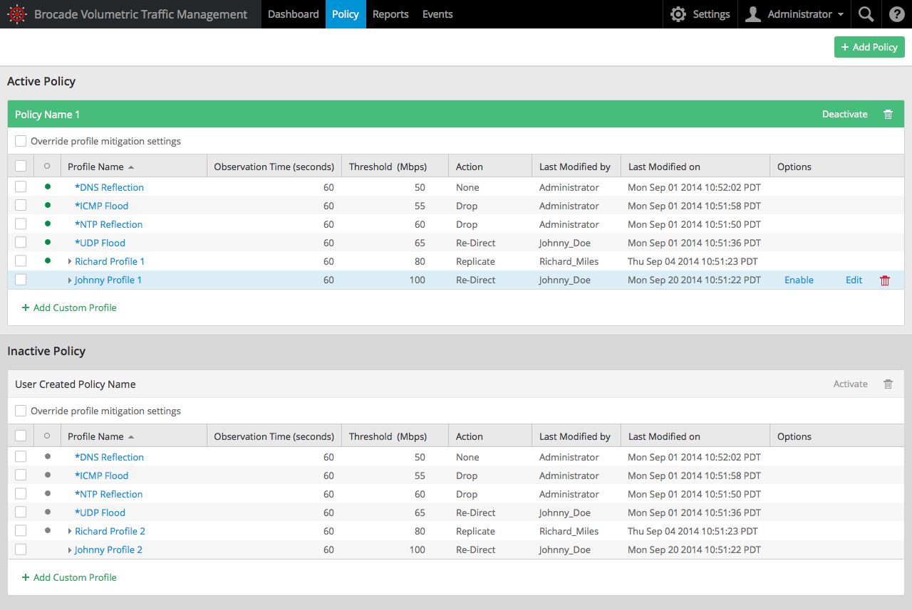
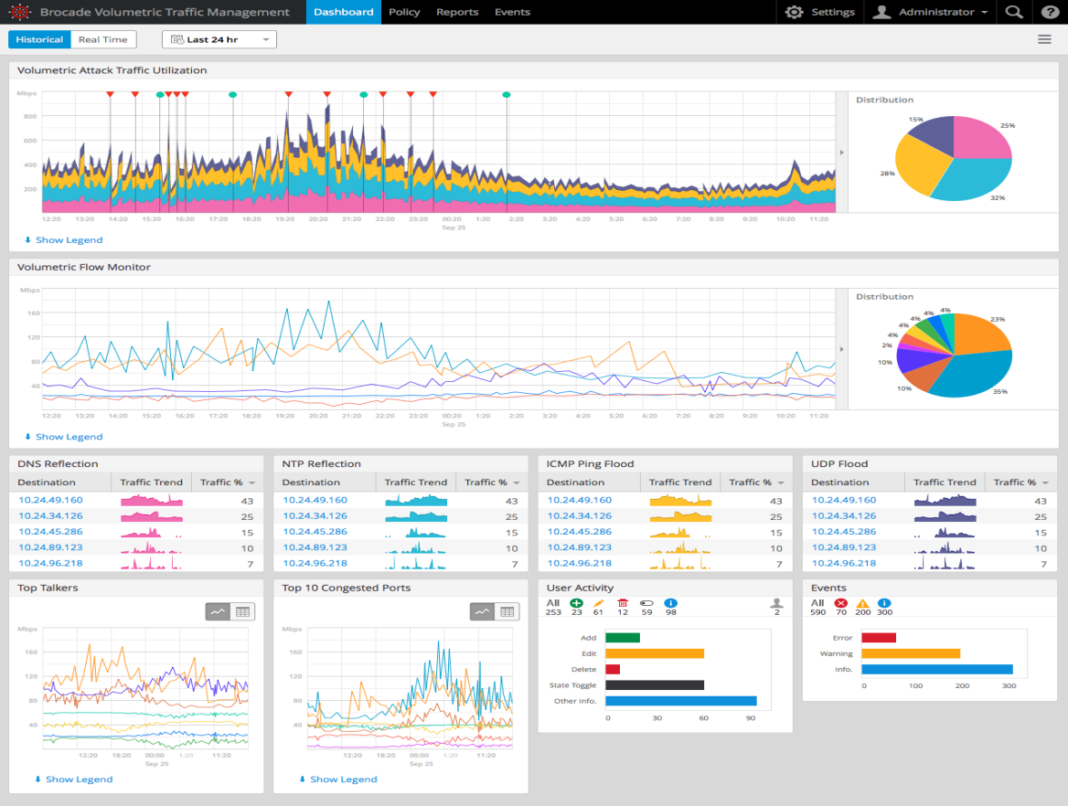
Flow Optimizer Highlights
Flow Optimizer
. . .
App N
OpenFlow
sFlow
MLXe
Policy-based large flow detection and management
Embedded sFlow collector
Flow Detection
  Custom profiles based on L2, L3, L4, and Overlay matches
  Built-in profiles: UDP/ICMP Flooding, NTP/DNS Reflection
Supported Actions
  Drop; Redirect; Meter (Rate Limit); Replicate; QoS Re-Mark
OpenFlow-based App
Browser based UI: Dashboard, Real-time Graphs, Historical Charts/Graphs

Slide 10
Benefits
New services and monetization opportunities
  Threat Mitigation
  Application Management
  Wiretap Services
Increased network efficiency
  Eliminate congestion
  Better capacity and resource planning
Improved user experience
  Granular and improved SLAs
  Increased service velocity

Slide 11
Thank you
Notes:
11

