Slide 2

A Closer Look at CALIBRATE_IO
Luca Canali, CERN
Marcin Blaszczyk, CERN
UKOUG TECH14, Liverpool, December 2014

Slide 3
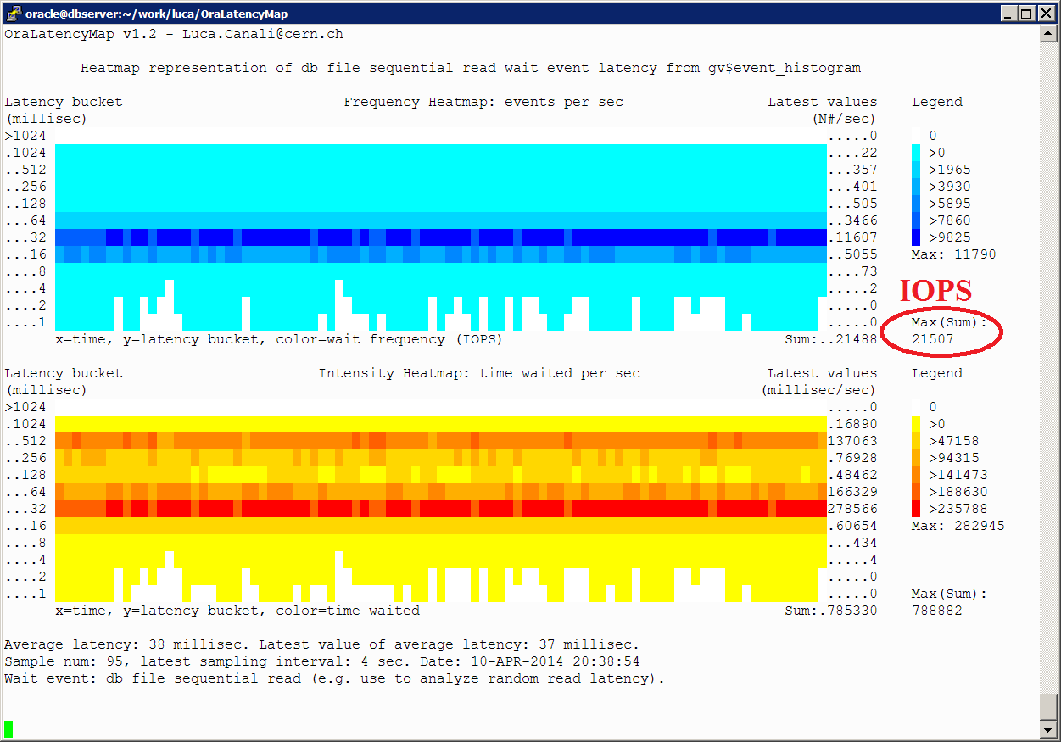

About Luca
Senior DBA and team lead at CERN IT
  Joined CERN in 2005
  Working with Oracle RDBMS since 2000
Passionate to learn and share knowledge, how to get most value from database technology
@LucaCanaliDB - http://cern.ch/canali

Slide 4

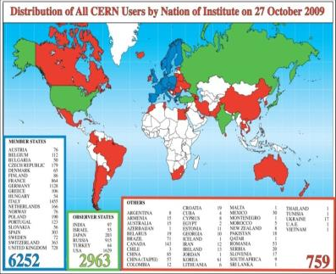
About CERN
CERN - European Laboratory for Particle Physics
Founded in 1954 by 12 countries for fundamental physics research in a post-war Europe
Today 21 member states + world-wide collaborations
  About ~1000 MCHF yearly budget
  2’300 CERN personnel + 10’000 users from 110 countries

Slide 5
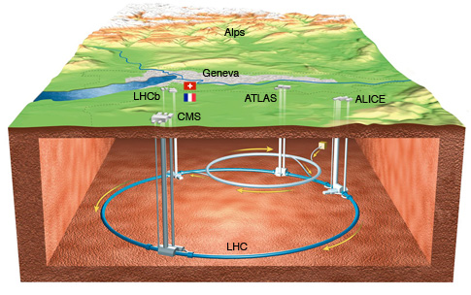
LHC is the World’s Largest Particle Accelerator
LHC = Large Hadron Collider
  27km ring of superconducting magnets
  Currently undergoing upgrades, restart in 2015

Slide 6
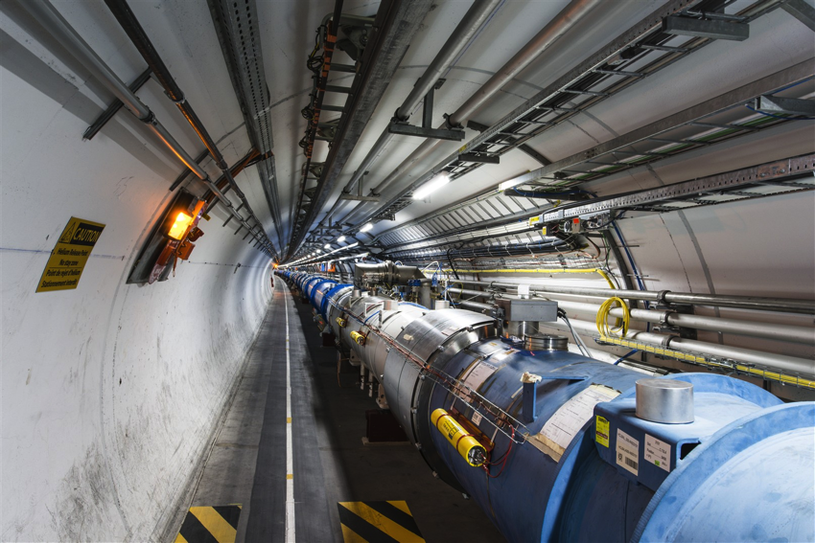

From particle
to article..
How do you get from this
to this
Notes:
New particle discovery: see also CMS and Atlas announcement on July 4th 2012.

Slide 7





CERN Database Services
~100 Oracle databases, most of them RAC
  Mostly NAS storage plus some SAN with ASM
  ~500 TB of data files for production DBs in total
Example of critical production DBs:
  LHC logging database ~170 TB, expected growth up to ~70 TB/year
But also as DBaaS, as single instances*
  160 MySQL CE (5.6, Dec 2014)
  16 PostgreSQL databases (version 9.2, Dec 2014)
  12 Oracle DBs (11g and 12c)

Slide 8
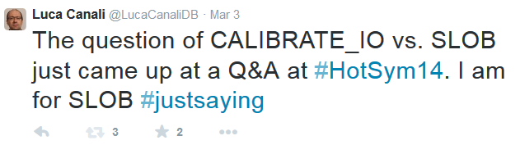
How I Became Interested in the Subject of Evaluating CALIBRATE_IO

Slide 9


About Marcin
~9 years of working with Oracle DBs
  7+ of administering mission critical DB systems
5 years spent @CERN DB group
Certified Oracle DBA & SQL Expert
3rd time speaking @UKOUG/TECH conference
Privately
  Fan of motorbikes and ….
  sport fishing☺

Slide 10
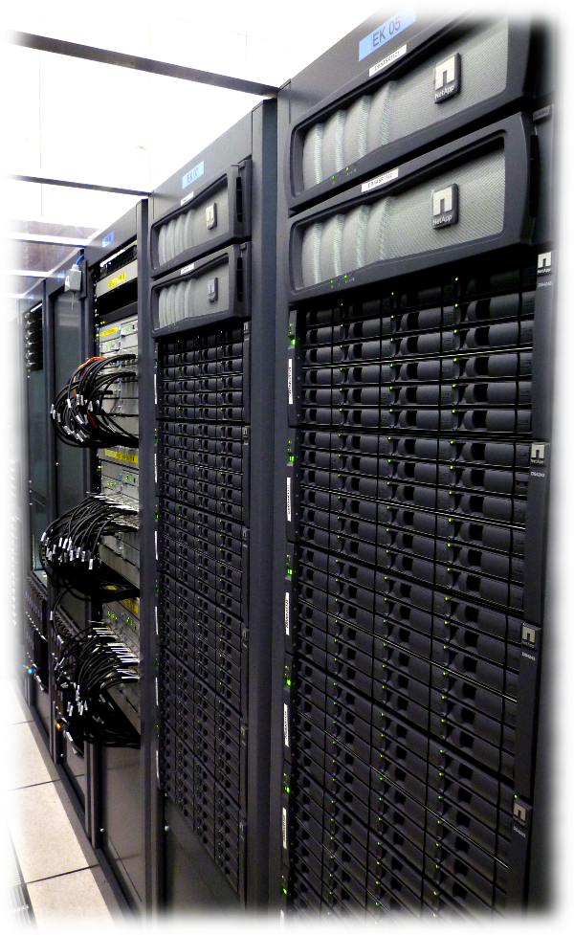
Testing Oracle I/O
I/O is critical for databases
Learn techniques for
  Investigating
  Testing
  Troubleshooting
  Performance optimization
How to measure Oracle DB workload?

Slide 11
Throughput, IOPS, Latency
In the context of storage testing
IOPS number of I/O operations per second
  Random Read IOPS very important for OLTP
Latency time to perform single operation
Throughput amount of data moved in a given time
  Depends on IOPS, Latency and type of data access
Meaningful numbers - only if we know what happens on the storage level

Slide 12
Why Use Calibrate_IO to Test Storage?
Simple & easy to run
  Works out of the box
  Integrated into DB engine
  Do not require additional installation
  Works on Active Data Guard

Slide 13
Calibrate_IO – Procedure
User with SYSDBA privilege
TIMED_STATISTICS=TRUE (STATISTICS_LEVEL=TYPICAL)
Needs asynchronous I/O
DECLARE
l_latency PLS_INTEGER;
l_iops PLS_INTEGER;
l_mbps PLS_INTEGER;
BEGIN
DBMS_RESOURCE_MANAGER.calibrate_io (num_physical_disks => &1,
max_latency => &2,
max_iops => l_iops,
max_mbps => l_mbps,
actual_latency => l_latency);
DBMS_OUTPUT.put_line('Max IOPS = ' || l_iops);
DBMS_OUTPUT.put_line('Max MBPS = ' || l_mbps);
DBMS_OUTPUT.put_line('Latency = ' || l_latency);
END;
/

Slide 14
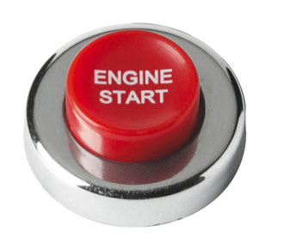
Calibrate_IO – Input Parameters
num_physical_disks
  „Approximate number of physical disks in the storage”
  Used to determine initial I/O load for calibration run
max_latency
  „Maximum tolerable latency for database-block-sized IO requests”
  We used value of 100 miliseconds
So Let’s try!

Slide 15
Calibrate_IO – Workload
We can use:
  GV$SESSION
  GV$ACTIVE_SESSION_HISTORY
Drilling down „Disk File I/O Calibration” wait event
system@ORCL> @top ← SCRIPT QUERYING FROM GVSESSION
INST_ID SID SERIAL USERNAME SQL_ID CALL_DT EVENT SERV_MOD_ACTION
-------- ------ ------- ----------- ------ ------- ------------------------- --------------- → 1st RAC NODE (…)
1 387 1311 SYS (CS0E) 26 Disk file I/O Calibration SYS$USERS
1 390 14655 SYS (CS09) 26 Disk file I/O Calibration SYS$USERS
1 2658 7163 SYS (CS08) 27 Disk file I/O Calibration SYS$USERS
1 2657 8981 SYS (CS0D) 26 Disk file I/O Calibration SYS$USERS
1 1904 187 SYS (CS0C) 26 Disk file I/O Calibration SYS$USERS
1 1523 375 SYS (CS0B) 26 Disk file I/O Calibration SYS$USERS
1 1141 23 SYS (CS0A) 26 Disk file I/O Calibration SYS$USERS
1 765 29 SYS (CS0F) 26 Disk file I/O Calibration SYS$USERS
→ 2nd RAC NODE (…)
2 8 3253 (CS00) 27 Disk file I/O Calibration SYS$USERS
2 2277 3951 (CS06) 27 Disk file I/O Calibration SYS$USERS
2 1899 79 (CS05) 27 Disk file I/O Calibration SYS$USERS
2 1520 18449 (CS04) 27 Disk file I/O Calibration SYS$USERS
2 765 27311 (CS03) 27 Disk file I/O Calibration SYS$USERS
2 387 59069 (CS02) 27 Disk file I/O Calibration SYS$USERS
2 11 31477 (CS01) 27 Disk file I/O Calibration SYS$USERS
2 2654 8195 (CS07) 27 Disk file I/O Calibration SYS$USERS

Slide 16
How to Measure I/O Workload?
GV$IOFUNCMETRIC - available since 11g (11.1)
Displays I/O statistics information, e.g:
Throughput
  Single block / Multiblock megabytes read/write per second
IOPS
  Single block / Multiblock read/write requests per second
system@ORCL> @iops
INST_ID BEGIN_TIME IOPS
-------------- -------------------- --------------
1 01-DEC-2014 11:19:00 3171 ← 1st RAC NODE
2 01-DEC-2014 11:18:21 2402 ← 2nd RAC NODE
system@ORCL> @throughput
B_TIME E_TIME READ_TOT_MBPS WRITE_TOT_MBPS TOT_MBPS
-------------------- -------------------- -------------- -------------- --------------
01-DEC-2014 11:20:21 01-DEC-2014 11:21:21 607 321 928
→ IOPS per RAC node
select inst_id,begin_time,
sum(round(small_read_iops+small_write_iops+large_read_iops+large_write_iops)) IOPS
from GV$IOFUNCMETRIC
group by inst_id, begin_time
order by inst_id;
→ THROUGHPUT for whole RAC database
select min(begin_time) b_time, min(end_time) e_time,
round(sum(large_read_mbps+small_read_mbps)) read_TOT_mbps,
round(sum(large_write_mbps+small_write_mbps)) write_TOT_mbps,
round(sum(large_read_mbps+small_read_mbps+large_write_mbps+small_write_mbps)) TOT_mbps
from GV$IOFUNCMETRIC;

Slide 17
Calibrate_IO: 1st Phase
Random reads from all nodes
DB level: GV$IOFUNCMETRIC
system@ORCL> @iometric_details ← SCRIPT QUERYING FROM GV$IOFUNCMETRIC
INST_ID BEGIN_TIME FUNCTION RD_IOPS_SM RD_IOPS_LG RD_MBPS_SM RD_MBPS_LG WT_IOPS_SM WT_IOPS_LG WT_MBPS_SM WT_MBPS_LG
------- ----------------- -------- ---------- ---------- ---------- ---------- ---------- ---------- ---------- ----------
1 02-12-14 22:20:09 Others 1813 0 14 1 84 0 0 0
2 02-12-14 22:21:31 Others 1856 0 15 0 21 0 0 0
BEGIN_TIME END_TIME READ_TOT_IOPS READ_TOT_MBPS WRITE_TOT_IOPS WRITE_TOT_MBPS
----------------- ----------------- -------------- -------------- -------------- --------------
02-12-14 22:21:31 02-12-14 22:22:31 3763 31 215 0
OS level: `strace –p <PID>`
io_submit(47804644147200, 1, {{0x2b7a62e600b0, 0, 0, 0, 288}}) = 1
times({tms_utime=26, tms_stime=38, tms_cutime=0, tms_cstime=0}) = 1776996225
io_getevents(47804644147200, 1, 128, {{0x2b7a62e60320, 0x2b7a62e60320, 8192, 0}}, {600, 0}) = 1
(...)
io_submit(47804644147200, 1, {{0x2b7a62e611c0, 0, 0, 0, 286}}) = 1
times({tms_utime=26, tms_stime=38, tms_cutime=0, tms_cstime=0}) = 1776996226
io_getevents(47804644147200, 1, 128, {{0x2b7a62e600b0, 0x2b7a62e600b0, 8192, 0}}, {600, 0}) = 1
8KB reads
ASYNCH IO

Slide 18
Calibrate_IO: 1st Phase
Random reads from all nodes
DB level: GV$IOFUNCMETRIC
system@ORCL> @iometric_details ← SCRIPT QUERYING FROM GV$IOFUNCMETRIC
INST_ID BEGIN_TIME FUNCTION RD_IOPS_SM RD_IOPS_LG RD_MBPS_SM RD_MBPS_LG WT_IOPS_SM WT_IOPS_LG WT_MBPS_SM WT_MBPS_LG
------- ----------------- -------- ---------- ---------- ---------- ---------- ---------- ---------- ---------- ----------
1 02-12-14 22:24:09 Others 2404 0 19 1 51 0 0 0
2 02-12-14 22:23:31 Others 2568 0 20 0 21 0 0 0
BEGIN_TIME END_TIME READ_TOT_IOPS READ_TOT_MBPS WRITE_TOT_IOPS WRITE_TOT_MBPS
----------------- ----------------- -------------- -------------- -------------- --------------
02-12-14 22:23:31 02-12-14 22:24:31 4972 40 72 0
OS level: `strace –p <PID>`
io_submit(47804644147200, 1, {{0x2b7a62f6c140, 0, 0, 0, 275}}) = 1
times({tms_utime=130, tms_stime=166, tms_cutime=0, tms_cstime=0}) = 1777017121
io_submit(47804644147200, 1, {{0x2b7a62e627b0, 0, 0, 0, 278}}) = 1
times({tms_utime=130, tms_stime=166, tms_cutime=0, tms_cstime=0}) = 1777017121
io_submit(47804644147200, 1, {{0x2b7a62e90a40, 0, 0, 0, 281}}) = 1
times({tms_utime=130, tms_stime=166, tms_cutime=0, tms_cstime=0}) = 1777017121
(...)
io_getevents(47804644147200, 1, 128, {{0x2b7a62e781d0, 0x2b7a62e781d0, 8192, 0}, {0x2b7a62f78e00,
(...)
0x2b7a62ea6e20, 8192, 0}}, {600, 0}) = 128
ASYNCH IO

Slide 19
Calibrate_IO: 2nd Phase
Sequential reads from all nodes
DB level: GV$IOFUNCMETRIC
system@ORCL> @iometric_details ← SCRIPT QUERYING FROM GV$IOFUNCMETRIC
INST_ID BEGIN_TIME FUNCTION RD_IOPS_SM RD_IOPS_LG RD_MBPS_SM RD_MBPS_LG WT_IOPS_SM WT_IOPS_LG WT_MBPS_SM WT_MBPS_LG
------- ----------------- -------- ---------- ---------- ---------- ---------- ---------- ---------- ---------- ----------
1 02-12-14 23:00:09 Others 5 0 0 554 1 15 0 15
2 02-12-14 23:00:31 Others 3 0 0 715 20 0 0 0
BEGIN_TIME END_TIME READ_TOT_IOPS READ_TOT_MBPS WRITE_TOT_IOPS WRITE_TOT_MBPS
----------------- ----------------- -------------- -------------- -------------- --------------
02-12-14 23:00:09 02-12-14 23:01:09 8 1268 36 15
OS level: `strace –p <PID>`
io_submit(46921770770432, 1, {{0x2b22821be9b0, 0, 0, 0, 290}}) = 1
times(NULL) = 1831042508
(…)
io_submit(46921770770432, 1, {{0x2b2282259350, 0, 0, 0, 298}}) = 1
times(NULL) = 1831042509
io_getevents(46921770770432, 1, 128, {{0x2b22821e9050, 0x2b22821e9050, 1048576, 0}}, {600, 0}) = 1
times(NULL) = 1831042509
io_submit(46921770770432, 1, {{0x2b22821e9050, 0, 0, 0, 287}}) = 1
times(NULL) = 1831042509
io_getevents(46921770770432, 34, 128, {{0x2aacd396d310, 0x2aacd396d310, 1048576, 0},
(...) , {600, 0}) = 34
1MB reads

Slide 20
Calibrate_IO: 3rd Phase
Sequential reads from a single session
DB level: GV$IOFUNCMETRIC
system@ORCL> @iometric_details ← SCRIPT QUERYING FROM V$IOFUNCMETRIC
INST_ID BEGIN_TIME FUNCTION RD_IOPS_SM RD_IOPS_LG RD_MBPS_SM RD_MBPS_LG WT_IOPS_SM WT_IOPS_LG WT_MBPS_SM WT_MBPS_LG
------- ----------------- -------- ---------- ---------- ---------- ---------- ---------- ---------- ---------- ----------
1 02-12-14 23:00:09 Others 5 0 0 554 1 15 0 15
2 02-12-14 23:00:31 Others 3 0 0 715 20 0 0 0
BEGIN_TIME END_TIME READ_TOT_IOPS READ_TOT_MBPS WRITE_TOT_IOPS WRITE_TOT_MBPS
----------------- ----------------- -------------- -------------- -------------- --------------
02-12-14 23:00:09 02-12-14 23:01:09 8 1268 36 15
system@ORCL> @iometric_details ← SCRIPT QUERYING FROM GV$IOFUNCMETRIC
INST_ID BEGIN_TIME FUNCTION RD_IOPS_SM RD_IOPS_LG RD_MBPS_SM RD_MBPS_LG WT_IOPS_SM WT_IOPS_LG WT_MBPS_SM WT_MBPS_LG
------- ----------------- -------- ---------- ---------- ---------- ---------- ---------- ---------- ---------- ----------
1 02-12-14 23:17:09 Others 8 0 0 0 81 0 0 0
2 02-12-14 23:16:31 Others 5 0 0 328 11 0 0 0
BEGIN_TIME END_TIME READ_TOT_IOPS READ_TOT_MBPS WRITE_TOT_IOPS WRITE_TOT_MBPS
----------------- ----------------- -------------- -------------- -------------- --------------
02-12-14 23:16:31 02-12-14 23:17:32 14 328 92 0
OS level: `strace –p <PID>`
io_submit(46921770770432, 1, {{0x2b22821be9b0, 0, 0, 0, 290}}) = 1
times(NULL) = 1831042508
(…)
io_submit(46921770770432, 1, {{0x2b2282259350, 0, 0, 0, 298}}) = 1
times(NULL) = 1831042509
io_getevents(46921770770432, 1, 128, {{0x2b22821e9050, 0x2b22821e9050, 1048576, 0}}, {600, 0}) = 1
times(NULL) = 1831042509
io_submit(46921770770432, 1, {{0x2b22821e9050, 0, 0, 0, 287}}) = 1
times(NULL) = 1831042509
io_getevents(46921770770432, 34, 128, {{0x2aacd396d310, 0x2aacd396d310, 1048576, 0},
(...) , {600, 0}) = 34
1MB reads

Slide 21
I/O Distribution Across Storage
Calibrate_IO reads from all files in the database
Load proportional to file size
system@ORCL> SELECT sysdate, file_no, filetype_name, sum(small_read_reqs), sum(small_read_servicetime)
FROM GV$IOSTAT_FILE
WHERE filetype_name='Data File‘ GROUP BY file_no, filetype_name
ORDER BY file_no, filetype_name;
SYSDATE FILE_NO FILETYPE_NAME SMALL_READ_REQS SMALL_READ_SERVICETIME
----------------- ------- ------------- --------------- ----------------------
02-12-14 23:57:55 1 Data File 1045986 33694991
02-12-14 23:57:55 2 Data File 789106250 409393779
(…)
system@ORCL> /
SYSDATE FILE_NO FILETYPE_NAME SMALL_READ_REQS SMALL_READ_SERVICETIME
----------------- ------- ------------- --------------- ----------------------
02-12-14 23:58:21 1 Data File 1046037 33702193
02-12-14 23:58:21 2 Data File 789106352 409408018
(…)
system@ORCL> /
SYSDATE FILE_NO FILETYPE_NAME SMALL_READ_REQS SMALL_READ_SERVICETIME
----------------- ------- ------------- --------------- ----------------------
02-12-14 23:59:28 1 Data File 1046199 33781055
02-12-14 23:59:28 2 Data File 789106607 409532304
(…)
02-12-14 23:59:28 8 Data File 70293 3234810

Slide 22
Calibrate_IO – Outputs
MAX_IOPS
  Maximum number of I/O requests that can be sustained
MAX_MBPS
  Maximum throughput of I/O that can be sustained
LATENCY
  Average latency of database-block-sized I/O
MAX_PMBPS
  Maximum throughput of large I/O requests that can be sustained by a single process
  max_pmbs avaliable only in DBA_RSRC_IO_CALIBRATE:
Max IOPS = 4997
Max MBPS = 1257
Latency = 42
PL/SQL procedure successfully completed.
system@ORCL> select * from DBA_RSRC_IO_CALIBRATE;
START_TIME END_TIME MAX_IOPS MAX_MBPS MAX_PMBPS LATENCY NUM_PHYSICAL_DISKS
----------------- ----------------- -------- -------- --------- ------- ------------------
02-12-14 17:08:01 02-12-14 17:20:37 4997 1257 398 42 50
Automatic degree of parallelism uses MAX_PMBPS and MAX_MBPS

Slide 23
JBOD & ASM
46 SATA disks in JBOD, 2 node RAC on 11.2.0.4, Linux (RHEL)
system@ORCL> @calio 50 100
old 6: DBMS_RESOURCE_MANAGER.calibrate_io (num_physical_disks => &&1,
new 6: DBMS_RESOURCE_MANAGER.calibrate_io (num_physical_disks => 50,
old 7: max_latency => &&2,
new 7: max_latency => 100,
Max IOPS = 4778
Max MBPS = 1251
Latency = 47
PL/SQL procedure successfully completed.
Elapsed: 00:09:54.25
IOPS
  Value seems correct (46 disks * ~100IOPS)
Latency:
  What does this number mean to us?
  Different values reported for the same system and same input parameters
Throughput:
  Value too small but close to expected maximum
  2ports 4Gb/s per node, we expect ~1600MBPS for this system, which we confirmed by measurements taken with parallel query

Slide 24
NAS Storage
NAS with SSD Cache, 2 node RAC on 11.2.0.4, Linux (RHEL)
system@ORCL> @calio 60 100
old 6: DBMS_RESOURCE_MANAGER.calibrate_io (num_physical_disks => &&1,
new 6: DBMS_RESOURCE_MANAGER.calibrate_io (num_physical_disks => 60,
old 7: max_latency => &&2,
new 7: max_latency => 100,
Max IOPS = 4378
Max MBPS = 400
Latency = 5
PL/SQL procedure successfully completed.
Elapsed: 00:10:44.90
IOPS
  Value seems to be correct (60 SATA disks, 7200rpm 60*~70 IOPS – we expect ~4200 IOPS)
Latency:
  What does this number mean to us?
  Different values reported for the same system and same input parameters
Throughput:
  Seems too low (this system is able to reach 1 GBPS as measured with other methods)

Slide 25
Latency & Asynchronous I/O
Let’s rerun Calibrate_IO and measure latency
  Using GV$SYSMETRIC:
system@ORCL> @sysmetric.sql ← SCRIPT QUERYING FROM GV$SYSMETRIC
Time+Delta Metric Total
-------------- -------------------------------------------------------- ----------
12:04:59 /60s Average Synchronous Single-Block Read Latency - Millisec 130
12:06:00 /60s Average Synchronous Single-Block Read Latency - Millisec 167
12:06:21 /60s Average Synchronous Single-Block Read Latency - Millisec 328
12:07:00 /60s Average Synchronous Single-Block Read Latency - Millisec 588
12:08:00 /60s Average Synchronous Single-Block Read Latency - Millisec 1981.1
12:09:00 /60s Average Synchronous Single-Block Read Latency - Millisec 5001.5
Not relevant - we know that I/O is ASYNCH

Slide 26
Latency & Asynchronous I/O
Let’s rerun Calibrate_IO and measure latency
  Using GV$EVENT_HISTOGRAM:
sys@INTR:SQL> @ehm 60 Disk%Calibration ← SCRIPT QUERYING FROM GV$EVENT_HISTOGRAM
waiting for 60 sec (delta measurement interval = 60 sec)
Wait (ms) N# Event Last update time
----------- ----------- ----------------------- -----------------------------------
1 32968 Disk file I/O Calibration 04-DEC-14 04.22.17.057413 PM +01:00
2 25805 Disk file I/O Calibration 04-DEC-14 04.22.17.055425 PM +01:00
4 40757 Disk file I/O Calibration 04-DEC-14 04.22.17.057053 PM +01:00
8 48935 Disk file I/O Calibration 04-DEC-14 04.22.17.055730 PM +01:00
16 31128 Disk file I/O Calibration 04-DEC-14 04.22.17.054248 PM +01:00
32 6078 Disk file I/O Calibration 04-DEC-14 04.22.17.046247 PM +01:00
64 189 Disk file I/O Calibration 04-DEC-14 04.22.17.001269 PM +01:00
128 13 Disk file I/O Calibration 04-DEC-14 04.22.12.773398 PM +01:00
256 6 Disk file I/O Calibration 04-DEC-14 04.22.12.533209 PM +01:00
512 10 Disk file I/O Calibration 04-DEC-14 04.22.12.669338 PM +01:00
Avg_wait(ms) N# Tot_wait(ms) Event
------------ ---------- ------------ -------------------
5.1 185258 947481.3 Disk file I/O Calibration
Not relevant – event represents Random & Sequential IO

Slide 27
Calibrate_IO – Some Conclusions
Easy to generate I/O workload
Use Asynchronous I/O
Describe I/O subsystem characteristics
  IOPS –
    For systems we tested value seems to be correct
  Latency –
    Average value seem to be incorrect and may vary (even for the same system and the same input parameters)
  Throughput –
    For JBOD & ASM is close to expected value (~80% of max)
    For NAS storage seems to be too small (~50% of max)

Slide 28
IOPS and Latency Measurements Should Go Together
Latency figures reveal details about the IOPS
  I/O from cache or SSD, or HDD, high latency values..
Latency drill down
  With latency histograms
  Heat map representation also very useful

Slide 29
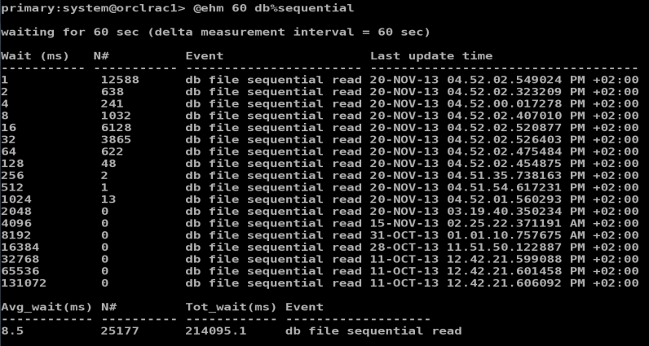
Monitoring Latency - Snapshots
Custom script: ehm.sql

Slide 30
How Many IOPS a Modern System Can Sustain is Often Not Well Defined
IOPS
  HDD and SSD have different limit
  SSDs much more performant than HDD for random IO
Systems with HDD and SSD cache
  Max N# of IOPS depends of how much of the workload is served by SSD and how much from HDD

Slide 31
I/O Workload Generation and Measurements with ORION
ORION (Oracle I/O Numbers)
  Calibrate_io is a sort of simplified ORION integrated in the engine DB
Latest versions have latency histogram details
ORION allows to run tests at variable load
  Study how the system reacts from low load to saturation
  Can run mixed workload (read + write)
  Several other useful feature..

Slide 32
Example of ORION Produced Histogram
  Latency Histogram for small IOs @ Small=35 and Large=0
  Latency: # of IOs (read) # of IOs (write)
  256 - 512 us: 0 0
  512 - 1024 us: 2 0
  1024 - 2048 us: 2 0
  2048 - 4096 us: 71 0
  4096 - 8192 us: 2126 0
  8192 - 16384 us: 9572 0
  16384 - 32768 us: 6149 0
  32768 - 65536 us: 2829 0
  65536 - 131072 us: 890 0
  131072 - 262144 us: 581 0
  262144 - 524288 us: 538 0
  524288 - 1048576 us: 655 0
  1048576 - 2097152 us: 460 0
  2097152 - 4194304 us: 64 0
  4194304 - 8388608 us: 1 0

Slide 33
Passive Benchmarking
We trust the measuring tool to do all the work
We run a given benchmarking tool and just collect the output
For a complex system the results can be misleading
  No understanding of why the system behaves in a certain way
  Does not help in predicting the behaviour in the real-world scenarios

Slide 34
Active Benchmarking Provides Understanding
Active benchmarking is about measuring the system while the benchmark workload runs
  Use many measurement tools
  Use standard tools
This is a good methodology because it allows to
  Understand why the system behaves in a certain way
  Understand the limiting factors (bottlenecks)
  Helps in predicting the systems behaviour
Reference: Brendan Gregg’s blog

Slide 35

SLOB for Storage Testing
SLOB – “Silly little Oracle benchmark”
  Free tool, written and maintained by Kevin Closson
  Version 2.2 just released, check it out!
Several advantages
  Runs the workload directly from the Oracle DB
    Excellent to produce concurrent random I/O
  Configurable load (concurrency)
    Allows to ramp up from low load to saturation
  Mixed workload (read+write) possible
  It’s becoming a standard: simplify sharing results

Slide 36
Active Benchmarking with SLOB
Run SLOB workload and measure it with standard tools
Focus moves from benchmarking to measuring
  Know what to measure, know how to measure!
  Use many tools at different layers and compare
Use AWR reports
Use real-time measurement
  From V$ views
  From ASM
  From OS
  From the storage instrumentation

Slide 37
Use GV$ Views on the DB Instance to Measure I/O
Some of the interesting GV$ to use are:
  GV$SYSMETRIC
  GV$IOFUNCMETRIC
  GV$IOSTAT_FILE (and rest of GV$IOSTAT_*)

Slide 38
Produce Latency Heatmaps from SLOB Tests
Easy way to understand IOPS and latency using SLOB
  Measure latency details using histograms of db file sequential read wait time from V$EVENT_HISTOGRAM
  Plot data as latency heatmap (ex with OraLatencyMap)
Note:
  Oracle can execute SLOB workload with asynchronous I/O too, this shows as ‘db file parallel read’ wait event and does not represent a measurement of I/O latency
  See notes on this slides to revert to ‘db file sequential read’ wait events
Notes:
Parameters useful when doing slob testing to force oracle not to use async I/O (db file parallel read) optimizations and rather use synch I/O and db file sequential read waits. These parameters are listed in the slob distribution, they are repeated here for the interested reader:
*._db_block_prefetch_limit = 0
*._db_block_prefetch_quota = 0
*._db_file_noncontig_mblock_read_count = 0

Slide 39
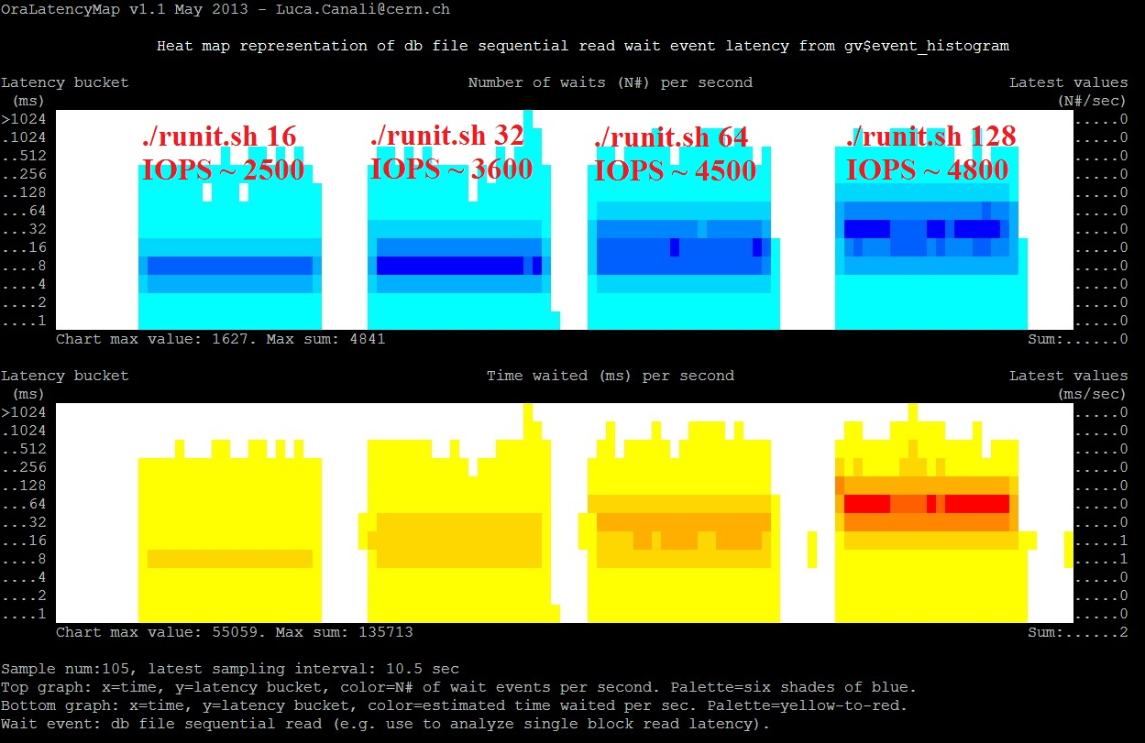
Example: Latency Heatmap of Random I/O at Increasing Load
23 SAS disks
JBOD & ASM
4 consecutive
tests with
increasing load
OraLatencyMap available at: http://canali.web.cern.ch/canali/resources.htm

Slide 40
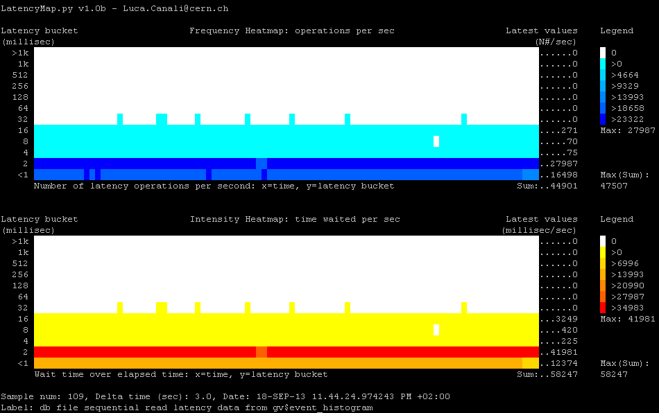
Example: All I/Os from SSD cache
0.5 TB dataset, 100% in SSD, 56 sessions, random reads - NAS

Slide 41
ASM Examples
Measure from ASM V$ metrics
  GV$ASM_DISK_IOSTAT
  GV$ASM_DISK_STAT
  GV$ASM_DISKGROUP_STAT
See also work of Bertrand Drouvot
  asm_metrics.pl utility

Slide 42
Use OS Tools to Measure Activity on the I/O Subsystem
Measure disk activity:
  Use iostat, sar, collectl, dstat
Advanced tools to measure latency
  Oracle wait events do not measure correctly latency for asynchronous I/O
  Measure directly from OS block device interface
  Ftrace and SystemTap probes
  See also talk “Modern Linux Tools for Oracle Troubleshooting”, in Hall 4A at 12:00

Slide 43
Another Way to Measure I/O from OS: Use Ftrace
https://github.com/brendangregg/perf-tools
  # ./iolatency 10
  Tracing block I/O. Output every 10 seconds. Ctrl-C to to end.
  >=(ms) .. <(ms) : I/O |Distribution |
  0 -> 1 : 95 |## |
  1 -> 2 : 74 |## |
  2 -> 4 : 475 |######### |
  4 -> 8 : 2035 |######################################|
  8 -> 16 : 1245 |######################## |
  16 -> 32 : 37 |# |
  32 -> 64 : 11 |# |
  64 -> 128 : 7 |# |
  128 -> 256 : 23 |# |
  256 -> 512 : 10 |# |
  512 -> 1024 : 4 |# |

Slide 44
Oracle Wait Events for Asynchronous I/O Cannot Be Used to Study Latency
Example of how to measure I/O latency from the block I/O interface using SystemTap:
  global latencyTimes, requestTime[10000]
  probe ioblock_trace.request {
  requestTime[$bio] = gettimeofday_us()
  }
  probe ioblock.end {
  t = gettimeofday_us()
  s = requestTime[$bio]
  if (s > 0) {
  latencyTimes <<< (t-s)
  delete requestTime[$bio]
  }
  }

Slide 45
Interpreting the Results
How to translate IOPS and latency measurements into answers to questions that matter?
  Will production workload be OK on this storage?
Measure production workload and compare
  use active benchmarking and workload measurement with standard tools
  Use the same measurement tools against production
Do application-specific stress tests too

Slide 46
Conclusions
Storage is critical and complex, need to test!
CALIBRATE_IO provides an easy way to generate I/O load
  However the output misses critical details
Methodology: use active benchmarking
  Run an I/O workload generator
  Measure key metrics with standard tools
SLOB is a very good I/O workload generator
  Great help for active benchmarking of storage

Slide 47
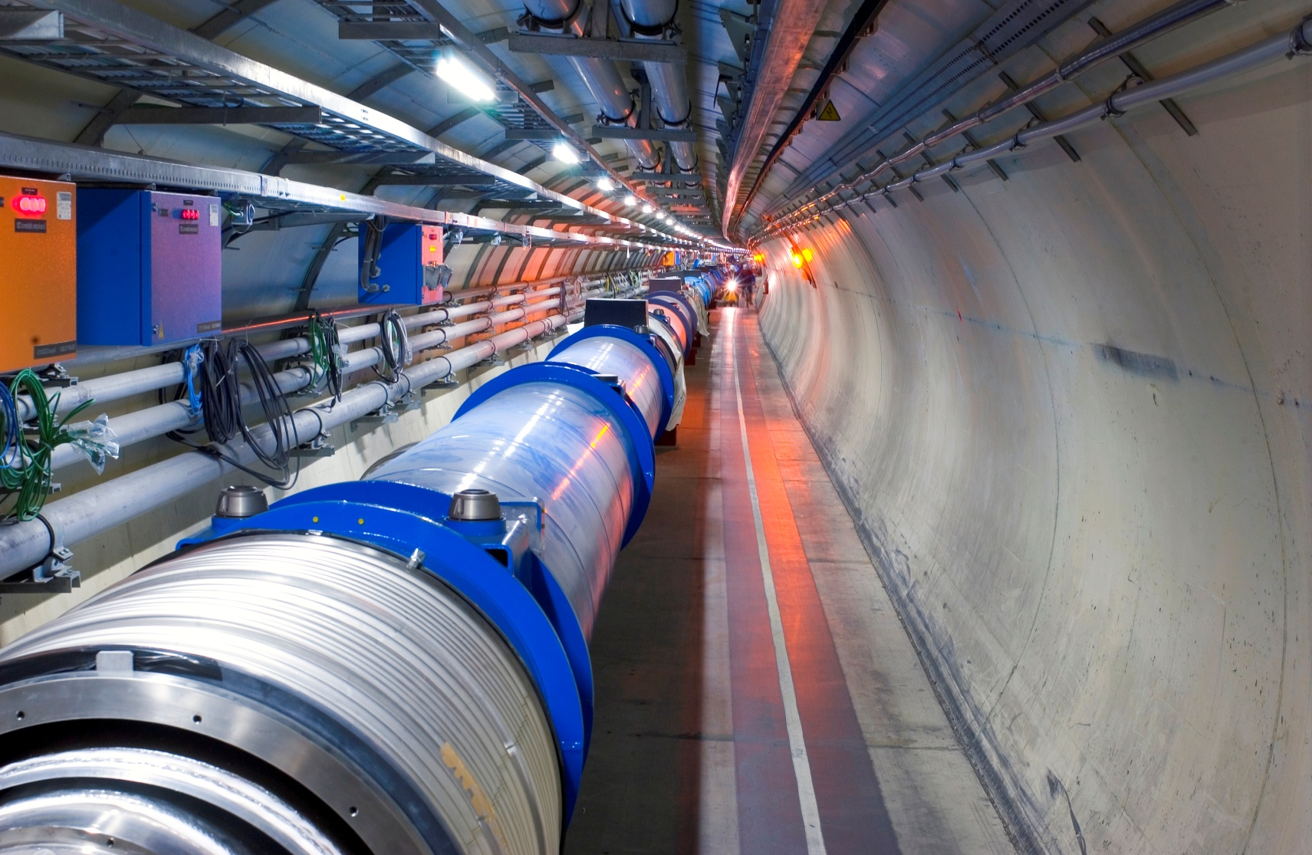
Acknowledgements and Contacts
CERN Colleagues and in particular the Database Services Group
  We have a blog http://db-blog.web.cern.ch
Contacts:
Luca.Canali@cern.ch,
Marcin.Blaszczyk@cern.ch
* All scripts demonstrated in this presentation: http://canali.web.cern.ch/canali/resources.htm

