Slide 1
Optimizing the transport layer of ALFA on the Intel Xeon Phi coprocessor
17/4/2015
CHEP 2015
Aram Santogidis

Slide 2
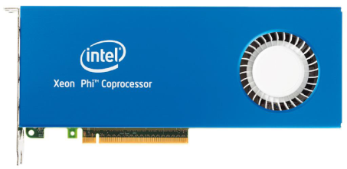
Abstract overview: ALFA and FairMQ
Process
Process
Data Input
Data Sink
Process
Process
Process

Slide 3
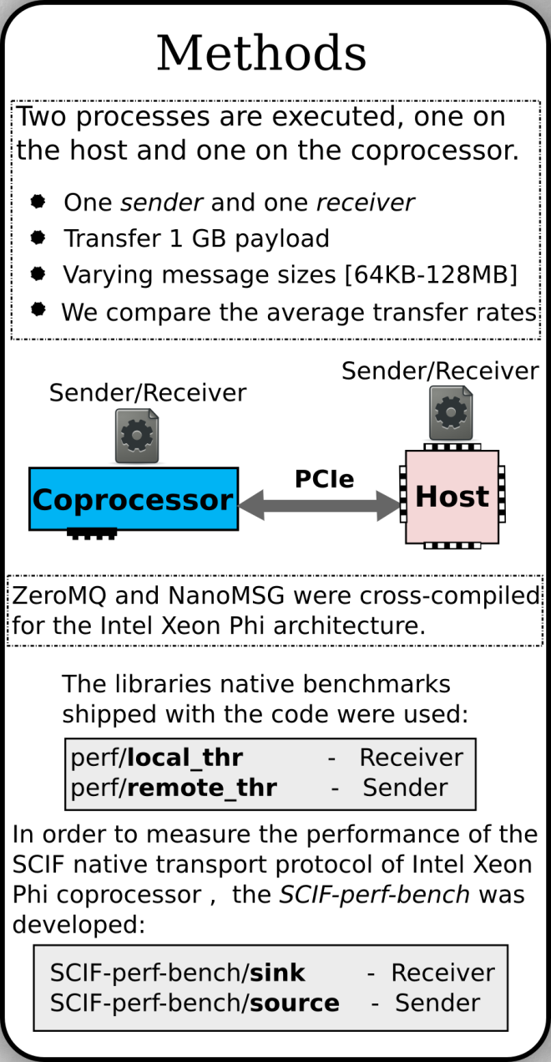
Experimental results

Slide 4
The ICE-DIP Project
More results at:
cern.ch/manycore
by me and
Przemyslaw Karpinski

