Slide 1

Testing Storage for Oracle RAC 11g with NAS, ASM and DB Smart Flash Cache
Luca Canali, CERN
Dawid Wojcik, CERN
UKOUG Conference, Birmingham, Dec 6th,2011

Slide 2

Outline
Why testing storage for Oracle
Define the goals of testing
Example: NAS, SAN, etc, how to compare ?
  Results from our configurations and tests
Lessons learned and wrap-up
D
L

Slide 3
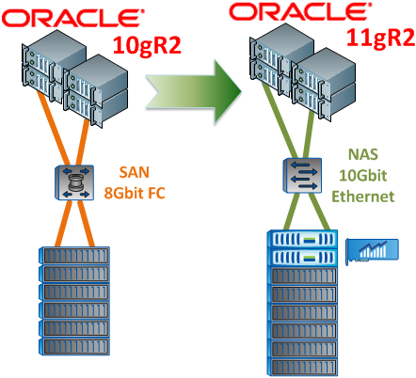
Motivations
New HW acquisition
  refresh cycle ~ every 3 years
  Occasion to test and deploy new technology
Additional input this time
  Consolidate storage solution
  NAS and SAN
  Upgrade 10gR2 to 11gR2
L

Slide 4

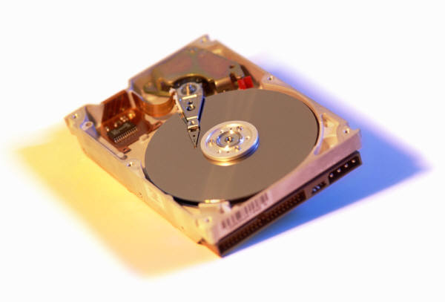
Focus on Storage
Matching requirements from production
What do we need (in our environment)?
Random read IOPS most critical
  Index-based access and nested loop joins
Fast sequential read
  Mostly for backup, stats gathering and some full scans
Also critical
  HA and management features
  Cost and economies of scale
L

Slide 5
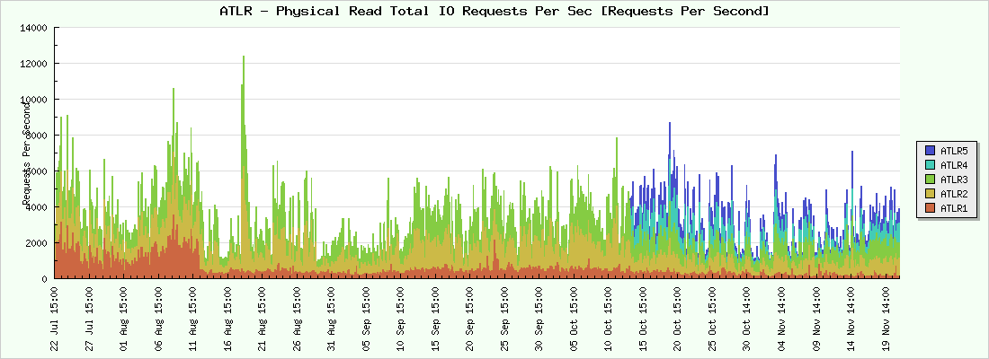
Measurements from Production
AWR data for capacity planning and trend analysis
L

Slide 6
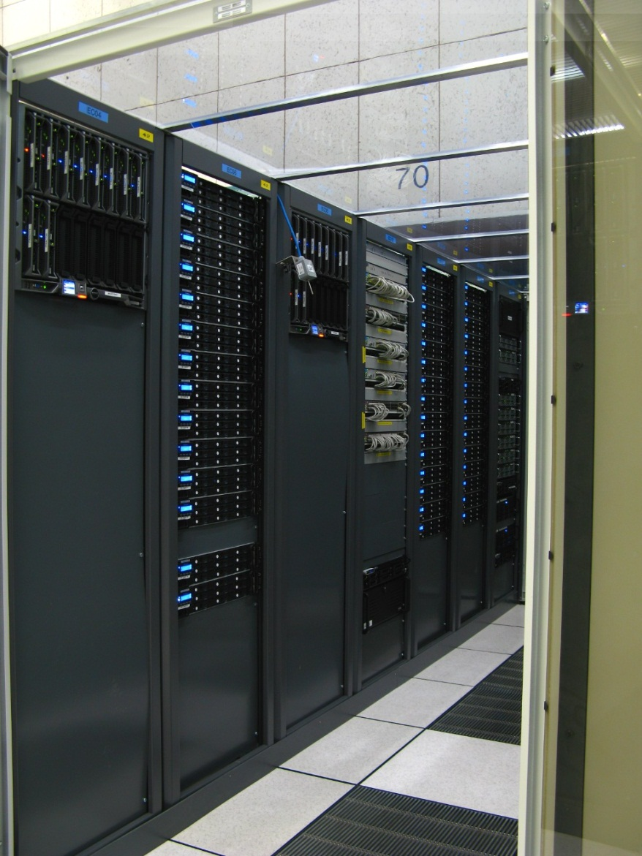
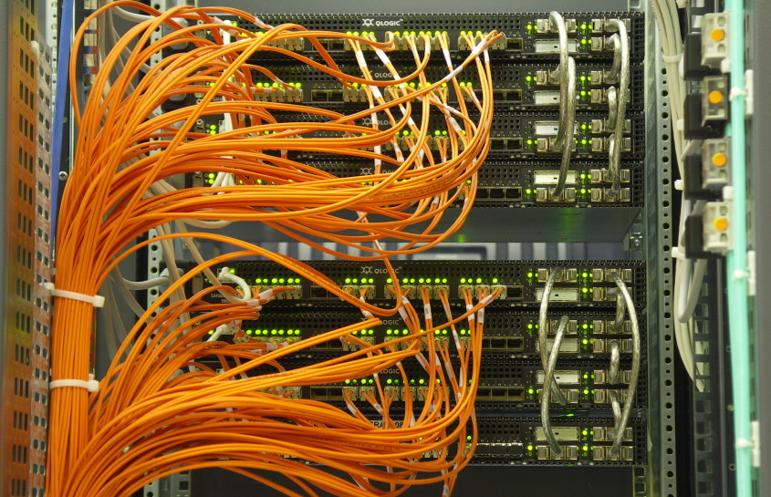
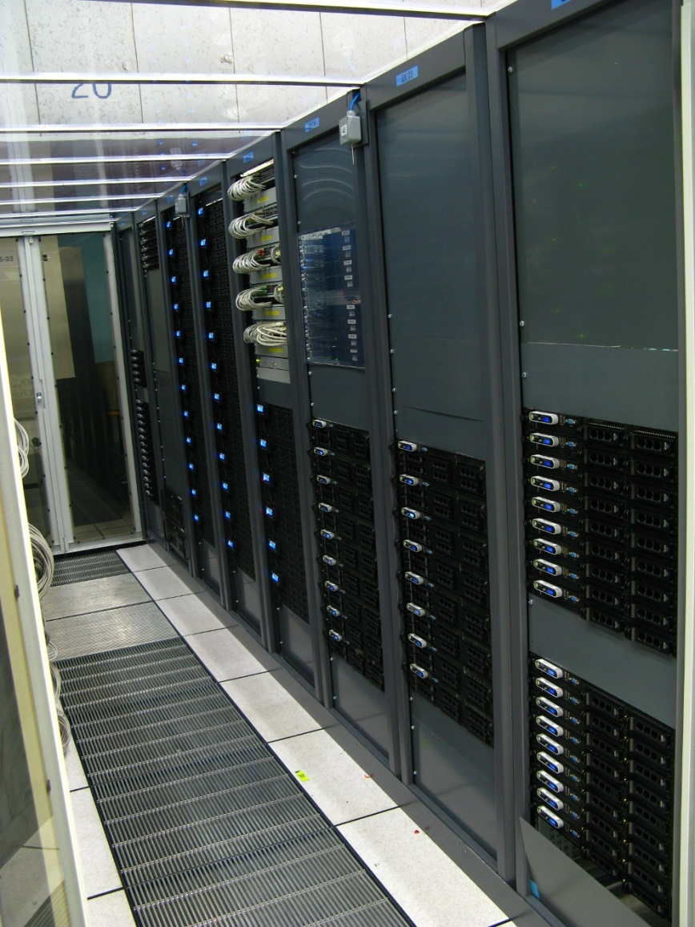
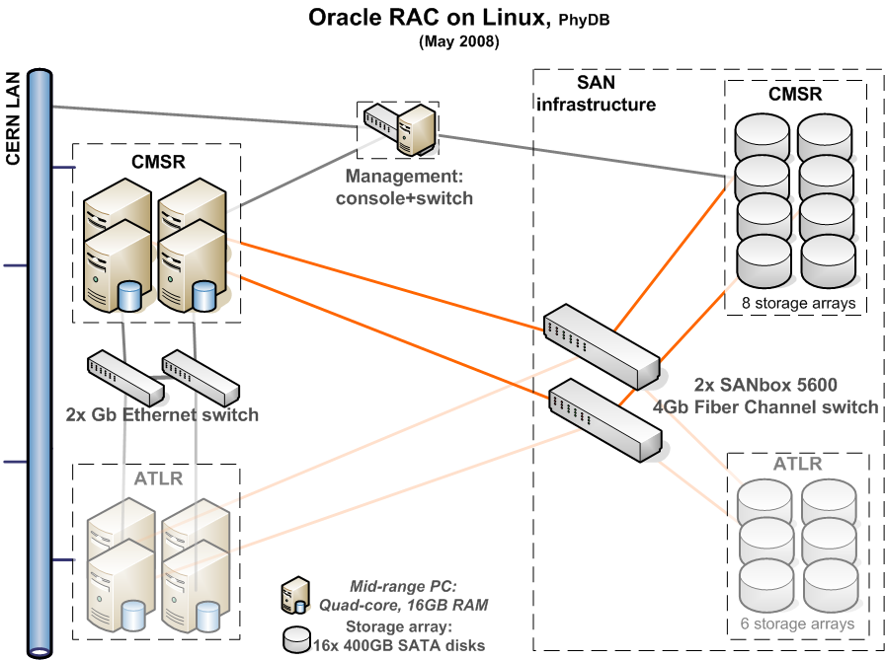
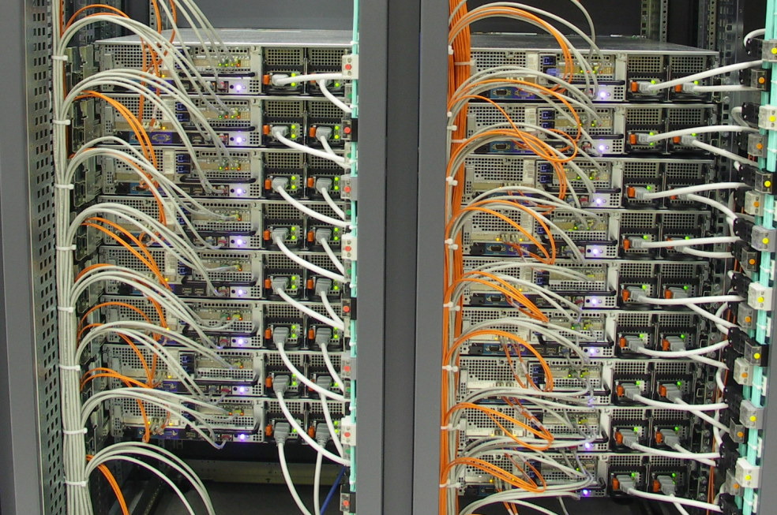
ASM Normal Redundancy
Dual-CPU quad-core blade servers, 24GB memory, Intel Nehalem low power; 2.26GHz clock
Redundant power, mirrored local disks, 4 NIC (2 private/ 2 public), dual HBAs, “RAID 1+0 like” with ASM
L
Notes:
More recent HW uses Nehalem processors and 24 GB of RAM

Slide 7
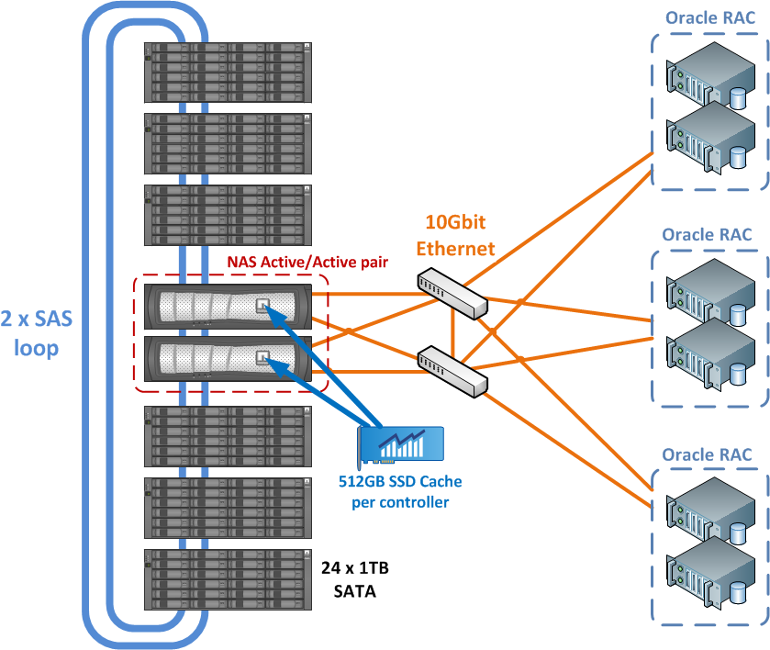
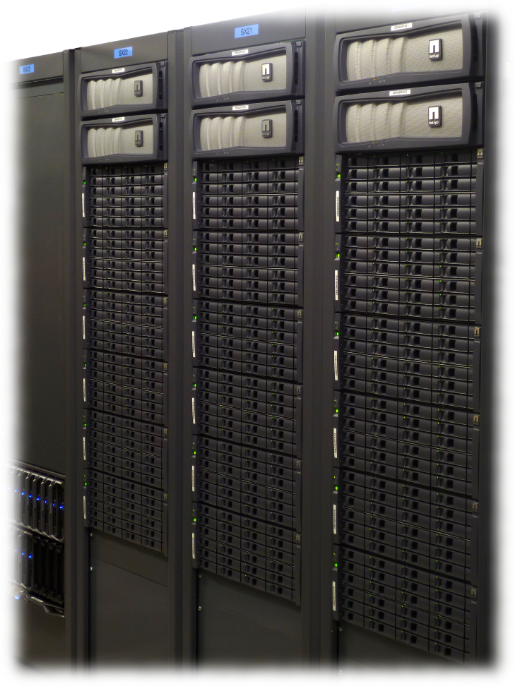
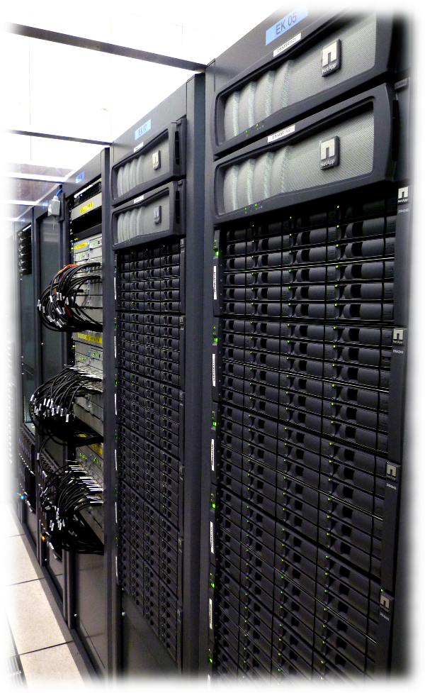
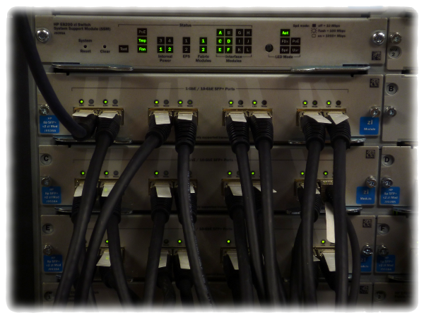
NetApp NAS
D
Notes:
FAS3240 with OnTap8.0.2P1
DS4243 shelves with 1TB SATA

Slide 8
Measuring IO performance
D

Slide 9


Apples and Oranges
Different solutions, strong and weak points
  May be quite different
How to compare, then?
  Define a few configurations that we understand and make sense for us
  Define and test the IO metrics
Further tests with real application workload
D

Slide 10

Tools to Measure IO
We want something that we can understand
  Workload that makes sense for databases
  Avoid caching traps (i.e. testing with little data)
Analysis
  Use metrics that relate to DB usage
  Possibly allow to build a model to correlate measurements and HW architecture
D

Slide 11
Sequential Read
How to test:
  Parallel query of very large table
  Measure throughput for example from gv$sysmetric
    Metric: “Physical Read Total Bytes Per Sec”
    See also SQL on slide’s comment section
Tested SAN
  2 storage arrays with 12 disks each, 8+8 Gig FC
  Throughput=1.5 GB/sec
Tested NAS
  1 box with 72 disks in RAID DP, 10GigE
  Throughput=0.7 GB/sec
D
D
L
Notes:
A query the authors find useful to monitor OS resources usage in oracle and especially in RAC via v$views
select to_char(min(begin_time),'hh24:mi:ss')||' /'||round(avg(intsize_csec/100),0)||'s' "Time+Delta",
metric_name||' - '||metric_unit "Metric",
sum(value_inst1) inst1, sum(value_inst2) inst2, sum(value_inst3) inst3, sum(value_inst4) inst4,
sum(value_inst5) inst5, sum(value_inst6) inst6
from
( select begin_time,intsize_csec,metric_name,metric_unit,metric_id,group_id,
case inst_id when 1 then round(value,1) end value_inst1,
case inst_id when 2 then round(value,1) end value_inst2,
case inst_id when 3 then round(value,1) end value_inst3,
case inst_id when 4 then round(value,1) end value_inst4,
case inst_id when 5 then round(value,1) end value_inst5,
case inst_id when 6 then round(value,1) end value_inst6
from gv$sysmetric
where metric_name in ('Host CPU Utilization (%)','Current OS Load', 'Physical Write Total IO Requests Per Sec',
'Physical Write Total Bytes Per Sec', 'Global Cache Average Current Get Time', 'Global Cache Average CR Get Time',
'Physical Read Total Bytes Per Sec', 'Physical Read Total IO Requests Per Sec',
'CPU Usage Per Sec','Network Traffic Volume Per Sec','Logons Per Sec','Redo Generated Per Sec',
'User Transaction Per Sec','Database CPU Time Ratio','Database Wait Time Ratio','Database Time Per Sec')
)
group by metric_id,group_id,metric_name,metric_unit
order by metric_name;

Slide 12
Sequential Write
How to test:
  Multiple session running SQL for tablespace creation
  OS tools: ORION and unix command dd
Tested SAN
  2 x storage arrays with 12 disks each
  Normal redundancy ASM (needs to write 2 copies)
  Throughput= 700 MB/sec (limited by 8G FC)
Tested NAS
  1 storage box, 72 disks
  Throughput=300 MB/sec
D
D
L
Notes:
2 or 3 concurrent executions of SQL similar to “create tablespace deleteme1 datafile size 1t;” are often enough to saturate sequential write throughput.

Slide 13
Random IO and IOPS measurements
L

Slide 14
ORION
Oracle tool, available since 10g
Easy to use
Used it for several years
  good results for JBOD configs for ASM
Output easy to understand
  In particular for read-related metrics
Some critique
  Proprietary tool
  Possible ‘cache trap’ (see also Kyle Hailey’s dtrace measurements)
L
Notes:
http://dboptimizer.com/2011/09/27/orion-io-calibration-tool-bug/ reports possible issues

Slide 15
ORION - Example
Basic IO metrics measured by ORION
  IOPS for random I/O (8KB)
  MBPS for sequential I/O (in chunks of 1 MB)
  Latency associated with the IO operations
  Since 11.2.0.2, latency histogram (helps testing SSD)
Simple to use
  Getting started:
  ./orion_linux_em64t -run simple -testname mytest -num_disks 24
  More info: https://twiki.cern.ch/twiki/bin/view/PDBService/OrionTests
L

Slide 16


DB-Oriented Tests
Look at your production DBs’ workload
  Read/write ratio and average IO size
  Sequential vs. scattered access
Create a test DB
Define simple DB workloads
  Test cases that match your average production workload
Produce load on the metrics of interest
  Random IO read
  Sequential read
  Sequential write
D

Slide 17
More Details on Tests
Nested loops join with parallel query to drive load
  How to measure IOPS: from gv$sysmetric
BigTable (n TB)
1 row per 8K block
Probe Table: List of ROWIDs of big table in random order
Row 1
ROWID of row 51
Row 51
ROWID of row 1
ROWID of row 151
ROWID of row 101
Row 101
NL Join
Row 151
D
Notes:
SQL used for preparing and executing the test
Main idea:
(1) create a big table of a few TBs and a small tables with its rowids in random order.
(2) use NL join to create single-block read workload.
(3) use parallel query on the small table to create concurrent activity of single block reads
(4) use wait event interface and gv$sysmetric to confirm that load is indeed single block reads
create bigfile tablespace testiops2 datafile ‘{PATH}…../testiops2.dbf' size 4000g autoextend on maxsize 4500g; -- or bigger size for larger tests
create user testiops2 identified by {pass}
default tablespace testiops2
quota unlimited on testiops2;
grant connect,dba to testiops2;
grant select any dictionary to testiops2;
grant execute on dbms_lock to testiops2;
connect testiops2
set timing on
set time on
drop table testtable1;
drop table probetest1;
drop table probetest1_1pct;
drop table probetest1_01pct;
define NUMBLOCKS=120000000
define PARALLDEG=40
Create table testtable1 pctused 10 pctfree 80
tablespace testiops2 nologging
as
select /*+ parallel (a &PARALLDEG) parallel (b &PARALLDEG) */
rownum num, rpad('name',2000,'P') name
from sys.col$ a, sys.col$ b
where rownum<=&NUMBLOCKS;
set timing on
define NUMBLOCKS=360000000
define PARALLDEG= 8
set autotrace on
alter session force parallel ddl parallel &PARALLDEG;
Create table testtable_3T pctused 10 pctfree 80 -- a test table of 3TB minimum, scale up to larger values by adding more ‘union all’. Author tested up to 9TB (14 hours to create)
tablespace testiops2 nologging
as
select * from testiops2.testtable1
union all
select * from testiops2.testtable1
union all
select * from testiops2.testtable1;
exec dbms_stats.set_table_stats('TESTIOPS2','TESTTABLE_3T',numrows=>&NUMBLOCKS,numblks=>&NUMBLOCKS)
create table probetest3T_norandom pctfree 0
tablespace testiops2 nologging
as
select /*+ parallel (a &PARALLDEG ) */ rowid id
from testiops2.testtable_3t a ;
exec dbms_stats.set_table_stats('TESTIOPS2','PROBETEST3T_NORANDOM',numrows=>&NUMBLOCKS)
create table probetest3T_2pct pctfree 0
tablespace testiops2 nologging
as
select a.id id from
(select rownum n, id from probetest3t_norandom) a
where mod(a.n,50)=1
order by dbms_random.value(1,&NUMBLOCKS);
alter system set db_recycle_cache_size=100m scope=both sid=‘{inst1}'; --repeat for all instances
alter table testiops2.testtable_3t storage (buffer_pool recycle);
Check parall parameters. Here 11gR2 version
parallel_adaptive_multi_user boolean TRUE
parallel_automatic_tuning boolean FALSE
parallel_degree_limit string CPU
parallel_degree_policy string MANUAL
parallel_execution_message_size integer 16384
parallel_force_local boolean FALSE
parallel_io_cap_enabled boolean FALSE
parallel_max_servers integer 135
parallel_min_percent integer 0
parallel_min_servers integer 0
parallel_min_time_threshold string AUTO
parallel_server boolean TRUE
parallel_servers_target integer 256
select /*+USE_NL(t p) parallel(128) */ sum(1) from testtable_3t t, probetest3t_2pct p where t.rowid=p.id;
See from gv$session that parallel executio is OK and that wait events are db file sequential read or db file parallel read (both related to single block random access)
Measure IOPS from gv$session metric
Example:
select "Time+Delta", "Metric",
case when "Total" >10000000 then '* '||round("Total"/1024/1024,0)||' M'
when "Total" between 10000 and 10000000 then '+ '||round("Total"/1024,0)||' K'
when "Total" between 10 and 1024 then ' '||to_char(round("Total",0))
else ' '||to_char("Total")
end "Total"
from (
select to_char(min(begin_time),'hh24:mi:ss')||' /'||round(avg(intsize_csec/100),0)||'s' "Time+Delta",
metric_name||' - '||metric_unit "Metric",
nvl(sum(value_inst1),0)+nvl(sum(value_inst2),0)+nvl(sum(value_inst3),0)+nvl(sum(value_inst4),0)+
nvl(sum(value_inst5),0)+nvl(sum(value_inst6),0)+nvl(sum(value_inst7),0)+nvl(sum(value_inst8),0) "Total",
sum(value_inst1) inst1, sum(value_inst2) inst2, sum(value_inst3) inst3, sum(value_inst4) inst4,
sum(value_inst5) inst5, sum(value_inst6) inst6, sum(value_inst7) inst7, sum(value_inst8) inst8
from
( select begin_time,intsize_csec,metric_name,metric_unit,metric_id,group_id,
case inst_id when 1 then round(value,1) end value_inst1,
case inst_id when 2 then round(value,1) end value_inst2,
case inst_id when 3 then round(value,1) end value_inst3,
case inst_id when 4 then round(value,1) end value_inst4,
case inst_id when 5 then round(value,1) end value_inst5,
case inst_id when 6 then round(value,1) end value_inst6,
case inst_id when 7 then round(value,1) end value_inst7,
case inst_id when 8 then round(value,1) end value_inst8
from gv$sysmetric
where metric_name in ('Host CPU Utilization (%)','Current OS Load', 'Physical Write Total IO Requests Per Sec',
'Physical Write Total Bytes Per Sec', 'Global Cache Average Current Get Time', 'Global Cache Average CR Get Time',
'Physical Read Total Bytes Per Sec', 'Physical Read Total IO Requests Per Sec',
'CPU Usage Per Sec','Network Traffic Volume Per Sec','Logons Per Sec','User Transaction Per Sec',
'Redo Generated Per Sec','Database CPU Time Ratio','Database Wait Time Ratio','Database Time Per Sec')
)
group by metric_id,group_id,metric_name,metric_unit
order by metric_name
);

Slide 18
DB Workload for Tests
A standard way to run workload from DB would be very beneficial
A step in this direction:
  DBMS_RESOURCE_MANAGER.CALIBRATE_IO
  Similar to Orion, although more difficult to interpret results
Critique
  From our tests IOPS seems to be overestimated
  Sequential throughput underestimated
  Unaware of array cache
D
Notes:
SET SERVEROUTPUT ON
DECLARE
lat INTEGER;
iops INTEGER;
mbps INTEGER;
BEGIN
-- DBMS_RESOURCE_MANAGER.CALIBRATE_IO (<DISKS>, <MAX_LATENCY>, iops, mbps, lat);
DBMS_RESOURCE_MANAGER.CALIBRATE_IO (24, 100, iops, mbps, lat);
DBMS_OUTPUT.PUT_LINE ('max_iops = ' || iops);
DBMS_OUTPUT.PUT_LINE ('latency = ' || lat);
DBMS_OUTPUT.PUT_LINE ('max_mbps = ' || mbps);
end;
/
ASM config output (24 SAS disks on 8+8 G FC):
max_iops = 7147
latency = 17
max_mbps = 1314
NAS (72 disks in RAID DP on 10 GigE):
max_iops = 7193
latency = 0
max_mbps = 538

Slide 19
Random reads SAN
SAN for ASM normal redundancy
IOPS scale up with Number of disks
  ~100 IOPS/disk for SATA,
  ~200 IOPS/disk for SAS
Example:
  24 SAS disks -> ~5000 small random read IOPS
  Test config of 400 SATA disks: ~40K IOPS
L

Slide 20
Random Reads NAS
NAS:
Random reads -> ~100 IOPS per disk
  Take about 20% disks off as they are used for DP
  Example raid group of 72 disks -> ~5000 IOPS
Random reads served by Solid State cache
  512 GB PAM module
  Up to ~33K IOPS
  Note we find DNFS improves IOPS we can get
D

Slide 21
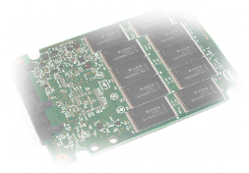
Solid State Disks for IOPS
L

Slide 22

IOPS-Hungry Applications
SSD provide high IOPS and low latency
  Great for many OLTP-like applications
Possible usage of SSD
  Full DB on SSD
  Parts of the DB on SSD (e.g. critical tablespaces)
  SSD as cache on storage controller
  Database smart flash cache
L

Slide 23

DB Flash Cache
Goal:
  Cost-effective, high capacity, high read IOPS
Problem:
  Low-cost arrays often don’t have SSD cache
Idea:
  Use SAN and ASM with normal redundancy with high capacity disks
  Use DB flash cache to enhance DB buffer cache
L

Slide 24
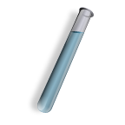
Setup for Testing
Supported on Solaris and OEL
  Tip for red-hat testing: actually just need package ‘enterprise-release’ from OEL to replace ‘redhat-release’
HW:
  Local SSD of 200 GB used for this test
  Idea: low cost HW
DB parameters
  *.db_flash_cache_size=160g
  inst1.db_flash_cache_file=‘+SSD_NODE1/flashc1.dbf’
    inst2.db_flash_cache_file=‘+SSD_NODE2/flashc2.dbf’
L
Notes:
SSD: STEC ZEUS-IOPS

Slide 25
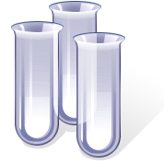
Basic Tests
ORION on local SSD:
  Random small reads: 16000 IOPS
  Latency histogram: 0.5-1ms range
  Random small writes: 2900 IOPS
  Sequential IO: read 240 MB/s, write 60 MB/s
Oracle-based test
  Measure exec time for 1M single-block cached reads
  Time is latency bound, with SSD vs disk: 6x speedup
    single block read from flash cache: ~0.6 ms
    See also SQL in slide’s note section
L
Notes:
SQL to read the table with single block reads
define NUMBLOCKS=1024000
Create table testtable1M pctused 10 pctfree 80
tablespace testiops2 nologging
as
select
rownum num, rpad('name',2000,'P') name
from sys.col$ a, sys.col$ b
where rownum<=&NUMBLOCKS;
exec dbms_stats.set_table_stats('TESTIOPS2','TESTTABLE1M',numrows=>&NUMBLOCKS,numblks=>&NUMBLOCKS)
create index i_testtable1M on testtable1M(num) pctfree 0 tablespace testiops2 nologging noparallel;
alter table TESTTABLE1M storage (buffer_pool default FLASH_CACHE keep);
set timing on
--1M blocks
declare
v_name varchar2(1);
begin
for c in (select rownum id from dual connect by level<=1000000 order by dbms_random.random) loop
select substr(name,1,1) into v_name from testtable1M where num=c.id and rownum=1;
end loop;
end;
/
Execute multiple time to see db flash cache effect
query gv$bh to see how many blocks cached
Relevant wait events:
when reading from disk: db file sequential read,
when reading from db flash cache: db flash cache single block physical read

Slide 26

Flash Cache and SSD
DB Flash Cache
  (+) Can boost IOPS performance
  (+) Can be tuned at segment level
    SQL: storage (flash_cache keep)
  (-) consumes CPU on DB server (DBWR)
  (-) requires extra memory from buffer cache
  (-) cache is local and not RAC-aware
  (-) New feature
  (-) runs only on some Linux distributions
L

Slide 27
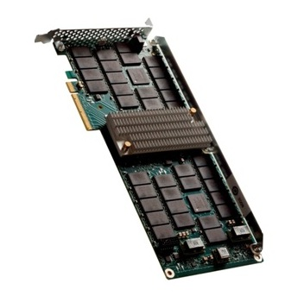
Solid State Cache and NAS
Storage controller-based solid state cache
  (+) Easy to understand and proven
  (+) No additional server CPU, RAM consumed
  (+) 33K random read IOPS in tested config
  (-) Cost can be high for large amounts of cache currently
D

Slide 28

Conclusions
Many interesting lessons learned by testing
New technology of high impact
  Solid State Disks for OLTP applications
  10 GigE
11g new features of interest
  Direct NFS and db flash cache
Storage for Oracle (RAC)
  Complex ecosystem, evolving fast
D

Slide 29

Acknowledgments
CERN IT Database Services Group
In particular: Ruben Gaspar Aparicio, Jacek Wojcieszuk, Eric Grancher
More info:
http://cern.ch/it-dep/db
http://cern.ch/canali
(Picture: ATLAS Experiment © 2011 CERN)
D

