Slide 1


Smart Technologies for Large Control Systems
CERN Open Day
10th June 2015
Elisabeth Bakany, Siemens-ETM
Filippo Tilaro, CERN
Notes:
Siemens: intro

Slide 2
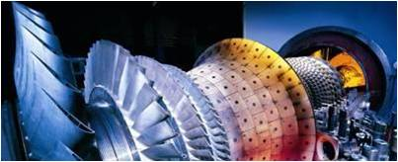


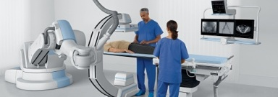

Siemens - Smart Data to Business
Power Plants
Power Grids
Factories
Hospitals
  Customer Advantage
  Better Performance
  Lower Costs
  Saving
  Energy
  Reduce Risks
  New Business Models
…
Data from Products, Systems, Sensors, Processes ...
''Smart data to business''
Data
Data analytics
Business Intelligence
Business Innovation
Value
Generation
Domain
know-how
Device
know-how
Analytics
know-how
Smart
Data

Slide 3



WinCC Open Architecture (OA)
  Perfect for large scale applications
  for big and/or complex systems
  for geographically wide distributed plants
  freely scalable and expandable
  for supervisory layer
  supports redundancy
  for the highest security requirements
  the only SCADA system with SIL 3-certification
  Supports > 10,000,000 data points
PPS / MES layer
Business systems
Supervisory layer
WinCC OA
Flexible concept for special needs to integrate other applications
SCADA / DCS
layer
WinCC OA
PCS 7
3rd Party DCS
WinCC
3rd Party SCADA
Control layer
PLC
RTU
S7
AS
PLC
S7
PLC
RTU
AS
RTU
S7
PLC
RTU
S7
Notes:
Supervisory control systems for:
Water plant networks
Oil & Gas pipelines and production
Energy supplies
Undergrounds
Traffic management
Building automation
Passenger information systems

Slide 4
WinCC OA Manager Concept
UIM
UIM
UIM
user interface layer
Ctrl
API
processing layer
DM
EV
communication and
memory layer
driver layer
D
D
D

Slide 5
WinCC OA as Distributed System
System 1
System 3
UI
UI
Ctrl
Ctrl
Redu
Redu
Ctrl
DM
EV
DM
EV
EV
DM
T
Dist
T
Dist
Dist
T
System 2
UI
System- or
machine boundaries
Ctrl
Network-
connections
EV
DM
Logical links
Dist
T

Slide 6
WinCC OA Redundancy
Remote
UI
UI
System
System‘
Ctrl
Ctrl‘
DM
EV
EV‘
DM‘
Redu
Redu‘
D
D‘
Peripherals

Slide 7
WinCC OA – flexible and open
  Fast adaptation of control and visualization of the plant to suit current market requirements
  Implement new processes quickly and easily also by
  in-house programming and developments enabling independence and know-how protection
  Standardized solutions enable continuous use
  SCADA Platform for OEMs
  Brand labeling is supported
  Platform independent (Windows, Linux, Solaris)
  Object orientation
  Open achitecture
  Platform in use in many industrial sectors
  Easy Integration with other SW
  Fast development time
Notes:
Used in many industrial sectors:
Water plant networks
Oil & Gas pipelines and production
Energy supplies
Undergrounds
Traffic management
Building automation
Passenger information systems

Slide 8


WinCC OA within Siemens
PG
Power
and Gas
WP
Wind Power &Renewables
EM
Energy management
BT
Building technologies
MO
Mobility
DF
Digital
factory
PD
Process Industries and Drives
HC
Healthcare
PG
Power Generation Services
DG
WP
LP
BT
MM
FA
LD
AU
SU
HP
CPS
TPE
PL
OM
CX
CP
MS
MLT
EC
PA
DX
ES
EA
UT
CP
MD
CP
IE
SG
CS
CS
IM
GT
TS
MC
TR
17 products based on OA

Slide 9
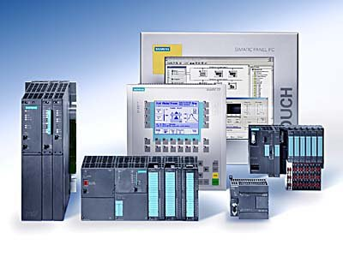
A bit of history…
Long successful collaboration
  For more than 20 Years
  More than 600 Simatic control systems installed
  Partnership, Much more than a client-provider relationship
Large deployment of Siemens systems
  Supervision systems (WinCC OA, WinCC)
  Programmable Logic Controllers (PLC)
  Control modules
  Panels, …
Joined openlab in 2009
  Phase III (2009-12): Security, Large scale deployment
  Phase IV (2012-15): High performance archiving, Data Analysis
  Next phase V (2015-18): Data Analytics, WinCC OA enhancements
Application | Systems installed
ALICE | ~100
ATLAS | ~130
CMS | ~90
LHCb | ~160
Accelerators | ~200
Total | >600
Notes:
CERN
-Collaboration with Siemens is long term and in many areas
-Large base of systems installed at CERN. They produce large amounts of data → suited for the data analysis framework.

Slide 10
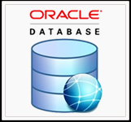



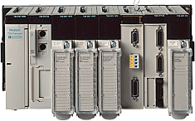

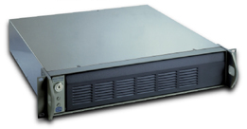




Typical Control System Architecture
Data Analytics
Improve functionality, efficiency, and predictability of CERN control systems
Support operators to take decisions, enhance the online monitoring systems
Supervision
layer
MOON
(Monitoring)
Manage multiple SCADA applications in a centralized way
WinCC OA:
Deployment
tool
RDB Archiver
TN
Improve WinCC OA archiving capabilities
DIM/CMW
OPC
Process
layer
Front-end
PC
PLCs
Fieldbus
High Voltage
Field
layer
Sensors
&
Actuators
Notes:
3 activities for the same project

Slide 11
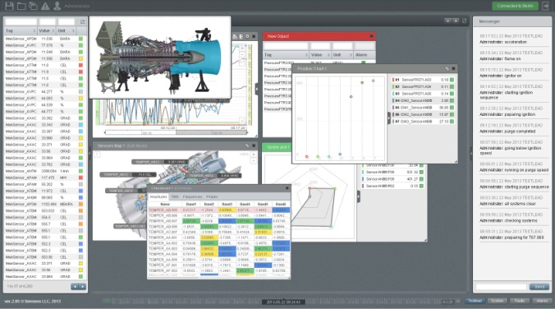
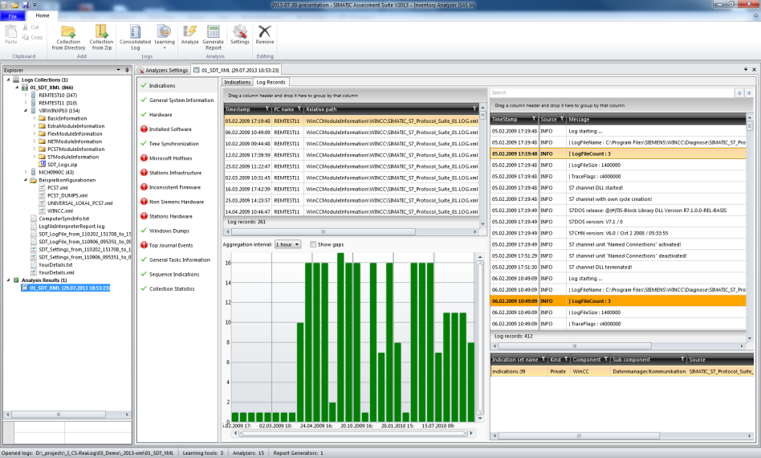
Siemens’ Smart Data Technologies @ CERN
Code name “ELVis”
  Cloud-based BIG Data Analytics for Time Series Sensor Data
  Real-Time Stream Processing at customizable KHz-Rates
  High Performance Online Visualization in Rich Web-based UI
  Intelligence for Sensor Data Validation
  Job-based Offline Data Analysis
Code name “WatchCAT”
  Data Fusion of events & sensors
  Complex Event Processing
  Automated Learning of fault patterns
  Logical Reasoning for Fault Detection & Isolation
  Fault prediction based on recognizable patterns

Slide 12

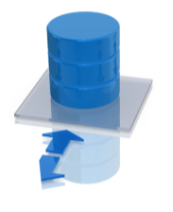




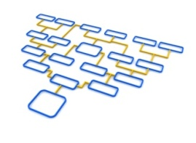
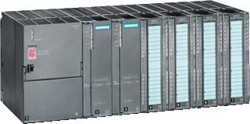
Siemens’ Smart Data Technologies:
Control System Analysis
Control Systems
Analyze
Learn
Diagnose
~200 systems
Data
Identify and detect fault / abnormal pattern for Diagnosis and Prognostics based on domain knowledge
Provide experts with Root-cause and Gap Analysis using Rules and Patterns Mining
Forecasts, Trends and Early-Warnings to increase Operating Hours
~300PLCs
~100 FECs
Pattern
АА B A A B
Alarm
~5*10⁷ I/Os
X T C D F A A E D N D B K D F A A B K D
Notes:
Siemens removing

Slide 13
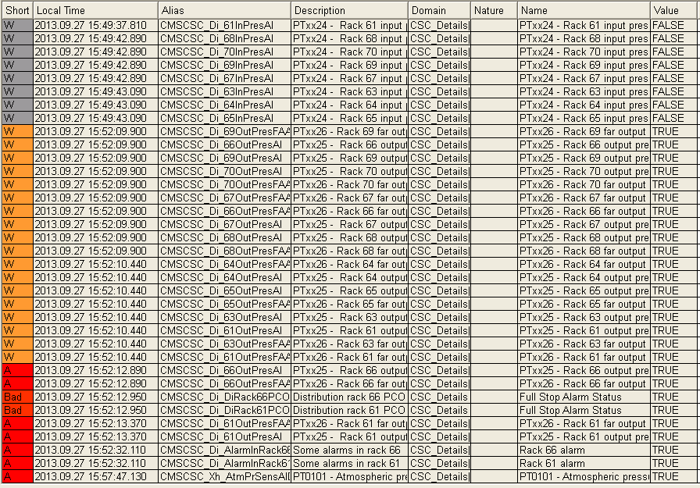
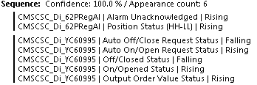
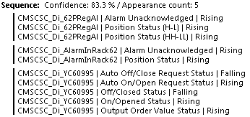

Understanding the GAS system behaviour with Smart Data:
Identifying a root-cause
Event lists generated
by the same fault
Extracted fault signatures
Objective: Support the operator during diagnostic activities shortening the analysis time and avoiding or shorting the downtimes
  1st Phase: learning system behaviour by extracting fault signatures
  2nd Phase: automatic fault classification by comparing the current events and alarm with the previously extracted signatures
Notes:
Siemens

Slide 14
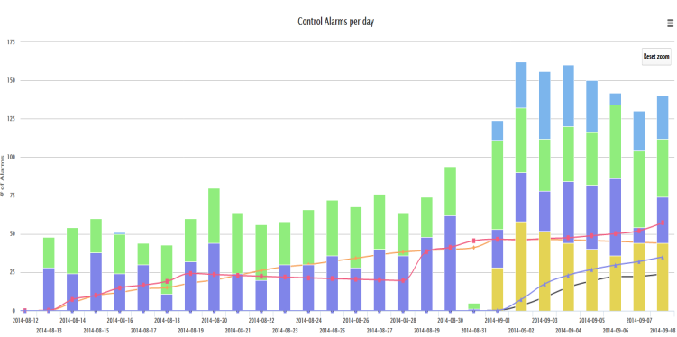
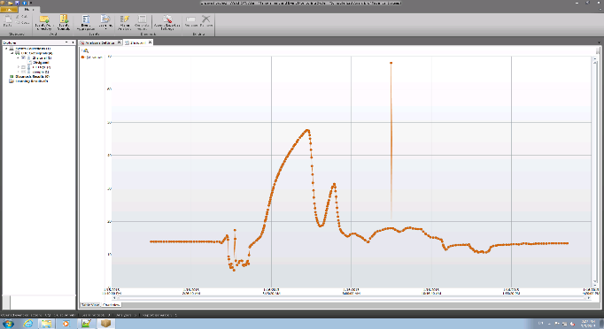

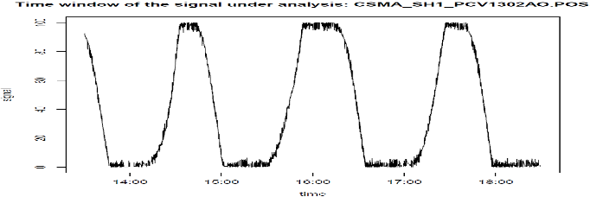
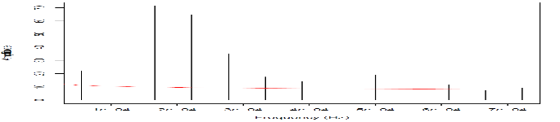


Data Analytics use-cases: few examples, but many more!
Title | Description | Analysis Results
On-line analysis of control alarms | Alarms analysis to detect anomalies or abnormal behaviours at the single device level
Fault sensor measurements detection for the cryogenic system | Design and implementation of algorithm to detect faults in sensors measurements
Cryogenic valves oscillation | Optimize the regulation of control valves by spotting oscillator behaviours
$$T \sim 1.5h$$
$$s\left(t\right)=Ak sin⁡(2∗π∗fk∗t)$$

Slide 15







Centralized Deployment Tool (CDT)
Large control applications @CERN:
  +150 interconnected WinCC OA systems
Upgrade sets of WinCC OA applications in a centralized fashion
ASCII Manager is a key component of the CDT
                Projects DB imports/exports from/to files
                Hardware equipment configuration
UIM
UIM
UIM
Ctrl
API
Goal
                Introduce XML based file format for export/import
                XML is easier to validate and integrate with external tools than current ASCII files
DM
EV
DIST
ASCII
Manger
D
D
D

Slide 16


ASCII Manager
WinCC OA 3.X
  XML schema defined
  First implementation of XML export functionality
  Code and schema currently under review at ETM
IOWA-based SCADA system
  Completely new platform (including data model)
  New way to interact with the runtime
  CERN involvement since an early stage
  Influence the requirements and technology selection
  Pioneering the usage of the new SDK
  Valuable feedback sent to ETM on SDK and tutorials
  Prototype available

Slide 17



RDB Archiver for WinCC OA 3.11
Performance, robustness and stability
Successful collaboration
  Improvements implemented and tested at CERN
  Code transferred to ETM
  New functionality made available to all ETM customers
Success story: migration to Oracle Archiver
  200 LHC-related applications
  Required to run the LHC at 13 TeV (QPS)
  200 000 values/s steady state, 10⁶ values/s in peak
Essential also for CERN experiments
  Oracle archiver used since 2007
Unified archiving technology CERN-wide
  ~500 CERN production systems and ~10 databases
  Deployed on time for the LHC Run II
LHC Logging
RDB
Notes:
Before value archiver (file based with low performances when compared to DB)
Overflow RDB Manger buffer
1DB per project?
Data schema reduction
Bug fixing in WinCC OA core code
Direct access to the DB by shared lib

Slide 18
More on Data Processing
Reporting Manager
Significant performance improvements
  parallel request processing
  redesign of architecture for Oracle queries
Already available in WinCC OA 3.13
R&D: Big data and NoSQL
Research on technology for future archiving system
  Prepare future run of LHC: throughput/size increase by a 10x factor
Hadoop
  Workshop to transfer knowledge to ETM
Initial investigation of other technologies
  Elasticsearch, IMPALA
Synergy with Data Analytics
  Archiving subsystem is essential
Notes:
Simple SOAP based interface for external tools

Slide 19
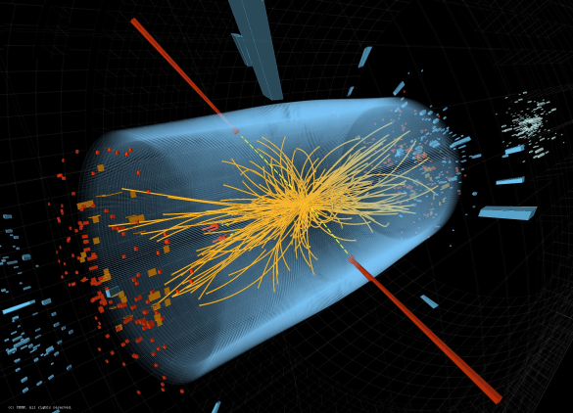
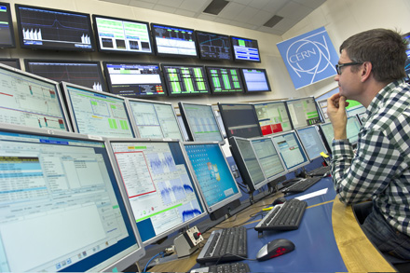


CERN & Siemens collaboration:
Benefits for CERN
Increased System Reliability
  Minimized forced outages
Complete data analysis
  Reduced service effort: weeks → hours
24/7 Expert Knowledge Availability
  One central knowledge base
Operation support
Forecast system status and
take proper actions in time
Prevent possible faults and system downtime
Identify hidden patterns
Diagnosis support
Identify root causes
More accurate analysis
Accelerate analysis
From weeks to hours
Engineering support
Improve operational performance
Increase reliability and efficiency by design
Lead control system decisions
Notes:
Siemens: top part
CERN: bottom part

Slide 20
CERN & Siemens collaboration :
Next Steps
Data Analytics
  Innovative Siemens’ Smart Data technologies suited for the analysis of many CERN control systems
  Integration of CERN specific extensions & data analysis algorithms
Q3/2015
Q1/2016
Q2/2016
Q1/2017
2018
Control Systems Integration
Online analysis
Further Performance & Scalability
Large scale deployment & further extensions
WinCC OA
  Continue the work on the open fronts: RDB and CDT
  Broaden the spectrum of activities to other areas like:
    Visualization: Web, widgets enhancements
    Secure Remote Access
    Alarms: Screen and alarm hierarchies
    Enhanced Reporting / Data Analytics integration
    Prototype of NoSQL-based archiver system
    Development tools
Notes:
Status from CERN
Next steps from Siemens

Slide 21

Any Questions
Thank you for your attention!

