Slide 1
Porting LHC detector simulations on Intel Xeon and Xeon Phi architectures
Andrei Gheata for the GeantV project
Intel HPC Developers Conference, November 14th – 15th, 2015

Slide 2
Outline
GeantVectorized – a fresh start for HPC particle transport simulations
The problem
Challenges, ideas, goals, design
Main components and features
Vectorization: overheads vs. gains
Geometry and physics performance
Performance benchmarks
GeantV on Intel®Xeon
Harnessing the Phi: the X-Ray benchmark

Slide 3
The problem
Detailed simulation of subatomic particle transport and interactions in detector geometries
Using state of the art physics models, propagation in fields in geometries having complexities of millions of parts
Heavy computation requirements, massively CPU-bound, seeking organically HPC solutions…
The LHC uses more than 50% of its distributed GRID power for detector simulations (~250.000 CPU years equivalent so far)
http://atlas.ch

Slide 4
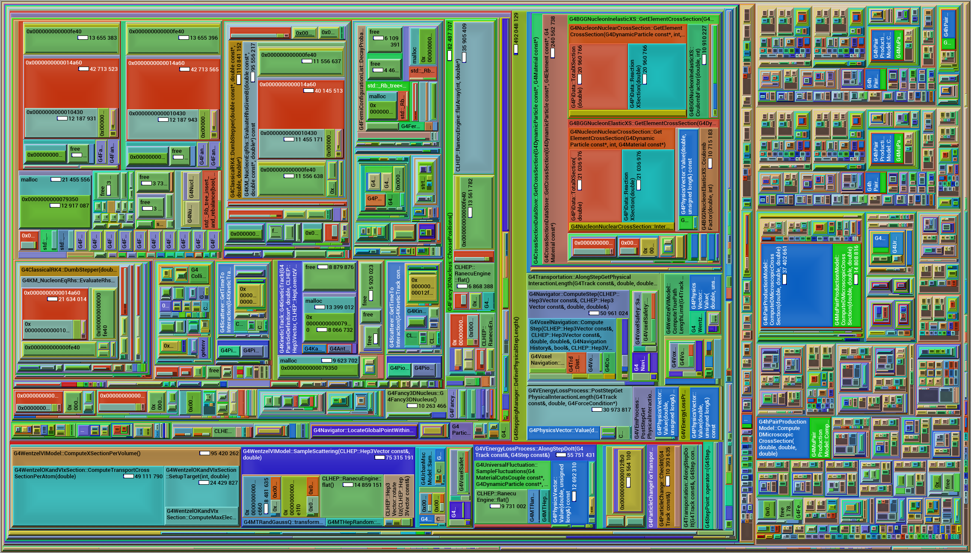
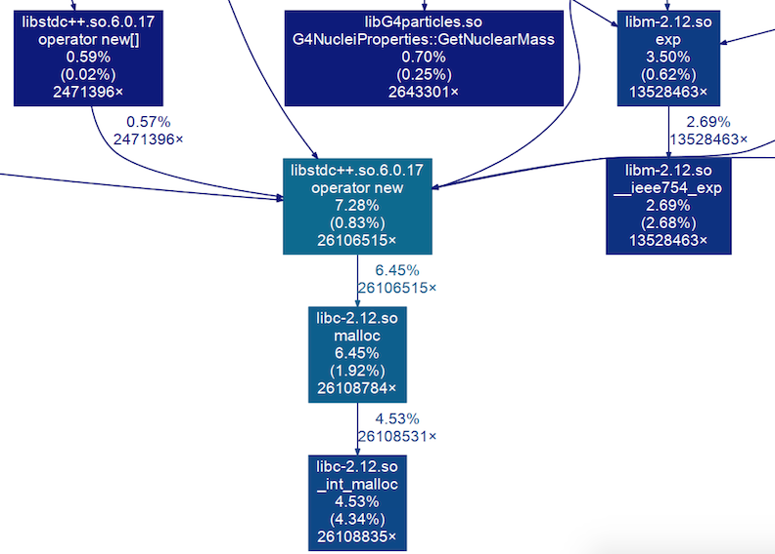
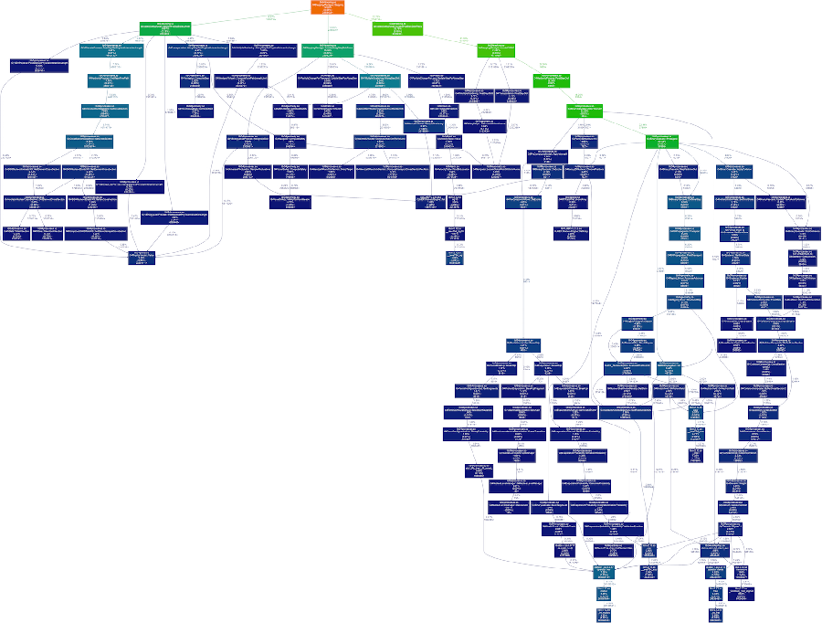
Optimizing the legacy code…
The state of the art HEP code is Geant4
Code of large complexity, used in high energy, nuclear and accelerator physics, as well as studies in medical and space science
Why not Geant4+?
Scalar by design
Very deep call stack (IC misses) and virtual table structure
Hotspots practically inexistent
Codebase very large and non-homogenous
Embarrassing parallelism implemented already
Fine grain concurrency (ILP) hard to address with this design
Callgrind call map of Geant4
Snapshot of Geant4 call stack
Smaller and smaller boxes…

Slide 5
… or starting afresh
Transport particles in groups (vectors) rather than one by one
Group particles by geometry volume or same physics
No free lunch: data gathering overheads < vector gains
Dispatch SoA to functions with vector signatures
Use backends to abstract interface: vector, scalar
Use backends to insulate technology/library: Vc, Cilk+, VecMic, …
Redesign the library and workflow to target fine grain parallelism
CPU, GPU, Phi, Atom, …
Aim for a 3x-5x faster code, understand hard limits for 10x
distance( double &);
distance( vector_type &);
Scalar interface
Vector interface
template<class Backend>
Backend::double_t
common_distance_function( Backend::double_t input )
{
// Single kernel algorithm using Backend types
}
struct ScalarBackend
{
typedef double double_t;
typedef bool bool_t;
static const bool IsScalar=true;
static const bool IsSIMD=false;
};
// Functions operating with backend types
struct VectorVcBackend
{
typedef Vc::double_v double_t;
typedef Vc::double_m bool_t;
static const boolIsScalar=false;
static const bool IsSIMD=true;
};
// Functions operating with backend types
code.compeng.uni-frankfurt.de/projects/vc

Slide 6
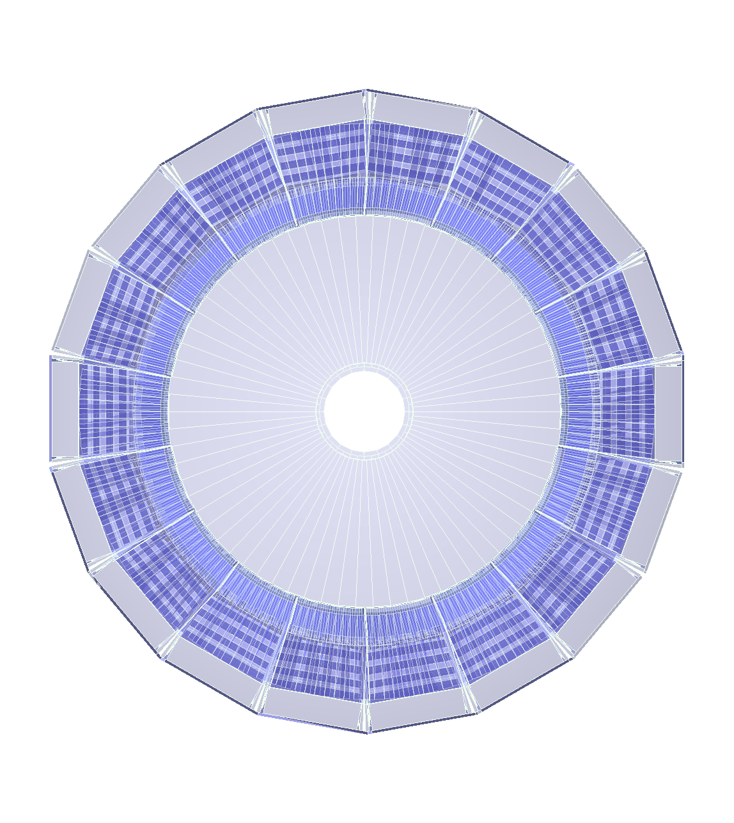
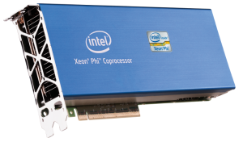
Geometry
Filters
(Fast)Physics
Filters
Stepper
Input queue
Vol₁
Vol₂
Vol₃
Vol_{n}
e⁺/e⁻
γ
10⁵ baskets/sec
Vector
stepper
Baskets
Step sampling
Filter neutrals
(Field) Propagator
Step limiter
reshuffle
Outputs
Coproc. broker
VecGeom
navigator
Physics sampler
Scheduler
Full geometry
Simplified geometry
Phys. Process
post-step
GeantV
Secondaries
TO SCHEDULER

Slide 7
Geometry
Filters
(Fast)Physics
Filters
Stepper
Input queue
Vol₁
Vol₂
Vol₃
Vol_{n}
e⁺/e⁻
γ
10⁵ baskets/sec
Vector
stepper
Baskets
Step sampling
Filter neutrals
(Field) Propagator
Step limiter
reshuffle
Outputs
Coproc. broker
VecGeom
navigator
Physics sampler
Scheduler
Full geometry
Simplified geometry
Phys. Process
post-step
GeantV
Secondaries
TO SCHEDULER

Slide 8
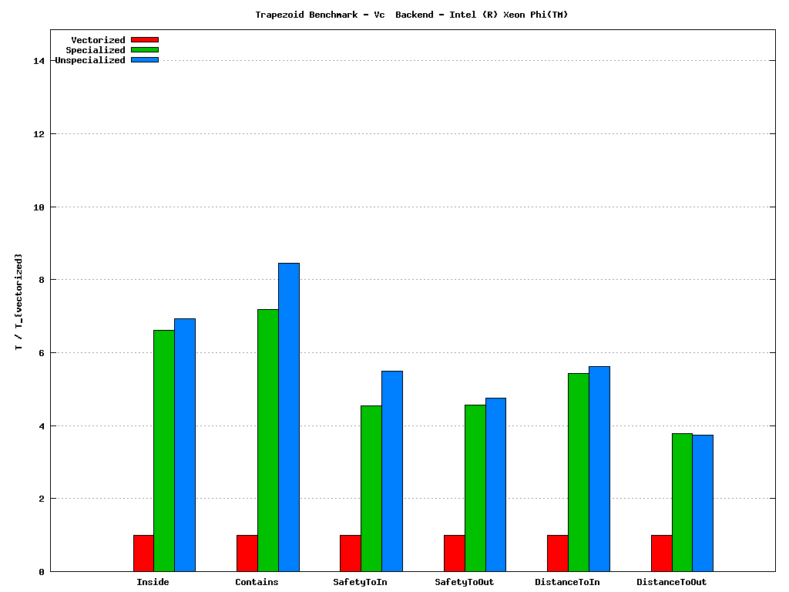
Geometry performance
 | 16 particles | 1024 particles | SIMD max
Intel Ivy-Bridge (AVX) | ~2.8x | ~4x | 4x
Intel Haswell (AVX2) | ~3x | ~5x | 4x
Intel Xeon Phi (AVX-512) | ~4.1 | ~4.8 | 8x
Geometry is 30-40% of the total CPU time in Geant4
A library of vectorized geometry algorithms to take maximum advantage of SIMD architectures
Substantial performance gains also in scalar mode
Overall performance for a simplified detector vs. scalar ROOT/5.34.17
Vectorization performance for trapezoid shape navigation (Xeon®Phi® C0PRQ-7120 P)

Slide 9
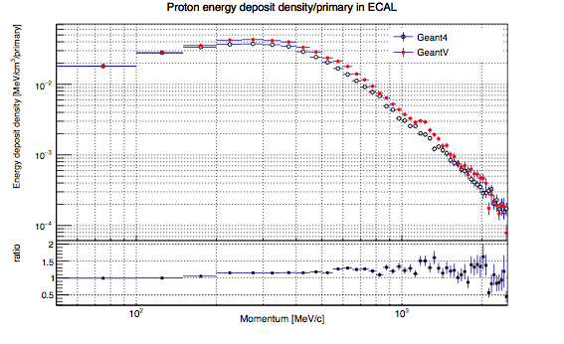
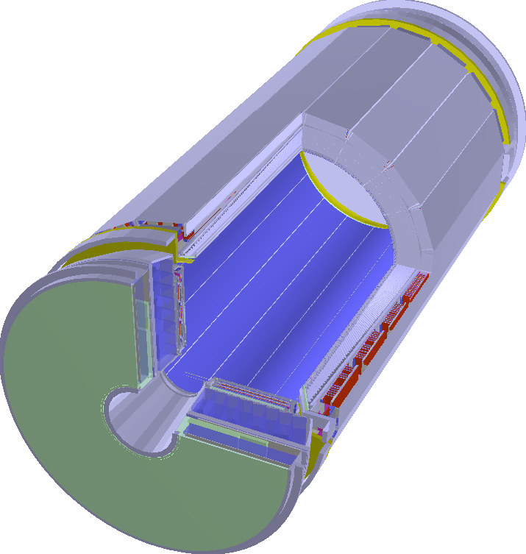
Physics performance
Objective: write a vector version for most of the physics code
The vectorised Compton scattering shows good performance gains
Vector code is better scalar code!
Current prototype able to run an exercise at the scale of an LHC experiment (CMS)
Simplified (tabulated) physics but full geometry
Very preliminary results needing validation
CMS Ecal

Slide 10
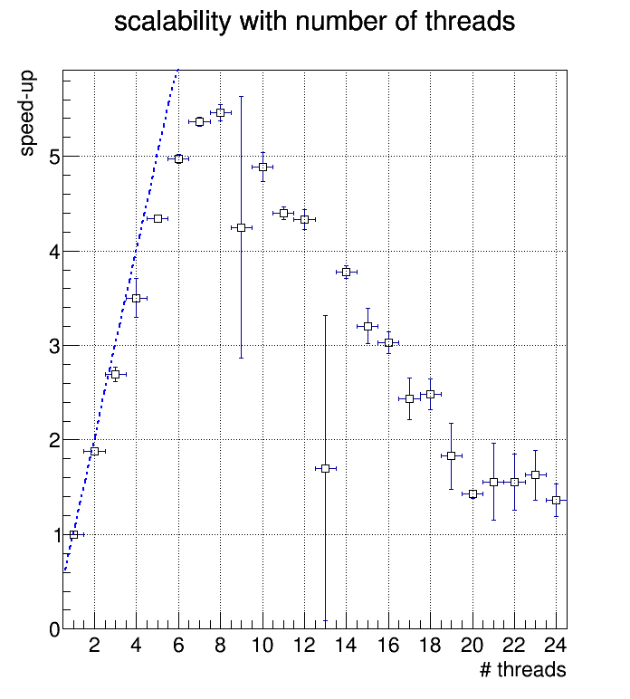
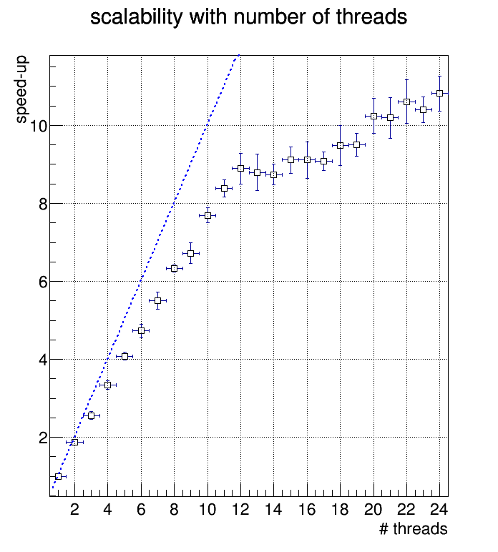
Basketizer performance
Rebasketizing
2x Intel(R) Xeon(R) CPU E5-2630 v3 @ 2.40GHz
Investigated different ways of scheduling & sharing work - lock free queues, ..
Changes in scheduler require non-trivial effort (rewrite)
Amdahl still large, due to high re-basketizing load (concurrent copying)
O(10⁵) baskets/second on Intel Core i7™
Algorithm already lock free
Rate will go down with physics processes
Ongoing work to improve scalability
Re-use baskets in the same thread after step if enough particles doing physics-limited steps
Clone scheduling in NUMA aware groups
Algorithm using spinlocks
Lock-free algorithm
(memory polling)
CPU1
RAM_1
GeantPropagator (NUMA manager)
Scheduler1
Transport
queue1
Work stealing only
when needed
CPU2
RAM_2
queue2
Scheduler2
MPI manager

Slide 11
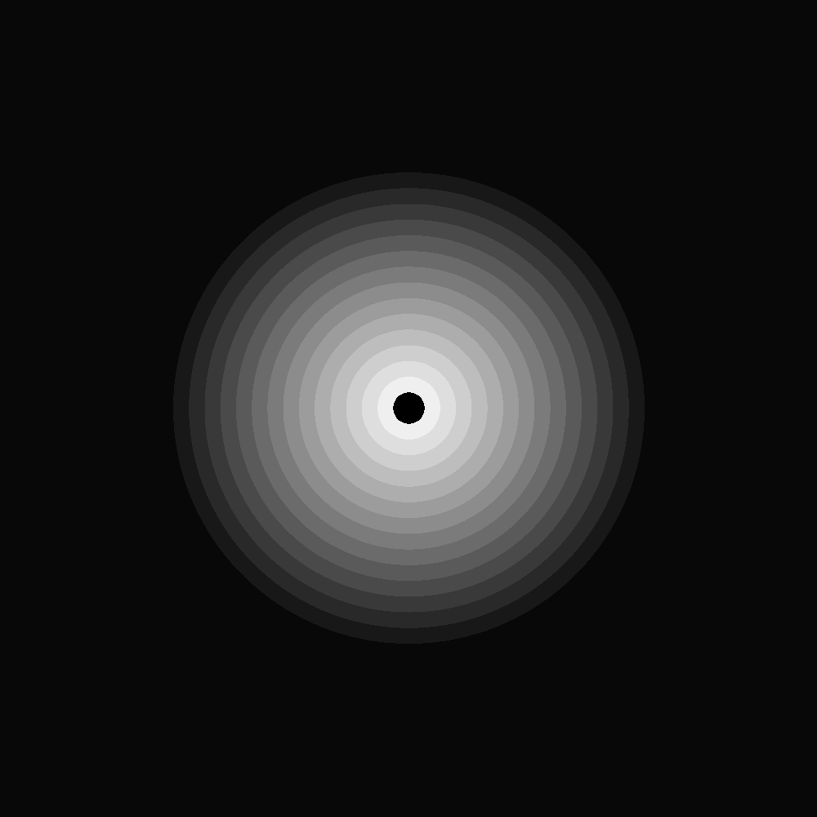
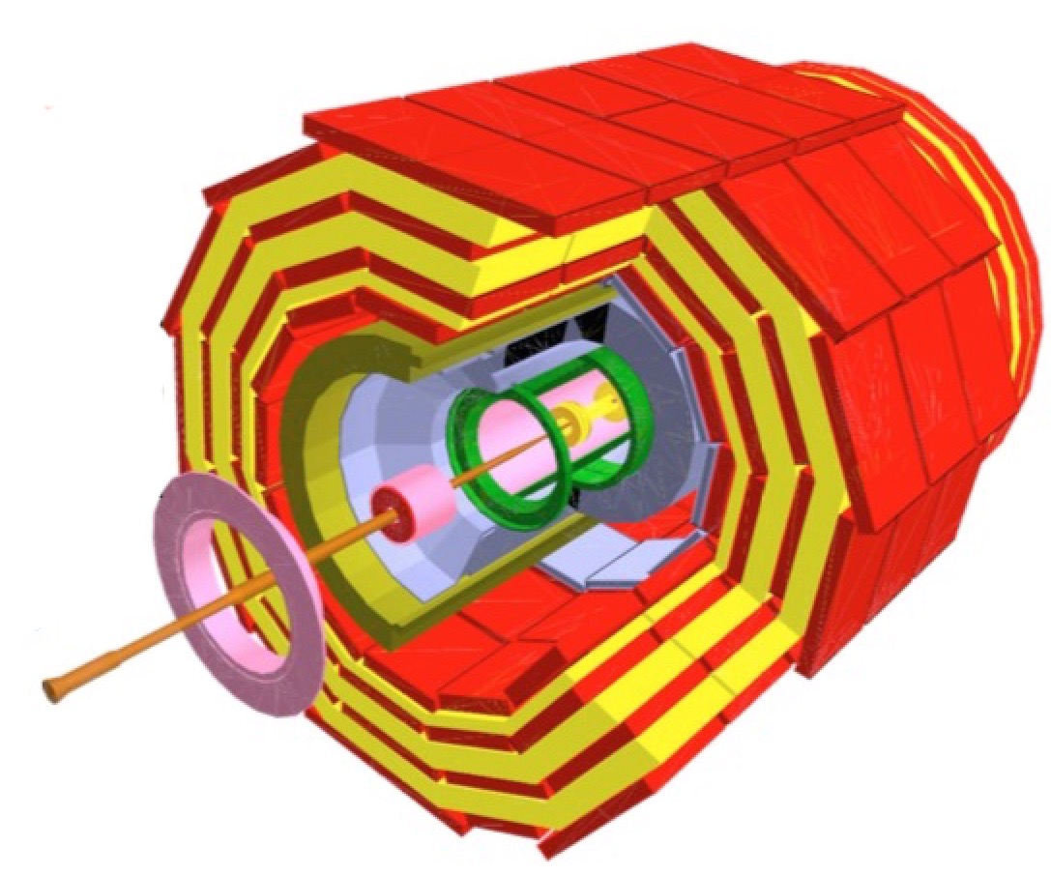
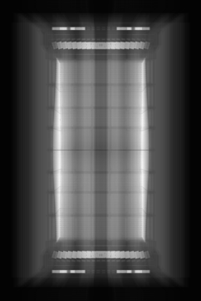
The X-Ray benchmark
The X-Ray benchmark tests geometry navigation in a real detector geometry
X-Ray scans a module with virtual rays in a grid corresponding to pixels on the final image
Each ray is propagated from boundary to boundary
Pixel gray level determined by number of crossings
A simple geometry example (concentric tubes) emulating a tracker detector used for Xeon©Phi benchmark
To probe the vectorized geometry elements + global navigation as task
OMP parallelism + “basket” model
OMP threads

Slide 12
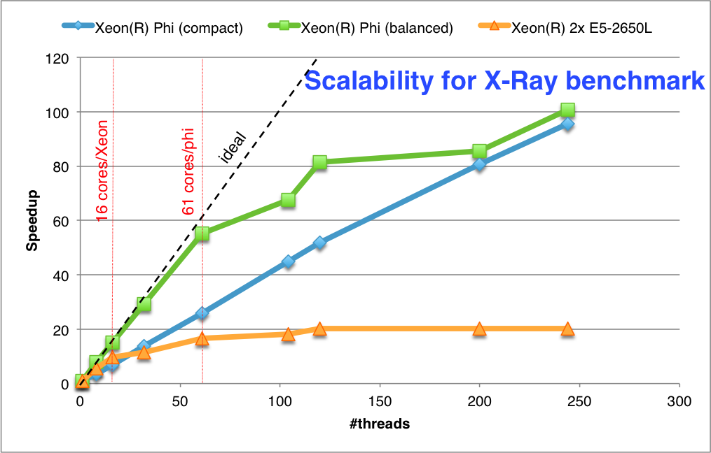
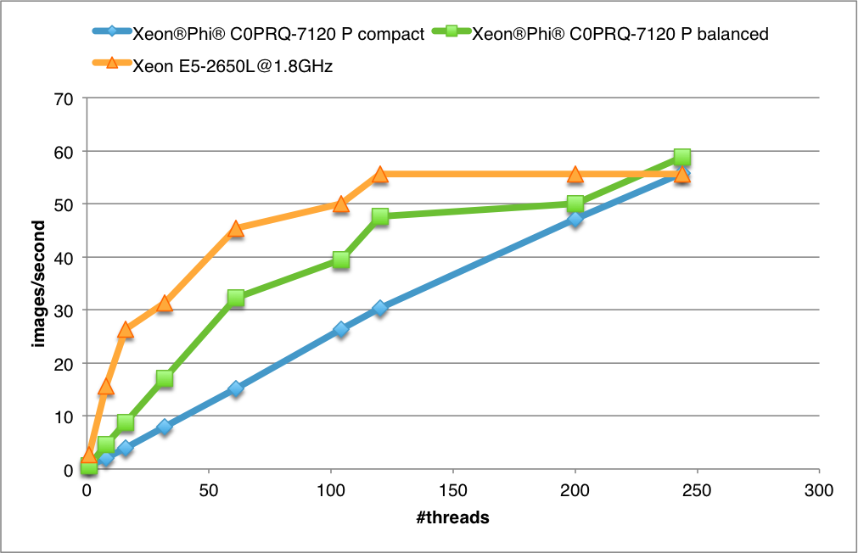
Scalability and throughput
Better behavior using OMP balanced
Approaching well the ideal curve up to native cores count
Balanced threading converges towards the compact model as all the thread slots are filled
It’s worth to run Xeon Phi saturated for our application
The throughput performance for a saturated KNC is equivalent (for this setup) to the dual Xeon E5-2650L@1.8GHz server which hosts the card.

Slide 13
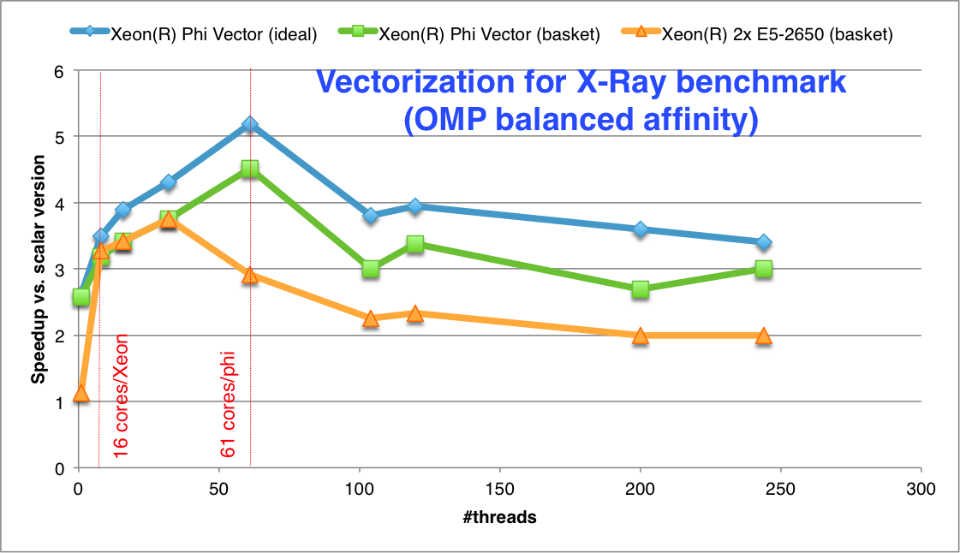
Vector performance
Gaining up to 4.5 from vectorization in basketized mode
Approaching the ideal vectorization case (when no regrouping of vectors is done) .
Vector starvation starts when filling more thread slots than the core count
Performance loss is not dramatic
Better vectorization compared to the Sandy-Bridge host (expected)
Scalar case: Simple loop over pixels
Ideal vectorization case: Fill vectors with N times the same X-ray
Realistic (basket) case: Group baskets per geometry volume

Slide 14
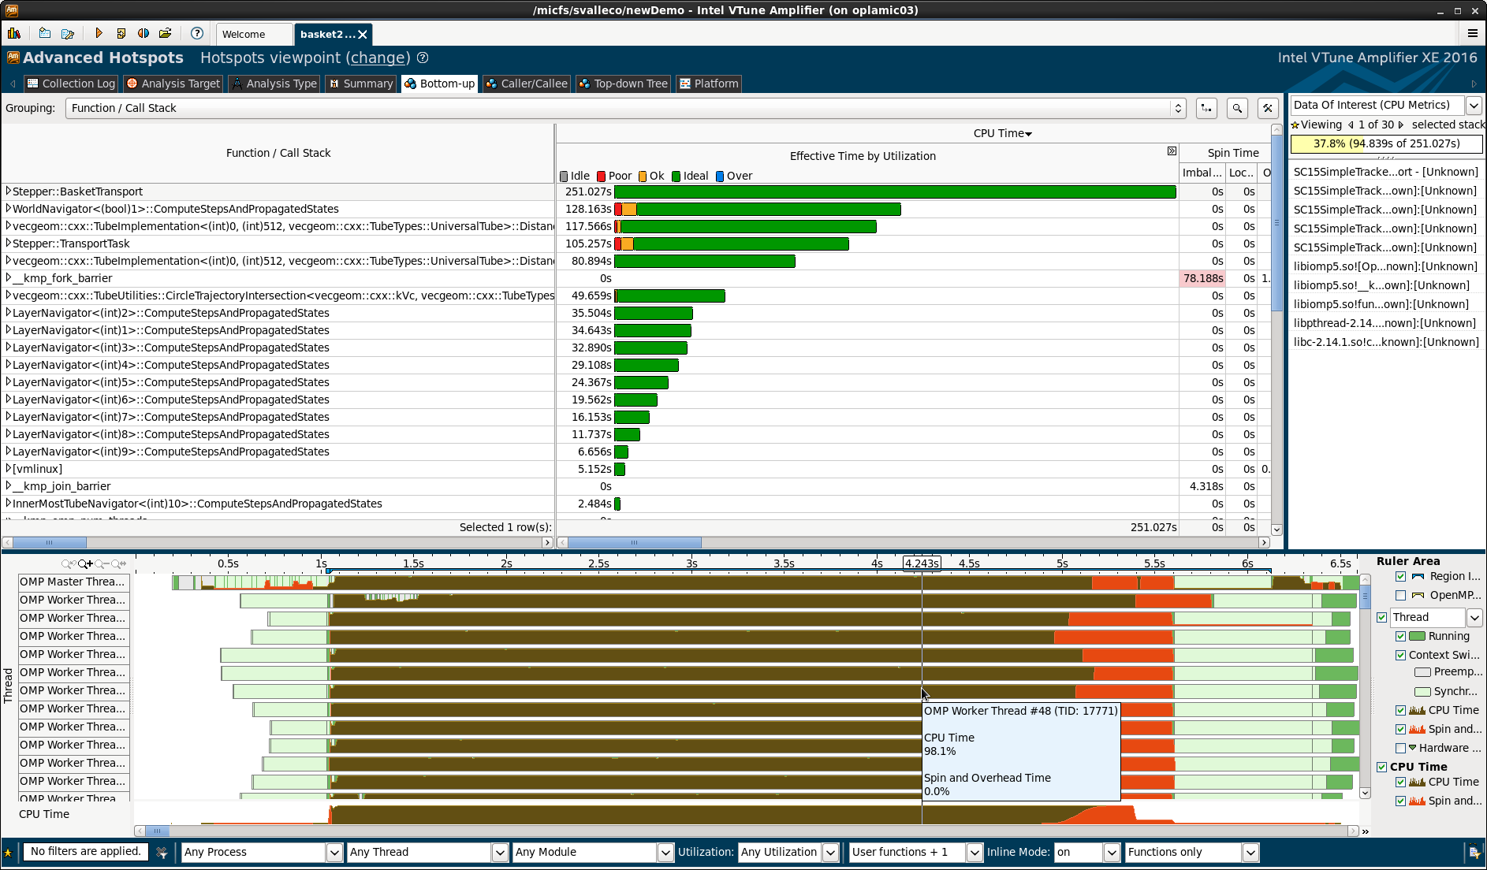
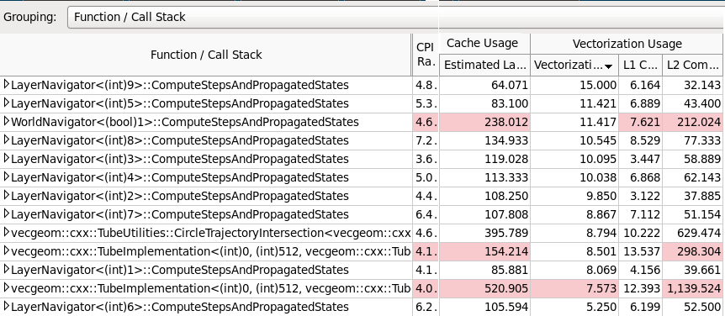
Profiling for the X-Ray benchmark
Good vectorization intensity, thread activity and core usage for the X-Ray basketized benchmark on a Xeon Phi (61 core C0PRQ-7120 P)
The performance tools gave us good insight on the current performance of GeantV

Slide 15
Looking forward to…
… implementing a “smoking gun” demonstrator combining all prototype features
SIMD gains in the full CMS experiment setup
Coprocessor broker in action: part of the full transport kernel running on Xeon®Phi® and GPGPU
Scalability and NUMA awareness for rebasketizing procedure
… achieving these just moves the target a bit further
… testing and optimizing the workflow on KNL
Important architecture to test how flexible our model is
Expecting epic “fights” for scaling up the performance
Already working on implementing device-specific scheduling policies and addressing NUMA awareness

Slide 16
Thank you!

