Slide 2

Oracle: Database and Data Management Innovations with CERN
Presented to
Public Day
Kevin Jernigan, Oracle
Lorena Lobato Pardavila, CERN
Manuel Martin Marquez, CERN
June 10, 2015

Slide 4
Program Agenda
1
Introduction
Oracle openlab IV achievements
Oracle strategic direction
Oracle openlab V projects
Conclusions
2
3
4
5

Slide 5
Program Agenda
1
Introduction
Oracle openlab IV achievements
Oracle strategic direction
Oracle openlab V projects
Conclusions
2
3
4
5

Slide 6


Slide 7
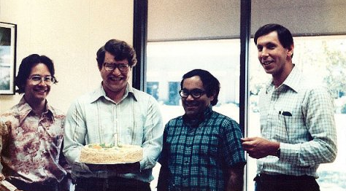
Oracle Begins as SDL
Software Development Laboratories
“About five years into the company, it became pretty clear that the horizons were unlimited. The only limitations were us” – Larry Ellison

Slide 8
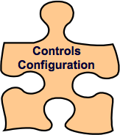
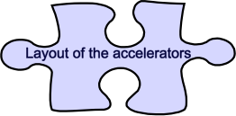

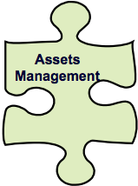
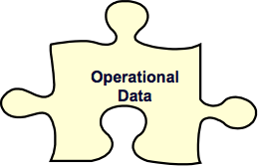
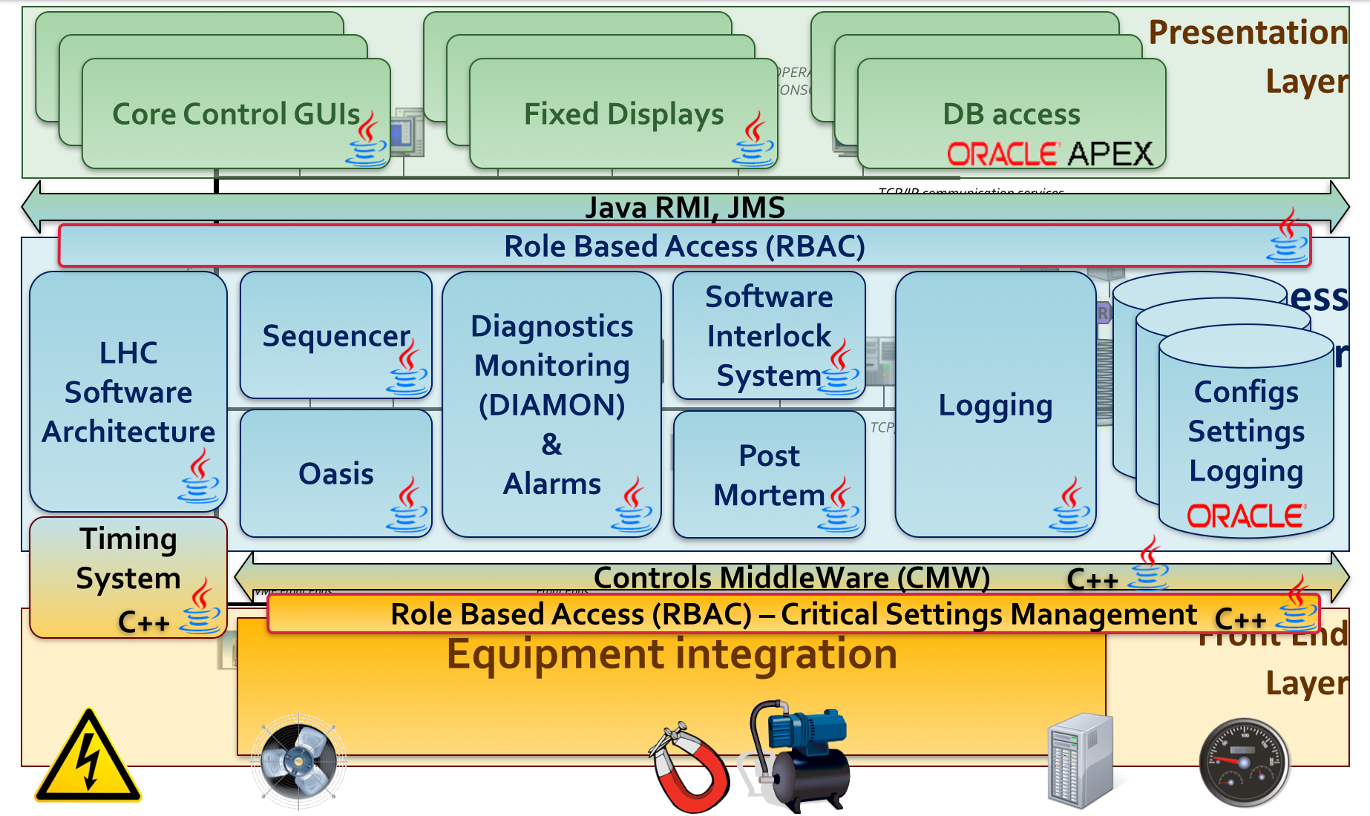


  Accelerator Controls Configuration
configuration of:
ALL Control System Entities & their relationships
Since 1985!
ABC@ACCCON
Heterogeneous Entities
Credit: Chris Roderick (CERN)
Notes:
The basics of high-level accelerator operation require that operators can modify and send the correct settings to 10’s of thousands of accelerator devices, so that they can be executed in a coordinated way in order to produce the desired beam behavior. Operators can modify settings at many different levels, and any change needs to be reflected in all related settings. For example, it could be desirable to modify a low level parameter like a current of a quadruple magnet power converters, which will implicitly modify the so called tune of the accelerator. Likewise it may be desirable to take a top down approach and directly modify the tune. A full history of modifications is required, with support to revert to prior settings at any moment in time.
Question to students - what technology would you use for this?

Slide 9
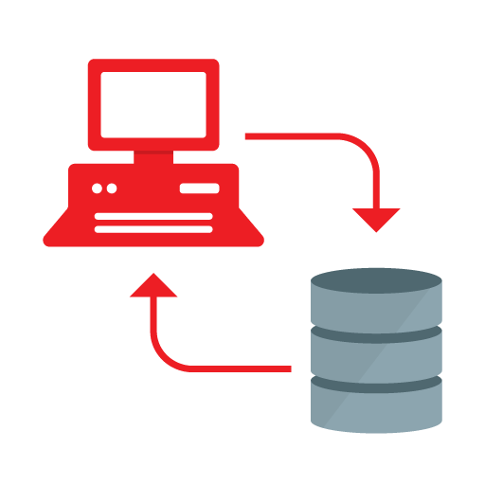
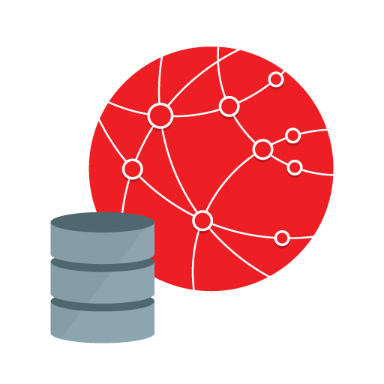
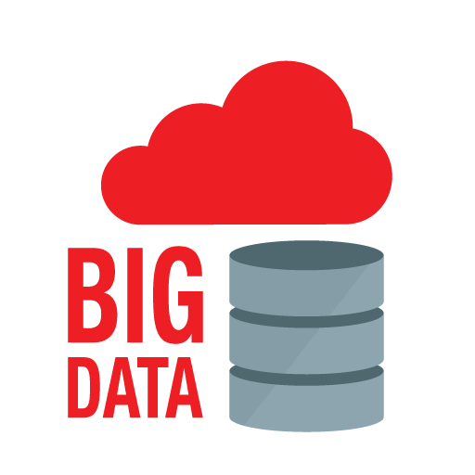
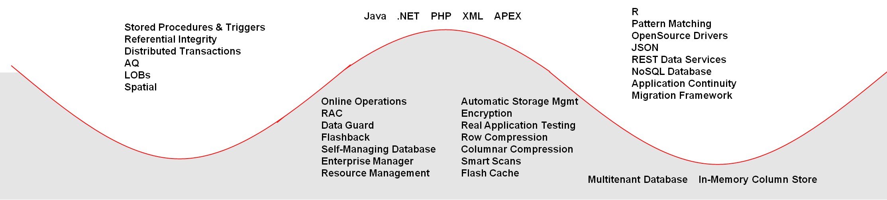

Market Leader from Continuous Innovation
Changing dynamics
Client-Server
Internet
Big Data & Cloud
Release | 1985 – 1997: 6, 7 and 8 | 1998 – 2012: 8i, 9i, 10g, 11g |  | 2013-2014: 12c
Developer
Engine
OLTP throughput
Parallel Query, Partitioning

Slide 10

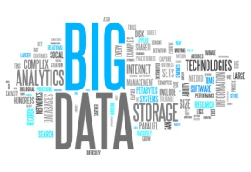
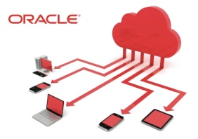
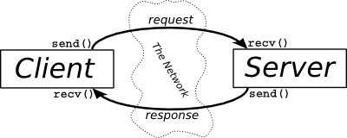
Market Leader from Continuous Innovation
Responsive to customer demands and industry trends
Internet
Cloud
1993
2001
2004
2007
2013
Tomorrow
Oracle9i Database
Oracle7 Database
Oracle Database 10g
Oracle Database 11g
Oracle Database 12c
Declarative Referential Integrity
PLSQL Triggers and Stored Procedures
Two Phase Commit
Parallel Operations
Object Relational Support
Multimedia Support
Real Application Clusters
Materialized Views
XML Database
Data Guard
Flashback Query
Virtual Private Database
Built in Java VM
Automatic Storage Management
Transparent Data Encryption
Self Managing Database
Automatic Workload Repository
SQL Tuning Advisor and ADDM
Flashback Table and Database
Application Express
Active Data Guard
Advanced Compression
Real Application Testing
Hybrid Columnar Compression
Exadata Smart Scans
Exadata Smart Flash Cache
Exadata I/O Resource Management
Multitenant
Heat Map & Automatic Data Optimization
Data Redaction
Pattern Matching
Global Data Services
Application Continuity

Slide 11
Program Agenda
1
Introduction
Oracle openlab IV achievements
Oracle strategic direction
Oracle openlab V projects
Conclusions
2
3
4
5

Slide 12
openlab IV
Database Competence Centre
Lorena Lobato Pardavila
Andrei Dumitru
Ignacio Coterillo Coz
Antonio Romero Marin
Manuel Martin Marquez
Luis Rodriguez Fernandez
Maaike Limper
Stefano Russo

Slide 13
Openlab IV projects
Database Competence Centre
Virtualization
Monitoring
Oracle Database 12c
In-Database Physics Analysis
Data Analytics
Replication Technologies
Java Enterprise Edition

Slide 14
Database Competence Centre Achievements
Performance tests of Intel SR-IOV network cards on Oracle virtual platforms
Integration of the Oracle VM hypervisor as a compute provider on the OpenStack Cloud Operating System
Virtualization
Monitoring
Migrated from Oracle Enterprise Manager 11g to version 12c
Integrated with CERN Agile Infrastructure (Active Directory)
Early validation of new functionalities thanks to involvement in Beta program
Oracle Database 12c being deployed in production
Oracle Database 12c
In-Database Physics Analysis
Proven for a subset of the SQL-based queries
Better understanding of Oracle Database In-Memory

Slide 15
Database Competence Centre Achievements
Java Web Hosting Service (Middleware on Demand)
Upgrade 500 Oracle Weblogic Servers to 12c
Oracle Weblogic and APEX SSO integration
Java Enterprise Edition
Oracle R Enterprise added new functionalities proposed by CERN
Applied Oracle Endeca Information Discovery to explore future possibilities in control and monitoring improvement
Data Analytics
Replication Technologies
Oracle GoldenGate evolution to fulfill CERN needs
Smooth migration from Oracle Streams to Oracle GoldenGate

Slide 16
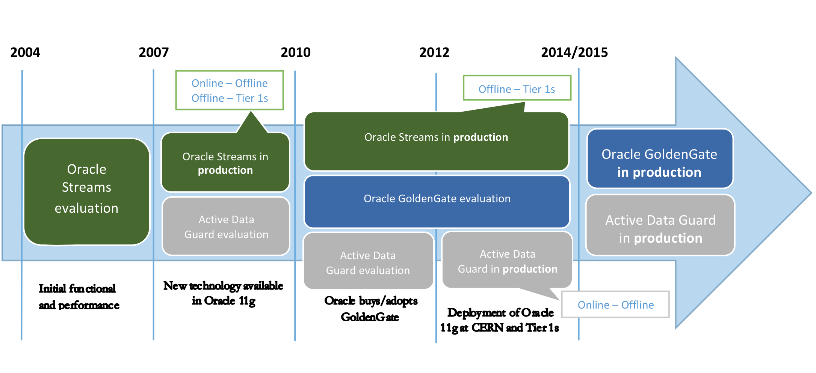
Replication Technologies Evolution

Slide 17
Replication Technologies Evolution
Feedback to Oracle GoldenGate development team
Replication Technologies Environment
Oracle GoldenGate 12c fit in CERN use cases
Oracle GoldenGate 11g did not fulfill CERN needs
Oracle GoldenGate 12c contained new functionalities as suggested by CERN
Improvements in transactions dependencies (including DDL)
Data Filtering based on session tagging
Offloading primary system with downstream capture database
Native DDL support (Table creation, granting of user privileges)
Centralized system at CERN for physics data distribution in WLCG
Migration completed from Oracle Streams to Oracle GoldenGate in our productions databases during 2014

Slide 18
Program Agenda
1
Introduction
Oracle openlab IV achievements
Oracle strategic direction
Oracle openlab V projects
Conclusions
2
3
4
5

Slide 19
Oracle Database Innovations for each Computing Era
Now innovating for big data and the cloud
Client-Server
Internet
Big Data & Cloud
Release | 1985 – 1997: 6, 7 and 8 | 1998 – 2012: 8i, 9i, 10g, 11g |  | 2013-2014: 12c
Developer
Engine
OLTP throughput
Parallel Query, Partitioning

Slide 20
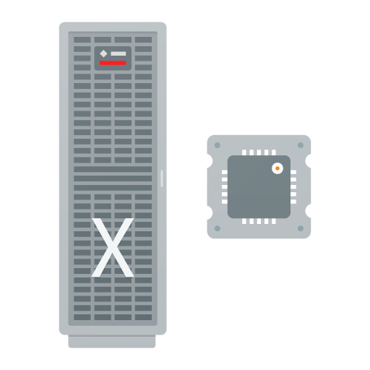

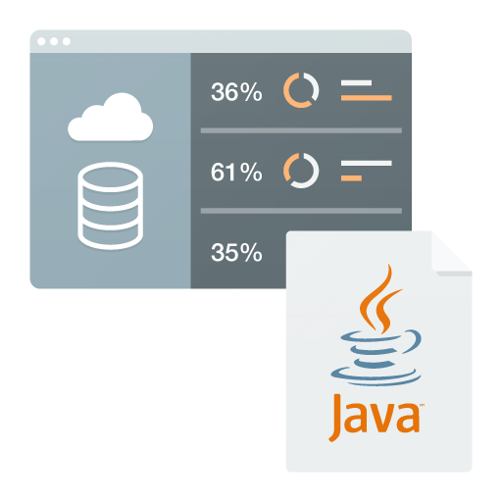
Cloud Services
Apps
Platform
Infrastructure
Software as a Service (SaaS)
Platform as a Service (PaaS)
Infrastructure as a Service (IaaS)
Notes:
Cloud services are typically in 3 flavors

Slide 21

























Oracle Cloud
Full stack enterprise cloud services SaaS + PaaS + IaaS
CX
HCM
ERP
SCM
EPM
Analytics
Social
Data
Database
Java
EM
Node.js
Big Data
Big Data
Discovery
Business
Intelligence
Mobile
Integration
Developer
Documents
Messaging
Process
Database
Backup
Compute
Storage
https://cloud.oracle.com
Notes:
Infrastructure completes the picture
Elastic compute capacity to address growing business needs
Oracle Cloud Infrastructure as a Service (IaaS) offers a set of core infrastructure capabilities like elastic compute and storage to provide customers the ability to run any workload in the cloud.

Slide 22

Enterprise Big Data Architecture
Discover And
Predict, Fast
Accelerate Data-Driven Action
BIG DATA
ANALYTICS
BIG DATA
APPLICATIONS
DATA
CAPITAL
Simplify Access
To All Data
Connect And Govern Any Data
BIG DATA
MANAGEMENT
BIG DATA
INTEGRATION
Copyright © 2014 Oracle and/or its affiliates. All rights reserved. |
Notes:
To connect this back to big data strategy, remember that the whole point is to create value from data capital. We’re now talking about how you do that.
Bringing big data into the enterprise relies on all the things you already know how to do -- integrating, managing, analyzing, and acting on data – but makes them all harder. Because in each case you have to bring together systems of record containing data you carefully curate and silos of innovation containing data that’s born in many different formats, changes its shape frequently and sometimes is completely beyond your control.
You’ll need Big Data Integration, including both streaming capability for real-time capture like sensor data from oil drills or medical devices plus batch capability for inevitable bulk loads from new sources or data replication across distributed data centers for disaster recovery.
All the data you capture has to land somewhere, so you’ll need big data management consisting of both data reservoirs and data warehouses. A data reservoir is a Hadoop cluster that lets you pour in highly diverse data and scale out at low cost. The data warehouse is the critical respository you already know. But in a world of big data, it also will have to deliver more processing power and storage at lower total cost of ownership. These two live side-by-side and, wherever possible, should act as one, single, high-performance system.
One of the most important places where all this data gets used is in Big Data Analytics. This includes highly flexible discovery environments where managers can explore diverse data and learn from it before it’s organized into a nice, neat model. It also includes the full range of business analytics found in BI and EPM. In addition, Big Data Analytics must provide tools for data scientists to conduct experiments, moving back and forth between in-the-lab theory and in-production practice. It’s in Big Data Analytics demands the seamless interoperation of systems of record and silos of convenience.
Of course, you have to act on this data ultimately, and Big Data Applications make this possible. These apps may include embedded analytics from based on data in the reservoir or warehouse or both, delivered to mobile devices or to the desktop through Web apps. They may also include on-device applications in connected things, like microcontrollers in buildings, enabling the equipment to take data-driven action on your behalf. The actions then produce data which starts the cycle all over again.
And, of course, you may choose to deploy these capabilities using public cloud services, private cloud or on-premise deployments, or (most likely) a combination of all three.

Slide 23
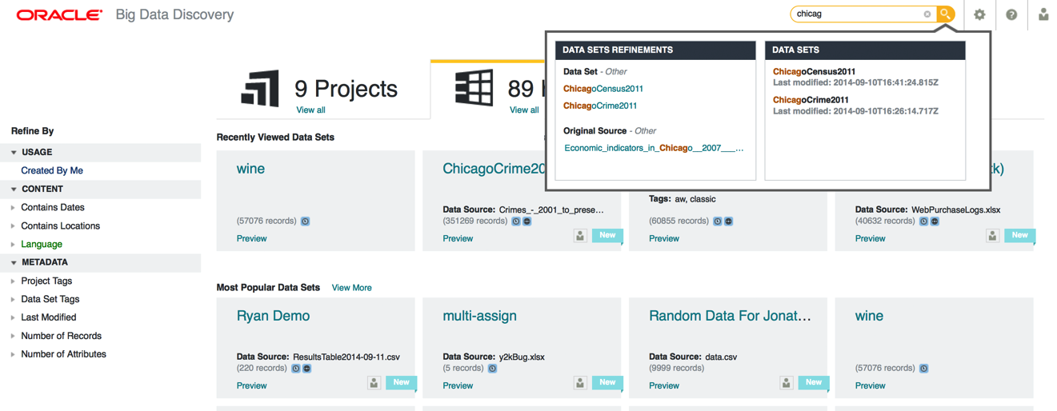
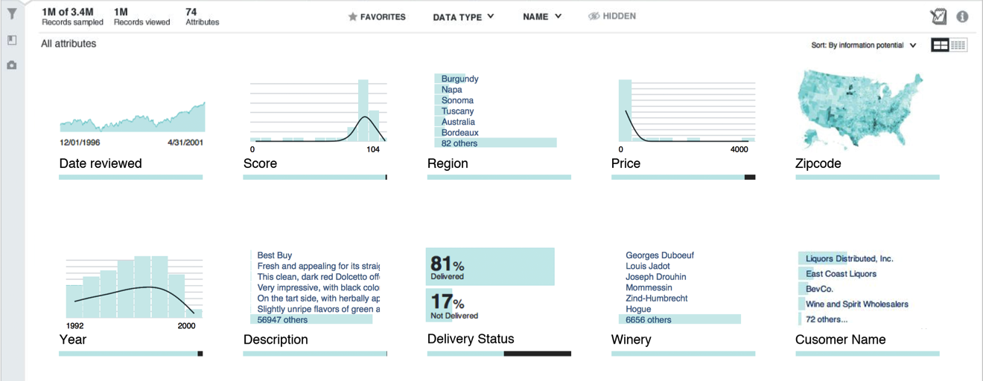

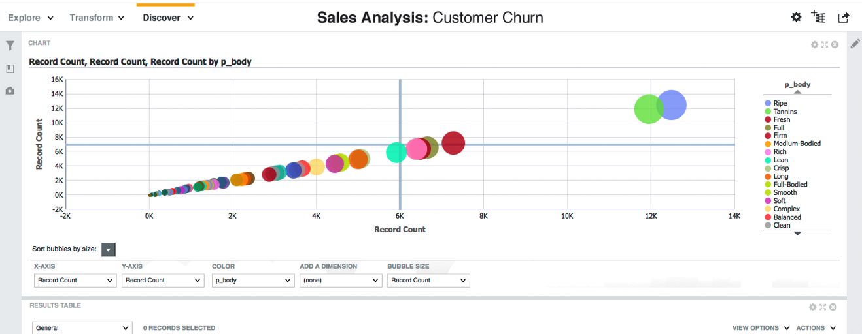
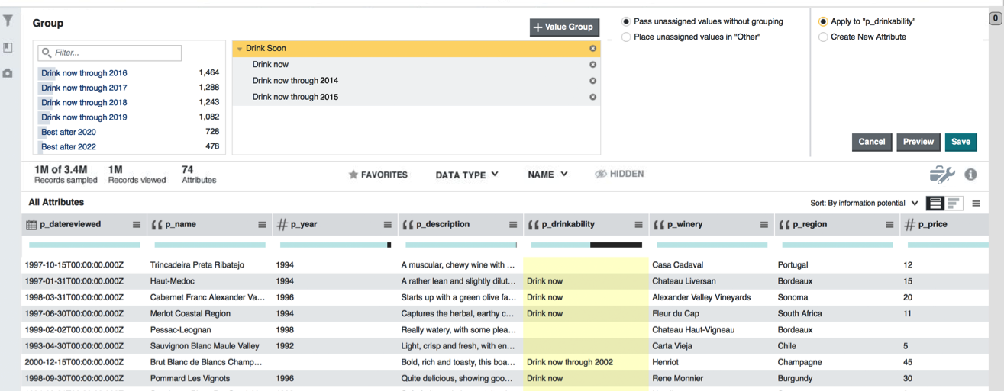
Oracle Big Data Discovery. The Visual Face of Hadoop
Find
Explore
Discover
Transform

Slide 24
Program Agenda
1
Introduction
Oracle openlab IV achievements
Oracle strategic direction
Oracle openlab V projects
Conclusions
2
3
4
5

Slide 25
CERN openlab V
Continuous Innovation
Exploit new Java and WebLogic features for improving Java Infrastructure
  Developer Productivity
  Improve application consolidation density
Java Web
Private, Hybrid and Public
  Cloud Database back-up and recovery
  Transparent application deployment between CERN and public Cloud
Cloud Services
CERN’s and High Energy Physics Oriented
  RAC evolution
  In-memory, data “sharding”
  High availability monitoring
Database Evolution
Data Analytics
Data Analytics as a Service Infrastructure
  Joint effort between CERN and openlab members

Slide 26
Data Analytics as a Service
Feature and Challenges
Centralize and standardize Data Analytics requirement
Integration with existing data repositories
Provide Storage for large data volume
Different actors and Data Analytics requirements
Extremely Heterogeneous data environment
Large number of mission-critical data systems need to be integrated
Logging, fault tracking, major events, etc.
Deliver real-time, batch analytics and information discovery
Batch predicted models deployed for real time monitoring and control
Deliver self-service Information Discovery
Structured and unstructured
Flexible platform for CERN and external institution

Slide 27
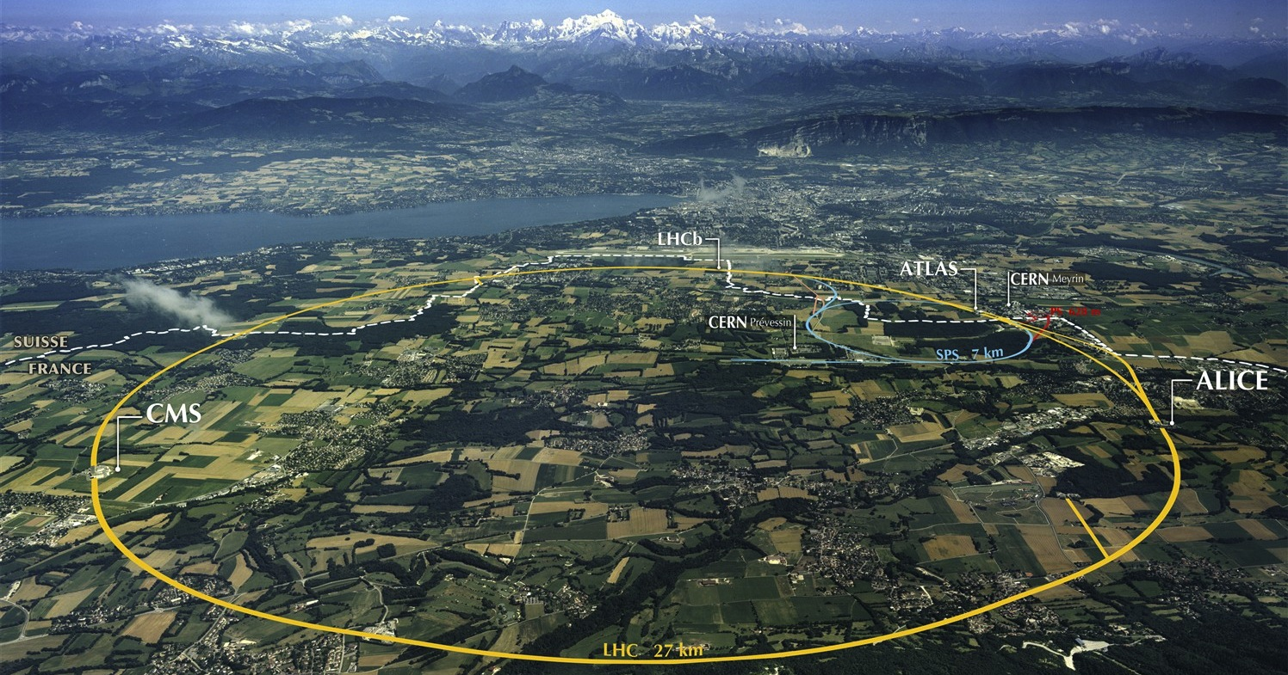

Notes:
CERN

Slide 28
Future Circular Collider Study
Reliability, Availability & Maintainability
Model the accelerator complex and to simulate the particle acceleration process.
Reliability and Availability Study
Key indicators for the performance of circular colliders
FCC RAMS studies will be needed to assess the feasibility of such a large scale project
FCC, Tampere University of Technology and CERN openlab
Collaboration project
For the HL-LHC availability will be one of the fundamental

Slide 29
Program Agenda
1
Introduction
Oracle openlab IV achievements
Oracle strategic direction
Oracle openlab V projects
Conclusions
2
3
4
5

