Slide 1
Oracle Parallel Query vs Hadoop MapReduce for Sequential Data Access
Zbigniew Baranowski
Notes:
Today I would like to present you results of some test that were conducted by us this summer, which were focused on measuring of speed of sequential data access by Oracle and Hadoop

Slide 2
Outline
Motivation
SW & HW architecture
Test setup
Results
Summary

Slide 3
Outline
Motivation
SW & HW architecture
Test setup
Results
Summary

Slide 4
Motivation for testing
Relational model does not work well for
data analysis
big data volumes
random data access (and not by primary key)
indexes consumes too much space
table joins are inefficient
e. g. ATLAS Events Metadata, ATLAS DQ2 logs
Full data scans (brute force) works best!
Notes:
There are number of application like ATLAS Events Metadata ATLAS DQ2 (Don Quijote or DQ, is the data management service for the ATLAS Production System. Using Don Quijote users can locate replicas of files, add, remove or modify both logical and physical entries in grid replica catalogs. In addition a transfer service is provided to replicate files between storage locations as well as query each grid information system regarding data storage facilities.)

Slide 5
What do we want to test?
Full Scan
?

Slide 6
Why Hadoop?
Emerging technology…
Yahoo, Google (BigTable/GFS)
… that people are interested in
ATLAS…
Strong for data analytics and data warehousing
On this field Oracle can be hard to optimize and/or can be very expensive (Exadata)
IT maybe about to provide a Hadoop service

Slide 7
Why Oracle?
30 years at CERN
a lot of data already in Oracle
Full ACID transactional system
Optimized for various data access methods

Slide 8
Compare apples to apples
Comparable test for Hadoop and Oracle
simple data structure
simple data access (sequential)
Application
Application
?
Map Reduce
Oracle RDBMS
Oracle I/O interface
Hadoop
I/O interface
Hardware
Hardware

Slide 9
Outline
Motivation
SW & HW architecture
Test setup
Results
Summary

Slide 10
Hardware architecture
Shared Storage
Shared Nothing
Interconnect
Node 1
Node 2
Node n
Interconnect
Storage 1
Storage 2
Storage n
Interconnect
Node 1
Node 2
Node n

Slide 11
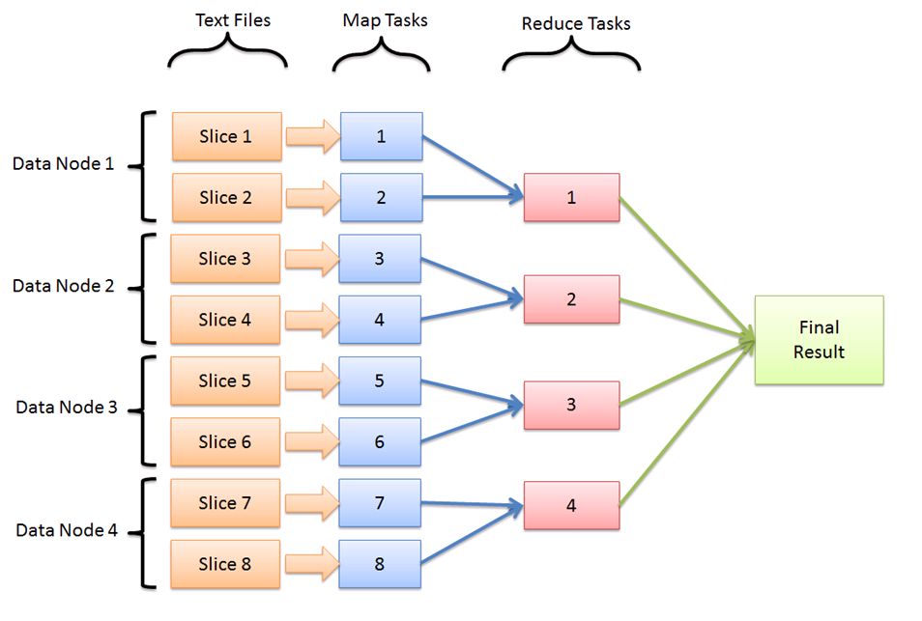
Software architecture Map Reduce

Slide 12
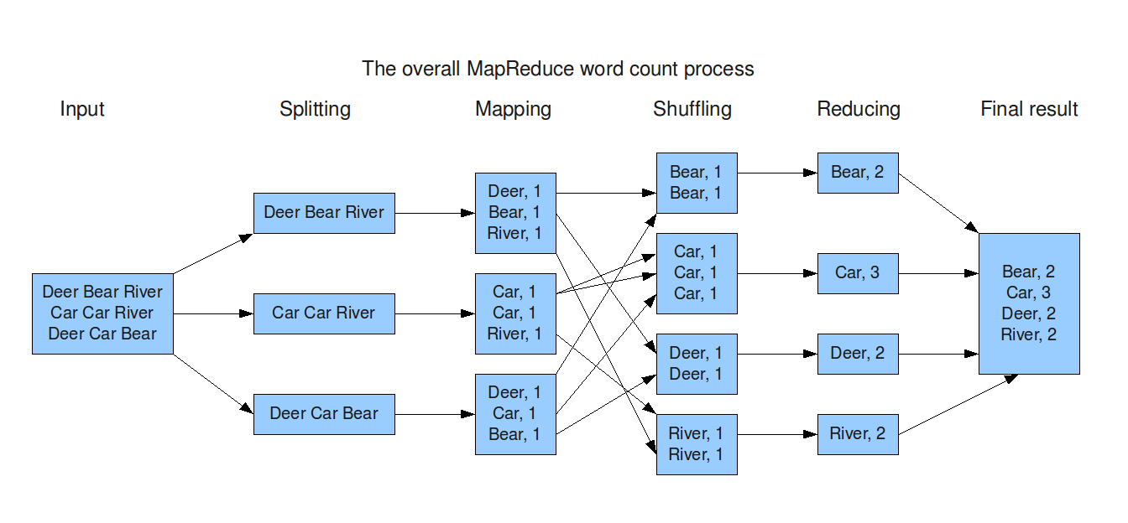
Map Reduce Example

Slide 13
Software architecture Oracle Parallel Query
Reading and filtering
Parallel Executors #1
Grouping and counting
Parallel Executors #2
Aggregation
Parallel Coordinator
Table
1
1
Blocks set #1
2
2
Blocks set #2
1
Blocks set #3
3
3
Blocks set #4
4
4
Final result
Blocks set #5
5
5
Degree Of Parallelism = 5
Notes:
Rotate

Slide 14
Parallel Query Example
PE set#1
Reading, joining and
sub-counting
PE set#2
Counting and sorting
Input table
Splitting
Coordinator
Agregating
Deer ,1
Bear,1
River,1
Bear,2
Car,3
Deer Bear River
Bear,2
Car,3
Deer,2
River,2
Deer Bear River
Car Car River
Deer Car Bear
Car,2
River,1
Deer,2
Car Car River
Deer Car Bear
Deer,1
Car,1
Bear,1
River,2
Degree Of Parallelism = 3

Slide 15
Outline
Motivation
SW & HW architecture
Test setup
Results
Summary

Slide 16
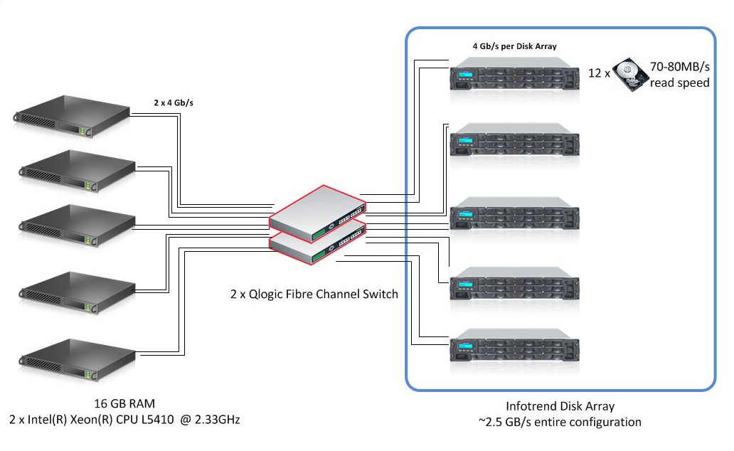
Hardware used

Slide 17
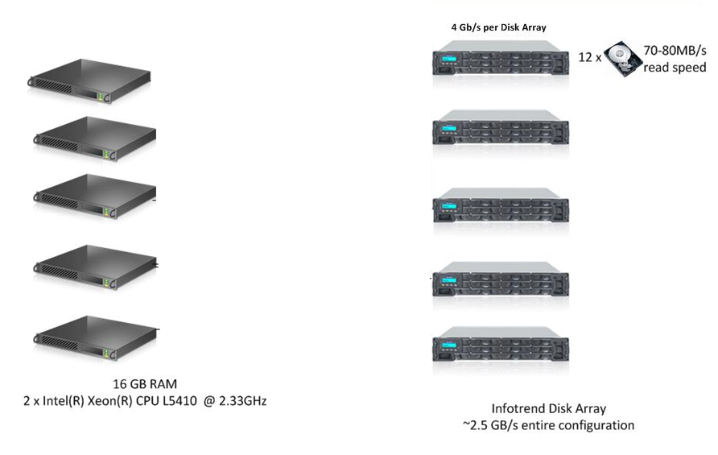
Hardware config for Hadoop
Shared nothing implementation

Slide 18
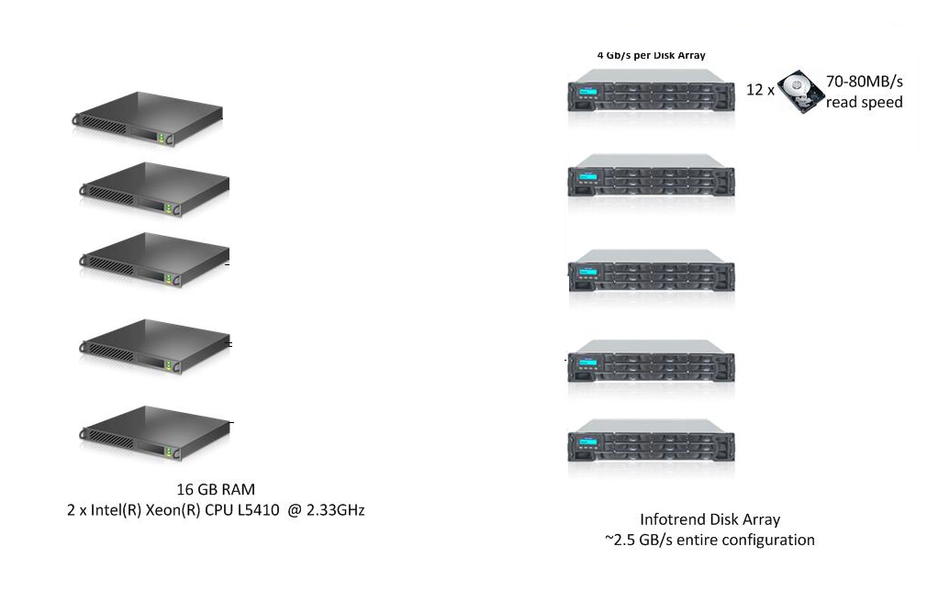
Hardware config for Oracle
Shared storage implementation

Slide 19
Software configuration
Hadoop
v1.0.3
Cluster file system: HDFS on top of ext3
More specific configuration/optimization
Delayed Fair Scheduler
JVM reuse
File block size 1GB
…
Oracle database
12c RAC
Cluster file system: Oracle’s ASM
Configuration recommended by Oracle
Notes:
Hadoop optimization

Slide 20
Data set used
Could be generic, but…
How do we know if we got the right results?
1TB CSV file with physics data
Numeric values (integers, floats)
532M lines/records
244 columns/attributes per record/line

Slide 21
Test case
Counting „exotic” muons in the collection
Oracle version
MapReduce
select /*+ parallel(x) */ count(*)
from iotest.muon1tb
where col93>100000 and col20=1;
//MAP body
LongWritable one = new LongWritable(1);
NullWritable nw = NullWritable.get();
String[] records = line.split(',');
tight = Integer.parseInt(records[19]);
pt = Float.parseFloat(records[92]);
if (tight==1 && pt>100000)
{
collector.collect(nw,one);
}
//REDUCER body
long sum = 0;
while (values.hasNext()) {
sum += values.next().get();
}
output.collect(NullWritable.get(), new LongWritable(sum));

Slide 22
Outline
Motivation
SW & HW architecture
Test setup
Results
Summary

Slide 23
Results

Slide 24
Step I
Optimize read workload using one machine
2x4 cores
16GB RAM
1x Storage, controller speed 4 Gbps

Slide 25
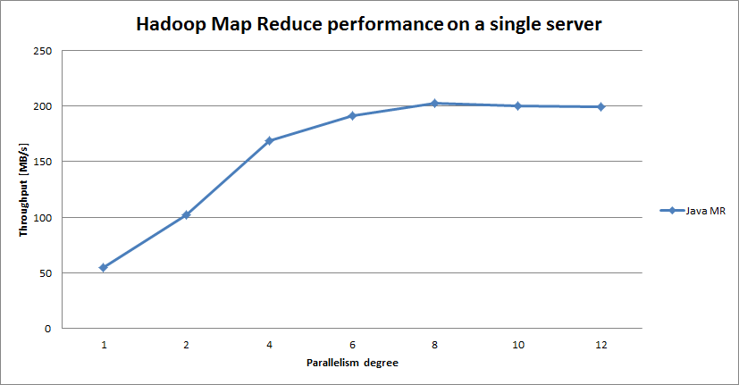
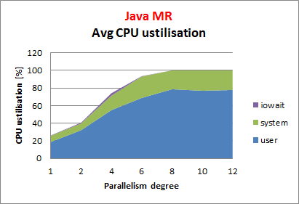
Map Reduce results (I)
Running proccessing one a single node – CPU bound
Number of CPU cores
Number of disks
Notes:
????

Slide 26
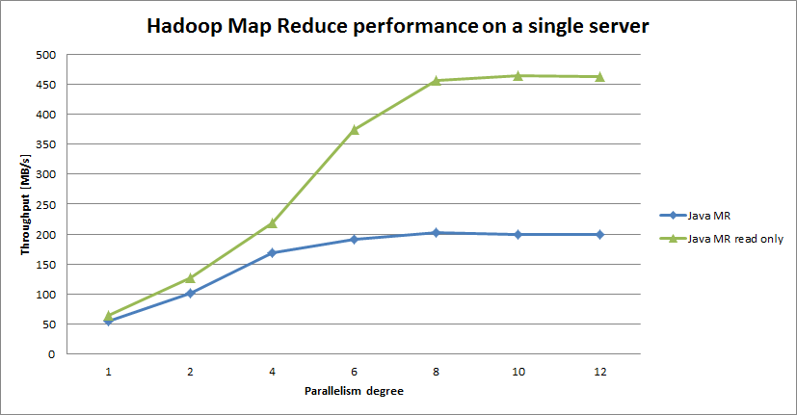
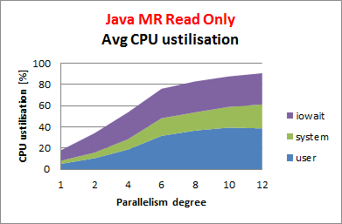
Map Reduce results (II)
Running read only proccessing one a sigle node – IO bound
Number of CPU cores
Number of disks

Slide 27
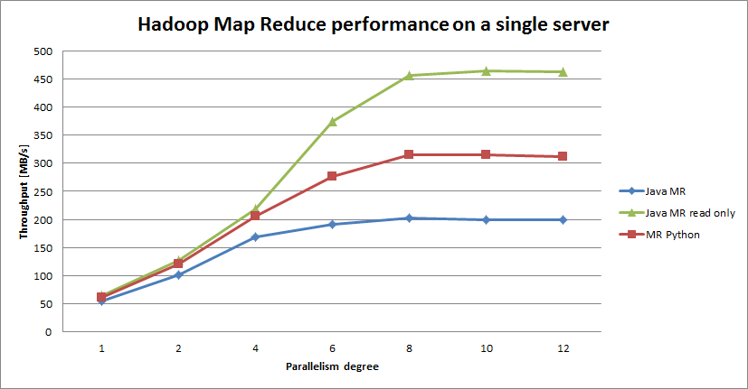
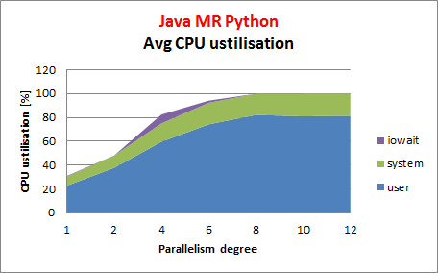
Map Reduce results (III)
Running python MR ( Hadoop Streaming ) processing one a sigle node – CPU bound
Number of CPU cores
Number of disks

Slide 28
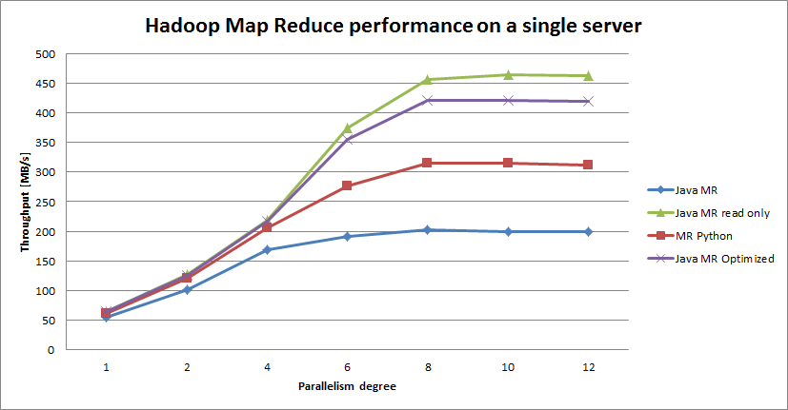
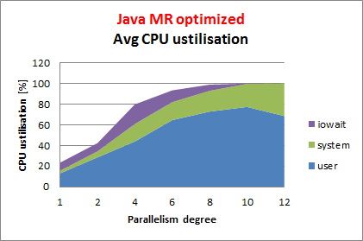
Map Reduce results (IV)
Running optimized java MR proccessing one a sigle node
Number of CPU cores
Number of disks

Slide 29
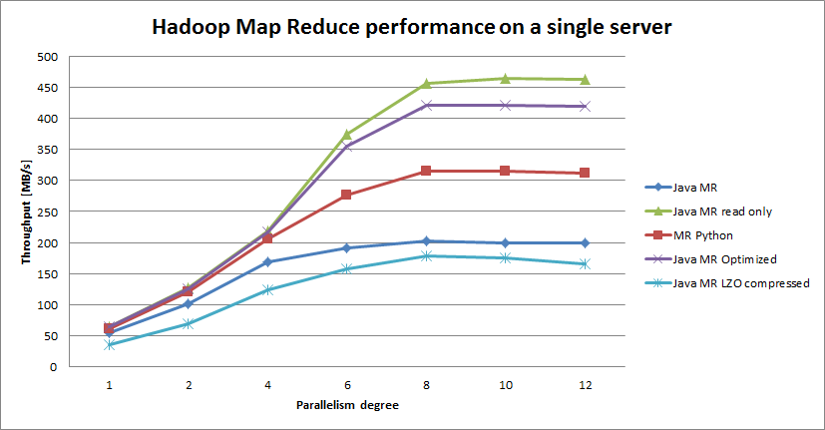
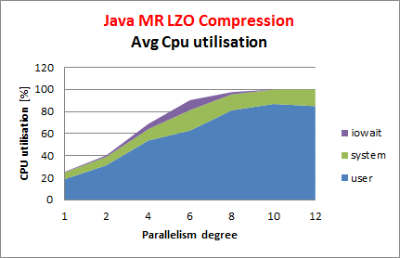
Map Reduce results
Running Java optimized MR on LZO compressed data (568GB) – CPU bound
Number of CPU cores
Number of disks

Slide 30
What we have learnt so far
Optimized reading for single node
High CPU utilisation
100% of available memory utilised by Java
Managed to deliver performance close to maximum capability of the hardware

Slide 31
Step II
Scaling up
5 nodes
5 storages, FC connection 4gbps
parallelism degree = 8

Slide 32
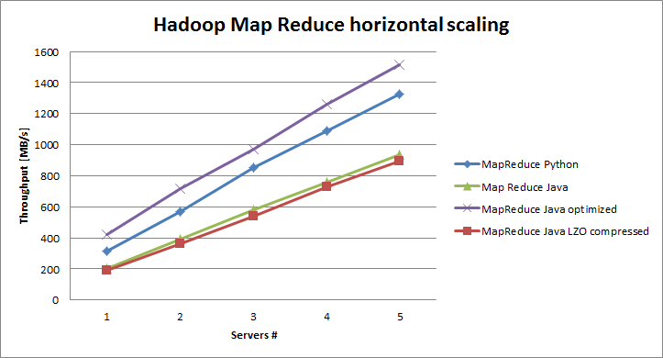
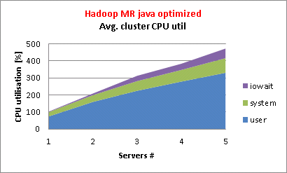
Map Reduce Results
Scaling the cluster
Notes:
horizontal

Slide 33
Results

Slide 34
Step 0
Data design - there are few possibilites of storing CSV file in a database
Single column table
all attributes as a CSV string
Multi column table
different column data types (NUMBERS, STRING etc)
columns can be compressed
Storage type | Size
Single column [STRING] | 1204 GB
Multi column [NUMBERS] | 580 GB
Multi column [NUMBERS] compressed | 418 GB
Multi column [STRINGS] | 1203 GB
Multi column [STRINGS] compressed | 956 GB

Slide 35
Step I
Optimize read workload using one machine

Slide 36
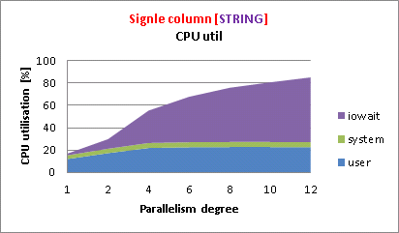
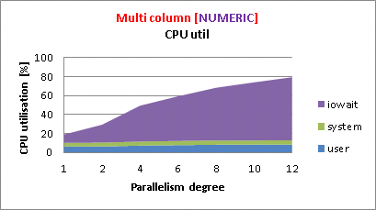
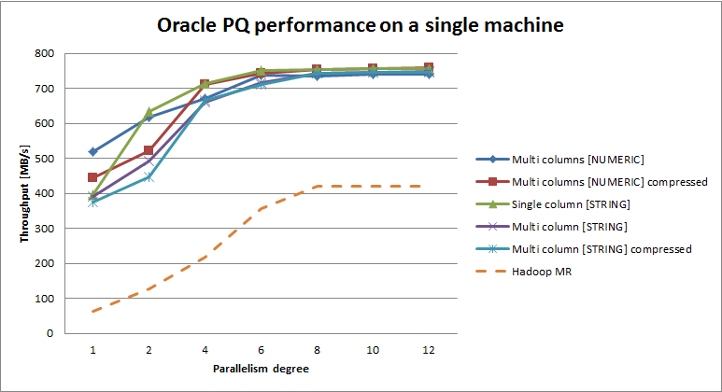
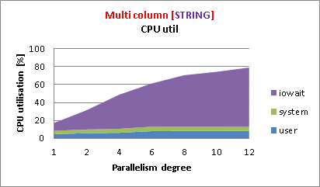
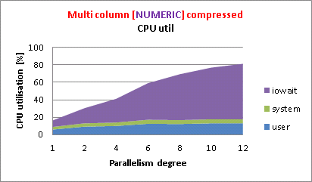
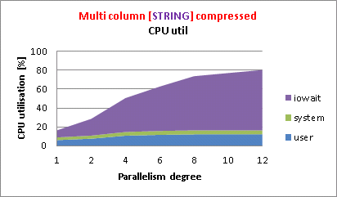
Oracle results
PQ on single instance/machine attached to shared storage
Number of CPU cores

Slide 37
What we have learnt so far
Data processing is IO bound
CPU is not heavily utilized
async and direct IO are used
memory utilisation under control
Server’s FC controller speed throttles the IO throughput
Max 750 MB/s
When adding more machines -> more FC controllers = better IO performance should be observed

Slide 38
Step II
Scaling up
5 nodes
Parallelism degree = 8
5 storages in shared configuration, FC connection 4gbps

Slide 39
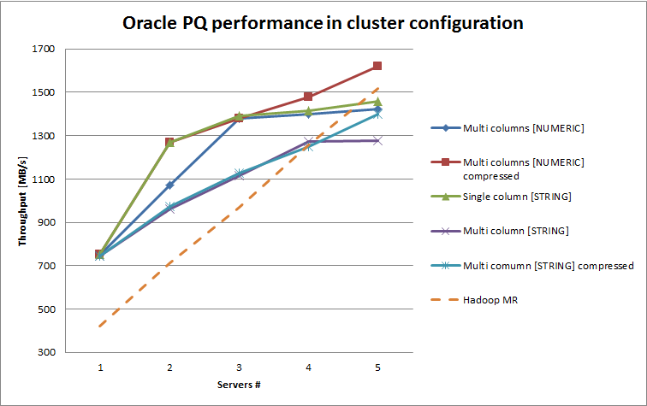
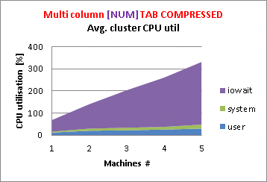
Oracle results (II)
PQ on cluster database (RAC)
Notes:
Best performance for natureal representaiton

Slide 40
Outline
Motivation
SW & HW architecture
Test setup
Results
Summary

Slide 41
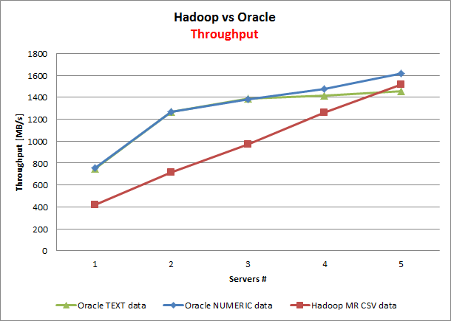
Comparision (I) - Throughput
Similar results for Oracle and Hadoop.
Less than theoretical max throughput in both cases
Understood why the difference
Throughput is dominated by disk read contention.

Slide 42
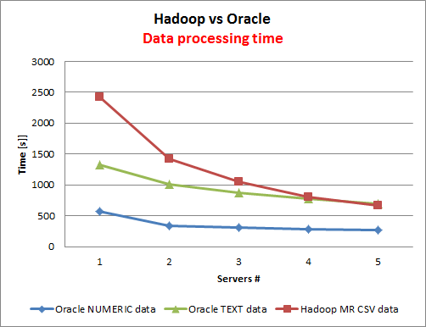
Comparision (II) - Time
Oracle’s implementation can have lower data processing time. Explained by optimal data representation.

Slide 43
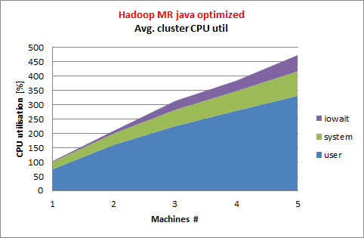
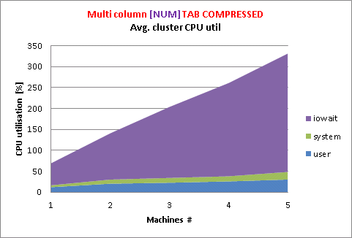
Comparison (III) – CPU utilisation
Hadoop consumes a lot of CPU and memory
for more complex processing it might be an issue
Oracle is IO-bound
Notes:
A lot of optimization can be done for Hadoop

Slide 44
Conclusions
What is faster?
Oracle performs well for small clusters
Hadoop slightly slower, but…
What scales better?
Oracle scaling ability is limited by a shared storage
Hadoop scales very well
We can guess that on a bigger cluster should outperform Oracle
Cost-performance
Hadoop license vs Oracle license
Shared nothing vs Shared storage
Notes:
Native Hadoop solution is not performing

Slide 45
Comments
Writing efficient Map Reduce code is not trivial
optimized implementation can significantly improve the performance
Hadoop is still in very active develop
new releases can address observed issues
A lot of data at CERN is already in Oracle
Cost of exporting it to other system is not negligible
Valuable experience gained for helping others with Hadoop Map Reduce implementations

Slide 46
Many Thanks!
Luca Canali
Andrei Dumitru
Eric Grancher
Maaike Limper
Stefano Russo
Giacomo Tenaglia

Slide 47
Q&A

Slide 48
Backup slides

Slide 49
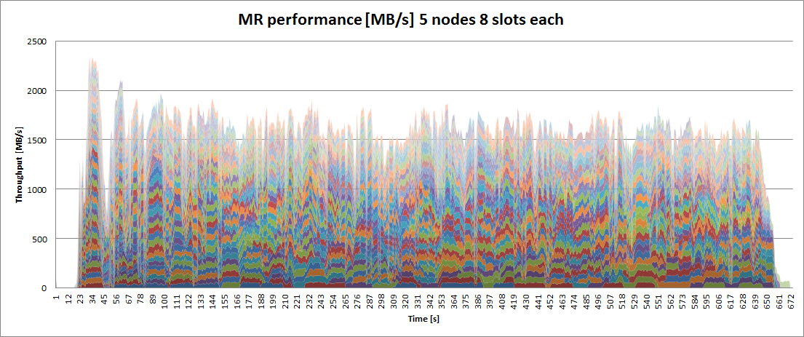
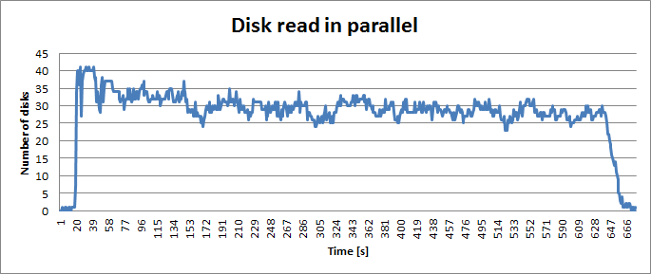
How fast HDFS could be?
MR scheduler is not „hard drives aware”
Multiple processes are reding from same devices

Slide 50
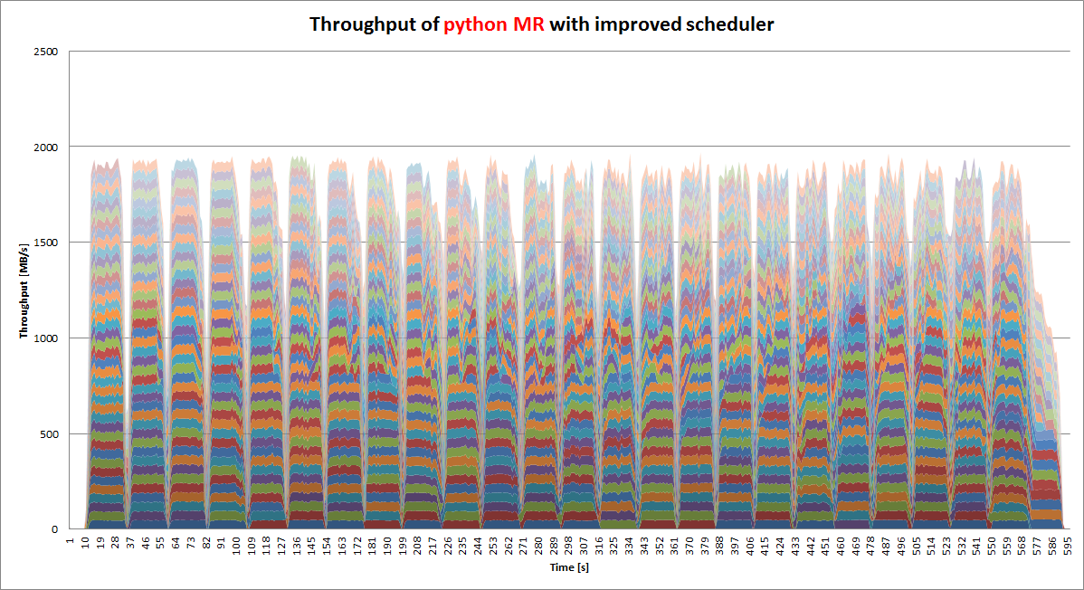
Improved scheduler
Custom MR implementation in python
scheduling „disk aware”
Better performance achived
Custom Python MR : 1,7 GB/s
Optimized Java MR: 1,52 GB/s
Python MR: 1,3 GB/s

