Slide 2

Information Discovery as a Service:
Better Decisions for More Efficient Operations at CERN
Manuel Martín Márquez

Slide 3

CERN
CERN - European Laboratory for Particle Physics
Founded in 1954 by 12 Countries for fundamental physics research in a post-war Europe
    Major milestone in the post-World War II recovery/reconstruction process

Slide 4
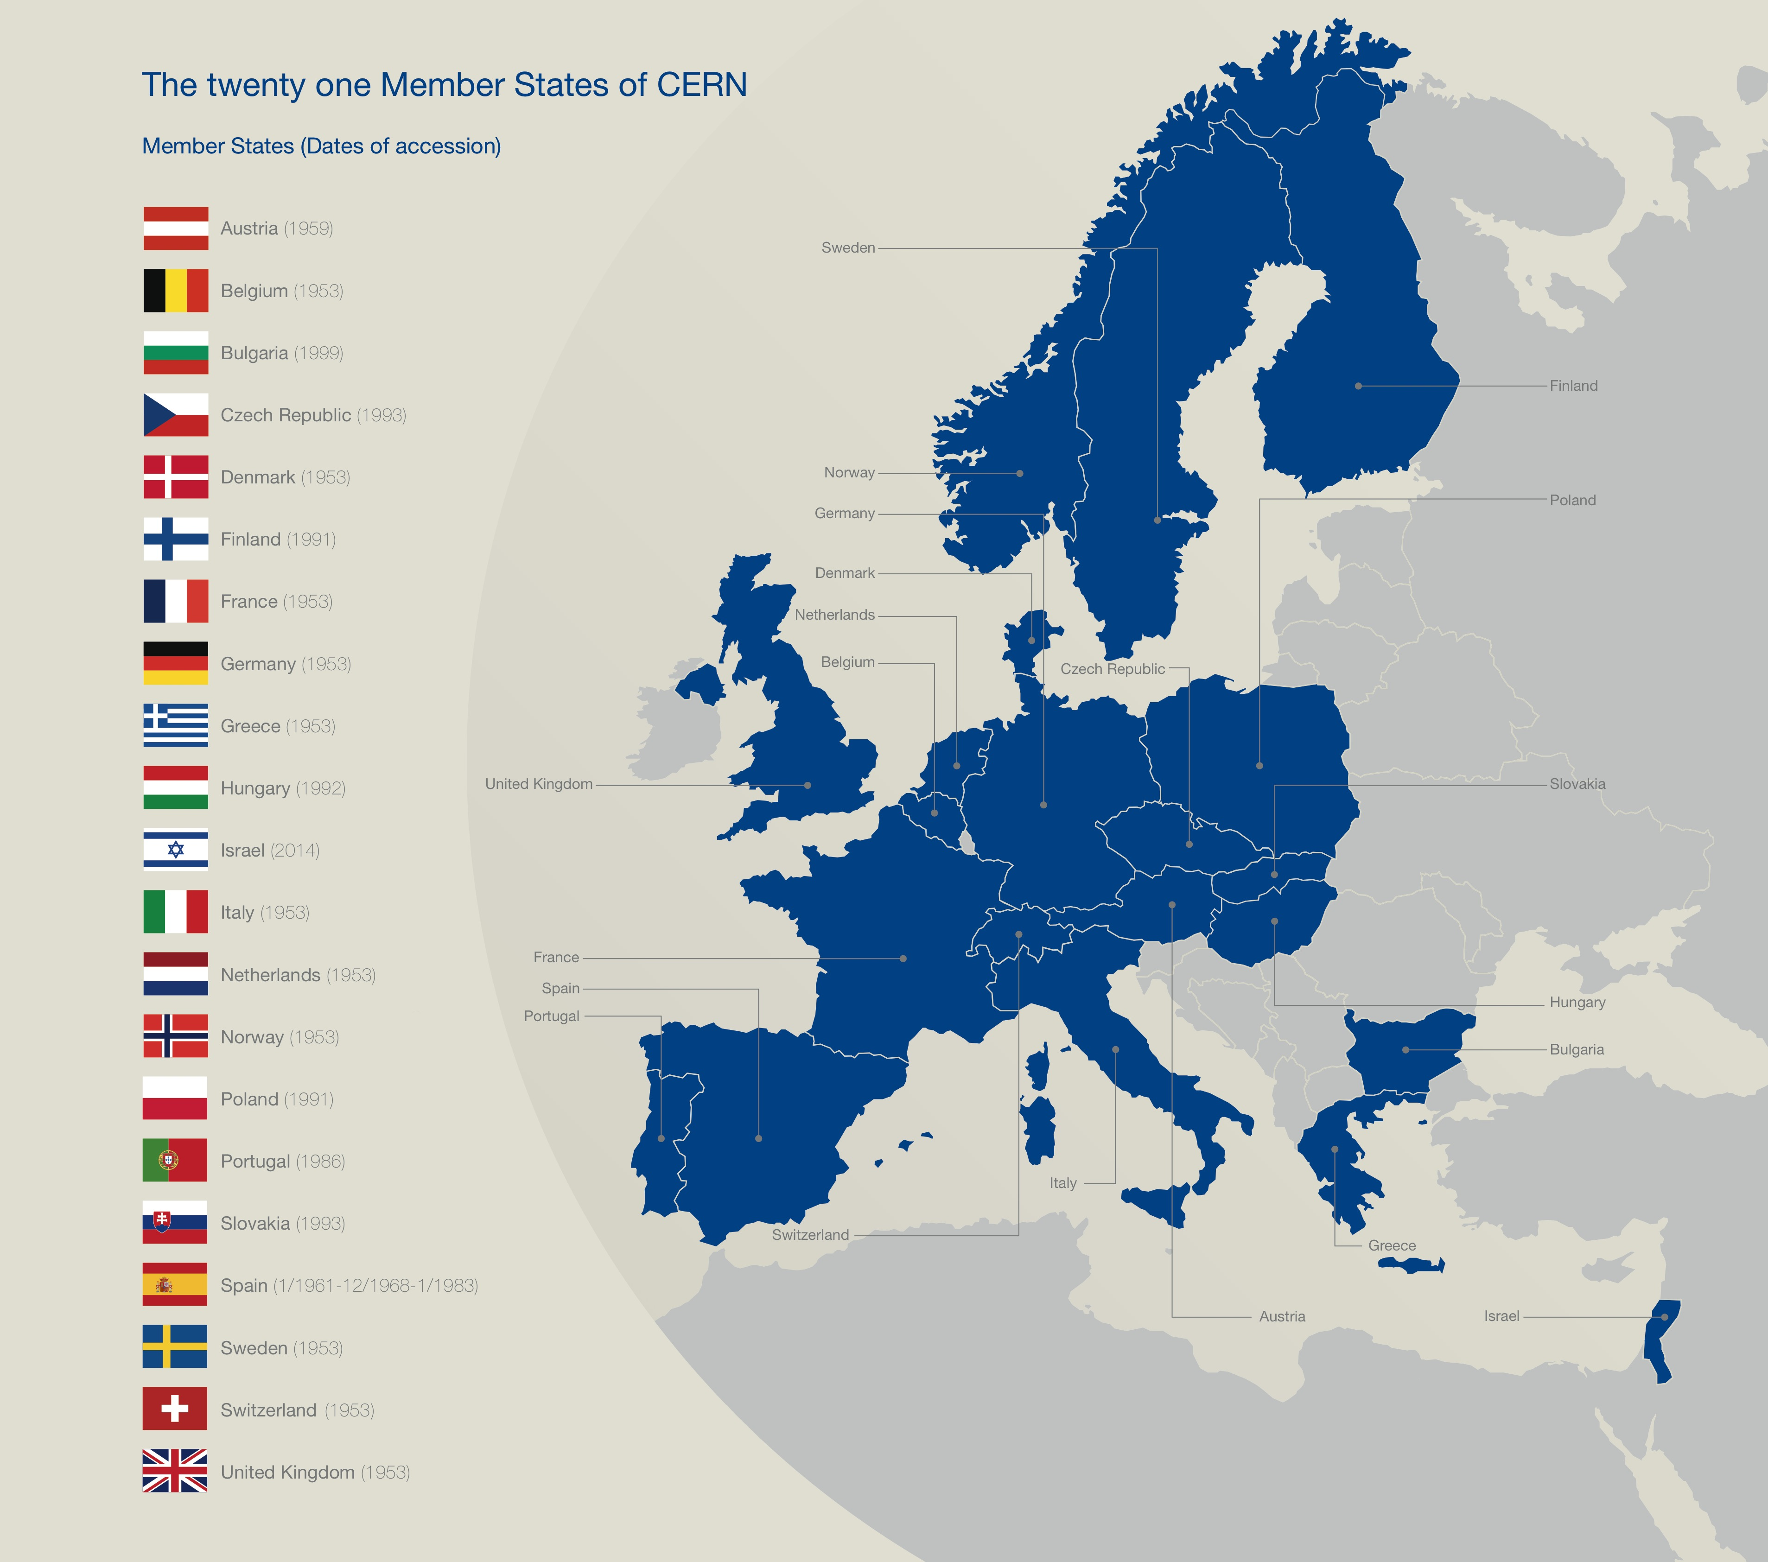

Slide 5
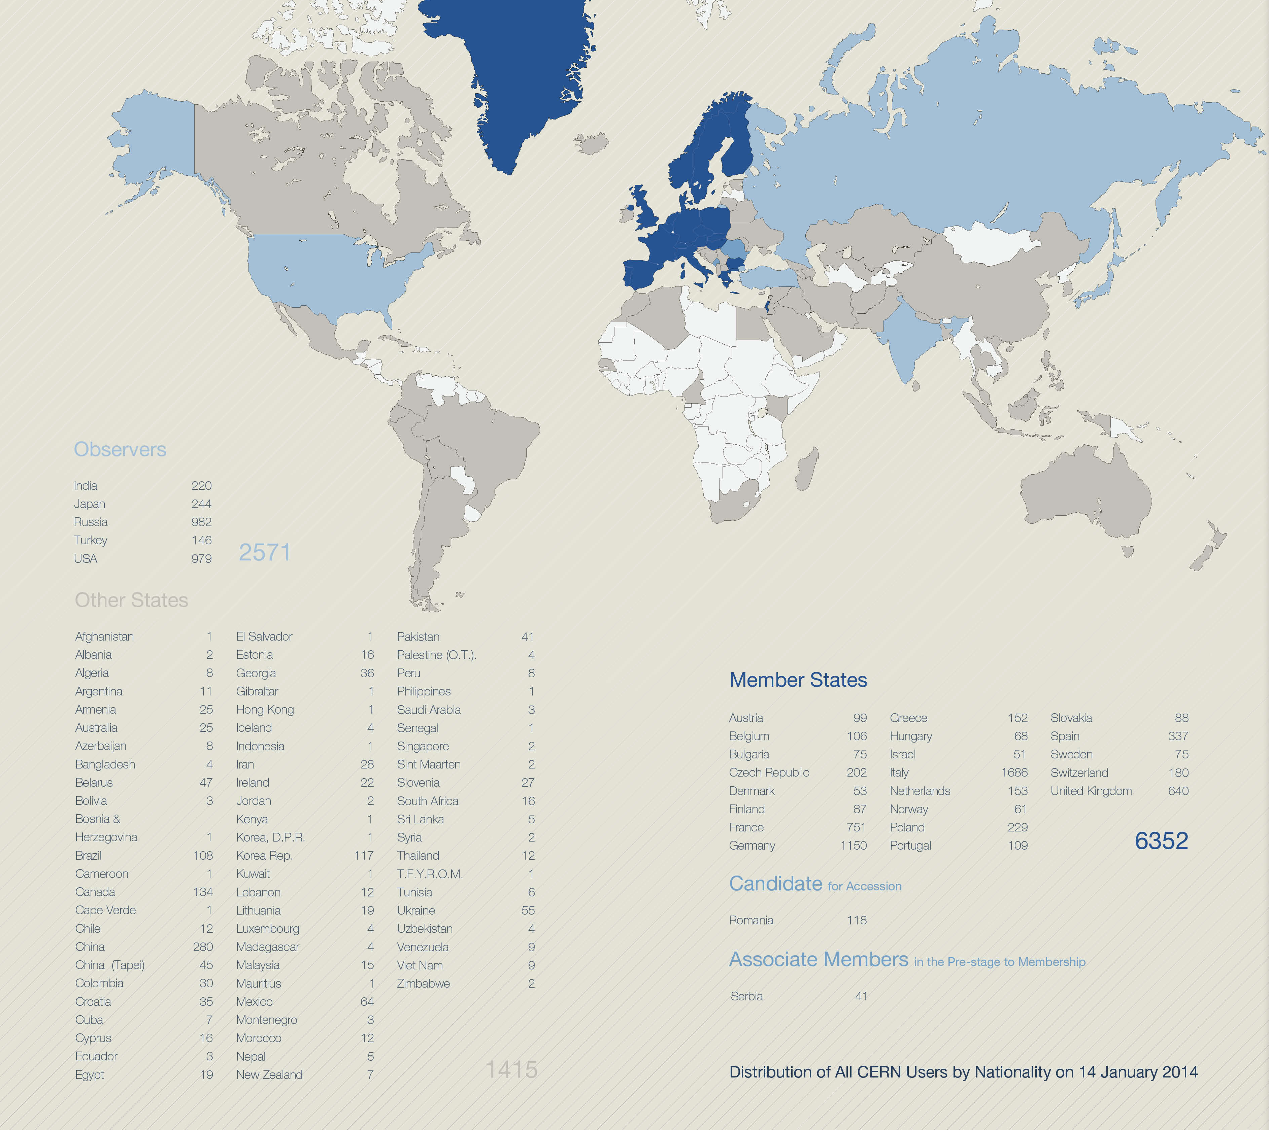
A World-Wide Collaboration

Slide 6

How the Universe works
and what is made of…

Slide 7
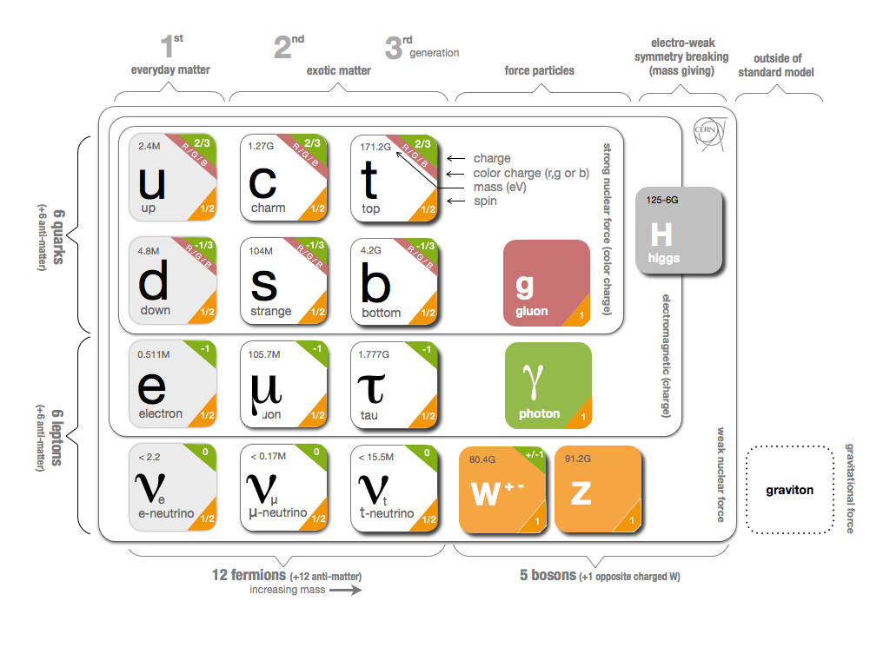
Fundamental Research
Why do particles have mass?

Slide 8
Fundamental Research
Why is there no antimatter left in the Universe?
  Nature should be symmetrical
What was matter like during the first second of the Universe, right after the "Big Bang"?
  A journey towards the beginning of the Universe gives us deeper insight.

Slide 9
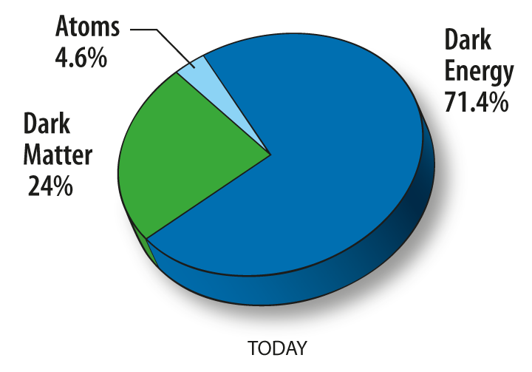
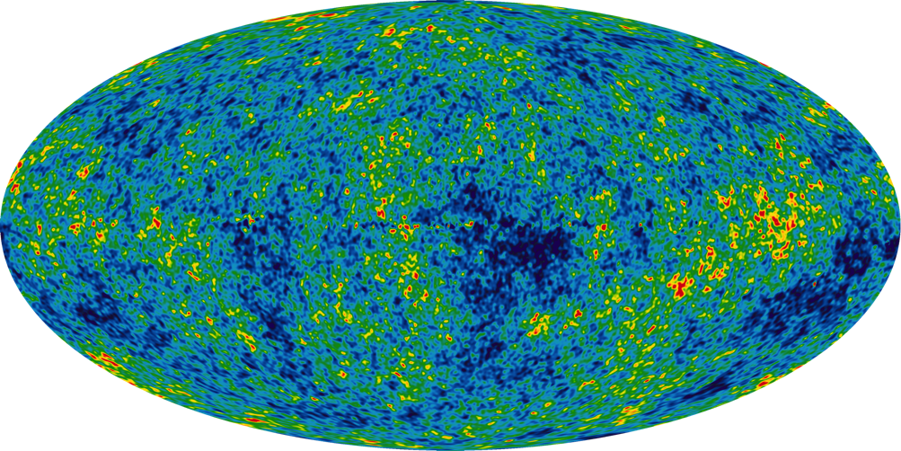
Fundamental Research
What is 95% of the Universe made of?

Slide 10
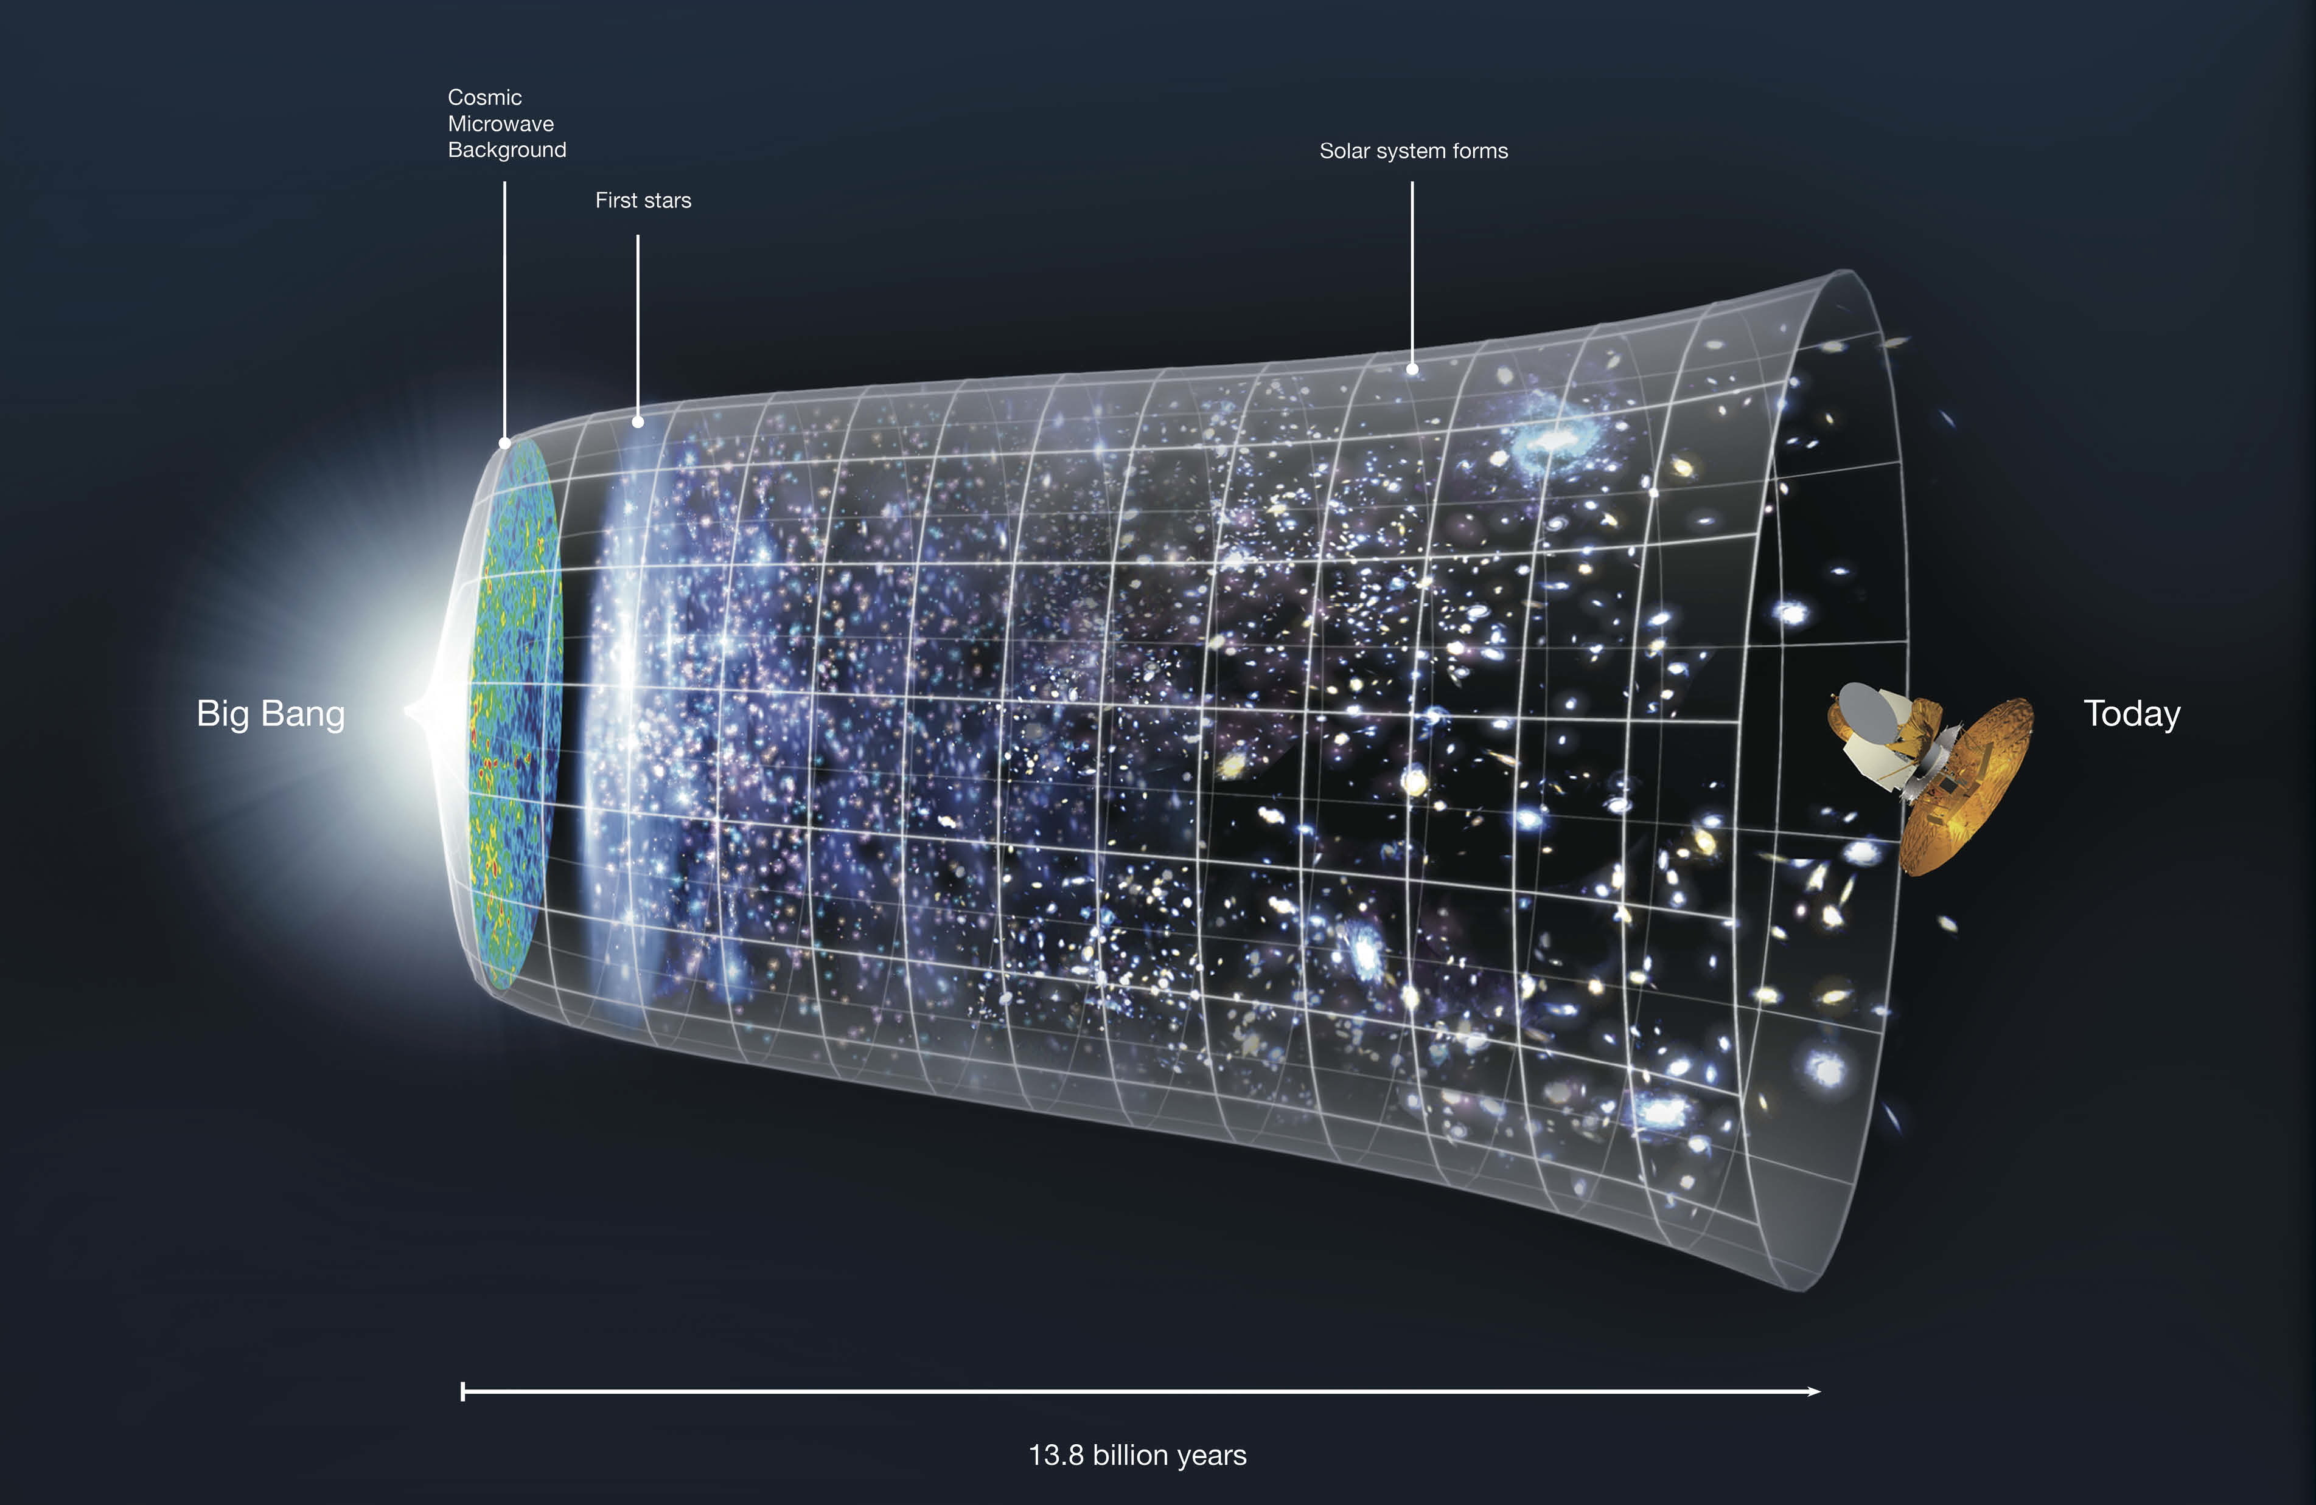

Slide 11

The Large Hadron Collider (LHC)
Largest machine in the world
27km, 6000+ superconducting magnets
Fastest racetrack on Earth
Protons circulate 11245 times/s (99.9999991% the speed of light)
Emptiest place in the solar system
High vacuum inside the magnets
Hottest spot in the galaxy
During Lead ion collisions create temperatures 100 000x hotter than the heart of the sun;

Slide 12
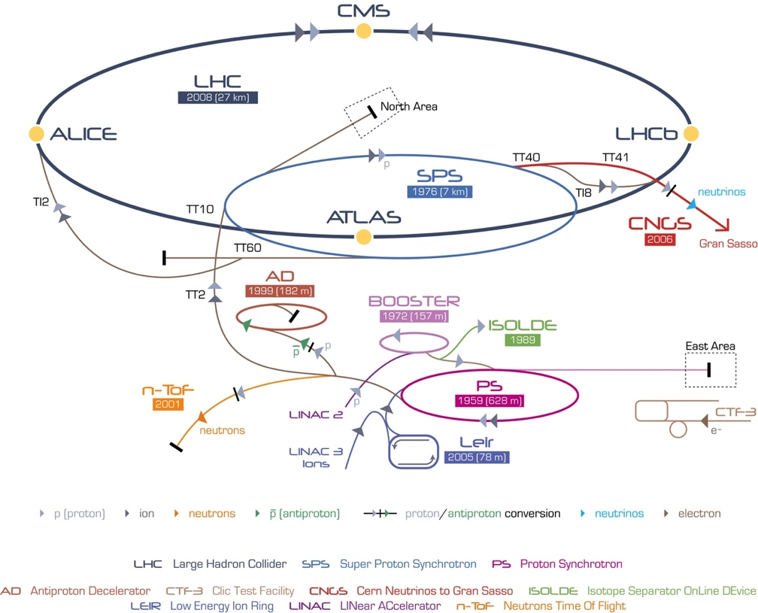
CERN Accelerator Complex

Slide 13
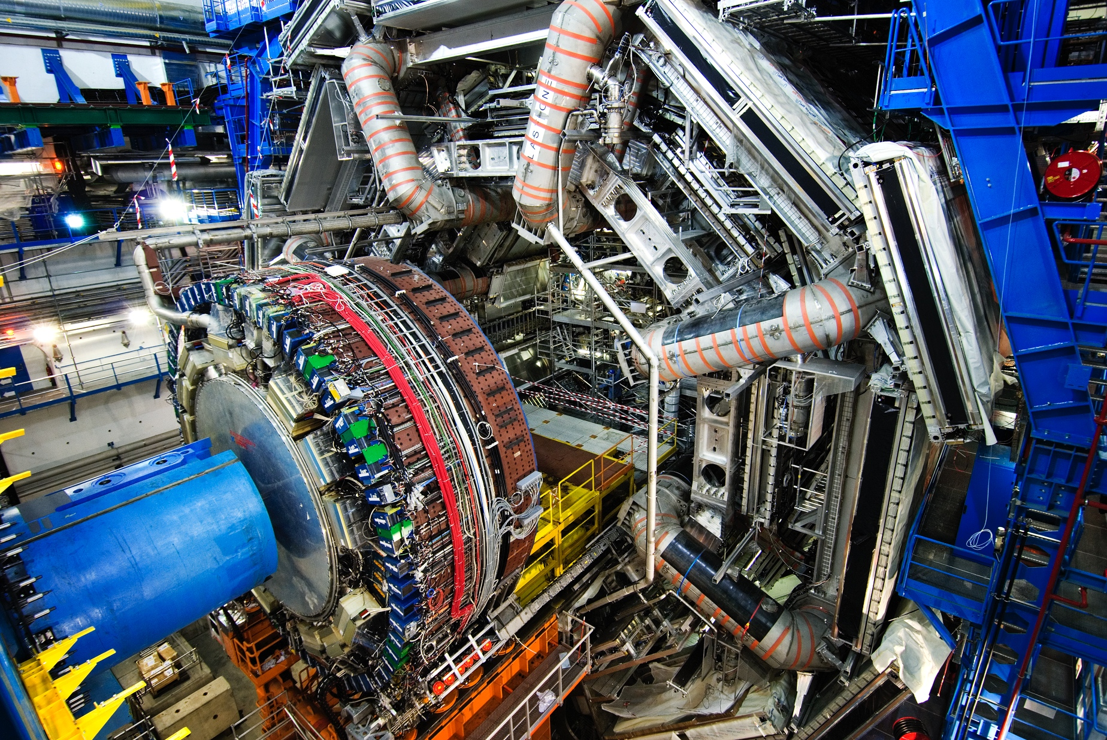
ATLAS Detector
150 Million of sensor
Control and detection sensors
Massive 3D camera
Capturing 40+ million collisions per second
Data rate TB per second

Slide 14
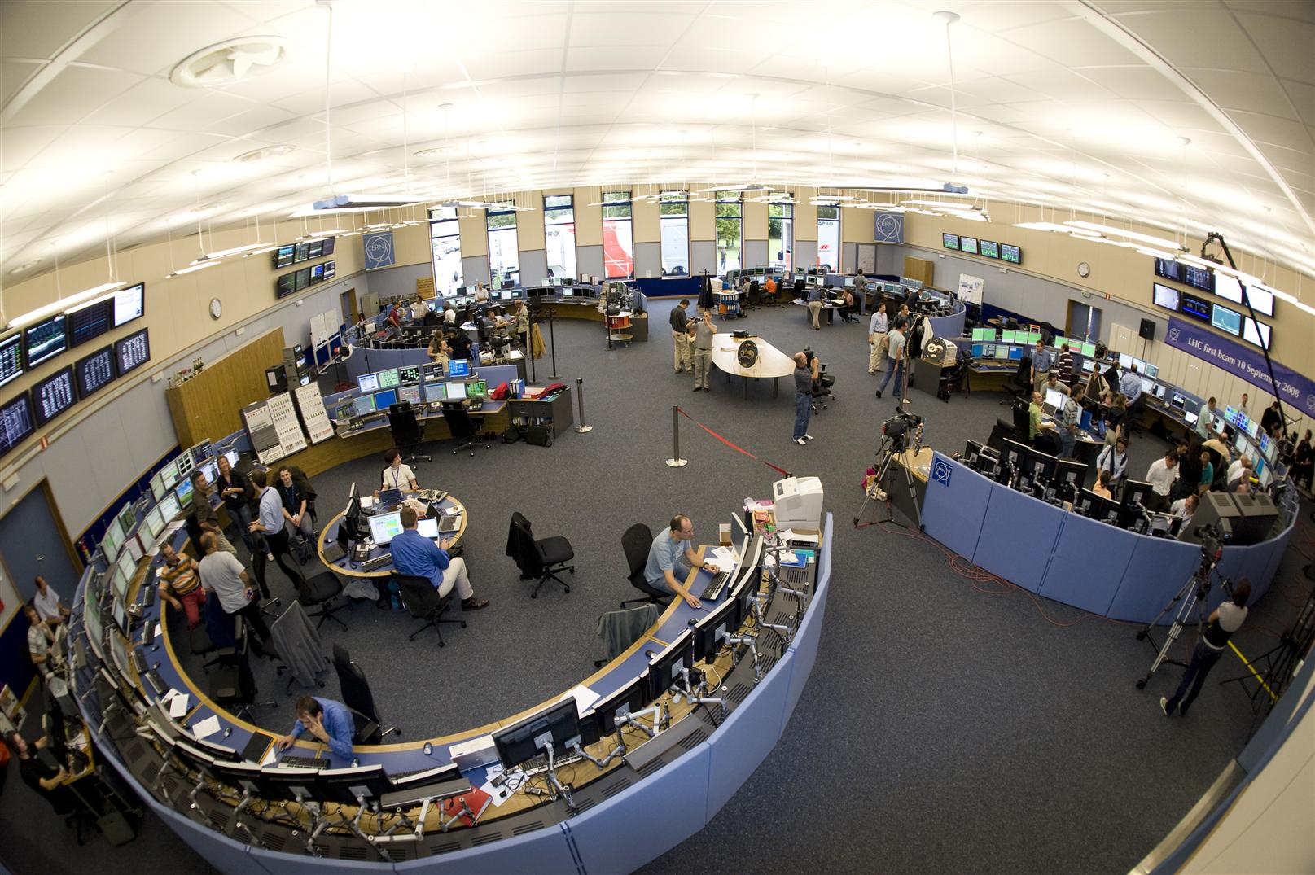
CERN Control Centre
CERN Accelerator Complex is unique installation
Therefore, we have to face unique challenges
Control and Operations
Million of sensors, large number of control devices, front-end equipment, etc.
Many critical systems: Cryogenics, Vacuums, Machine Protection, etc.

Slide 15
Data Analytics Challenges
Control and Monitoring Systems
  Proactive
  Predictive
  Intelligent
Optimize our systems is mandatory
  Reducing and predicting faults and corrective interventions
  Increase the availability and operations efficiency
Profit from our data investment
  Knowledge Extraction
  Information Discovery

Slide 16
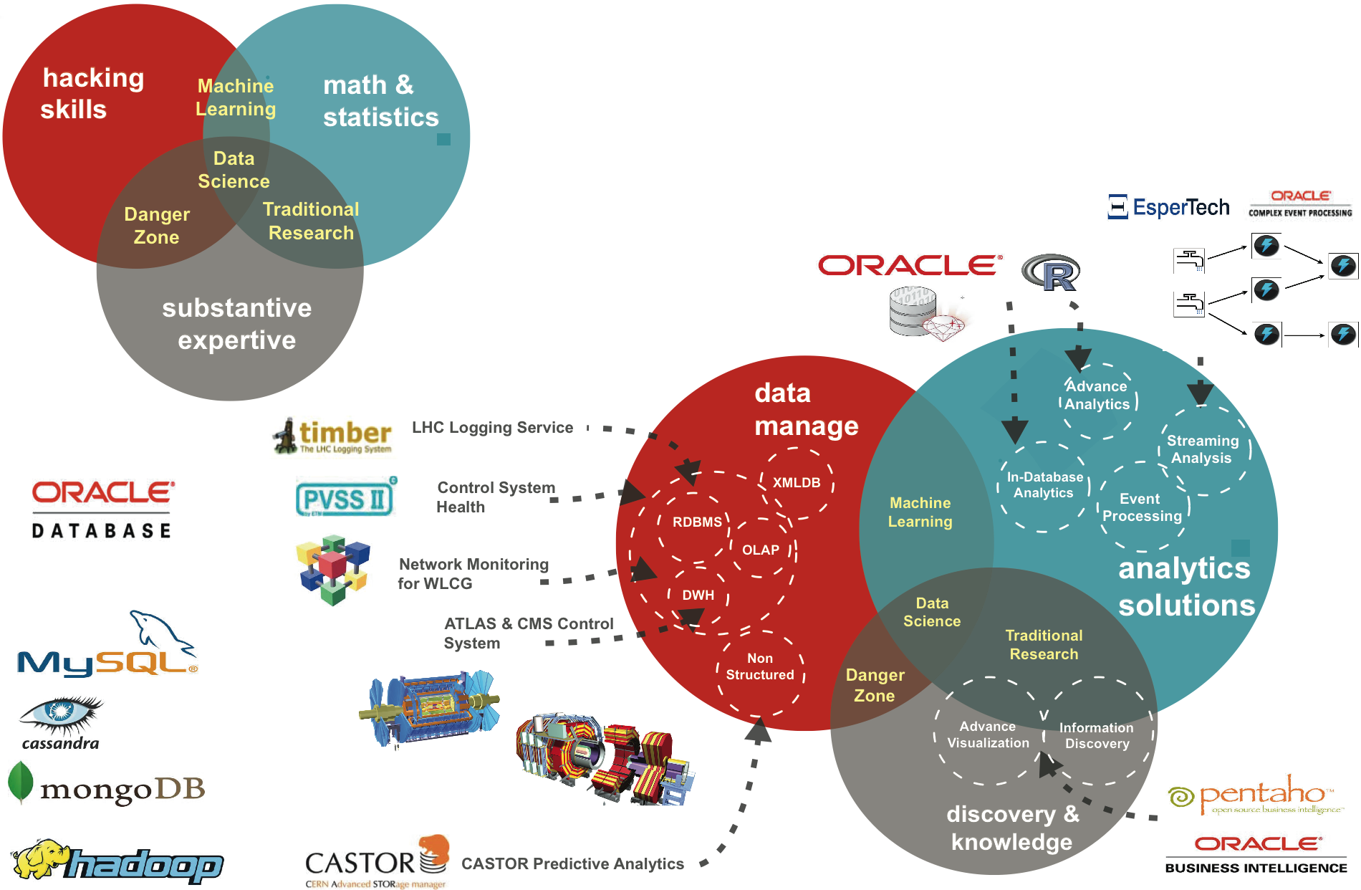

Data Analytics Challenges

Slide 17
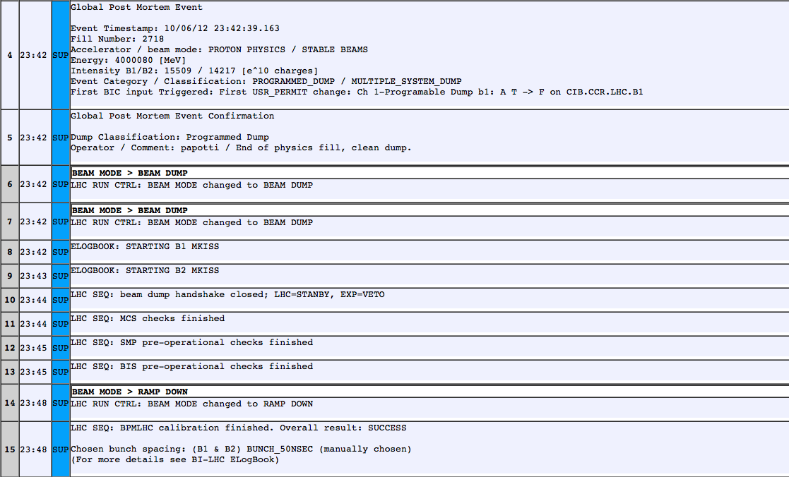
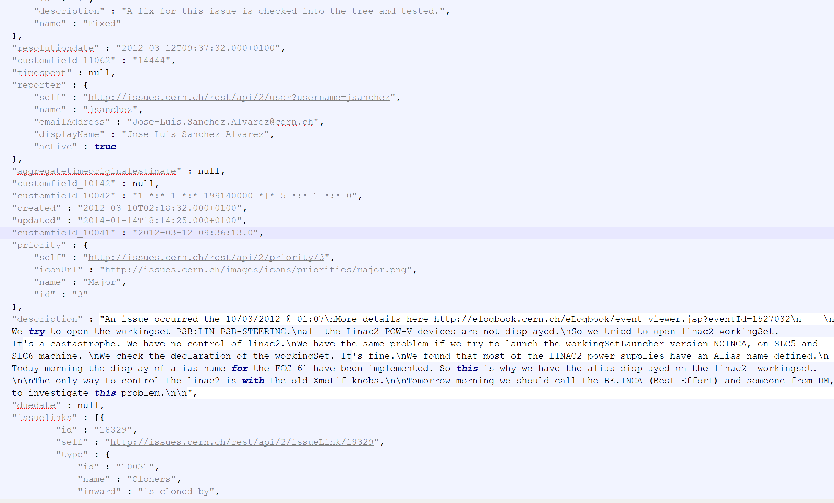
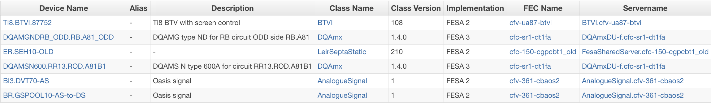
Endeca Information Discovery
Better LHC Operations
  Events Analysis
  Correlate Information
    Fault Tracking System
    Operational Modes
    Operational Issues
    Control Equipment

Slide 18
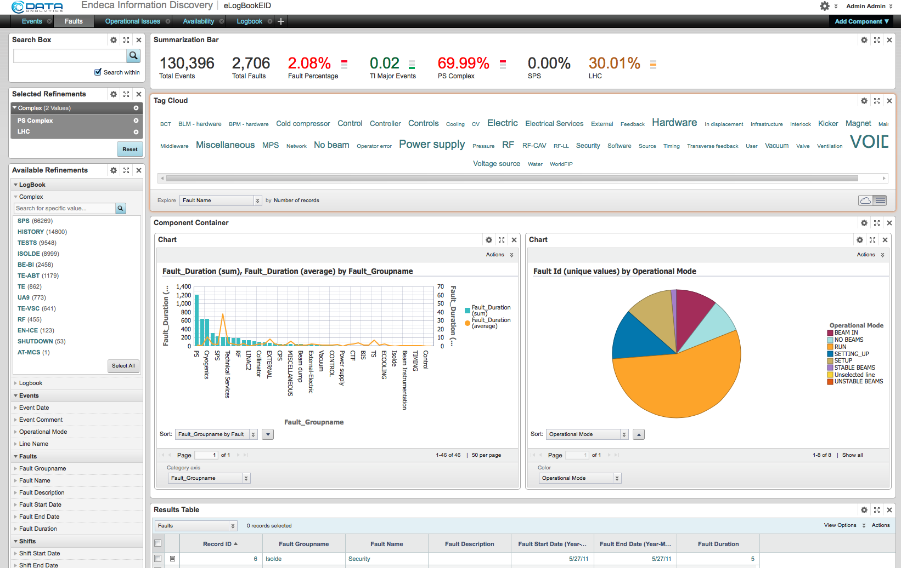
Endeca Information Discovery
Information Discovery for improving the Accelerator Complex Operations
Integrating Data Sources
  Electronic Logbook
  Control Configuration DB
  JIRA (JSON)

Slide 19
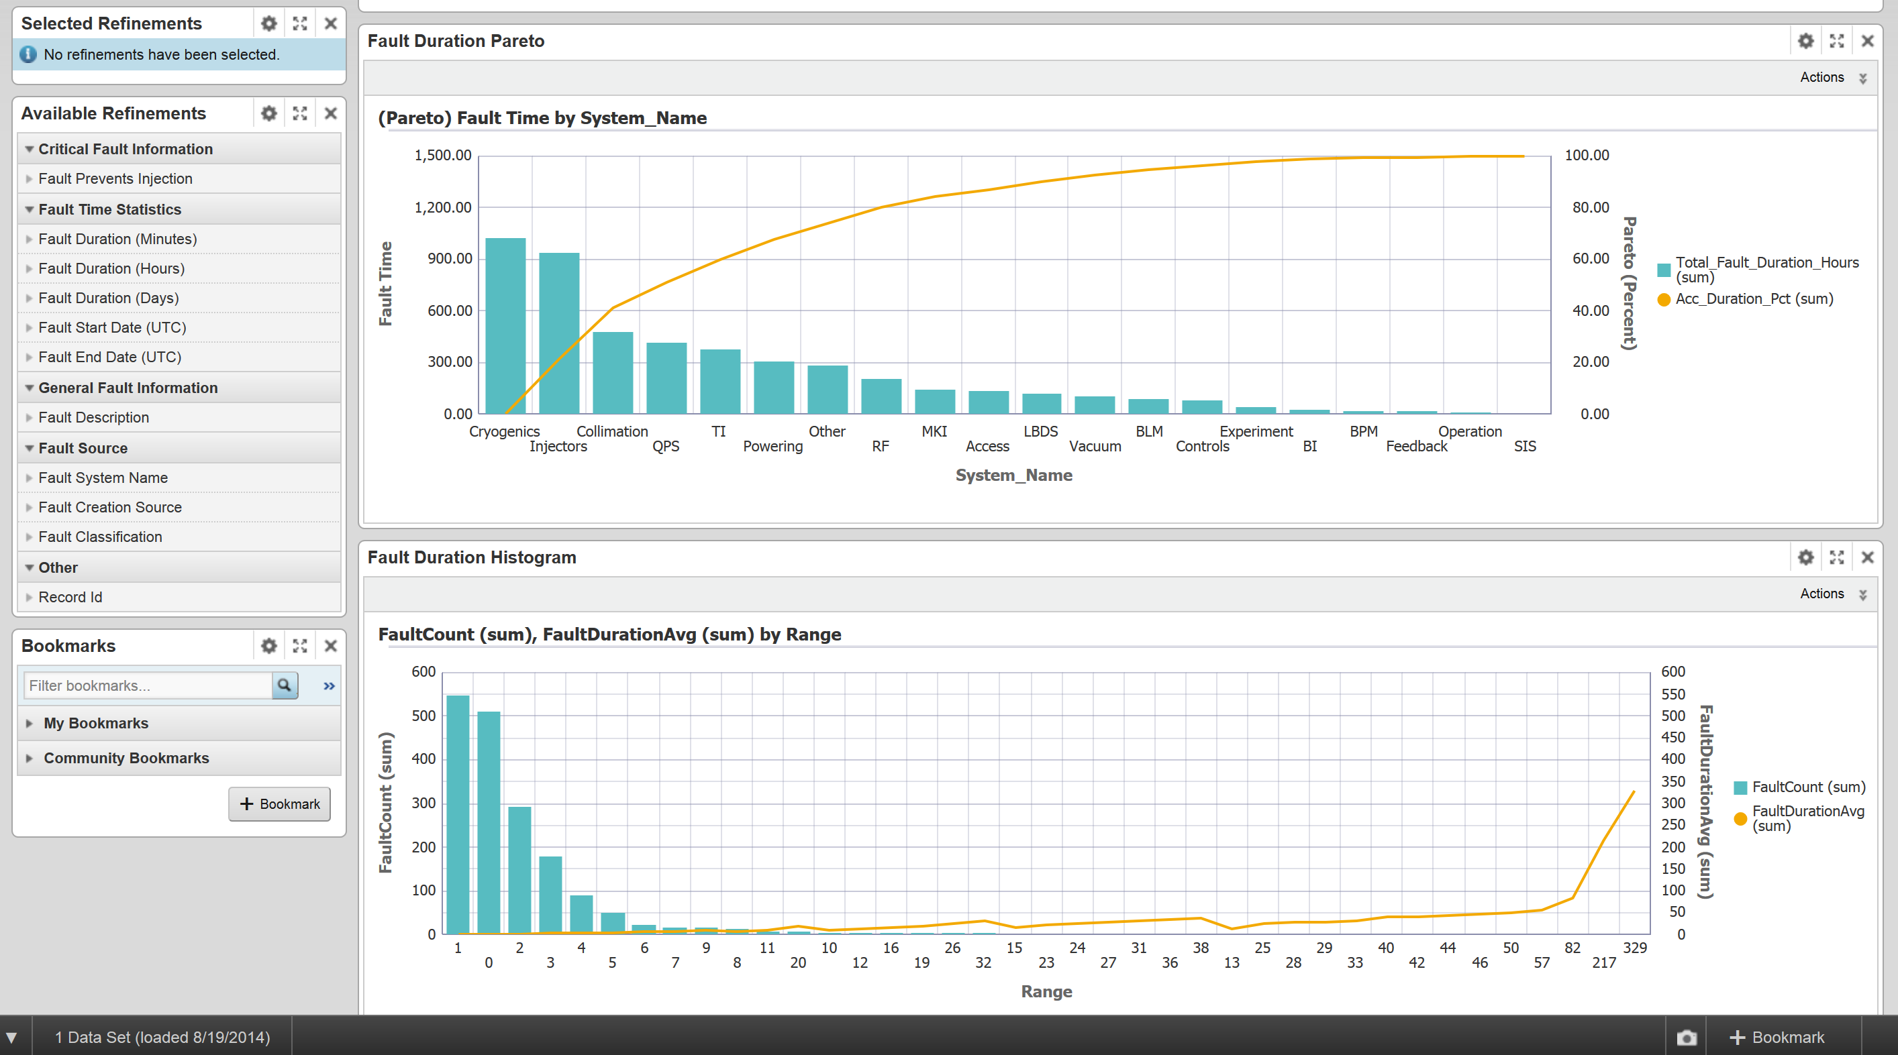
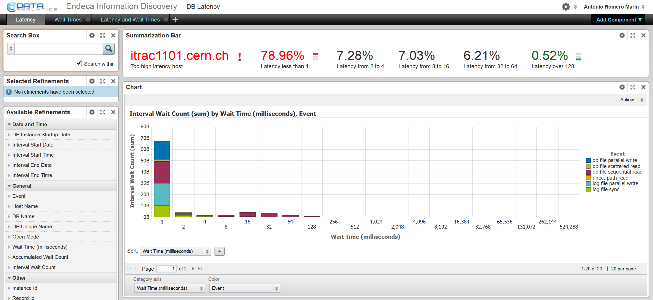
Endeca Information Discovery
Many different Applications at CERN
  Control and Operation
    Fault tracking
    Accelerator eLogbooks
    Diagnostic and monitoring
  IT Infrastructure
    Cloud storage performance analysis
    Database Latency
  Human Resources

Slide 20

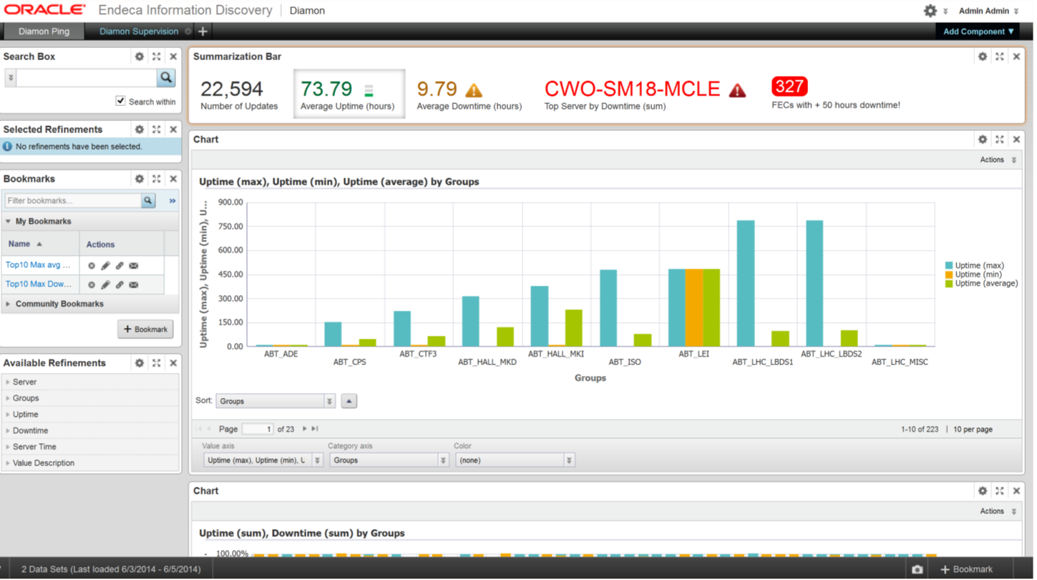
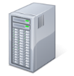





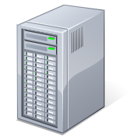

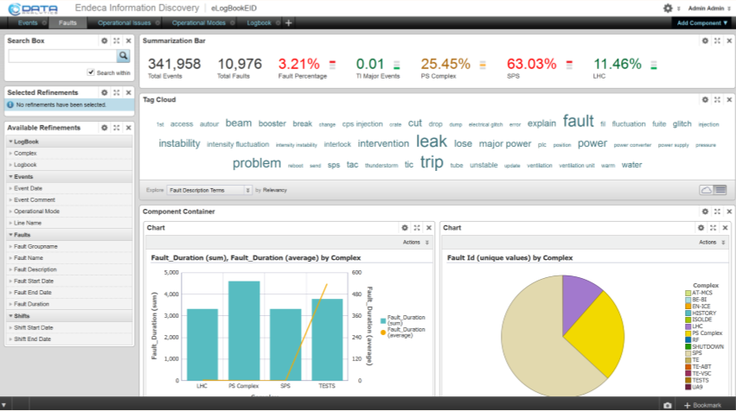








Information Discovery as a Service
Controls and Operations
System Configuration
Logging and Monitoring
Engineering
IT
Endeca Studio
(user group dedicated)
Provisioning Service
Logs
HR
DIAMON
Equipment
Experts
Wide Range of Data Sources
HR Surveys
Accelerator Operators

Slide 21
Conclusions
Flexible
  Important data visualization and correlation capabilities
Easy to use but powerful
  Almost non-existing learning period
Efficient Integration of heterogeneous data
  Structure and non-structure
  Different Domains

