Slide 2

Using the In-Memory Columnar Store to Perform
Real-Time Analysis of CERN Data
Maaike Limper
Emil Pilecki
Manuel Martín Márquez
Notes:
Introduce myself: 8 years data engineering, data analytics (make sense)

Slide 3


CERN
CERN - European Laboratory for Particle Physics
Founded in 1954 by 12 Countries for fundamental physics research in a post-war Europe
    Major milestone in the post-World War II recovery/reconstruction process

Slide 4

CERN openlab
Public-private partnership between CERN and leading ICT companies
Accelerate cutting-edge solutions to be used by the worldwide LHC community
Train the next generation of top engineers and scientists.

Slide 5
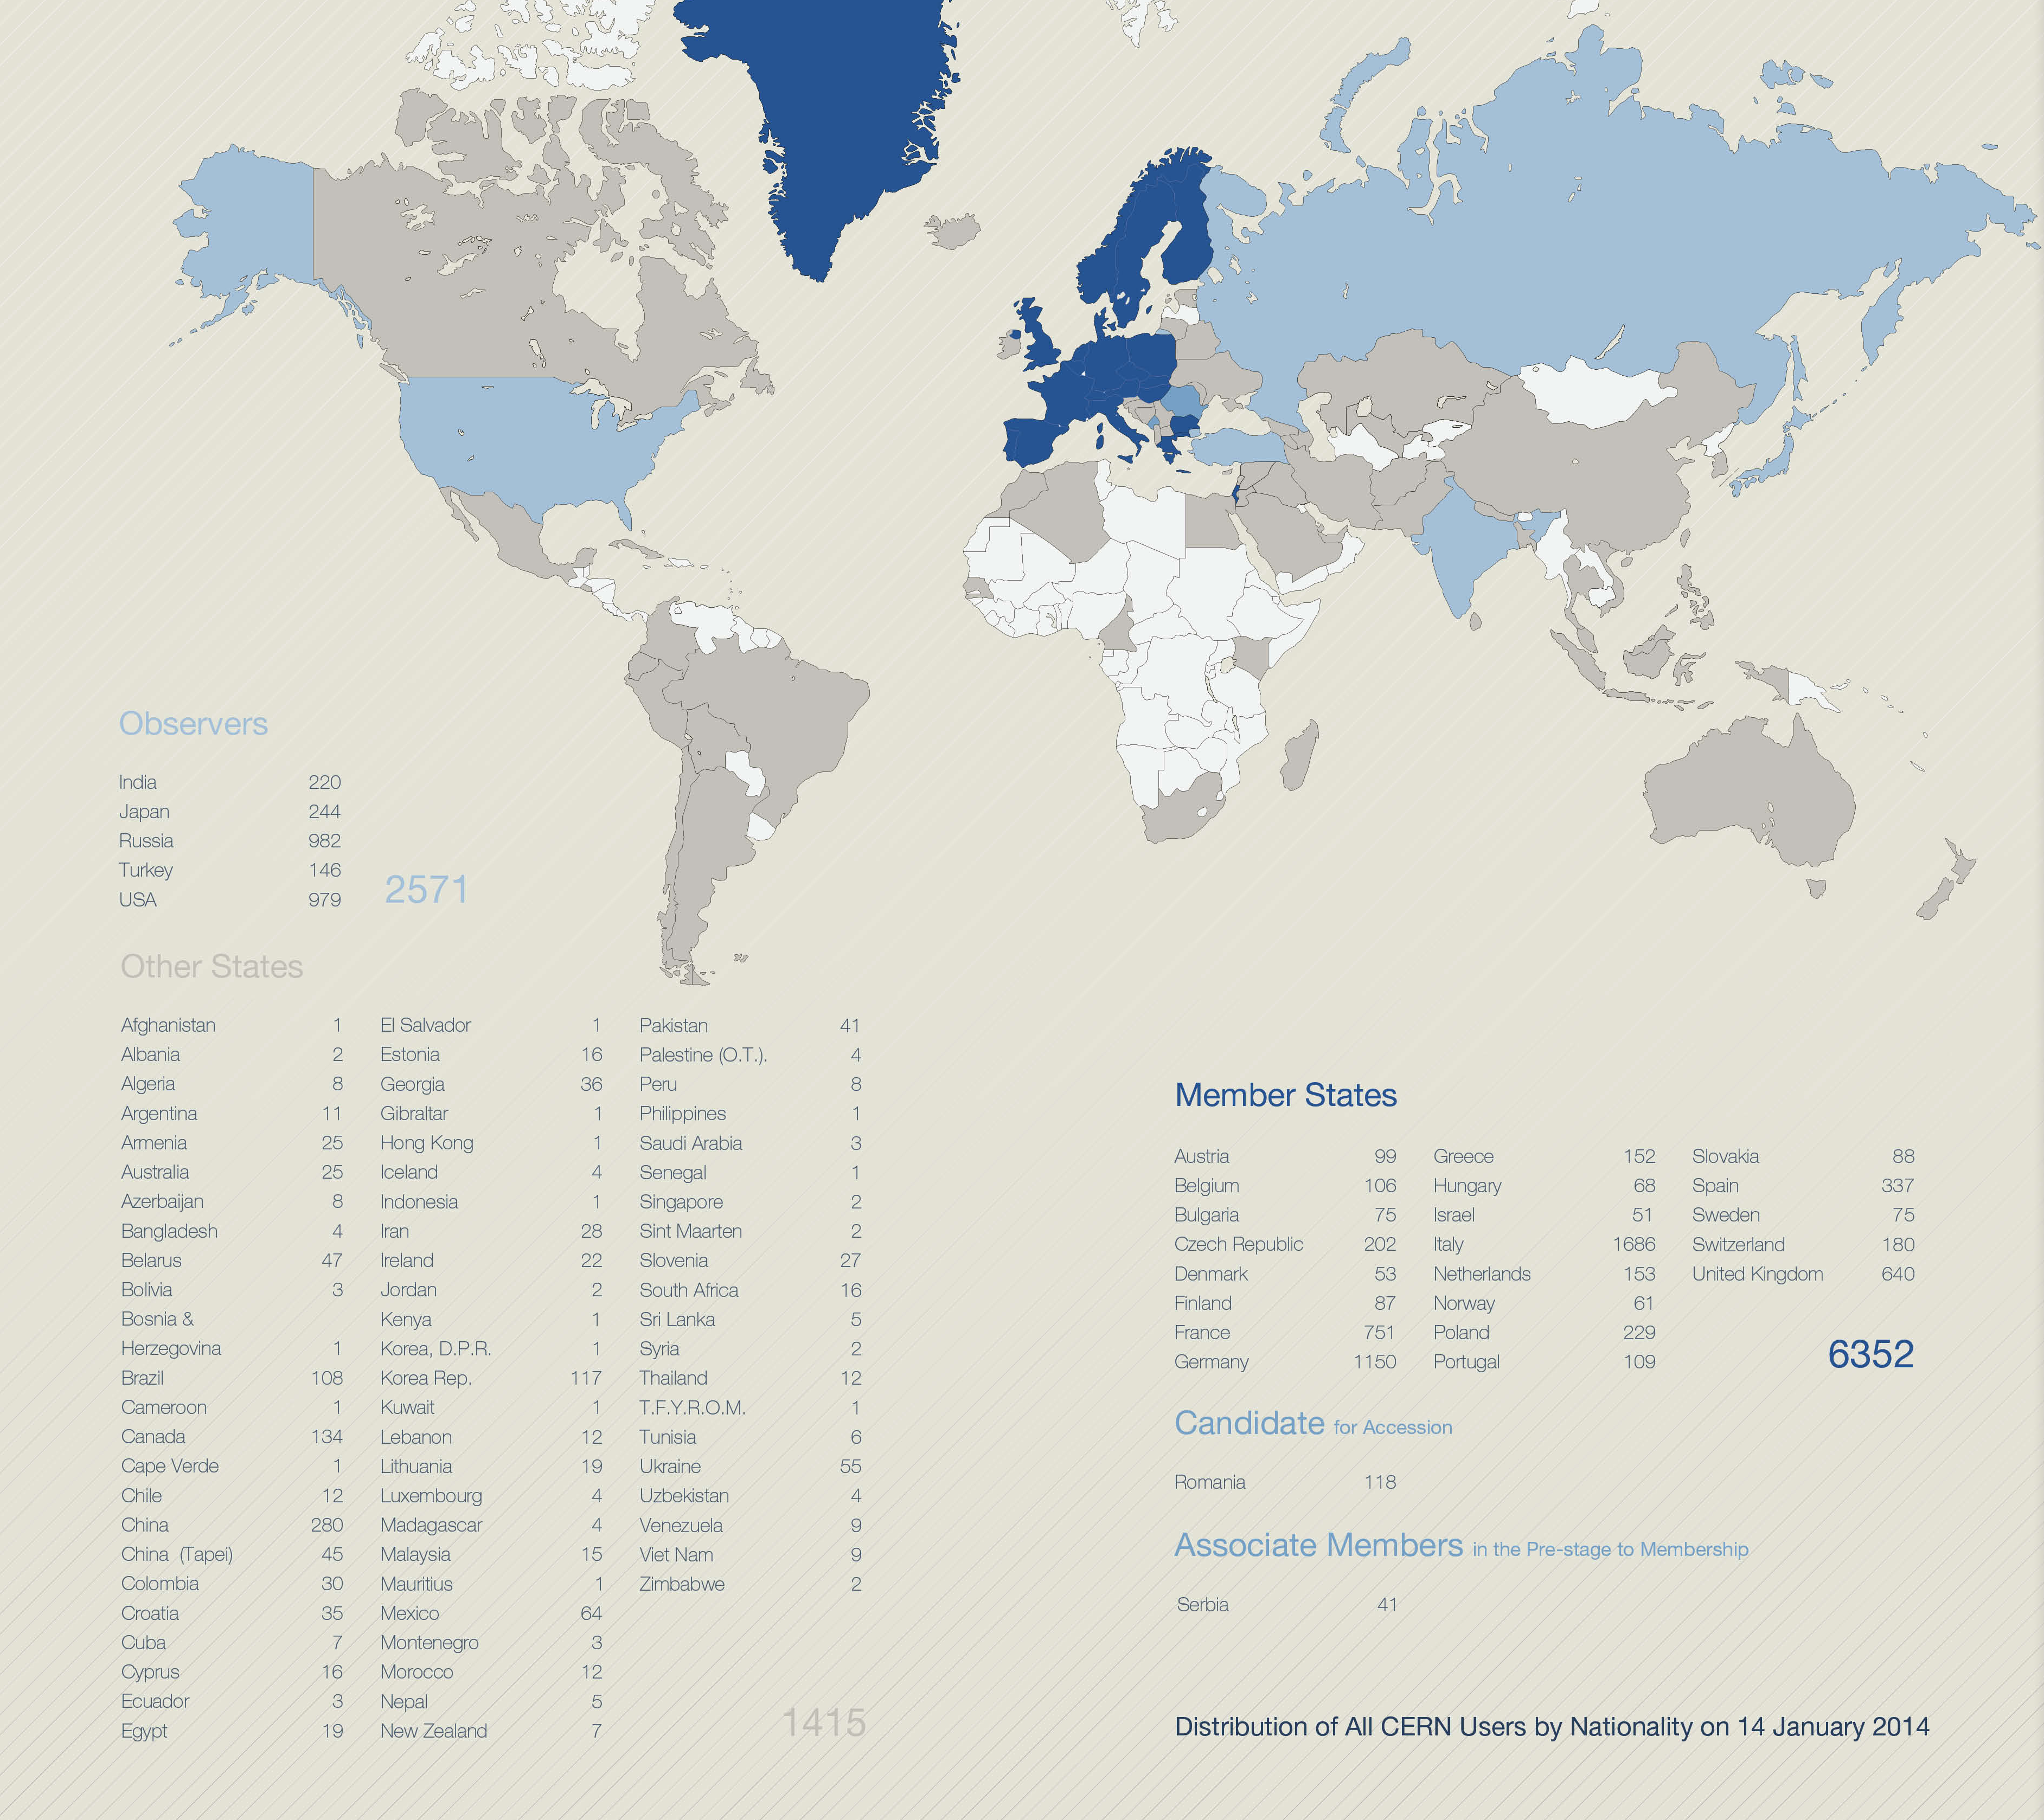
A World-Wide Collaboration

Slide 6
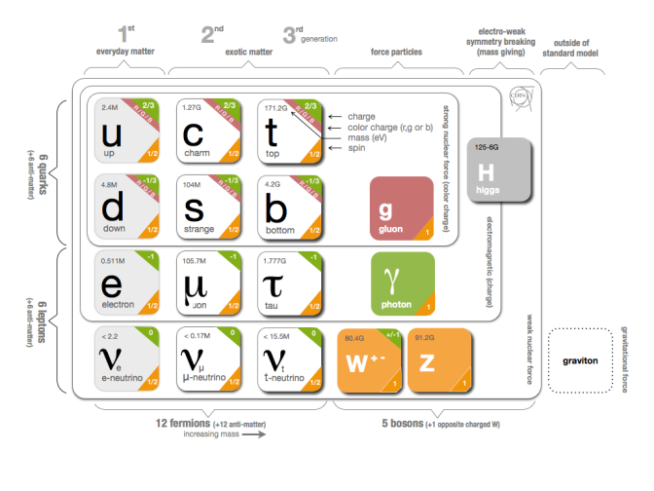
Fundamental Research
Why do particles have mass?
  Higgs Mechanism
Why is there no antimatter left in the Universe?
  Nature should be symmetrical
What was matter like during the first second of the Universe, right after the "Big Bang"?
  A journey towards the beginning of the Universe gives us deeper insight.

Slide 7
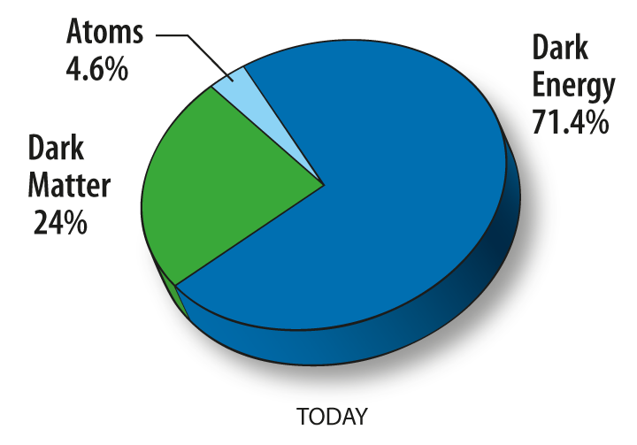
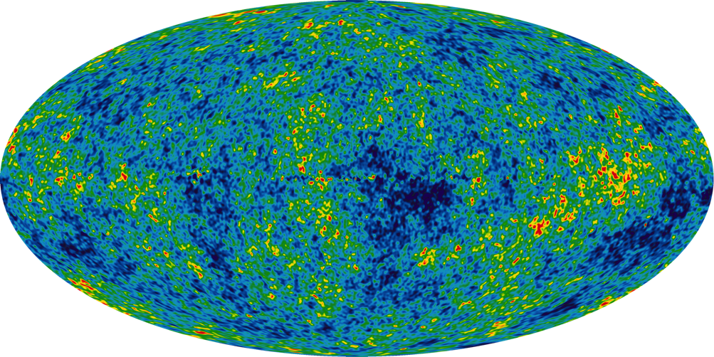
Fundamental Research
What is 95% of the Universe made of?

Slide 8
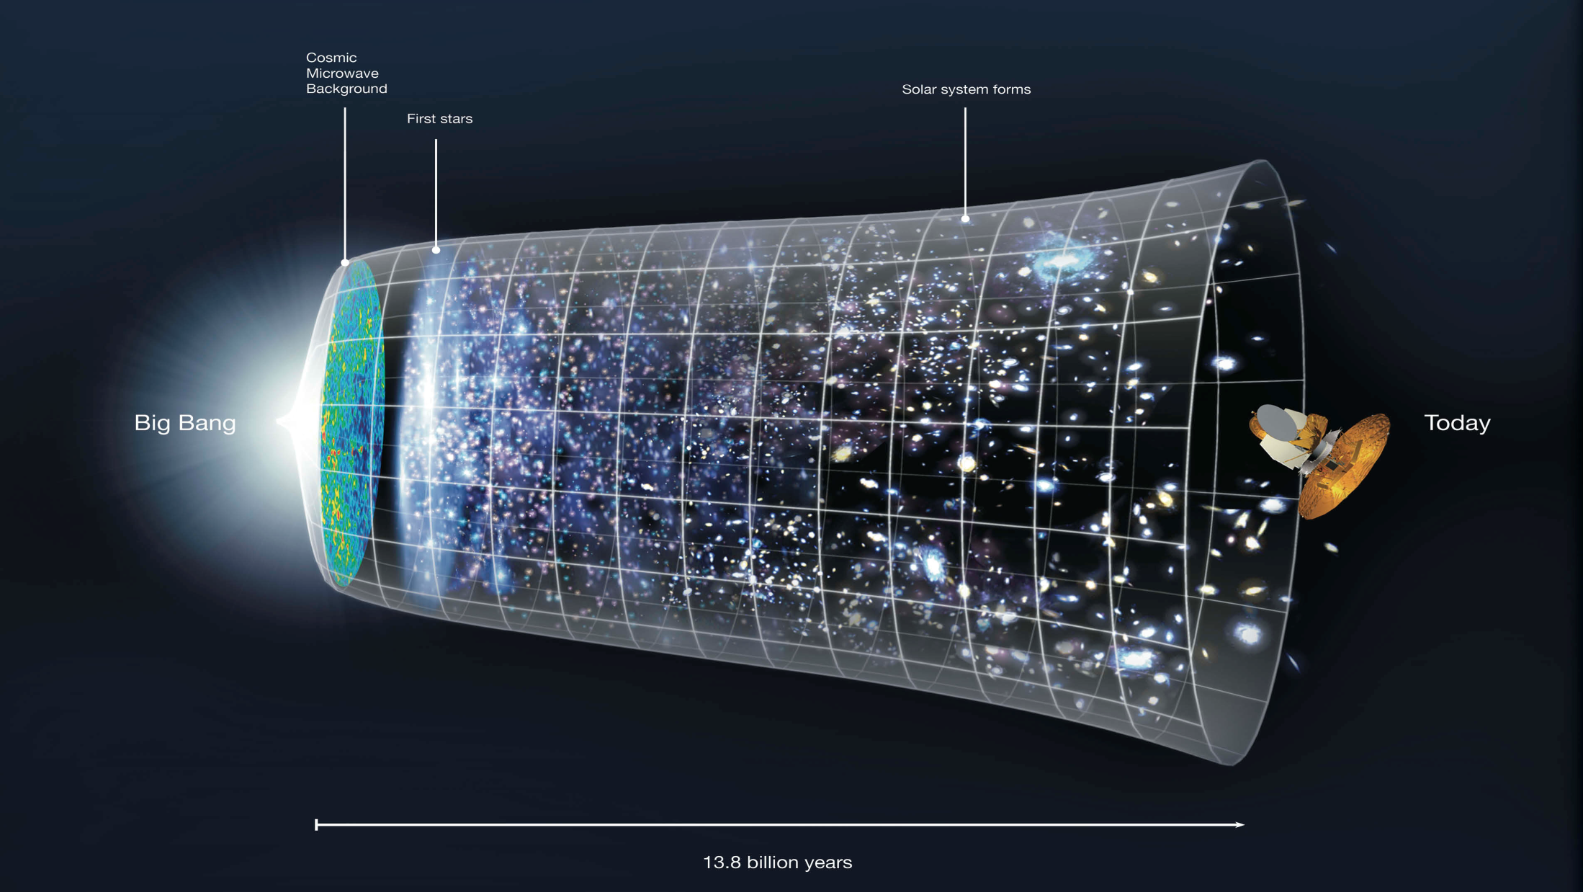

Slide 9

The Large Hadron Collider (LHC)
Largest machine in the world
27km, 6000+ superconducting magnets
Fastest racetrack on Earth
Protons circulate 11245 times/s (99.9999991% the speed of light)
Emptiest place in the solar system
High vacuum inside the magnets
Hottest spot in the galaxy
During Lead ion collisions create temperatures 100 000x hotter than the heart of the sun;

Slide 10
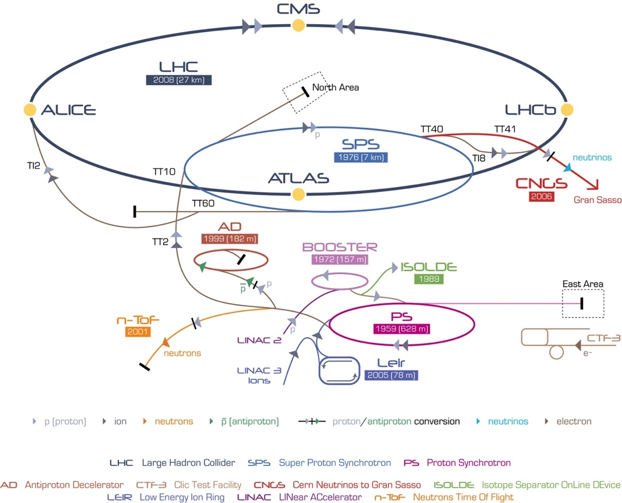
CERN’s Accelerator Complex

Slide 11
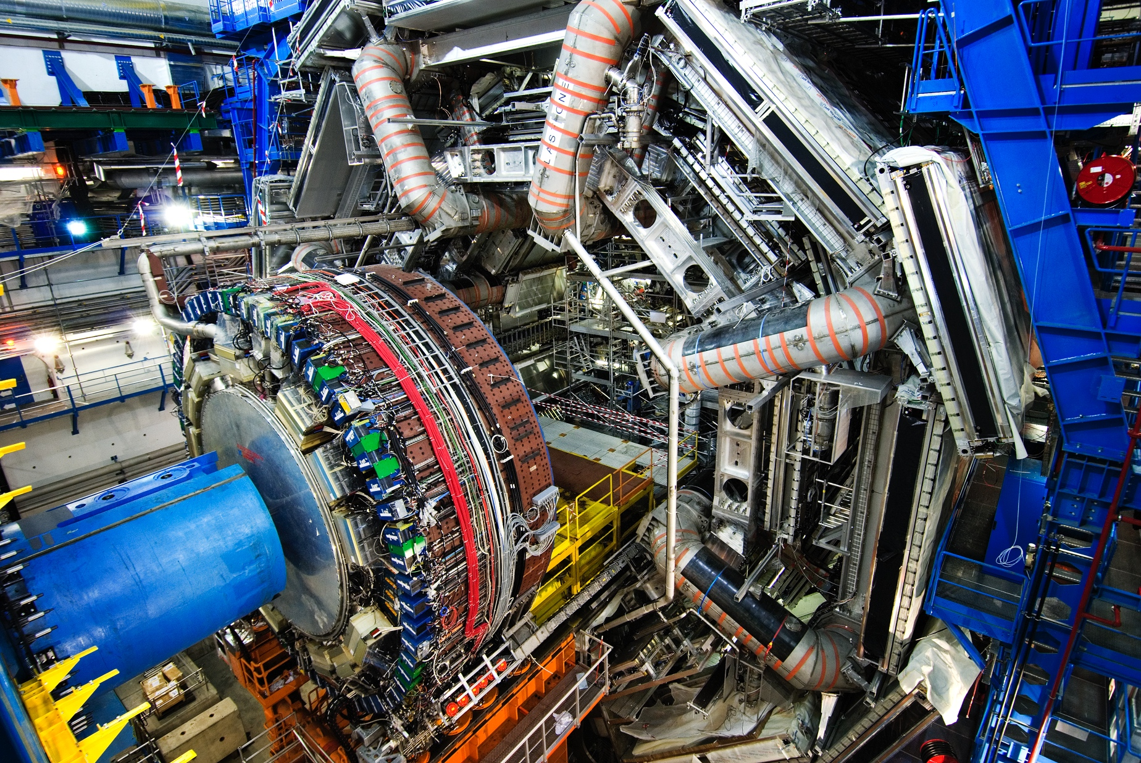
ATLAS Detector
150 Million of sensor
Control and detection sensors
Massive 3D camera
Capturing 40+ million collisions per second
Data rate TB per second

Slide 12
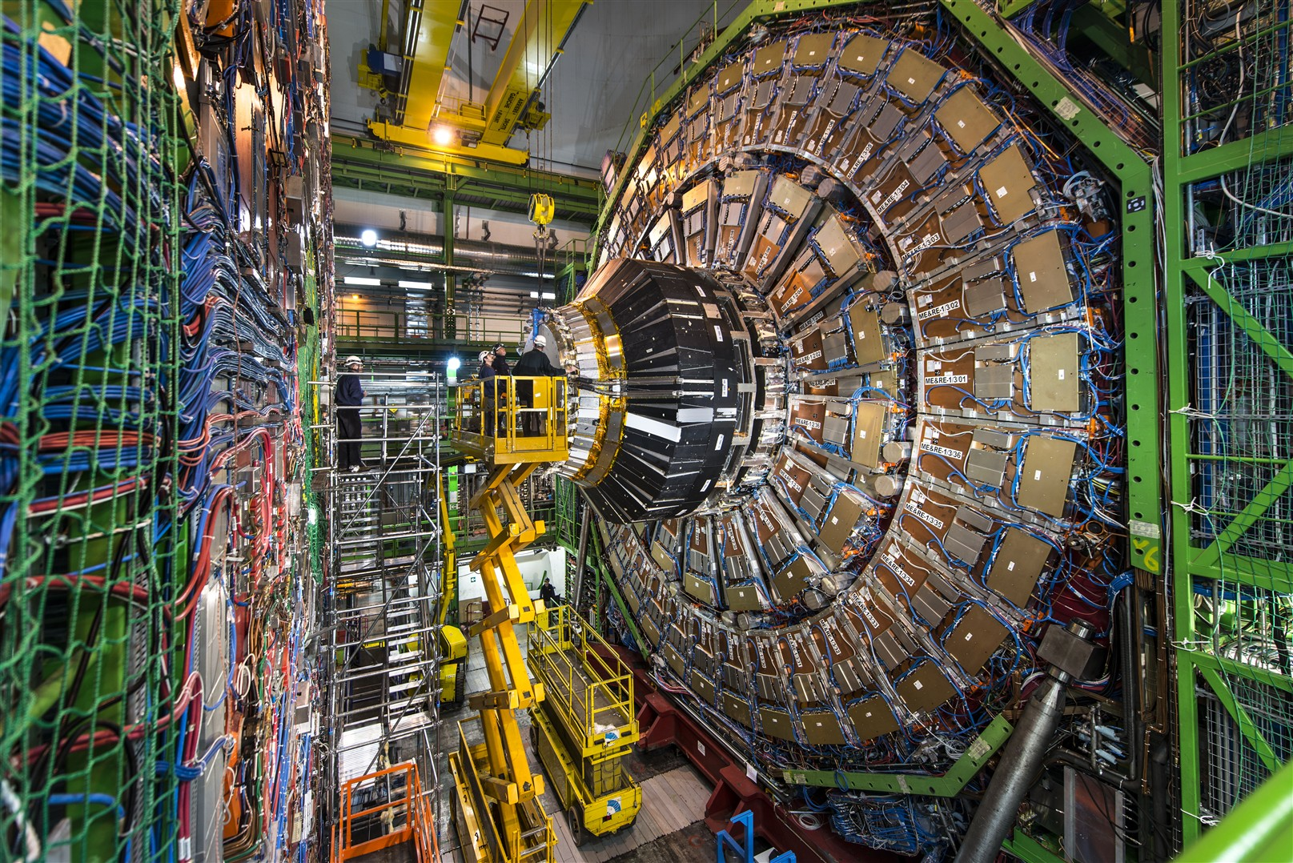
CMS Detector
Raw Data
Was a detector element hint?
How much energy?
What time?
Reconstructed Data
Particle Type
Origin
Momentum of tracks (4 vectors)
Energy in cluster (jets)
Calibration Information

Slide 13
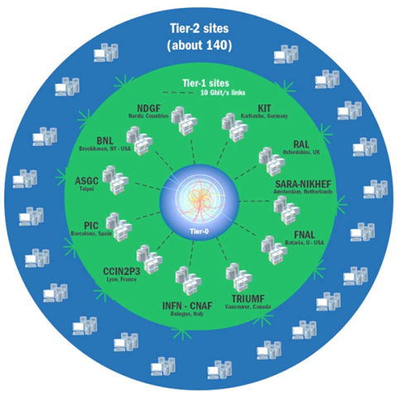
Worldwide LHC Computing Grid
Provides Global computing resources
  Store, distribution and analysis
Physics Analysis using ROOT
  Dedicated analysis framework
  Plotting, fitting, statistics and analysis

Slide 14

Data Analysis in Practice
ROOT works with N-tuples
  Specifically produced by physics groups
    Physics objects, level of details, filter and pre-analysis steps
Small Datasets
  Copy files and run locally
Large Datasets
  WLCG infrastructure split the analysis in multiple jobs
  Each job is sent to Grid site where input files are available

Slide 15
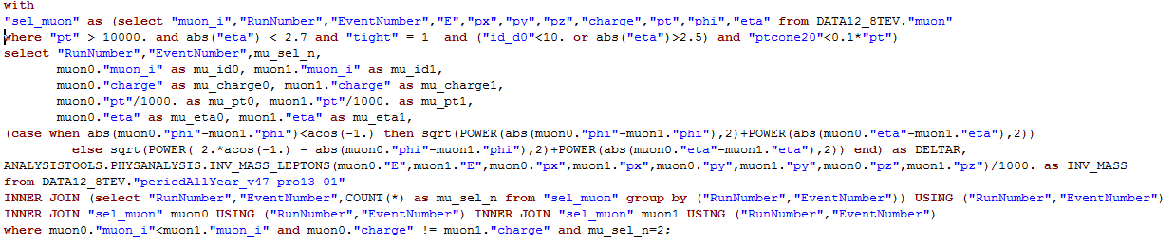

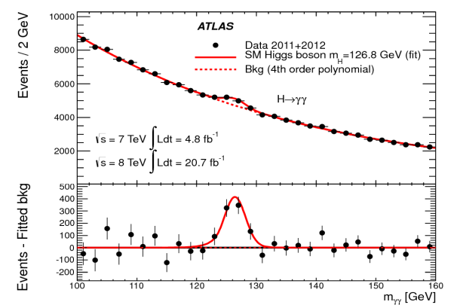
The Challenge
Can we replace the file based analysis with a model where the data is analyzed inside a centrally accessible Oracle Database?

Slide 16
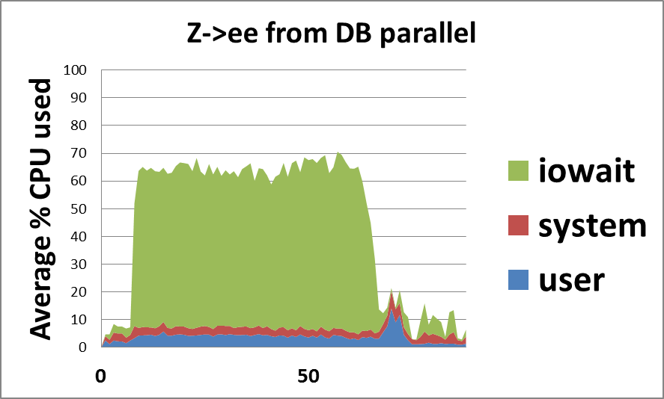
The Challenge
Physics-objects described by hundreds of variables
Each query uses unique subset of variables
  Cannot index all possible combinations
Query performance typically limited by I/O reads
  Root N-tuples Optimized to reduce I/O

Slide 17
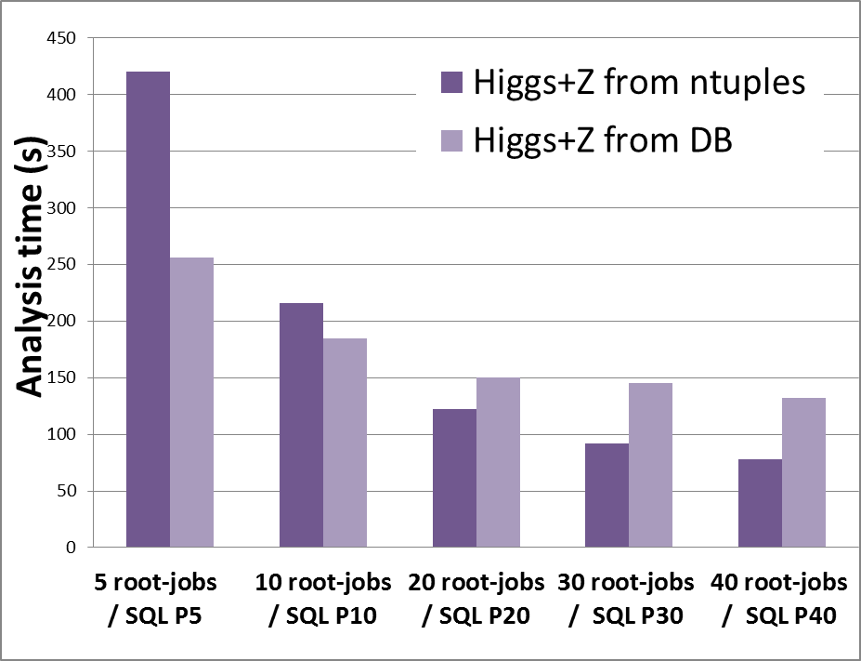
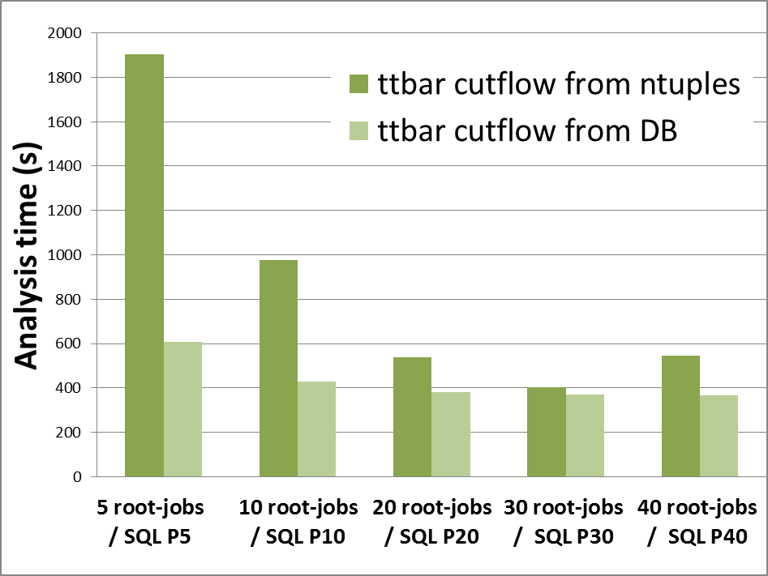
The Challenge
Higgs+Z: 40 variables
TTbar cutflow: 262 variables

Slide 18

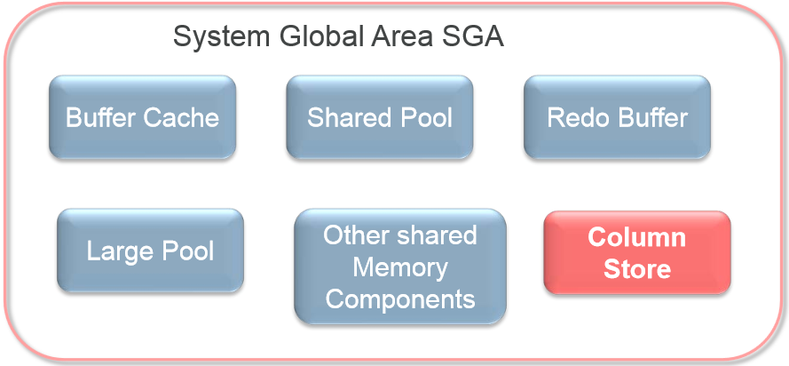
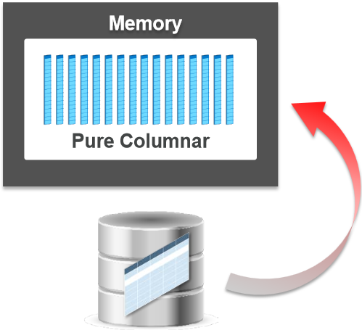
In-Memory Column Store
New static pool in System Global Area
Data in-memory – columnar format
Huge performance boost for table scans!
Graphics: www.oracle.com, Oracle In-Memory white paper

Slide 19
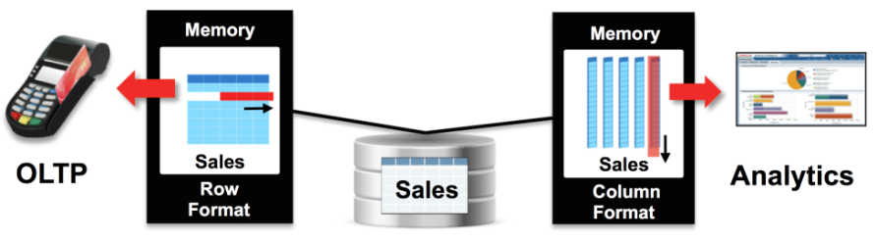
In-Memory Column Store
Both row and columnar format simultaneously in memory
  Buffer Cache for OLTP workload and data modifications (DML)
  IM Column Store for analytics and reporting queries
  Guaranteed transactional consistency
Transparent for applications
  No code change needed
No storage overhead
  Row format on disk
Graphics: Oracle In-Memory data sheet

Slide 20
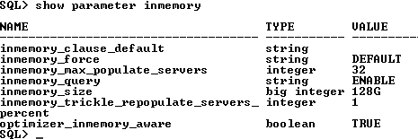
IMC – Setup
Very simple setup
alter system set inmemory_size=128G scope = spfile;
Database restart required
Other parameters: data population, optimizer awareness…

Slide 21



IMC – Memory
Distribute memory between IMC and Buffer Cache
Data pool (1M chunks) and Metadata pool (64K chunks)
V$INMEMORY_AREA view to monitor IMC pools

Slide 22
IMC – Data Population
ALTER TABLE „electron” INMEMORY;
Table can be loaded immediately (on database startup)
or on-demand, when first accessed
Data populated and re-populated in the background
New processes IMCO, SMCO, Wnnn
Optimizer automatically uses In-Memory table scans
for fully populated tables

Slide 23
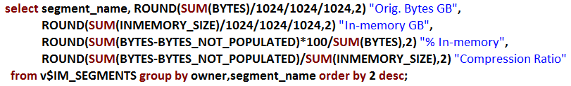
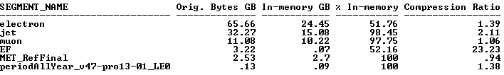
IMC – Data Population
V$IM_SEGMENTS view to monitor in-memory area contents on segment level

Slide 24
IMC - Compression
Reduces the amount of extra memory needed for IMC
5 levels of compression
NOCOMPRESS → FOR DML → FOR QUERY LOW|HIGH → FOR CAPACITY LOW|HIGH
2x-20x compression
  Depends on data type and distribution (number of unique values)
Filters for In-memory table scans applied directly on compressed data
  Except FOR CAPACITY compression
Very low performance impact on queries

Slide 25
IMC – Questions
How much performance can we gain with In-Memory Column Store for physics queries?
How does it cope with numeric data used in physics?
  int, float, double
  Very high cardinality columns – almost every value is unique
Is it really transparent?
  e.g. no negative impact on DML operations
Can the analysis now be performed in real-time?

Slide 26
IMC Tests – Methodology
A workload consisting of all 4 benchmark queries
Queries run in Parallel and some also in Serial mode
Sample 115GB set of physics experiment data
Multiple runs of the workload for each DB configuration
  4 undisturbed workload runs with a stable execution plan
  Results averaged out of all test runs
  3-4 warmup runs before the actual test

Slide 27
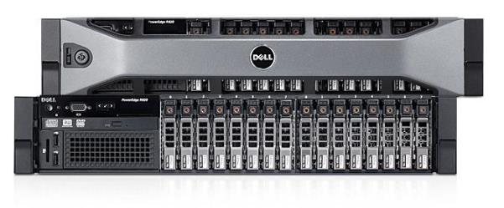
IMC Tests - Environment
Server: Dell PowerEdge R820
CPU: Intel Xeon 2.7Ghz
32 cores / 64 threads
Memory: DDR3 256GB
Storage: local SSD drive and NetApp NAS
OS: Red Hat Enterprise Linux Server 6.5
RDBMS: 12.1.0.2 Enterprise Edition - 64bit Production
Graphics: www.dell.com

Slide 28
IMC Tests – DB Configurations
Row format only – Buffer Cache
  With empty buffer (flushed before each query)
  With pre-warmed big buffer – 160GB
  With pre-warmed reduced buffer – 32/80GB
In-Memory Columnar format – IM Column Store
  In addition to Buffer Cache
  All possible compression levels
  BC/IMC pool sizes dependent on compression: total = 160GB

Slide 29
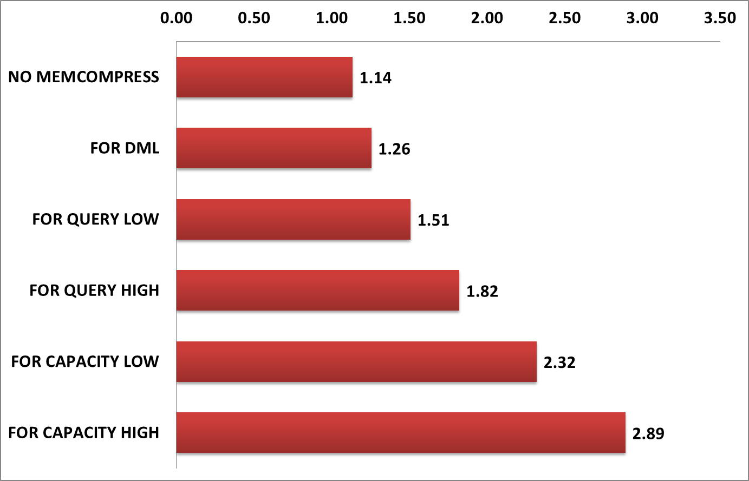
IMC Tests – Compression Rates
For tables used in physics analysis – 115GB in row format
  „electron”, „jet”, „muon” → typical physics data: mixture of int, float, double
  „Event Filter” → only boolean columns (mostly false), best compression
  „Missing Energy” → table with float & double columns, worst compression
Table: | electron | jet | muon | Event Filter | Missing Energy | Total (all tables) | Size GB (all tables)
NO MEMCOMPRESS | 1.07 | 1.41 | 1.10 | 0.70 | 1.42 | 1.14 | 101.2
FOR DML | 1.17 | 1.62 | 1.12 | 0.95 | 1.46 | 1.26 | 91.5
FOR QUERY LOW | 1.39 | 2.11 | 1.06 | 21.75 | 0.94 | 1.51 | 76.2
FOR QUERY HIGH | 1.60 | 2.77 | 1.30 | 30.08 | 1.49 | 1.82 | 63.0
FOR CAPACITY LOW | 2.00 | 3.71 | 1.80 | 39.44 | 1.54 | 2.32 | 49.5
FOR CAPACITY HIGH | 2.44 | 4.83 | 2.44 | 56.28 | 1.71 | 2.89 | 39.7

Slide 30
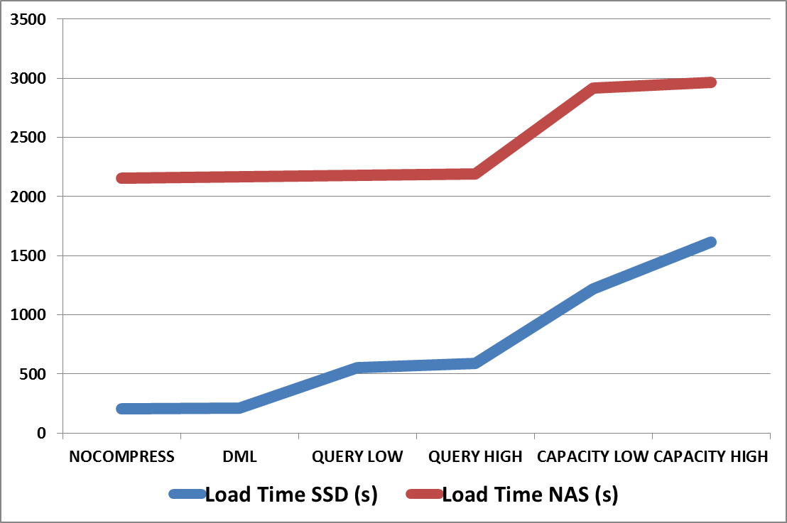
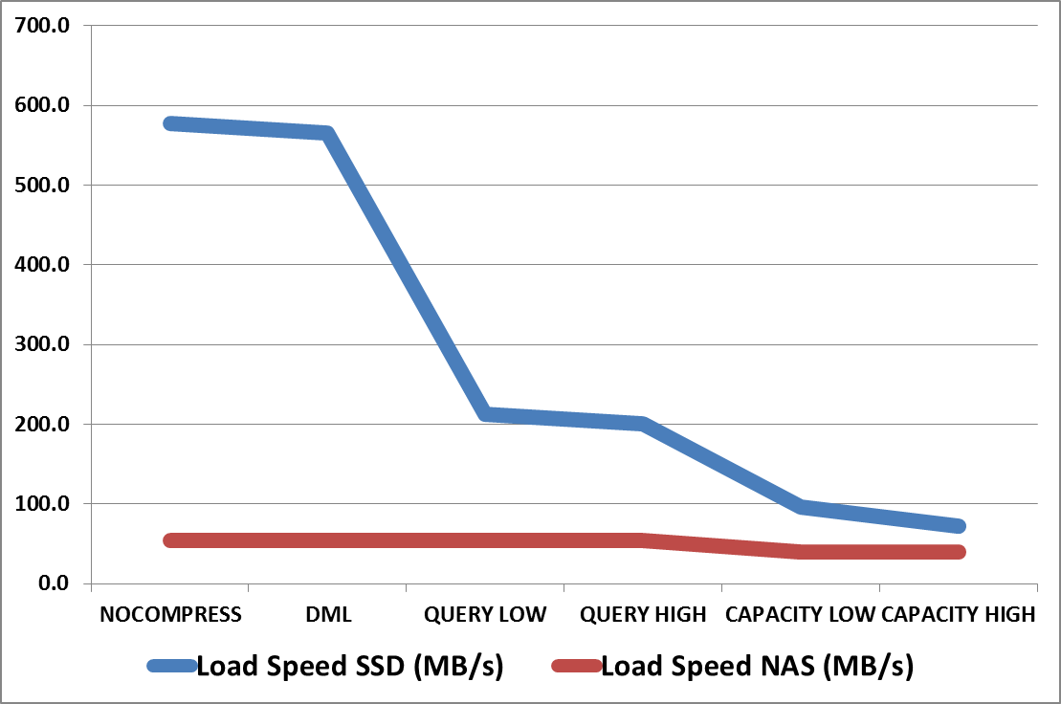
IMC Tests – Population Time
For tables used in physics analysis – 115GB in row format
32 populate processes
SSD vs NAS storage
Compression Level | Load Time SSD (s) | Load Time NAS (s)
NO MEMCOMPRESS | 3:24 | 35:57
FOR DML | 3:28 | 36:04
FOR QUERY LOW | 9:15 | 36:20
FOR QUERY HIGH | 9:48 | 36:30
FOR CAPACITY LOW | 20:20 | 48:34
FOR CAPACITY HIGH | 26:57 | 49:24
Compression Level | Load Speed SSD (MB/s) | Load Speed NAS (MB/s)
NO MEMCOMPRESS | 576.7 | 54.5
FOR DML | 565.6 | 54.4
FOR QUERY LOW | 212.0 | 54.0
FOR QUERY HIGH | 200.1 | 53.7
FOR CAPACITY LOW | 96.4 | 40.4
FOR CAPACITY HIGH | 72.8 | 39.7

Slide 31
IMC Tests – Physics Benchmark
Query 1: „Electron Counter”
  Count number of electrons meeting certain criteria
Query 2: „Electron Filter”
  Find good quality electron-positron pairs, calculate properties
Query 3: „Interesting Events” (TTbar cutflow)
  Find interesting collision events, meeting certain criteria
Query 4: „Higgs Boson” (Higgs+Z)
  Find collision events in which Higgs boson was produced

Slide 32
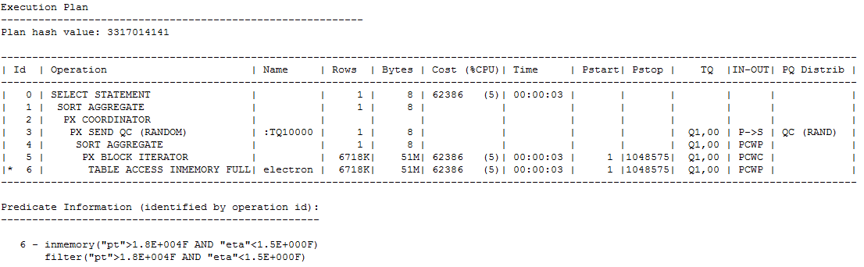
IMC Tests – Benchmark Query 1
„Electron Counter”
  Big table scan (66GB) with filters
In-Memory scan: electron
TABLE ACCESS INMEMORY FULL
Fraction of a second

Slide 33
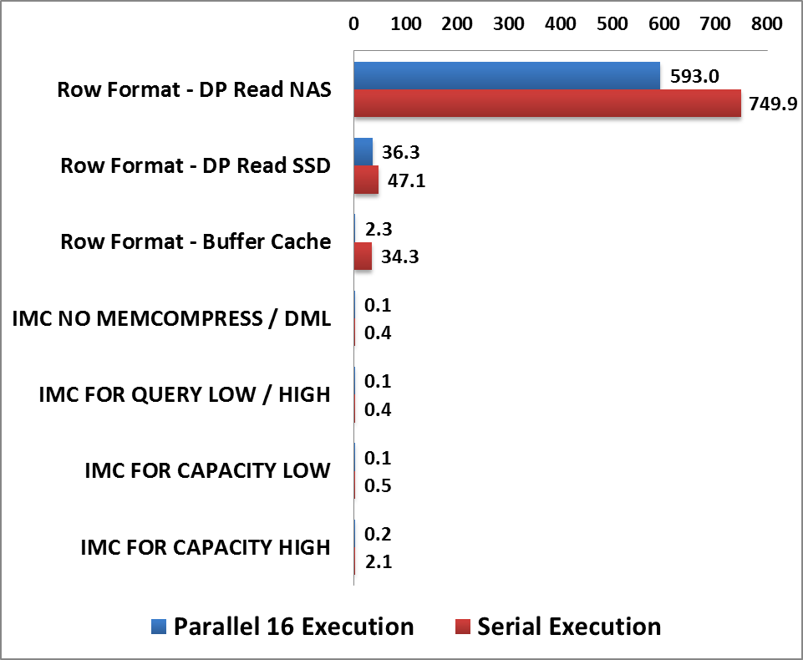
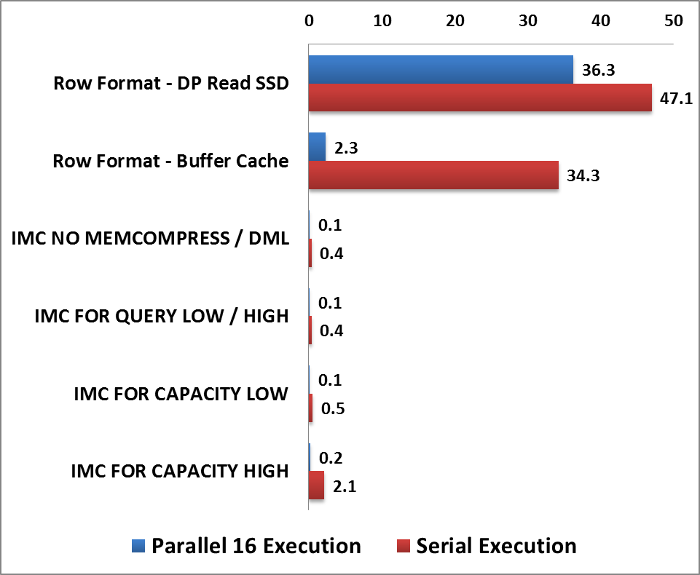
IMC Tests – Benchmark Results Q1
„Electron Counter”
Configuration | Parallel 16 Execution | Serial Execution
Row Format - Direct Path Read NAS | 593.0 | 749.9
Row Format - Direct Path Read SSD | 36.3 | 47.1
Row Format - Buffer Cache | 2.3 | 34.3
IMC NO MEMCOMPRESS / DML | 0.1 | 0.4
IMC FOR QUERY LOW / HIGH | 0.1 | 0.4
IMC FOR CAPACITY LOW | 0.1 | 0.5
IMC FOR CAPACITY HIGH | 0.2 | 2.1
IMC vs Buffer Cache serial
86x faster!!!
IMC vs SSD Direct Path serial
118x faster!!!
IMC vs NAS Direct Path serial
1900x faster!!!

Slide 34
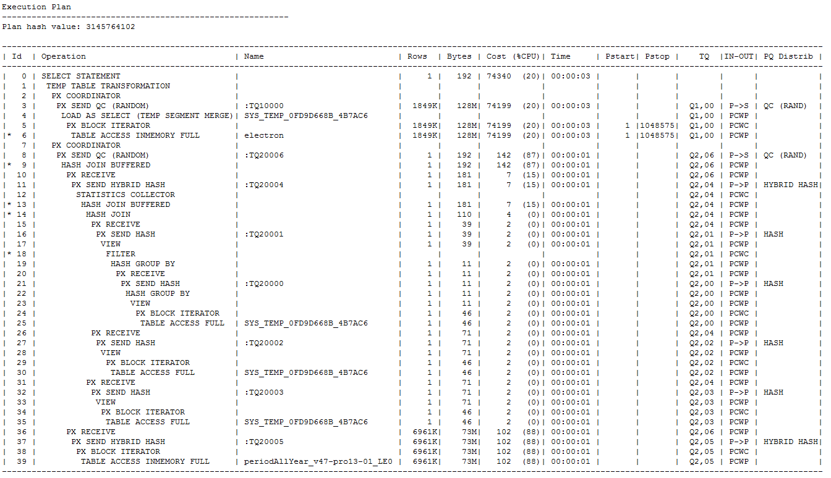
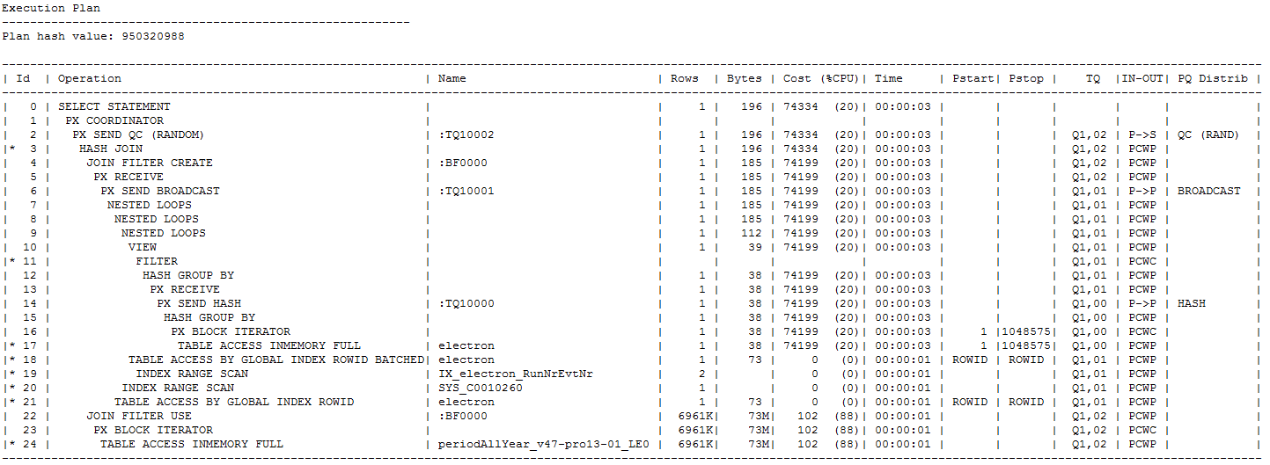
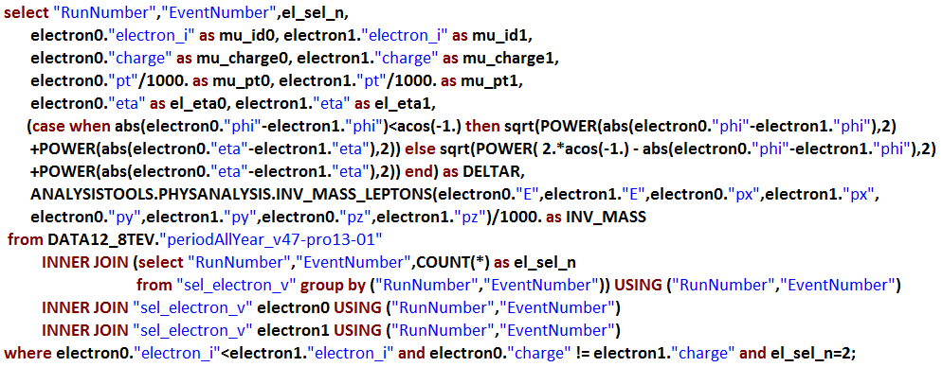
IMC Tests – Benchmark Query 2
„Electron Filter”
  Big table scan with 2 self-joins and a join to time dimension
  physics analytic calculations of electron properties
Sub-query factoring – temporary table
LOAD AS SELECT (TEMP SEGMENT MERGE)
In-Memory scan: electron
TABLE ACCESS INMEMORY FULL
In-Memory scan: electron
TABLE ACCESS INMEMORY FULL
Combined with 2 index scans (buffer cache)
INDEX RANGE SCAN

Slide 35
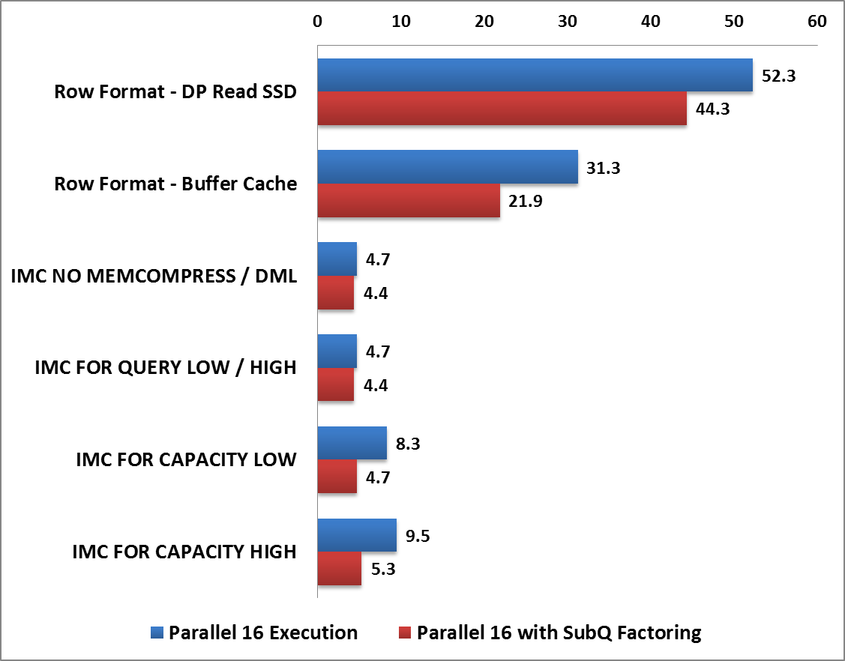
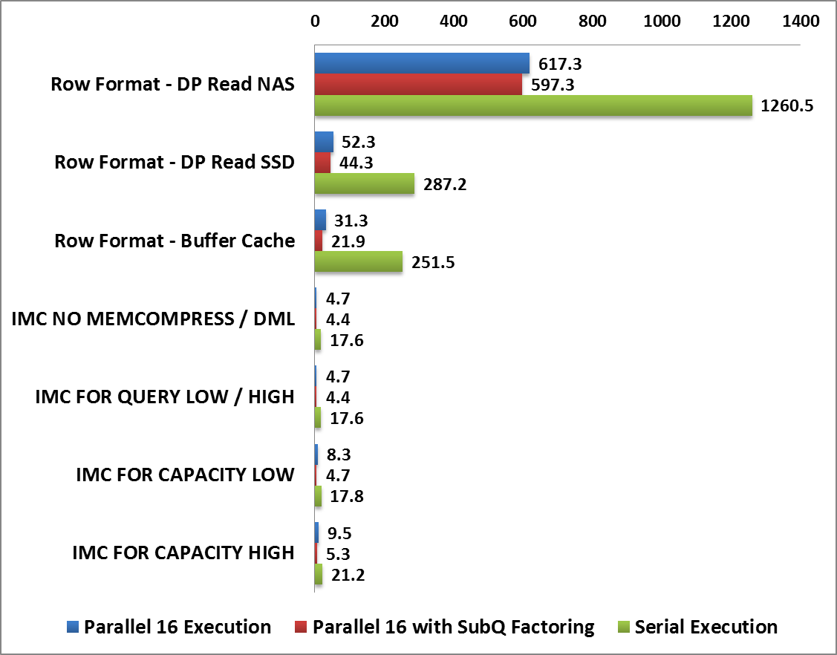
IMC Tests – Benchmark Results Q2
„Electron Filter”
Configuration | Parallel 16 Execution | Parallel 16 with SubQ Factoring | Serial Execution
Row Format - DP Read NAS | 617.3 | 597.3 | 1260.5
Row Format - DP Read SSD | 52.3 | 44.34 | 287.2
Row Format - Buffer Cache | 31.3 | 21.9 | 251.5
IMC NO MEMCOMPRESS / DML | 4.7 | 4.4 | 17.6
IMC FOR QUERY LOW / HIGH | 4.7 | 4.4 | 17.6
IMC FOR CAPACITY LOW | 8.3 | 4.7 | 17.8
IMC FOR CAPACITY HIGH | 9.5 | 5.3 | 21.2
IMC vs Buffer Cache serial
14x faster!!
IMC vs SSD Direct Path serial
16x faster!!
IMC vs NAS Direct Path serial
72x faster!!

Slide 36
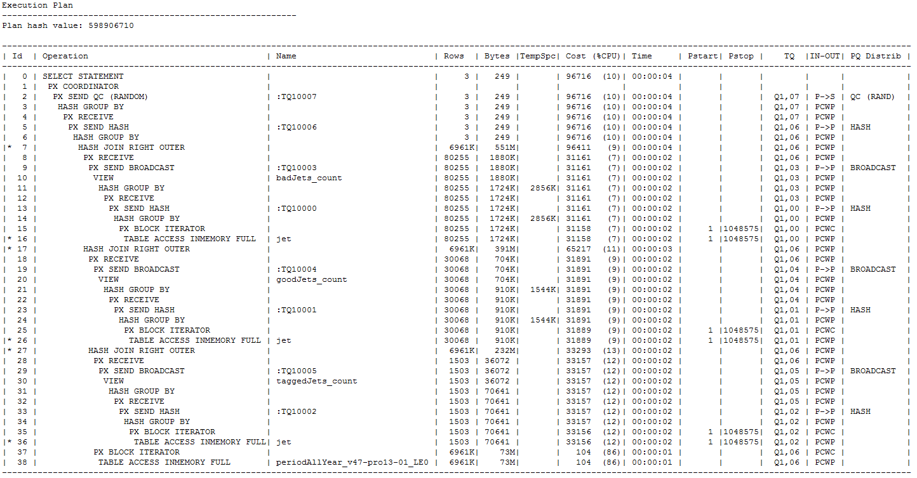
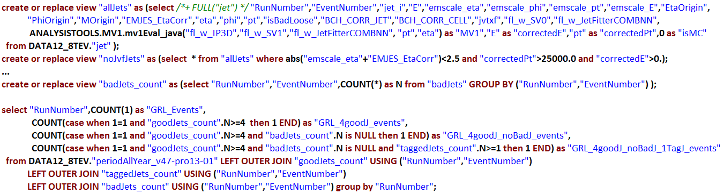
IMC Tests – Benchmark Query 3
„Interesting Events” (TTbar cutflow)
  3 scans of a big table with filters and aggregations
  2x self-join, 100GB of data scanned
  Sub-queries converted into views for simplicity
3x In-Memory scan: jet
TABLE ACCESS INMEMORY FULL
No In-Memory joins
HASH JOIN RIGHT OUTER

Slide 37
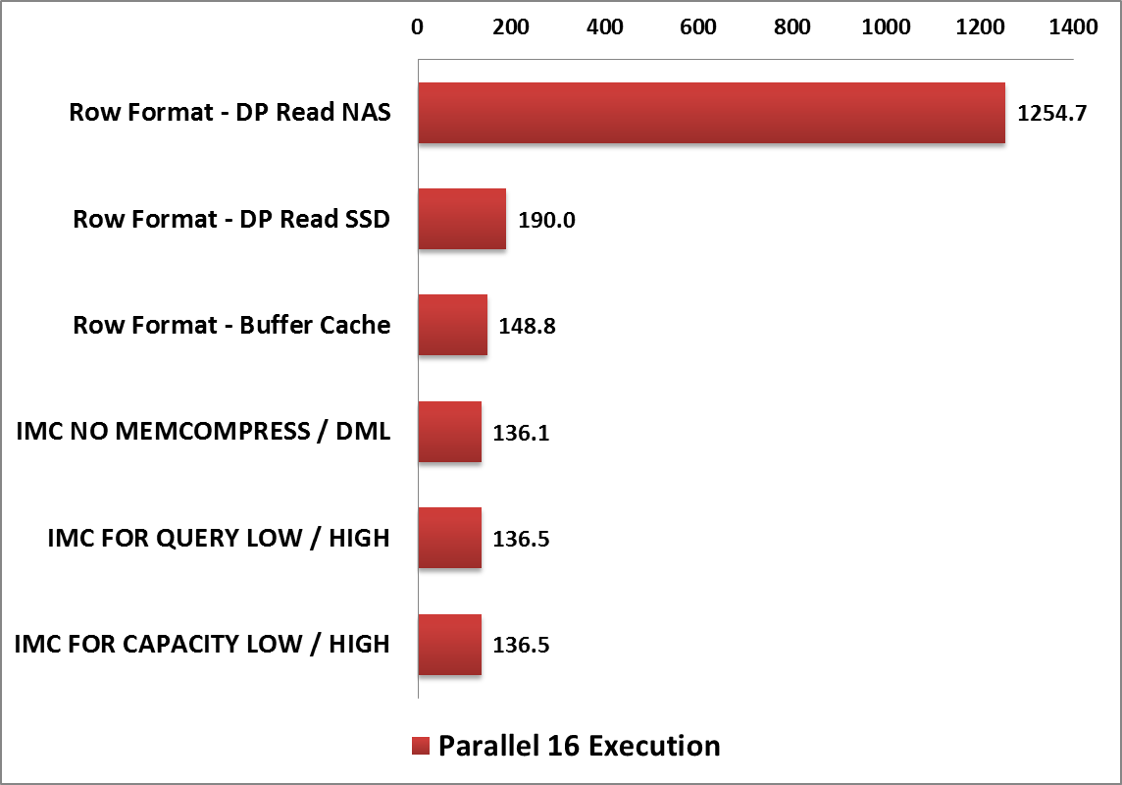
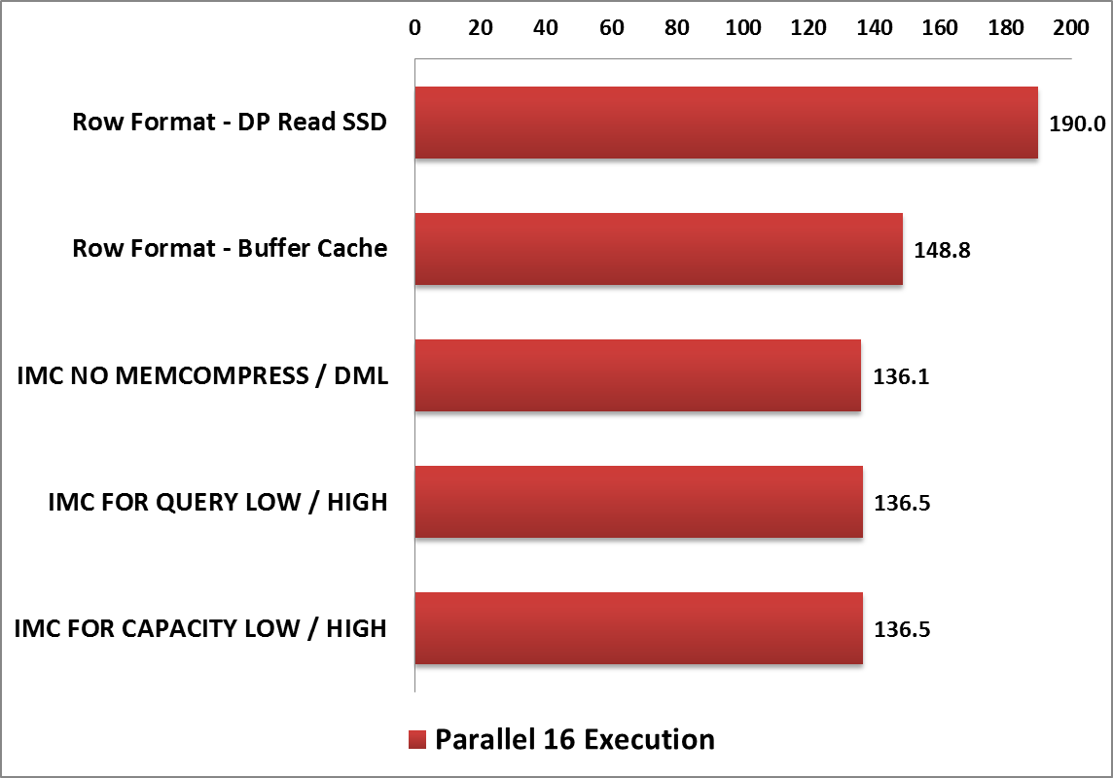
IMC Tests – Benchmark Results Q3
„Interesting Events”
Configuration | Parallel 16 Execution
Row Format - DP Read NAS | 1254.7
Row Format - DP Read SSD | 190.0
Row Format - Buffer Cache | 148.8
IMC NO MEMCOMPRESS / DML | 136.1
IMC FOR QUERY LOW / HIGH | 136.5
IMC FOR CAPACITY LOW / HIGH | 136.5
IMC vs Buffer Cache
1.1x faster
IMC vs SSD Direct Path
1.4x faster
IMC vs NAS Direct Path
9.2x faster

Slide 38
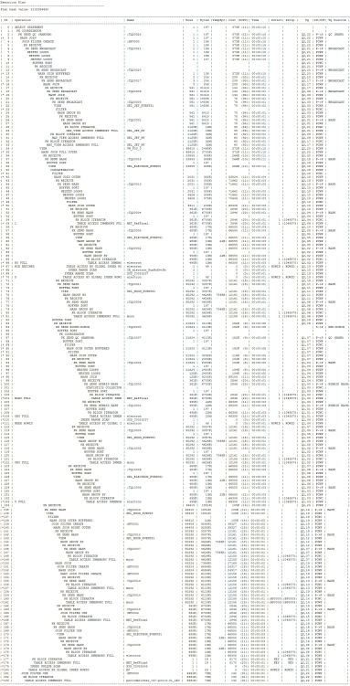
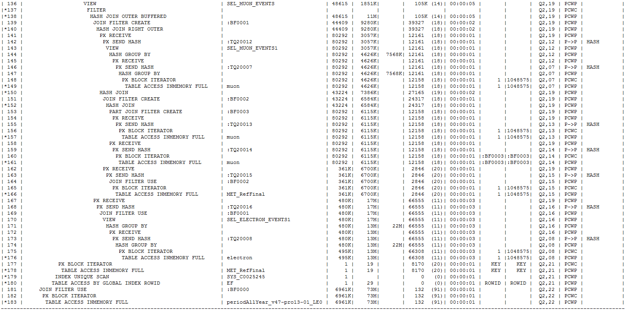
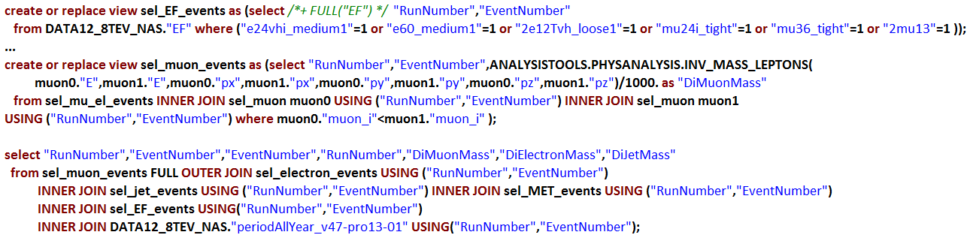
IMC Tests – Benchmark Query 4
„Higgs Boson” (Higgs+Z)
  Join of 6 tables + 2 self joins
  Over 200GB of data to be scanned
  Very complex query with analytic calculations
  Multiple layers of views for simplicity
Bloom Filters for
In-Memory join
JOIN FILTER CREATE
In-Memory scans: muon, electron, …
TABLE ACCESS INMEMORY FULL
In-Memory join executed
JOIN FILTER USE

Slide 39
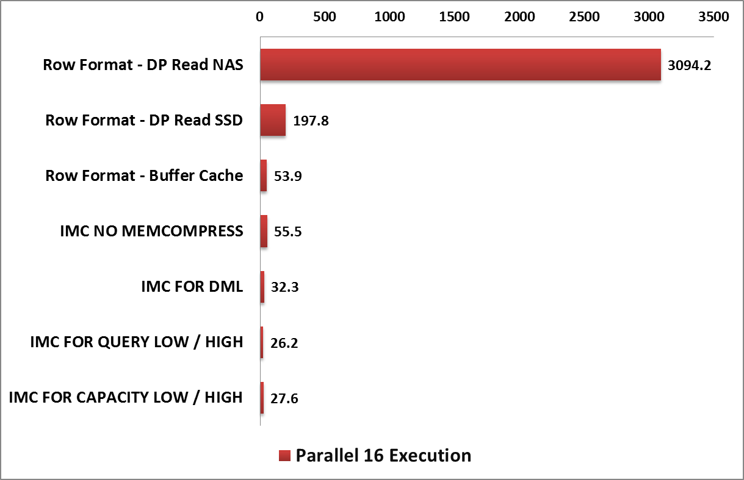
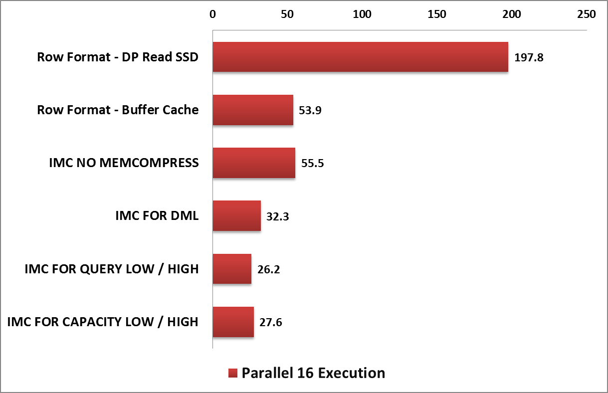
IMC Tests – Benchmark Results Q4
„Higgs Boson”
Configuration | Parallel 16 Execution
Row Format - DP Read NAS | 3094.2
Row Format - DP Read SSD | 197.8
Row Format - Buffer Cache | 53.9
IMC NO MEMCOMPRESS | 55.5
IMC FOR DML | 32.3
IMC FOR QUERY LOW / HIGH | 26.2
IMC FOR CAPACITY LOW / HIGH | 27.6
Effect of a small Buffer Cache
IMC vs Buffer Cache
2.1x faster!
IMC vs SSD Direct Path
7.6x faster!
IMC vs NAS Direct Path
118x faster!

Slide 40
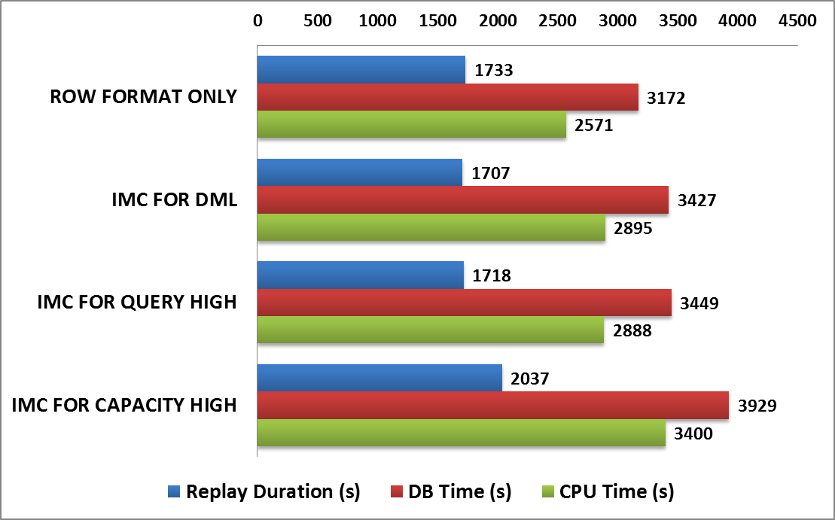
IMC Tests – OLTP Benchmark
OLTP schema from one of the physics databases (CMS)
  High concurrency workload with ~300 simultaneous sessions
  Mixed DML and SELECT queries – mostly with index access path
Real Application Testing – 1h of peak activity captured
Replay comparison: row format (BC) vs In-Memory Store
  IMC with 3 compression levels: DML / QUERY HIGH / CAPACITY HIGH
Configuration | Replay Duration (s) | DB Time (s) | CPU Time (s) | Physical Reads (GB)
ROW FORMAT | 1733 | 3172 | 2571 | 97.9
IMC FOR DML | 1707 | 3427 | 2895 | 7.9
IMC FOR QUERY HIGH | 1718 | 3449 | 2888 | 7.5
IMC FOR CAPACITY HIGH | 2037 | 3929 | 3400 | 7.1

Slide 41
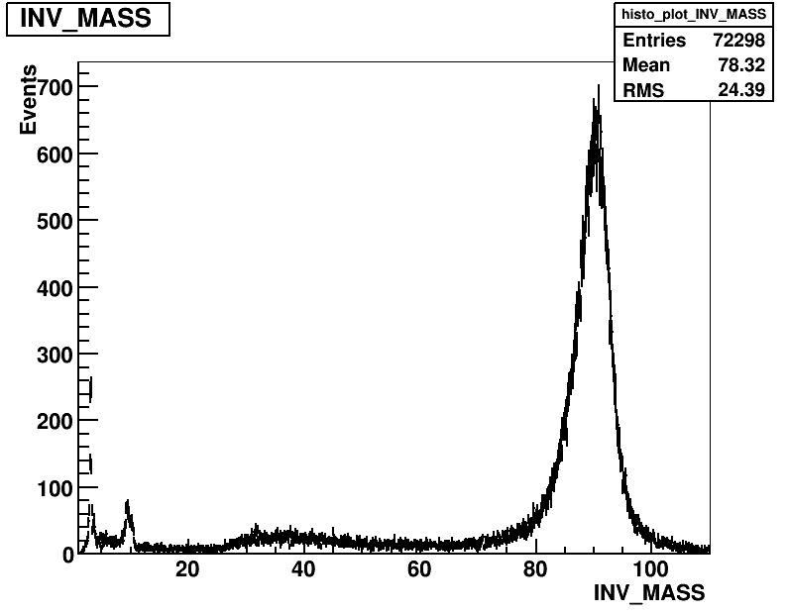
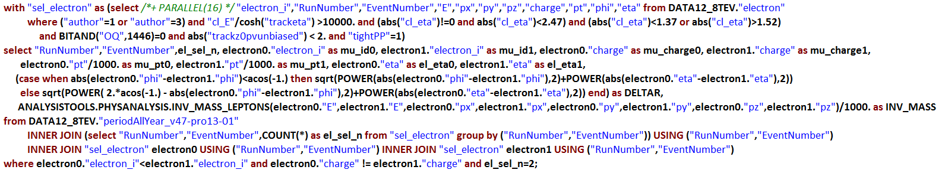
Physics Analysis NOW – with IMC
In-memory Column Store provides significant performance boost for physics queries
Very positive benchmark results
Real-time analysis now possible
<10s

Slide 42
Conclusions
In-Memory Column Store is both powerful and easy to use
Huge performance improvements of analytic-type queries on the same hardware
  On average 10x for fast SSD storage
  On average 100x for slower spindles
No negative impact on OLTP, high concurrency workloads
More data can go to memory due to the columnar format with compression
  Very low performance impact of higher compression levels
Do we plan to use In-Memory Column Store at CERN?
Will definitely consider it
in future projects!
Many good use-cases identified

Slide 43
Maaike: Maaike.Limper@cern.ch
Manuel: Manuel.Martin.Marquez@cern.ch
Emil: Emil.Pilecki@cern.ch
Q & A
See also: https://db-blog.web.cern.ch/

