Slide 1


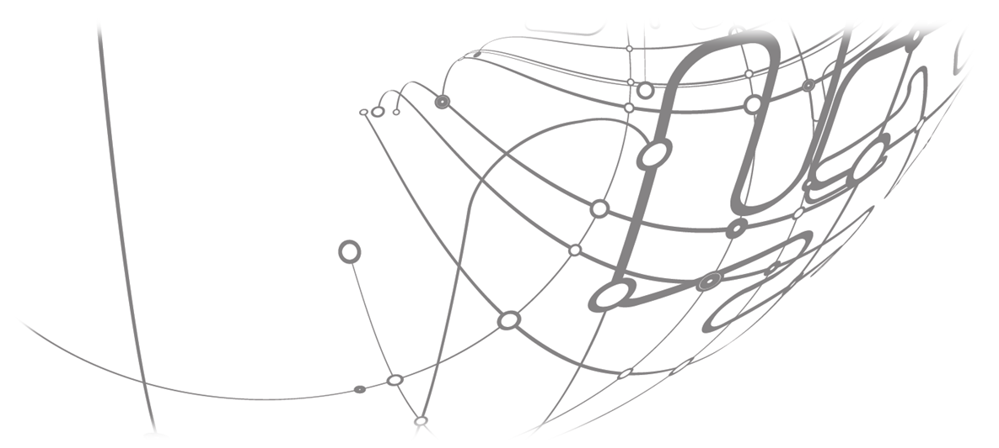


GeantV
Taking up the technology challenge
CERN openlab Open Day
June 10, 2015

Slide 2
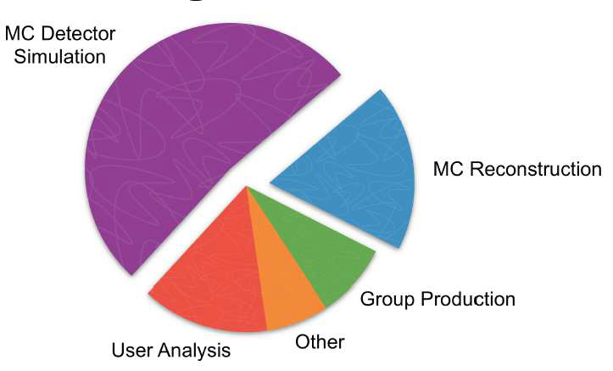
Detector simulation and the LHC challenge
ATLAS GRID CPU utilization
LHCb GRID usage | 2013 | 2016
Sim | 64.5% | 63%
User | 20.2% | 8%
Rest (str, repro, rec) | 15.3% | 29%
Run1➔Run2
O. Bruning 2014 – ECFA HL LHC workshop
Aiming for a factor of 100 integrated luminosity over 20 years
x25 data rate vs. Run1, with much increased pile-up
  Simulated sample requests will follow in some way…
  More fast simulation…
Detector studies for upgrades, new experiments
  … and faster full simulation
Factors needed in throughput…
Run 2
LS 2
Run 3
30 fb⁻¹
LS 3
Run 4
300 fb⁻¹
LS 4
Run 5
LS 5
Goal of 3’000 fb⁻¹ by mid 2030’s

Slide 3
HEP SIMULATION WORLD
Generators
Particles
Full parametric (generator smearing)
Any shortcuts possible…
Simulation
ln(speed)
Digitization
Library (reuse)
Framework
(FastSim +
FastTrk + FastDigi)
Reconstruction
Alternative approaches
(combinations)
Tracks
Full simulation
physics performance

Slide 4

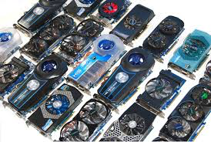
COMPUTING TECHNOLOGY Challenges
HEP software hibernating for long into “sequentiality” waking up in a “parallel” world
Multi-stage process: make the first steps, interact with the environment, change old behaviors, live with diversity…
Making the software parallel ≠ gaining throughput
The last requires re-thinking the code in terms of data and code locality, better use of SIMD vectorisation
  Less CPI and much less cache misses
  Rethinking algorithms and processing flow
  Using standard or opportunistic resources efficiently

Slide 5
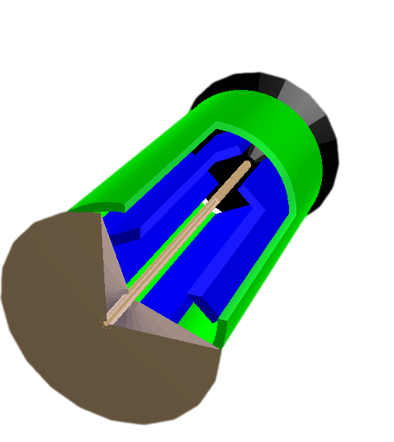
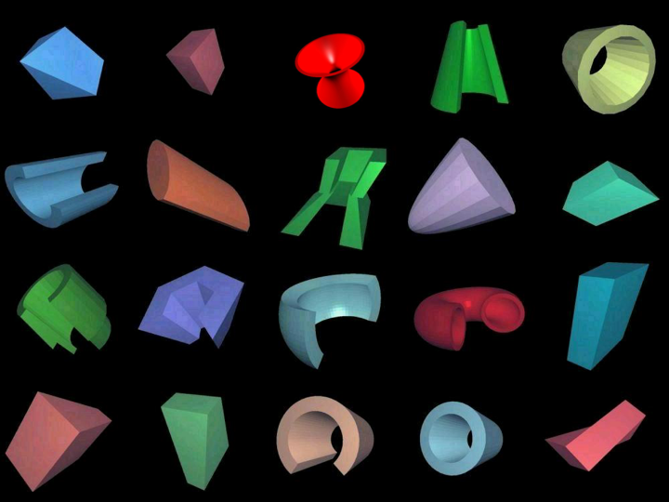
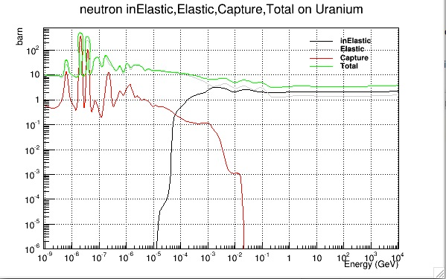
GeantV concept
Scheduler
Re-basketizer
Basket of tracks
Basket of tracks
Dispatching
MIMD
SIMD
Geometry navigator
Physics
Geometry algorithms
x-sections
Reactions

Slide 6
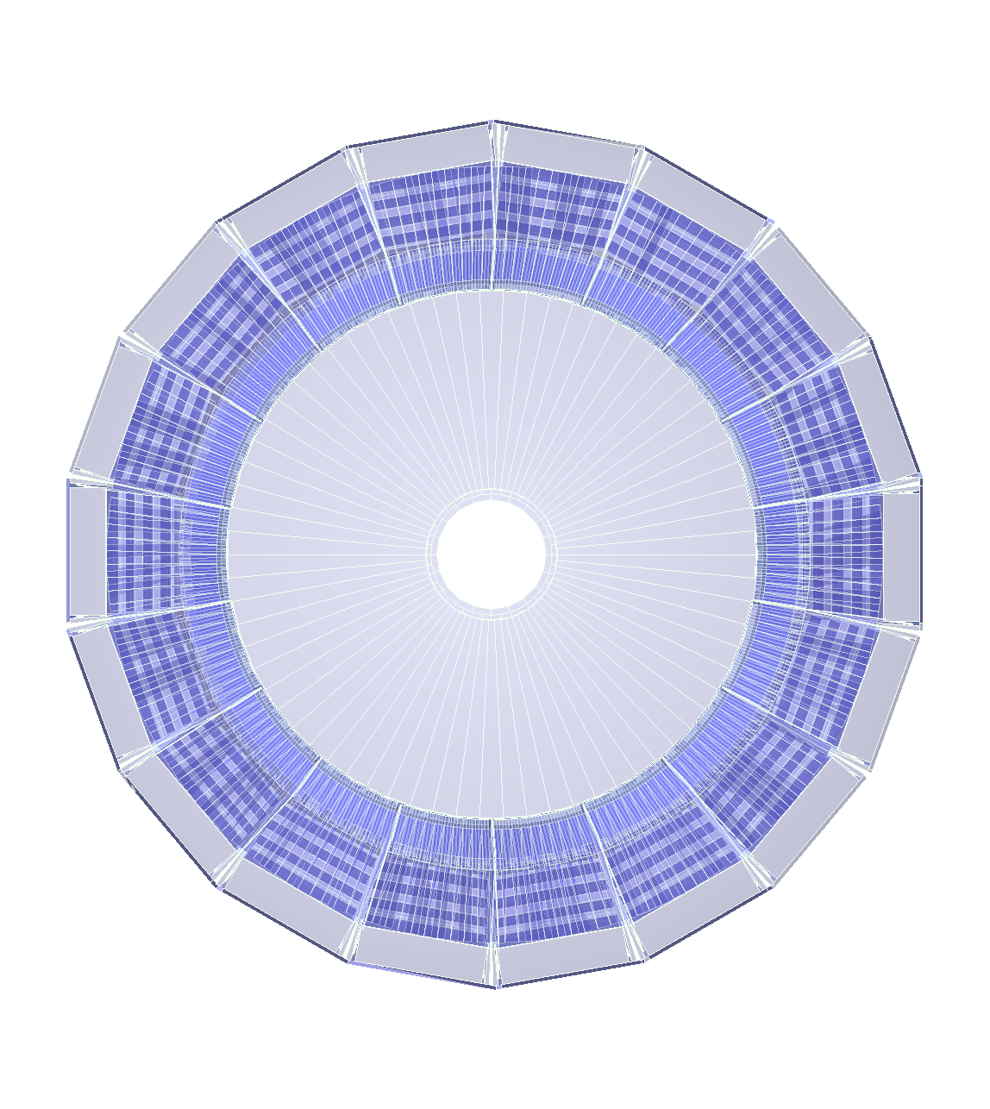
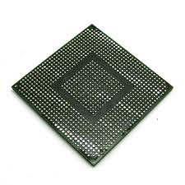
Geometry
Filters
(Fast)Physics
Filters
Stepper
Input queue
Vol₁
Vol₂
Vol₃
Vol_{n}
e⁺/e⁻
γ
Vector
stepper
Baskets
Step sampling
Filter neutrals
(Field) Propagator
Step limiter
reshuffle
Outputs
Coproc. broker
VecGeom
navigator
Physics sampler
Scheduler
Full geometry
Simplified geometry
Phys. Process
post-step
GeantV
Secondaries
TO SCHEDULER

Slide 7
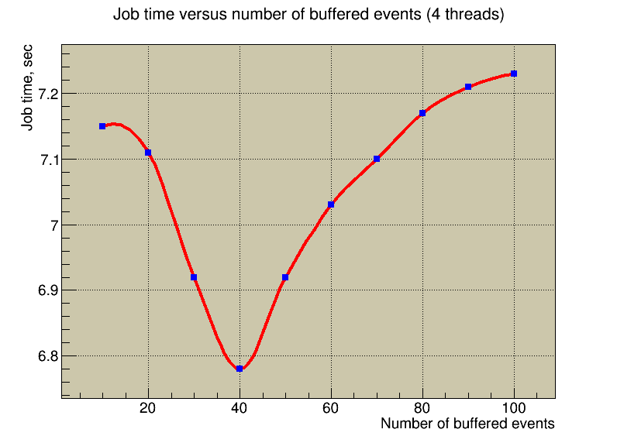
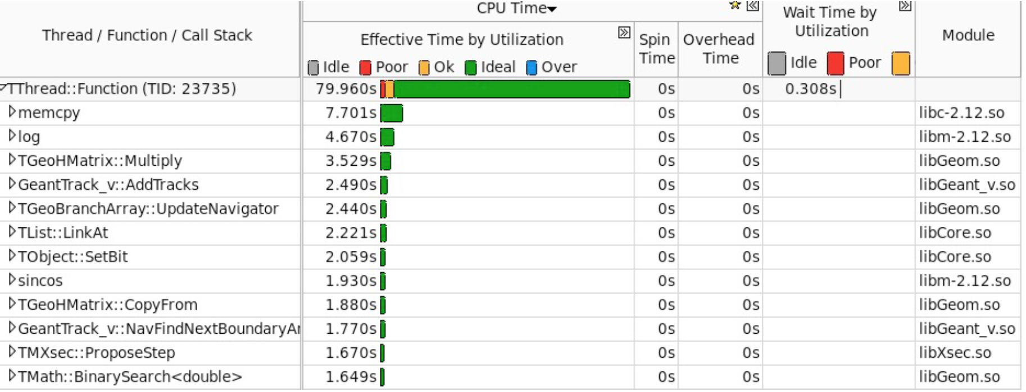
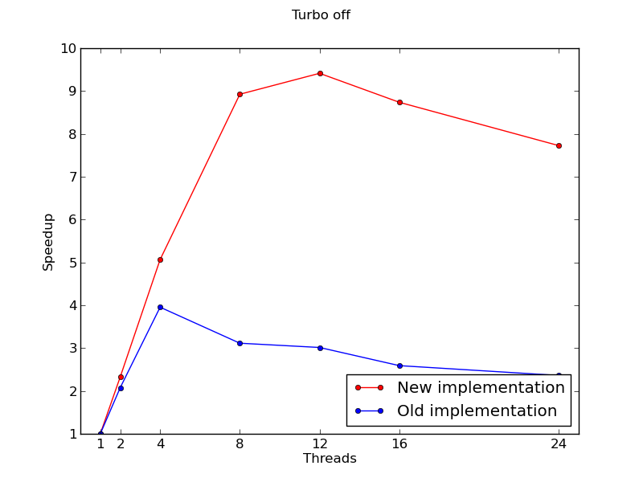
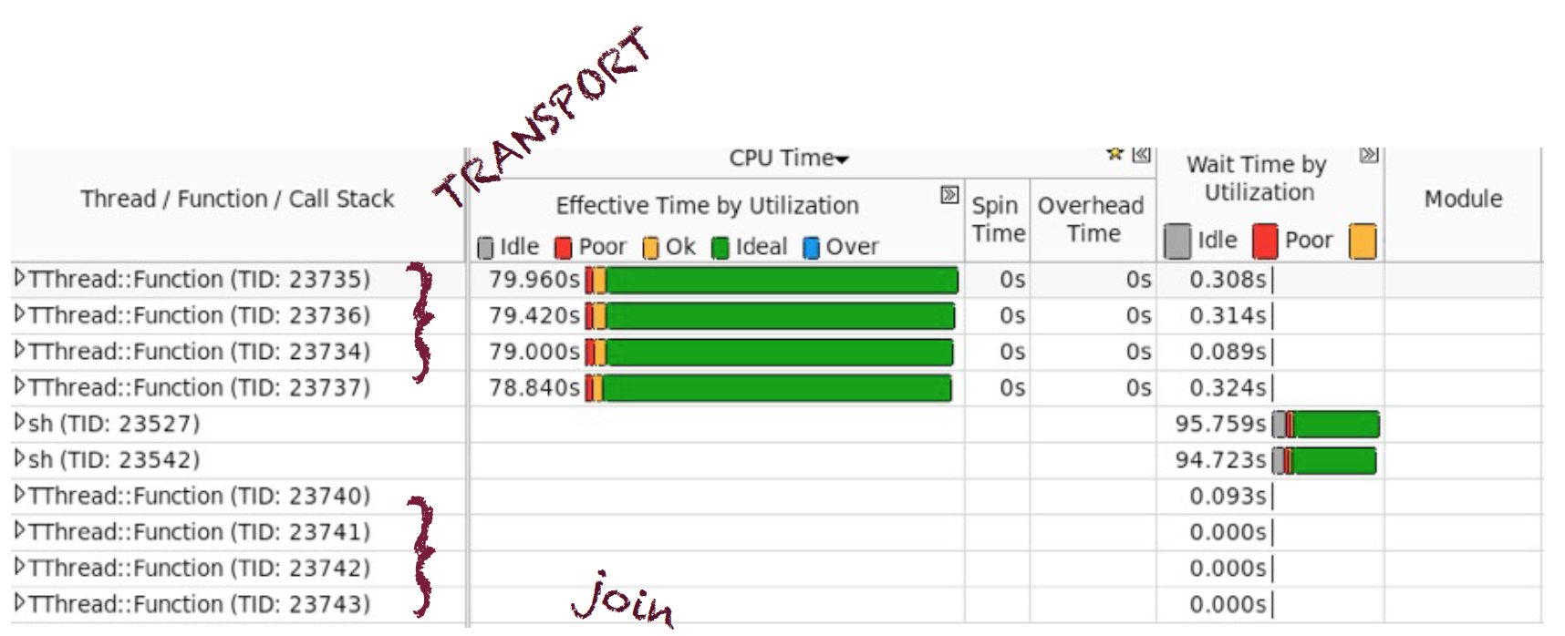

Fine grain parallelism is challenging
Several parameters to be tuned
Performance is monitored
  Allows detecting and fixing bottlenecks
Amdahl still high due to rebasketizing operations
Optimising scheduler performance against several parameters using GA and automatic learning
CMS2015.root
1000 events with 100 tracks each, measured on a 24-core dual socket E5-2695 v2 @ 2.40GHz (IVB).
Notes:
All this to be done in a fine grain parallel environment-> monitor scalability
Removed a bottleneck due to unnecessary object allocation
Amdahl still high – we have clear ideas on how to improve this using atomics

Slide 8
Geometry
We have developed a library of vectorised geometry algorithms to take maximum advantage of SIMD architectures
We obtain excellent performance gains also in scalar mode
The code is available in the AIDA usolid library and is being validated for Geant4 use

Slide 9

Portability
http://code.compeng.uni-frankfurt.de/projects/vc
“Backend” is a (trait) struct encapsulating standard types/properties for “scalar, vector, CUDA” programming; makes information injection into template function easy
Long-term maintainability of the code => write one single version of each algorithm and to specialise it to the platform via template programming and low level optimised libraries (Vc in our case)
Results are quite encouraging: may be portable HPC is NOT an oxymoron after all…
1 particle API
Many particle API
(SIMD)
Common C++ template functions
double distance( double );
Vc::double_v distance( Vc::double_v );
template<class Backend>
Backend::double_t
common_distance_function( Backend::double_t input )
{
// Algorithm using Backend types
}
struct ScalarBackend
{
typedef double double_t;
typedef bool bool_t;
static const bool IsScalar=true;
static const bool IsSIMD=false;
};
struct VectorBackend
{
typedef Vc::double_v double_t;
typedef Vc::double_m bool_t;
static const boolIsScalar=false;
static const bool IsSIMD=true;
};
Other backends:
CilkTM Plus
Intel Xeon Phi
CUDA
Native C++xx when available

Slide 10


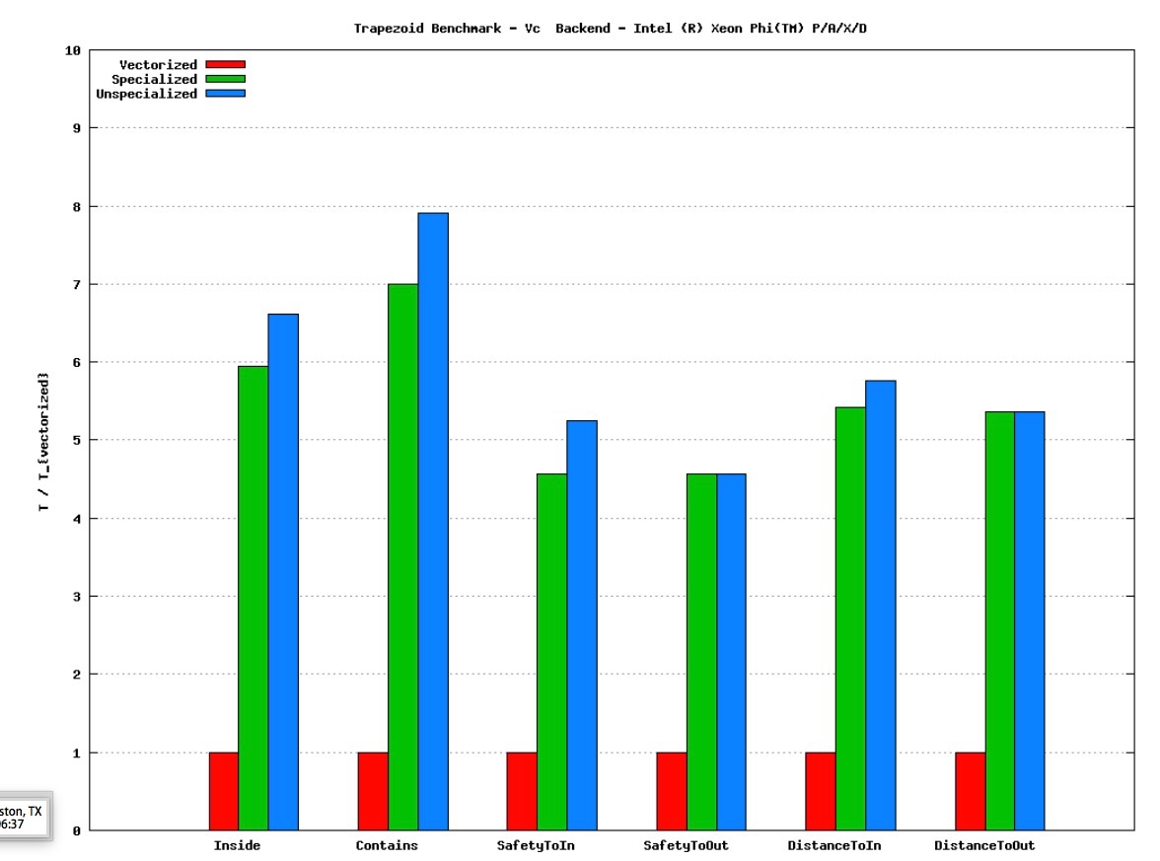
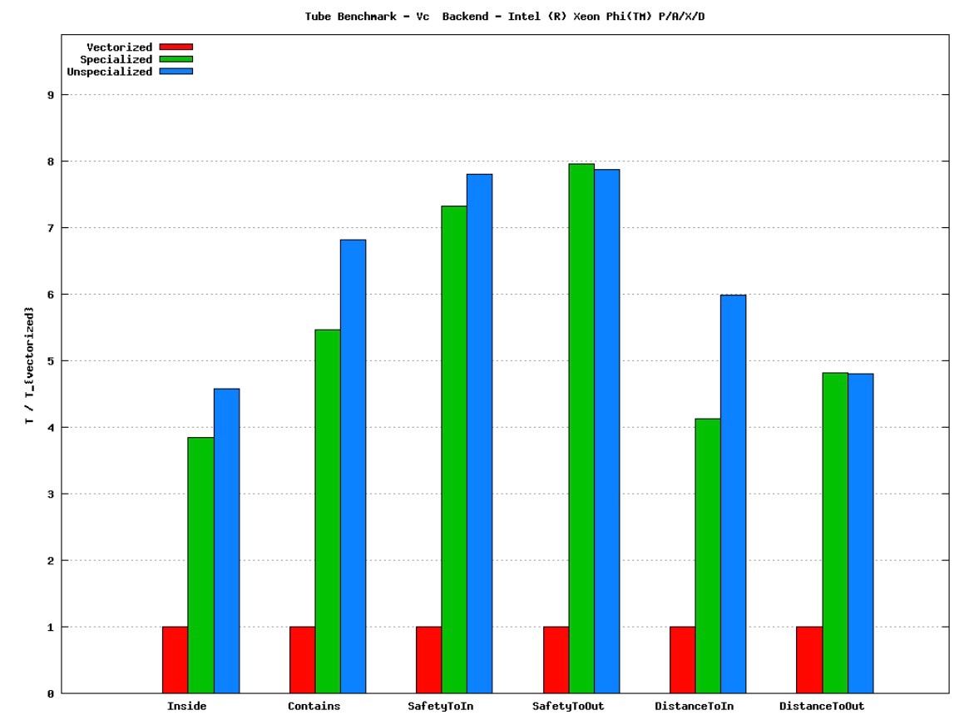


How does it work?
Results obtained by CERN and UNESP Intel IPCCs on Xeon Phi
SIMD optimisation gives us more than half order of magnitude
Remember: for single thread SIMD the max lim is 8 (IMCI) – difficult to do better…
9
Speedup ratio
9
Speedup ratio
7
7
5
5
3
3
1
1
Inside Contains SafetyToIn SafetyToOut DistanceToIn DistanceToOut
Inside Contains SafetyToIn SafetyToOut DistanceToIn DistanceToOut
https://software.intel.com/en-us/articles/ipcc-at-cern-european-organisation-for-nuclear-research

Slide 11
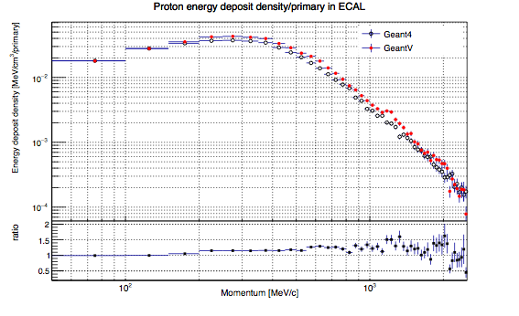
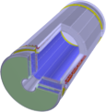
Basket (no-)overhead
Full CMS2015 geometry with 1MeV cuts
Comparison (tabulated physics) of
GeantV scheduler w. TGeo (the geom package of ROOT) in single thread
Geant4
NOT a performance comparison!!
Cannot compare functionality of the two programmes
But a circumstantial proof that the overhead of basket handling is under control
Gains of up to x2 in single thread mode with no vectorisation need to be fully understood, not explained only by:
  ~x5 less instruction cache misses
  ~20% less CPI
CMS Ecal

Slide 12
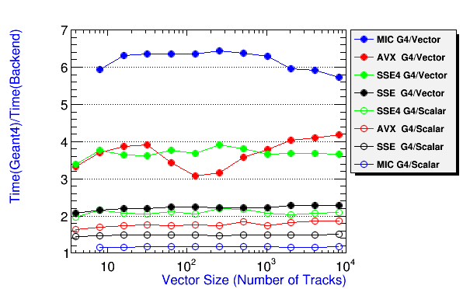
Vectorizing physics
Physics vectorisation has started with the electromagnetic processes
The vectorised Compton scattering shows good performance gains
Vector code is better scalar code!
We will consider to retrofit this into Geant4
Compton benchmark

Slide 13
Road path
Improve scalability and enable MIMD mode
  Dispatch multiprocessor and multi node
Integrate more realistic setups (more LHC experiments)
  Including scoring/digitization/I/O
I/O of kinematics, support for user hits/digits
  Offer a choice of a factory based, generic multithreaded I/O
0.0 release aimed for end of the year
  User able to simulate in realistic geometry using tabulated physics
Alpha release for 2018
  Usable at large scale, most features available
Vectorized version of CMS2015 benchmark on Xeon
  VecGeom global navigation in CMS
  Fall 2015
Gradual addition of vector physics models in the prototype workflow
  EM could have good progress by the end of 2015
  Requires interfaces (partly done), models, basketizing on physics
KNC/KNL and GPU benchmarks
  Use as coprocessor/native mode
  KNC&GPU in offload mode by the fall

