Slide 1


The Challenges of Scientific Computing
Alberto Di Meglio
CERN openlab CTO
DOI: 10.5281/zenodo.7116

Slide 2
Outline
What is CERN and How it Works
Computing and Data Challenges in HEP
New Requirements and Future Directions
Scientific Collaborations

Slide 3
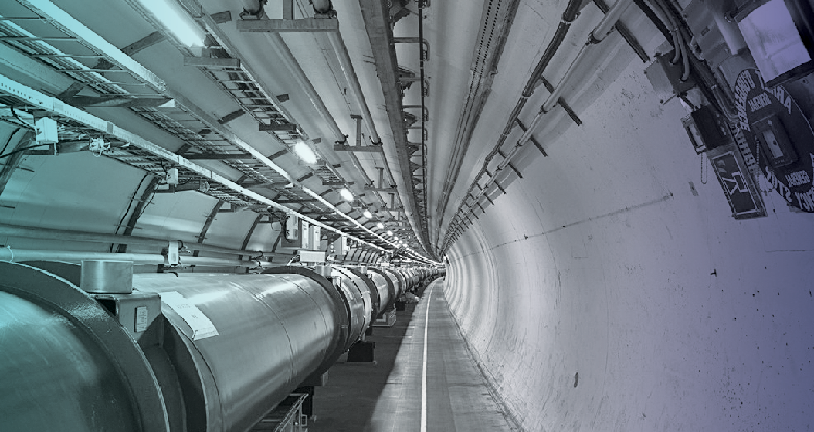
What is CERN and How Does it Work?

Slide 4
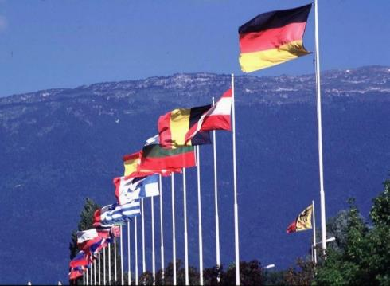
What is CERN?
European Organization for Nuclear Research
~ 2300 staff
~ 1050 other paid personnel
~ 11000 users
Budget (2012) ~1100 MCHF
Founded in 1954
20 Member States: Austria, Belgium, Bulgaria, the Czech Republic, Denmark, Finland, France, Germany, Greece, Hungary, Italy, the Netherlands, Norway, Poland, Portugal, Slovakia, Spain, Sweden, Switzerland and
the United Kingdom
Candidate for Accession: Romania
Associate Members in the Pre-Stage to Membership: Israel, Serbia, Cyprus
Applicant States: Slovenia, Turkey
Observers to Council: India, Japan, the Russian Federation, the United States of America, Turkey, the European Commission and UNESCO

Slide 5
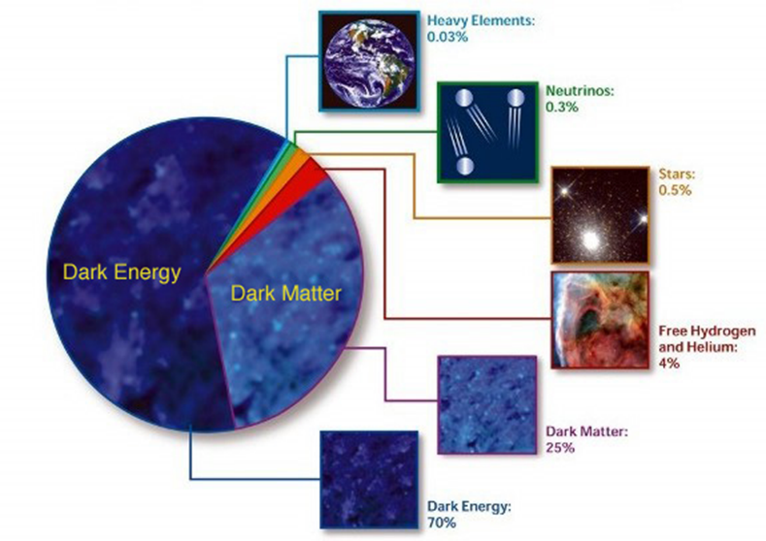
What is the Universe made of?
What gives the particles their masses?
How can gravity be integrated into a unified theory?
Why is there only matter and no anti-matter in the universe?
Are there more space-time dimensions than the 4 we know of?
What is dark energy and dark matter which makes up 95% of the universe ?

Slide 6
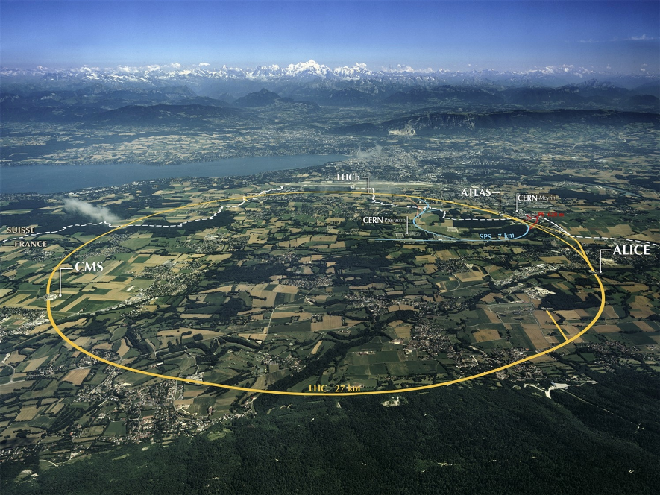
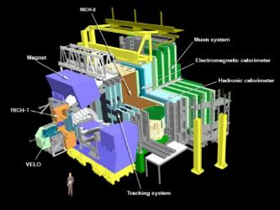
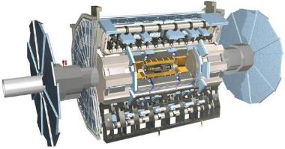
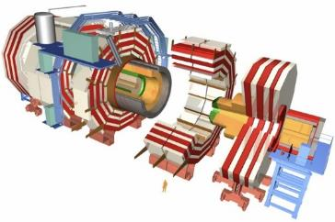
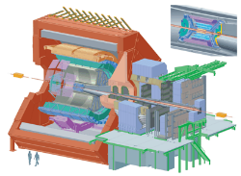
The Large Hadron Collider (LHC)

Slide 7
LHC Facts
Biggest accelerator (largest machine) in the world
Fastest racetrack on Earth
  Protons circulate at 99.9999991% the speed of light
Emptiest place in the solar system
  Pressure 10⁻¹³ atm (10x less than on the moon)
World’s largest refrigerator -271.3 °C (1.9K)
Hottest spot in the galaxy
  temperatures 100 000x hotter than the heart of the sun
  5.5 Trillion K
World’s biggest and most sophisticated detectors
Most data of any scientific experiment
  20-30 PB per year (as of today we have about 75 PB)

Slide 8
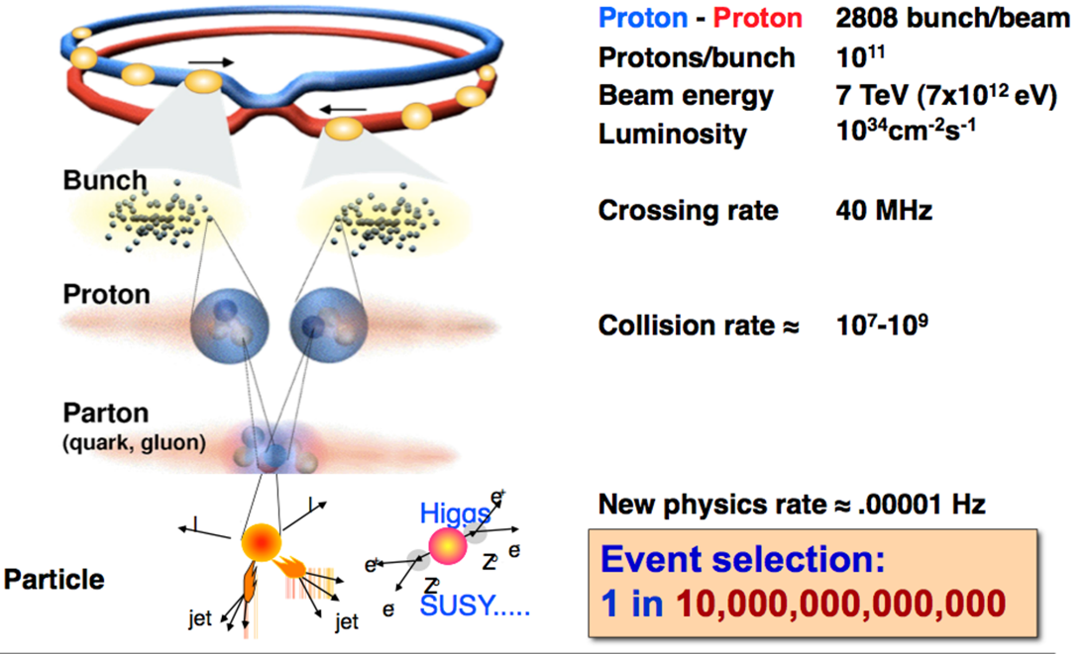
Collisions in the LHC

Slide 9
Computing and Data Challenges in HEP

Slide 10
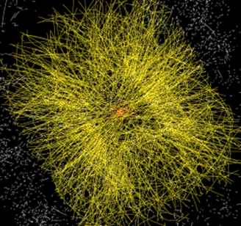
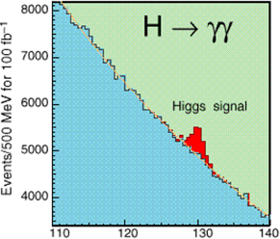
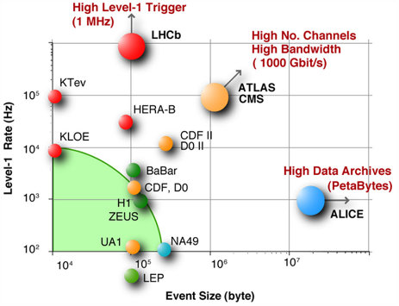
The LHC Challenges
Signal/Noise: 10⁻¹³ (10⁻⁹ offline)
Data volume
  High rate * large number of channels * 4 experiments
➔ ~30 PB of new data each year
Compute power
  Event complexity * Nb. events * thousands users
➔ 300 k CPUs
➔ 170 PB of disk storage
Worldwide analysis & funding
  Computing funding locally in major regions & countries
  Efficient analysis everywhere
  ~1.5M jobs/day, 150k CPU-years/year
➔ GRID technology

Slide 11
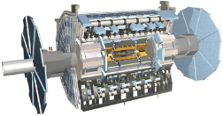
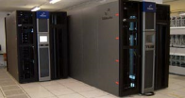
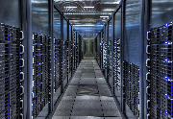



Data Handling and Computation
Online Triggers and Filters
Offline Reconstruction
Selection & reconstruction
Processed data (active tapes)
10%
(event summary)
Offline Analysis
Batch Physics Analysis
1%
100%
(raw data, 6 GB/s)
Event reprocessing
Offiine Simulation
Event simulation
Interactive Analysis

Slide 12
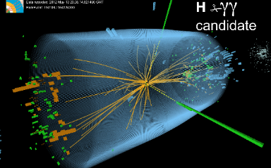
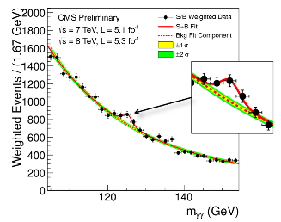
What is this data?
Raw data
  Was a detector element hit?
  How much energy?
  What time?
Simulated data
  Simulate particle collisions (hard interaction) according to a candidate theory
  Simulate interaction of primary and secondary particles with detector material
  Outcome: detailed response of the detector to a known “event”
Reconstructed data (derived from both of the above)
  Momentum of tracks (4-vectors)
  Origin
  Energy in clusters (jets)
  Particle type
  Calibration information
  Highest data complexity is here…
Analysis data (derived from RECO data)
  User or group specific data abstractions or selections
  Science happens here…

Slide 13
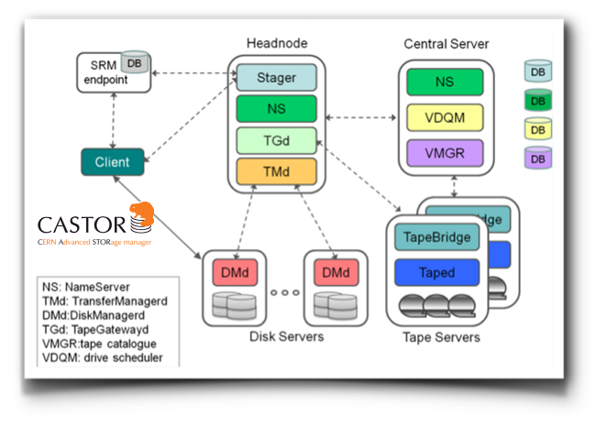
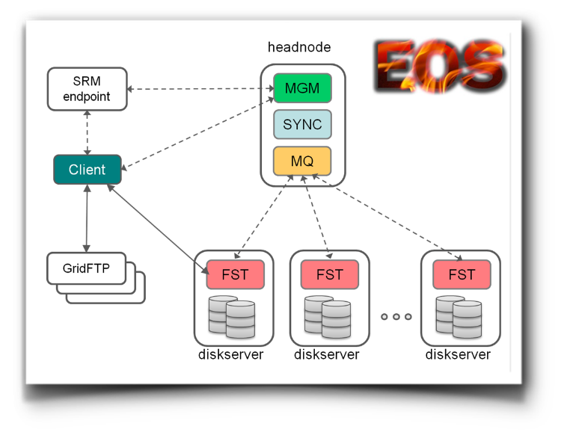
Data Storage
CASTOR and EOS
Storage Systems developed at CERN
CASTOR and EOS are using the same commodity disk servers
With RAID-1 for CASTOR (2 copies in the mirror)
JBOD with RAIN for EOS
Replicas spread over different disk servers
Tunable redundancy

Slide 14
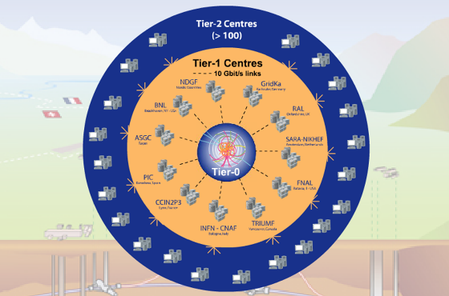
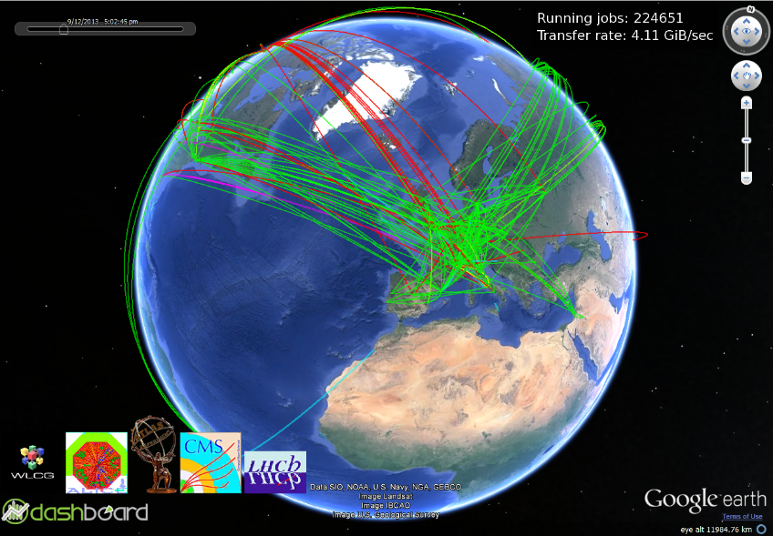
The Grid
Tier-0 (CERN):
Data recording
Initial data reconstruction
Data distribution
Tier-1 (11 centres):
Permanent storage
Re-processing
Analysis
Tier-2 (~130 centres):
Simulation
End-user analysis

Slide 15
New Requirements and Future Directions
(Big Data and Data Analytics)

Slide 16
LHC Schedule
2009
2010
2011
2011
2013
2014
2015
2016
2017
2018
2019
2020
2021
2022
2023
2024
…
2030?
First run
LS1
Second run
LS2
Third run
LS3
HL-LHC
LHC startup
900 GeV
Phase-0 Upgrade
(design energy,
nominal luminosity)
Phase-1 Upgrade
(design energy,
design luminosity)
Phase-2 Upgrade
(High Luminosity)
7 TeV
L=6x10³³ cm⁻²s⁻²
Bunch spacing = 50 ns
14 TeV
L=1x10³⁴ cm⁻²s⁻²
Bunch spacing = 25 ns
14 TeV
L=2x10³⁴ cm⁻²s⁻²
Bunch spacing = 25 ns
14 TeV
L=1x10³⁵ cm⁻²s⁻²
Spacing = 12.5 ns

Slide 17
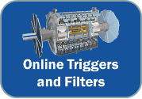
Online DAQ and Triggers
Most events produced in the detectors describe known physics
Only 1 in 10¹³ events are considered interesting now, but discarded raw data is lost forever
Filtering is done using two-level triggers, the first in HW (L1), the second in SW (HLT)
L1 triggers use complex custom processors, difficult to program, maintain and reconfigure
LS1, LS2 and LS3 require higher and higher data rates
Can the L1 run at the same rate as LHC?
Implement L1 in software
Replace HW triggers with commodity processors/co-processors (GPGPUs/XeonPhis?) → easier to program and upgrade/maintain
Long-term, merge L1 and HLT, need lots of fast, low-power, low-cost links
DAQ evolution
  multi Tbit transfers
  Close integration of network and CPUs
Rackscale architecture?

Slide 18

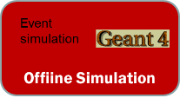
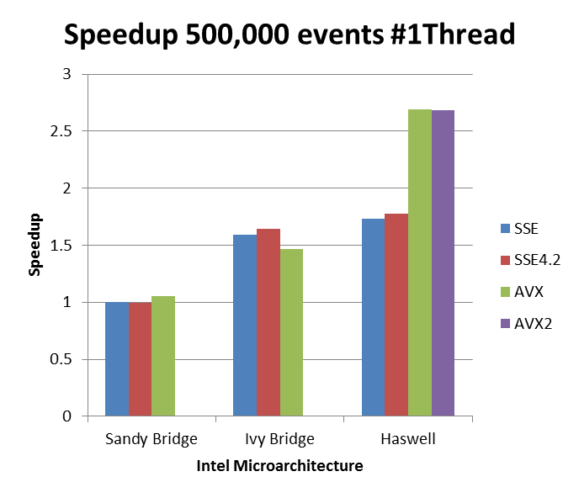
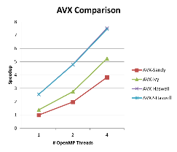
Multi-Core Platforms
Very high-level of parallelism, both online and offline
Parallelism exploited sending multiple independent computational jobs on separate physical or virtual nodes
Multiple physical cores partitioned across virtual machines
Current software not written to exploit multi-cores
Very important issue with detector simulations, very CPU intensive tasks
Exploit multi-core platforms using vectorization techniques
Build experience with data and task parallelism using Cilk and Haswell (CilkPlus and GCC)
Requires rewriting the software → Geant 5

Slide 19
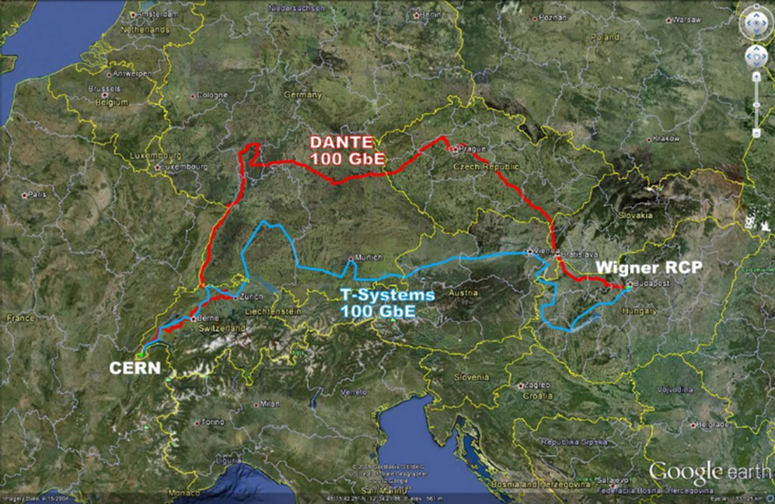
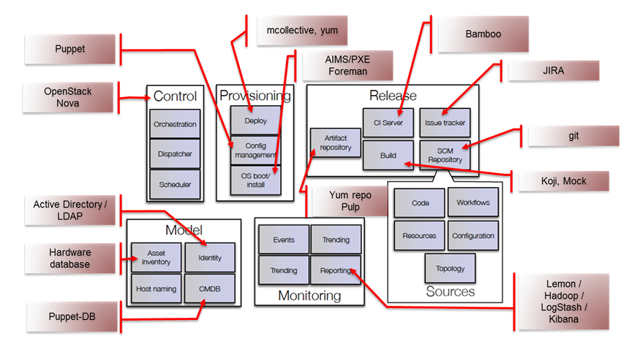
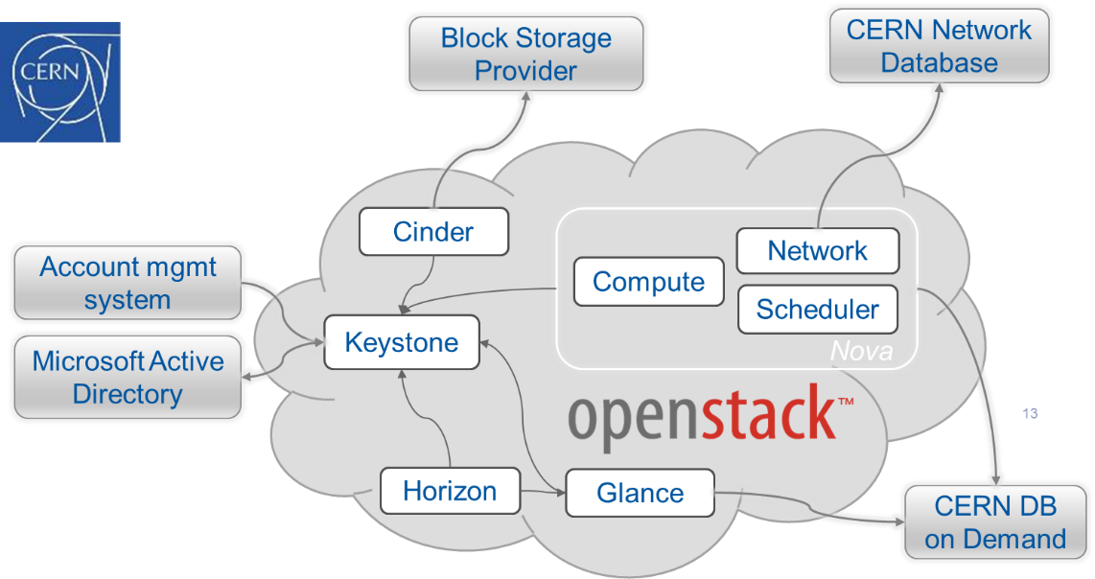
Cloud Infrastructure
New CERN Computer Centre
  Two 100GB lines, one academic, one commercial
  Additional capacity, redundancy
  Remote management, dynamic provisioning
No increase in staff, decrease in budget

Slide 20

Cloud Storage
Data storage is critical
  Currently 75/100 PB tapes, 25/40 PB disk, getting close to max capacity
Need to be able to scale both predictably (planning) and dynamically (peak times)
Can industrial cloud storage deliver the required quality of service maximizing Reliability, Performance and Cost at the same time?
Partership CERN/IT & Huawei (S3 Storage Appliance, 0.8 PB, 1 year)
Shared areas of investigations
  Reliability (100% despite disk failures)
  Functional tests on Amazon S3 protocol and interoperability with Grid production environments (tested ok)
  Performance measurements with sparse data read (comparable to existing LHC production systems)
  Total Cost of Ownership (TCO): clear model, no hidden costs found
References used for comparison
  Open Source self assembled solutions (based on openstack / swift)
  Traditional Intel-based file server based on Linux operating system and locally attached disks
Expensive
Flash, Solid State Disks
Premium filers, SANs, …
Tapes
Disks
Slow
(latency)
Unreliable

Slide 21
Data Analytics
Massive amounts of data from
  The LHC data processing
But also
  The LHC subsystems
    Magnets
    Cryogenics
    Control systems
    Electrical systems
  Logging data and alerts
How can the data be analyzed efficiently to find patterns or detect problems at early stages?
Investigations of
  Physics data analysis in databases exploiting columnar DBs (Oracle Exadata)
  Hadoop and MapReduce techniques
  Physics event indexing, filtering and searching
    Machine Learning techniques

Slide 22
Scientific Collaborations

Slide 23







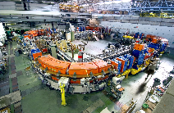


International Scientific Collaborations
Many scientific projects are global collaborations of 100s of partners
Efficient computing and data infrastructures have become critical as the quantity, variety and rates of data generation keep increasing
Funding does not scale in the same way
  Optimization and sharing of resources
Collaboration with commercial IT companies increasingly important
  Requirements are not unique anymore
CERN Biomedical Facility

Slide 24







Scientific Computing as a Service
An on-demand computing and data analysis service
Unique IDs and formal relationships among digital objects (publications, datasets, software, people identities)
Reproducibility and preservation
Results attribution and recognition
Researchers
Applications
Discovery
Software
Repos and Registries
Datasets
Scientific results
Publications
Patents
Reproducibility
Preservation
Authorship
Citations
on-demand
SCaaS
“Click ’n’ cite”
Registration
Developers

Slide 25
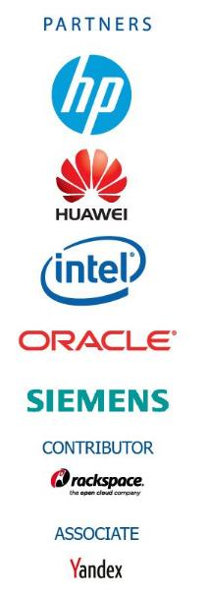
CERN openlab in a nutshell
A science – industry partnership to drive R&D and innovation with over a decade of success
Evaluate state-of-the-art technologies in a challenging environment and improve them
Test in a research environment today what will be used in many business sectors tomorrow
Train next generation of engineers/employees
Disseminate results and outreach to new audiences

Slide 26
CERN openlab recipe: key ingredients
The extreme demands from CERN’s scientific programme
The alignment of goals between partners
Trust
Young researchers with their talents, expertise and energy
Efficient and lightweight structure
Regular checkpoints/reviews
Outreach/communications/training

Slide 27
ICE-DIP: Intel CERN European Doctorate Industrial Program
The project starts today: CERN will recruit the 5 PhD students on 3 year fellowship contracts in autumn 2013
Each PhD student will be seconded to Intel for 18 months
Will work with LHC experiments on future upgrade research themes:
usage of many-core processors for data acquisition
future optical interconnect technologies
reconfigurable logic
data acquisition networks
Associate partners: Nat. Univ. Ireland Maynooth & Dublin City Univ. (recruits will be enrolled in PhD programmes), Xena Networks (SME, Denmark)
EC funding: ~ €1.25 million over 4 years

Slide 28
Conclusions
CERN and the LHC program have been among the first to address “big data” challenges
Solutions have been developed and important results obtained
However, not unique anymore in both scientific and consumer applications
Need to exploit emerging technologies and share expertise with academia and commercial partners
LHC schedule will keep it at the bleeding edge of technology, providing excellent opportunities to companies to test ideas and technologies ahead of the market

Slide 29
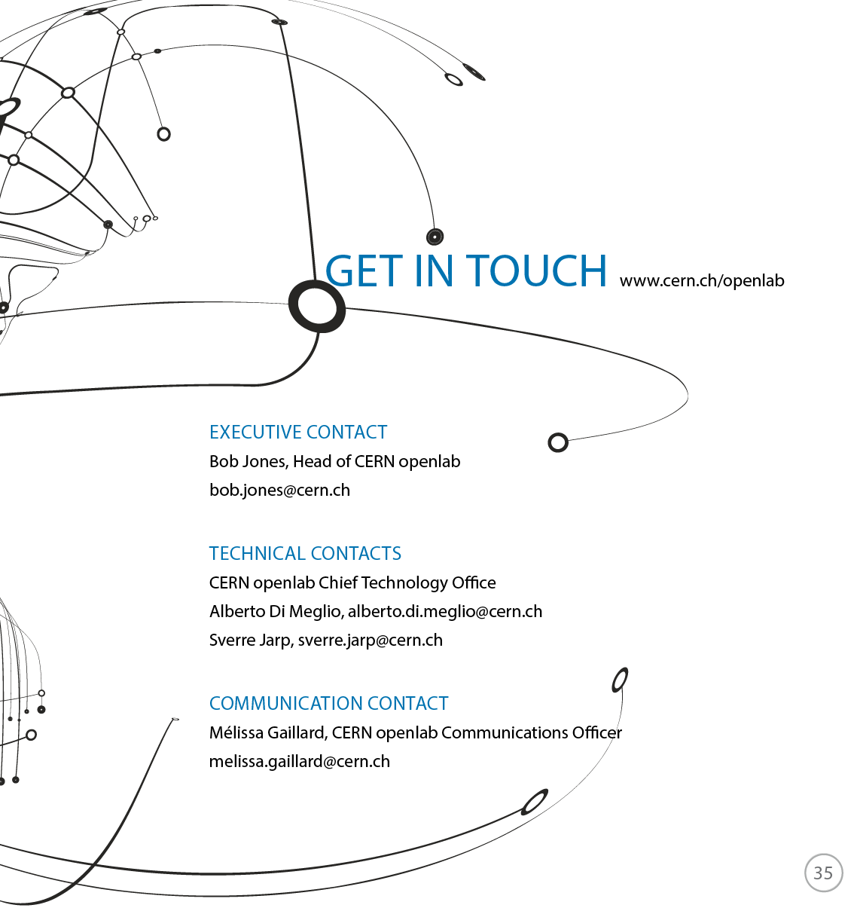
This work is licensed under a Creative Commons Attribution-ShareAlike 3.0 Unported License. It includes photos, models and videos courtesy of CERN and uses contents provided by CERN and CERN openlab staff

