Slide 1
ALFA: Next generation concurrent framework for ALICE and FAIR experiments
Mohammad Al-Turany
GSI-ExpSys/CERN-PH

Slide 2
This Talk
Introduction:
GSI/FAIR : Research and Experiments
Computing at GSI/FAIR
Green Cube
FairRoot
ALICE-FAIR (ALFA) General concept
Project with OpenLab

Slide 3
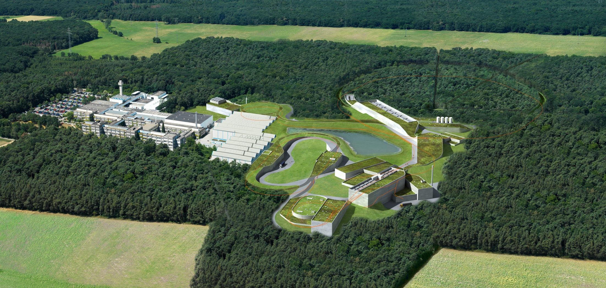
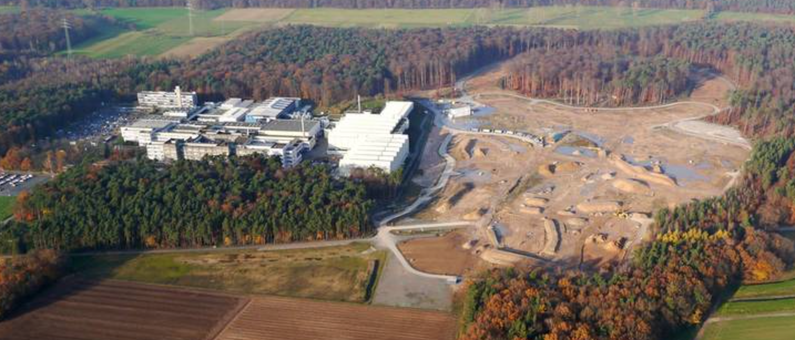

Slide 4
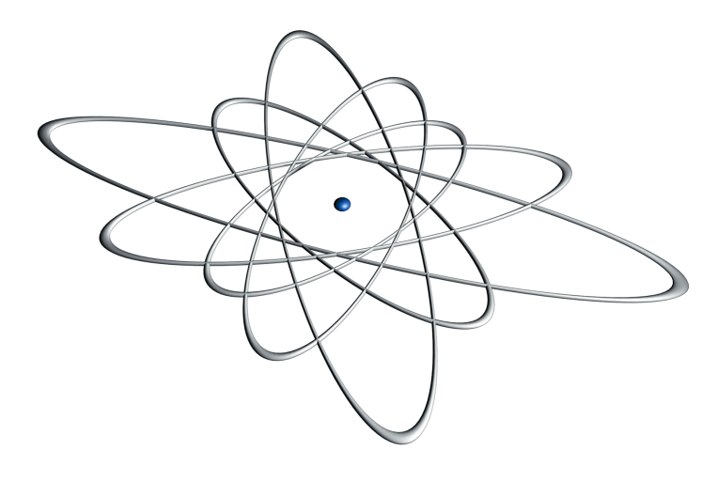
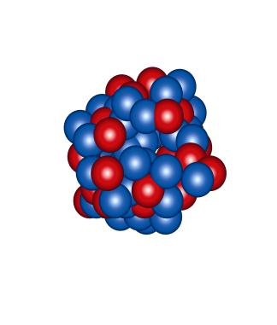
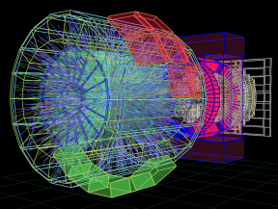
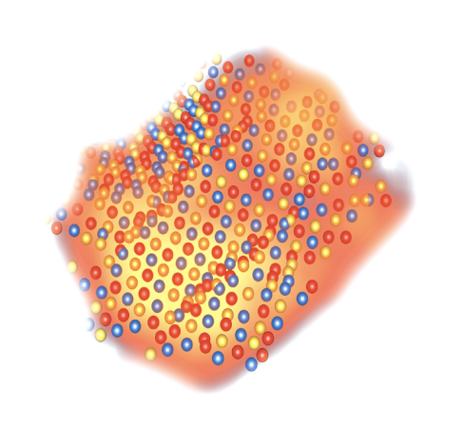
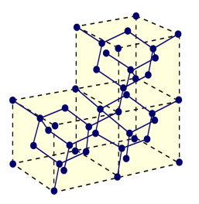
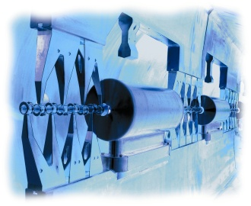
Research Areas at GSI
Nuclear Physics
Nuclear reactions
Superheavy elements
Hot dense nuclear matter
Atomic Physics
Alice
Atomic Reactions
Precision spectroscopy of highly
charged ions
Biophysics and radiation medicine
Radiobiological effect of ions
Cancer therapy with ion beams
Plasma Physics
Hot dense plasma
Ion-plasma-interaction
Materials Research
Accelerator Technology
Ion-Solid-Interactions
Structuring of materials with ion
beams
Linear accelerator
Synchrotrons and storage
rings

Slide 5
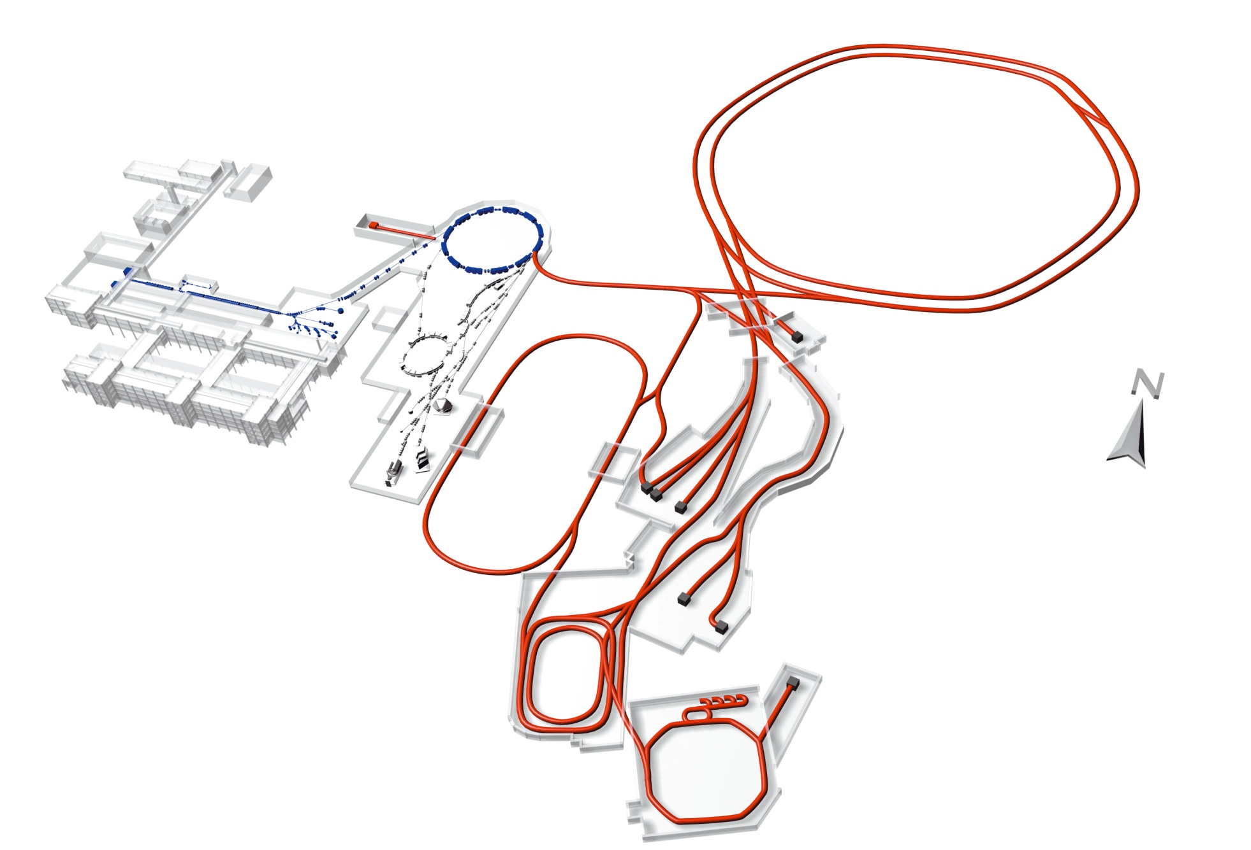
FAIR - Facility for Antiproton and Ion Research
Added value
Today
Higher beam intensity
Higher beam energy
Anti-matter beams and experiments
Unique beam quality by beam cooling measures
Parallel operation
SIS 100/300
UNILAC
SIS 18
ESR
Cost,user community
Construction cost > 1 Billion Euro
Scientific Users: appr.2500 - 3000 per year
HESR
Super
FRS
Funding (Construction)
65 % Federal Republic
10 % State of Hesse
25 % International Partners
CR
RESR
100 m
Future Facility
NESR

Slide 6
Experiments at FAIR/GSI
Heavy ion physics
CBM
Hadron physics
PANDA
Nuclear structure and astrophysics
(NUSTAR)
Super-FRS
HISPEC / DESPEC
MATS
LASPEC
R3B
Atomic physics, plasma physics and applied physics (APPA)
SPARC
FLAIR
HEDgeHOB
WDM
BIOMAT
Each collaboration may involve a few dozen or a few hundred scientists. Some experiment set-ups are small, others will cost ca. 80 million euros.
ILIMA
AIC
ELISe
EXL

Slide 7
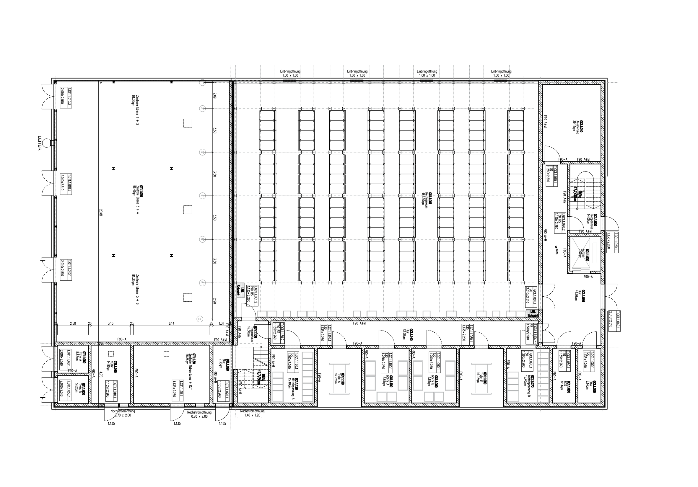
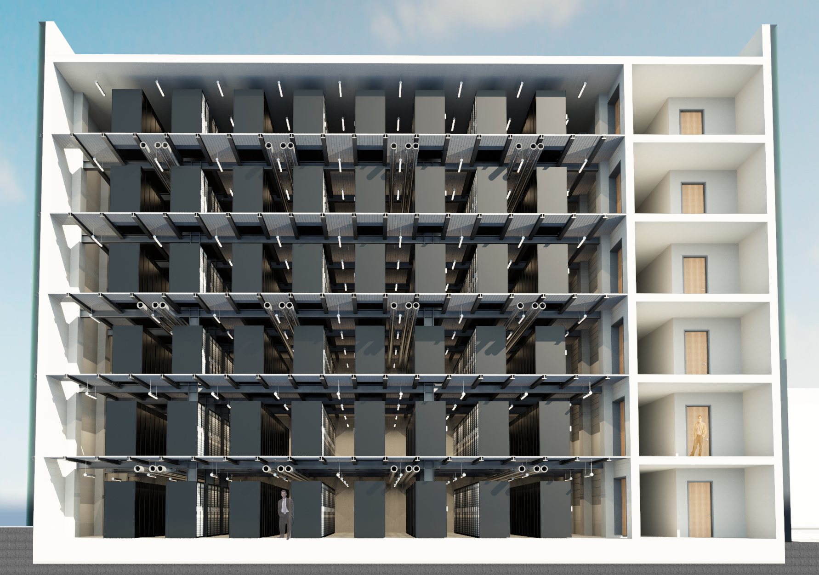
The FAIR Data Center (Green Cube)
Space for 768 19” racks (2,2m)
4 MW cooling (baseline)
Max cooling power 12 MW
Can be used for any commercial IT
PUE <1.07
Baseline building cost 12 M€
Notes:
Höchst Effizientes RZ in Planung bei GSI

Slide 8
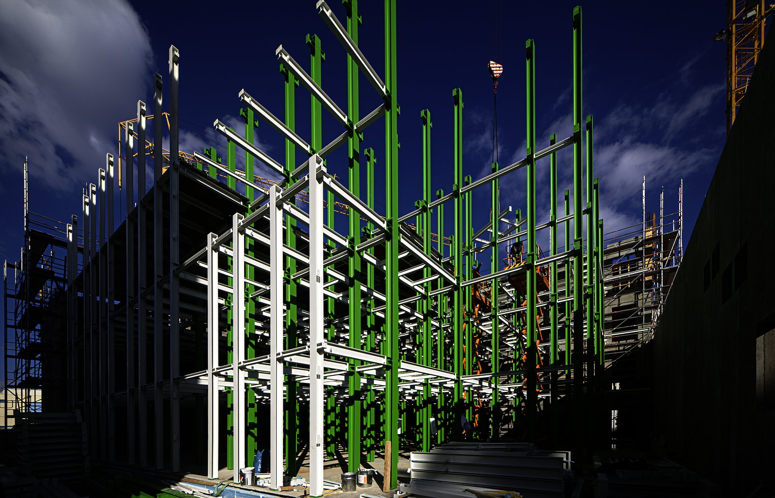
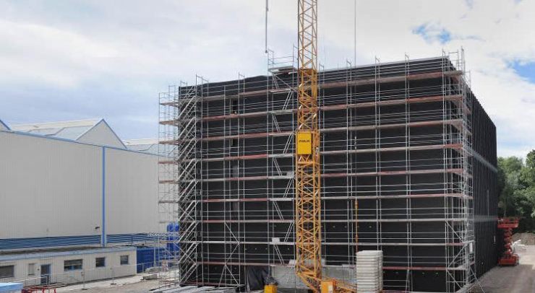
Green Cube
Construction started in Dec 2014
On schedule for start of operation in Q4/2015

Slide 9
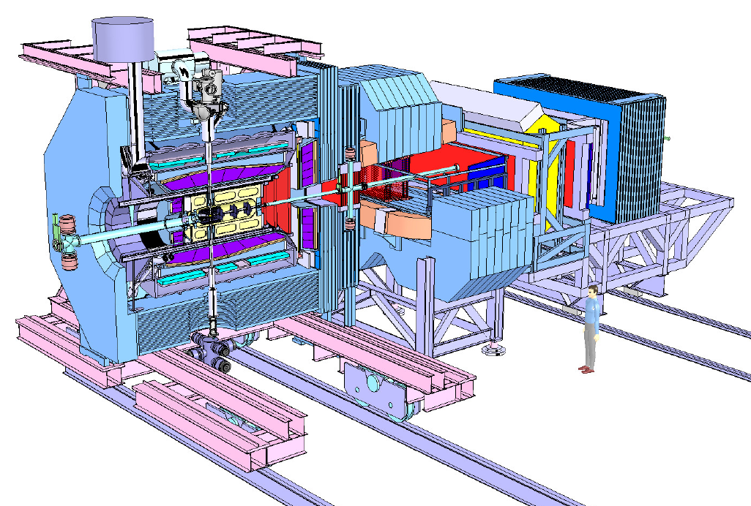
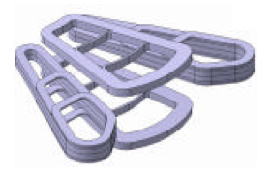
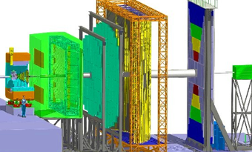
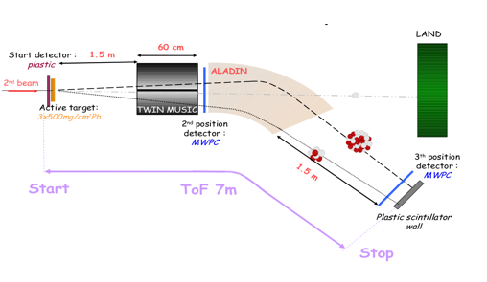
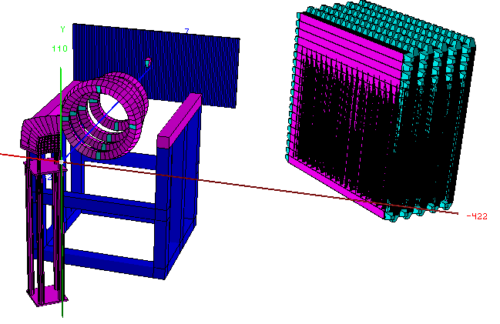
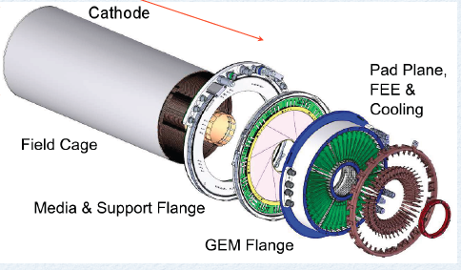
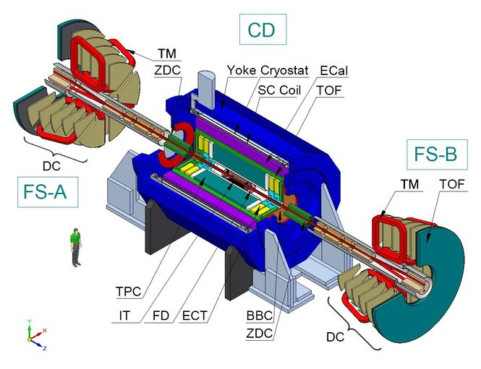
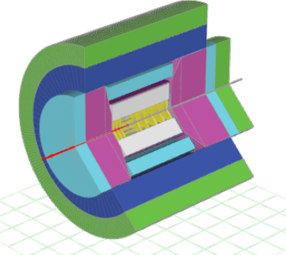
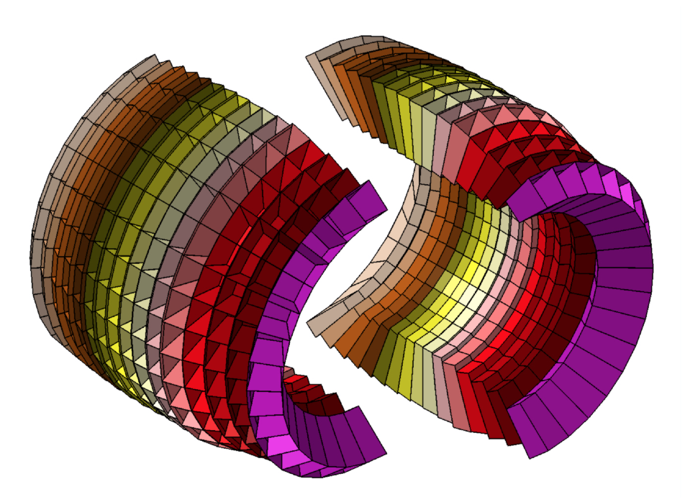
FairRoot Framework
https://github.com/FairRootGroup/FairRoot

Slide 10
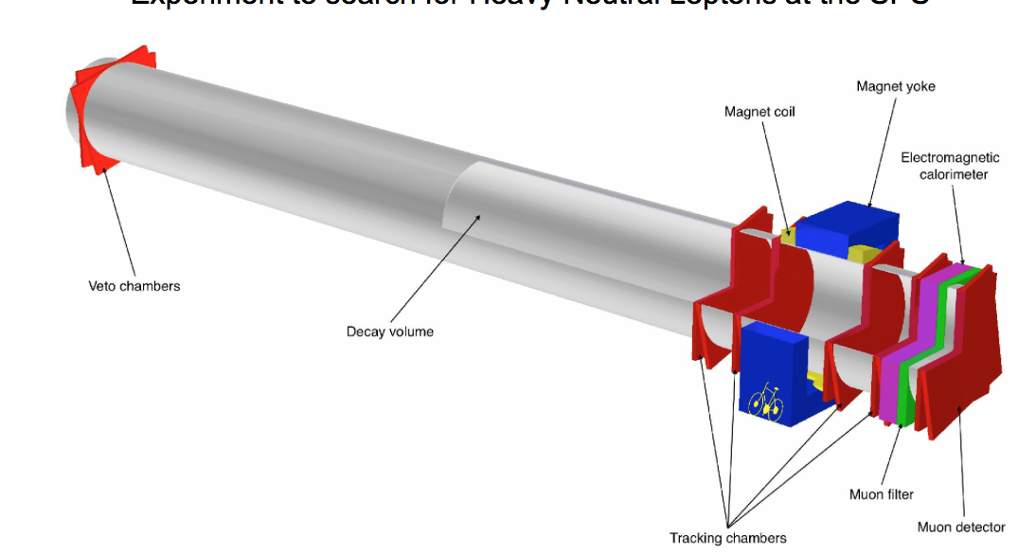
FairRoot
Start testing the VMC concept for CBM
Panda decided to join->
FairRoot: same Base package for different experiments
EIC (Electron Ion Collider BNL)
EICRoot
R3B joined
SOFIA (Studies On Fission with Aladin)
SHIP - Search for HIdden Particles
2004
2006
2010
2011
2012
2013
2014
First Release of CbmRoot
MPD (NICA) start also using FairRoot
GEM-TPC seperated from PANDA branch (FOPIRoot)
ENSAR-ROOT
Collection of modules used by structural nuclear phsyics exp.
ASYEOS joined
(ASYEOSRoot)

Slide 11
ALICE and FAIR: Why?
Two projects – same requirements
Massive data volume reduction (1 TByte/s input)
Data reduction by (partial) online reconstruction
Online reconstruction and event selection
Much tighter coupling between online and offline reconstruction software
Lets work together

Slide 12
ALFA
A tools set library that contains:
Transport layer (FairMQ, based on: ZeroMQ, nanomsg)
Configuration tools
Management and monitoring tools
….
A data-flow based model (Message Queues based multi-processing ).
Provide unified access to configuration parameters and databases.

Slide 13
Scalability through multi-processing with message queues?
Each process assumes limited communication and reliance on other processes.
No locking, each process runs with full speed
Easier to scale horizontally to meet computing and throughput demands (starting new instances) than applications that exclusively rely on multiple threads which can only scale vertically.

Slide 14
Correct balance between reliability and performance
Multi-process concept with message queues for data exchange
Each "Task" is a separate process, which:
Can be multithreaded, SIMDized, …etc.
Can run on different hardware (CPU, GPU, XeonPhi, …etc.)
Be written in an any supported language (Bindings for 30+ languages)
Different topologies of tasks can be adapted to the problem itself, and the hardware capabilities.

Slide 15
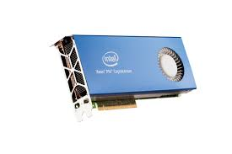
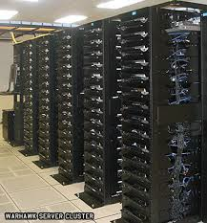
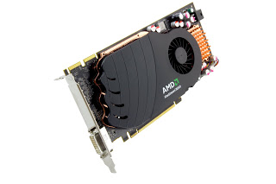
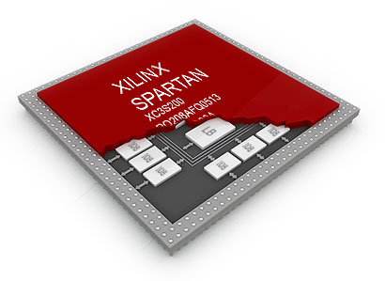
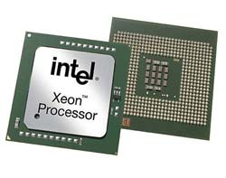
ALFA uses FairMQ to connect different pieces together
FairMQ
FairMQ
nanomsg

Slide 16
Co-Processors in ALFA
Up to now:
Offload portions of code to the co-processors
GPUs, FPGAs and Xeon Phi support this mode of operation

Slide 17
GPUs in ALFA
Ludovico BIANCHI
http://indico.cern.ch/event/304944/session/1/contribution/363

Slide 18
Xeon Phi
Aram SANTOGIDIS
http://indico.cern.ch/event/304944/session/9/contribution/27

Slide 19
Xeon Phi & FairMQ
Aram SANTOGIDIS
Work is ongoing on a transport mechanism on top of SCIF that can be integrated in FairMQ (ZeroMQ and nanomsg)
A direct support of SCIF in FairMQ will improve the data transport performance from/to Xeon Phi tremendously
The solution developed for Knights Corner will be ported in the future to Knights Landing and Omni-Path.

Slide 20
Future Plans
Porting compute-intensive code to Xeon Phi and use them via traditional offloading (the message handling will be exclusively done on the host)
As soon as the direct support of SCIF in FairMQ becomes available, the prospects of using messages directly for communication with the accelerator cards will be investigated

Slide 21
Backup

Slide 22
Integrating ALICE-HLT code into ALFA
http://indico.cern.ch/event/304944/session/1/contribution/439
Matthias RICHTER

Slide 23
Results
Aram SANTOGIDIS
http://indico.cern.ch/event/304944/session/9/contribution/27

Slide 24
Heterogeneous Platforms: Message format
The framework does not impose any format on messages.
It supports different serialization standards
BOOST C++ serialization
Google’s protocol buffers
ROOT
User defined

Slide 25
How to deploy ALFA on a laptop, few PCs or a cluster?
DDS: Dynamic Deployment System
Users describe desired tasks and their dependencies using topology files
The system takes so called “topology file” as the input.
Users are provided with a WEB GUI to create topology (Can be created manually as well).

Slide 26
DDS: Basic concepts
Implements a single-responsibility-principle command line tool-set and APIs,
Treats users’ tasks as black boxes,
Doesn’t depend on RMS (provides deployment via SSH, when no RMS is present),
Supports workers behind FireWalls,
Doesn’t require pre-installation on WNs (Worker nodes),
Deploys private facilities on demand with isolated sandboxes,
Provides a key-value properties propagation service for tasks,
Provides a rules based execution of tasks.
...
http://dds.gsi.de

Slide 27
Tests of ALFA devices via DDS
Devices (user tasks) | startup time* | propagated key-value properties
2721 (1360 FLP + 1360 EPN + 1 Sampler) | 17 sec | ~ 6x10⁶
5441 (2720 FLP + 2720 EPN + 1 Sampler) | 58 sec | ~ 23x10⁶
10081 (5040 FLP + 5040 EPN + 1 Sampler) | 207 sec | ~ 77x10⁶
FLP(First Level Processer), EPN (Event Processor Event)
N –To-N connections
Each EPN need to connect to each FLPs (Time frame building)
Each FLP need to connect to all EPNs (Heartbeat signal)
Throughout tests only one DDS commander server was used. In the future we will support multiple distributed servers.
Our current short term target is to manage 100K devices and keep startup time of the whole deployment within 10-50 sec.
* startup time - the time which took DDS to distribute user tasks, to propagate all needed properties, plus the time took devices to bind/connect and to enter into RUN state.

Slide 28
ALFA and FairRoot
AliRoot6 (O²)
CbmRoot
R3BRoot
SofiaRoot
MPDRoot
ShipRoot
PandaRoot
AsyEosRoot
FopiRoot
EICRoot
ALFA
FairRoot
????
DDS
Building configuration
Testing
Fair MQ
MC Application
Module
Detector
Magnetic Field
Event
Generator
Runtime DB
Libraries and Tools
Protocol Buffers
BOOST
ROOT
ZeroMQ
CMake
Geant4
Genat4_VMC
Geant3
VGM
…

Slide 29
Data Center State of the Art
Electrical
Light, etc.
Power
3%
UPS
10%
IT Equipment
Total Facility Power
Data Center
Cooling 12%
50%
PUE =
IT Equipment Power
Power Usage Effectiveness
Back
Cooling
25%
PUE = 2
(typical PUE = 1,6 to 3,5)
Note: 12C/kWh → 1W = 1,05€/a
Source: EYP Mission Critical Facilities Inc., New York
Volker Lindenstruth (www.compeng.de) May 22, 2012— Copyright ©, Goethe Uni, Alle Rechte vorbehalten
Volker Lindenstruth (www.compeng.de) May 22, 2012— Copyright ©, Goethe Uni, Alle Rechte vorbehalten
Notes:
Die PR PUE Story – Watt = Euro/a

