Slide 1
Big Data and Big Science
Alberto Di Meglio
CERN openlab CTO
DOI: 10.5281/zenodo.8616

Slide 2
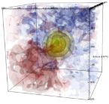
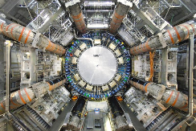
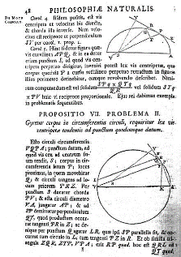
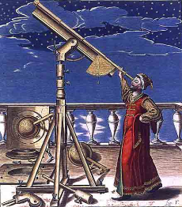
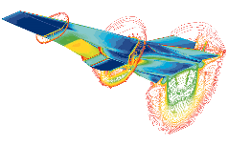
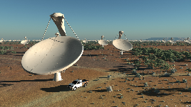
Scientific Research Paradigms
4000 years
500 years
~50 years
Today
1 – Empirical observations
2 - Generalization
Theoretical models
3 - Simulations
Computational sciences
4 - Data-driven science
eScience

Slide 3
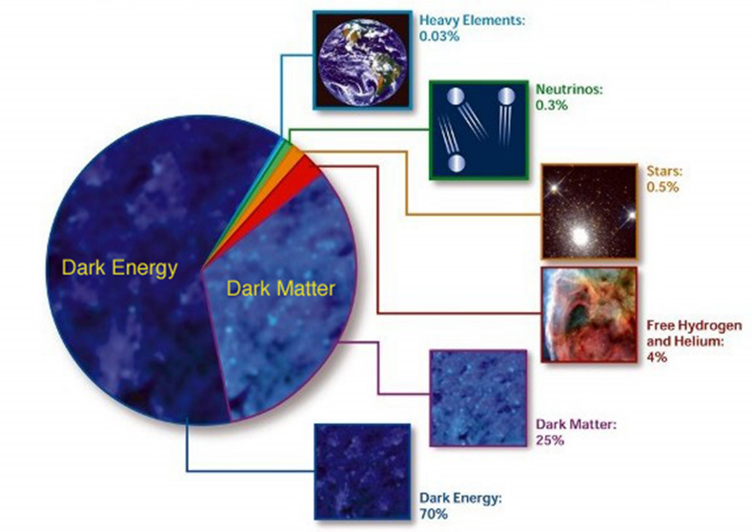
What is the Universe made of?
What gives the particles their masses?
How can gravity be integrated into a unified theory?
Why is there only matter and no anti-matter in the universe?
Are there more space-time dimensions than the 4 we know of?
What is dark energy and dark matter which makes up 95% of the universe ?

Slide 4
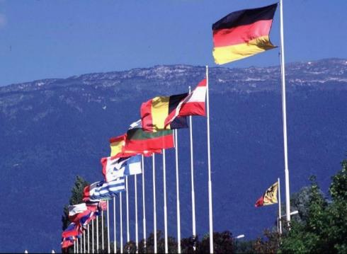
What is CERN?
European Organization for Nuclear Research
~ 2300 staff
~ 1050 other paid personnel
~ 11000 users
Budget (2012) ~1100 MCHF
Founded in 1954 – 60th Anniversary Celebration!
21 Member States: Austria, Belgium, Bulgaria, Czech Republic, Denmark, Finland, France, Germany, Greece, Hungary, Israel, Italy, Netherlands, Norway, Poland, Portugal, Slovakia, Spain, Sweden, Switzerland and United Kingdom
Candidate for Accession: Romania
Associate Members in the Pre-Stage to Membership: Serbia, Ukraine, (Brazil, Cyprus)
Applicant States: Slovenia
Observers to Council: India, Japan, Russia, Turkey, United States of America, the European Commission and UNESCO

Slide 5
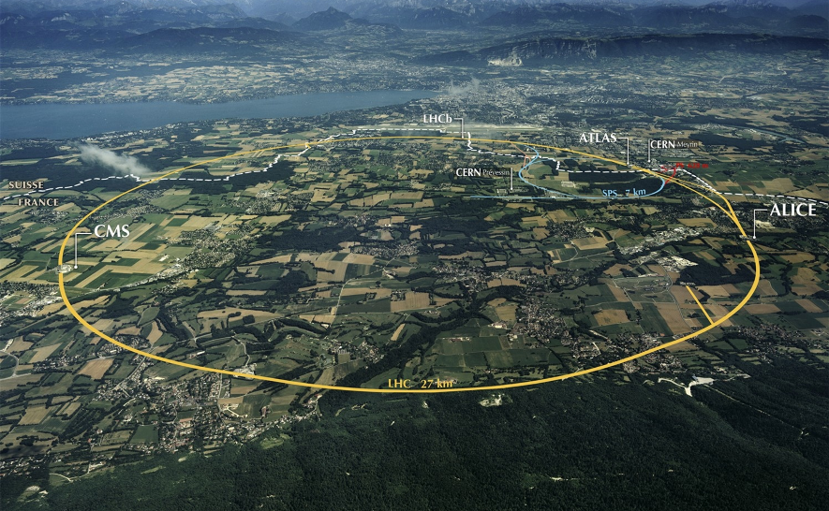
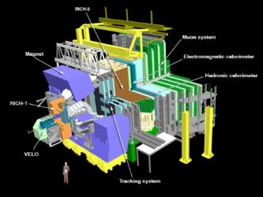
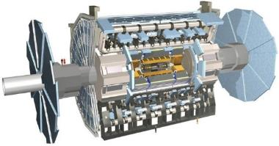
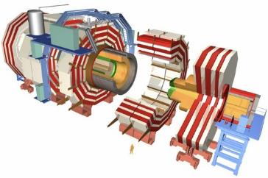
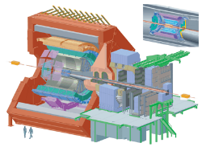
The Large Hadron Collider (LHC)

Slide 6
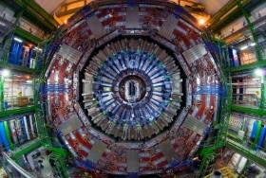
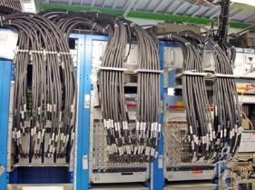
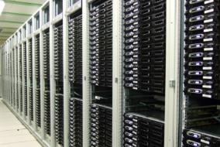
Big Data !
Detectors: 7000 tons “microscopes”
150 million sensors
Select 40 million times per second
➔ Peta Bytes / sec !
Level-1 Filters (Triggers)
Select 100,000 times per second
➔ Tera Bytes / sec !
High-Level Filters
Select 100 times per second
➔ Giga Bytes / sec !

Slide 7
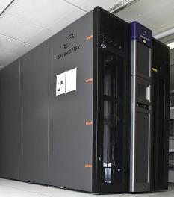
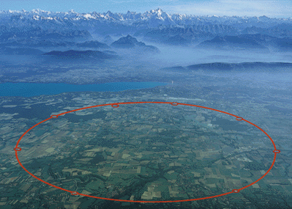
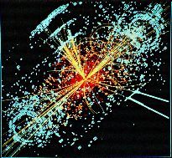
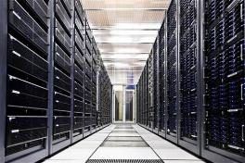
Storage, Reconstruction, Simulation, Distribution
6 GB/s

Slide 8
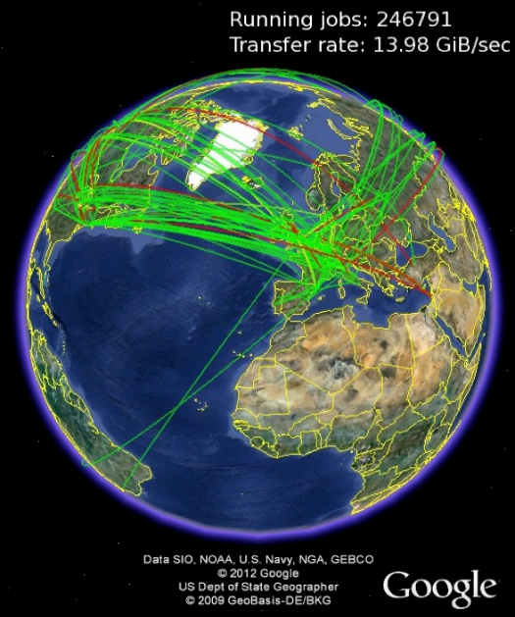
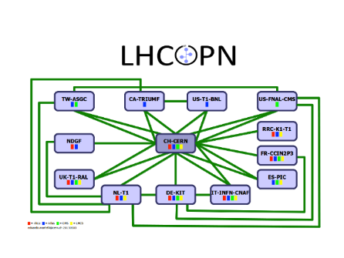
Worldwide LHC Computing Grid
Tier-2s
140 Sites
Tier-1s
12 Sites
350,000 Cores

Slide 9
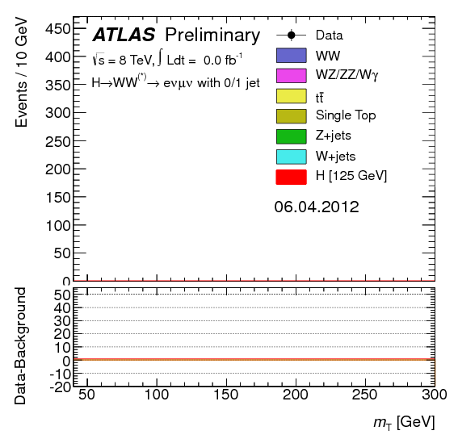
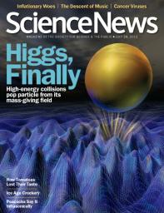
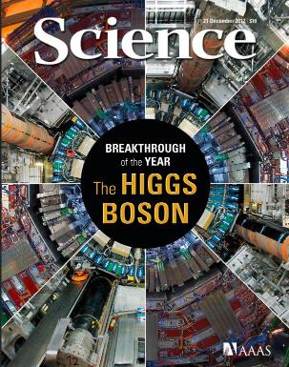
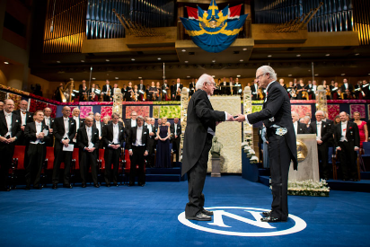
The Higgs Boson

Slide 10
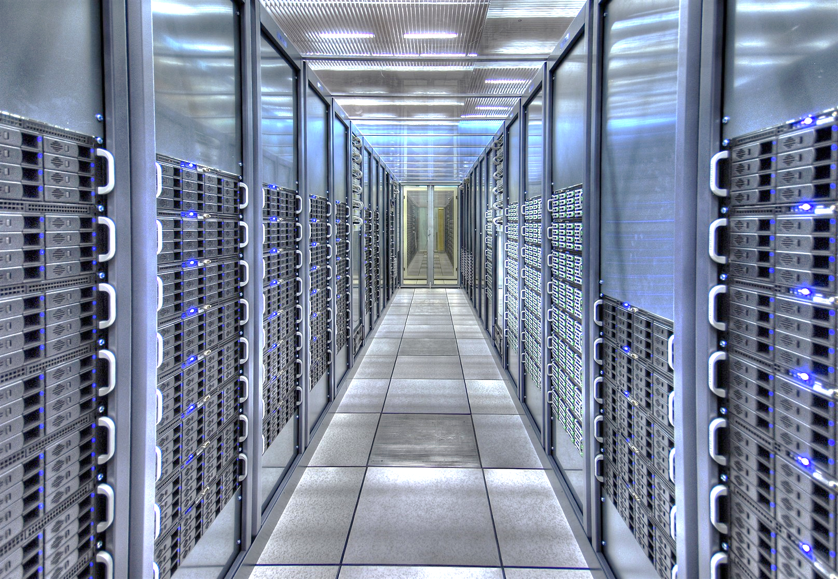
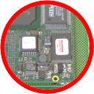
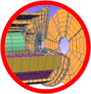
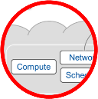
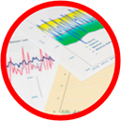
Information Technology Research Areas
Data acquisition and filtering
Multi-core CPUs, GPGPUs, optimized software
Computing platforms, data analysis, simulation
Data storage, distribution, preservation
Cloud computing and storage
Compute provisioning
Networks
SDN
Data analytics
Data analytics

Slide 11
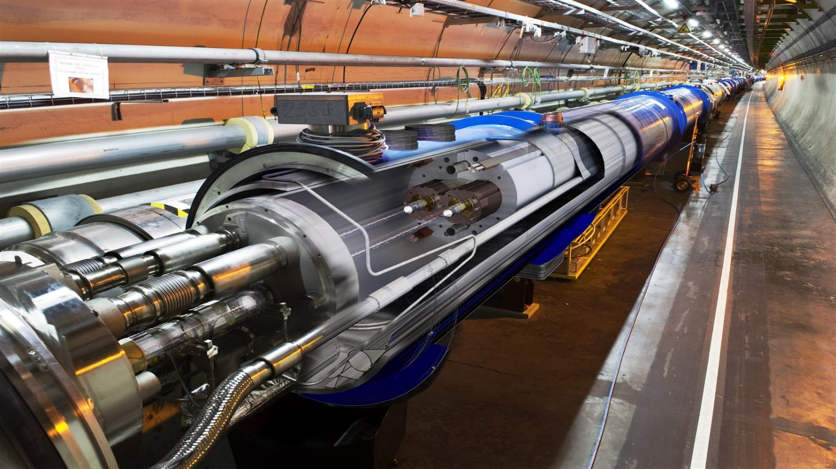
New professional profiles
Multicore CPU programming, graphical processors (GPU),
multithreaded
software
Data analysis platforms,
statistics, mathematics,
Data visualization and presentation,
(familiarity with HEP)
Applications of physics to medical research (hadron therapy, etc.)
Software & Computing Engineers
Data Scientists
Multidisciplinary applications

Slide 12
CERN openlab in a nutshell
A science – industry partnership to drive R&D and innovation with over a decade of success
Evaluate state-of-the-art technologies in a challenging environment and improve them
Test in a research environment today what will be used in many business sectors tomorrow
Train next generation of engineers/employees
Disseminate results and outreach to new audiences

Slide 13
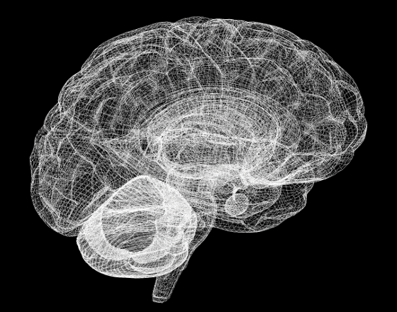
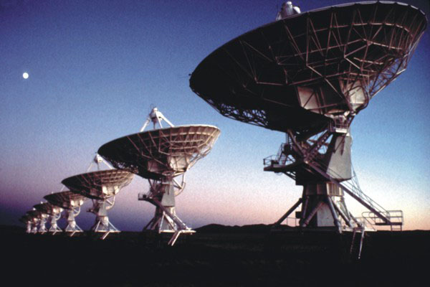
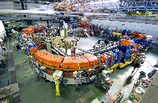
Public-Private Collaborations
New partners

Slide 14
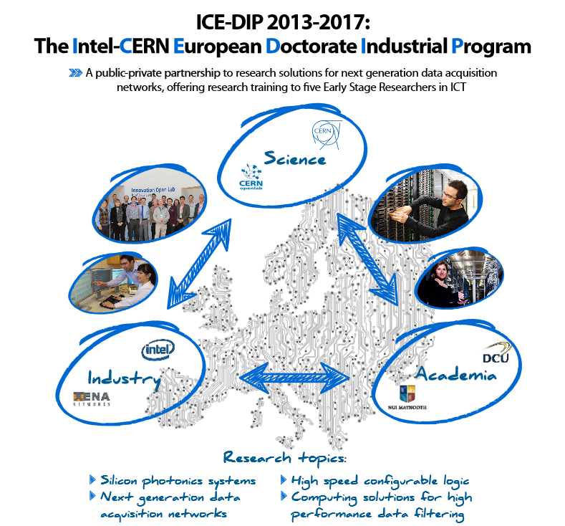
CERN has recruited 5 PhD students on 3 year fellowship contracts starting autumn 2013
Each PhD student is seconded to Intel for 18 months and works with LHC experiments on future upgrade research themes
Associate partners: Nat. Univ. Ireland Maynooth & Dublin City Univ. (recruits are enrolled in PhD programmes), Xena Networks (SME, Denmark)
EC funding: ~ €1.25 million over 4 years

Slide 15
This work is licensed under a Creative Commons Attribution-ShareAlike 3.0 Unported License. It includes photos, models and videos courtesy of CERN and uses contents provided by CERN and CERN openlab

