Slide 1
My career path
29/05/2014
Grzegorz Jereczek

Slide 2


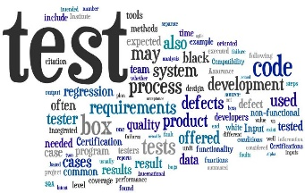


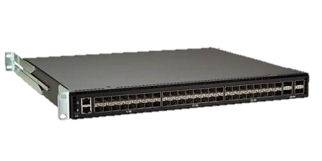

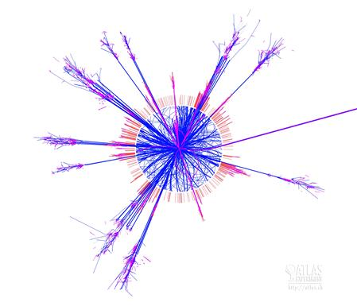


My career path is rather short…
http://www.techspotters.co.uk/
Graduation ’10
Intel ’11
http://www.waveguide.com/
Doctorate ’13
…but moves dynamically

Slide 3
Looking backward…
Challenges
  Change microwave for network software engineering
  Abandon the stabilized lifestyle for a PhD
Successes
  Quick adaptation to new
  projects and roles
  Path from validation through development to pure research in 3 years

Slide 4
At Intel I appreciate…
  Collaboration within the projects
The People
  Managerial support and trust
  Sharing the expertise

Slide 5
To be successful at Intel…
Risk
  Don’t be afraid to take it
Opportunities
  Just use them
Learn
  From the smarter than you

