Slide 1


Sequential data access with Oracle and Hadoop: a performance comparison
Zbigniew Baranowski
Luca Canali
Eric Grancher

Slide 2

Outline
Motivation
Test setup
Results
Summary

Slide 3
Outline
Motivation
Test setup
Results
Summary

Slide 4


Motivation for testing
Relational model sometimes is not optimial for
  data analytics
  very big data volumes
Why?
  transaction-support features of relational database engines are not used for these workloads
  table joins don’t scale well for large tables
  indexes can waste a lot of storage
    and be less efficient than full scans
  e. g. ATLAS Events Metadata catalogue
Full data scans (brute force) work best!
Notes:
There are number of application like ATLAS Events Metadata ATLAS DQ2 (Don Quijote or DQ, is the data management service for the ATLAS Production System. Using Don Quijote users can locate replicas of files, add, remove or modify both logical and physical entries in grid replica catalogs. In addition a transfer service is provided to replicate files between storage locations as well as query each grid information system regarding data storage facilities.)

Slide 5

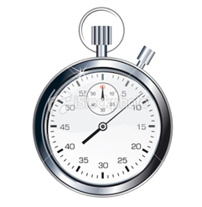
What do we want to test?
Full Scan
?

Slide 6
Comparing apples to apples
Comparable test for Hadoop and Oracle
  simple data structure (same content)
  simple data access (full and sequential)
  same hardware
Application
Application
?
Map Reduce
Oracle RDBMS
Oracle I/O interface
Hadoop
I/O interface
Hardware
Hardware

Slide 7
Why Hadoop?
Emerging technology…
  Yahoo, Google (BigTable/GFS)
… that people are interested in
  ATLAS…
    poster P4.29
Strong for data analytics and data warehousing
  On this field Oracle can be hard to optimize and/or can be very expensive (Exadata)

Slide 8
Why Oracle?
30 years at CERN
  a lot of data already in Oracle
Full ACID transactional system
Optimized for various data access methods

Slide 9


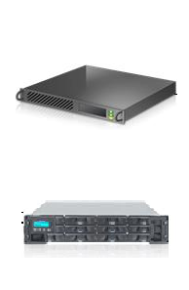

Hardware architecture
Shared Storage
Shared Nothing
Interconnect
Node 1
Node 2
Node n
Interconnect
Storage 1
Storage 2
Storage n
Interconnect
Node 1
Node 2
Node n

Slide 10
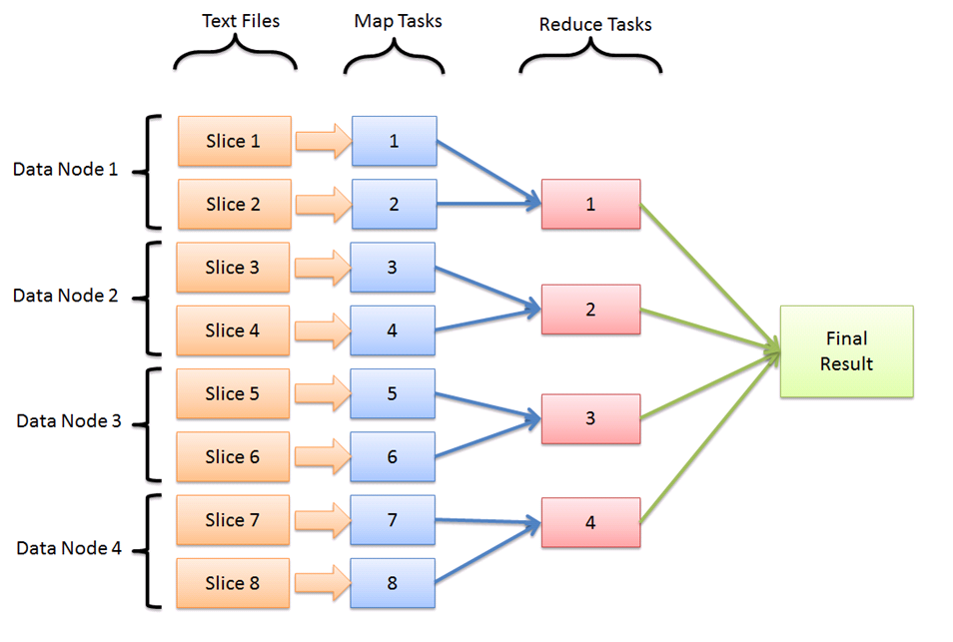

Software architecture
Map Reduce

Slide 11

Software architecture
Oracle Parallel Query
Reading and filtering
Parallel Executors #1
Grouping and counting
Parallel Executors #2
Aggregation
Parallel Coordinator
Table
1
1
Blocks set #1
2
2
Blocks set #2
1
Blocks set #3
3
3
Blocks set #4
4
4
Final result
Blocks set #5
5
5
Degree Of Parallelism = 5
Notes:
Rotate

Slide 12
Outline
Motivation
Test setup
Results
Summary

Slide 13
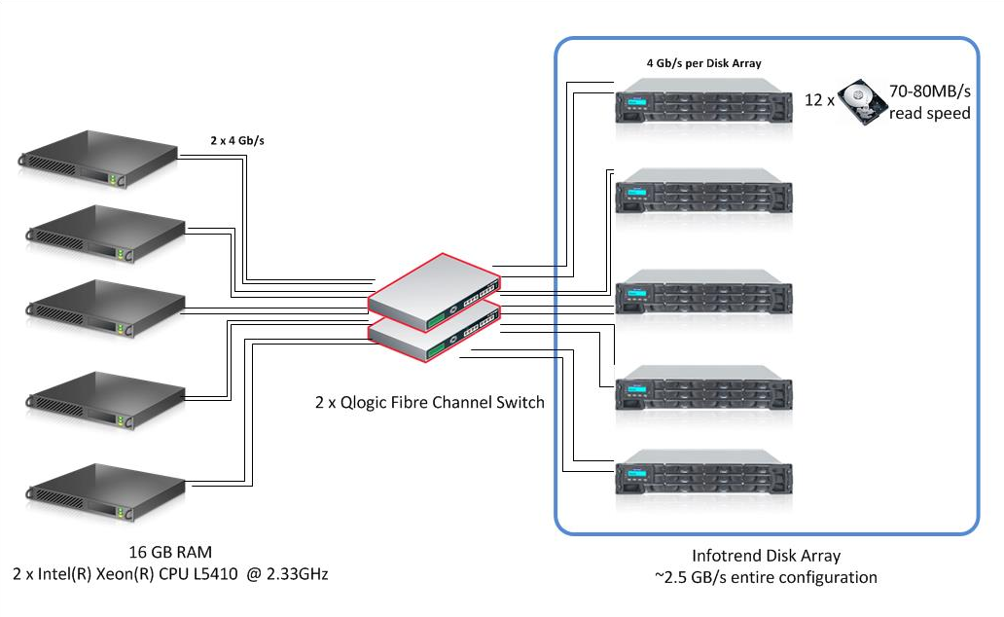
Hardware used

Slide 14
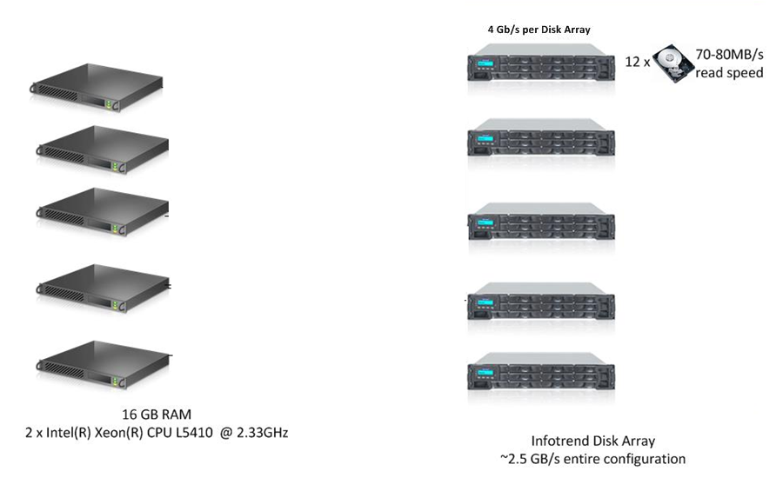
Hardware config for Hadoop
Shared nothing implementation

Slide 15
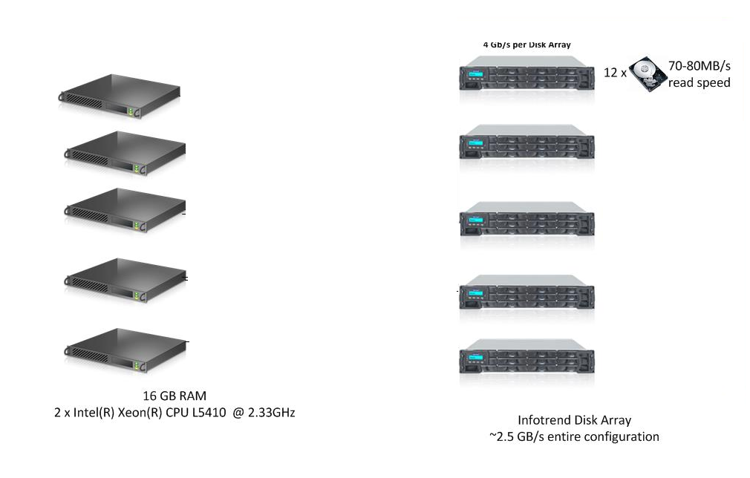
Hardware config for Oracle
Shared storage implementation

Slide 16

Data set used
Could be generic, but…
How do we know if we are getting the same results?
1TB CSV file with physics data
  Numeric values (integers, floats)
  244 columns/attributes per record/line
  532M lines/records

Slide 17
Test case
Counting „exotic” muons in the collection
  Oracle version
  MapReduce
select /*+ parallel(x) */ count(*)
from iotest.muon1tb
where col93>100000 and col20=1;
//MAP body
LongWritable one = new LongWritable(1);
NullWritable nw = NullWritable.get();
String[] records = line.split(',');
tight = Integer.parseInt(records[19]);
pt = Float.parseFloat(records[92]);
if (tight==1 && pt>100000)
{
collector.collect(nw,one);
}
//REDUCER body
long sum = 0;
while (values.hasNext()) {
sum += values.next().get();
}
output.collect(NullWritable.get(), new LongWritable(sum));

Slide 18
Software configuration
Hadoop
  v1.0.3
  Cluster file system: HDFS on top of ext3
  More specific configuration/optimization
    Delayed Fair Scheduler
    JVM reuse
    File block size 1GB
    …
Oracle database
  12c RAC
  Cluster file system: Oracle’s ASM
  Configuration recommended by Oracle
Notes:
Hadoop optimization

Slide 19
Outline
Motivation
Test setup
Results
Summary

Slide 20
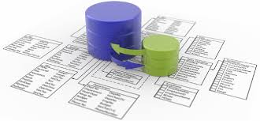
Step I
Loading the data
  Oracle
  Hadoop
Storage type | Size
Single column [TEXT] | 1204 GB
Multi column [NUMBERS] | 580 GB
Multi column [NUMBERS] compressed | 418 GB
Multi column [TEXT] | 1203 GB
Multi column [TEXT] compressed | 956 GB
Storage type | Size
HDFS CSV file | 992 GB
HDFS CSV file compressed with LZO | 568 GB
HBase single column [TEXT] | 1011 GB
HBase single column [TEXT] compr. LZO | 586 GB
Hbase multi column [TEXT] | ~ 7TB

Slide 21

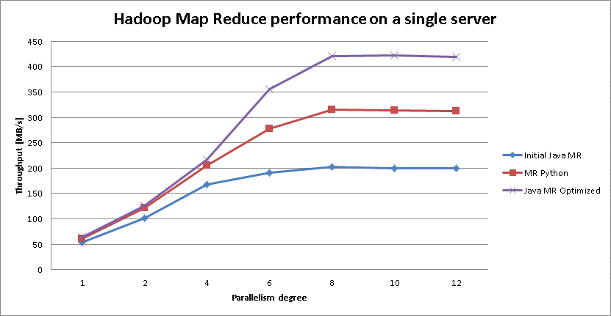
Step II
Optimize read workload using a single machine
  2x4 cores
  16GB RAM
  Hadoop
    1x Storage, controller speed 4 Gbps
  Oracle
    Shared storage, controller speed 8 Gbps

Slide 22

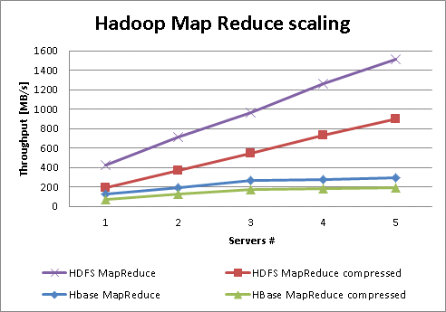
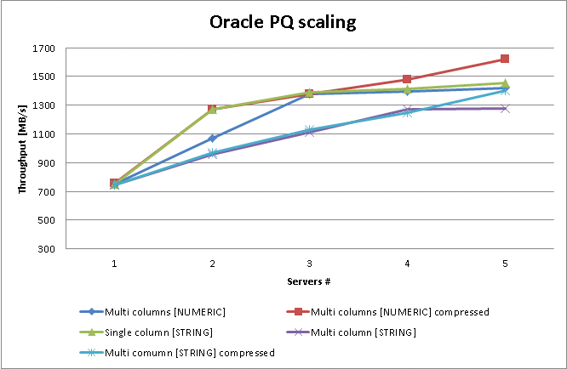
Step III
Scaling up
  5 nodes
  parallelism degree = number of cores = 8

Slide 23
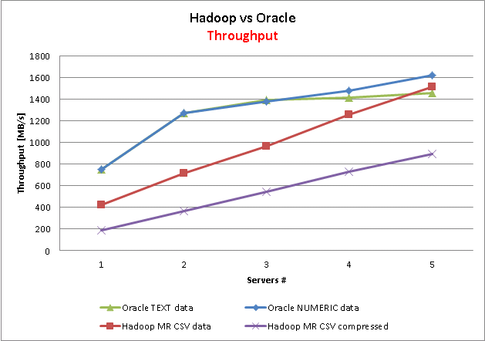
Comparision (I) - Throughput
Similar results for Oracle and Hadoop.
  Less than theoretical max throughput in both cases
  Understood why the difference
    Throughput is dominated by disk read contention.

Slide 24
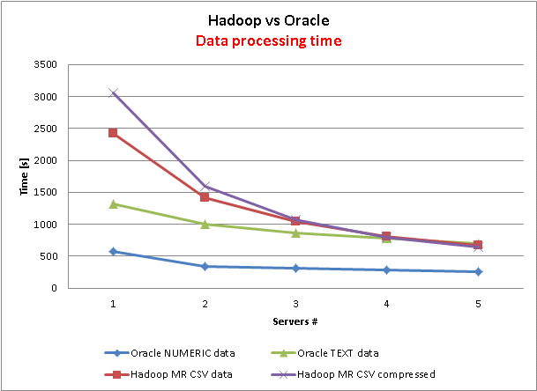
Comparision (II) - Time
Oracle’s implementation can have lower data processing time. Explained by optimal data representation.

Slide 25
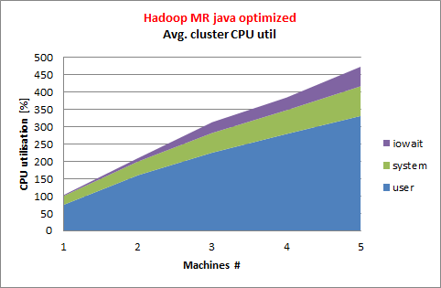
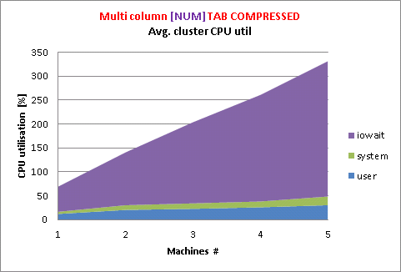
Comparison (III) – CPU utilisation
Hadoop consumes a lot of CPU and memory
  for more complex processing it might be an issue
Oracle is IO-bound
Notes:
A lot of optimization can be done for Hadoop

Slide 26
Outline
Motivation
Test setup
Results
Summary

Slide 27

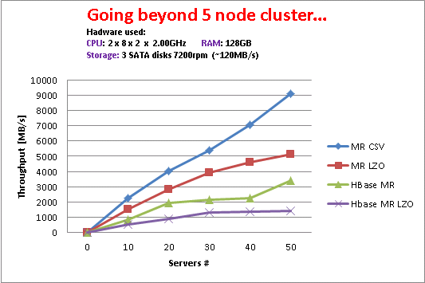
Conclusions
What is faster?
  Oracle performs well for small clusters
  Hadoop slightly slower, but…
What scales better?
  Oracle scaling ability is limited by a shared storage
  Hadoop scales very well
Costs?
  Software license and support
  Hardware: Shared Nothing costs less than Shared Storage
  For real-life data analitics results see poster P2.29
Notes:
Native Hadoop solution is not performing

Slide 28
Comments
Sequential data access on HBase does not give good results
  it was design to perform with random reads!
Writing efficient Map Reduce code is not trivial
  optimized implementation can significantly improve the performance
  aviod using String.split() or Tokenizer!
Hadoop is in very active development
  new releases can address observed issues
A lot of data at CERN is already in Oracle
  Effort and time of exporting it to other system is not negligible
Oracle and Hadoop can compete in the database space for analytics, but not for transactional workloads!

Slide 29
Many Thanks!
Tony Cass (CERN IT-DB/CS)
Andrei Dumitru (CERN IT-DB)
Maaike Limper (CERN IT-DB
Stefano Russo (CERN IT-DB)
Giacomo Tenaglia (CERN IT-DB)

Slide 30

Q&A

