Slide 2

Data Science for Improving CERN’s Accelerator Complex Control Systems
Manuel Martín Márquez
International Conference on Computing in High Energy and Nuclear Physics CHEP 2015 – Okinawa, Japan
Notes:
Introduce myself: 8 years data engineering, data analytics (make sense)

Slide 3
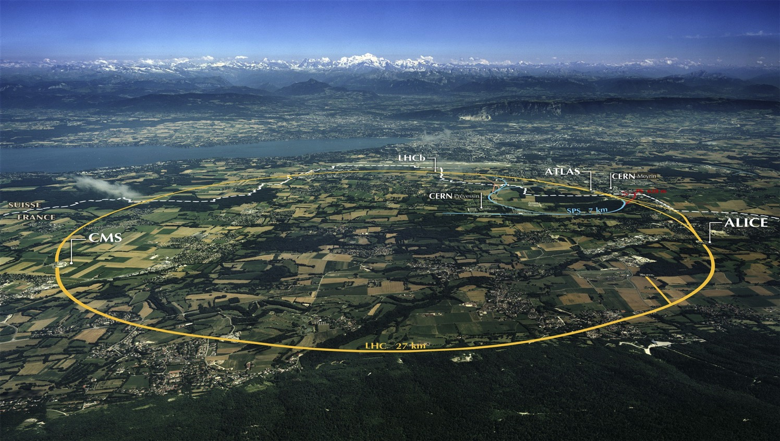
The Large Hadron Collider (LHC)
Largest machine in the world
27km, 6000+ superconducting magnets
Fastest racetrack on Earth
Protons circulate 11245 times/s (99.9999991% the speed of light)
Emptiest place in the solar system
High vacuum inside the magnets
Hottest spot in the galaxy
During Lead ion collisions create temperatures 100 000x hotter than the heart of the sun;

Slide 4

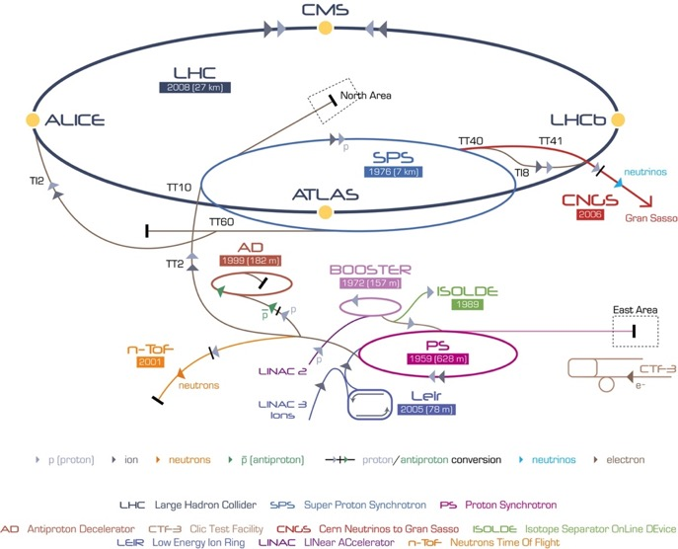
CERN’s Accelerator Complex

Slide 5
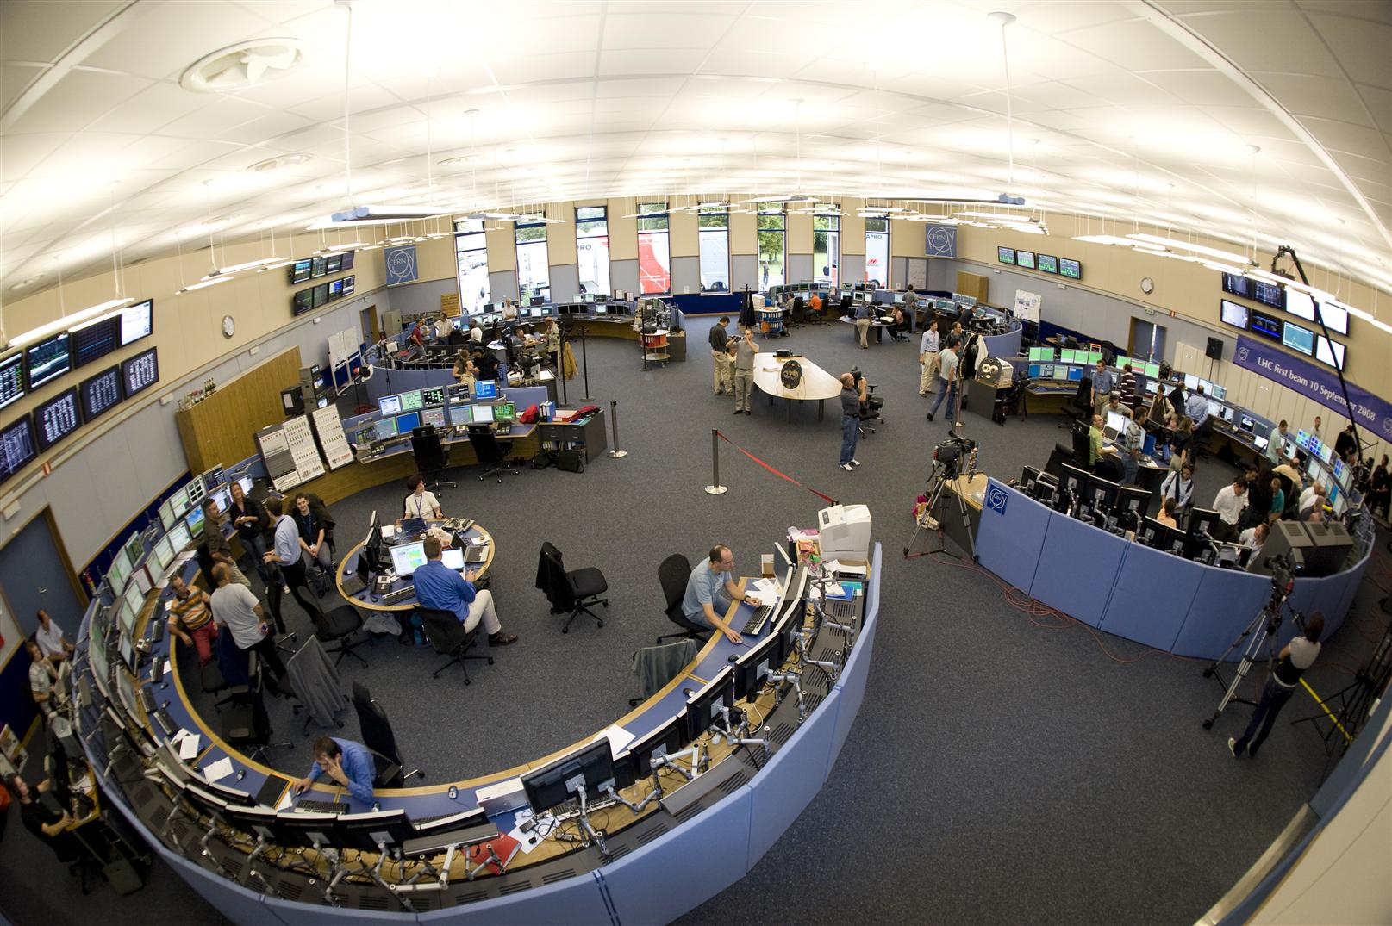
Accelerator Control and Operation
Improve Control and Operations
Million of sensors, large number of control devices, front-end equipment, etc.
Many critical systems: Cryogenics, Vacuums, Machine Protection, etc.

Slide 6
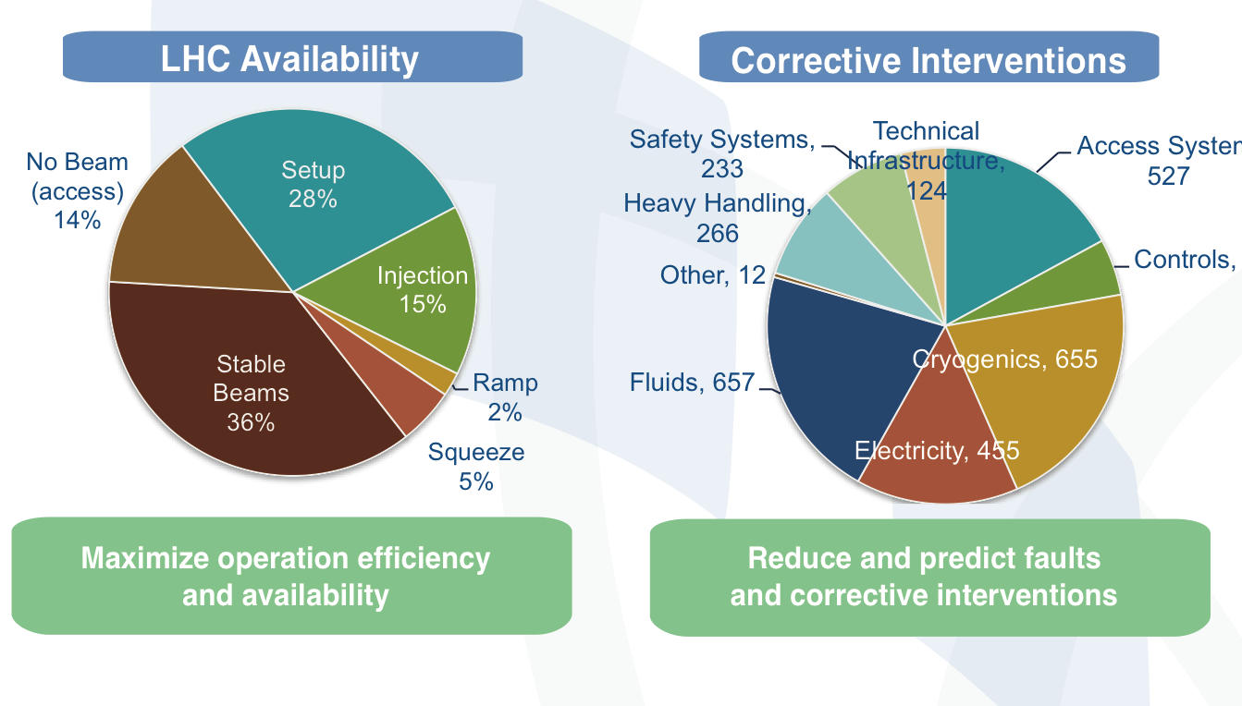
The Challenge

Slide 7
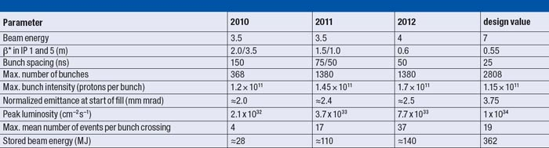
Data Analytics Challenges
A look into the future
2015

Slide 8
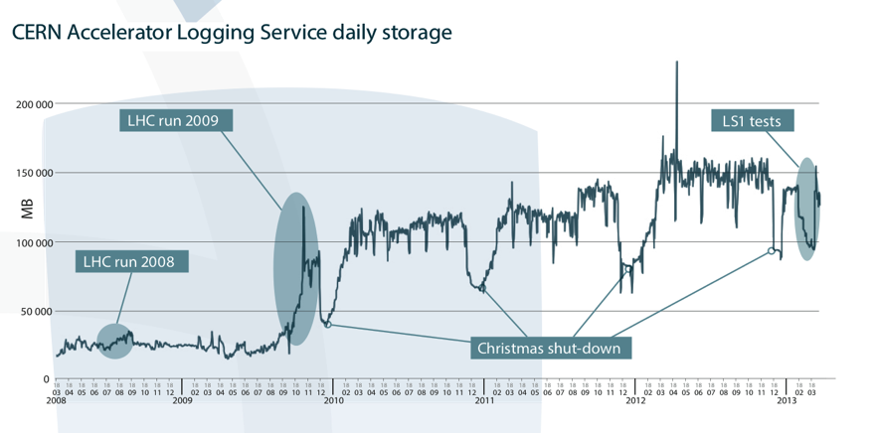
Data Analytics Challenges
Profit from our data investment

Slide 9
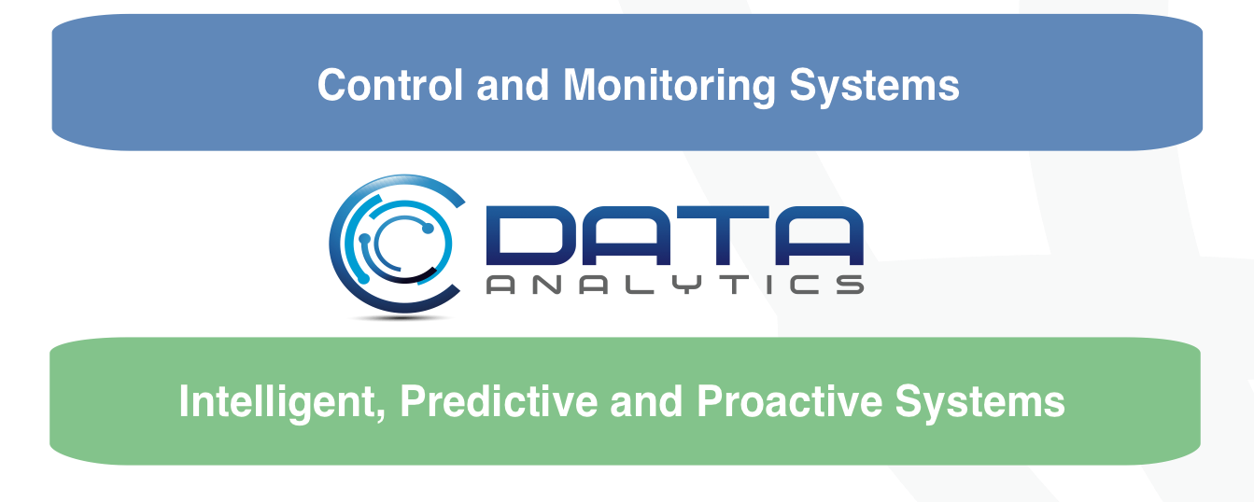
Data Analytics Objective

Slide 10
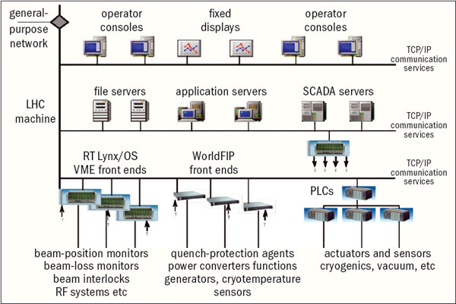
CERN’s Data Analytics Use Cases
  Control System
    Cryogenics
    Vacuum
    Machine Protection
    Power Converters
    QPS

Slide 11
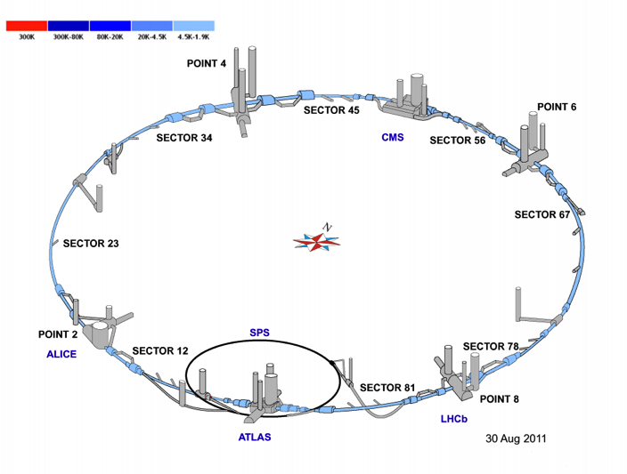
Largest Cryogenics Installation
27 km of decentralized instrumentation and control
50k I/O, 11k actuators, ~5k control loops
Control:
  ~100 PLCs (Siemens, Schneider),
  ~40 FECs (industrial PCs)
Supervision: 26 SCADA servers
Instrument/Actuators | Total
Temperature [1.6 – 300 K] Pressure [0 – 20 bar] Level Flow Flow Control valves On/Off valves Manual valves Virtual flow meters Controllers (PID) | 10361 2300 923 72 2633 3692 1835 1916 325 4833

Slide 12
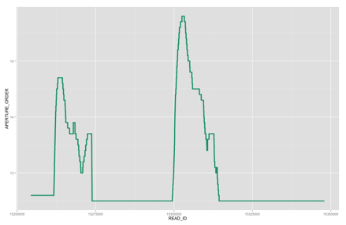
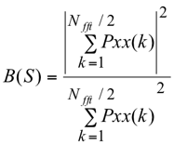
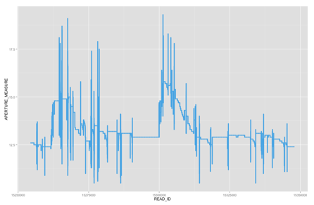

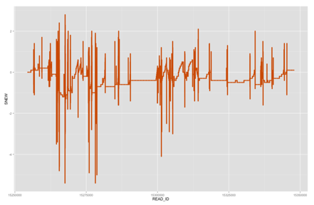
Faulty Cryogenics Valve Detection
  Signals used:
    S = aperture order - aperture measured
  Features extractions based on S
    Variance
    Percentile 99.9
    Rope distance – R(S)
    Noise Band – B(S) (Pxx be the power spectrum of the
    signal S, from 0 to 0.5Hz, where S has been previously mean-centred).
  Automatic Faulty Valves Detection System
    SVM - Support Vector Machine

Slide 13
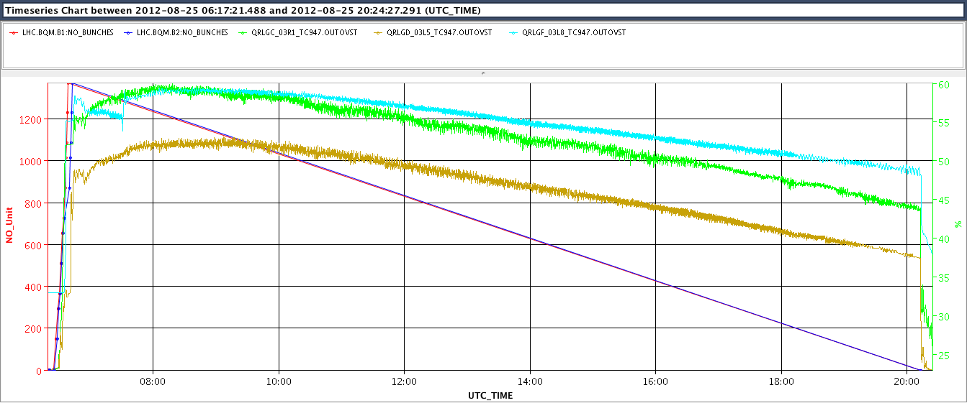
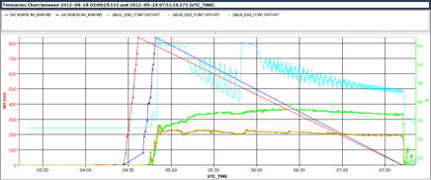
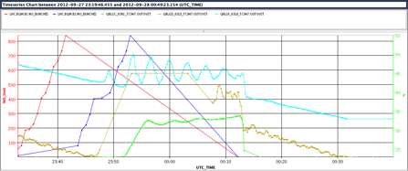
Anomaly Detection on Beam Screen Cryogenic Control
  PID output (time series) segmentation
  Characterization + Feature extraction
  Features based classification
EcosimPro by EA International
"
    Source: EN-ICE (Benjamin Bradu, Enrique Blanco)

Slide 14
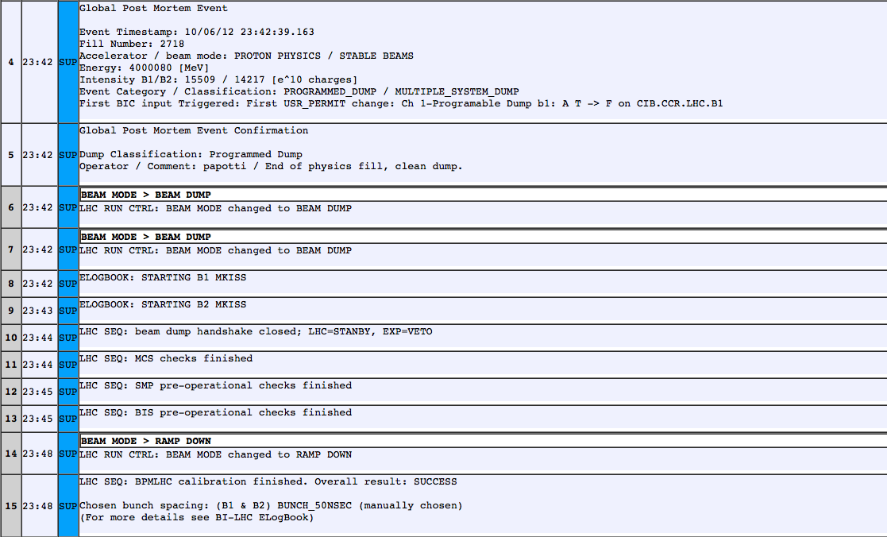
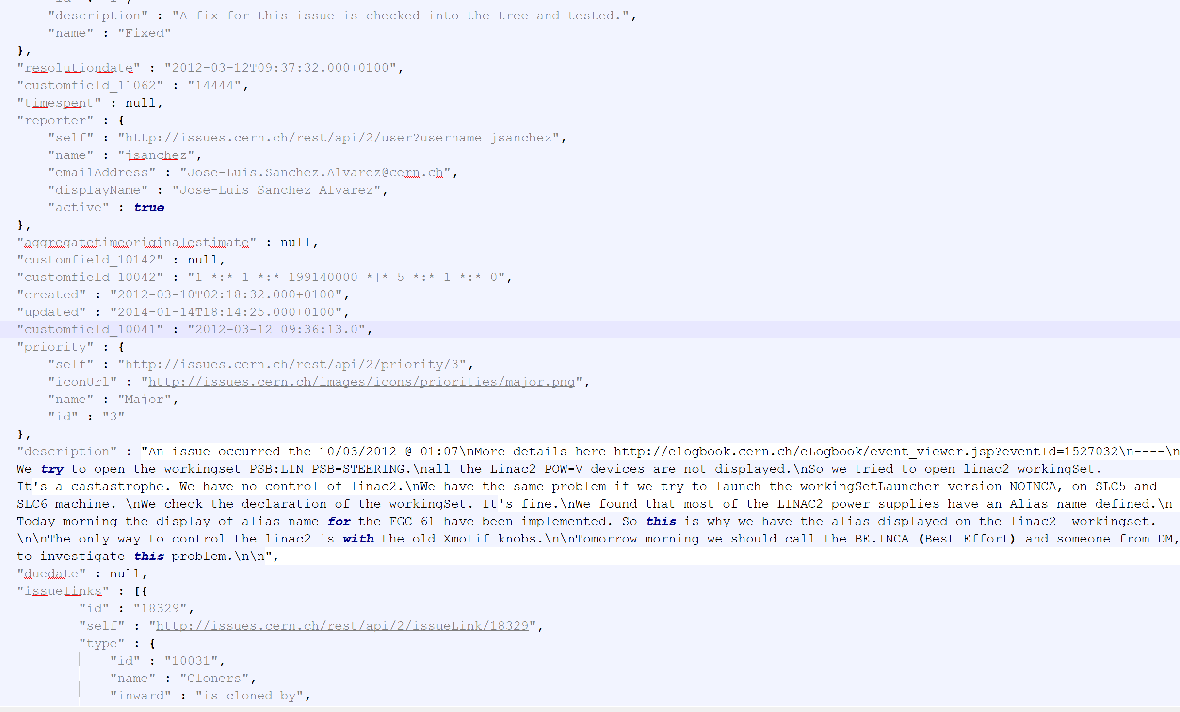
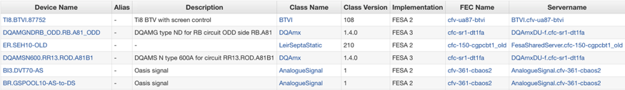
Data Discovery - Accelerator Complex Operations
Integrating Data Sources
Electronic Logbook
Controls Configuration DB
JIRA (JSON)
Text analysis
Better LHC Operations
Events Analysis
Correlate Information
  Fault Tracking System
  Operational Modes
  Operational Issues
  Control Equipment

Slide 15
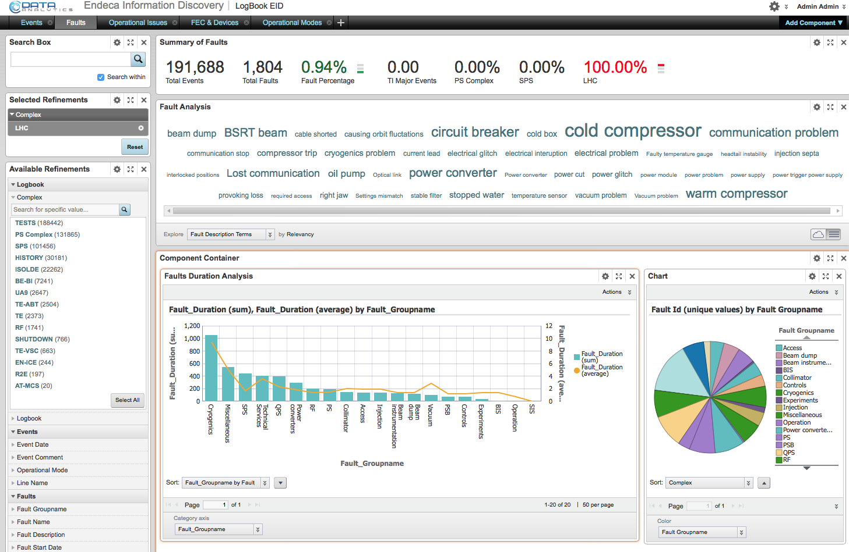
Data Discovery for Accelerator Complex Operations

Slide 16
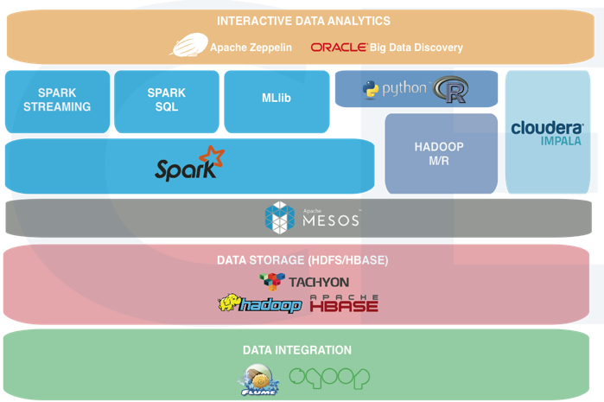
Big Data Analytics as a Service
Batch Processing
  Highly heterogeneous data
  Tools (Matlab, R, Python)
Near-real-time processing
  Low Latency (order of second)
  Expert knowledge + inferred
  Scalability and fault tolerant
Visual Analytics
  Data discovery and exploration
Data Repositories
  Store large amount of data
  Integrate with existing repositories

