Slide 1
Core Skills for a Digital Economy
Alberto Di Meglio
CERN openlab Head

Slide 2
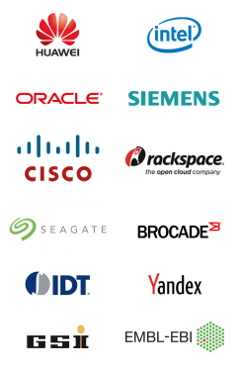
CERN openlab in a nutshell
A science – industry partnership to drive R&D and innovation with over a decade of success
Evaluate state-of-the-art technologies in a challenging environment and improve them
Test in a research environment today what will be used in many business sectors tomorrow
Train next generation of engineers/scientists
Disseminate results and outreach to new audiences

Slide 3
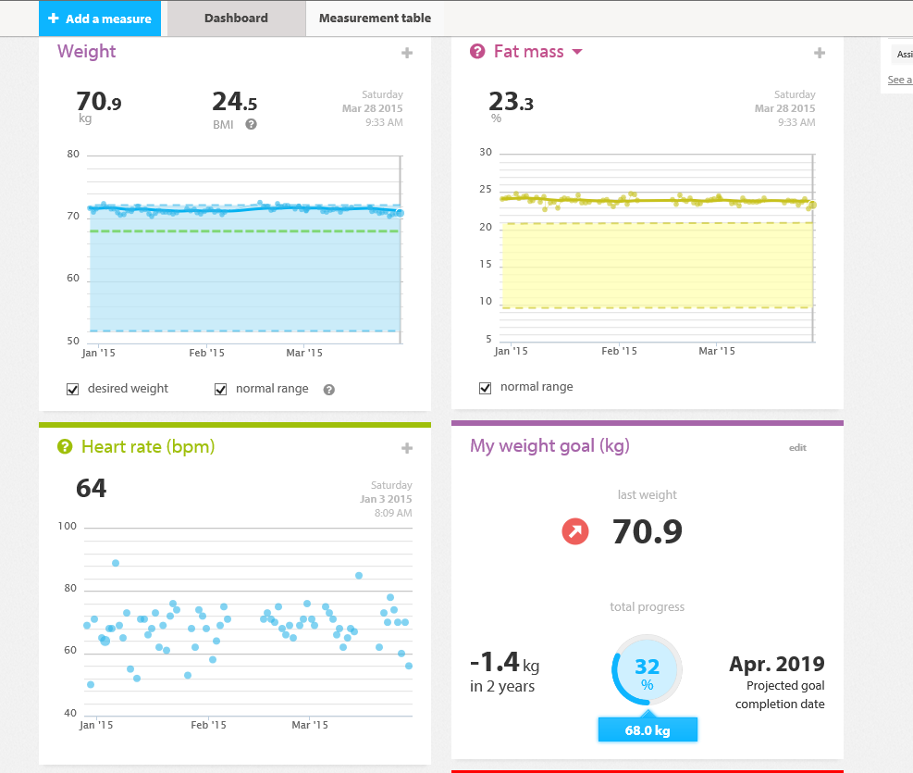
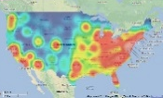
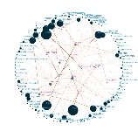
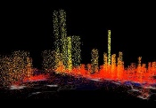
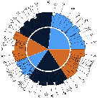
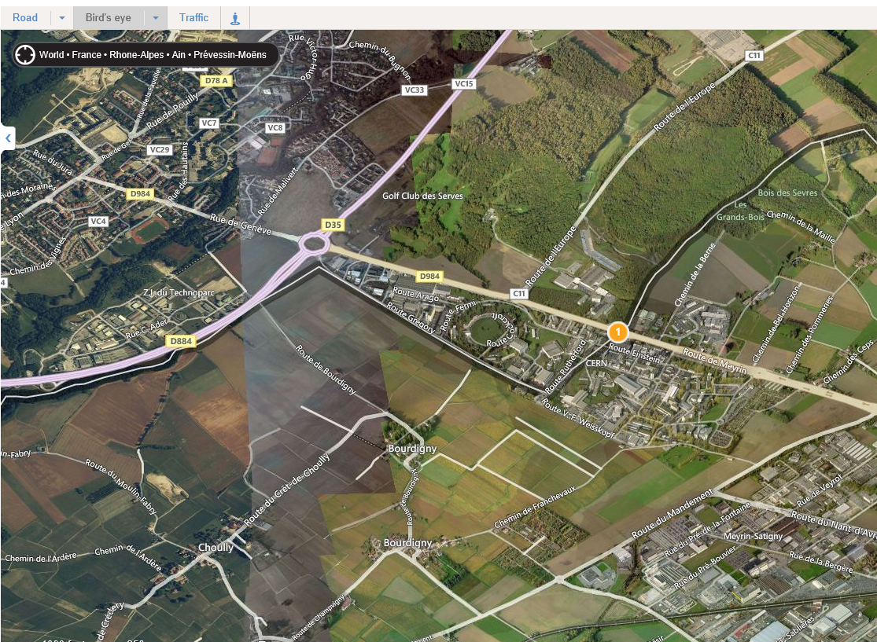
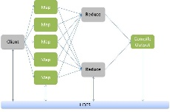
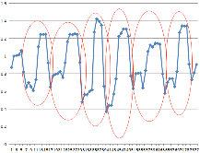
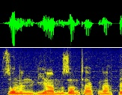
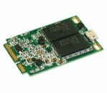
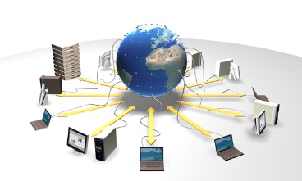
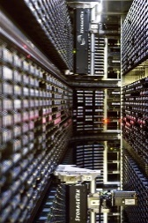
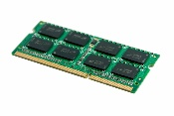
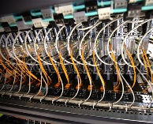
Bigger+Faster+Smarter
Information
Information
Applications designed
for “big data” (business processes, decision support systems, etc.)
Software
Data visualization,
representation
Value
Veracity
Variability
Variety
Volume
Velocity
Data analysis
and analytics platforms
Pattern recognition,
machine learning, predictive analytics
Platform
Large storage (disks, tapes, memory)
Distributed Computing and Data Grids, Clouds, HPC, Crowd Computing
Infrastructure
Fast data acquisition systems
Flexible networks

Slide 4
Open Science Cloud
users
Big Science
Small and Medium Scale Science
Other market sectors
Data from
instruments, devices, sensors, metadata,
simulations
Hybrid cloud platform
Analyse, share
Network Commercial/GEANT
Front-end
Front-end
Front-end
Front-end
Front-end
Front-end
Front-end
Publicly funded
Commercial
EGI
PRACE

Slide 5
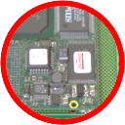
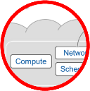
Information Technology Research Areas
Data acquisition and filtering
Computing platforms, data analysis, simulation
Innovation & Management
Data storage and long-term data preservation
Compute provisioning (cloud)
Networks
Data analytics

Slide 6
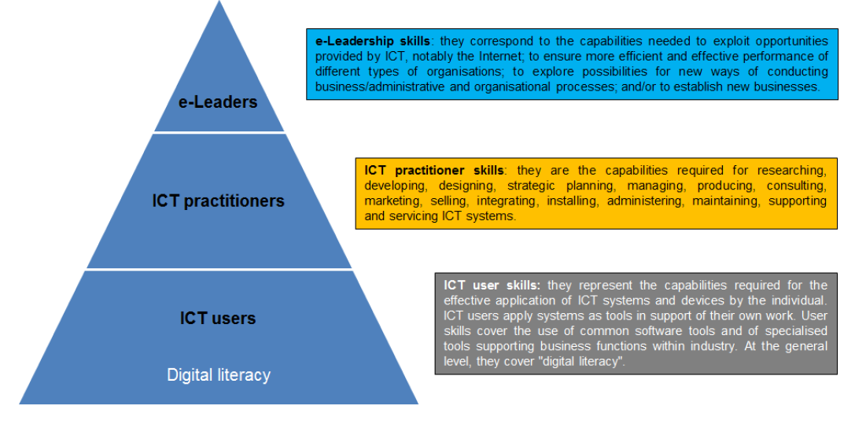
The e-Skills Pyramid
Computing/infrastructure coordinators,
IT Managers
Business vision, ICT managers (CIO, CTO), analysts
Core ICT practitioners (hardware, software, databases, networks, services procurement & management)
Core ICT practitioners (hardware, software, databases, networks)
Researchers
LHC/Detectors operators
Infrastructure operators
End-users
Device operators
Infrastructure operators
A. Richier – e-Skills for the 21st Century
E-Skills for Jobs High-Level Conference
Riga, 16 June 2015

Slide 7
eSkills Profiles
Multicore CPU programming, graphical processors (GPU),
parallel programming
Data analysis technologies,
tools,
data visualization,
monitoring, security, etc.
Computing and data services definition, procurement, deployment, benchmarking, monitoring
Software & Computing Engineers
Data Scientists/Engineers
Cloud Services Managers
Applications of physics to medical research (hadron therapy, etc.),
simulation
software
Knowledge and innovation exploitation, e-business management
Multidisciplinary Researchers
Entrepreneurs

Slide 8
European Initiatives
e-Skills for Competitiveness and Innovation (http://www.eskills-vision.eu/)
E-Leadership (http://www.eskills-guide.eu/ and http://www.eskills-lead.eu/)
European e-Competence Framework (http://www.ecompetences.eu/)
E-Skills for Jobs (http://eskills4jobs.ec.europa.eu/)
EIT Digital (https://www.eitdigital.eu/)

Slide 9
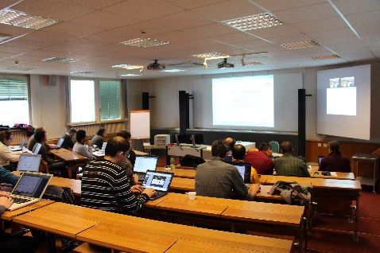
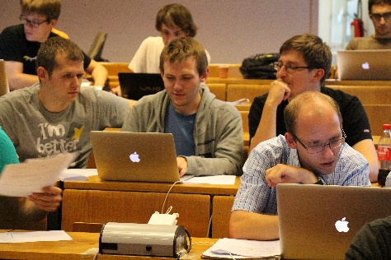
The CERN openlab Educational Program
At CERN
Regular workshops
Special workshops and lectures
Requirements workshops
Training courses on hardware platforms,
Parallel programming, etc.
Outside the lab:
CERN School of Computing in Portugal (August 2014)
Thematic CSC in Split (June 2014)
Summer student program
The ICE-DIP project
Programs is highly structured, with different tiers and specializations – students, young researchers, professional researchers and experts - including summer student lectures as well as numerous invited talks at CERN

Slide 10
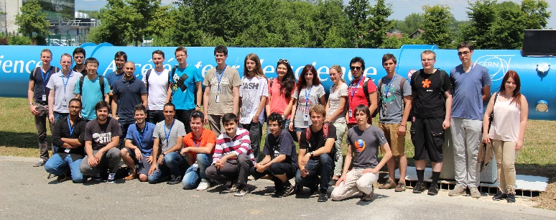
Summer Student Programme
Work programme
Individual project in collaboration with industrial companies
15 lectures by experts from CERN and other labs on applied IT
Lightning talks sessions
Published yechnical reports
Summer student program 2014
850+ applicants
23 selected candidates
Summer student program 2015
1580+ applicants
40 selected candidates
36 co-funded by CERN openlab companies and the IT Department
3 special scholarships from the CERN DG
1 Oracle/MTN scholarship for a Nigerian student

Slide 11
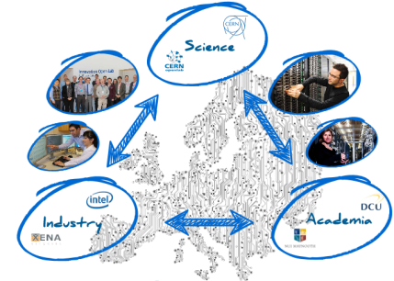
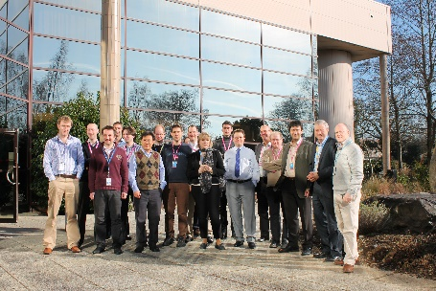
Started February 2013
Recruited 5 fellows
Model can be extended to other areas (e.g. data analytics)

Slide 12
Innovation and Entrepreneurship
CERN openlab/Intel Innovation and Entrepreneurship Project
Define a process for creating awareness, stimulate talent, support innovation and entrepreneurship
IT Lightning Talks Programme
A bimonthly series of 5-minute elevator pitches to propose ideas
IdeaSquare Challenge-Based Innovation (CBI)
Dedicated MSc-level program targeted to multidisciplinary student teams
Entrepreneurship Meet-ups
Organized by CERN KT to support future entrepreneurs

Slide 13
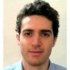
Concrete Examples
12 years of projects
50+ Fellows
160+ Summer Students
82 registered alumni
A.H., Fellow 2003
Senior HPC Solutions Engineer, Intel
X.G., Fellow 2006
Chief Data Scientist, Dassault Systèmes
A.U., Fellow 2003
Project Manager, Nagravision
M.H., Fellow 2007
Software Architect, Tyler Capital
J.D., Summer Student 2006
Senior Software Engineer, EMBL-EBI
M.L., Fellow 2012
Business Data Analyst, SITA OnAir

Slide 14
Executive contact
Alberto Di Meglio, CERN openlab Head
alberto.di.meglio@cern.ch
Technical contact
Fons Rademakers, CERN openlab CTO
fons.rademakers@cern.ch
Communication contact
Mélissa Gaillard, CERN openlab Communication Officer
melissa.gaillard@cern.ch
Admin contact
Kristina Gunne, CERN openlab Administration Officer
kristina.gunne@cern.ch

