Slide 1
Accelerating Clouds Through Science
Tim Bell, Compute and Monitoring Leader, CERN IT department
Notes:
Good afternoon and thanks for the opportunity to come to Berlin to share our experiences using clouds to make significant computing resources available to scientists around the world.
My name is Tim Bell and I am responsible for the computing and monitoring infrastructure in the CERN IT department.

Slide 2
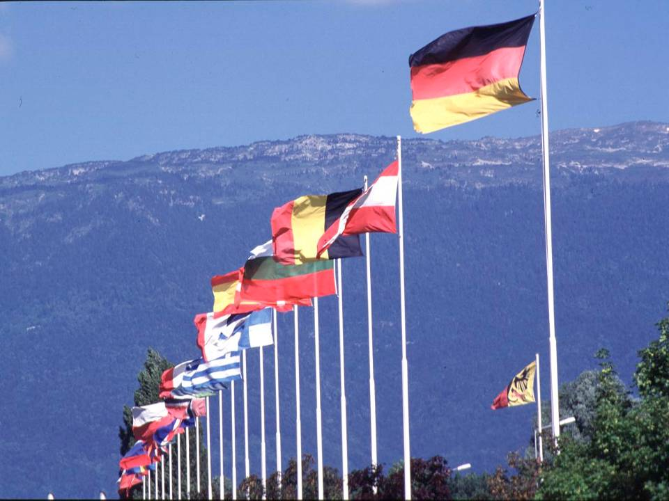
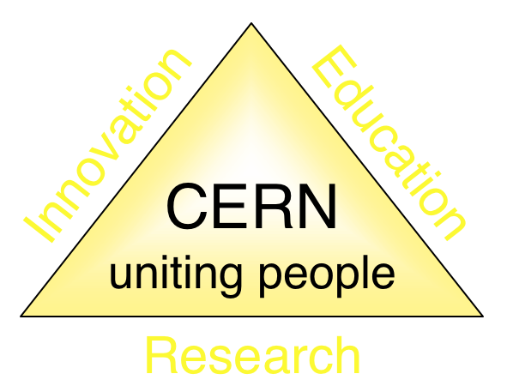
CERN: European Organisation For Nuclear Research
Founded in 1954 with 12 member states
Today 22 member states
Budget is ~1000 MCHF
Notes:
What is CERN? CERN is a french acronym, Centre European de Recherche Nuclear, or European Organisation for Nuclear Research.
It was founded in 1954 with the initial 12 member states from Europe and has now grown to 22 states and increased in geographic scope with Israel joining in 2014 and India and Pakistan are associate members.
CERN provides the infrastructure for experiments to analyse the fundamental scientific questions such as “what is the universe made of”, “how did it start”. This requires some of the most complex scientific instruments to study the building blocks of nature. This requires not only physics but also massive engineering and computing challenges to be overcome.
The budget is around 1B CHF, about 850M EUR which provides facilities to 13,000 physicists from around the world with a variety of accelerators, you could view CERN as an organisation providing “accelerators as a service”
It’s not only the physics though, CERN’s mission involves innovation and education also. The challenges produce spin off technologies, such as the capacity touch screen on many smart phones and the world wide web, invented at CERN in the ‘90s and placed into the public domain. The world without touch screens and the web would be very different from today.

Slide 3
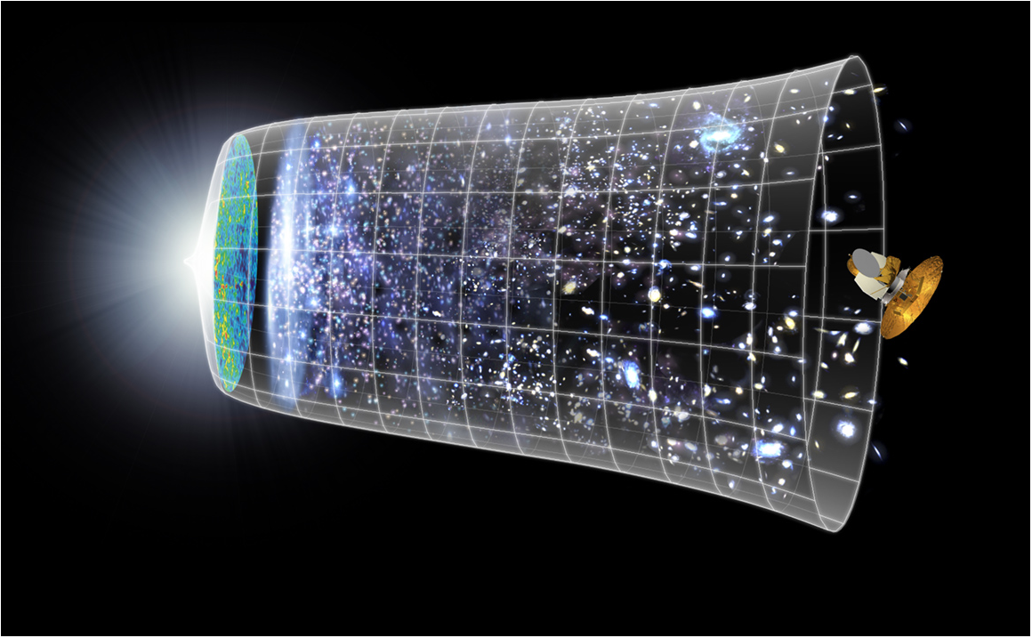
Understanding The Universe
Big Bang
13.8 Billion Years
Today
10²⁸ cm
Notes:
So How do we understand the universe? 13.8 billion years ago, the big bang produced a soup of matter and anti matter at very high energy that coalesced into atoms, molecules, planets and stars.
Today’s telescopes can look at the current state of the universe and given the speed of light, can look back far in time by looking at objects further away.
There are basic questions to be answered such as why is there more matter than anti-matter? The energy that created matter should have created an equal amount of anti matter, why is the universe prodimently matter?
To understand these kind of questions, CERN builds acclerators and the flagship is the large hadron collider.

Slide 4
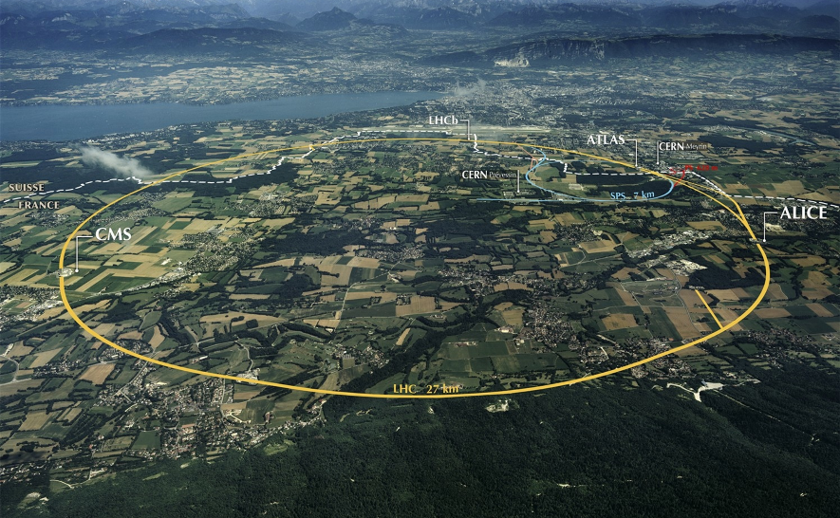
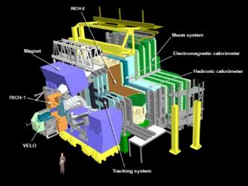
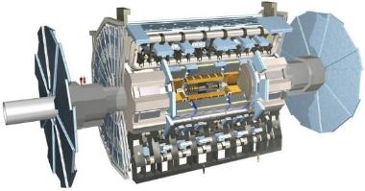
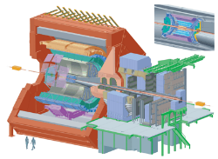
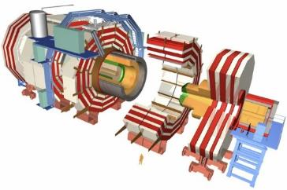
The Large Hadron Collider
>1 GB/s
~700 MB/s
~10 GB/s
>1 GB/s
Notes:
The large hadron collider is the largest scientific experiment on earth. It is a 27KM ring, 100M underground spanning the swiss/french border just outside Geneva. To get a feeling of scale, the airport and lake Geneva can be seen in the background/
It takes around 20 minutes to drive from one side of the ring to the other, the protons circulate 19,000 times a second, just below the speed of light.

Slide 5
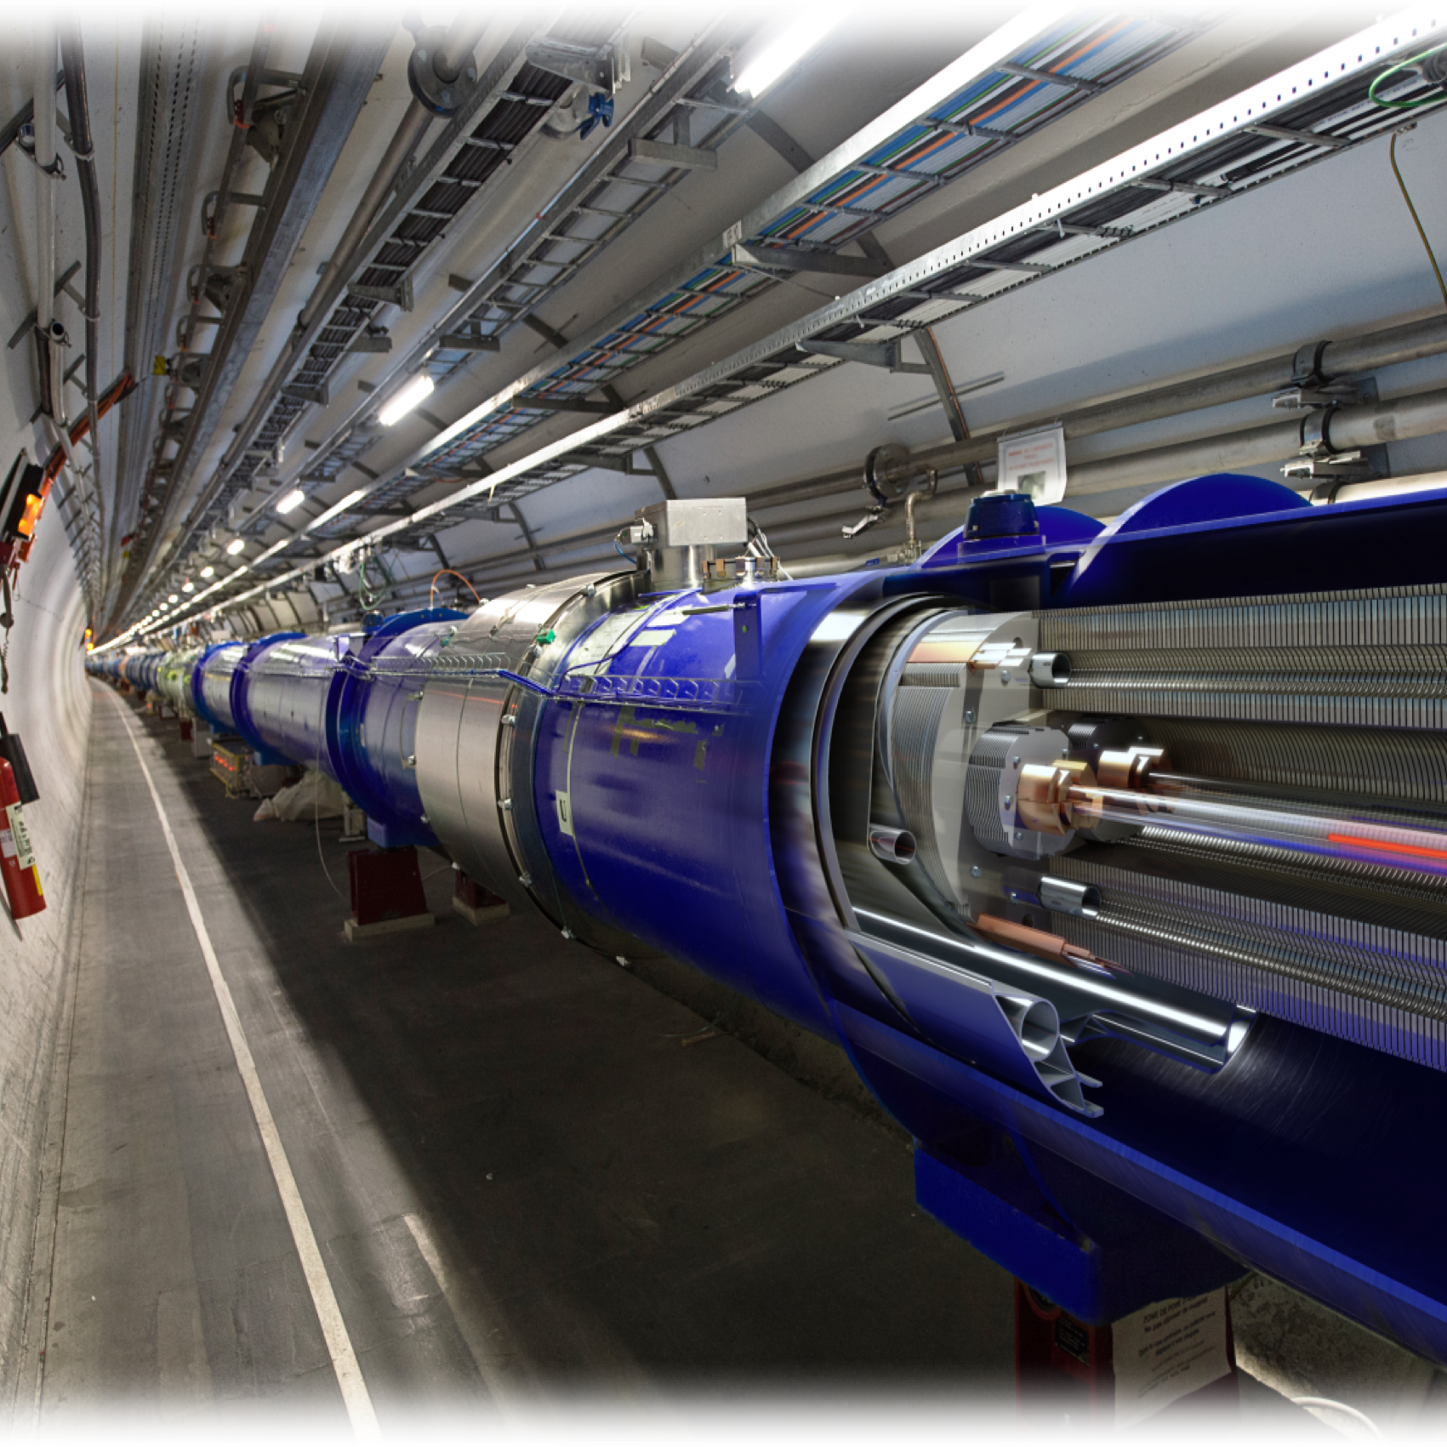
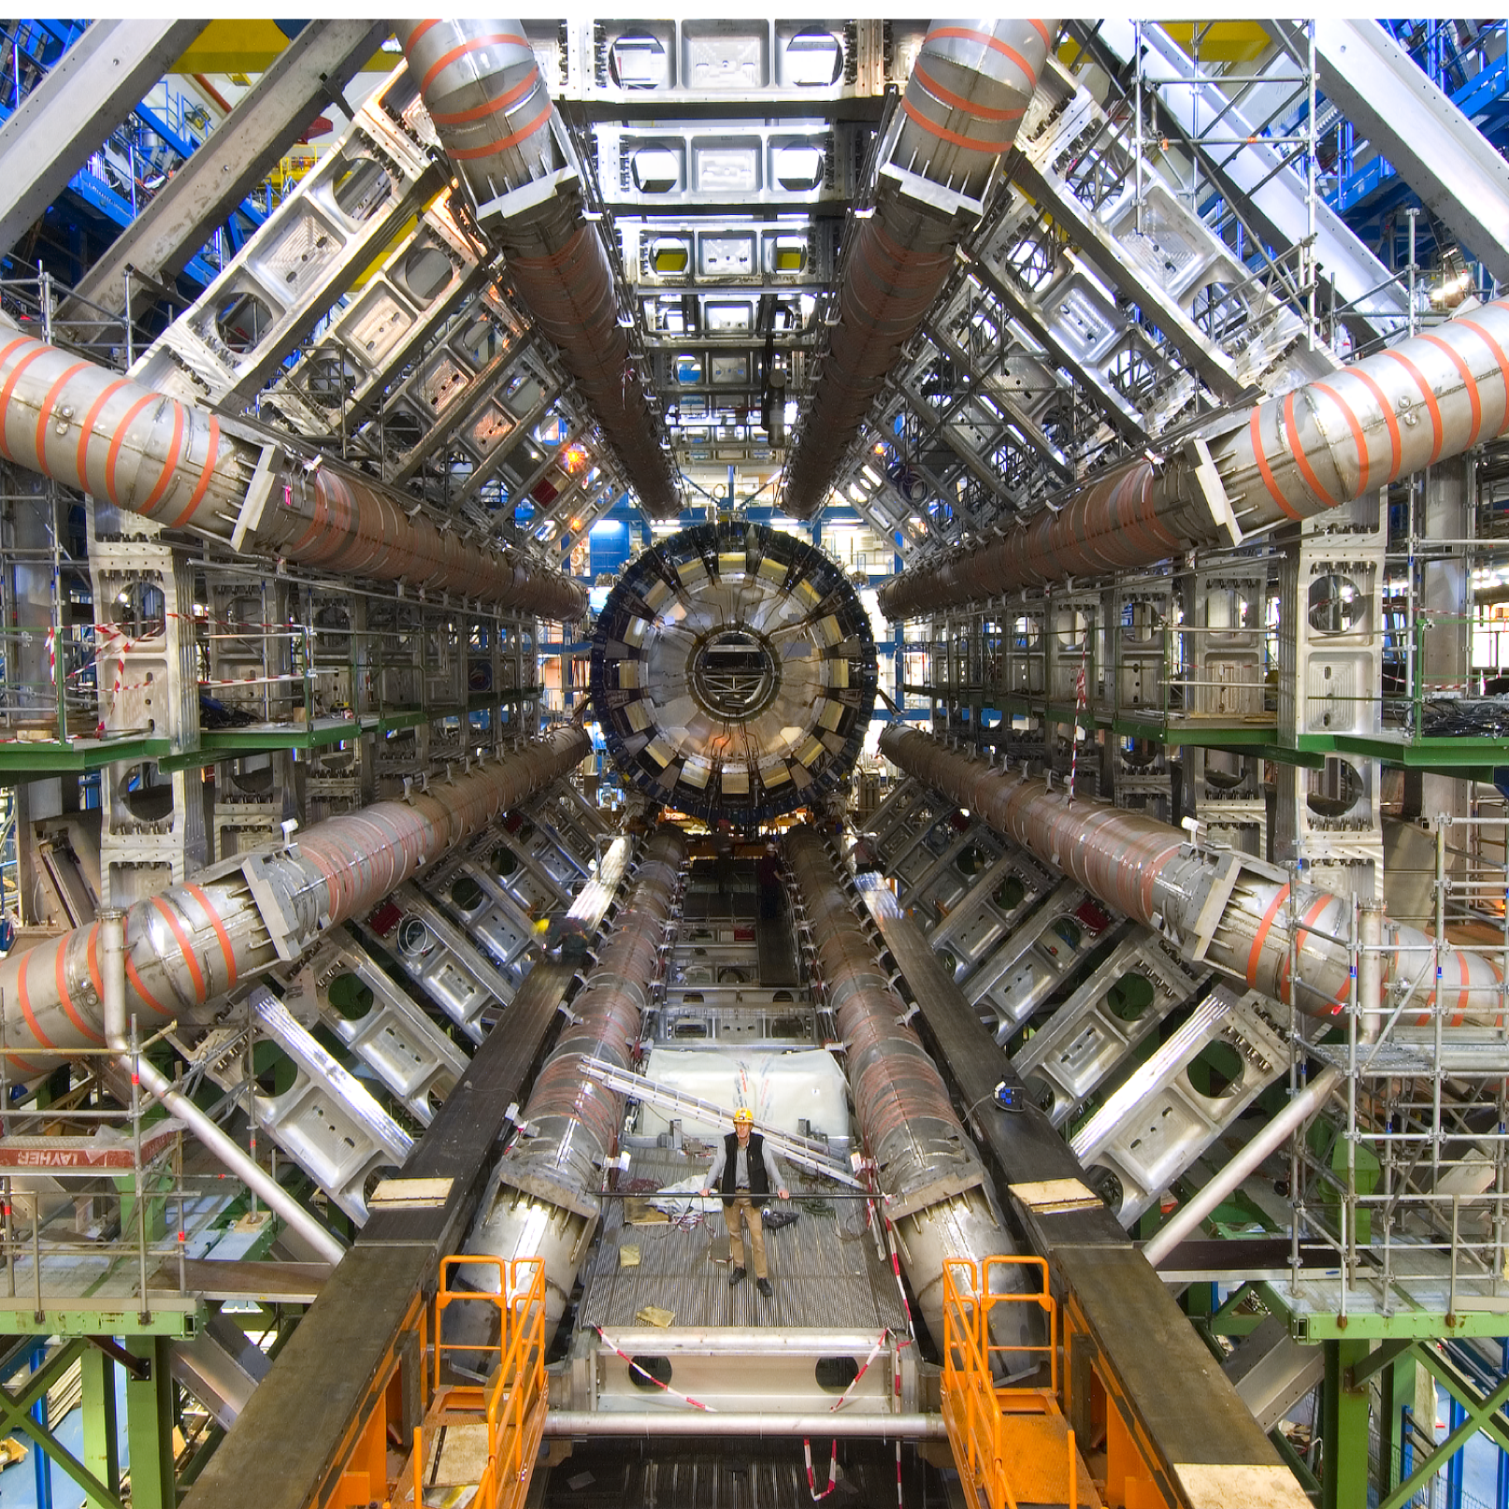
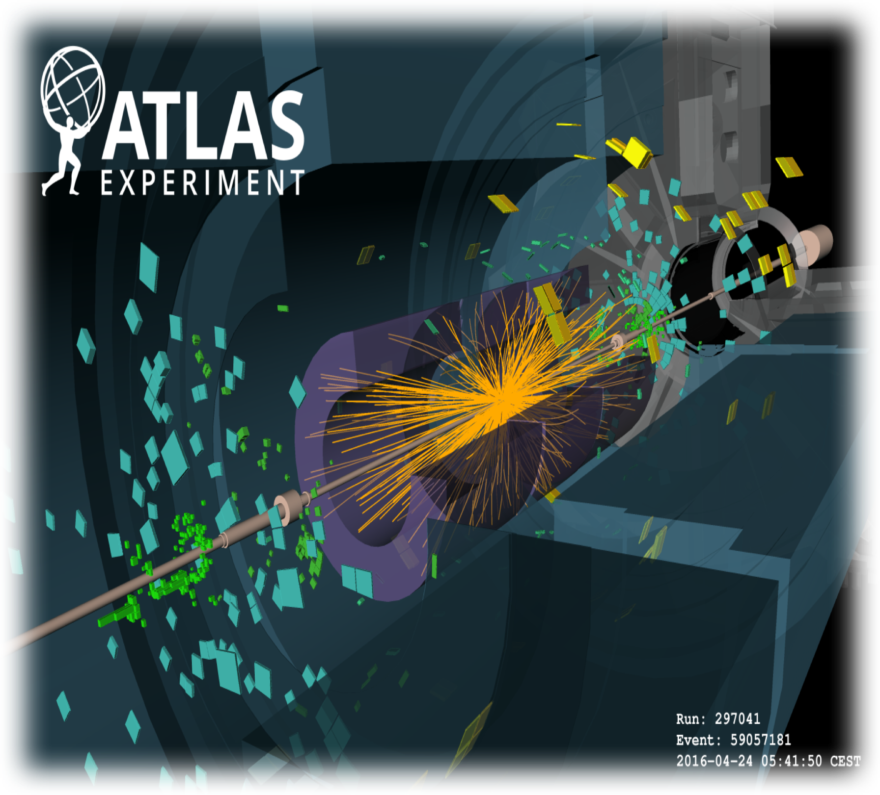
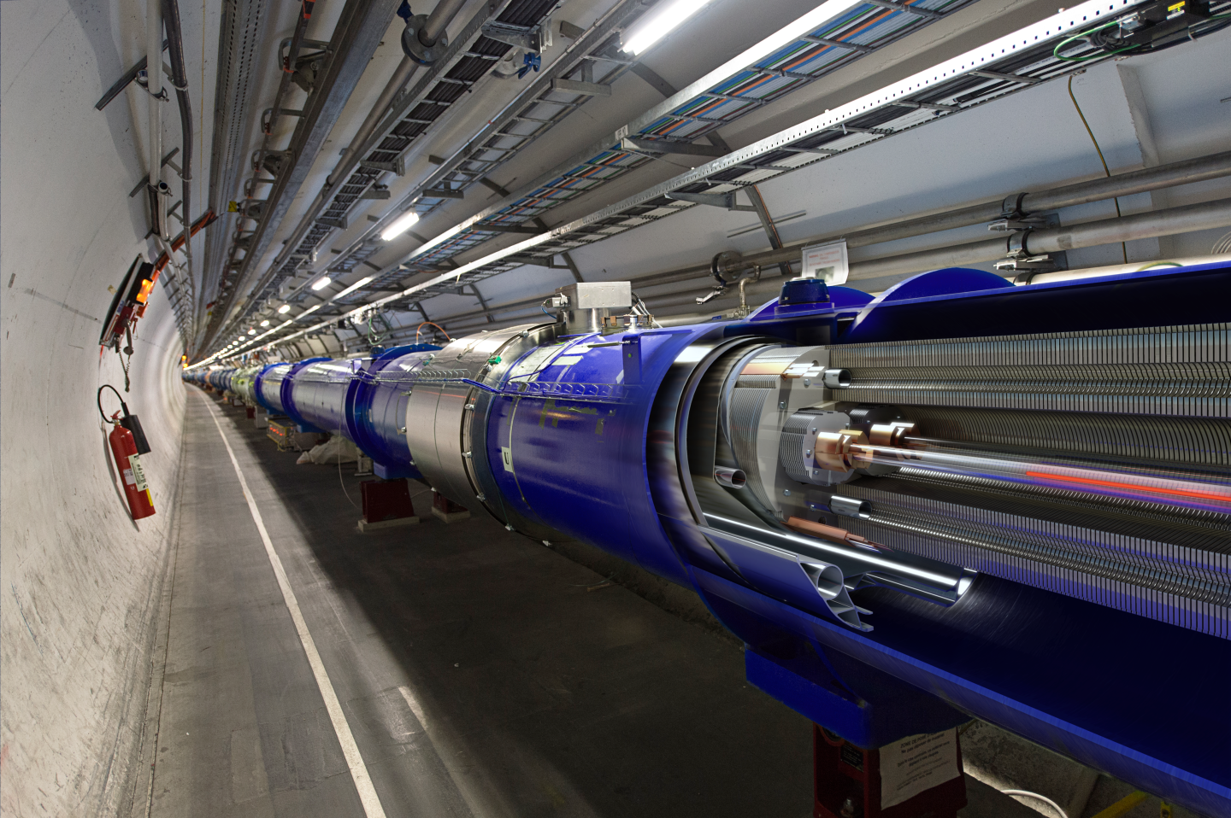
The LHC Components
The LHC Accelerator
Experiments
Particle Collisions
Notes:
The accelerator itself consists of thousands of magnets, cooled down to -271C, just above absolute zero, using liquid helium to maintain low temperatures. At this point, the magnets become superconducting, allowing high current and strong magnetic fields to bend the beams round the ring. Complex control systems keep the beams aligned inside two tubes, 1 cm diameter which are evacuated to 10 times lower pressure than the moon.
At 4 places around the ring, the beams are crossed in the experiments, ATLAS, CMS, ALICE and LHCb. These experiments are the height of Notre Dame cathedral and weigh over 7,000 tonnes. At a simple level, they can be viewed as 100M pixel cameras but they take 40M pictures per second.
The end result is about 1PB/s. As the particles pass through layers of the detector, these signals are analysed and the properties of fundamental particles can be analysed. With many collisionsand good statistics, particle physics theory can be validated such as in 2012 when Higgs Boson was confirmed by the ATLAS and CMS experiments, leading to profeesor H and E being awarded the Nobel prize for their work done over 50 yeas ago.

Slide 6
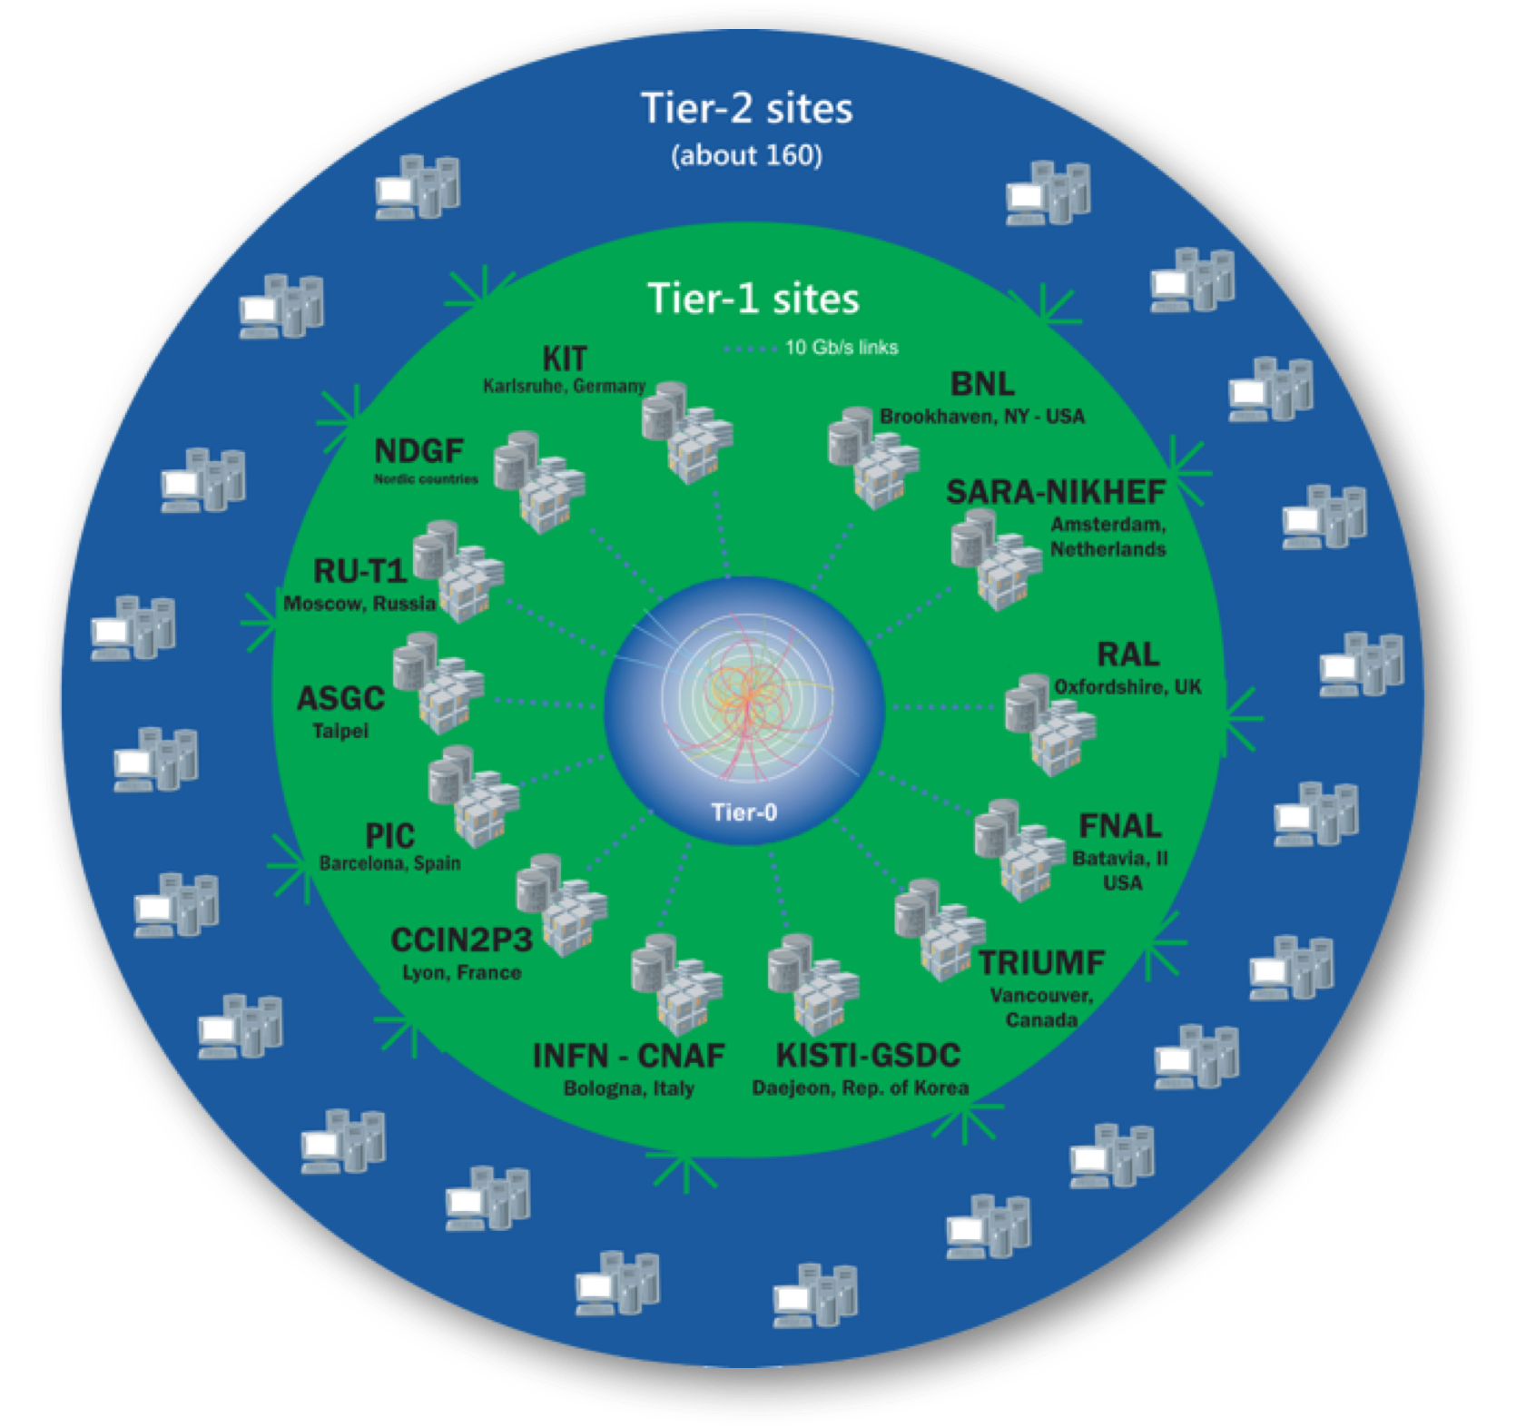
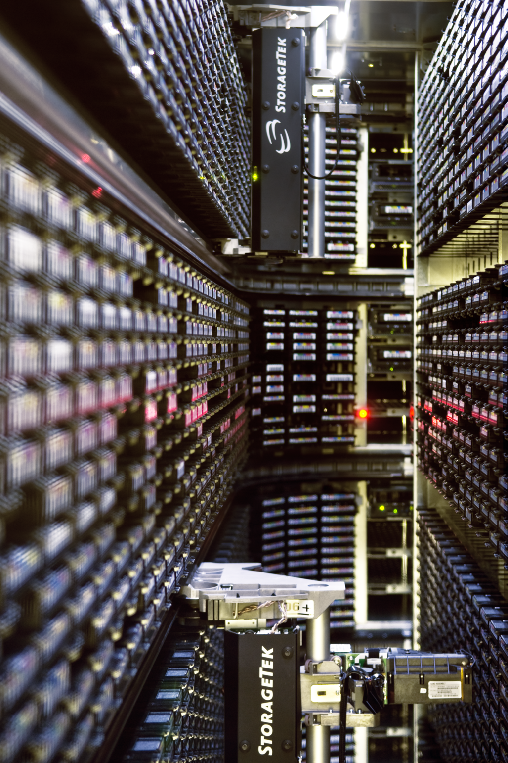
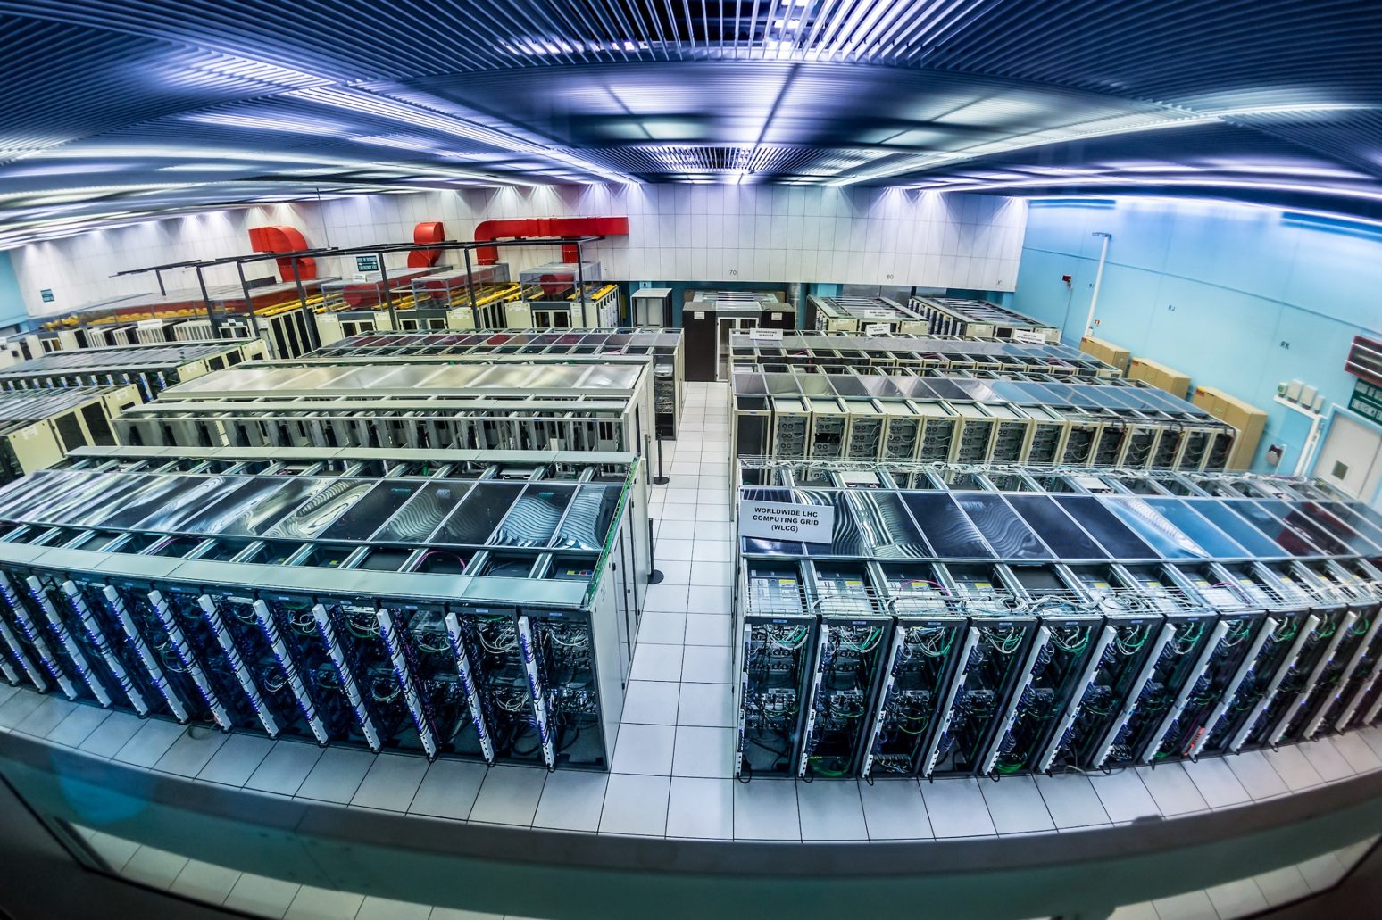
The Worldwide LHC Computing Grid
WLCG consists of 170 sites running more than 2 million jobs/day
600PB stored across the grid, 200PB at CERN alone
Tier-0 Computer Centres in Geneva and Budapest
Notes:
All of this data needs to be recorded and processed. This is performed using the Worldwide Computing Grid, a collaboration of 170 sites which is running more than 2 million jobs per day. It is organised in the heirachy with CERN at the centre, the Tier-0, a set of Tier-1 sites which have significant capacity and storage, including archival, and the Tier-2s which are labs and universities providing resources for analysis.
Across the grid, there is around 600PB of tape storage. CERN on its own has 200PB which provides long term archive, delivering 60,000 mounts per week. Large disk farms cache the data and thousands of servers to analyse the data.
The CERN computer centre is about 3.5MW. The accelerator complex uses 200MW in total, about the same as a small town. However, we were not able to increase the capacity of the Geneva centre, so CERN expanded it’s computing centre 5 years ago to include a 2nd site in Budapest, Hungary which is connected to the main CERN centre by 300GBit/s of network capacity.
You can actually see the computer centre on Google Street View, along with the accelerator tunnel itself.

Slide 7


CERN OpenStack Private Cloud
In production since 2013
8,000 servers
281,000 cores
33,000 virtual machines
3,600 projects
Notes:
While we expanded the computer facilities to Hungary, the staff to administer the resources needed was limited. We reworked the approach to managing compute resources at CERN adopting common open source solutions and integrating them. One of our key components was OpenStack, providing the physicists with a cloud experience where they could get computing resources in the time it takes to get a cup of coffee, compared to waiting weeks in the previous approach.
In production since 2013, we are now running over 8000 hypervisors under CERN openstack consisting of 280K cores and supporting 33,000 virtual machines.
These are not only the compute intensive applications, we also run services for the laboratory such as pension fund applications and administration workflows. In total, this is over 90% of the compute capacity in the data centre is under OpenStack.

Slide 8
Looking Forward to 2023
Compute needs for Run 4 expected to be 60x current capacity
Moore’s law will get 16x only
160
GRID
140
ATLAS
CMS
120
LHCb
100
ALICE
80
60
40
20
0
Run1
Run2
Run3
Run4
160
GRID
140
ATLAS
120
CMS
LHCb
100
ALICE
80
60
40
20
0
Run1
Run2
Run3
Run4
Notes:
Looking forward, we need to find ways to expand.
We are currently coming to the end of Run 2 in 2018 where we meet the computing requirements with the resources under OpenStack.
However, the accelerator will restart in 2021 with Run 3 at a much higher luminosity, more particles in each bunch and the computing requirements to extract the details of each collistion will significantly increase. Run 4 is expected to be 60x more compute than today but we are seeing Moore’s law slowing down.
Improved algorithms, CPU accelarators may help but additional measures could be necessary to ensure that computing does not limit the physics we would like to do.

Slide 9



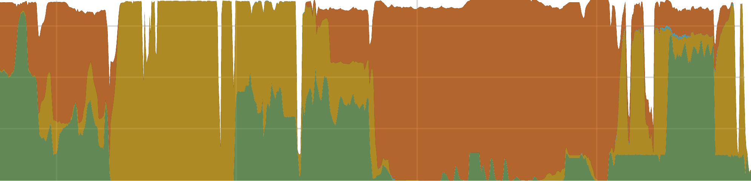

Clouds At Scale Collaboration
ALICE
ATLAS
CMS
LHCB
4000
4.0
mean
COMPLEXITY
3.5
COMPLEXITY
COMPLEXITY
COMPLEXITY
3000
COMPLEXITY
3.0
2.5
T-Systems
T-Systems
2.0
T-Systems
2000
T-Systems
Rejection Threshold
T-Systems
KV bmk [sec/evt]
1.5
IBM
IBM
IBM
IBM
1.0
DBCE
IBM
1000
DBCE
DBCE
0.5
Azure
DBCE
Azure
DBCE
ATOS
Azure
ATOS
Azure
0.0
ATOS
Azure
ATOS
0
ATOS
Cloud_1
Cloud_2
Cloud_3
Cloud_4
Cloud_5
Cloud_6
Cloud_7
Cloud_8
Cloud_9
Cloud_10
Cloud_11
Cloud_12
Cloud_13
Cloud_14
Cloud_15
Cloud_16
Cloud_17
Cloud_18
Cloud_19
Cloud_20
Cloud_21
Cloud_22
Cloud_23
Cloud_24
Cloud_25
Cloud_26
Cloud_27
Cloud_28
Cloud_29
…
2014
2015
2016
TIME
9/1
9/16
10/1
10/16
…
2014
2015
2016
TIME
…
2014
2015
2016
TIME
…
2014
2015
2016
TIME
…
2014
2015
2016
TIME
Notes:
Taking these extreme challenges posed by the LHC, CERN works with a number of companies to use the experience of processing the data from LHC, combined with advanced research in the companies, such that solutions can be developed for upcoming challenges.
CERN and Huawei have been contributors to the open source cloud project over the past years, with Huawei being a platinum sponsor of the OpenStack foundation.
Huawei has recently become a partner level partner in this activity. We are working together on the challenges of OpenStack at scale, improving the open source product with our combined skills and contributing back to the open source community. All changes are contributed back to the open source version and thus will become available in private and public cloud solutions from Huawei along with the CERN cloud as part of the standard release cycle.

Slide 10
Public Cloud Investigations
COMPLEXITY
COMPLEXITY
COMPLEXITY
COMPLEXITY
COMPLEXITY
T-Systems
T-Systems
T-Systems
T-Systems
T-Systems
IBM
IBM
IBM
IBM
DBCE
IBM
DBCE
DBCE
Azure
DBCE
Azure
DBCE
ATOS
Azure
ATOS
Azure
ATOS
Azure
ATOS
ATOS
…
2014
2015
2016
TIME
…
2014
2015
2016
TIME
…
2014
2015
2016
TIME
…
2014
2015
2016
TIME
…
2014
2015
2016
TIME
Notes:
However, the on-premise capacity at CERN may not be enough for Run 3 and 4. There are spikes in the use of computing resources, such as coming up to a major physics conference where additional capacity would help to complete the analysis. Additional capacity to the CERN data centres may be needed also so in 2014, we started investigating whether public cloud resources could be used for science.
Amongst the companies we worked with were T-Systems, whose open telekom cloud is based on the Huawei Fusionsphere product. Since this is an OpenStack cloud, we were able to use our existing tooling to rapidly bring up virtual machine resources in the T-Systems cloud and run a variety of experiment workloads there.

Slide 11
T-Systems Open Telekom Cloud Workloads
ALICE
ATLAS
CMS
LHCB
4000
4.0
mean
COMPLEXITY
3.5
COMPLEXITY
COMPLEXITY
COMPLEXITY
3000
COMPLEXITY
3.0
2.5
T-Systems
T-Systems
2.0
T-Systems
2000
T-Systems
Rejection Threshold
T-Systems
KV bmk [sec/evt]
1.5
IBM
IBM
IBM
IBM
1.0
DBCE
IBM
1000
DBCE
DBCE
0.5
Azure
DBCE
Azure
DBCE
ATOS
Azure
ATOS
Azure
0.0
ATOS
Azure
ATOS
0
ATOS
Cloud_1
Cloud_2
Cloud_3
Cloud_4
Cloud_5
Cloud_6
Cloud_7
Cloud_8
Cloud_9
Cloud_10
Cloud_11
Cloud_12
Cloud_13
Cloud_14
Cloud_15
Cloud_16
Cloud_17
Cloud_18
Cloud_19
Cloud_20
Cloud_21
Cloud_22
Cloud_23
Cloud_24
Cloud_25
Cloud_26
Cloud_27
Cloud_28
Cloud_29
…
2014
2015
2016
TIME
9/1
9/16
10/1
10/16
…
2014
2015
2016
TIME
…
2014
2015
2016
TIME
…
2014
2015
2016
TIME
…
2014
2015
2016
TIME
Notes:
The results were encouraging with good performance for the applications. This allowed us to simultaneously run workloads from all 4 experiments on the OTC cloud, storing the results back in Geneva. Sharing this experience with other science labs and the European Commission, it was clear that this was an option to be further explored.
With this interest, the Helix Nebula project was started and I have had the pleasure of working with Jurry as part of the delivery of public clouds for science.
I will now hand over to Jurry de la Mar, account director for the public sector from T-Systems to cover the follow on activities.

