Slide 1

CERN openlab a Model for Research,
Innovation and Collaboration
Alberto Di Meglio
CERN openlab CTO
DOI: 10.5281/zenodo.8518

Slide 2
Outline
What is CERN and how it works
Computing and data challenges in HEP
New requirements and future challenges
CERN openlab and technology collaborations

Slide 3
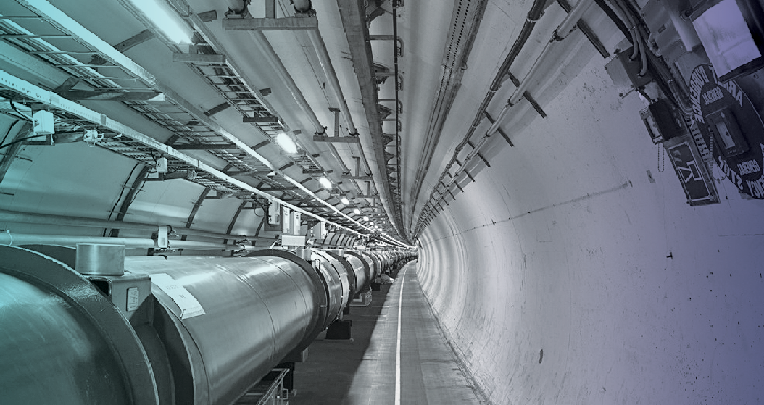
What is CERN and How Does it Work?

Slide 4
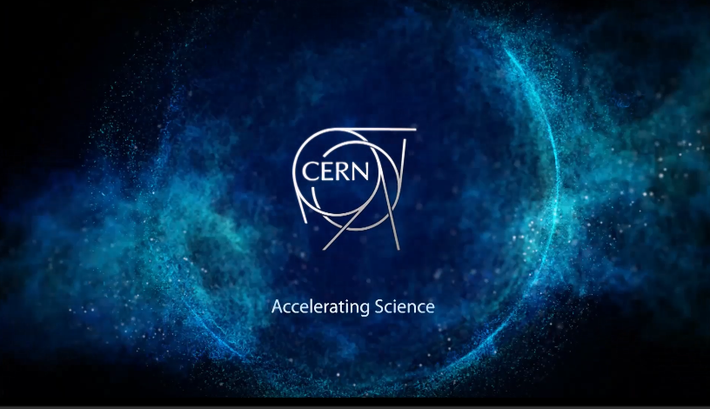
Video

Slide 5
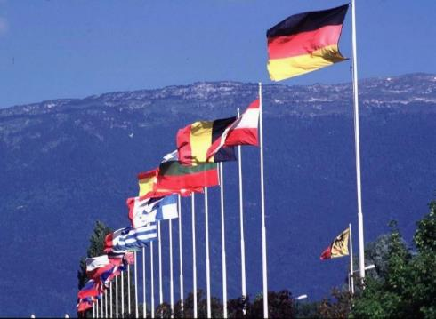
What is CERN?
European Organization for Nuclear Research
~ 2300 staff
~ 1050 other paid personnel
~ 11000 users
Budget (2012) ~1100 MCHF
Founded in 1954 – 60th Anniversary Celebration!
21 Member States: Austria, Belgium, Bulgaria, Czech Republic, Denmark, Finland, France, Germany, Greece, Hungary, Israel, Italy, Netherlands, Norway, Poland, Portugal, Slovakia, Spain, Sweden, Switzerland and United Kingdom
Candidate for Accession: Romania
Associate Members in the Pre-Stage to Membership: Serbia, Ukraine, (Brazil, Cyprus)
Applicant States: Slovenia
Observers to Council: India, Japan, Russia, Turkey, United States of America, the European Commission and UNESCO

Slide 6
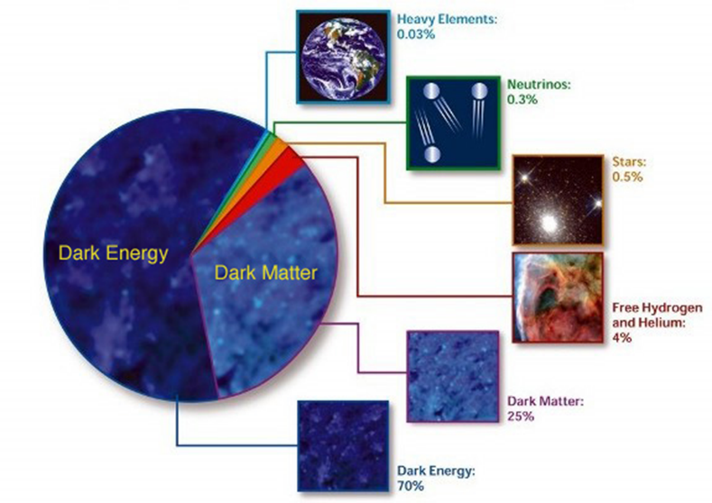
What is the Universe made of?
What gives the particles their masses?
How can gravity be integrated into a unified theory?
Why is there only matter and no anti-matter in the universe?
Are there more space-time dimensions than the 4 we know of?
What is dark energy and dark matter which makes up 95% of the universe ?

Slide 7
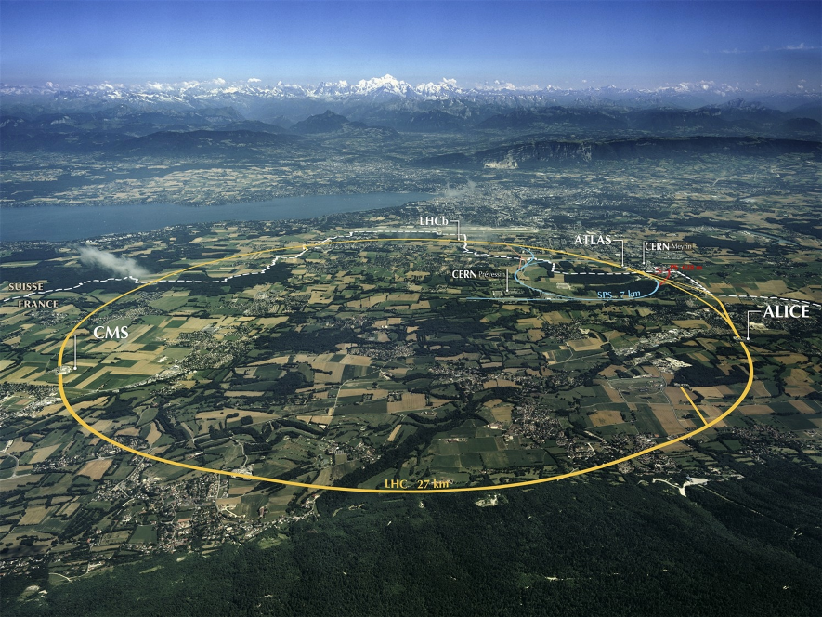
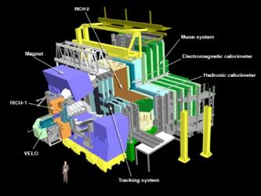
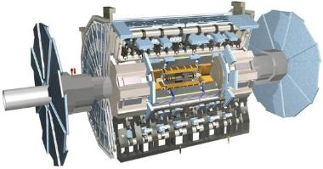
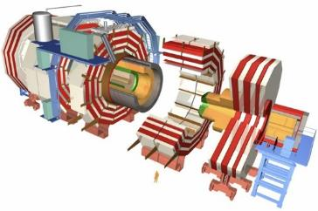
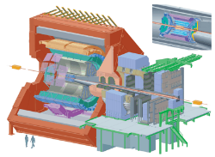
The Large Hadron Collider (LHC)

Slide 8
LHC Facts
Biggest accelerator (largest machine) in the world
Fastest racetrack on Earth
  Protons circulate at 99.9999991% the speed of light
Emptiest place in the solar system
  Pressure 10⁻¹³ atm (10x less than on the moon)
World’s largest refrigerator -271.3 °C (1.9K)
Hottest spot in the galaxy
  temperatures 100 000x hotter than the heart of the sun
  5.5 Trillion K
World’s biggest and most sophisticated detectors
Most data of any scientific experiment
  20-30 PB per year (as of today we have about 75 PB)

Slide 9
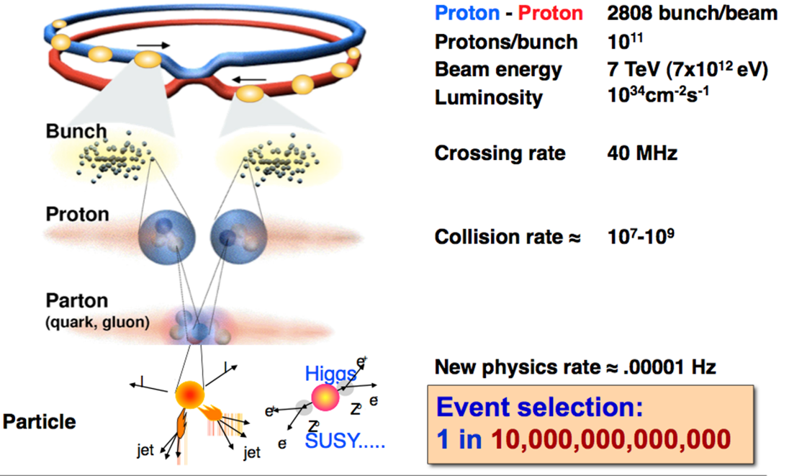
Collisions in the LHC

Slide 10
Computing and Data Challenges in HEP

Slide 11
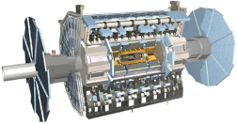
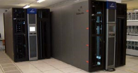
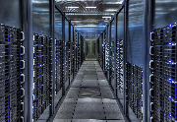



Data Handling and Computation
Online Triggers and Filters
Offline Reconstruction
Selection & reconstruction
Processed data (active tapes)
event summary
Offline Analysis
Batch Physics Analysis
raw data, 6 GB/s
Event reprocessing
Offiine Simulation
Event simulation
Interactive Analysis

Slide 12
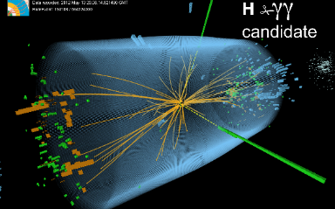
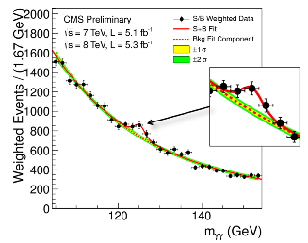
What is this data?
Raw data
  Was a detector element hit?
  How much energy?
  What time?
Simulated data
  Simulate particle collisions (hard interaction) according to a candidate theory
  Simulate interaction of primary and secondary particles with detector material
  Outcome: detailed response of the detector to a known “event”
Reconstructed data (derived from both of the above)
  Momentum of tracks (4-vectors)
  Origin
  Energy in clusters (jets)
  Particle type
  Calibration information
  Highest data complexity is here…
Analysis data (derived from RECO data)
  User or group specific data abstractions or selections
  Science happens here…

Slide 13
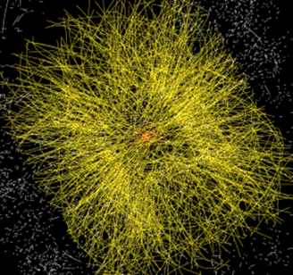
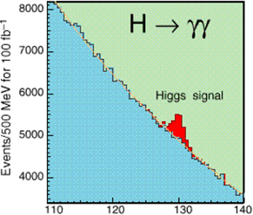
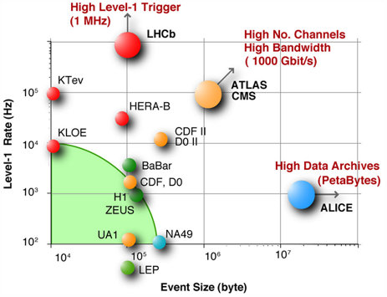
The LHC Challenges
Signal/Noise: 10⁻¹³ (10⁻⁹ offline)
Data volume
  High rate * large number of channels * 4 experiments
➔ ~25 PB of new data each year
Compute power and storage
  Event complexity * Nb. events * thousands users
➔ 300 k CPUs
➔ 170 PB of disk storage
Worldwide analysis & funding
  Computing funding locally in major regions & countries
  Efficient analysis everywhere
  ~1.5M jobs/day, 150k CPU-years/year
➔ GRID technology

Slide 14
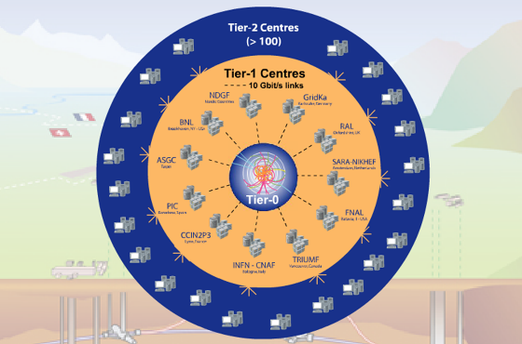
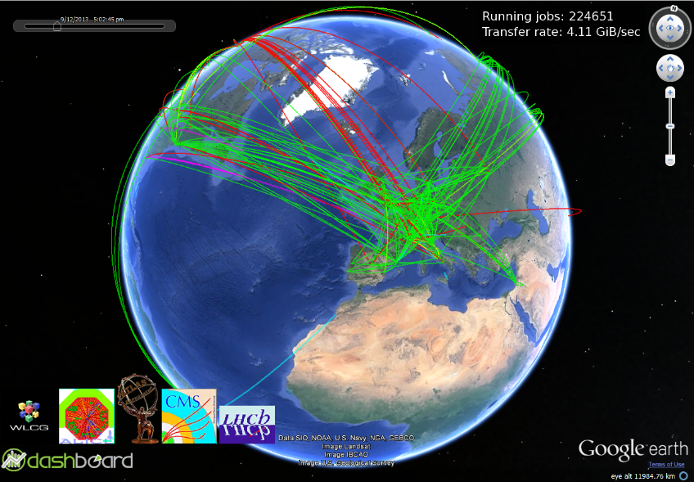
The Grid
Tier-0 (CERN):
Data recording
Initial data reconstruction
Data distribution
Tier-1 (12 centres):
Permanent storage
Re-processing
Analysis
Tier-2 (68 Federations, ~140 centres):
Simulation
End-user analysis

Slide 15
WLCG and Latin America
Mexico and other LA Countries provide active contributions to HEP and WLCG
2 WLCG T2 Federations:
  Latin America Federation (7 sites)
  SPRACE Federation (2 sites)
2014 Pledges | ALICE | ATLAS | CMS | LHCb | Total
CPU (HEP-SPEC06) | 852 | 7,340 | 20,000 | 8,000 | 36,192 (4% req.)
Disk (TB) | 300 | 236 | 1,202 | 120 | 1,858 (2% req.)

Slide 16
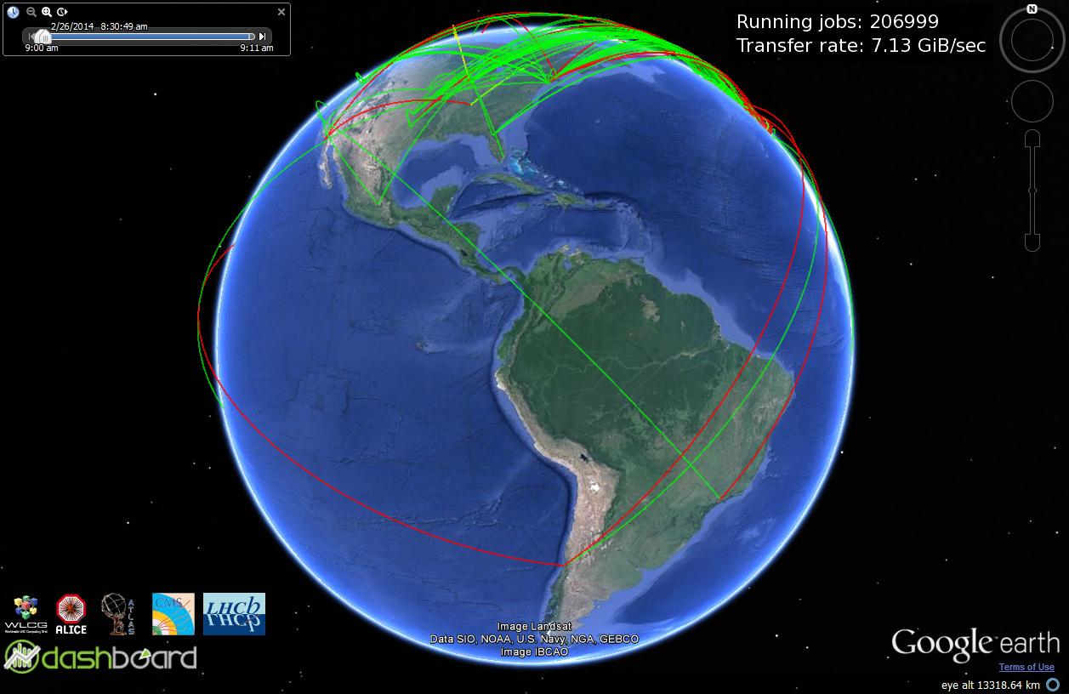
WLCG and Latin America
LA Fed
CBPF
SPRACE Fed
UERJ
ICN-UNAM
SAMPA
UNIANDES
SPRACE+UNESP
EELA-UTFSM
EELA-UNLP

Slide 17
HEP and Latin America
Argentina (UBA, UNLP): ATLAS
Brazil (UFJF, CBPF, CFET, UFRJ, UERJ, UFSJ, USP, UNICAMP, UNESP): ALICE, ATLAS, CMS, LHCb, ALPHA (AD), Pierre Auger
Chile (PUCC, Talca, UTFSM): ALICE, ATLAS
Colombia (UAN, UNIANDES, UN, Antioquia): ATLAS, CMS
Cuba (CEADEN): ALICE
Mexico (CINVESTAV, UNAM, UAS, BUAP, Iberoamericana, UASLP): ALICE, CMS
Peru (PUCP): ALICE
7 CERN – Latin American School of High-Energy Physics
  Every 2 years since 2001

Slide 18
New Requirements and Future Challenges

Slide 19
LHC Schedule
2009
2010
2011
2011
2013
2014
2015
2016
2017
2018
2019
2020
2021
2022
2023
2024
…
2030?
First run
LS1
Second run
LS2
Third run
LS3
HL-LHC
LHC startup
900 GeV
Phase-0 Upgrade
(design energy,
nominal luminosity)
Phase-1 Upgrade
(design energy,
design luminosity)
Phase-2 Upgrade
(High Luminosity)
7 TeV
L=6x10³³ cm⁻²s⁻²
Bunch spacing = 50 ns
14 TeV
L=1x10³⁴ cm⁻²s⁻²
Bunch spacing = 25 ns
14 TeV
L=2x10³⁴ cm⁻²s⁻²
Bunch spacing = 25 ns
14 TeV
L=1x10³⁵ cm⁻²s⁻²
Spacing = 12.5 ns

Slide 20
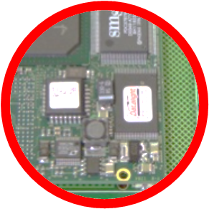
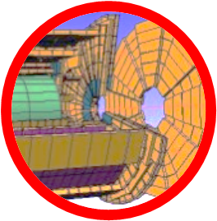
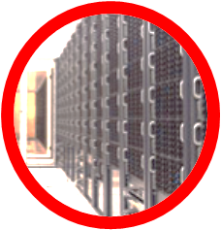
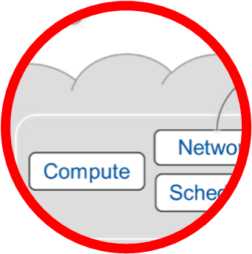

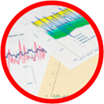
Challenges
Data acquisition (online)
Computing platforms (offline)
Data storage architectures
Resource management and provisioning
Networks and communications
Data analytics

Slide 21
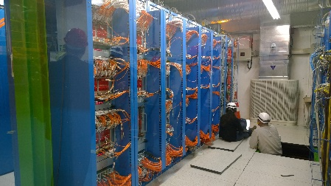
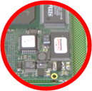

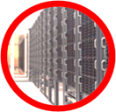
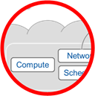


Major Use Cases
Data acquisition (online)
LHCb
CMS
ATLAS
ALICE
Redesign the L1 triggers to use commodity processors and software filters
instead of the current custom electronics
Deploy fast network links (TB/s) to the high-level triggers with close integration with the
computing resources

Slide 22


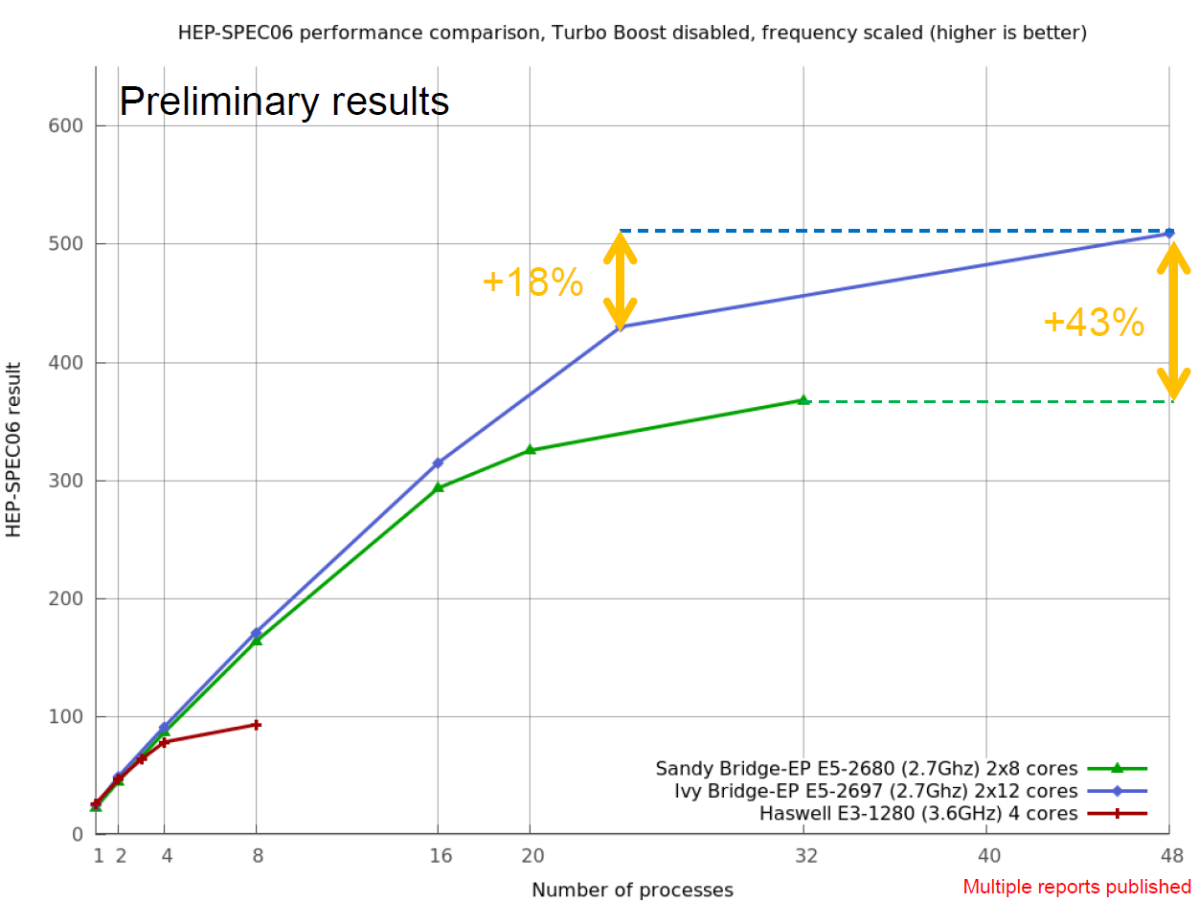

Major Use Cases
Computing platforms (offline)
Continuous benchmark of new platforms for both standard and experimental facilities
Optimization or redesign existing physics software to exploit many-core platforms
enhanced co-development, common code)
Ensure long-term expertise within IT Department and experiments
Geant V

Slide 23
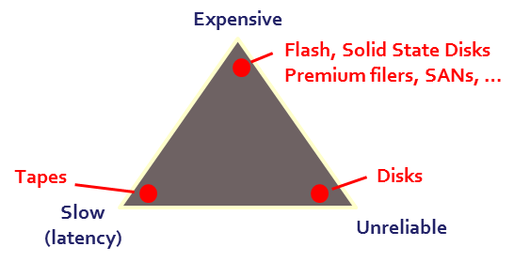
Major Use Cases
Data storage architectures
Evaluation of cloud storage for science use cases (optimization based on arbitrary
selection of storage parameters and varying QoS levels)
End-to-end operational procedures (in particular on data integrity and protection across architectures including tapes and disks)
Support for NoSQL solutions, data versioning, dynamic schemas, integration of data from different sources, etc. (support for data analytics services)

Slide 24
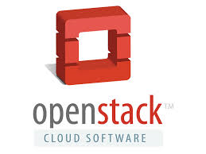
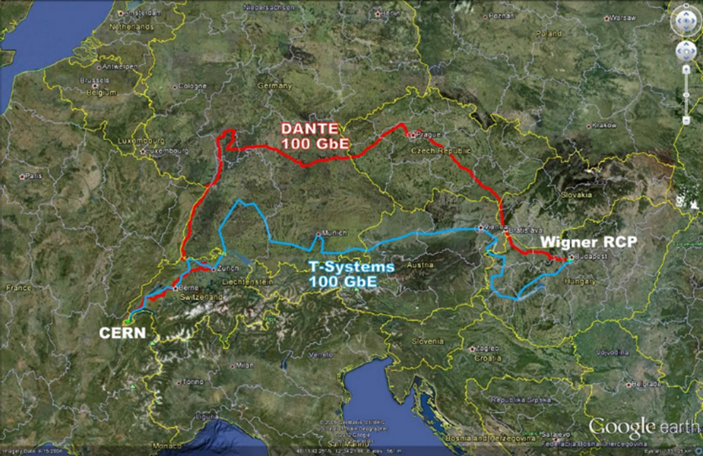
Major Use Cases
Compute provisioning and management
Scalable and agile data analysis facilities
Secure compute and data federations
Increased efficiency, lower costs

Slide 25

Major Use Cases
Networks and communication systems
Support for highly virtualized, software defined infrastructures (IP address migration
across sites, on-demand VLANs, intelligent bandwidth optimization, etc.)
TB/s networking for data acquisition
Seamless roaming across wi-fi and mobile telephony

Slide 26
Major Use Cases
Data analytics
Many identified use cases: offline and (quasi-)real-time data analytics for engineering
(LHC control systems, cryogenics, vacuum, beams status), physics analysis, IT services (data storage/management systems, logging systems) and data aggregation and extraction (including structured and non-structured data)
Pattern identification, predictive analysis, early warning systems
Data Analytics as a Service (DAaaS): multi-purpose data analytics facility able to provide on-demand serviced based on user-defined criteria.
Architectures, components (platforms, repositories, visualization tools, algorithms and processes, etc.)

Slide 27
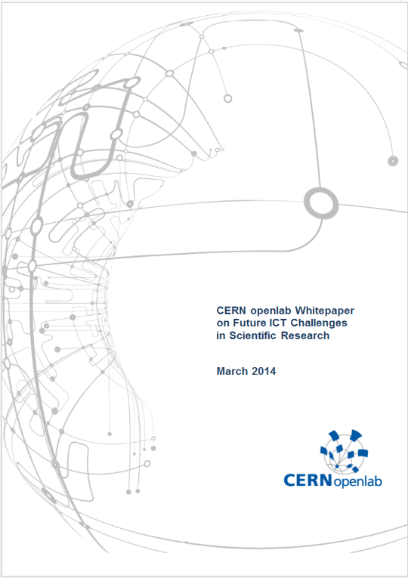
Future IT Challenges Whitepaper
Internal release published in February
Collecting feedback and more contributions
  Especially from other international research labs and projects
Expected final release date: March 28th

Slide 28
Technical Collaborations

Slide 29
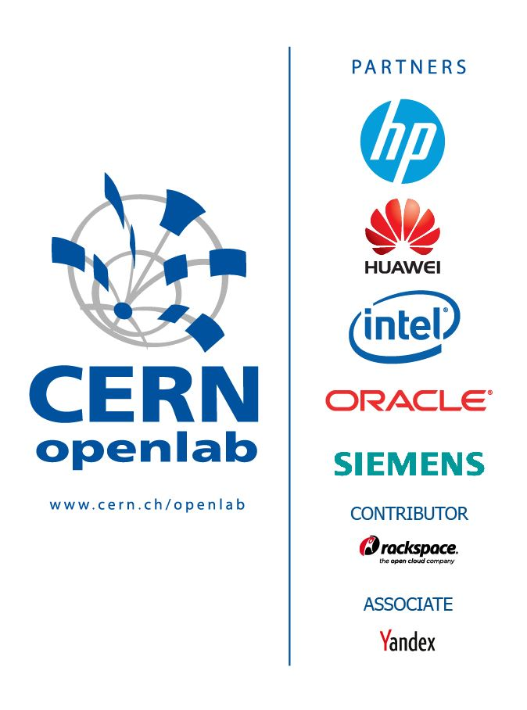
CERN openlab in a nutshell
A science – industry partnership to drive R&D and innovation with over a decade of success
Evaluate state-of-the-art technologies in a challenging environment and improve them
Test in a research environment today what will be used in many business sectors tomorrow
Train next generation of engineers/employees
Disseminate results and outreach to new audiences

Slide 30
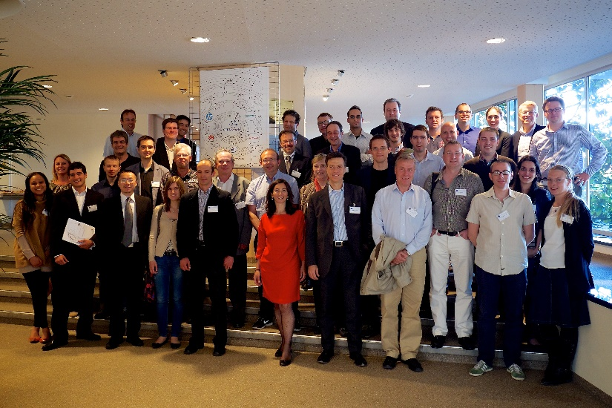
The history of openlab
I
2003
II
2006
III
2009
IV
2012
V
2015
Set-up
2001
CERN openlab Board of Sponsor 2013

Slide 31
Virtuous Cycle
CERN requirements push the limit
Apply new techniques and technologies
Joint development in rapid cycles
Test prototypes in CERN environment
Produce advanced products and services
A public-private partnership between the research community and industry

Slide 32
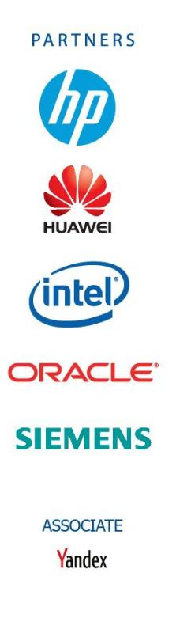



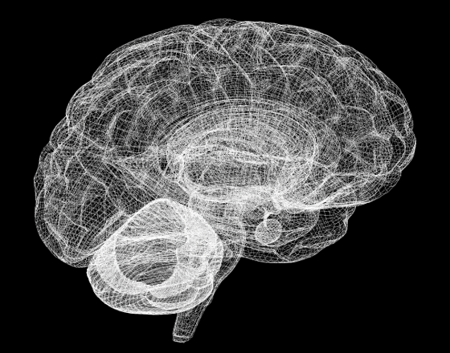




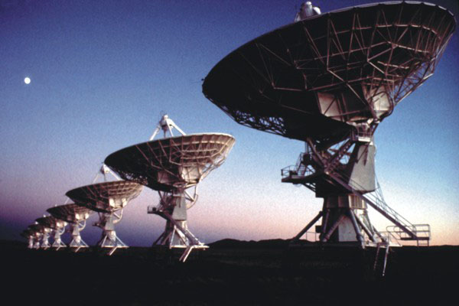

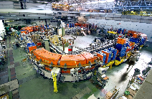









Who we are involving
New partners

Slide 33

Intel and CERN openlab: a log-lasting collaboration
Itanium-based Open Cluster. 10 GB link between CERN and Caltech, won the line speed record 2003, HP server, Intel NIC
First clean 64bit Linux OS with CERN applications (Root, Geant 4)
Started long-lasting collaboration on compilers and key math functions benchmarking in simulation software (Geant 4)
Early tests of Atom CPUs for servers, now known as micro-servers
First external partner to get access to Xeon Phi (collaboration still ongoing, from Larrabee to Knights Landing)
Systematic benchmarking of many Intel platforms (Westmere, Sandy Bridge and Ivy Bridge)
Investigation of vectorization techniques to optimize physics software on multi-core Intel platforms
Openlab I
2003
Openlab II
2006
Openlab III
2009
Openlab IV
2012

Slide 34
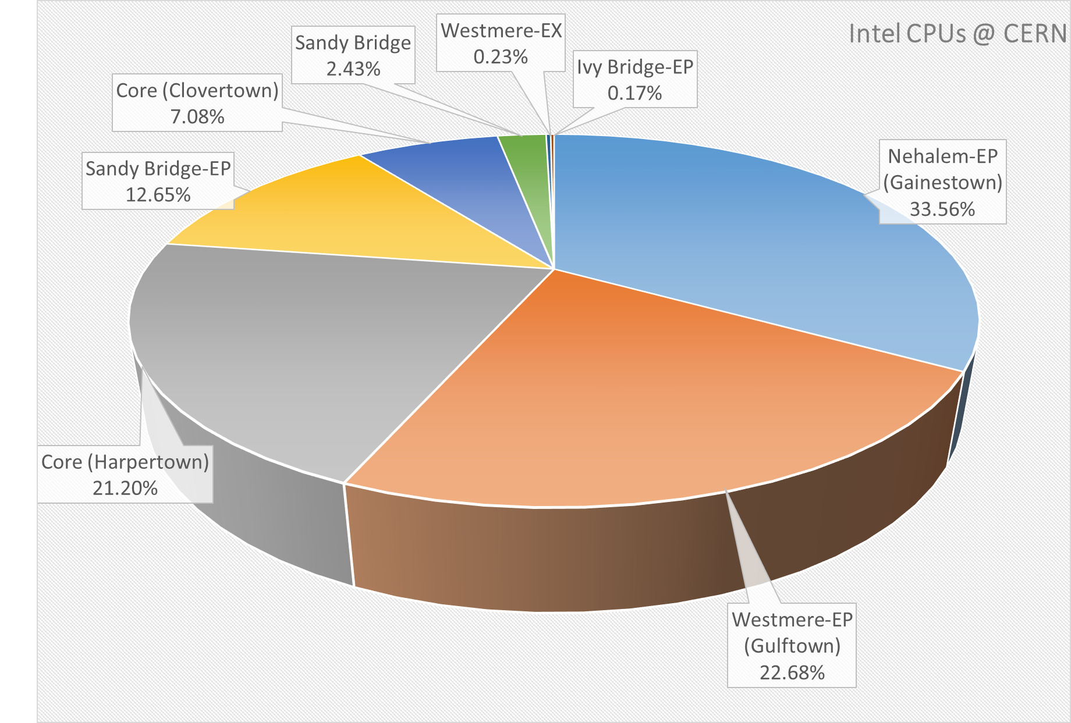
Intel CPUs in production
Nehalem-EP (Gainestown) | 5261
Westmere-EP (Gulftown) | 3556
Core (Harpertown) | 3324
Sandy Bridge-EP | 1983
Core (Clovertown) | 1110
Sandy Bridge | 381
Westmere-EX | 36
Ivy Bridge-EP | 27
Total CPUs | 15678
Cores | 81140
A new batch of 400 nodes with 800 Ivy Bridge CPUs is being deployed and will enter production at the end of March.
Data as of 28/02/2014

Slide 35
Intel-CERN openlab V activities
Data acquisition (online)
  Investigate move from custom hardware L1 filters/triggers to commodity CPU/CoP and software filters
  High-speed (multi TB/s) networking
Computing and data processing (offline)
  Software optimization on multi-core platforms (Geant V)
  Hardware benchmarking and testing
Compute provisioning and management
  OpenStack optimization, management modules (Service Assurance Manager, SAM)
Data Analytics
  Data center services and software (Hadoop, Lustre)

Slide 36
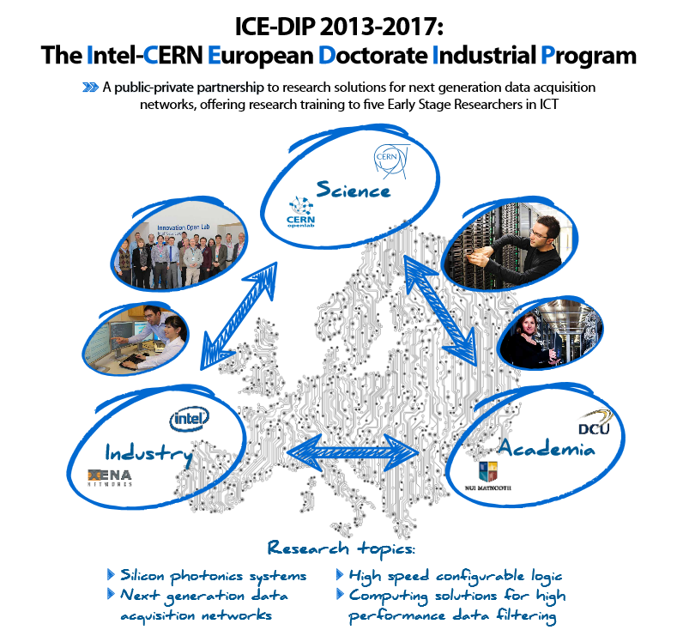

CERN has recruited 5 PhD students on 3 year fellowship contracts starting autumn 2013
Each PhD student is seconded to Intel for 18 months and works with LHC experiments on future upgrade research themes
Associate partners: Nat. Univ. Ireland Maynooth & Dublin City Univ. (recruits are enrolled in PhD programmes), Xena Networks (SME, Denmark)
EC funding: ~ €1.25 million over 4 years

Slide 37
Conclusions
CERN and the LHC program have been among the first to experience and address “big data” challenges
Solutions have been developed and important results obtained, also with important contributions from LA
Need to exploit emerging technologies and share expertise with academia and commercial partners
LHC schedule will keep it at the bleeding edge of technology, providing excellent opportunities to companies to test ideas and technologies ahead of the market
Intel and CERN openlab collaboration has been very successful until now and we look forward to future work together

Slide 38
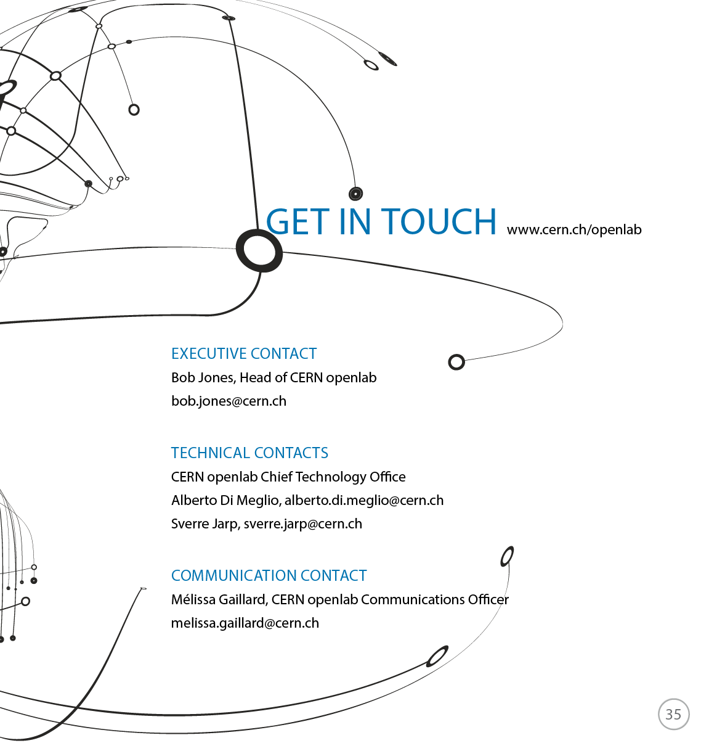

This work is licensed under a Creative Commons Attribution-ShareAlike 3.0 Unported License. It includes photos, models and videos courtesy of CERN and uses contents provided by CERN and CERN openlab staff and by Intel

