Slide 1
ICE-DIP project
Parallel processing on Many-Core processors
22/7/2014
ICE-DIP introduction at Intel

Slide 2
Agenda
CERN experiments and Online processing
High Level Trigger (HLT) architecture
The ICE-DIP Project
The research focus

Slide 3
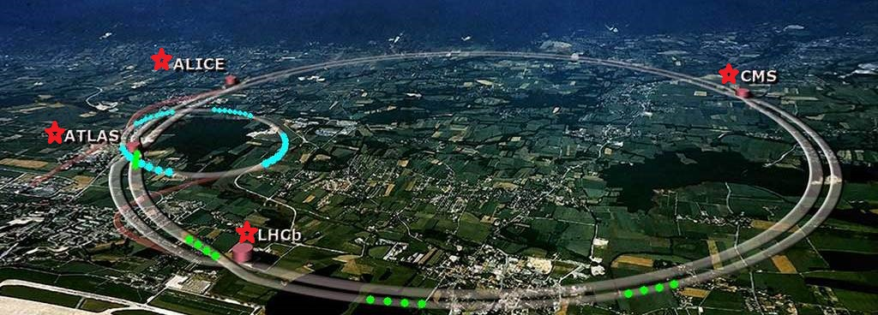
Physics Experiments at CERN

Slide 4
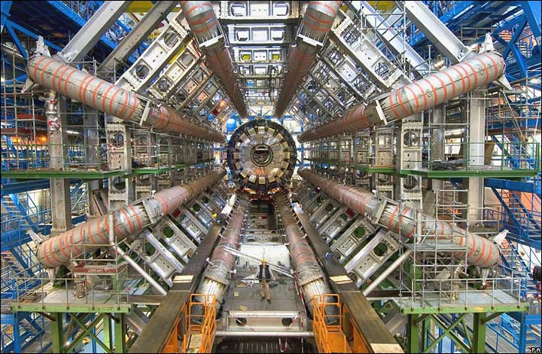
Particle Detector

Slide 5
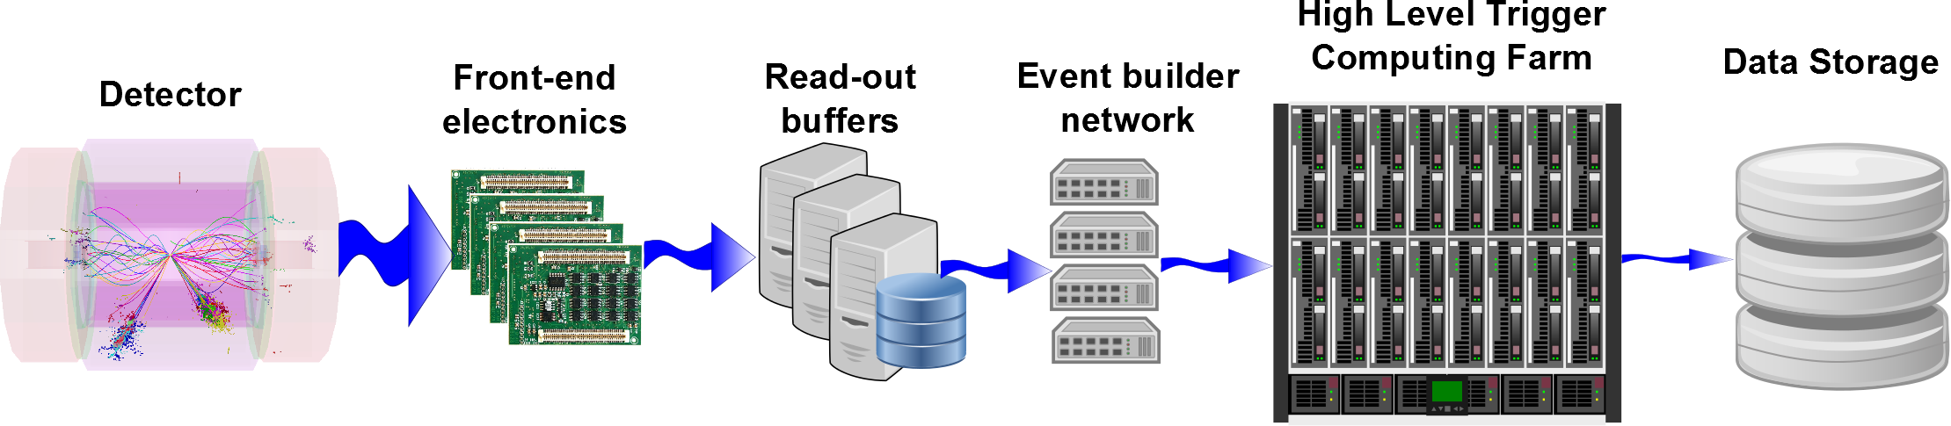
Online processing system

Slide 6
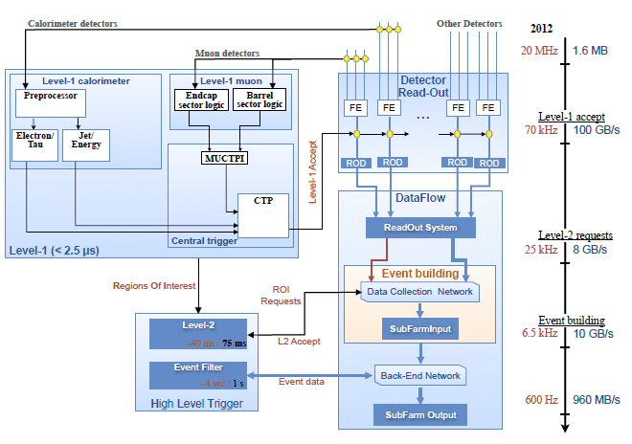
Trigger Data Acquisition(TDAQ) system – ATLAS, before upgrade

Slide 7
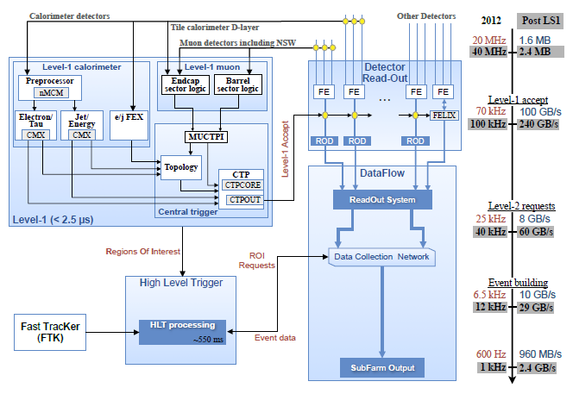
Trigger Data Acquisition(TDAQ) system – ATLAS, after upgrade

Slide 8
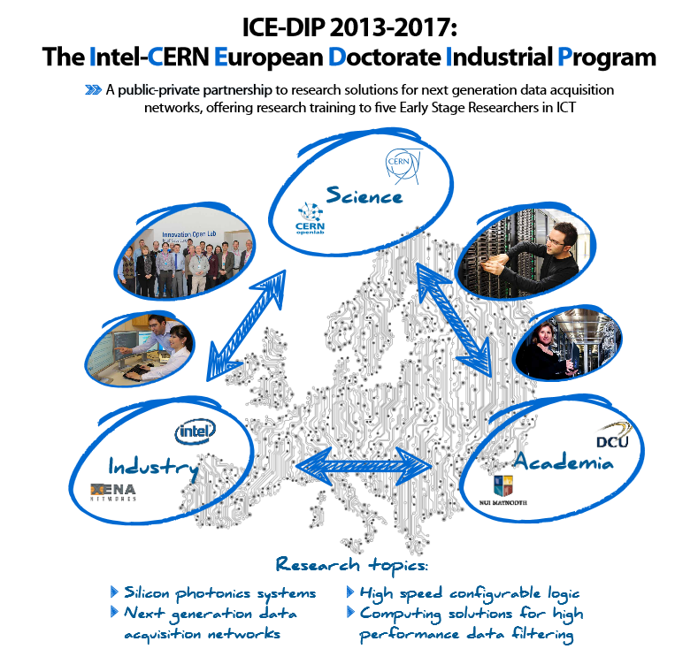

Slide 9
Science and Technology PoW reference
Theme | Researcher | WP | ESR | Challenge | Research
Silicon Photonics | Marcel Zeiler | WP1 | ESR1 | Need affordable, high throughput, radiation tolerant links | Design, manufacture, test under stress a Si- photonics link
Reconfi- gurable Logic | Srikanth Sridharan | WP2 | ESR2 | Reconfigurable logic is used where potentially more programmable CPUs could be proposed | A hybrid CPU/FPGA data pre-processing system
DAQ networks | Grzegorz Jereczek | WP3 | ESR3 | Bursts in traffic are not handled well by off-the-shelf networking equipment | Loss-less throughput up to multiple Tbit/s with new protocols
High performance data filtering | Aram Santogidis Przemysław Karpiński | WP4 | ESR4 | Accelerators need network data, but have very limited networking capabilities | Direct data access for accelerators (network- bus-devices-memory)
 |  |  | ESR5 | Benefits of new computing architectures are rarely fully exploited by software | Find and exploit parallelization opportunities and ensure forward scaling in DAQ networks
Material from Andrzej Nowak - ICE-DIP overview

Slide 10
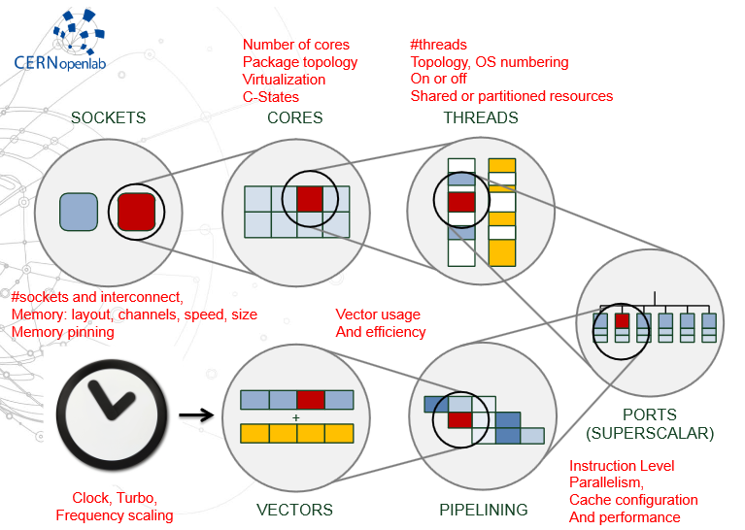
7 Degrees Of Freedom
Picture from: A. Nowak – „The evolving marriage of hardware and software”

Slide 11
7 Degrees Of Freedom Prison
Picture from: A. Nowak – „The evolving marriage of hardware and software”

Slide 12
7 Degrees Of Freedom Prison
Increase clock, increase speed. Can we do that?
Picture from: A. Nowak – „The evolving marriage of hardware and software”

Slide 13
7 Degrees Of Freedom Prison
Do we have vectors ready for computation?
Increase clock, increase speed. Can we do that?
Picture from: A. Nowak – „The evolving marriage of hardware and software”

Slide 14
7 Degrees Of Freedom Prison
Do we have vectors ready for computation?
Increase clock, increase speed. Can we do that?
Can we predict operation dependencies?
Picture from: A. Nowak – „The evolving marriage of hardware and software”

Slide 15
7 Degrees Of Freedom Prison
Do we have vectors ready for computation?
Are ports equally capable?
Increase clock, increase speed. Can we do that?
Can we predict operation dependencies?
Picture from: A. Nowak – „The evolving marriage of hardware and software”

Slide 16
7 Degrees Of Freedom Prison
Are threads competing for resources?
Do we have vectors ready for computation?
Are ports equally capable?
Increase clock, increase speed. Can we do that?
Can we predict operation dependencies?
Picture from: A. Nowak – „The evolving marriage of hardware and software”

Slide 17
7 Degrees Of Freedom Prison
Are the cores competing for resources?
Are threads competing for resources?
Do we have vectors ready for computation?
Are ports equally capable?
Increase clock, increase speed. Can we do that?
Can we predict operation dependencies?
Picture from: A. Nowak – „The evolving marriage of hardware and software”

Slide 18
7 Degrees Of Freedom Prison
Are the cores competing for resources?
Are threads competing for resources?
Are the sockets communicating with each other?
Do we have vectors ready for computation?
Are ports equally capable?
Increase clock, increase speed. Can we do that?
Can we predict operation dependencies?
Picture from: A. Nowak – „The evolving marriage of hardware and software”

Slide 19
CERN software
Multiple „big” frameworks
Code developed by physicists
Code developed in a hurry
Detector systems specific knowledge
Development criteria change over time

Slide 20
CERN software
Multiple „big” frameworks
- >250000 C++ code lines
Code developed by physicists
- unexperienced in computer science
Code developed in a hurry
- people employeed for short term contracts
Detector systems specific knowledge
- custom hardware
Development criteria change over time
- physics change

Slide 21
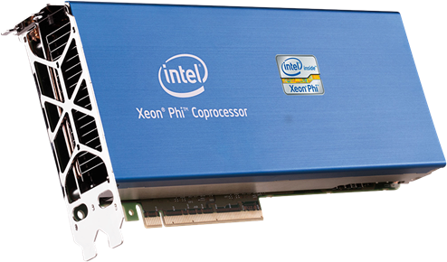
Many-core processors in high throughput data filtering applications
Will conduct research on the Intel Xeon Phi:
Time and energy costs in the context of High Energy Physics
Programmability in terms of existing frameworks
Deployment model and scalability
Performance tuning methodology

Slide 22
Current Ideas
Implicit vectorization library (www.agner.org/optimize)
Template metaprogramming for high hardware utilisation
LHCb Framework abstraction Layer for MIC (http://proj-gaudi.web.cern.ch/proj-gaudi/)
Performance Auto-tuning

Slide 23
Questions and Answers
?

