Slide 1
CERN Science and Technology
Alberto Di Meglio
CERN openlab Head
DOI: 10.5281/zenodo.18183, CC-BY-SA, images courtesy of CERN

Slide 2
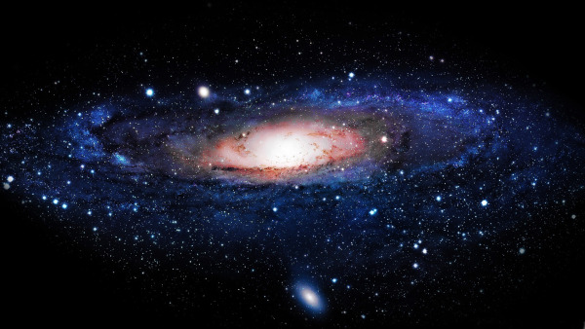
The Higgs Boson completes the Standard Model,
but the Model explains only about 5% of our Universe
What is the other 95% of the Universe made of?
How does gravity really works?
Why there is no antimatter in nature?

Slide 3
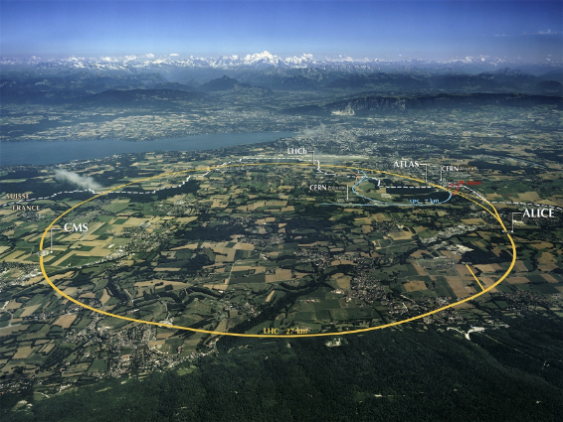
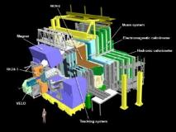
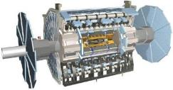
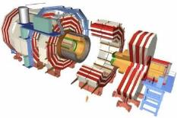
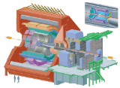
The Large Hadron Collider (LHC)
ATLAS
LHCb
CMS
ALICE

Slide 4
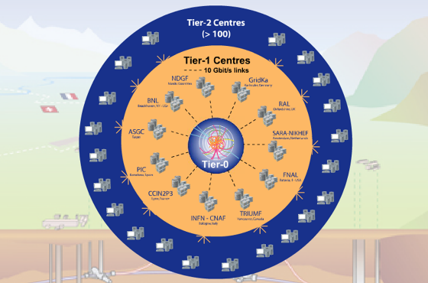
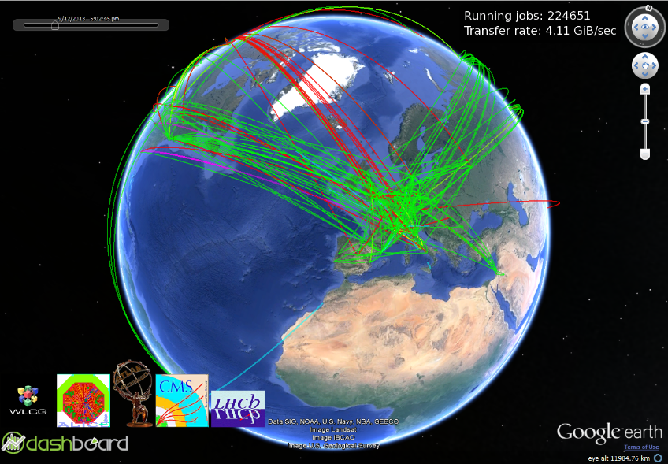
Worldwide LHC Computing Grid
Tier-0 (CERN):
Data recording
Initial data reconstruction
Data distribution
Tier-1 (12 centres):
Permanent storage
Re-processing
Analysis
Tier-2 (68 Federations, ~140 centres):
Simulation
End-user analysis
525,000 cores
450 PB

Slide 5
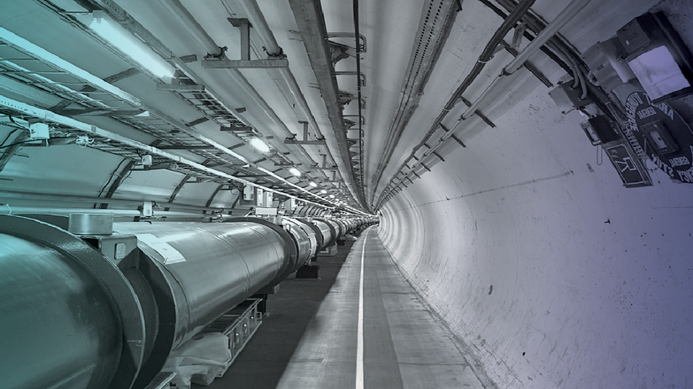
1 PB/s of data generated by the detectors
Up to 30 PB/year of stored data
A distributed computing infrastructure
of half a million cores working 24/7
An average of 40M jobs/month
An continuous data transfer rate of 4-6 GB/s
across the Worldwide LHC Grid

Slide 6
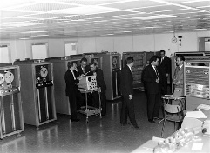
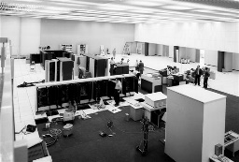
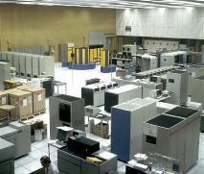
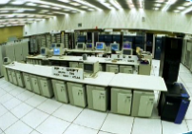
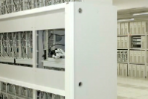
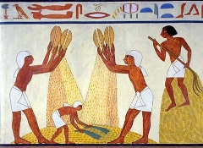
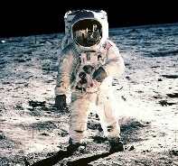
Processing 1 year of LHC data
?
IBM 7090
CDC 7670
Cray X-MP/48
HP-UX
Commodity
The Grid
Next Gen
1960
1970
1985
1995
2005
Today
Tomorrow
Big Bang
Cretaceous
“Lucy”
Agriculture
Moon
Higgs
~1 month
13.2B years
65M years
3.2M years
11,000 years
45 years
1 year

Slide 7
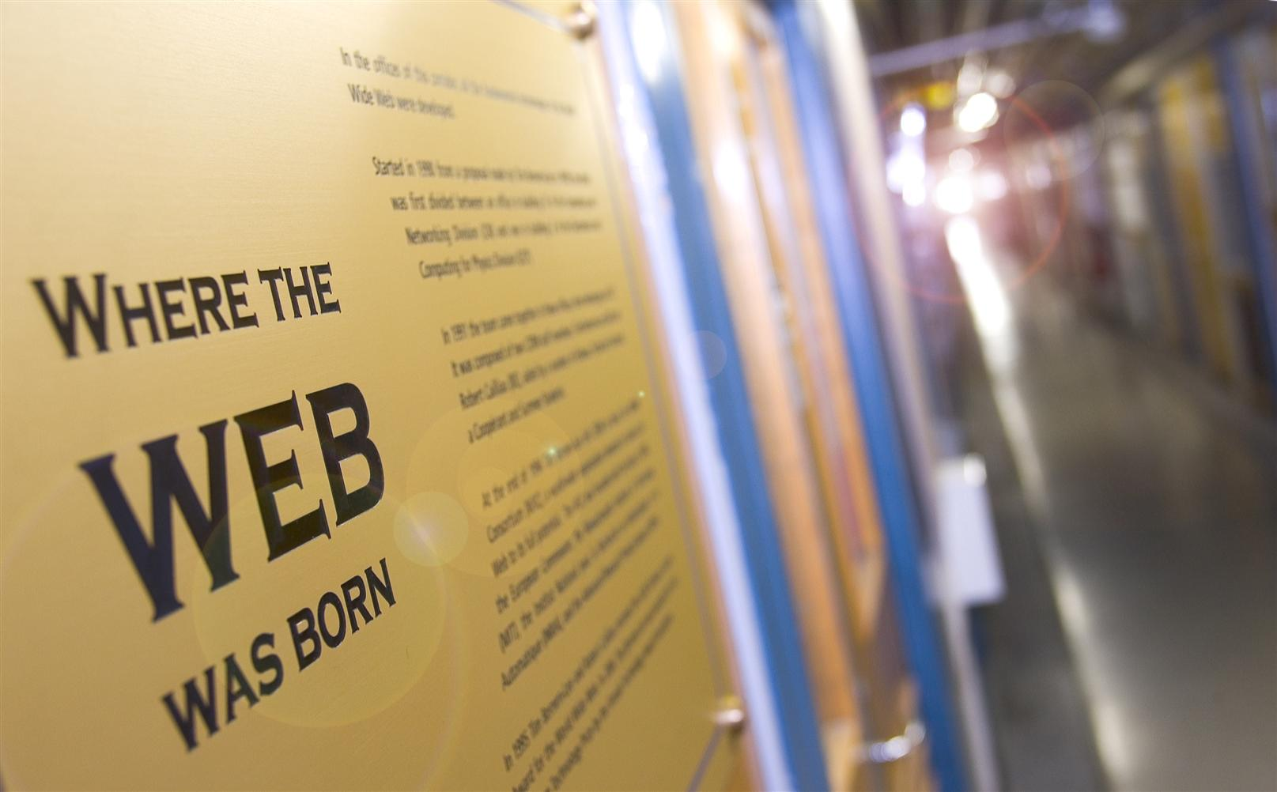
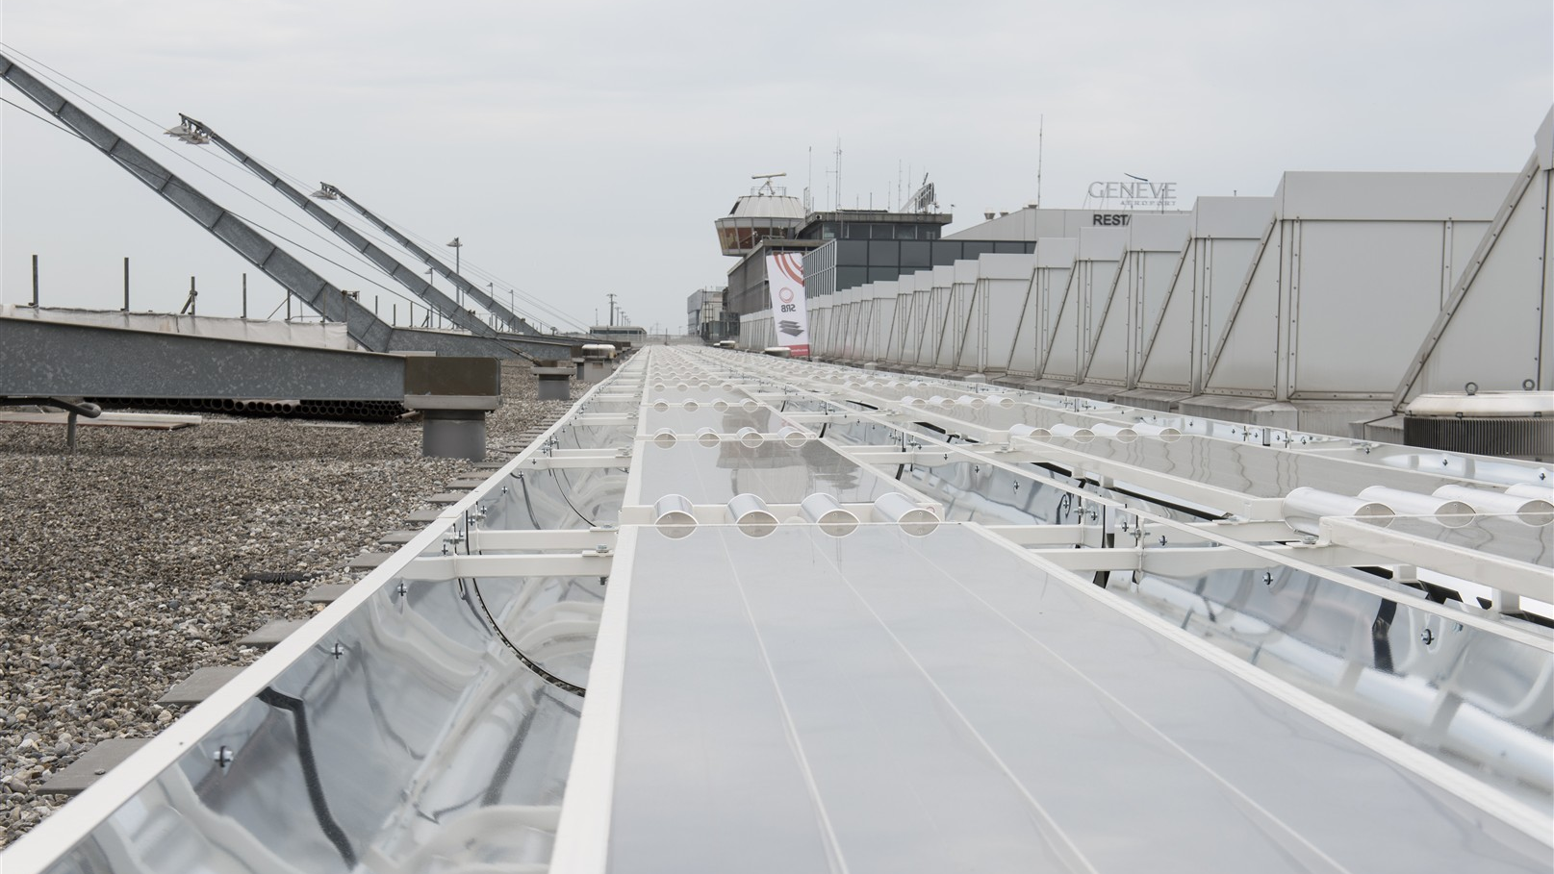
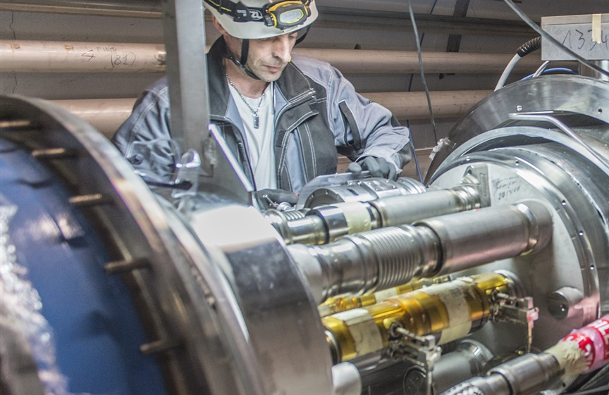
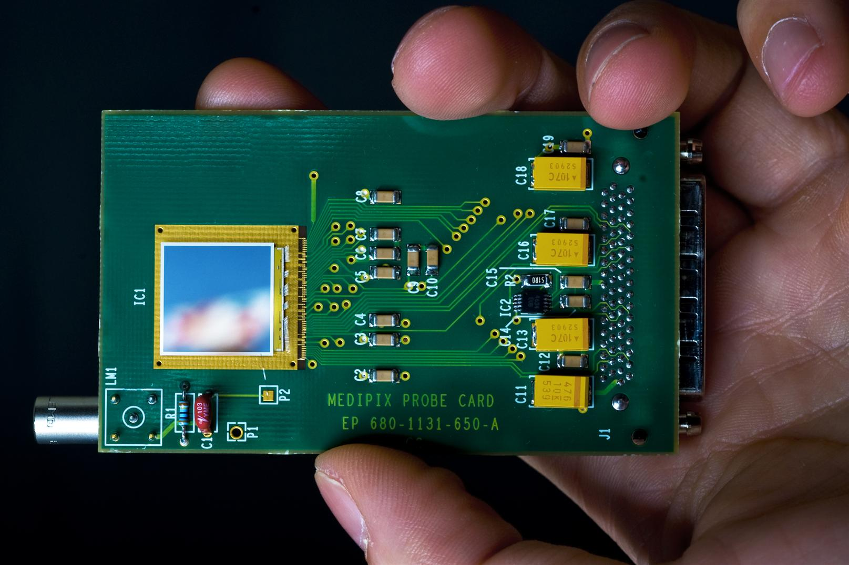
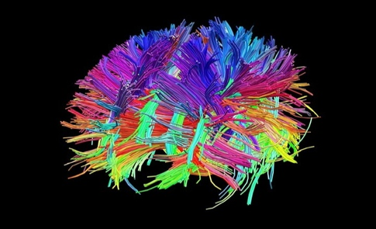
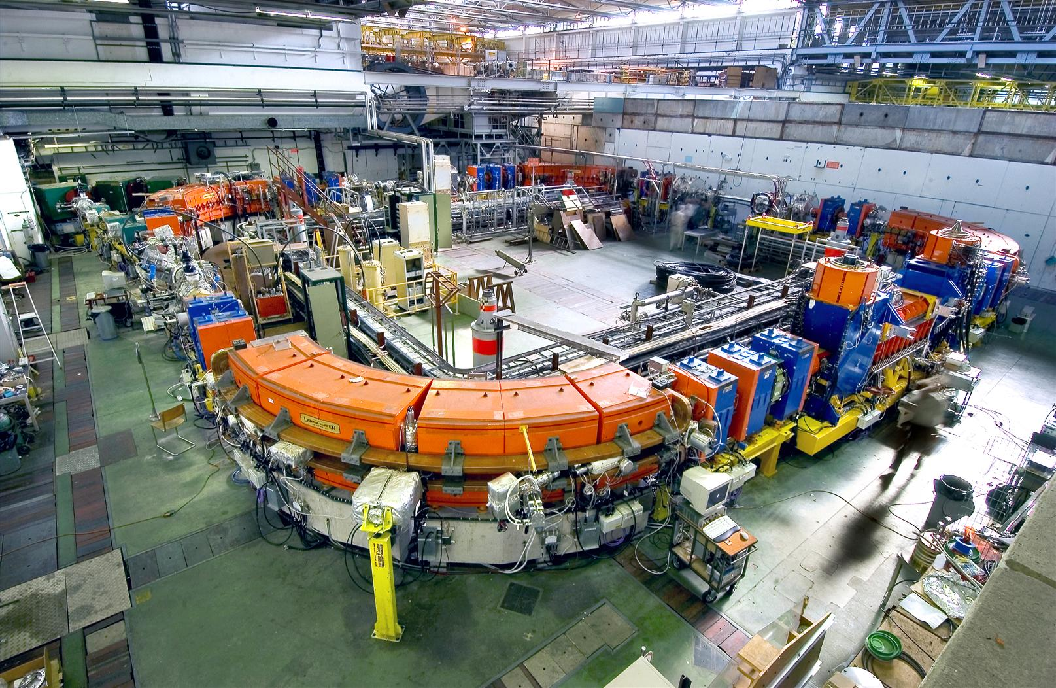
From Science to Technology
The World Wide Web
High-Efficiency Solar Panels
Mechanical Eng.
Material Science
Radiation Sensors
Simulation Software
Hadron Therapy

Slide 8
LHC Schedule
2009
2010
2011
2011
2013
2014
2015
2016
2017
2018
2019
2020
2021
2022
2023
2024
…
2030?
First run
LS1
Second run
LS2
Third run
LS3
HL-LHC
FCC?
LHC startup
900 GeV
Phase-0 Upgrade
(design energy,
nominal luminosity)
Phase-1 Upgrade
(design energy,
design luminosity)
Phase-2 Upgrade
(High Luminosity)
An order or two of magnitude
more data than today to be collected, processed and stored
in the next 10 years
7 TeV
L=6x10³³ cm⁻²s⁻¹
Bunch spacing = 50 ns
14 TeV
L=1x10³⁴ cm⁻²s⁻¹
Bunch spacing = 25 ns
14 TeV
L=2x10³⁴ cm⁻²s⁻¹
Bunch spacing = 25 ns
14 TeV
L=1x10³⁵ cm⁻²s⁻¹
Spacing = 12.5 ns

Slide 9
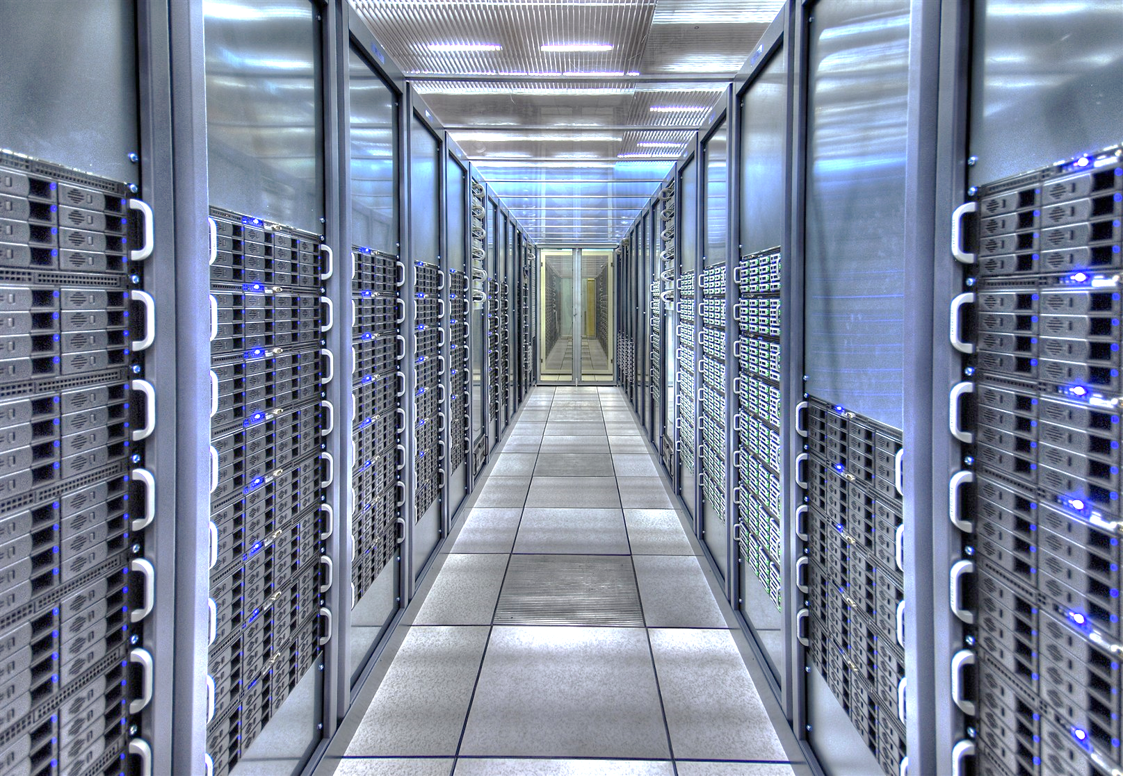
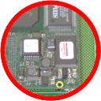
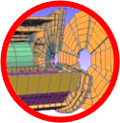
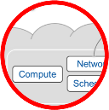
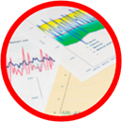
Information Technology Research Areas
Data acquisition and filtering
Computing platforms, data analysis, simulation
Data storage and long-term data preservation
Compute provisioning (cloud)
Networks
Data analytics

Slide 10
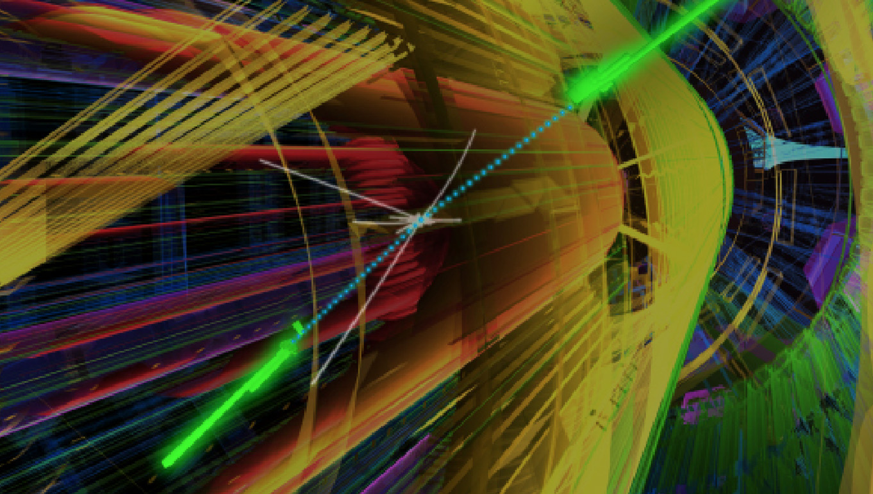
Next Frontiers
Exotic Particles
Supersymmetry
Dark Matter
13 TeV Collisions
Quark-Gluon Plasma
Extra Dimensions
Antimatter

Slide 11
Executive contact
Alberto Di Meglio, CERN openlab Head
alberto.di.meglio@cern.ch
Technical contact
Fons Rademakers, CERN openlab CTO
fons.rademakers@cern.ch
Communication contact
Mélissa Gaillard, CERN openlab Communication Officer
melissa.gaillard@cern.ch
Admin contact
Kristina Gunne, CERN openlab Administration Officer
kristina.gunne@cern.ch
This work is licensed under a Creative Commons Attribution-ShareAlike 3.0 Unported License. It includes photos, models and videos courtesy of CERN and uses contents provided by CERN and CERN openlab

