Slide 1
Big and Smart Data Analytics
Possible advantages to clinical practice
Medical Record Update, Pesaro, 20 October 2015
Alberto Di Meglio
CERN openlab Head
Marco Manca
Senior Research Fellow – CERN Medical Applications
DOI: 10.5281/zenodo.32481 License: CC-BY-SA

Slide 2
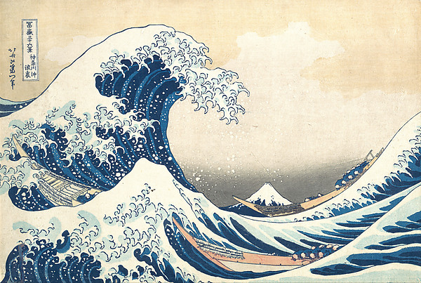
What is Big Data?
Under the wave off Kanagawa – Hokusai, ca. 1830 – MET - H. O. Havemeyer Collection, Bequest of Mrs. H. O. Havemeyer, 1929

Slide 3
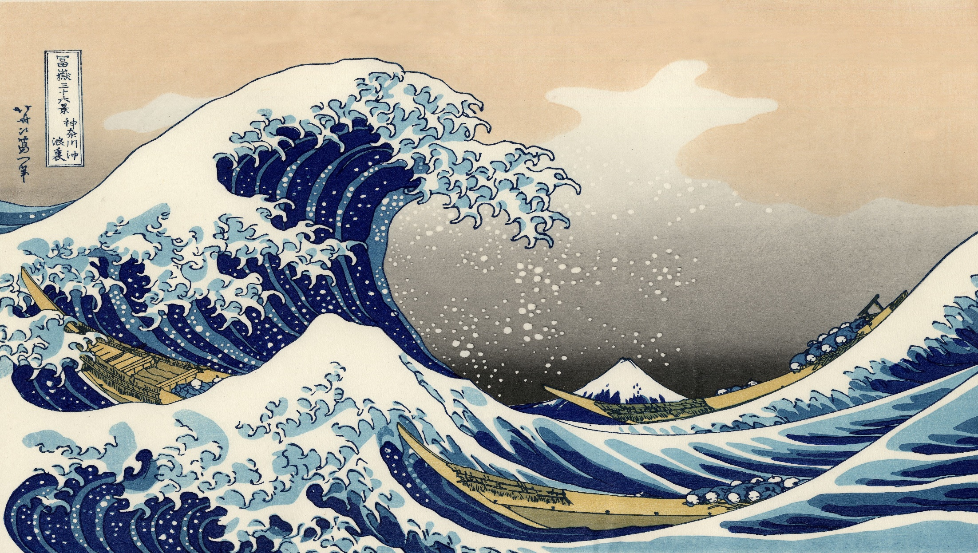
Value
Veracity
Variability
Variety
}
3-V Definition
Velocity
Volume

Slide 4
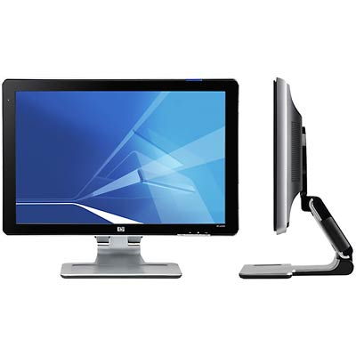
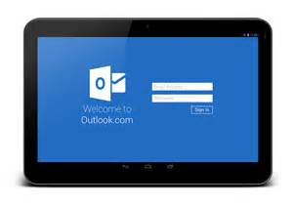
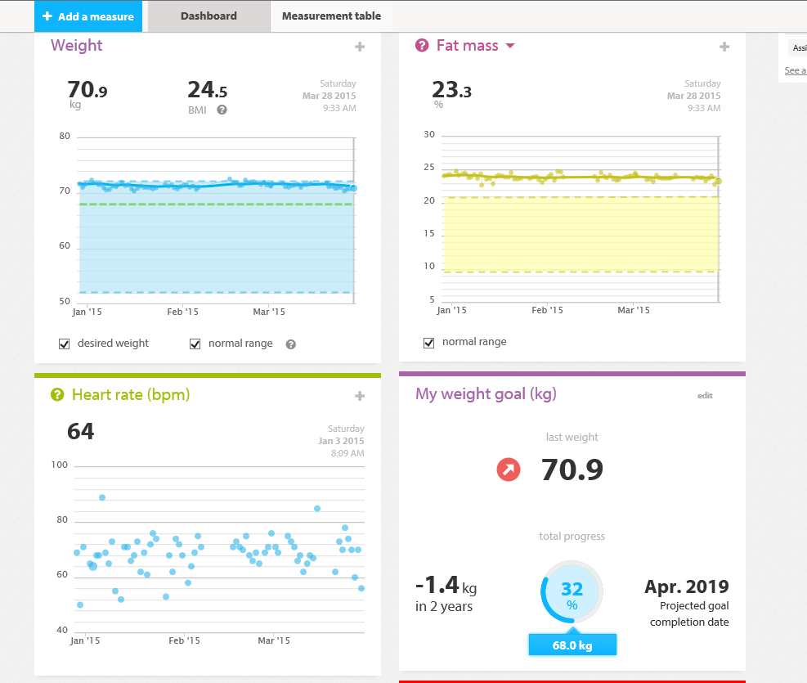
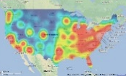
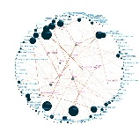
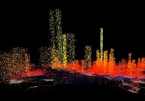
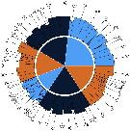
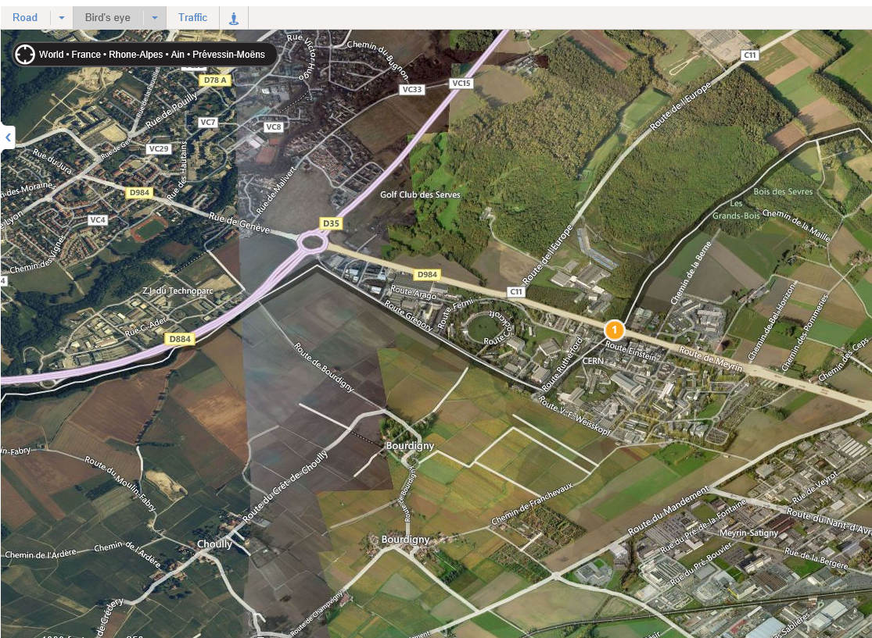

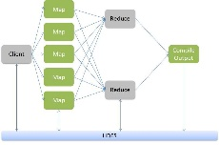

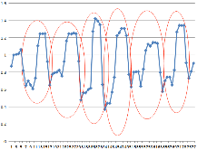
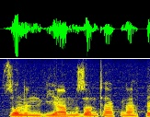


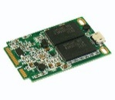
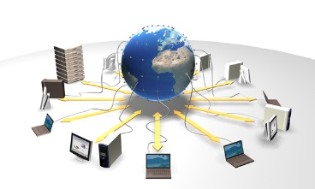
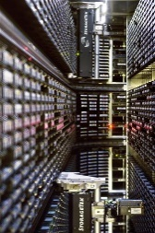
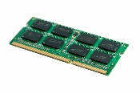
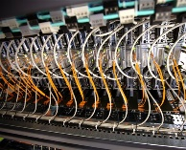

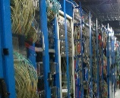
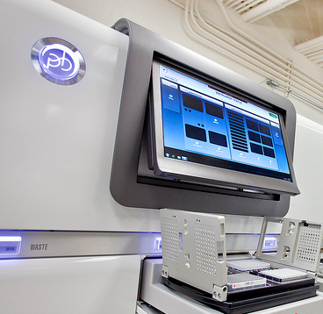
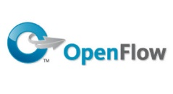
Information
Information
Applications designed
for “big data”
Software
Data visualization,
representation
Value
Veracity
Variability
Variety
Volume
Velocity
Data analysis
and analytics platforms
Pattern recognition, NLP
machine learning, predictive analytics
Platform
Large storage (disks, tapes, memory)
Distributed Computing and Data Grids, Clouds, HPC, Crowd Computing
Infrastructure
Fast data acquisition systems
Flexible networks

Slide 5
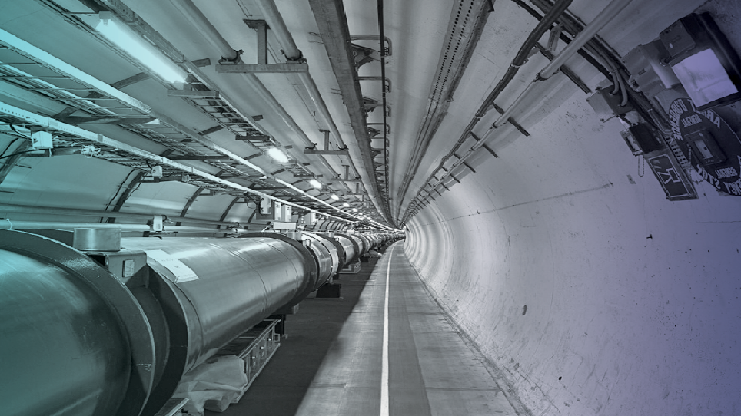
1 PB/s of data generated by the detectors
Up to 30 PB/year of stored data
A distributed computing infrastructure
of half a million cores working 24/7
An average of 40M jobs/month
An continuous data transfer rate of 4-6 GB/s
across the Worldwide LHC Grid

Slide 6
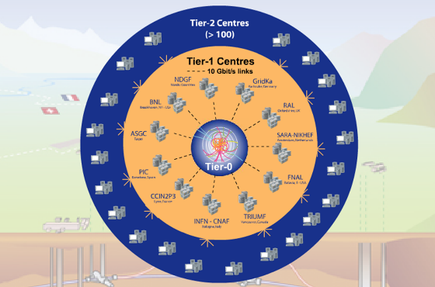
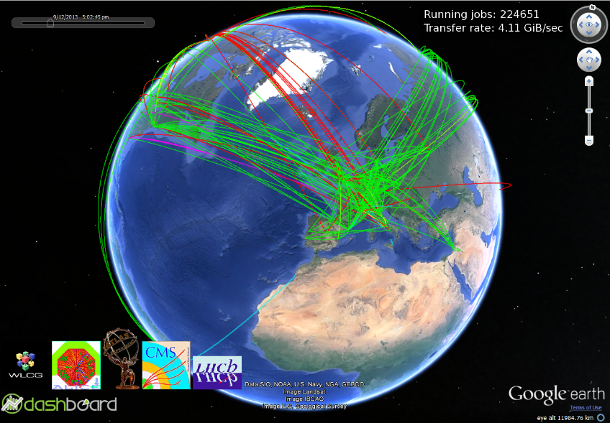
Worldwide LHC Computing Grid
Tier-0 (CERN):
Data recording
Initial data reconstruction
Data distribution
Tier-1 (13 centres):
Permanent storage
Re-processing
Analysis
Tier-2 (68 Federations, ~140 centres):
Simulation
End-user analysis
525,000 cores
450 PB

Slide 7
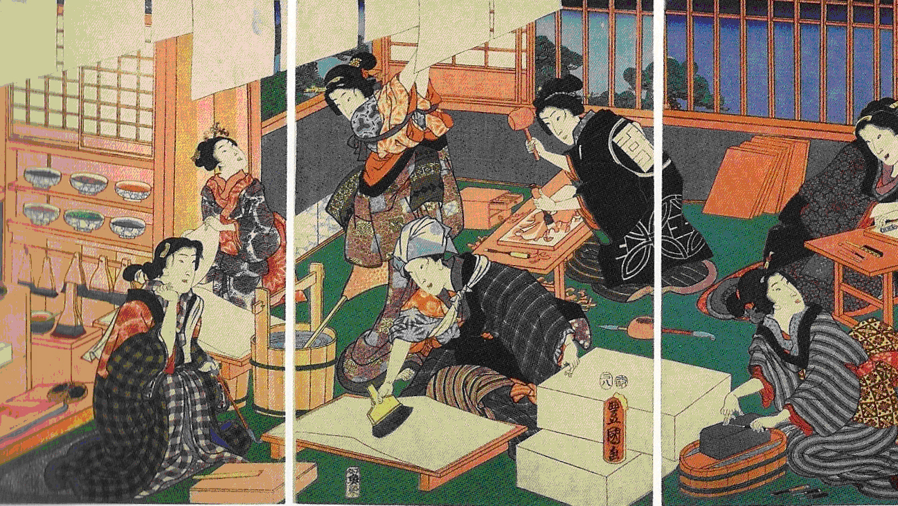
Big Data Technology
Artisans – Utagawa Kunisada, 1857 – British Museum -- CC BY-NC-SA 4.0

Slide 8
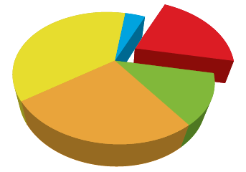

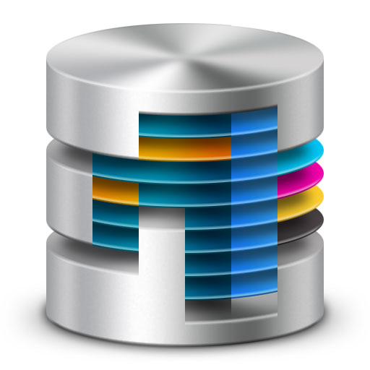

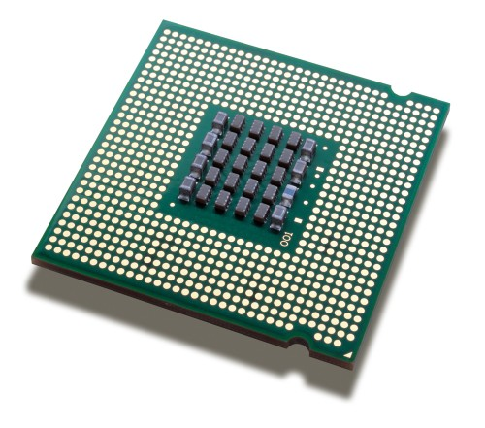
Data
Infrastructure
Computing
Analytics
Learning

Slide 9
It’s all about Data
Big > ~10s of TB over a (random) short period of time
Slow/Fast is not an absolute value
Local/Distributed: cost and logistics of (secure) data storage and transfers
Public/Private: most characterizing property of healthcare applications, not just technical
Legacy: not only the data itself (format), but how it is stored and accessed (Excel, SQL, etc.)
Unstructured ~ 80% (estimated)
Stand-alone/Shared is about interoperability and standards compliance
Store/Reproduce: how much must be stored, for how long, how much can be reproduced? Not the same as Raw or Processed data

Slide 10
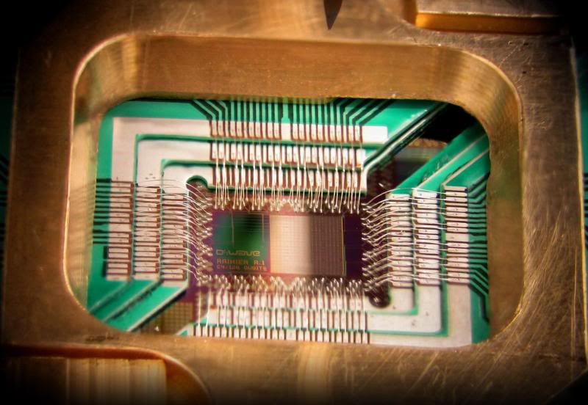
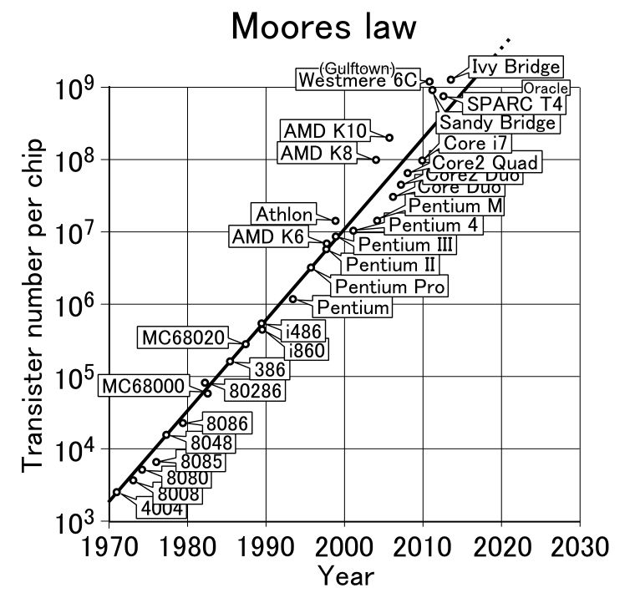
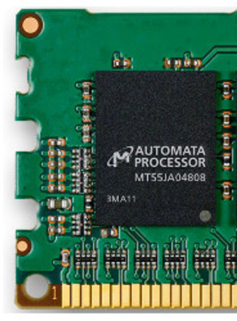
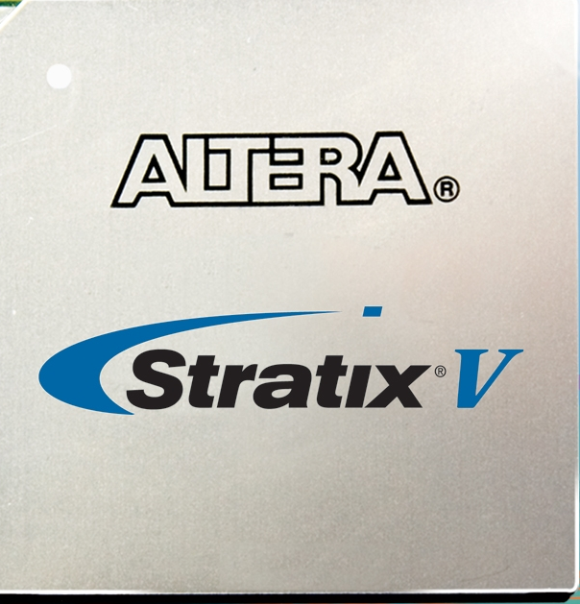
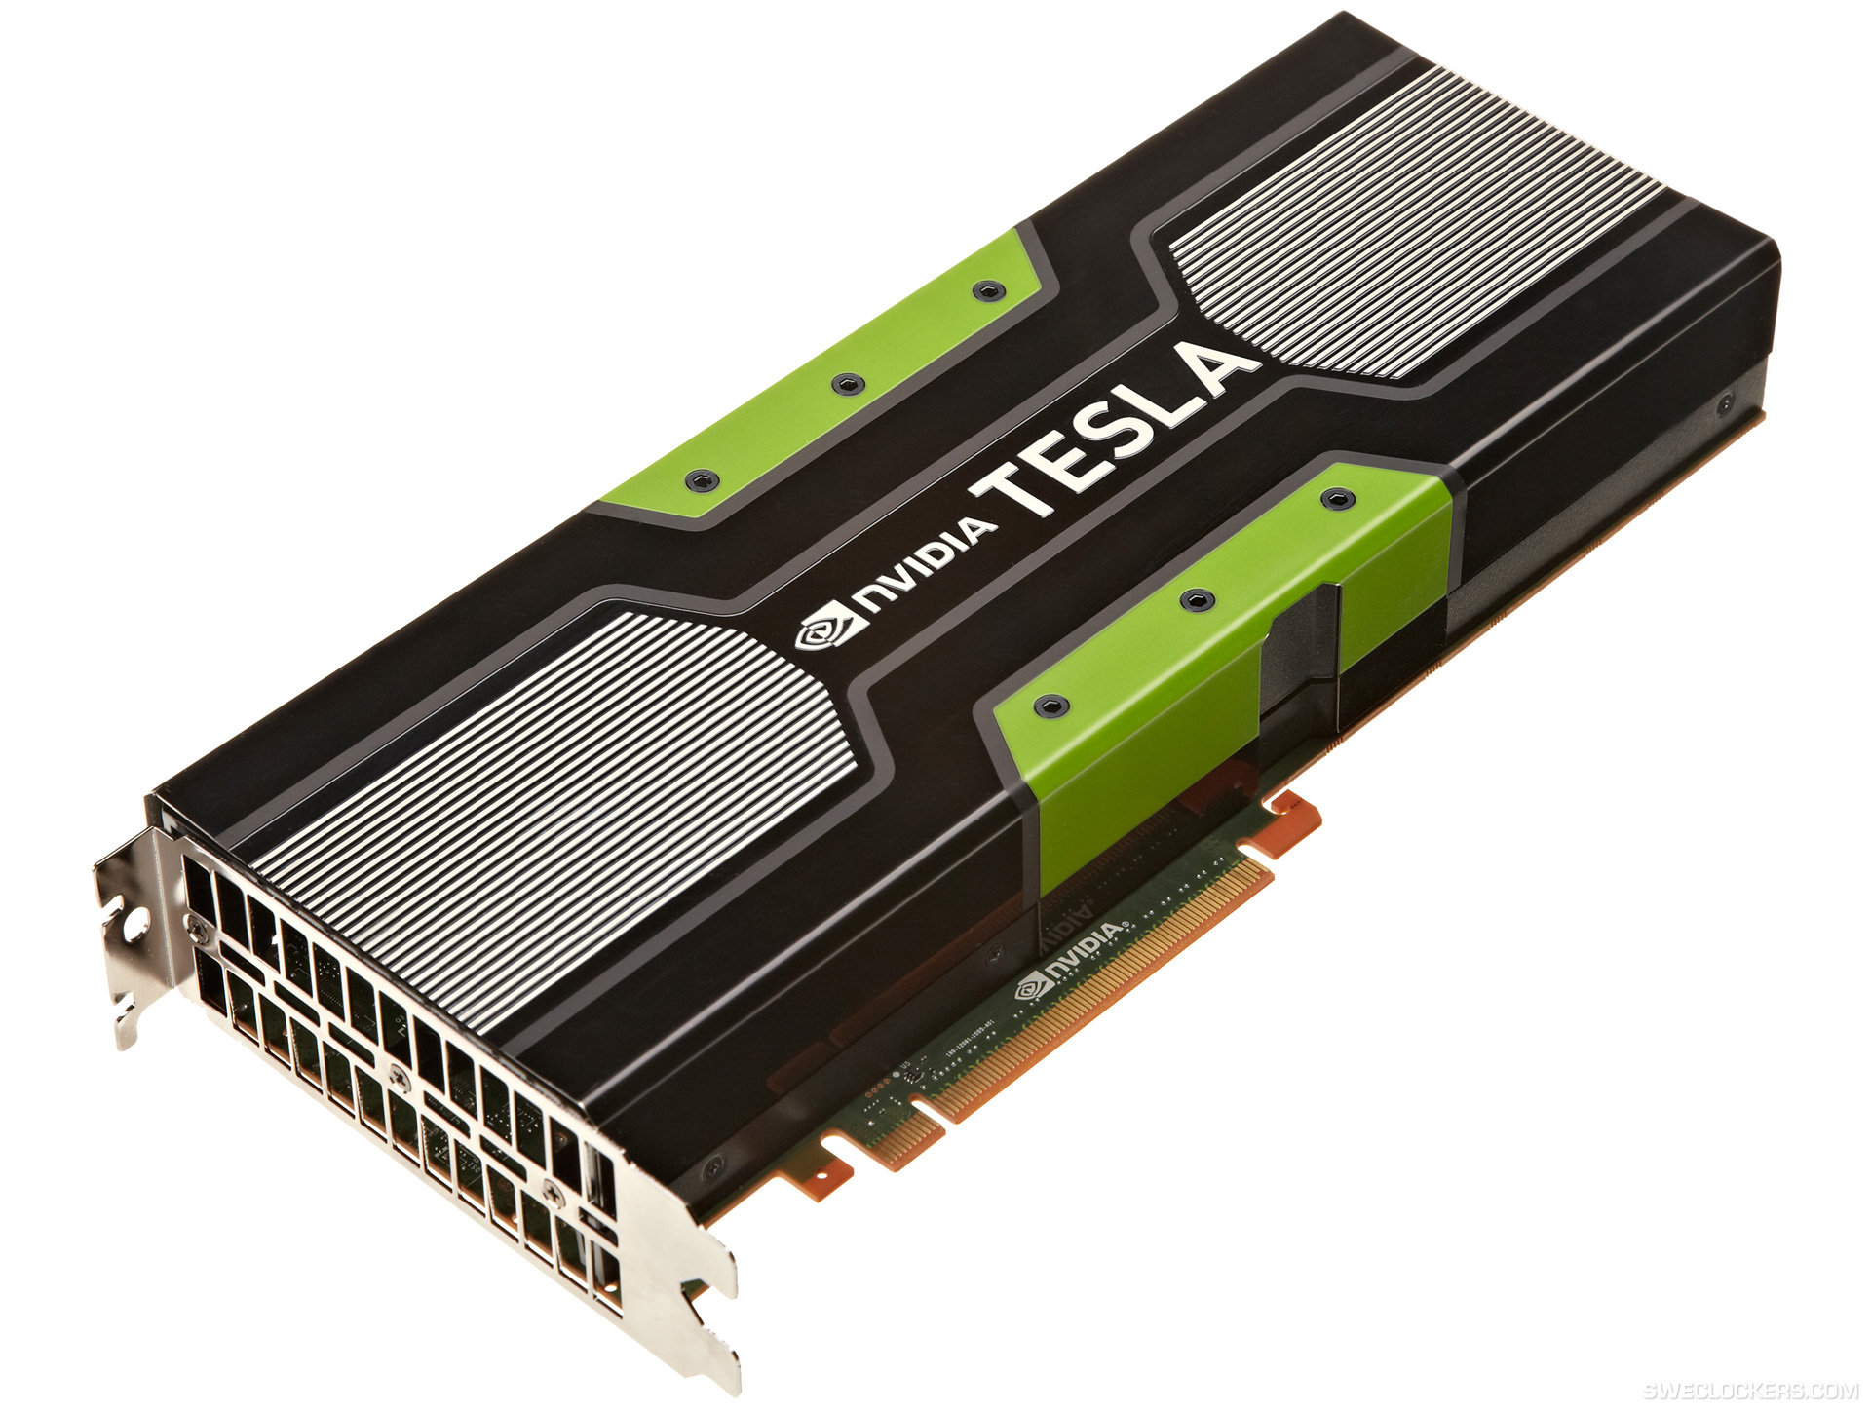
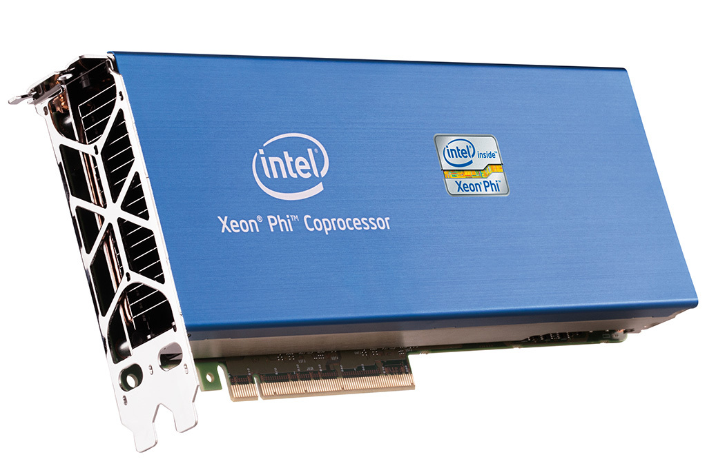
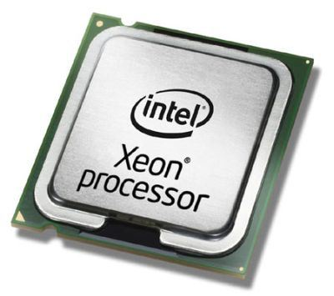
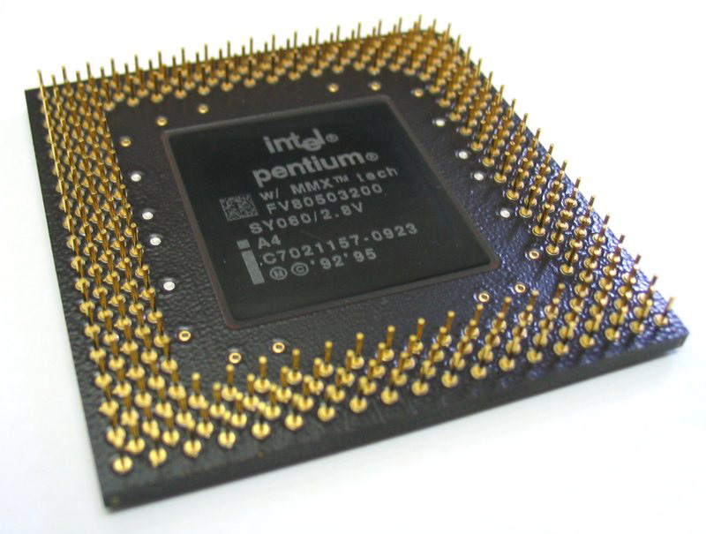
Computing Platforms
Moore’s Law
… and beyond
2015
2014
Skills
Multicore CPU programming, graphical processors (GPU),
multithreaded
software
2010
2000
Domain Specialist with Software & Computing Engineering skills
1995

Slide 11

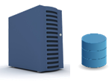
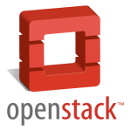

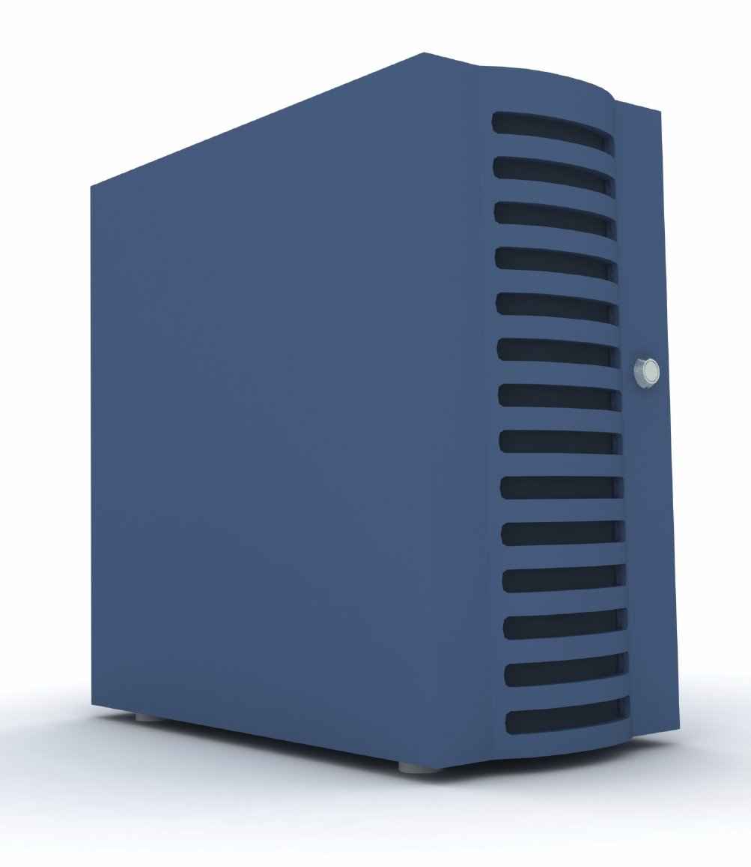


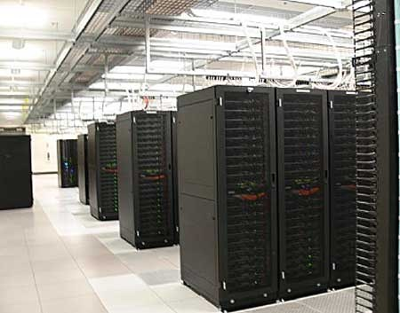


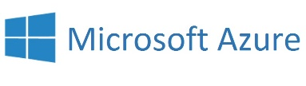
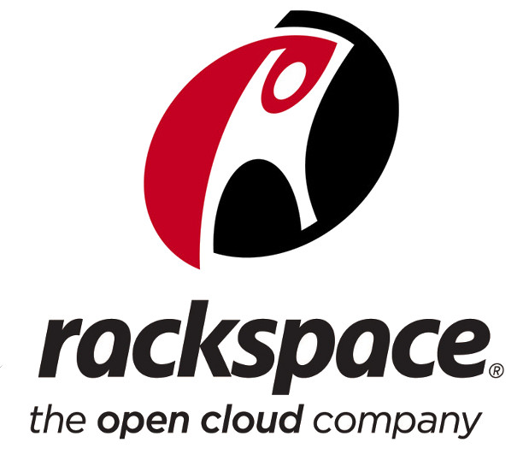
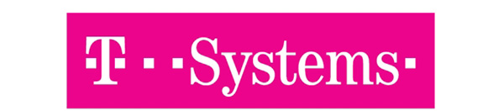
Cloud Federation
Infrastructures
Hybrid
Hybrid
Private
Public
Commercial
Skinny
Fat

Slide 12


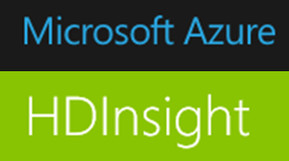


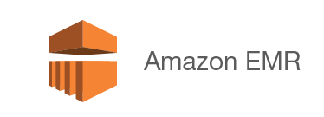
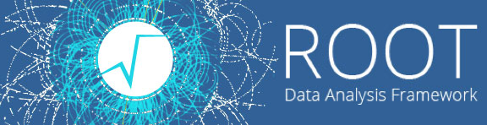
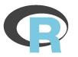



Data Analytics
Public
?
Data Analytics Platforms
(Offline) Batch
Stream (online, real-time)
Infrastructure

Slide 13



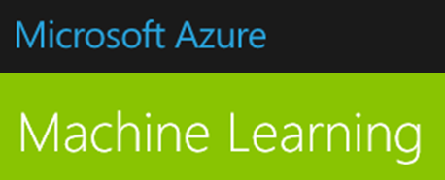

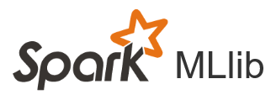

Machine Learning
NLP
Process automation
Data discovery models
Personalization
Predictive analytics
Decision Support Systems
Pattern recognition
Knowledge generation
Machine Learning Platforms
Oryx
Data Analytics Platforms

Slide 14
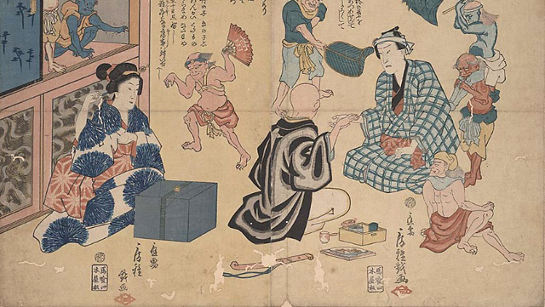
Healthcare and Clinical Practice Applications
Methods for preventing measles -- Utagawa Fusatane, 1858 -- UCSF Japanese Woodblock Print Collection

Slide 15








Image Analysis
Machine-learning-based content recognition, offline and (quasi) real-time anatomy localization, tissue segmentation,
support to diagnostics, automated/hybrid surgical rooms
Clinical Trials
Clinical Decision Support Systems
Optimization, targeted recruitment and enrollment via automated analysis of medical records, pipeline assessment/review
Large-scale data integration/analysis, structured/unstructured data, anonymization, treatment effectivess and risks predictions
Drug discovery
Trends and simulations
Combination of computing, simulations, textual descriptions of symptoms and expected outcomes
Preventive treatments, epidemics assessment and control, optimization of effort/budget allocations
Genomics
Healthy behaviour
NGS data,
analysis, storage, transfer at multi-PB scale, integration with other *omics and clinical data, personalized treatments
Monitoring/assessment, suggestions, personalized medicine, exploitation of data from wearable devices, social fitness/health platforms

Slide 16

















Healthcare Platforms: Examples
D3LVE
Green Brain
Distributed Data for Decision support and Learning as a Virtual Environment
D3LVE
Human Green Brain Project
CERN, Maestro Clinic, UCSC and others
Newcastle Neuroinformatics, CERN, other partners
(http://greenbrainproject.org)
Watson
Health and Fitness Social Networks
Watson Discovery Advisor for Life Sciences
Watson for Oncology
Watson for Clinical Trial Matching
Cúram

Slide 17

Big Data is also about Collaboration
Suminokura Red Seal Ship with Foreigners – Kiyomizu-dera Ema, 17th century

Slide 18

Towards the European Open Science Cloud
Hybrid – link public research organisations, e-Infrastructures & commercial cloud services
  Use GEANT network to link Research Infrastructures, repositories (EUDAT, OpenAIRE), EGI, PRACE etc. to commodity commercial cloud services (multiple providers)
  A cornerstone of the Open Science Commons*
Trust - Researchers keep control of the cloud and their data
  Guarantee a copy of all the data is kept on public resources
  Ensure long-term preservation of the data
  Insulate users from changes of service supplier and technology
  Transparent and inclusive governance model with strong voice for users
Economy - Must be cheaper than the ‘build our own’ approach
  Avoid separate ‘silos’ for each Research Infrastructure/Community
  Profit from the economies of scale in commercial data centres
* http://go.egi.eu/osc
http://dx.doi.org/10.5281/zenodo.16140
Courtesy Bob Jones - CERN
Notes:
So clearly there is a need to have a platform on which this data can be managed.
Sharing of data is necessary, increasing and must be encouraged by the platform but it has to respect the cultures and investments made by the research communities.
Researchers have fears, some of them irrational, about using commercial cloud services.
But telling someone who is afraid of flying that their fear is irrational does not mean they will get on the plane.
We have to make them feel secure. Here the hybrid cloud model can help by ensuring that a copy of their precious data is kept safe on publicly managed resources.
Economy – the price comparison must take into account all costs, not just the purchase price of h/w.

Slide 19

Coordination Activities
BioMedBridges is a joint effort of twelve biomedical sciences research infrastructures on the ESFRI roadmap.
Together, the project partners develop the shared e-infrastructure—the technical bridges—to allow data integration in the biological, medical, translational and clinical domains and thus strengthen biomedical resources in Europe
Copyright © BioMedBridges 2015

Slide 20
Final (humble) comments
The goals are ambitious
  Not really proven yet, a lot of hype to be aware of, but potential is great
Build accessible common platforms up to the SaaS layer
  Researchers cannot keep spending time in deploying technical infrastructures and tools
Co-design of domain-specific services
  Domain experts + compute/data scientists + service providers
  Build reusable services, integrate them in common platforms
Invest on education
  Handling data efficiently, selecting the right tools and methods requires specialised skills not easy to find today

Slide 21

Thank you!

