Slide 1

High performance I/O with the ZeroMQ (ØMQ) messaging library
thematic CERN School of Computing
Aram Santogidis <aram.snatogidis@cern.ch>
May 2015

Slide 2


Slide 3
What is the problem?
How to manage the complexity?
Multi-threaded applications on manycore CPUs (Andrzej Nowak, Danilo Piparo presentations)
I/O over Network in distributed systems (Sebastien Sponce)
Is there a robust solution for communication with high performance?
Notes:
How do we handle asynchronous I/O (Sebastien mentioned that we need that) (have a look at his slides again)
Dynamic components? (Reconnections etc.)
How to Represent messages on the wire (serialization, sequence numbers etc.). Does our messages representation scale both for small and large sizes?
How do we manage the queues? What if the consumer is slower than the producer?

Slide 4

What is
Intelligent socket library for messaging
High-speed asynchronous I/O
Concurrency framework (Erlang-style, CSP, Actor-model), scales on manycore
Common communication patterns
Bridges heterogeneous computing
Open Source, multi language-platform
Notes:
Custom TCP is expensive
First version 2007-8
Push-pull
Implicit synchronization with message passing
Publish subscribe, weather reporting up, Internet radio streaming
Publish-subscribe one-to-all broadcast
Push-pull (pipeline) one message to one worker in the pipeline
Actor model for inproc

Slide 5
What are the features of ZeroMQ?
Abstracts in-process, inter-process and inter-node transport layer
Over TCP, PGM, IPC and INPROC:
Asynchronous I/O, lock-free message passing
Automatic reconnections for dynamic modules
Message queue on Sender and Receiver
Zero-copy for large messages
Over 6 million messages / sec (8-cores machine) (http://zeromq.org/results:multicore-tests)

Slide 6
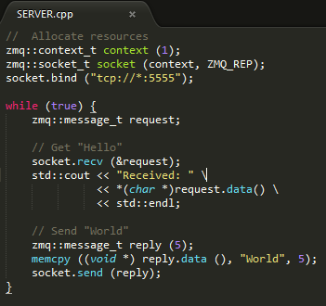
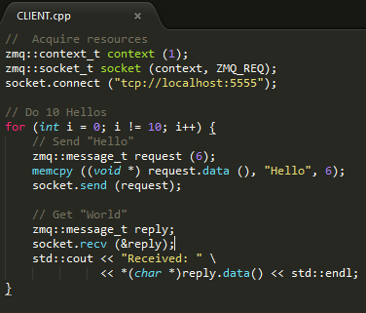
Request-Reply (Hello World) in ZeroMQ
Notes:
Notice the missing accept, with TCP you had to manage all the connected sockets, (select, etc.)
With TCP you would have to manage reconnection (say if the server is not available).

Slide 7
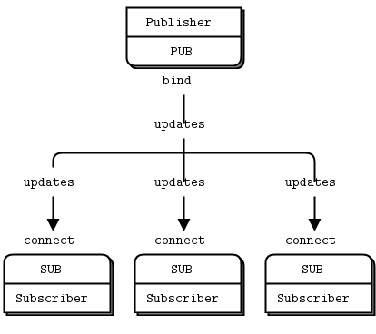
Publish-Subscribe pattern
One-way data distribution
Publisher broadcasts
Subscribers consume
Source: http://zguide.zeromq.org/page:all
Notes:
Check detector example, many publishers one subscriber

Slide 8
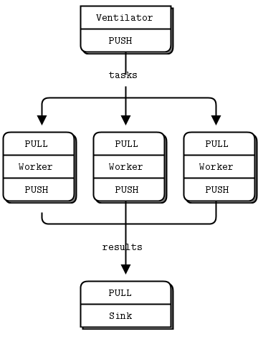
Pipeline (push-pull) pattern
Parallel data processing
Load balancing
Fair Queuing
Number of workers dynamically changes
Source: http://zguide.zeromq.org/page:all

Slide 9
ZeroMQ in the market
CERN: Comparison of messaging middleware (2011). ZeroMQ prevailed!
Stock trading companies
Multimedia streaming (Spotify)
Grid and Cloud computing
Embedded systems

Slide 10
THANK YOU
References:
* http://zguide.zeromq.org/page:all
* Middleware trends and market leaders 2011
A. Dworak, F. Ehm, W. Sliwinski, M. Sobczak, CERN, Geneva, Switzerland

