Slide 2

Modern Linux Tools for Oracle Troubleshooting
Luca Canali, CERN
Zbigniew Baranowski, CERN
UKOUG TECH14, Liverpool, December 2014

Slide 3
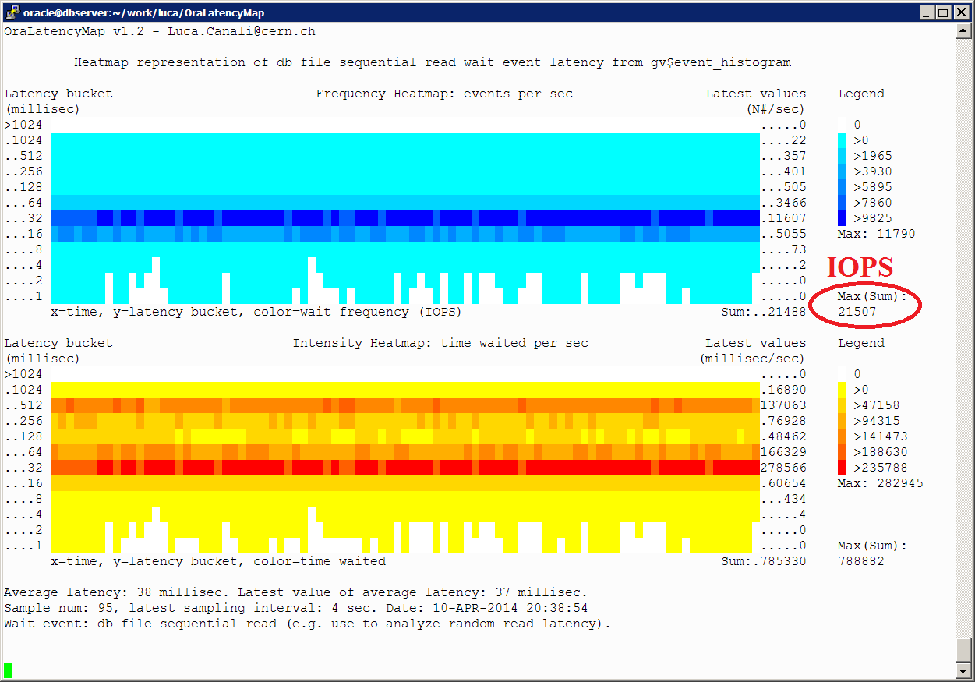

About Luca
Senior DBA and team lead at CERN IT
  Joined CERN in 2005
  Working with Oracle RDBMS since 2000
Passionate to learn and share knowledge, how to get most value from database technology
@LucaCanaliDB and http://cern.ch/canali

Slide 4

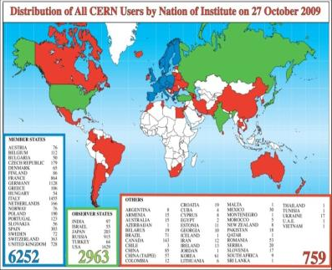
About CERN
CERN - European Laboratory for Particle Physics
Founded in 1954 by 12 countries for fundamental physics research in a post-war Europe
Today 21 member states + world-wide collaborations
  About ~1000 MCHF yearly budget
  2’300 CERN personnel + 10’000 users from 110 countries

Slide 5
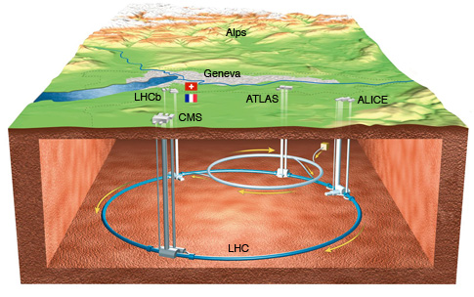
LHC is the world’s largest particle accelerator
LHC = Large Hadron Collider
  27km ring of superconducting magnets
  Currently undergoing upgrades, restart in 2015

Slide 6
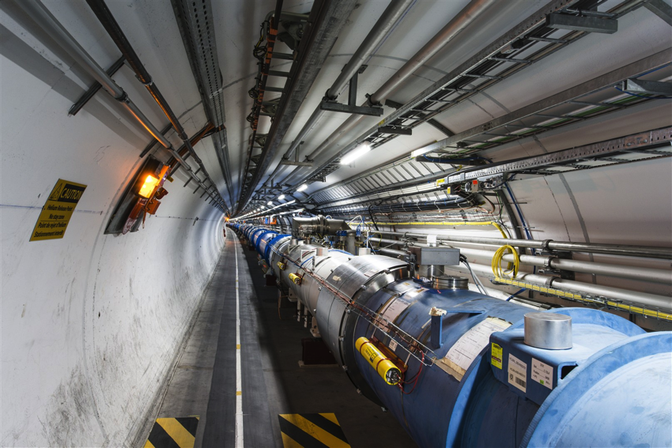

From particle
to article..
How do you get from this
to this
Notes:
New particle discovery: see also CMS and Atlas announcement on July 4th 2012.

Slide 7
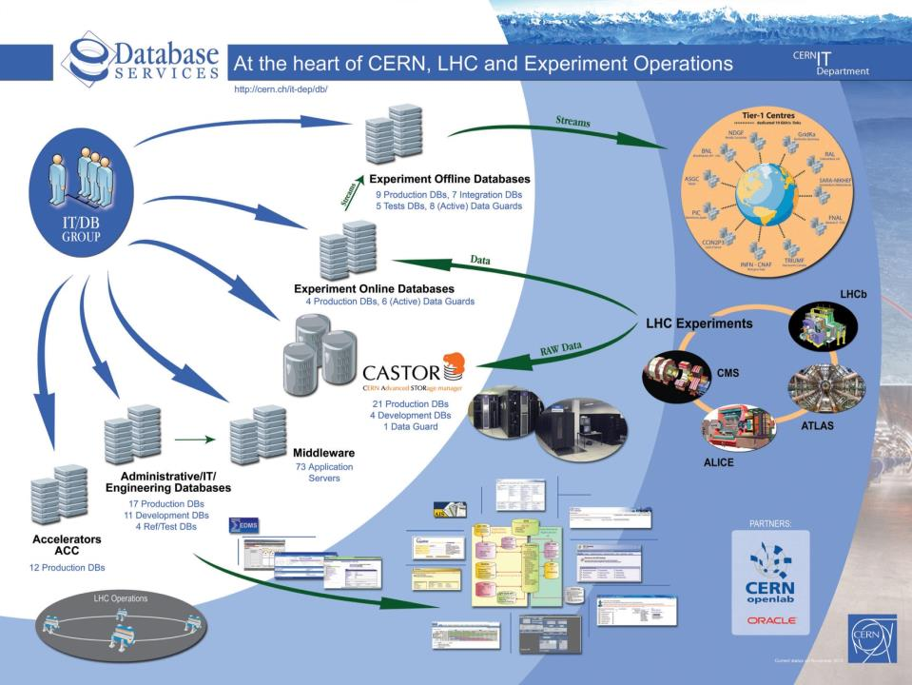

Slide 8
This talk covers Linux tools for advanced tracing and Oracle investigations
Modern tools opening new roads: Perf, DTrace, Systemtap, …
  Probes on the OS to understand system calls
  Probes for the userspace to understand Oracle internals
This is a short exploration rather than a lesson
Focus on techniques that you can use today

Slide 9
Prerequisites
Not covered here are many of the common and most used tools and utilities
  top
  strace
  vmstat
  iostat, sar, collectl, dstat
  use of the /proc filesystem (ex cat /proc/meminfo)
  …

Slide 10
You can probably run userspace and dynamic tracing tools in Linux already
Available with RHEL/OEL 6 or higher
You gain:
  Tools for advanced troubleshooting
  Insights in the working of Oracle and OS

Slide 11
Do I need dynamic tracing when I have Oracle wait events?
Data beyond wait events
  Instrument the latency details of ‘on CPU’ time
  Many Oracle wait events don’t provide good measurements of I/O latency
Wait event data + user space tracing + OS tracing = new insights

Slide 12
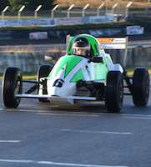
About Zbigniew
since 2009 at CERN
  Developer
  Researcher
  DBA
DBA with > 5 years of experience
Already presented twice at UKOUG
  about Streams and GoldenGate

Slide 13
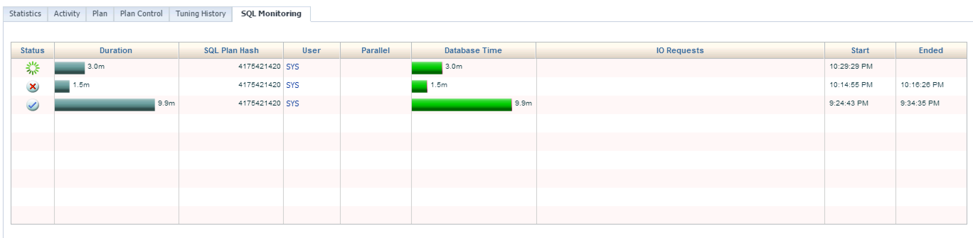
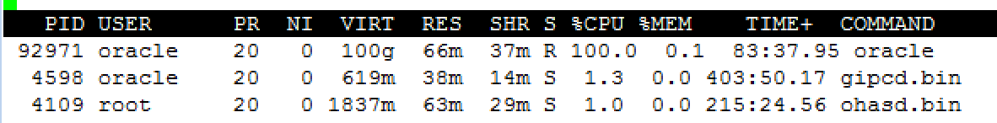
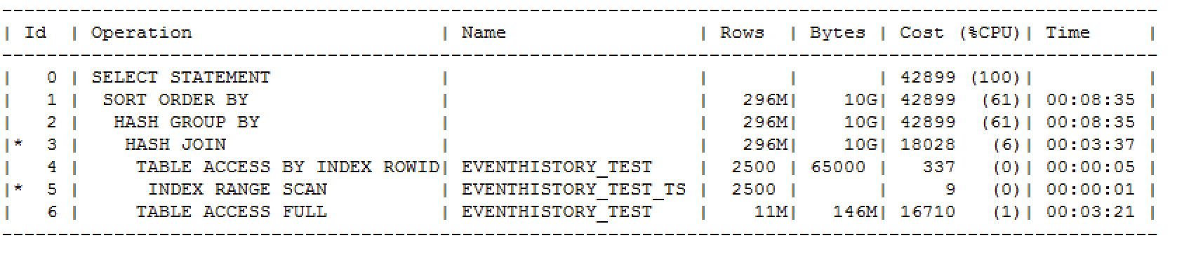
Long Running Query -> on CPU?
Enterprise Manager
OS
Execution plan

Slide 14
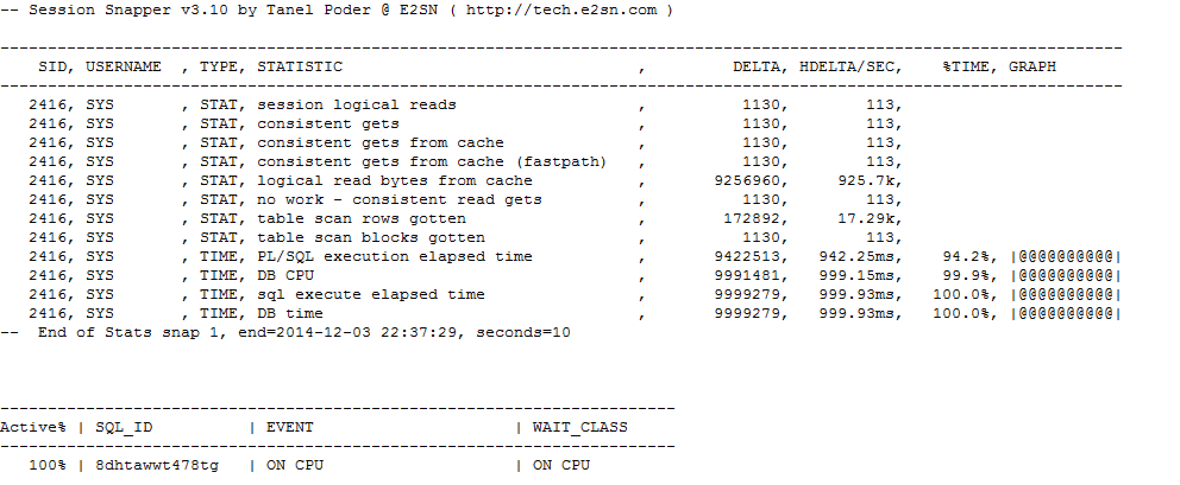
Snapper Can Help
Reading from db cache
PL/SQL?
Wait event interface not much useful in this case

Slide 15
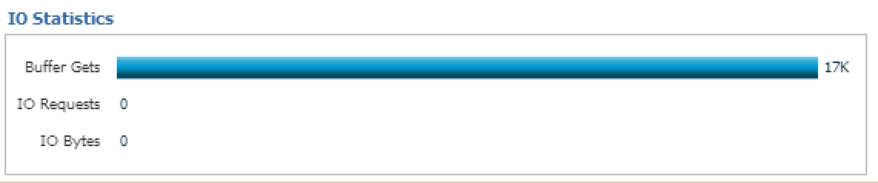
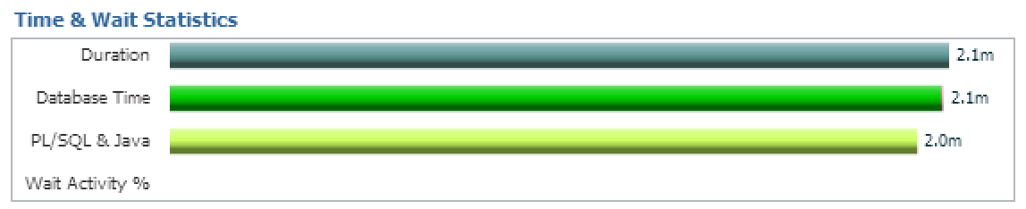
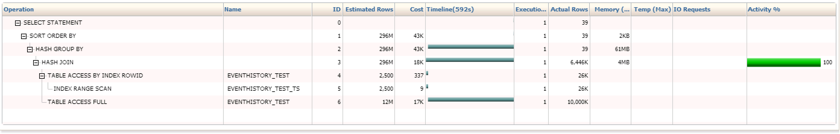
SQL Monitor
Buffer gets
PL/SQL almost all the time
100% activity on the hash join
Can we get more? Lets try with perf

Slide 16

Perf
Linux profiler tool for
  performance counters (PCL)
  events observer (LPE)
Integrated into the kernel
  Available for kernel versions >= 2.6.31 (RHEL6)
Safe to use on production systems
Notes:
Perf is a user tool for performance analyzing and process profiling available in Linux
it is capable of statistical profiling of the entire system
It leverages perf_event interface which is available in all kernel version since

Slide 17
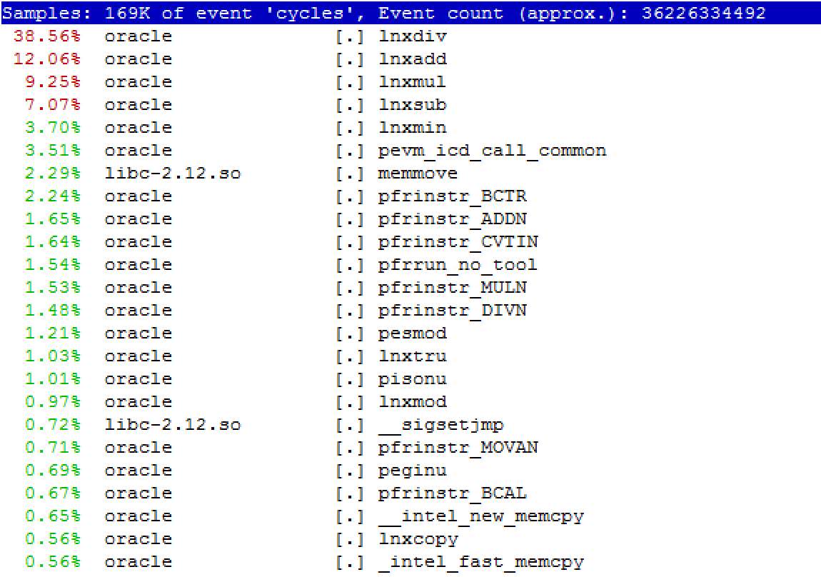
Live view of top active functions
  perf top [-p <pid of process> ]

Slide 18
What are those Oracle functions?
Complete description of the functions called by Oracle with is not officially published, but…
Google it or just guess ;)
Backups of some MOS notes can be handy
  "ORA-600 Lookup Error Categories” (formerly 175982.1)
For actions which are part of query execution
  http://blog.tanelpoder.com/files/scripts/tools/unix/os_explain by Tanel Poder

Slide 19
What have we learned so far?
Our sql is running some arithmetic operations:
  function lnxdiv (38%) => division
  function lnxadd (10%) => addition
  function lnxmul (9%) => multiplication
Is it all the time like that?
Why (by whom) they are called?

Slide 20
Recording Samples with Perf
Function currently being executed sampling
Full stack sampling
Be careful with the sampling frequency
  99Hz is reasonable
Samples are recorded to a binary file ‘perf.data’
  perf record [-p <pid of process>] [-F <frequency> ]
  perf record –g -p <pid of process> [-F <frequency> ]

Slide 21
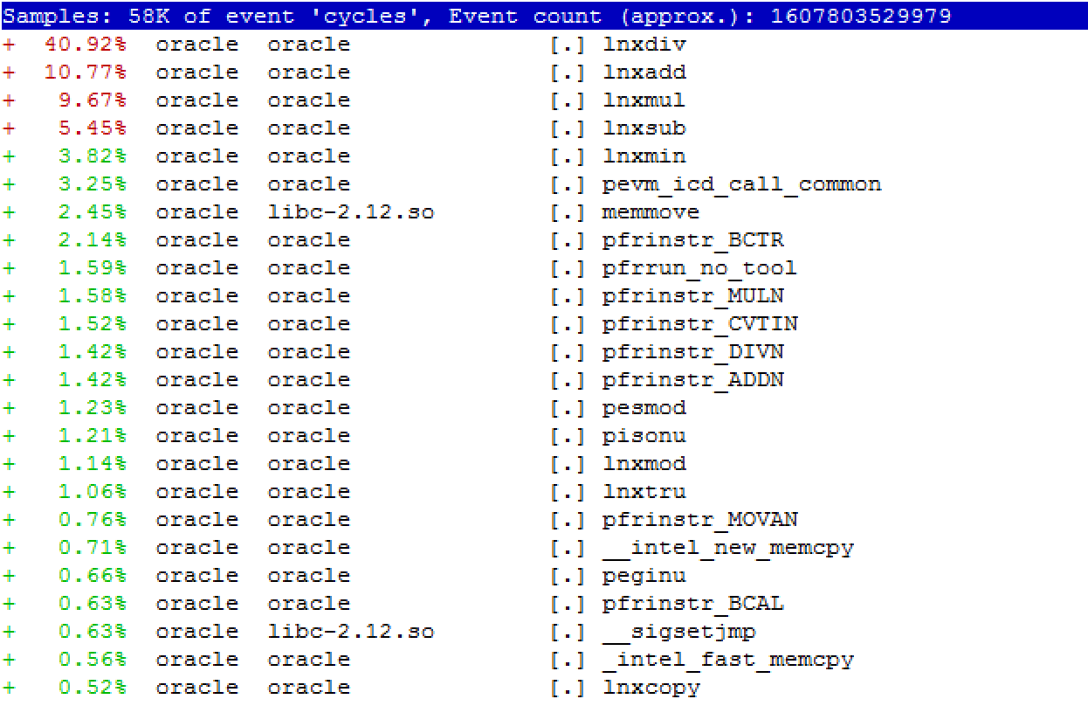
Displaying Recoded Data
In human readable format (same as top)
  perf report

Slide 22
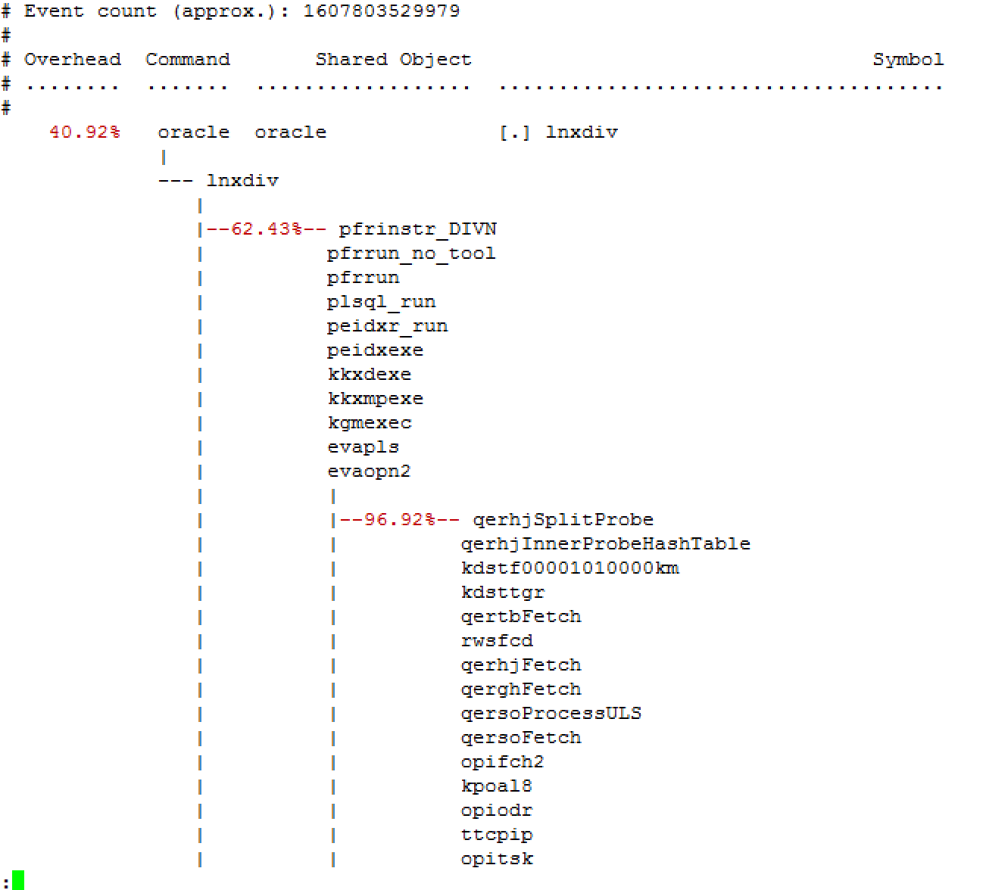
Displaying Recorded Stacks
  perf report --stdio
Tree format
Not easy to read!
There is a way of making stack samples easier to read…

Slide 23
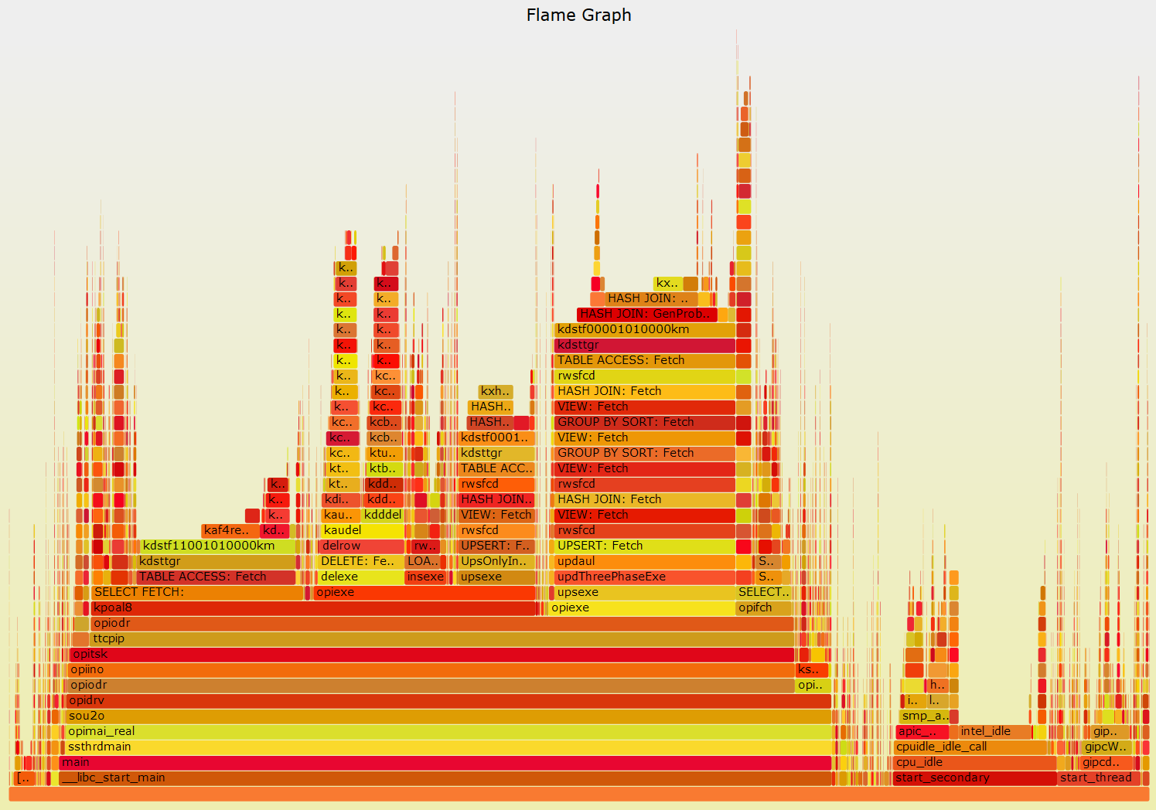
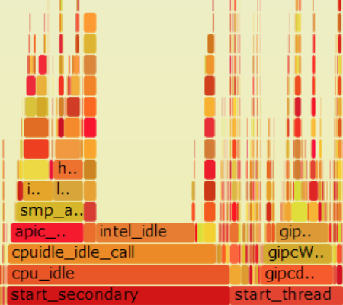
Flame Graphs
Visualization of stack samples
Author: http://www.brendangregg.com/
Stack Content
Alphabetically ordered samples (not time!)
Notes:
- Each box represents a function in the stack (a "stack frame").
- The y-axis shows stack depth. The top box shows the function that was on-CPU. Everything beneath that is ancestry. The function beneath a function is its parent, just like the stack traces shown earlier.
- The x-axis spans the sample population. It does not show the passing of time from left to right, as most graphs do. The left to right ordering has no meaning (it's sorted alphabetically).
- The width of the box shows the total time it was on-CPU or part of an ancestry that was on-CPU (based on sample count). The call count is not shown (or known via sampling).
- The colors aren't significant, and are picked at random to be warm colors. It's called "flame graph" as it's showing what is hot on-CPU. And, it's interactive: mouse over the SVGs to reveal details.

Slide 24
How to create a flame graph
1. Collect stack samples of our process under investigation
  99Hz is a reasonable sampling frequency
2. Dumpstack traces in a text file
perf script >myperf_script.txt
  3. Get scripts: https://github.com/brendangregg/FlameGraph
4. Create a flame graph
grep -v 'cycles:' myperf_script.txt|
../FlameGraph-master/stackcollapse-perf.pl |
../FlameGraph-master/flamegraph.pl --title "Flame Graph:”
  perf record -a -g –F99 -p <pid of process>
  perf script > myperf_script.txt
grep -v 'cycles:' myperf_script.txt|
../FlameGraph-master/stackcollapse-perf.pl |
../FlameGraph-master/flamegraph.pl --title ”My graph”

Slide 25
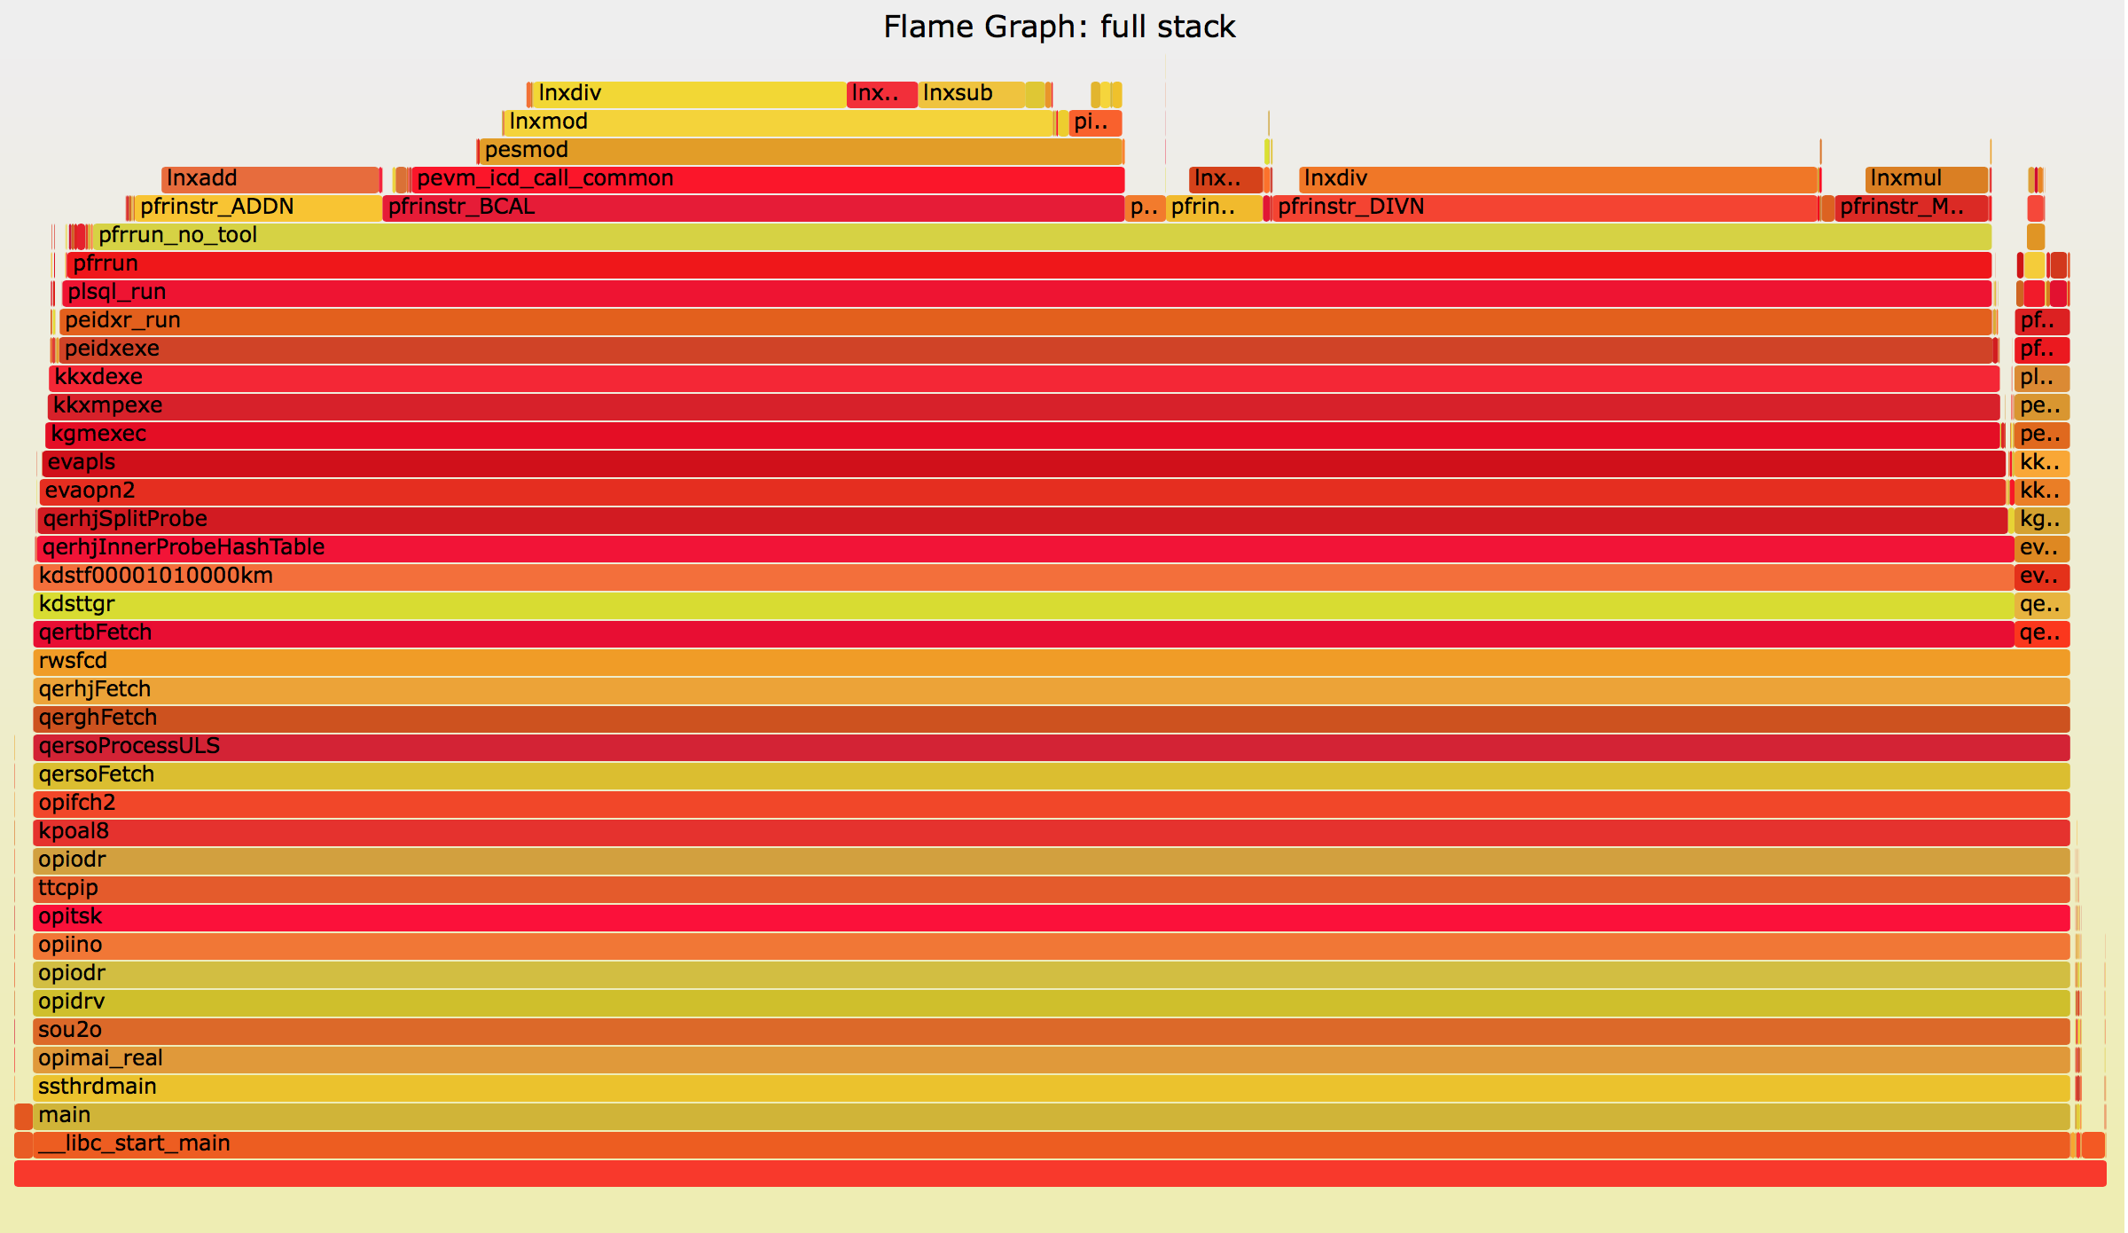
Flame Graph for our SQL
Is called lnxdiv in at least 2 different places
PLSQL_RUN

Slide 26
FG for Oracle Operations
4a) Extract sed commands from os_explain script (by Tanel Poder)
4b) Create the flame graph using os_explain mapping
\
  wget http://blog.tanelpoder.com/files/scripts/tools/unix/os_explain
  grep "s\/q" os_explain > os_explain.sed
grep -v 'cycles:' myperf_script.txt|
sed -f os_explain.sed|
../FlameGraph-master/stackcollapse-perf.pl |
../FlameGraph-master/flamegraph.pl --title ”My FG" >Figure1.svg

Slide 27
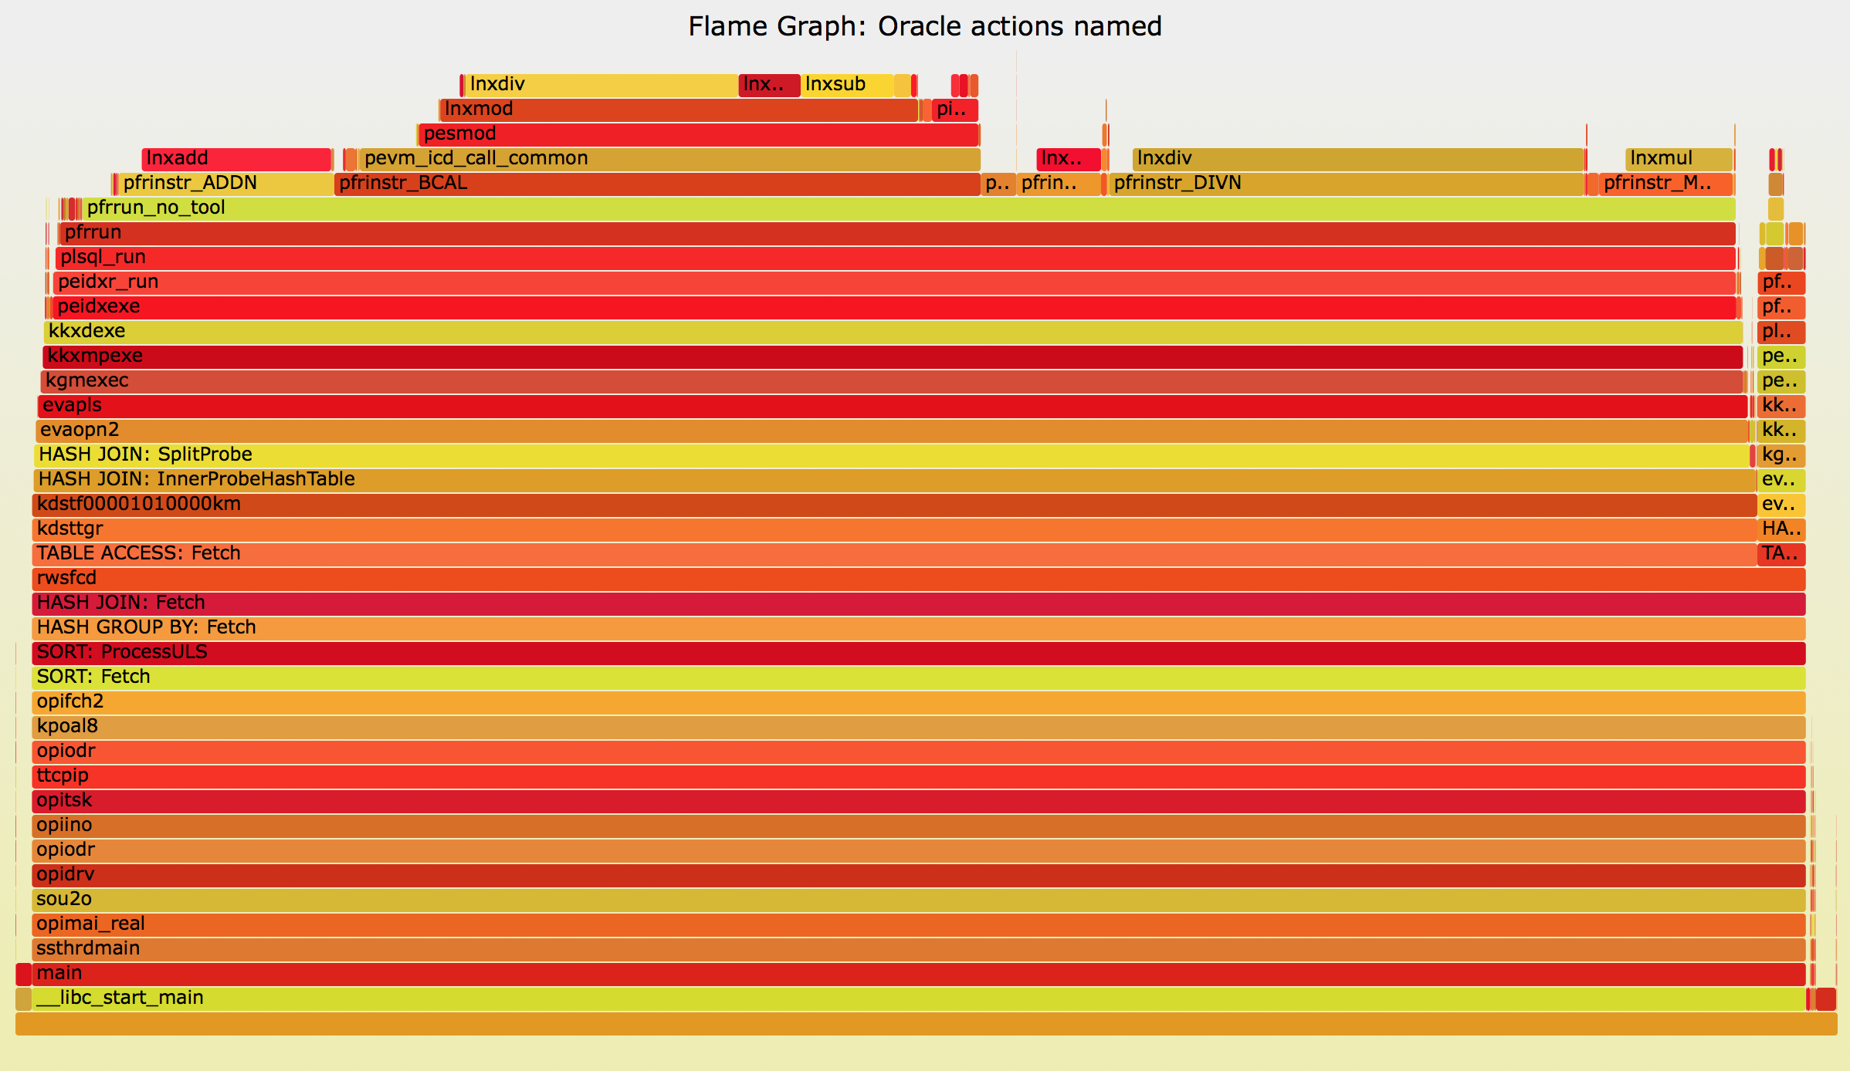
Flame Graph for our SQL
PLSQL_RUN
PLSQL_RUN
3. Hash Join
3b. Hash Join
6. Full TS
4. Table access by rowid
2. Hash Group by
1. Sort order by

Slide 28
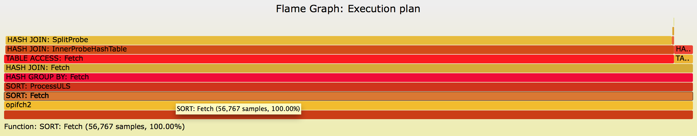
FG for an Execution Plan
Create flame graph for query execution operations only:
grep -i -e qer -e opifch -e ^$ myperf_script.txt|
sed -f os_explain.sed|
../FlameGraph-master/stackcollapse-perf.pl|
../FlameGraph-master/flamegraph.pl --title "Flame Graph Rowsource: my select" >Figure2.svg

Slide 29
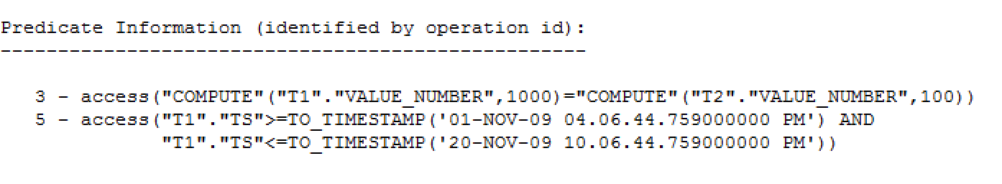
What was the join condition of the query?
compute(range_scan.VALUE_NUMBER,1000) = compute(full_table.VALUE_NUMBER,100)
create function compute(val in number,j number) return varchar2
as
ret number:=0;
begin
FOR i IN 1..j loop
ret:=ret + mod(val * i,100) / i;
end loop;
return ret;
end;

Slide 30
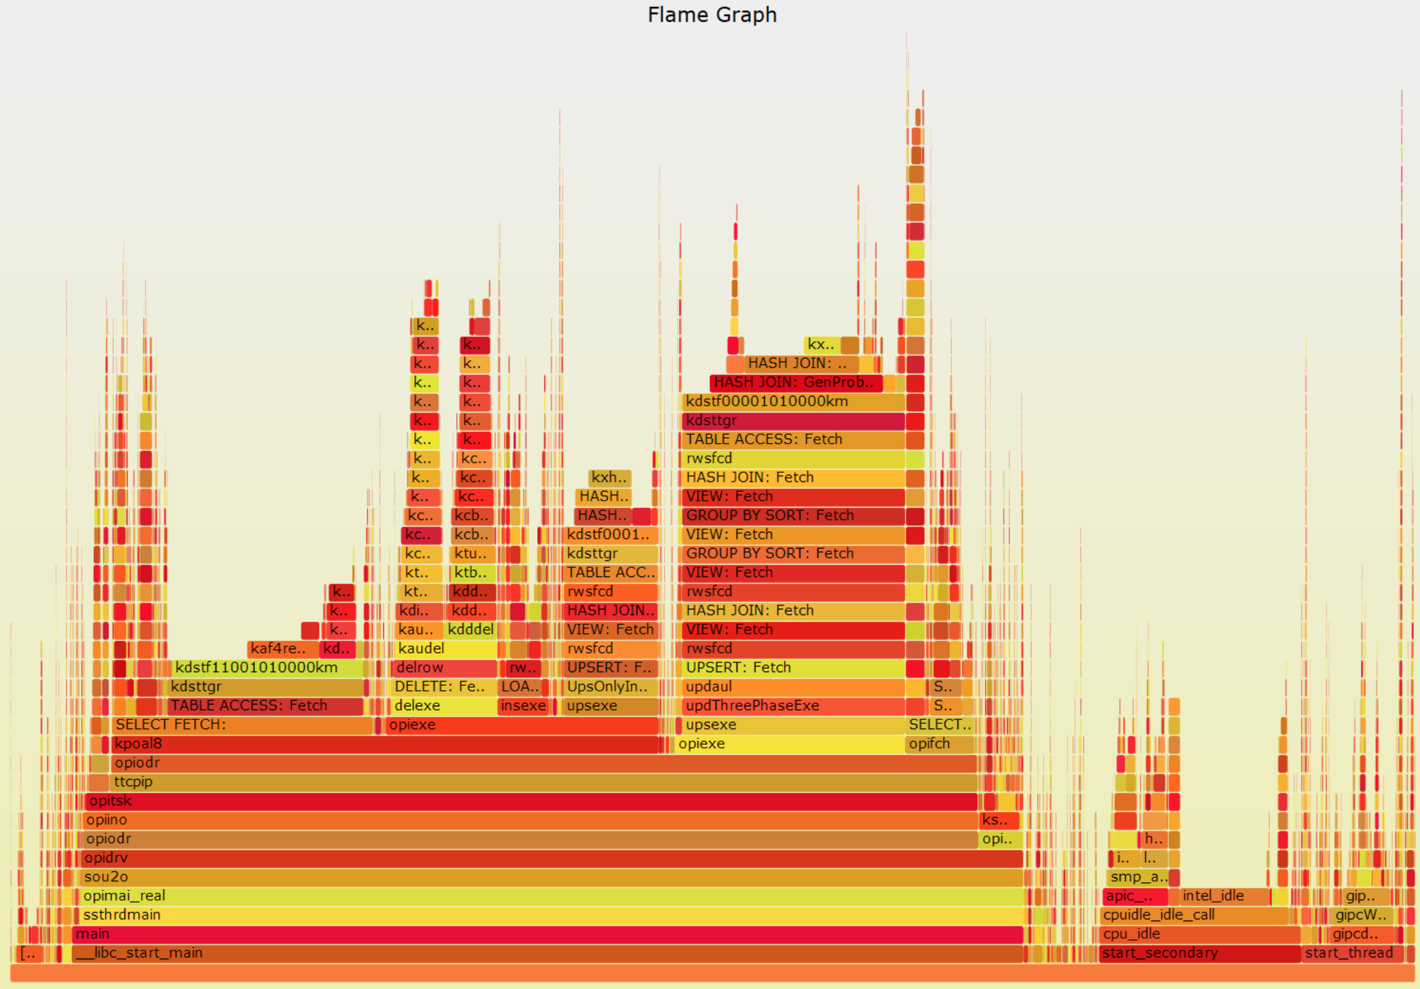
FG for Server Profiling
Entire server workload captured from 20 sec

Slide 31
Perf & Flame Graphs: Summary
Perf
  user space exploration
  available >RHEL 6
  there other useful features (events tracing and probes)
Flame graph
  call stack visualization
Perf + flame graph
  Performance investigation
    When wait-event interface does not deliver relevant information – CPU intensive processing

Slide 32
Advanced Tracing for Linux
Solaris has DTrace since 2005, Linux is catching up
Currently many tools available
  Oracle Linux DTrace, Dtrace4linux, SystemTap, perf_events, ftrace, ktap, LTTng, eBPF, sysdig
  Most of them still in development

Slide 33
DTrace and Linux
DTrace license is CDDL, incompatible with GPL
There are 2 ports of DTrace for Linux
  Both still in active development
  Oracle’s port for OEL (for ULN subscribers)
    Notably it does not yet have userspace tracing with the ‘pid provider’
  ‘dtrace4linux’: a one-person effort
    unstable but with more functionality
Notes:
See also https://docs.oracle.com/cd/E37670_01/E37355/html/section_mcn_sp4_2n.html
13.3 Differences Between DTrace on Oracle Linux and Oracle Solaris
“Other providers, such as the pid provider, the Function Boundary Tracing (fbt) provider, and the providers for the network protocols (ip, iscsi, nfsv3, nfsv4, srp, tcp, and udp), have not yet been implemented. “

Slide 34
How to Measure Latency with Dynamic Tracing
The main ingredients:
Trigger execution probe at the start of a system call (or a users function)
Run a probe at the return from the call
Measure the elapsed time
Aggregate data in a latency histogram

Slide 35
An Example with DTrace
Measure latency histogram of pread64 calls
  Note: IOPS and latency of random reads very important for troubleshooting OLTP performance
  # dtrace -n '
  syscall::pread64:entry { self->s = timestamp; }
  syscall::pread64:return /self->s/ {
  @pread["ns"] = quantize(timestamp -self->s);
  self->s = 0;
  }
  tick-10s {
  printa(@pread);
  trunc(@pread);
  }'

Slide 36

SystemTap
Backed by Red Hat, started in 2005
  Version 1.0 in 2009
Works by compiling and loading kernel modules
Scripting language similar to C, allows adding C extensions
Easy to start working with it:
  Look at example probes and build from there
  Many similarities between DTrace and SystemTap probes

Slide 37
SystemTap Userspace Probes
Probes into executable processes (userspace)
  Read function arguments
  Read from process memory (ex: SGA and PGA)
Linux support
  UTRACE -> available with SystemTap also in RHEL6
  UPROBES -> replace UTRACE for kernel version from 3.5, available with SystemTap and more tools
  Dtrace4linux can also do userspace tracing

Slide 38
How to check if userspace tracing is available/active on your system
This is how to check if UTRACE extensions are configured:
This is how to check if UPROBES are available:
  # grep CONFIG_UTRACE /boot/config-`uname -r`
  CONFIG_UTRACE=y
  # grep CONFIG_UPROB /boot/config-`uname -r`
  CONFIG_UPROBES=y
  CONFIG_UPROBE_EVENT=y

Slide 39
Key functions to probe the Oracle wait event interface
Function name | Purpose | Selected parameters
KSKTHBWT | Kernel Service Kompile Thread Begin Wait. This function is called at the start of an Oracle wait event. The suffix “bwt" most likely stands for “begin wait". kslwtbctx is its parent function call and marks the start of a wait event. | register r13 -> points into X$KSUSE (V$SESSION) SGA segmented array register rsi -> timestamp of the beginning of the wait (in microseconds) register rdx -> wait event number
KSKTHEWT | Kernel Service Kompile Thread End Wait. This function is called at the end of an Oracle wait event. The suffix "ewt" most likely stands for "end wait". kslwtectx is its parent function call marking the end of a wait event. | register r13 -> points into X$KSUSE (V$SESSION) SGA segmented array register rdi -> timestamp of the beginning of the wait (in microseconds) register rsi -> wait event number

Slide 40
Systemtap can read from the Oracle wait event interface
Example: how to write a probe tracing the beginning of each wait event:
probe process("oracle").function("kskthbwt") {
xksuse = register("r13")-3928 # offset for 12.1.0.2
ksusenum = user_uint16(xksuse + 1704)
printf("DB WAIT EVENT BEGIN: timestamp_ora=%ld, pid=%d, sid=%d, event#=%u\n", register("rsi"), pid(), ksusenum, register("rdx"))
}

Slide 41
How to read X$KSUSE from SGA
X$KSUSE -> underlying table of V$SESSION
  It’s a segmented array
  Base of the array record: from CPU register R13
    With offset that is version-dependent
    The column offsets (record values) are available by querying X$KQFCO and X$KQFTA
    Records contain info on: userid, sql_hash, wait elapsed time, …

Slide 42
Example: How to collect wait event histograms with microsec resolution
V$EVENT_HISTOGRAM useful to study latency
  However only milisec precision, a problem when studying SSD latency
  Note 12.1.0.2 has V$EVENT_HISTOGRAM_MICRO
Solution: userspace tracing of Oracle processes
  Provides way to collect and display microsec-precision histograms for all Oracle versions
  Capture event# and wait time in microseconds
  Collect data in a SystemTap aggregate
  Print output as a histogram

Slide 43
Example of wait event histograms collected with SystemTap
  # stap –v histograms_oracle_events_11204.stp -x <pid>
  # Note: omit –x to trace all oracle processes
  Histogram of db file sequential read waits in microseconds (us):
  value |-------------------------------------------------- count
  128 |@ 33
  256 |@@@ 60
  512 |@@@ 61
  1024 |@@@@ 93
  2048 |@@@@@@@@@@@@@ 260
  4096 |@@@@@@@@@@@@@@@@@@@@@@@@@@@@@@@@@@@@@@@@@@@@@@@ 951
  8192 |@@@@@@@@@@@@@@@@@@@@@@@@@@ 538
  16384 |@@ 47
  32768 |@@@ 71
  65536 |@ 34
  131072 |@@@@@@@ 153
  262144 |@@@ 62
  524288 | 16

Slide 44
SystemTap Probes for Oracle Logical and Physical I/O
Identify the Oracle internal functions of interest:
Function | Description
kcbgtcr | Kernel Cache Buffers Get Consistent Read Used for consistent reads
kcbgcur | Kernel Cache Buffers Current Read Used for current reads
kcbzib | kcbZIB should stand for: Z (kcbz.o is a module for physical IO helper functions), IB: Input Buffer Oracle will perform physical read(s) into the buffer cache
kcbzgb | The suffix GB in kcbZGB should stand for: Get (space for) Buffer. Oracle allocates space in the buffer cache for a given block (typically before I/O operations).
kcbzvb | Invoked after Oracle has performed I/O to read a given block Note: this function is used both for reads in the buffer cache and for direct reads

Slide 45
Find the key function call parameters and their meaning
Identify the function parameters of interest (block number, file number, etc)
Example for kcbgtcr and kcbgcur
  tbs# = user_int32(%rdi)
  rel file n# = user_int32(%rdi+4) >> 22 & 0x003FFFFF
  block# = user_int32(%rdi+4) & 0x003FFFFF
  data_object_id# = user_int32(%rdi+8)
  object_id# = user_int32(%rdi+12)
  Note: for bigfile tablespaces: block# = user_int32(%rdi+4)

Slide 46
Putting it all together: Trace wait events + logical and physical I/O
Provide insights on how Oracle does the I/O
  What are the I/O-related wait events really measuring?
  Can we rely on the measurements of wait elapsed time to understand I/O latency?
Trace:
  # stap –v trace_oracle_logicalio_wait_events_physicalio_12102.stp -x <pid> | sed –f eventsname.sed

Slide 47
Example of tracing ‘db file sequential read’ wait event
  ==========
  DB LOGICAL IO Consistent Read (kcbgtcr) for block: tbs#=7, rfile#=0, block#=2505675, obj#=32174
  ->kcbzib, Oracle logical read operations require physical reads into the buffer cache
  -> kcbzgb, Oracle has allocated buffer cache space for block: tbs#=7, rfile#=0, block#=2505675, obj#=32174
  ==========
  DB WAIT EVENT BEGIN: timestamp_ora=498893930487, pid=15559, sid=21, event=db file sequential read
  OS: ->pread: timestamp=498893930555, program=oracle_15559_or, pid=15559, fd=264, offset=83048882176, count(bytes)=8192
  OS: ->ioblock.request, timestamp=498893930588, pid=15559, devname=sdl, sector=162204848, size=8192, rw=0, address_bio=18446612144946364800
  OS: <-ioblock.end, timestamp=498893934550, pid=0, devname=sdl, sector=162204864, rw=0, address_bio=18446612144946364800
  OS: <-pread: timestamp=498893934592, program=oracle_15559_or, local_clock_us(), pid=15559, return(bytes)=8192
  DB WAIT EVENT END: timestamp_ora=498893934633, pid=15559, sid=21, name=SYSTEM, event=db file sequential read, p1=7, p2=2505675, p3=1, wait_time=4146, obj=32172, sql_hash=964615745
  ==========
  ->kcbzvb, Oracle has performed I/O on: file#=7, block#=2505675, rfile#=0
  ==========

Slide 48
What the trace shows about ‘db file sequential read’
Oracle starts with a logical I/O
If the block is not in the buffer cache a physical read is initiated
  A block in the buffer cache is allocated
  The wait event db file sequential read is started
Oracle calls pread to read 8KB
  This passed on to the block I/O interface
After the read is done, the wait event ends
Comment on the wait time: db file sequential read is dominated by synchronous I/O wait time
Notes:
Synch I/O time dominates the wait in this example as there is no additional time spent on concurrency and no significant CPU load.

Slide 49
The Case of Direct Reads and Tracing Oracle Asynchronous I/O
Asynchronous I/O is used by Oracle to optimize I/O throughput
  OS calls used: IO_SUBMIT and IO_GETEVENTS
  We consider the case of ASM on block devices
Findings:
  Oracle can perform reads that are not instrumented by the wait event interface
  The wait event ‘direct path read’, does not instrument all the reads
  The wait event elapsed time is not the I/O latency

Slide 50
The case of direct reads and asynchronous I/O
  ==========
  OS: ->io_submit: timestamp=769804010693, program=oracle_18346_or, pid=18346, nr(num I/O)=1
  1: file descriptor=258, offset=93460627456, bytes=1048576, opcode=0
  OS: <-io_submit: timestamp=769804010897, program=oracle_18346_or, pid=18346, return(num I/O)=1
  ….many more io_submit and also io_getevents..
  ==========
  DB WAIT EVENT BEGIN: timestamp_ora=769804024008, pid=18346, sid=250, event#=direct path read
  LIBAIO:->io_getevents_0_4: timestamp=769804024035, program=oracle_18346_or, pid=18346, min_nr=1, timeout.tv_sec=600
  OS: ->io_getevents: timestamp=769804024060, program=oracle_18346_or, pid=18346, min_nr=1, timeout={.tv_sec=600, .tv_nsec=0}
  OS: <-io_getevents: timestamp=769804028511, program=oracle_18346_or, pid=18346, return(num I/O)=4
  0:, fildes=260, offset=79065776128, bytes=1048576
  1:, fildes=261, offset=89295683584, bytes=1048576
  2:, fildes=263, offset=84572897280, bytes=1048576
  3:, fildes=262, offset=94479843328, bytes=1048576
  LIBAIO:->io_getevents_0_4: timestamp=769804028567, program=oracle_18346_or, pid=18346, min_nr=1, timeout.tv_sec=600
  OS: ->io_getevents: timestamp=769804028567, program=oracle_18346_or, pid=18346, min_nr=1, timeout={.tv_sec=600, .tv_nsec=0}
  OS: <-io_getevents: timestamp=769804034142, program=oracle_18346_or, pid=18346, return(num I/O)=1
  0:, fildes=264, offset=83009470464, bytes=1048576
  LIBAIO:->io_getevents_0_4: timestamp=769804034797, program=oracle_18346_or, pid=18346, min_nr=1, timeout.tv_sec=600
  OS: ->io_getevents: timestamp=769804034834, program=oracle_18346_or, pid=18346, min_nr=1, timeout={.tv_sec=600, .tv_nsec=0}
  OS: <-io_getevents: timestamp=769804037359, program=oracle_18346_or, pid=18346, return(num I/O)=4
  0:, fildes=265, offset=93436510208, bytes=1048576
  1:, fildes=267, offset=89061851136, bytes=1048576
  2:, fildes=269, offset=78286684160, bytes=1048576
  3:, fildes=268, offset=83802259456, bytes=983040
  DB WAIT EVENT END: timestamp_ora=769804037433, pid=18346, sid=250, name=SYSTEM, event#=direct path read, p1=7, p2=4324864, p3=128, wait_time
  =13425, obj=32176, sql_hash=1782650121
  ==========

Slide 51
Oracle wait events for asynchronous I/O cannot be used to study latency
Example of how to measure I/O latency from the block I/O interface using SystemTap:
  global latencyTimes, requestTime[10000]
  probe ioblock_trace.request {
  requestTime[$bio] = gettimeofday_us()
  }
  probe ioblock.end {
  t = gettimeofday_us()
  s = requestTime[$bio]
  if (s > 0) {
  latencyTimes <<< (t-s)
  delete requestTime[$bio]
  }
  }

Slide 52
Another way to measure I/O from the OS: using Ftrace
https://github.com/brendangregg/perf-tools
  # ./iolatency 10
  Tracing block I/O. Output every 10 seconds. Ctrl-C to to end.
  >=(ms) .. <(ms) : I/O |Distribution |
  0 -> 1 : 95 |## |
  1 -> 2 : 74 |## |
  2 -> 4 : 475 |######### |
  4 -> 8 : 2035 |######################################|
  8 -> 16 : 1245 |######################## |
  16 -> 32 : 37 |# |
  32 -> 64 : 11 |# |
  64 -> 128 : 7 |# |
  128 -> 256 : 23 |# |
  256 -> 512 : 10 |# |
  512 -> 1024 : 4 |# |

Slide 53
Example: Probe all blocks subject to physical I/O for performance investigations
Goal: analyse physical reads: how many are ‘new’ and how many are repeated reads
  Aid for sizing DB cache and SSD storage cache
  SystemTap probe on kcbzvb (block read)
  Can drill down per file/object number/process
Example:
  # stap -g -v oracle_read_profile.stp
  number of distinct blocks read: 24513631
  total number of blocks read: 86711189
Notes:
kcbzvb can be used to trace/measure all block I/O including direct I/O, I/O for temp etc. To trace only buffer cache allocation use instead: kcbzgb

Slide 54
Build Your Own Lab and Experiment
Install a test environment (under VirtualBox)
  RHEL/OEL 6.5 or higher
  RHEL/OEL 7.0 with 3.10 kernel as preference
Install additional packages
  kernel-devel
  debuginfo and debuginfo-common packages (available from https://oss.oracle.com )
Install the advanced tracing tools
  SystemTap version 2.5 or higher

Slide 55
Additional Tips for Userspace Investigations of Oracle
Information on Oracle internal functions from MOS
  Get a copy of “Note 175982.1”
gdb (GNU debugger)
  Read memory, stack backtraces and registers with gdb
  Know the Linux call convention: args are in %rdi, %rsi,…
Stack profile visualisations with flamegraphs
  Help understand which functions are called more often
DTrace-based tracing:
  ‘Digger’ by Alexander Anokhin (best on Solaris DTrace)

Slide 56
Wish List: Statically Defined Probes in Oracle Code
Statically defined probes
  Make userspace tracing more clean and stable across versions
  An elegant and direct way of collecting and aggregating info from the Oracle engine and correlate with OS data
Examples of database engines that have static probes:
  MySQL and PosgreSQL

Slide 57
Wish List: More Info on Oracle Functions, Variables, SGA Structures
Oracle provides symbols in the executable
  However no info on the kernel functions
  Ideally we would like to have Oracle debuginfo
  Documentation on what the functions do, which parameters they have, etc
We can profit from knowledge sharing in the community
  There is much more to investigate!

Slide 58
Acknowledgements and Contacts
CERN Colleagues and in particular the Database Services Group
  Our shared blog: http://db-blog.web.cern.ch/
Additional credits
  Frits Hoogland for original work and collaboration on the research
  Many thanks to for sharing their work and original ideas: Tanel Poder, Brendan Gregg, Alexander Anokhin, Kevin Closson

Slide 59
Example SystemTap Scripts for Oracle Userspace Investigations
Download from: http://cern.ch/canali/resources.htm
  histograms_oracle_events_11204.stp
  histograms_oracle_events_12102.stp
  histograms_oracle_events_version_independent.stp
  trace_oracle_events_11204.stp
  trace_oracle_events_12102.stp
  trace_oracle_logicalio_wait_events_physicalio_11204.stp
  trace_oracle_logicalio_wait_events_physicalio_12102.stp
  trace_oracle_logical_io_basic.stp
  trace_oracle_logical_io_count.stp
  trace_oracle_wait_events_asyncio_libaio_11204.stp
  trace_oracle_wait_events_asyncio_libaio_12102.stp
  measure_io_patterns
  blockio_latency.stp
  Oracle_read_profile.stp
  Oracle_read_profile_drilldown_file.stp
  Oracle_read_profile_drilldown_objectnum.stp
  experimental
  logical_io_latency.stp
  ..

Slide 60
Conclusions
Linux tools for advanced troubleshooting
  OS dynamic tracing, userspace tracing, ..
  Extend and complement Oracle wait interface data
  Collect data not available with other methods
Perf and Systemtap
  Already available on RHEL6 or higher
  Powerful and fun to work with
  Easy to start: build on example scripts
Happy testing!
Luca.Canali@cern.ch, Zbigniew.Baranowski@cern.ch

