Slide 1
The ICE-DIP project at CERN and my role
Place: System and Media Laboratory in HKUST
Author: Aram Santogidis (aram.santogidis@cern.ch)
22/4/2015
Notes:
Fellow At CERN

Slide 2
Agenda
What is CERN and its mission
About ICE-DIP project at CERN
My role in ICE-DIP
The Challenges and Opportunities as a Ph.D Student

Slide 3
CERN and its Mission
CERN, the European Organization for Nuclear Research (since1954) 60+ years
21 Member states, 2500 staff, 11000 users, 1 Billion CHF budget
How particles get their masses?
Why is there far more matter than antimatter in the universe?
What is Dark matter? (95% of the Universe by the way)

Slide 4
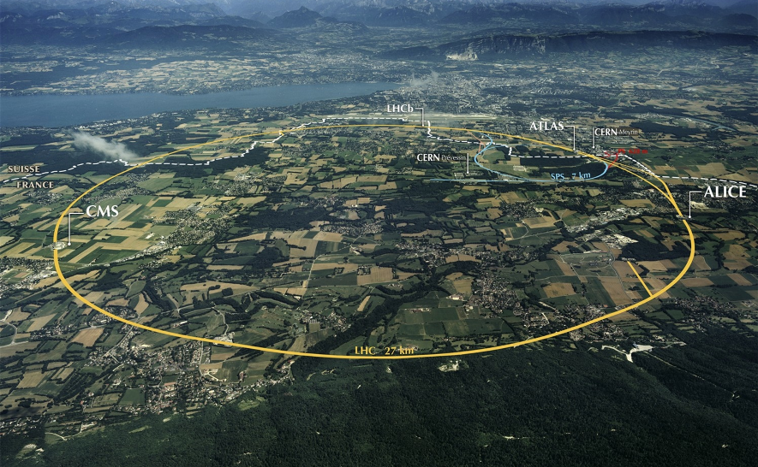
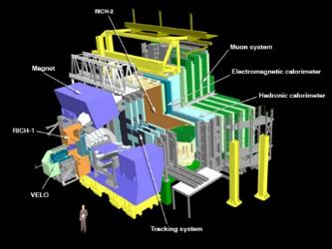
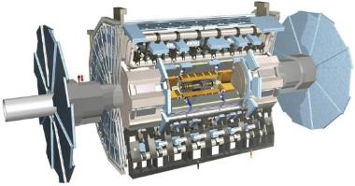
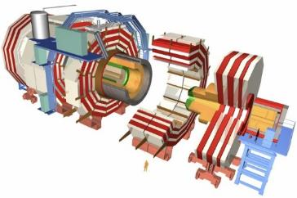
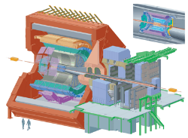
4 Large Particle and Nuclear physics experiments

Slide 5
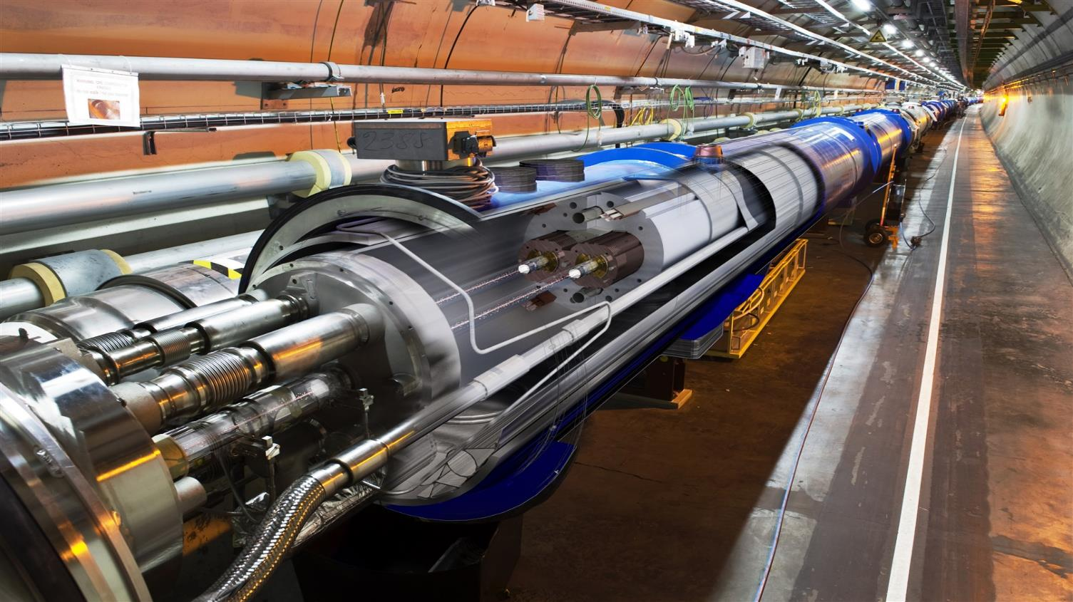
LHC: The Large Hadron Collider

Slide 6
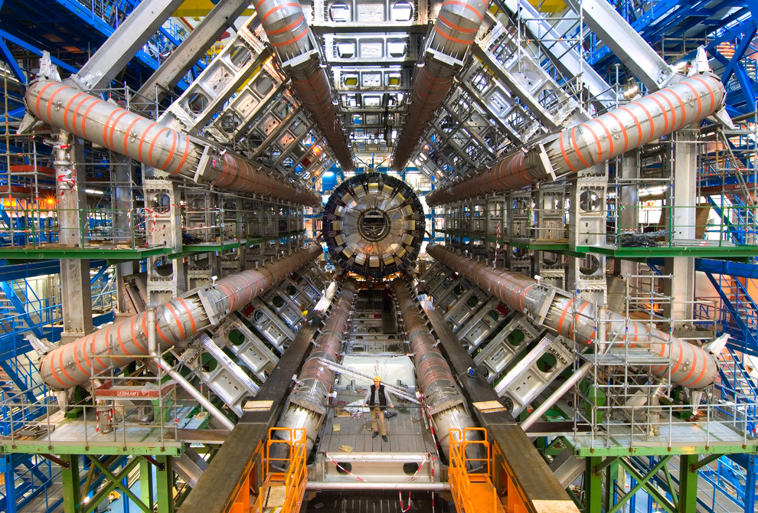
A Detector for particle physics
Person
http://www.boston.com/bigpicture/2009/11/large_hadron_collider_ready_to.html

Slide 7
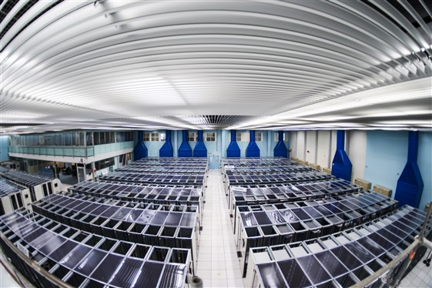
The Computing Center at CERN IT

Slide 8
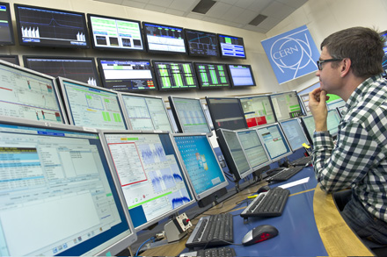
A control room for an experiment

Slide 9
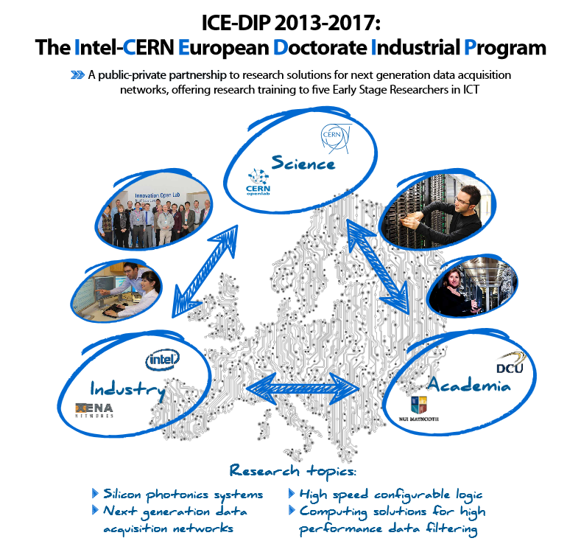
The ICE-DIP Project

Slide 10






The Gang of Five of ICE-DIP
Silicon Photonics
Reconfigurable Logic (FPGAs)
#2: Srikanth
Sridharan
#1: Marcel
Zeiler
DAQ Networks
Parallelization and Vectorization
on Accelerators
#4: Me
#3: Grzegorz
Jereczek
#5: Przemyslaw
Karpinski

Slide 11
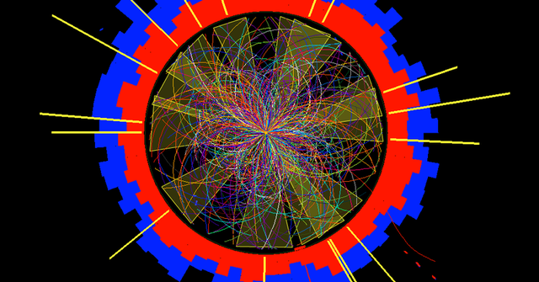




Online processing of physics events
Detector
1 PB/s
600 MB/s
Permanent
Storage
Front-end
Electronics
Read-out
Buffers
Computing
Farm
DAQ
Network

Slide 12
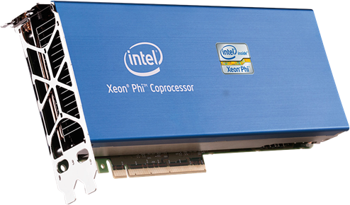
My Research in ICE-DIP
Data transfer
Manycore processors
High throughput distributed applications
Throughput
Latency
Energy
EFFICIENCY
RAW
DATA
PROCESSED
DATA

Slide 13




Challenges
What does Data transfer mean anyway?
Find balance in a diverse environment.
Notes:
I was kind of lost.
Overwhelming context information

Slide 14

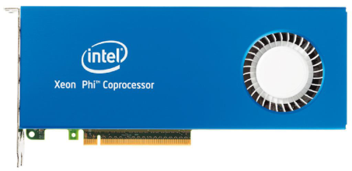
An opportunity for me and ALFA
Process
Process
Data Input
Data Sink
Process
Process
Process
A manycore
coprocessor
Optimize
THIS!
Notes:
A lot of reading, instinct and luck to find this opportunity

Slide 15
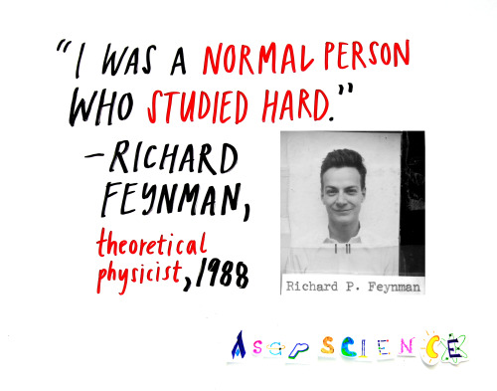
Lessons learned (so far)
Hard work ALWAYS pays of
Research should be IS fun
It takes a lot to REALLY know something

Slide 16
Thank you
Notes:
Consider introducing NN too

