Slide 1
Siemens openlab
Major Review
13 Feb 2014

Slide 2
Organization
Management
Siemens - Thomas Hahn
ETM - Guenther Zoffmann
CERN - Manuel Gonzalez
Database
Archiver
Kacper Szkudlarek
Deployment Tool
Pavel Fiala
Ewald Sperrer
Piotr Golonka
Ewald Sperrer
Fernando Varela
Control System Security
Filippo Tilaro
Brice Copy
Christoph Fischer,
Bernhard Petri
Data Analytics
Filippo Tilaro
Axel Voitier
M. Roshchin
M. Kalinkin
openlab
Researcher
CERN
Supervisor
Siemens/ETM
Supervisor

Slide 3




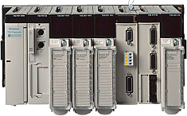

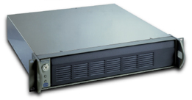



Typical Control System Architecture
MOON
(Monitoring)
Supervision
layer
Data Analytics
SCADA
WinCC OA
SECURITY
TN
DIM/CMW
OPC
Process
layer
PLCs
High Voltage
Fieldbus
Field
layer
Sensors
&
Actuators

Slide 4
Siemens openlab
Major Review
Control System Security
13 Feb 2014
Author: Filippo Tilaro
Supervised by: Brice Copy

Slide 5
Security project
Main goal:
  Improve the Siemens Process Control Systems (PCS) security level
Strategy:
  Design of a test-bench to evaluate the PCSs network robustness
  Determine key cyber security aspects relevant to CERN in accordance with recent cyber security standards

Slide 6
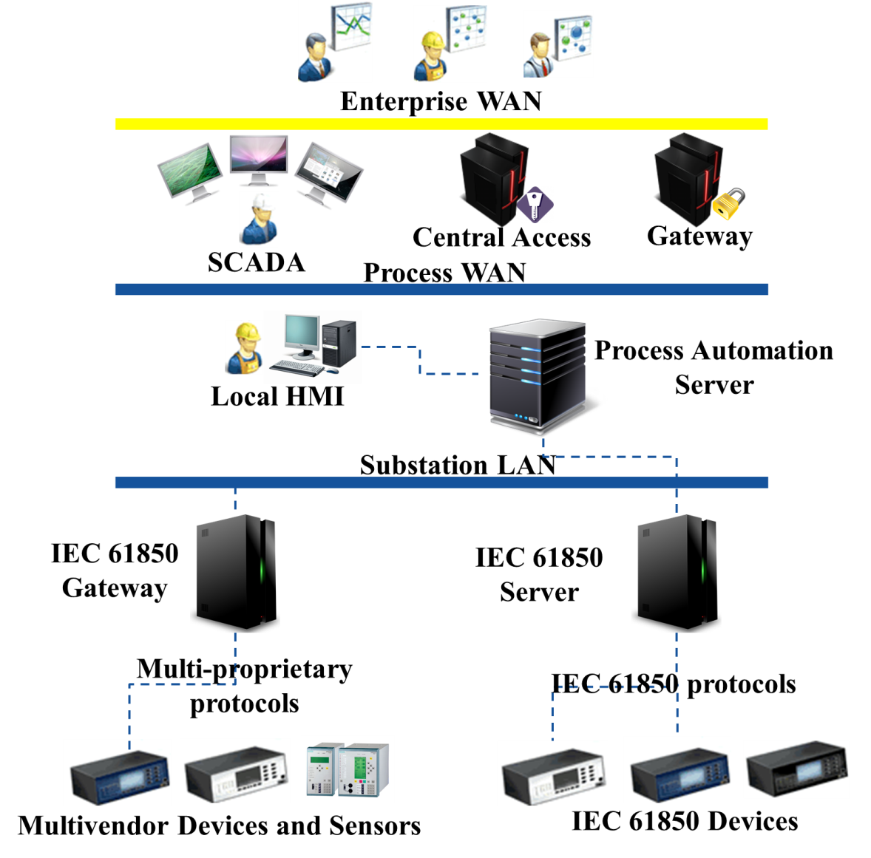
Security & Smart Grid
More efficient than electromechanical power grids
Integration of diverse energy resources and devices
Make use of:
  digitalized information
  communication technology
Any vulnerability can affect the entire electrical system!

Slide 7
Security & Smart Grid
Design
Phase
Analysis of the IEC-61850 protocols (SV, GOOSE, services over MMS)
specifications: parts 8-2, 8-1, 5.
Implementation
Phase
Peach Fuzzing Extension
XML Protocol Test files definition
through grammar rules
Execution
Phase
Traffic injection against the IED
(Intelligent Electronic Device) under test

Slide 8
Conclusions
Achievements:
  ISA Secure Committee Institute(ISCI) – Certification Robustness Test(CRT) extension for IEC-61850 standards communication protocols specifications
  Test-bench Release:
    Setup and installation into Siemens Headquarter
    Support for test execution and new test definitions
  Publication and presentation of the topics in ICALEPCS 2013
Possible future activities:
  SCADA System Testing
    WinCC OA internal communication protocol
    OPC UA
  Further communication protocols analysis
  Industrial Intrusion Detection System

Slide 9
Siemens openlab
Major Review
Data Analytics
13 Feb 2014
Author: Filippo Tilaro
Supervised by: Axel Voitier

Slide 10
Data Analytics project
Main goal:
  Build a computing system able to improve the functionality, the efficiency, and the predictability of any control process
Strategy:
  Use and extend the Siemens analysis tools to extract possible patterns and discover new insights hidden in the control data itself
  Take advantage of the huge amounts of control data produced by CERN facilities

Slide 11
Overview of the activities
Off-line analysis
  GAS alarms breakdown
  Control System Health
  Statistical Analysis of Alarms
On-line analysis
  Integration of CERN ICS with ELVis
  A scalable and customizable analysis framework

Slide 12
OFF-LINE analysis activities

Slide 13



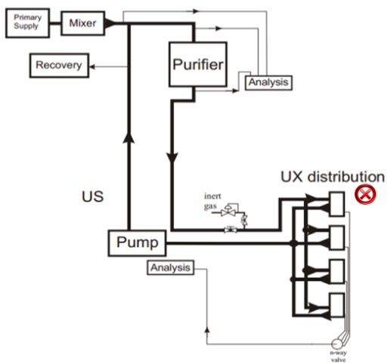

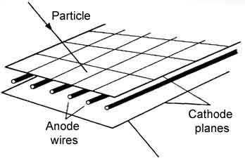
Gas System
28 Applications
(Sub Detector)
7 Apps
1 Data Server
9 Apps
1 Data Server
6 Apps
1 Data Server
6 Apps
1 Data Server
Multi-wire chamber

Slide 14
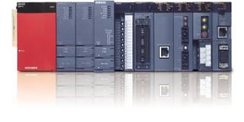

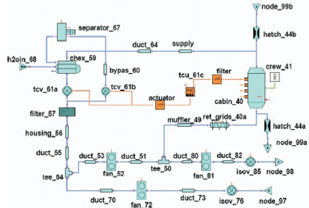

Gas System Analysis
XML Conversion
Extraction
Events List
Complex Diagnostic:
Alarm flooding, “domino effect”
A single fault can stop the whole process
The 1st alarm is not necessarily the most
relevant for the diagnosis
The alarm list depends on the system status
a knowledge-based model is not sufficient!
Siemens
WatchCAT
Pattern Extraction:
Complex Event Processing
Fault Signature
Sequence Alignment
Simulation of Physical Control System:
Complex System: more than 9000 equations to model all the system
Validated against the real system
Includes fault model!

Slide 15
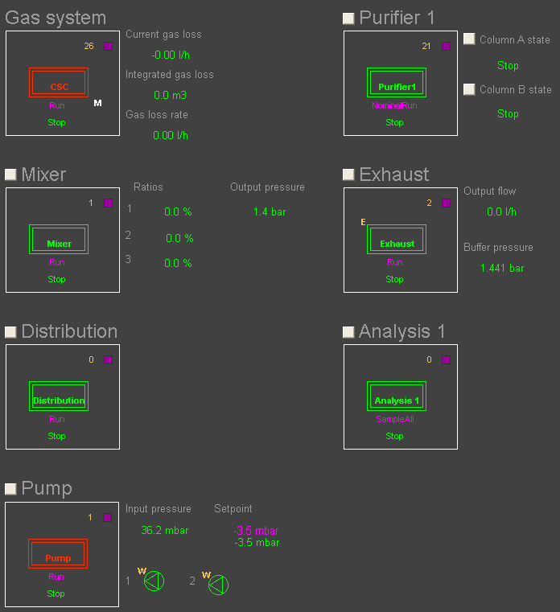
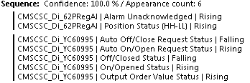
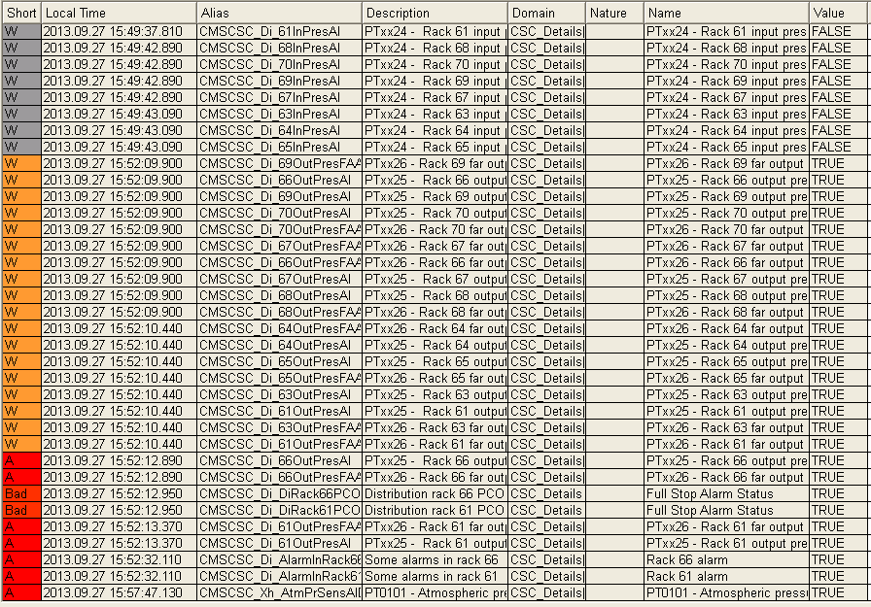
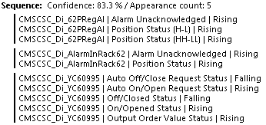
Example: Distribution Fault
Bubbler (safety device broken) line 2:
  Initial impact on the Pump module, then on the Distribution
  The Distribution seems to not have alarms yet
  The Entire Control Process collapses
Explosion of events combinations
WatchCAT
Under development
Several versions evaluated

Slide 16
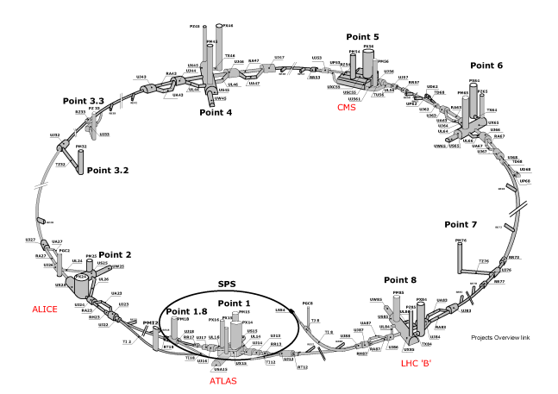
Offline Control System Health
Goal: control system faults/anomalies detection and diagnosis
Application | WinCC OA Systems | Parameters (Million dpes)
ALICE | 100 | 3
ATLAS | 130 | 12
CMS | 90 | 10
LHCb | 160 | 10
Accelerator Complex | 120 | 10
System architecture under analysis:
  16 Control Applications
    QPS, nQPS, CRYO, CIET, CIS, PIC, WIC, LHC-CIRCUIT, PSEN …
  Linux control PCs : ~120
  PLCs: ~300
  FECs: ~100

Slide 17


Offline Control System Health Analysis
MOON
Pre-Data Analysis
Long term storage
Diagnostic data, alarms, devices status
I
Data Extraction
II
XML-Conversion
III
Data Cleaning / Completion
Lemon
Performances metrics
Exceptions
Status information
LOGs
Repository:
Temporary on DFS
Common place for data analysis
Fetching data at different rates
WinCC OA logs
Sys logs
UNICOS
Unified Control System
Alarms
Shared Access
CMW FECs
FECs logs (from Splunk)
Other…
WatchCAT

Slide 18
Offline Control System Health: Status
Issues:
  Huge amount of data [~130GB + LHC]
  Different data types:
    Structured/Not Structured
    Numerical / Boolean / Plain-text
    Gaps, missing some metadata
  Unsynchronized data sources
  Different relationships among the subsystems
  …
Consequences:
  no single framework out of the box to analyse numerical data and not (next version of WatchCAT)
  Necessary a combination of tools for a complete data analysis (log processing, statistical analysis, pattern recognition…)
  Split this use-case into smaller ones:
    signal analysis use-case (next version of WatchCAT will provide predictive trending capabilities)
    semi-automatic extraction of statistical metrics and thresholds:
      threshold learning for alarms analysis

Slide 19
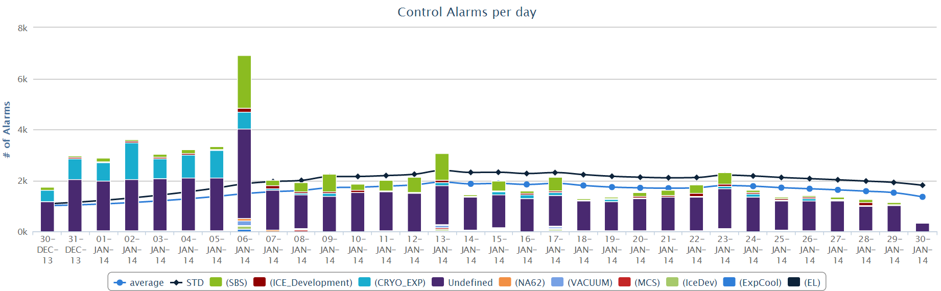

Threshold Learning for
Alarms Analysis Flow
Filtering & Aggregation
MOON
Alarms List
POJOs
Extraction
Conversion
Feedback
Injection
Reporting
CEP engine
Open-source rules engine
declarative paradigm

Slide 20
ON-LINE analysis activities

Slide 21
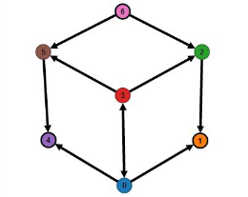

Our vision of the analysis framework
Scalable and fault-tolerant !!!
Data Analysis Framework
Data Processing Modules
Supervision
layer
FFT
MOON
(Monitoring)
Neural Network
(R)
Analysis memory and configuration
Machine
Learning
CEP
(Java)
Expert
TN
DIM/CMW
Visualisation
Patterns
(LabView)
(WatchCAT)
OPC
Process
layer
PLCs
High Voltage
Data collection & feedback
Fieldbus
Field
layer
Sensors
&
Actuators
Historical
Data
Notes:
Integration of analysis tools with our industrial control systems:
Pushing our data to analysis tools
Getting the analysis feedback within our software

Slide 22
Introducing ELVis from Siemens
Status:
  Under development
  Running on CERN Openstack VMs
Configurable analysis flow by user
  + It can use custom analysis software
High scalability of analysis processes
  From laptop to multi-node cluster
Stream based data processing engine: Storm
NoSQL data storage engine
Web-based visualisation interface
  HTML5, Data pushed by Web-Sockets
  Desktop and mobile devices

Slide 23
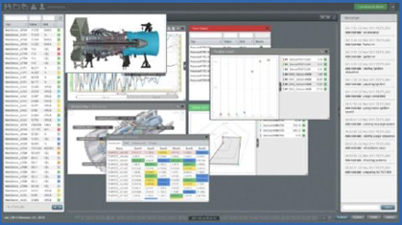
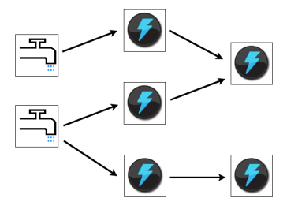
ELVis integration with
CERN control system
Control Process Data Flow
CERN WinCC OA Installation
“WinCC OA as data-source, visualisation with ELVis and/or WinCC OA”
Visualisation of ELVis processed data in WinCC OA
ELVis
Processing
Engine
OPC
Adapter
Web-based ELVis visualisation
On-line
Analysis
Analysis flow
web-based
configuration

Slide 24
Conclusions
Activities
  Various kinds of analysis to perform
We need a flexible analysis environment
  Integrated with our monitoring and control environments
Current focus
  Alarms/Signals threshold learning with Drools Fusion
  ELVis integration with CERN control system and assessment
  WatchCAT evolution for complex event processing
    Predictive trending based on time-series process data
    Base line analysis: rule model, analytical data relationships, temporal reasoning

Slide 25
Siemens openlab
Major Review
IOWA based SCADA
Logging Service
13 Feb 2014
Author: Kacper Szkudlarek
Supervised by: Piotr Golonka

Slide 26

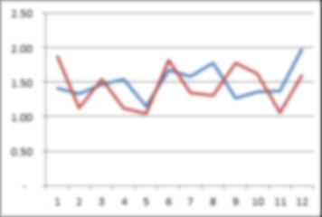


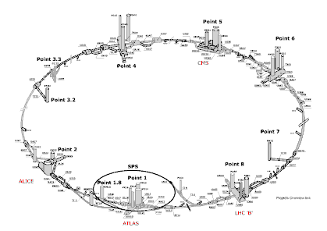
IOWA based SCADA and Logging Service
Upcoming SCADA system from
  New storage and component architecture.
  New design of Archiver (Logging Service).
Archiver subsytem:
  Important element of SCADA system:
  store/retrieve historical data,
  Essential component in Data Analytics.
WinCC OA
Archiver
up to 150 instances
Data Analytics
LHC
up to TB/day
up to 3M signals
Other sources

Slide 27






Archiving in WinCC OA
Version 3.11:
  File archiver.
  Oracle RDB Archiver*.
IOWA base version:
  Component based, DB backend plugins.
  Oracle plugin*
    desgined for:
      Large systems,
      Scalability,
      High-throughput.
  Other relational database plugins developed by Siemens/ETM.
  Research: NoSQL systems*.
UI
User interface
Editor
UI
User interface
Runtime
UI
User interface
Runtime
CTRL
Control manager
API
API manager
ARC
Archive manager
DM
Data manager
EV
Event manager
DIST
Other systems connection
D
Driver
D
Driver
D
Driver
  * Siemens/ETM openlab activities.

Slide 28

Status report
Achieved in IOWA based version:
  Working plugin in
  a complete project.
CTRL
Control manager
EV
Event manager
DM
Data manager
LS
Logging
service
Oracle
Plugin
IOWA based SCADA : first time @ CERN
  Initial performance tests
  (data write throughput):
    performance comparable to
    Oracle Archiver in WinCC OA 3.11.
    results reported to Siemens/ETM.

Slide 29
Current activities & outlook
IOWA based version:
  Redesing of the database structure
  (data segmentation/organisation).
  ...
Version 3.11:
  To address CERN needs:
    Performance optimization for high
    data-throughput setup:
      The use case of QPS upgrade.

Slide 30

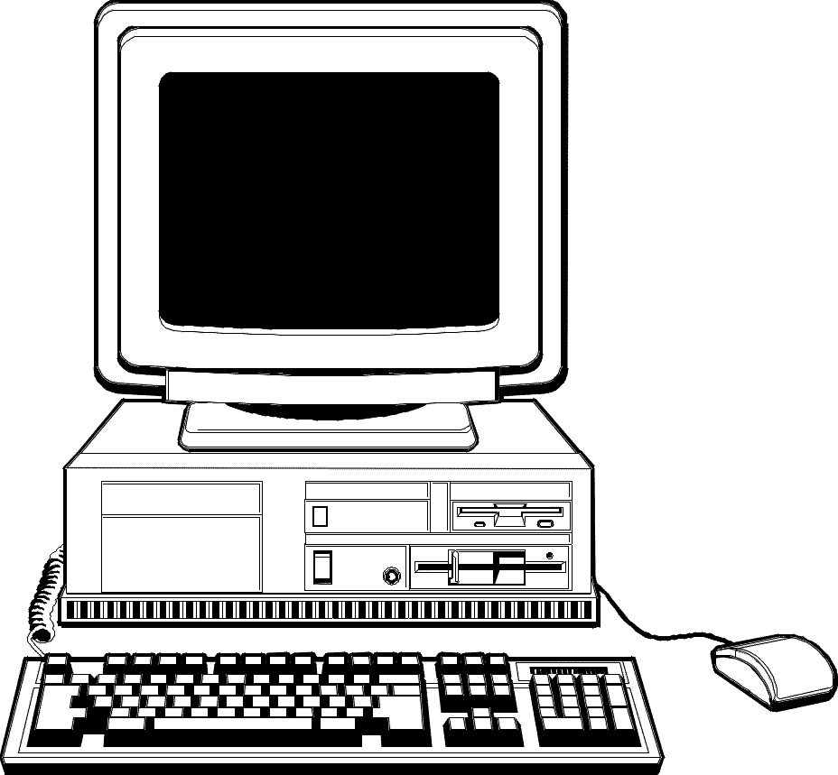
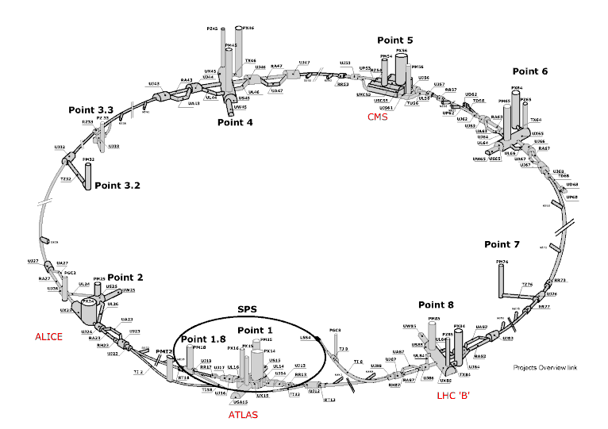


Upgrade of QPS:
LHC Quench Protection System
High archive throughput requirement
  150k changes/s
  100k tags
Criticial data for LHC safety.
Reduce storage space used by a single value-change record.
  Data size: 60+40(idx)B 60B 30B.
  Data throughput (in progress)
  cannot be reduced
  24/24, 7/7
IOT
Projects
Around LHC
RDB Archive
LHC Logging
(long-term
storage)
Backup

Slide 31
Siemens openlab
Major Review
IOWA based SCADA
Centralized Deployment Tool
13 Feb 2014
Author: Pavel Fiala
Supervised by: Fernando Varela

Slide 32






Centralized Deployment Tool (CDT)
Large controls applications at CERN comprise >150 interconnected WinCC OA systems
The CDT will allow pushing upgrades onto sets of WinCC OA applications in a centralized fashion
ASCII Manager is a key component of the CDT
              Imports/exports of the runtime DB of a project from/to files
              Configures communication with the hardware equipment
UI
User interface
Editor
UI
User interface
Runtime
UI
User interface
Runtime
CTRL
Control manager
API
API manager
DM
Data manager
EV
Event manager
DIST
Other systems connection
ASCII
manager
D
Driver
D
Driver
D
Driver

Slide 33
Why a new ASCII Manager?
IOWA based SCADA is a new product
  New internal run-time database
  Layered architecture design: two data models exposed at different layers
    New ASCII manager must be aware of the mapping between data models
New file format
  XML based format for export/import files

Slide 34
Ongoing work
Data models comparison
  Differences identified
Some functionality currently used at CERN is not foreseen in IOWA based version
  Big impact on existing frameworks and applications
  CERN to identify importance and prioritize development if functionality needed
List of change requests to underlying framework for next development phase
Learning workspace
  New functionality, still under heavy development
  Working version of documentation received including training tutorial
XML parser
  Benchmark
  Integration in workspace

Slide 35
XML parser benchmark
Large projects consist of up to several million DP elements
  Huge runtime database
  XML files several hundreds MBs big
ASCII Manager may run on mobile devices
Memory consumption is more critical than parsing time

Slide 36
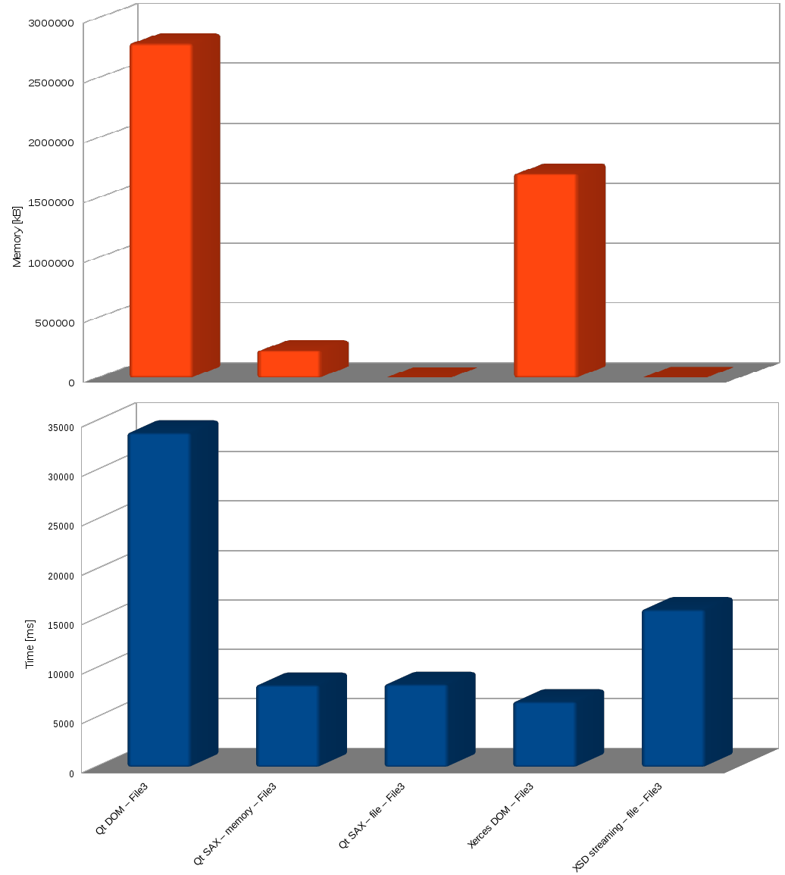
XML parser benchmark
Xerces-C++ & Qt 4.8
  DOM
  SAX
XSD – XML to C++ binding
  cxx-tree
  cxx-tree with streaming

Slide 37
Next tasks
Transition from requirement gathering and definition of functionality phases to design and implementation phase
Software architecture design
Prototyping
  Learn how to interact with data sources
  Basic import/export functionality
  Hosting different OA services
    Common Name Service
    Localization Service
    …

