Slide 2

Information Discovery as a Service:
Better Decisions for More Efficient Operations at CERN
Manuel Martín Márquez

Slide 3

CERN
CERN - European Laboratory for Particle Physics
Founded in 1954 by 12 Countries for fundamental physics research in a post-war Europe
    Major milestone in the post-World War II recovery/reconstruction process

Slide 4
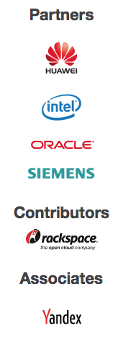
CERN openlab
Public-private partnership between CERN and leading ICT companies
Accelerate cutting-edge solutions to be used by the worldwide LHC community
Train the next generation of top engineers and scientists.
Manuel Martin Marquez

Slide 5























CERN openlab

Slide 6
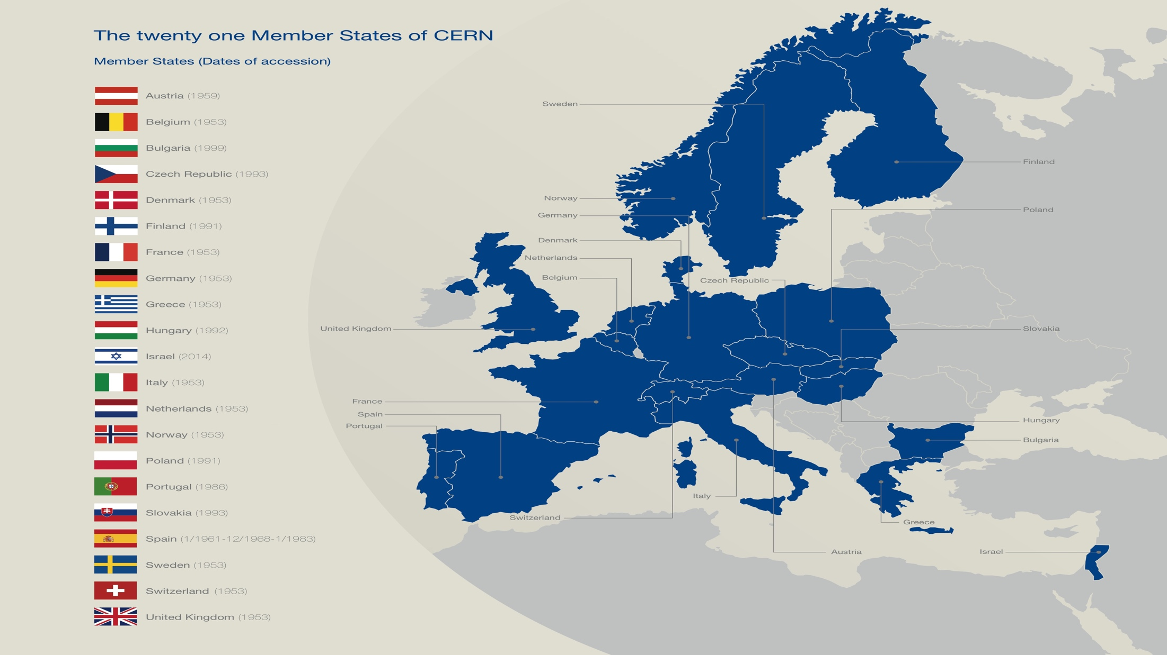

Slide 7
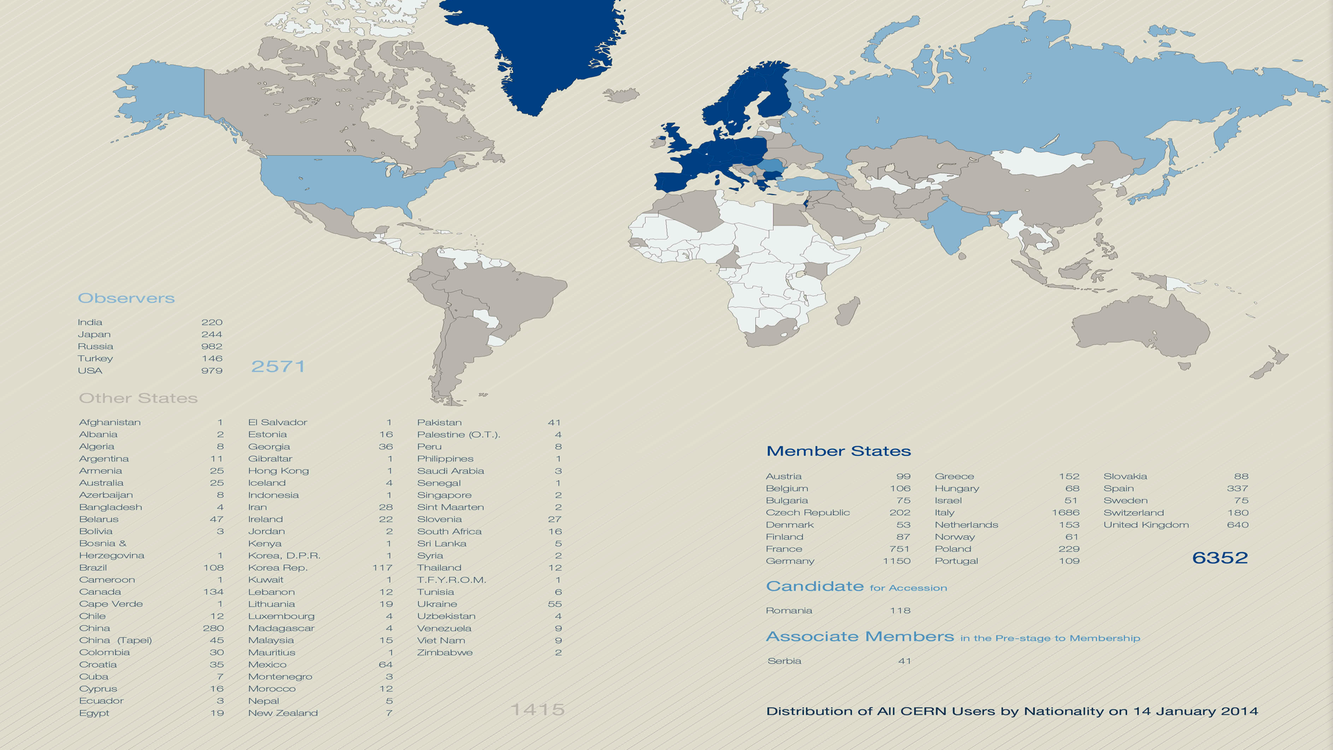
A World-Wide Collaboration

Slide 8

How the Universe works
and what is made of…

Slide 9
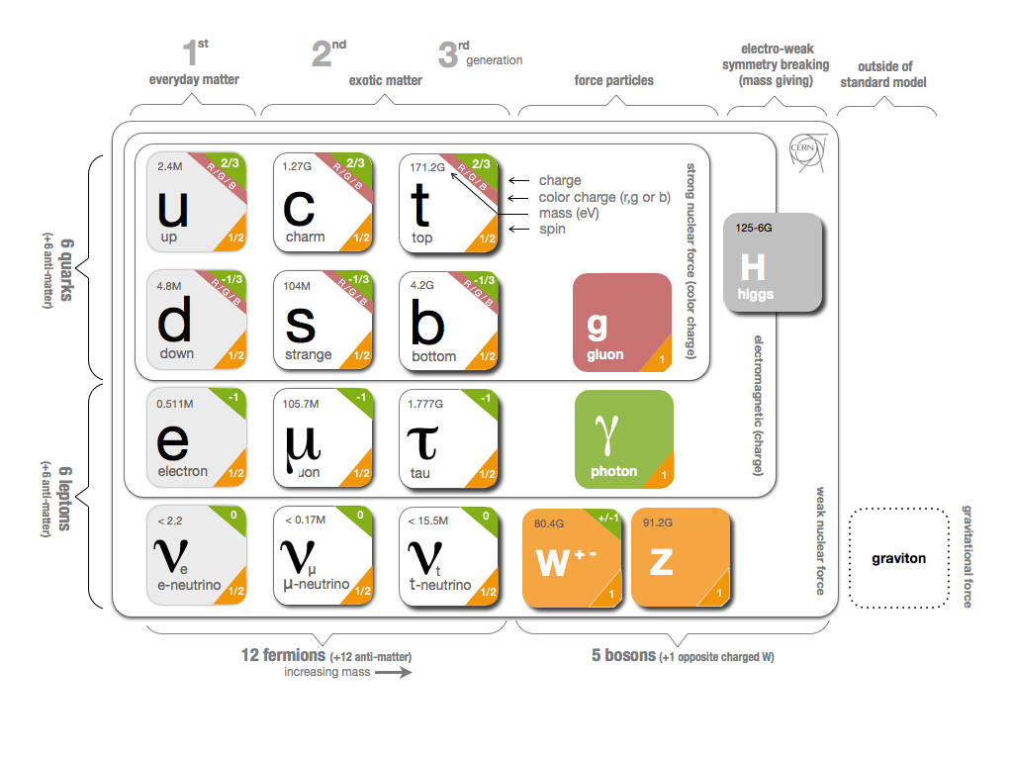
Fundamental Research
Why do particles have mass?

Slide 10
Fundamental Research
Why is there no antimatter left in the Universe?
  Nature should be symmetrical
What was matter like during the first second of the Universe, right after the "Big Bang"?
  A journey towards the beginning of the Universe gives us deeper insight.

Slide 11
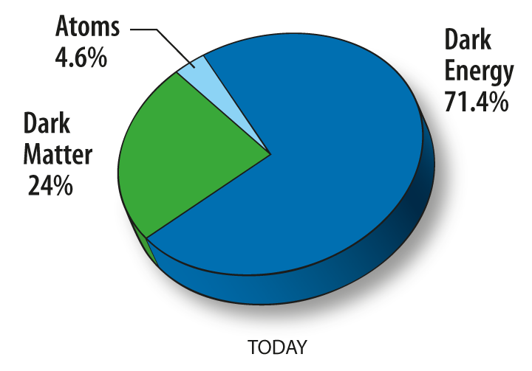
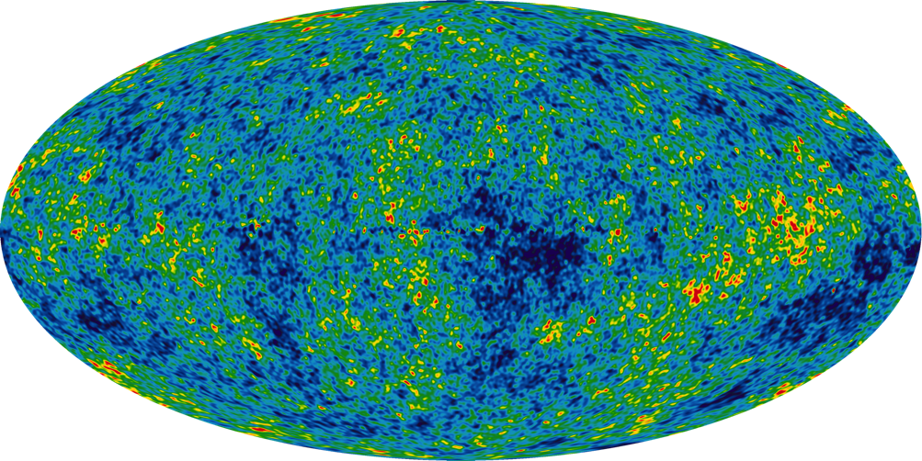
Fundamental Research
What is 95% of the Universe made of?

Slide 12
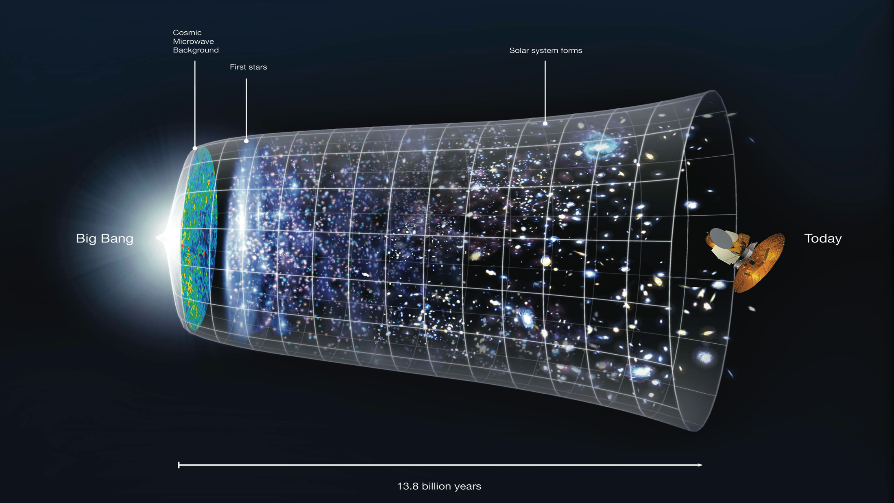

Slide 13

The Large Hadron Collider (LHC)
Largest machine in the world
27km, 6000+ superconducting magnets
Fastest racetrack on Earth
Protons circulate 11245 times/s (99.9999991% the speed of light)
Emptiest place in the solar system
High vacuum inside the magnets
Hottest spot in the galaxy
During Lead ion collisions create temperatures 100 000x hotter than the heart of the sun;

Slide 14
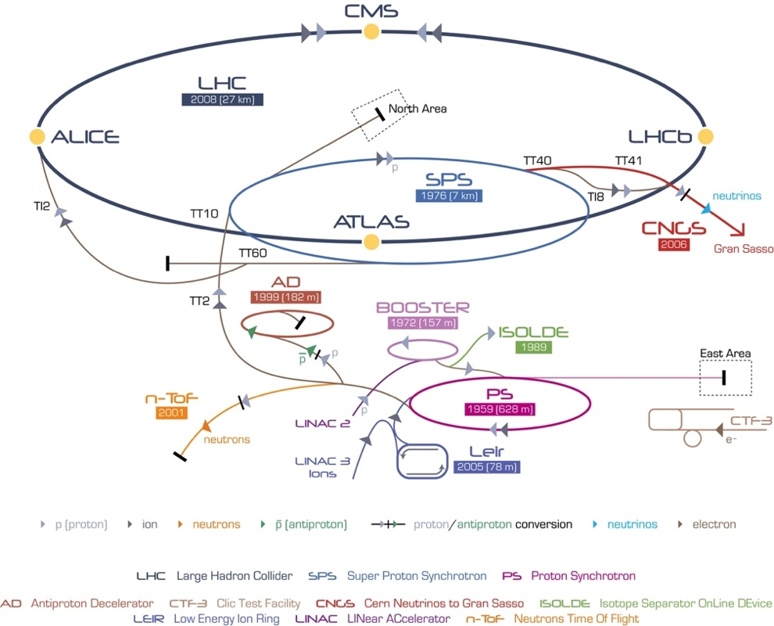
CERN Accelerator Complex

Slide 15
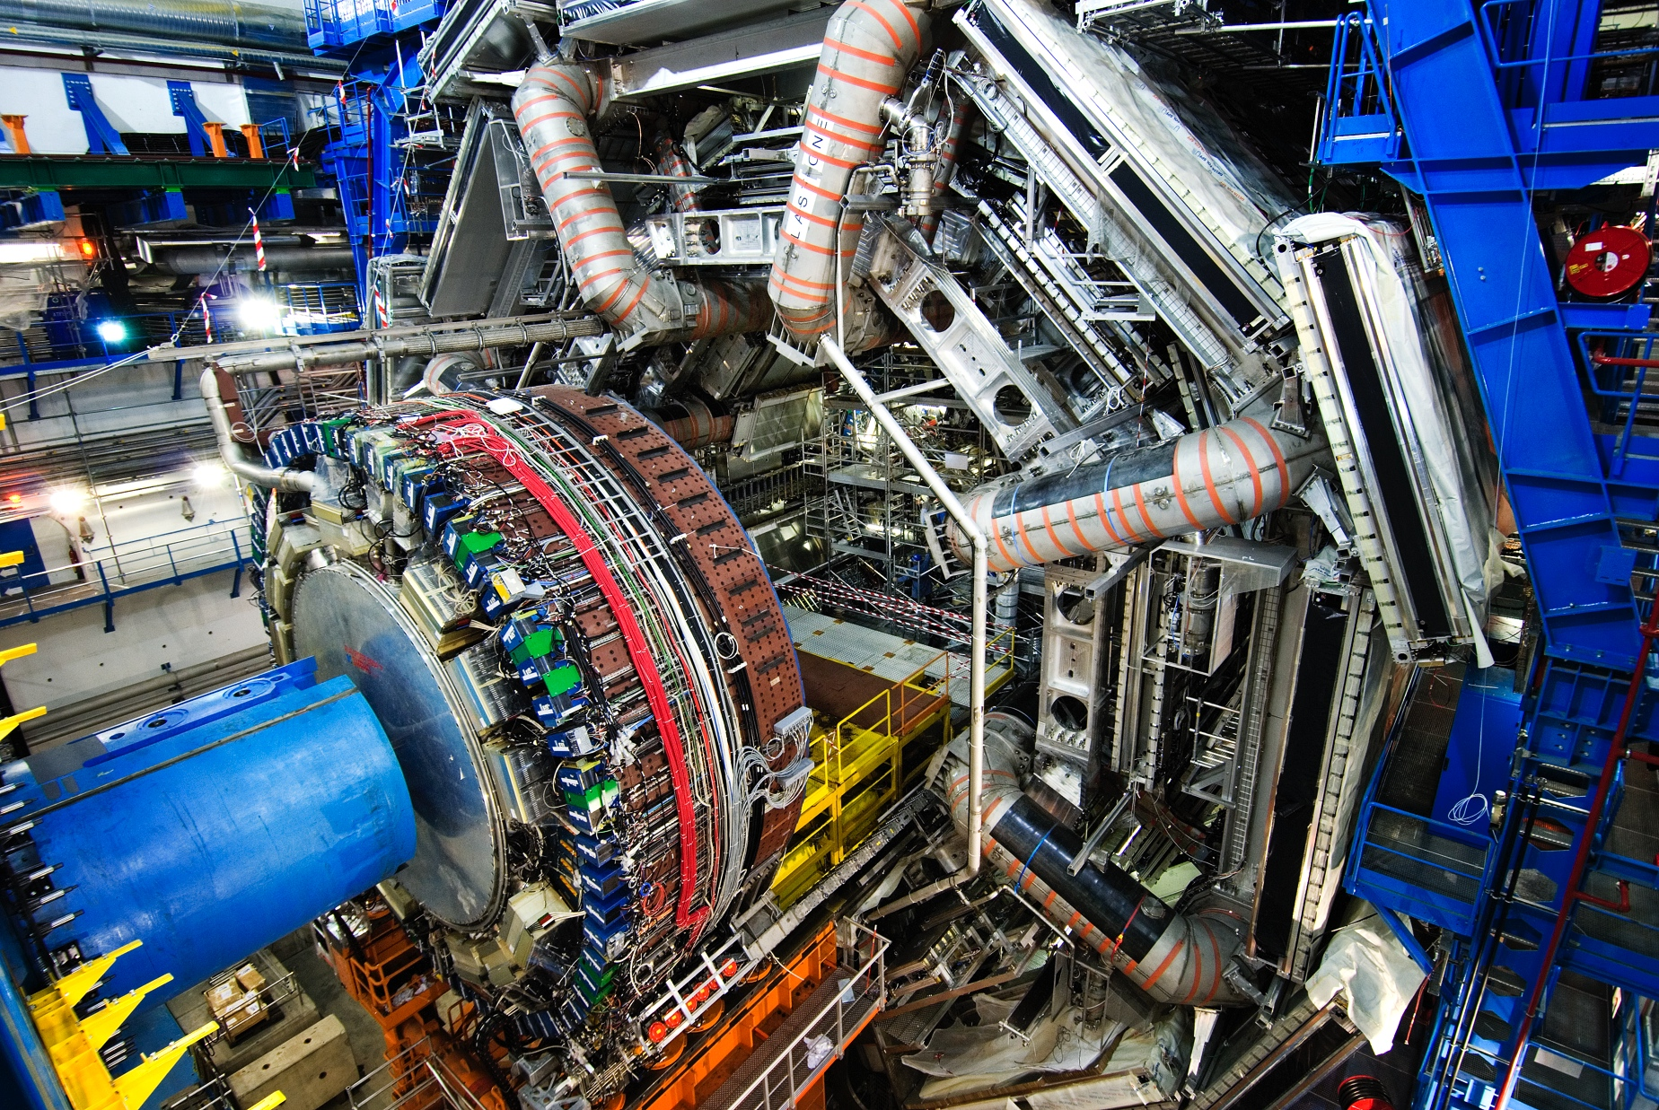
ATLAS Detector
150 Million of sensor
Control and detection sensors
Massive 3D camera
Capturing 40+ million collisions per second
Data rate TB per second

Slide 16
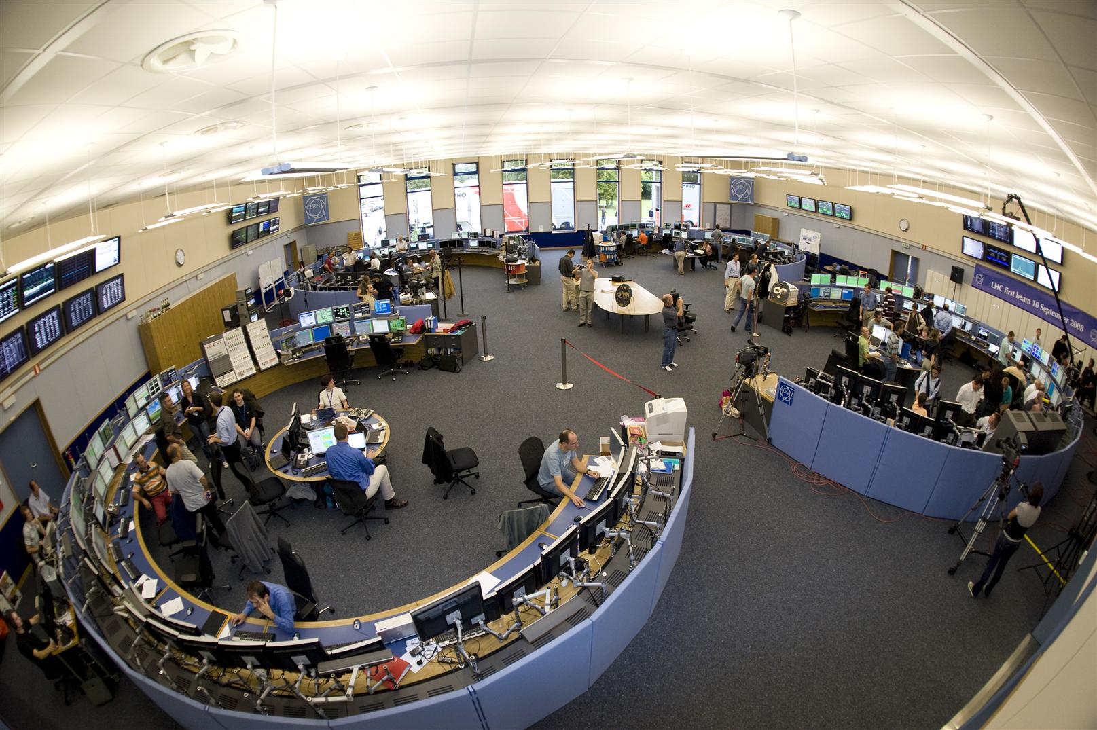
CERN Control Centre
CERN Accelerator Complex is unique installation
Therefore, we have to face unique challenges
Control and Operations
Million of sensors, large number of control devices, front-end equipment, etc.
Many critical systems: Cryogenics, Vacuums, Machine Protection, etc.

Slide 17
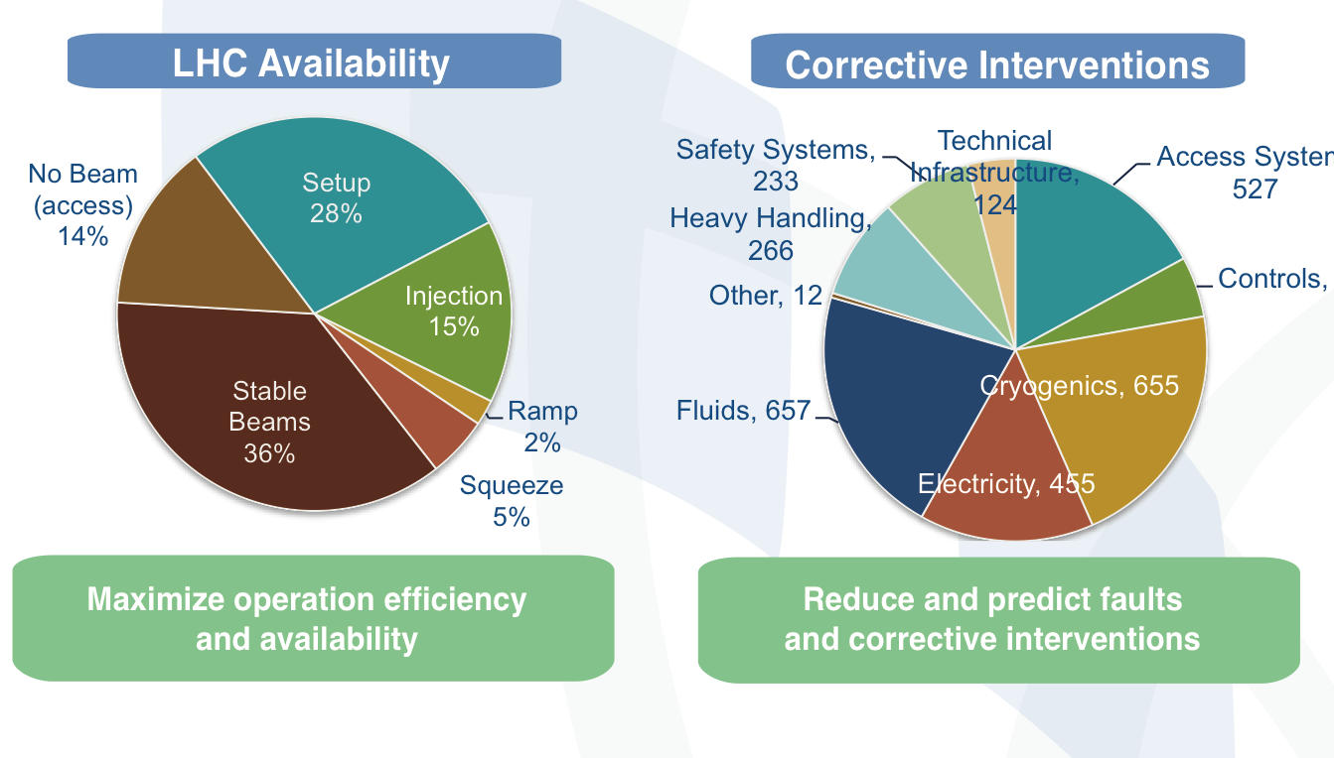
The Challenge

Slide 18
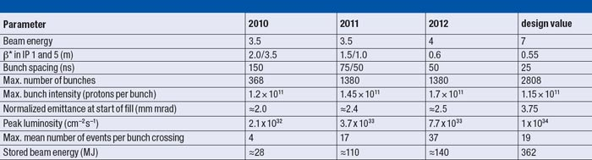
Data Analytics Challenges
A look into the future
2015

Slide 19
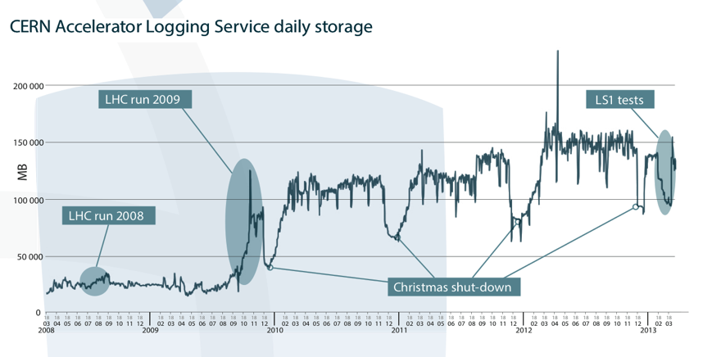
Data Analytics Challenges
Profit from our data investment

Slide 20
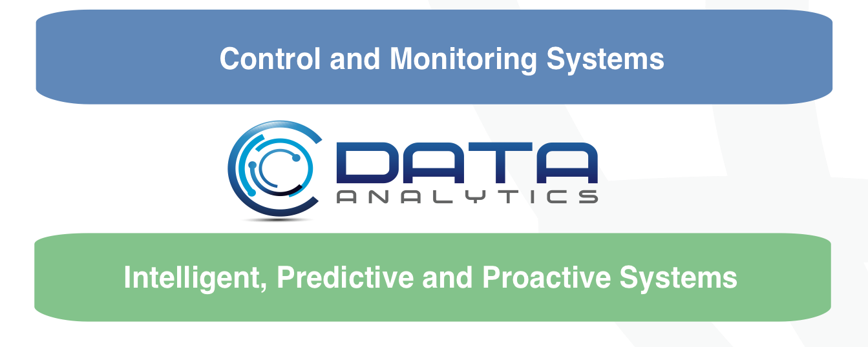
Data Analytics Objective

Slide 21
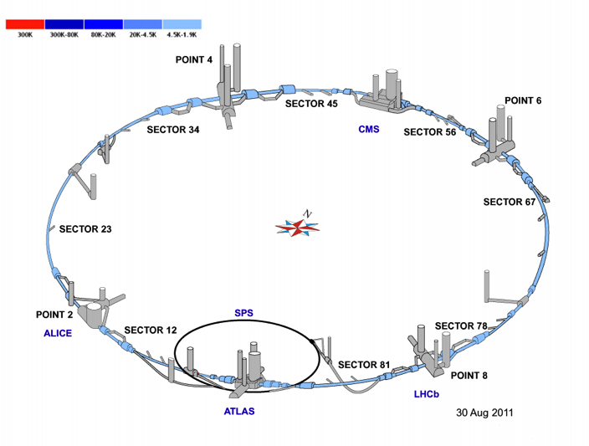
Predicting Modeling – Oracle Advance Analytics
27 km of decentralized instrumentation and control
50k I/O, 11k actuators, ~5k control loops
Control:
  ~100 PLCs (Siemens, Schneider),
  ~40 FECs (industrial PCs)
Supervision: 26 SCADA servers
Instrument/Actuators | Total
Temperature [1.6 – 300 K] Pressure [0 – 20 bar] Level Flow Flow Control valves On/Off valves Manual valves Virtual flow meters Controllers (PID) | 10361 2300 923 72 2633 3692 1835 1916 325 4833

Slide 22
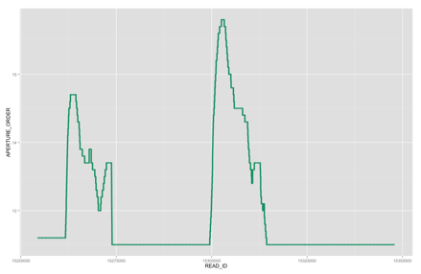
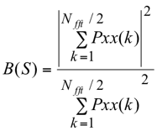
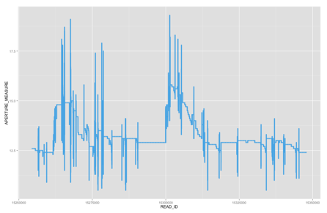

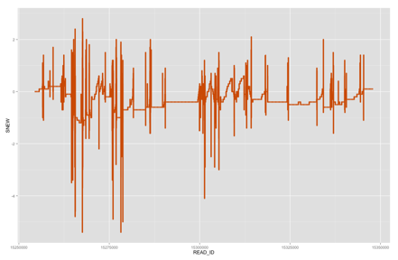
Faulty Cryogenics Valve Detection
  Signals used:
    S = aperture order - aperture measured
  Features extractions based on S
    Variance
    Percentile 99.9
    Rope distance – R(S)
    Noise Band – B(S) (Pxx be the power spectrum of the
    signal S, from 0 to 0.5Hz, where S has been previously mean-centred).
  Automatic Faulty Valves Detection System
    SVM - Support Vector Machine

Slide 23
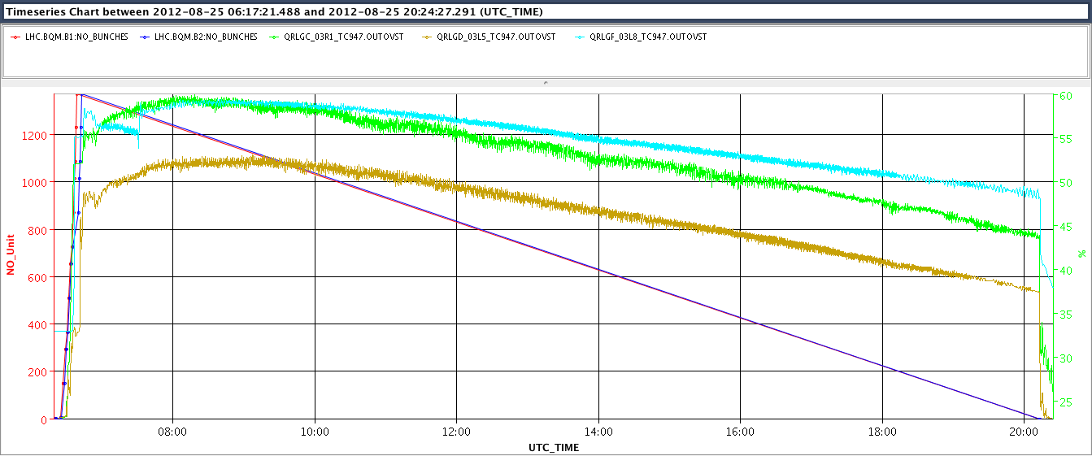
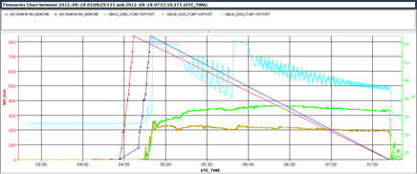
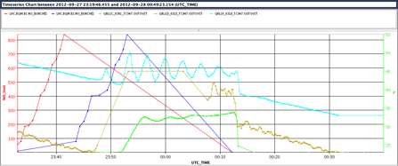
Anomaly Detection on Beam Screen Cryogenic Control
  PID output (time series) segmentation
  Characterization + Feature extraction
  Features based classification
EcosimPro by EA International
"
    Source: EN-ICE (Benjamin Bradu, Enrique Blanco)

Slide 24
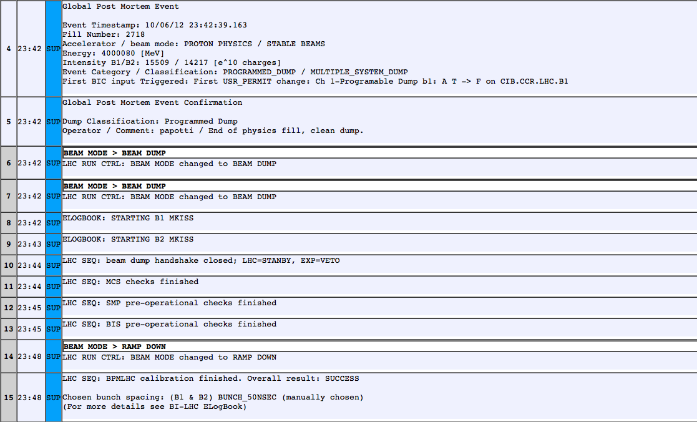
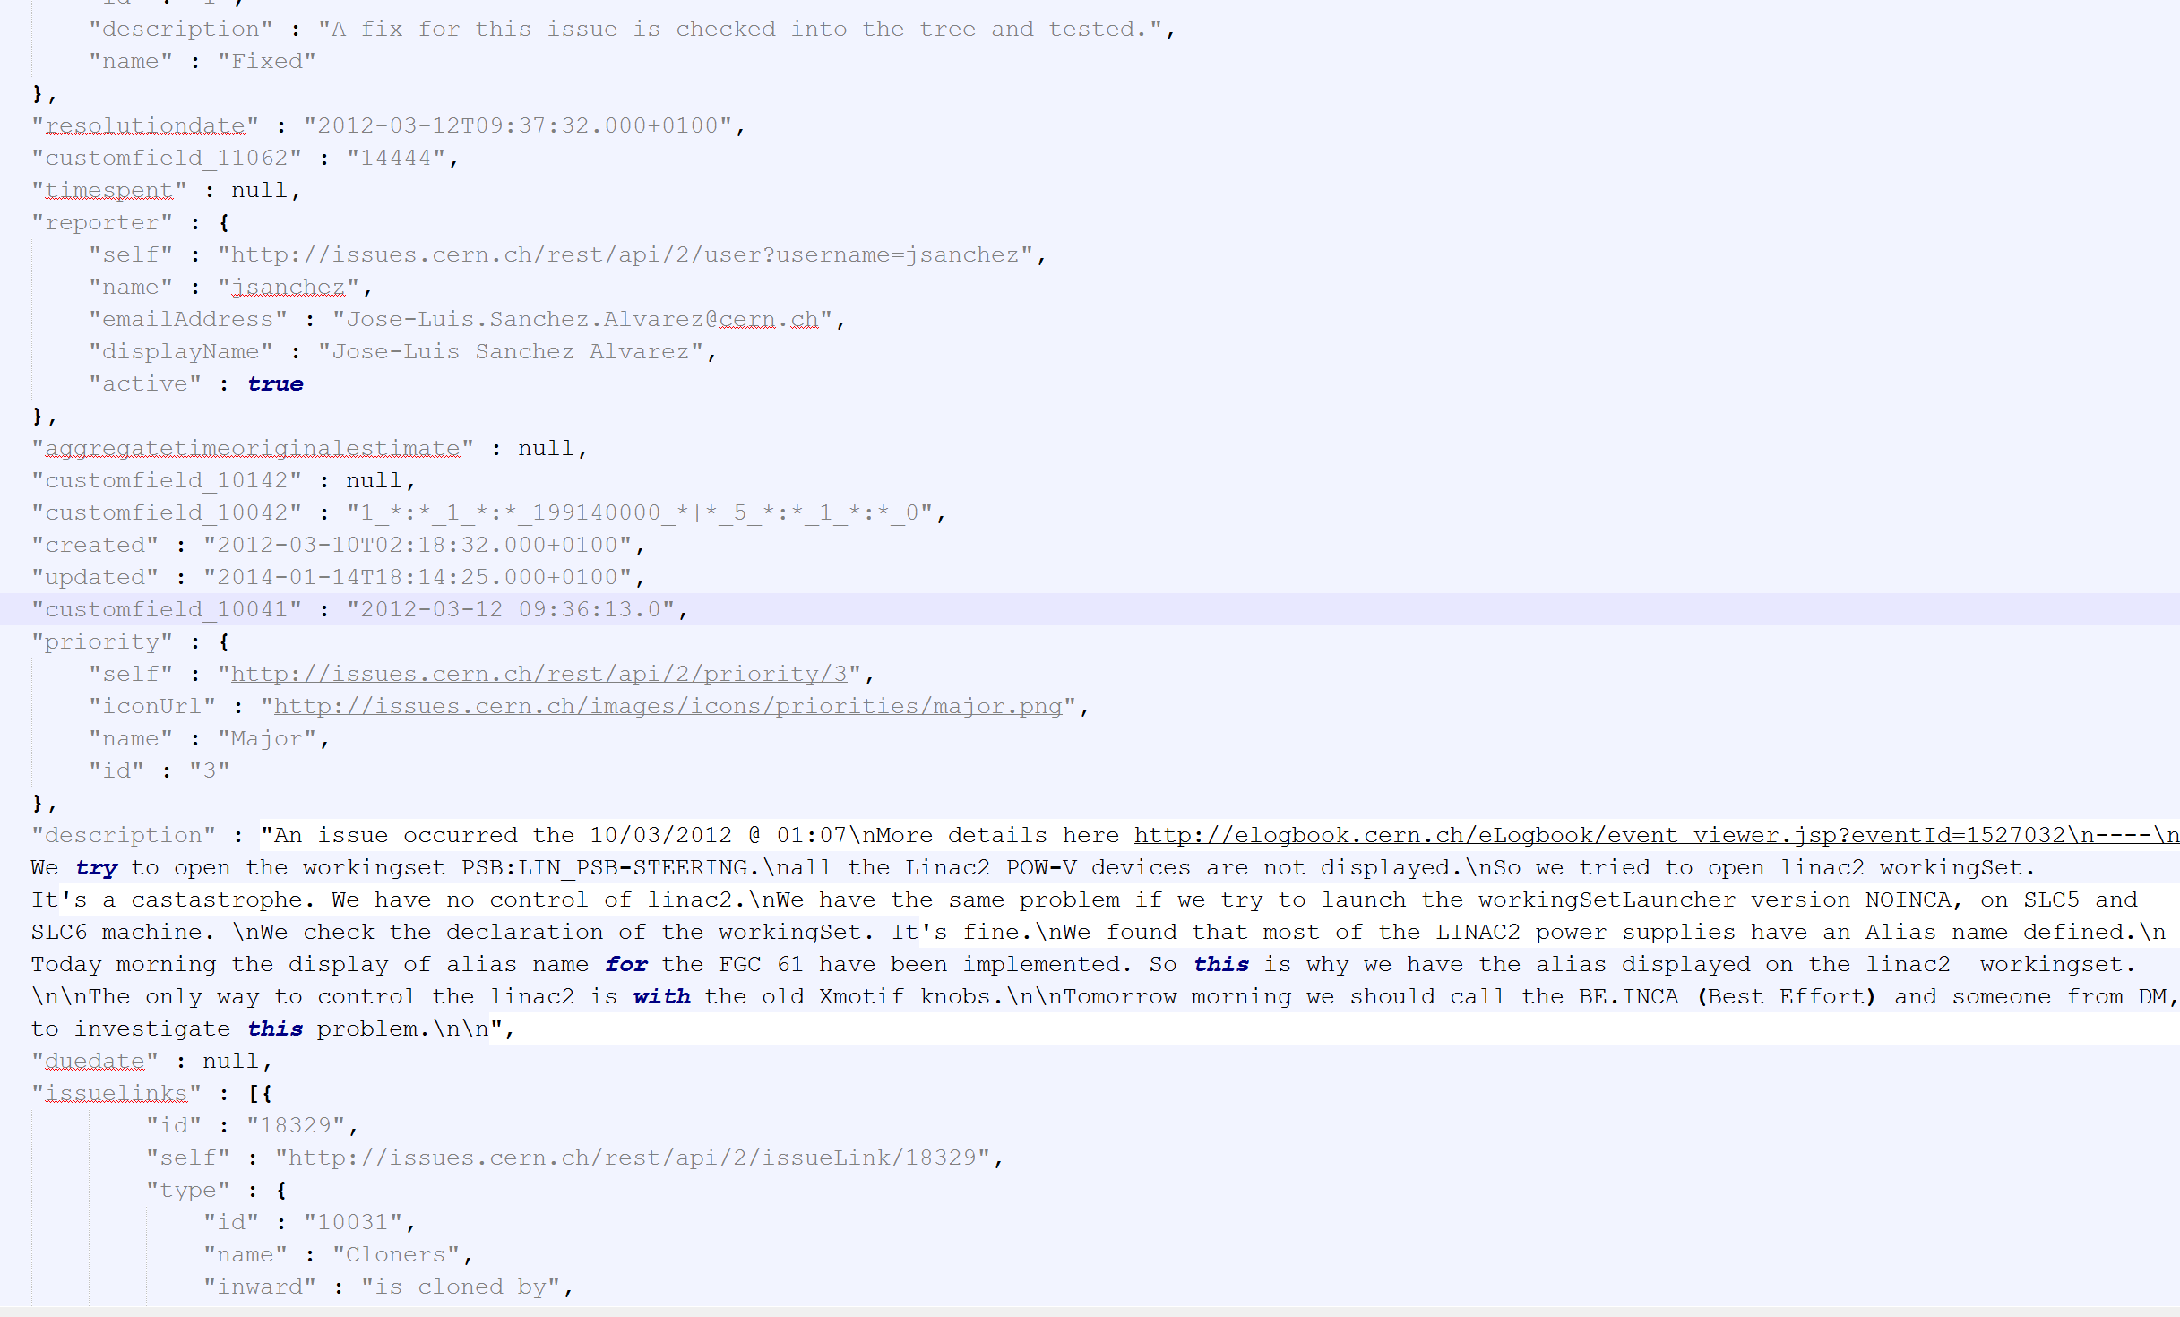
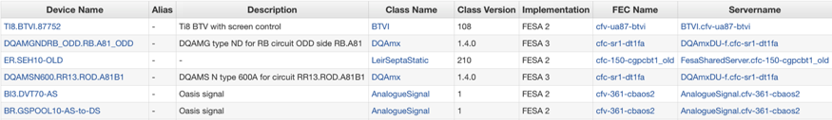
Data Discovery - Accelerator Complex Operations
Integrating Data Sources
Electronic Logbook
Controls Configuration DB
JIRA (JSON)
Text analysis
Better LHC Operations
Events Analysis
Correlate Information
  Fault Tracking System
  Operational Modes
  Operational Issues
  Control Equipment

Slide 25
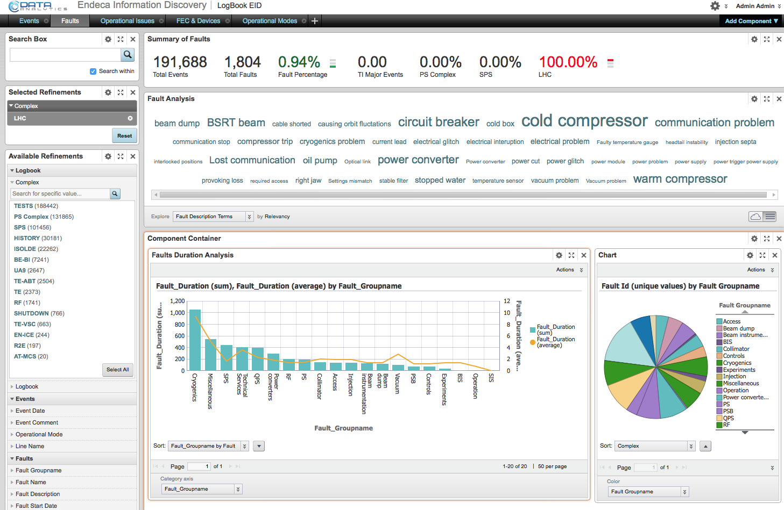
Data Discovery for Accelerator Complex Operations

Slide 26
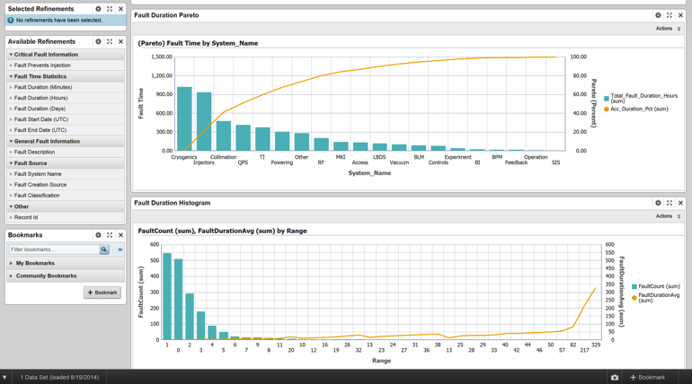
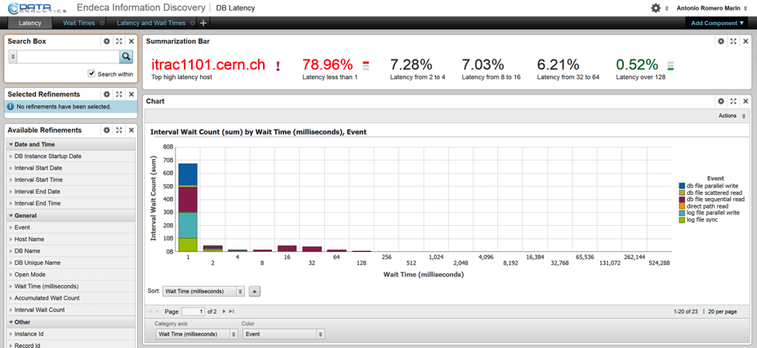
Endeca Information Discovery
Many different Applications at CERN
  Control and Operation
    Fault tracking
    Accelerator elogbooks
    Diagnostic and monitoring
  IT Infrastructure
    Cloud storage performance analysis
    Database Latency
  Human Resources

Slide 27




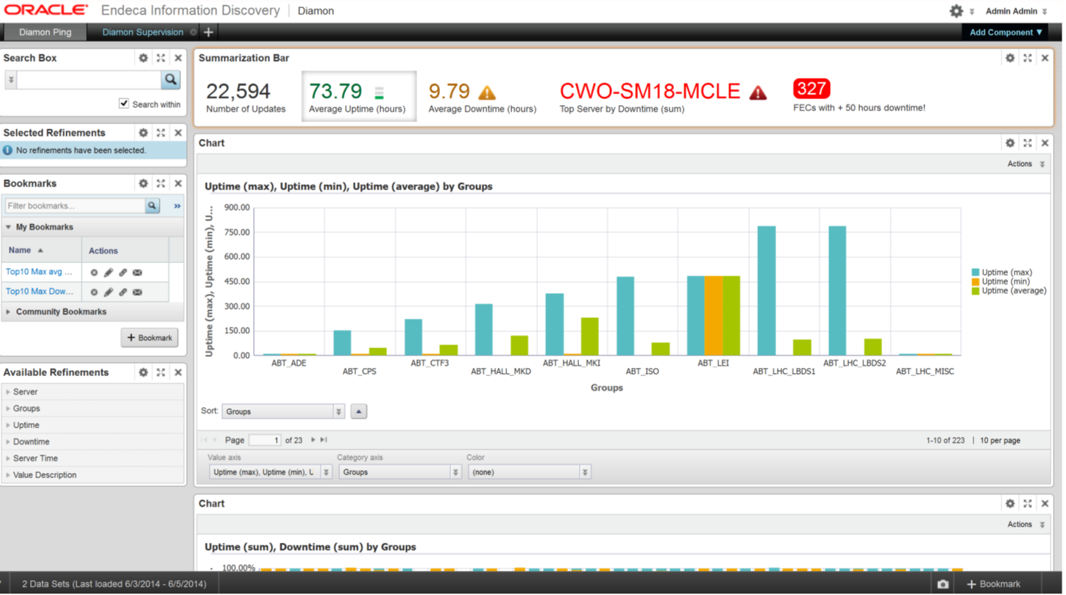






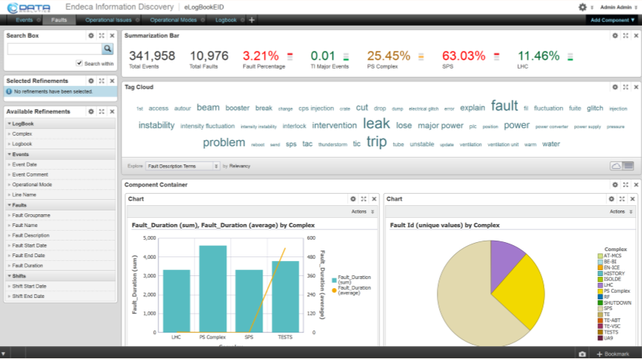



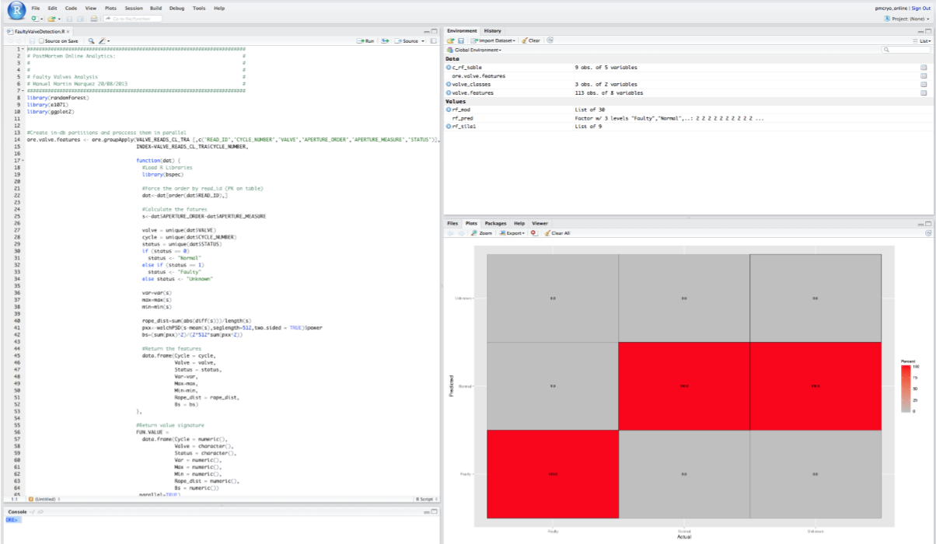







Wide-Ranging Data Sources
Endeca Studio
(user group dedicated)
Provisioning Service
Endeca Server
Cluster
Controls and Operations
System Configuration
Logging and Monitoring
Engineering
IT
HR
Logs
DIAMON
Server
System Administrators
LanDB
R ENTERPRISE
HR Surveys
Oracle Database
Oracle Database
Oracle Database
…
Engine
Engine
Engine
Accelerator Operators

Slide 28
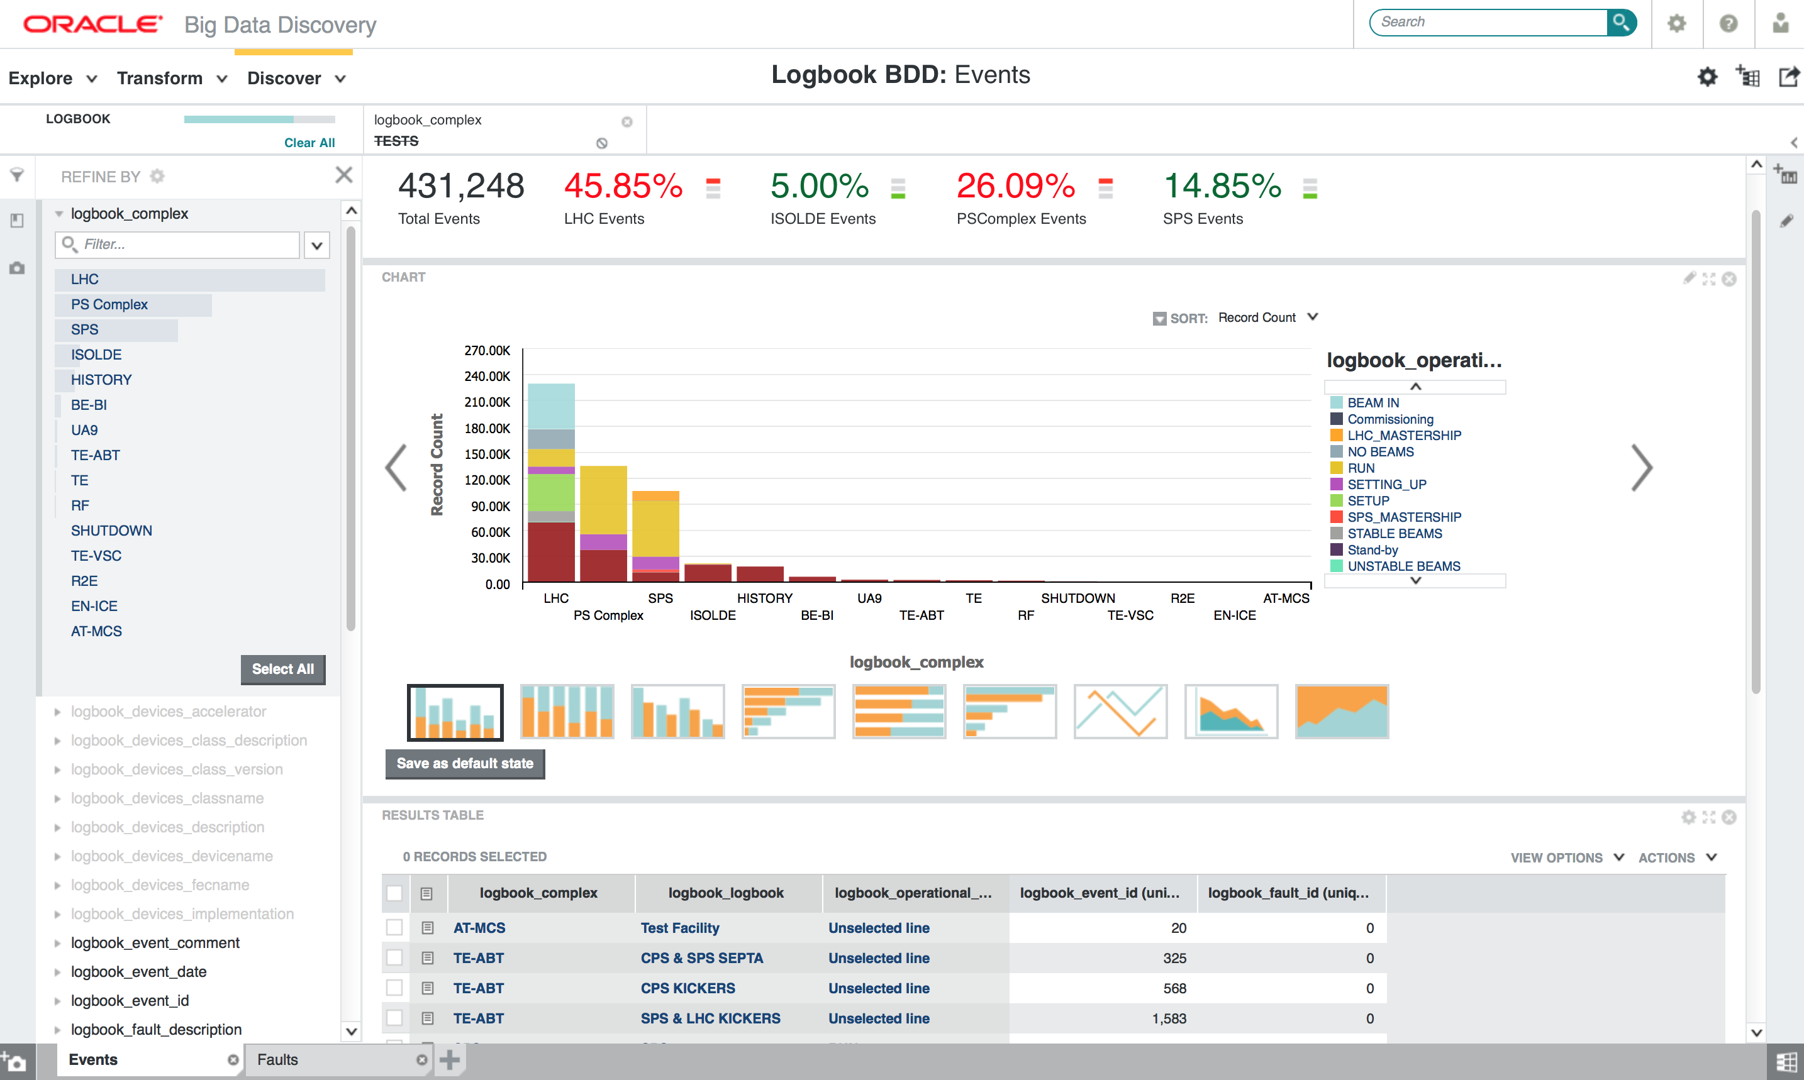

Slide 29
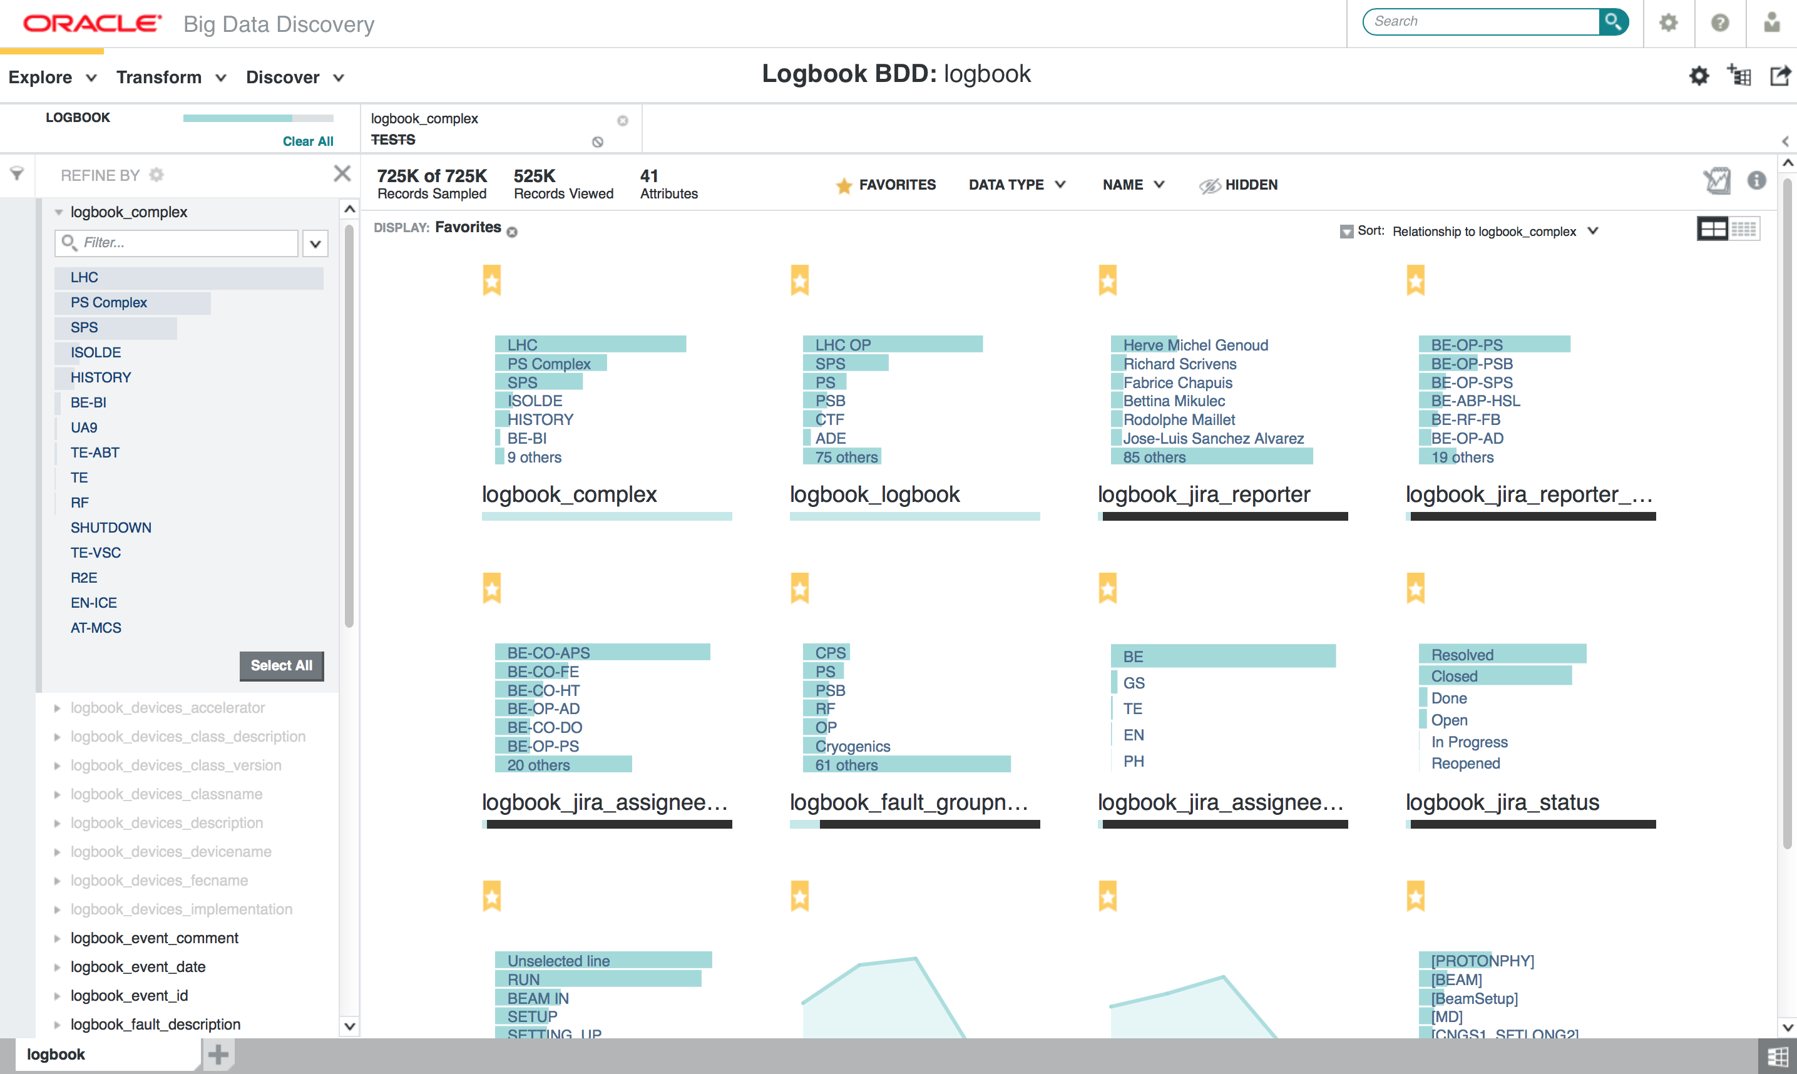

Slide 30
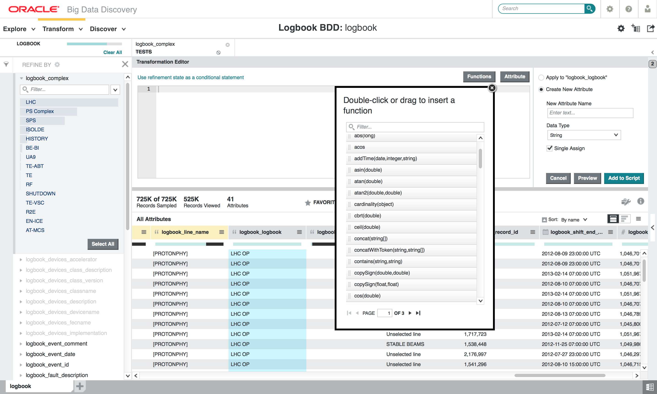

Slide 31
Manuel Martin Marquez
Manuel.Martin.Marquez@cern.ch

