Slide 2
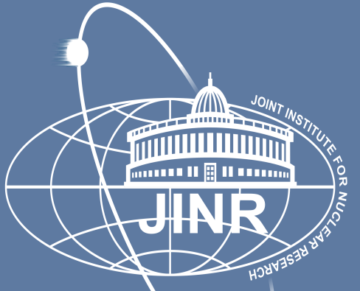
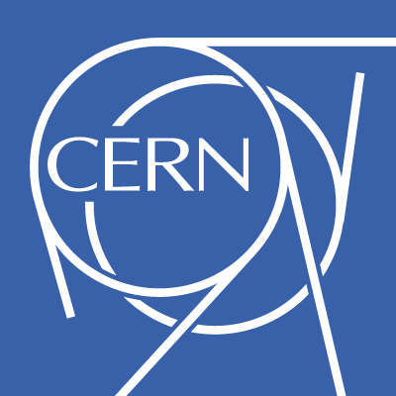
Replication Technologies at WLCG
Lorena Lobato Pardavila
CERN IT Department – DB Group

Slide 3

Agenda
Introduction
Worldwide LHC Computing Grid(WLCG)
Role of databases in LHC data management
Replication Technologies: Oracle GoldenGate
Monitoring: GGSCI, OGG Director, OGG EM Plugin and STRMMON
Verification: Oracle GoldenGate Veridata
Questions
Replication Technologies at WLCG - Lorena Lobato Pardavila

Slide 4

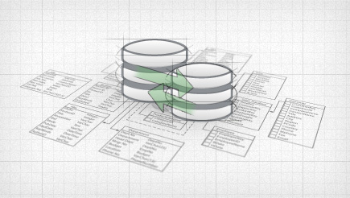
Introduction
What is replication?
“Replication is the process of copying and maintaining database objects, such as tables, in multiple databases that comprise a distributed database system. Changes applied at one site are captured and stored locally before being forwarded and applied at each of the remote locations. “
Replication Technologies at WLCG - Lorena Lobato Pardavila

Slide 5
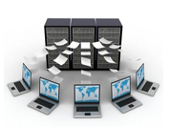
Introduction
What is replication so important?
  Availability
  Performance
  Disconnected Computing
  Network Load Reduction
Replication Technologies at WLCG - Lorena Lobato Pardavila

Slide 6
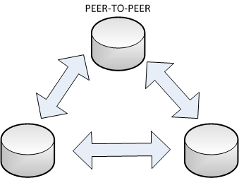
Introduction
Different configurations supported
    UNIDIRECTIONAL
    BI-DIRECTIONAL
    PEER-TO-PEER
    BROADCAST
    CONSOLIDATION
    CASCADING
Replication Technologies at WLCG - Lorena Lobato Pardavila

Slide 7
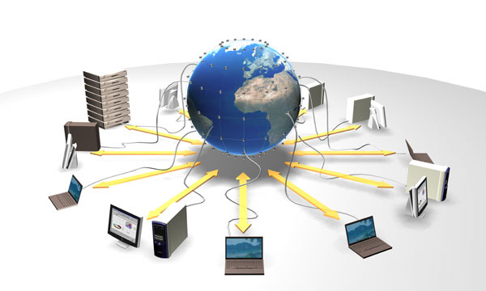
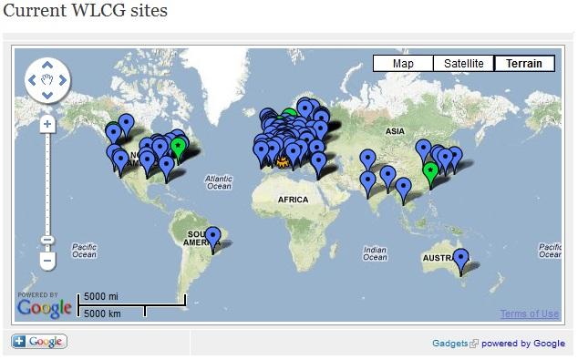
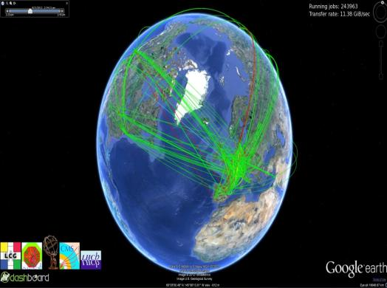
Worldwide LHC Computing Grid(WLCG)
The world’s largest computing grid
  More than 20 Petabytes
  of data stored and analysed every year
  Over 68 000 physical CPUs
  Over 305 000 logical CPUs
  +170 computer centres in 36 countries
  More than 8000 physicists with real-time access to LHC data
Replication Technologies at WLCG - Lorena Lobato Pardavila

Slide 8

Worldwide LHC Computing Grid(WLCG)
Global collaboration of more than 170 computing centers around the world
Provide computing resources to store, distribute and analyze the data generated by the LHC
Managed and operated by a worldwide collaboration between experiments and computer centers
2 million jobs run every day
Replication Technologies at WLCG - Lorena Lobato Pardavila

Slide 9
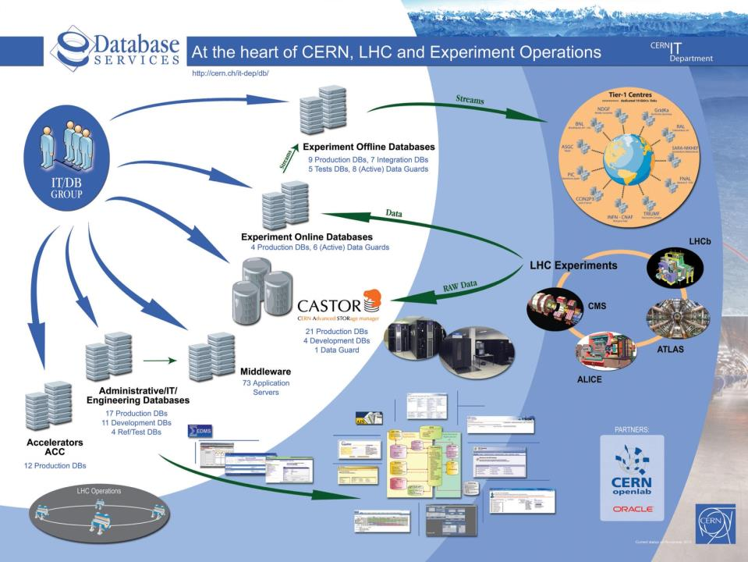
Role of Database in LHC Data Management
Replication Technologies at WLCG - Lorena Lobato Pardavila

Slide 10
Role of Database in LHC Data Management
What do we use SQL-based replication for?
PVSS - Supervisory Control and Data Acquisition
    Data from hw (or sw) devices in order to use it for their controls (DDL and DML operations)
    4TB of data, 81% of source db, average workload : 694 LCRs/s
Experiments conditions data
    Record the state of the detector: calibration, alignment, environmental parameters, … (DDL and DML operations)
    900 GB of data, 8% of source db, avg workload 50 LCRs/s
Other
    Muon calibration data (DML & DDL); 72 GB
    ATLAS Metadata Interface (DML & DDL); 80 GB
Replication Technologies at WLCG - Lorena Lobato Pardavila

Slide 11

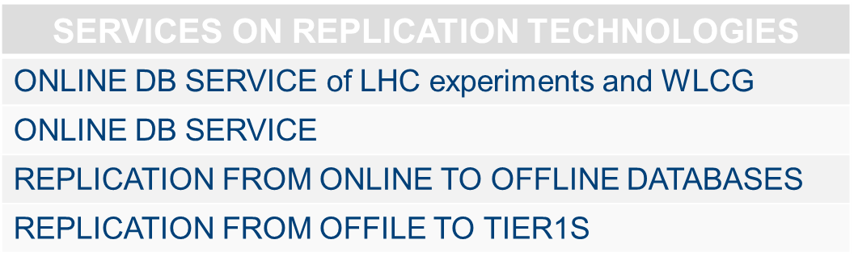
Role of Database in LHC Data Management
Replication Technologies at WLCG - Lorena Lobato Pardavila

Slide 12

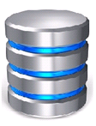
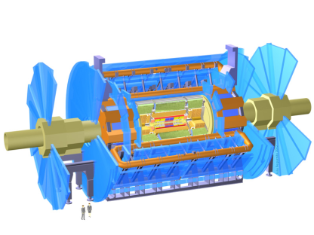
Role of Database in LHC Data Management
Online
Database
Downstream
Capture
Database
Conditions
RAL
(UK)
Offline
Database
STREAMS
Conditions
Conditions
STREAMS
IN2P3
(FRANCE)
REDO
STREAMS
PVSS
Conditions
STREAMS
STREAMS
TRIUMF
(CANADA)
STREAMS
Conditions
BNL
(USA)
UMICH
(USA)
ROME
(ITALY)
IN2P3
(FRANCE)
MUNICH
(GERMANY)
Replication Technologies at WLCG - Lorena Lobato Pardavila

Slide 13
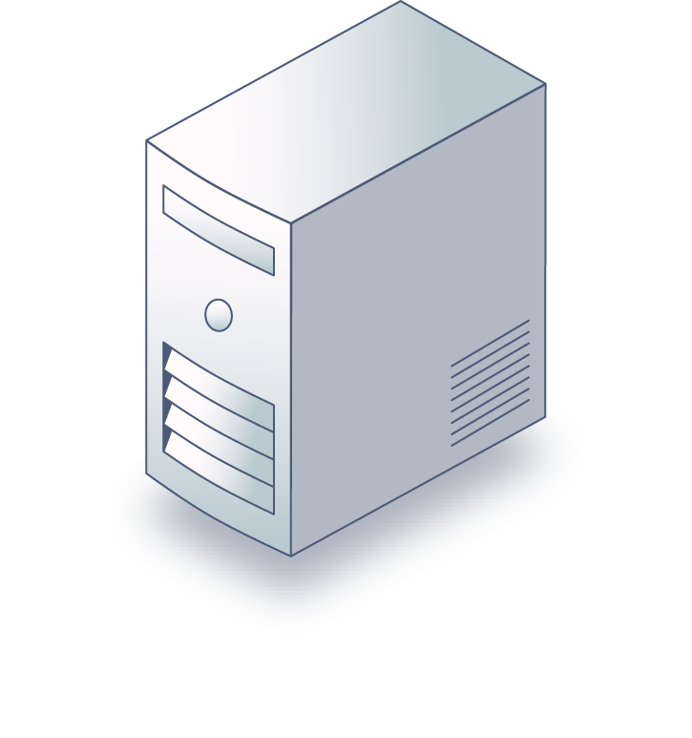
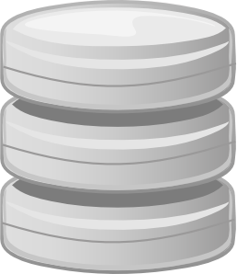
Role of Database in LHC Data Management
Centralised configuration at CERN
Replica databases
GoldenGate processes
Monitoring agents
Source databases
Central GG servers
Source databases
A’
A
A”
B
B’
C
NAS storage
with configuartion and trail files
C’
15/10/2014
Replication Technologies at WLCG - Lorena Lobato Pardavila

Slide 14
Replication Technologies
Streams: Product from Oracle to work with replications
    SQL Statement
    Phased out
Active Data Guard: Evolution of Data Guard. “Blocks”
    Supports any type of data ( “mirror”)
    Only Oracle databases
    Supports active-passive replication
    Create read-only copies of production databases
    Used by CMS, ALICE and more recently by ATLAS for control data
Oracle GoldenGate: New strategy of Oracle
    Extract, Data Pump and Replication
    Heterogeneous replication (Oracle DB and non-Oracle DB)
    Partial replication
    Supports active-active replication
    Used by ATLAS and LHCb
Replication Technologies at WLCG - Lorena Lobato Pardavila

Slide 15
Replication Technologies
    Oracle GoldenGate (Currently version 12.1.2.1.0)
MANAGER
EXTRACT
GGSCI
GLOBALS
DATA PUMP
REPLICAT
Replication Technologies at WLCG - Lorena Lobato Pardavila

Slide 16
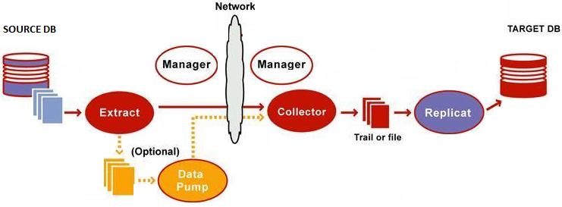
Replication Technologies: OGG
Applies data with transaction integrity, transforming the data as required
Commited changes are captured as they occur by reading the transaction logs
Distribute data for routing to multiple targets
Trail files: Stages and queues data for routing
Replication Technologies at WLCG - Lorena Lobato Pardavila

Slide 17
Replication Technologies: OGG
  CERN since 2010 intensively evaluates Oracle GoldenGate as part of Openlab program
    GG is the recommended replication technology by Oracle
          Streams is in maintenance mode
    Active Data Guard does not apply in all cases
          Partial database replication to remote sites
    Migration from Streams to Oracle GoldenGate done during July – September 2014 in our Production databases☺
Oracle GoldenGate@CERN
Replication Technologies at WLCG - Lorena Lobato Pardavila

Slide 18
Monitoring
GGSCI environment
Oracle GoldenGate Director
OGG Enterprise Manager plugin
CERN’s Streams Monitor

Slide 19
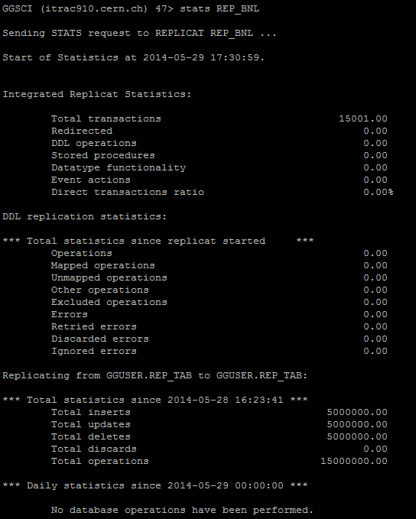
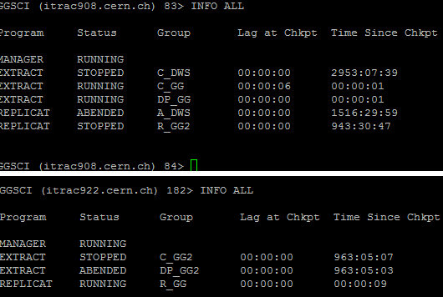
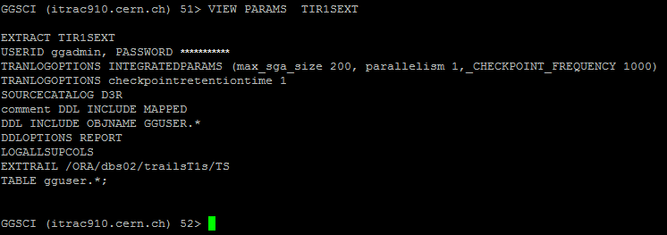
Monitoring: GGSCI environment
GGSCI environment

Slide 20
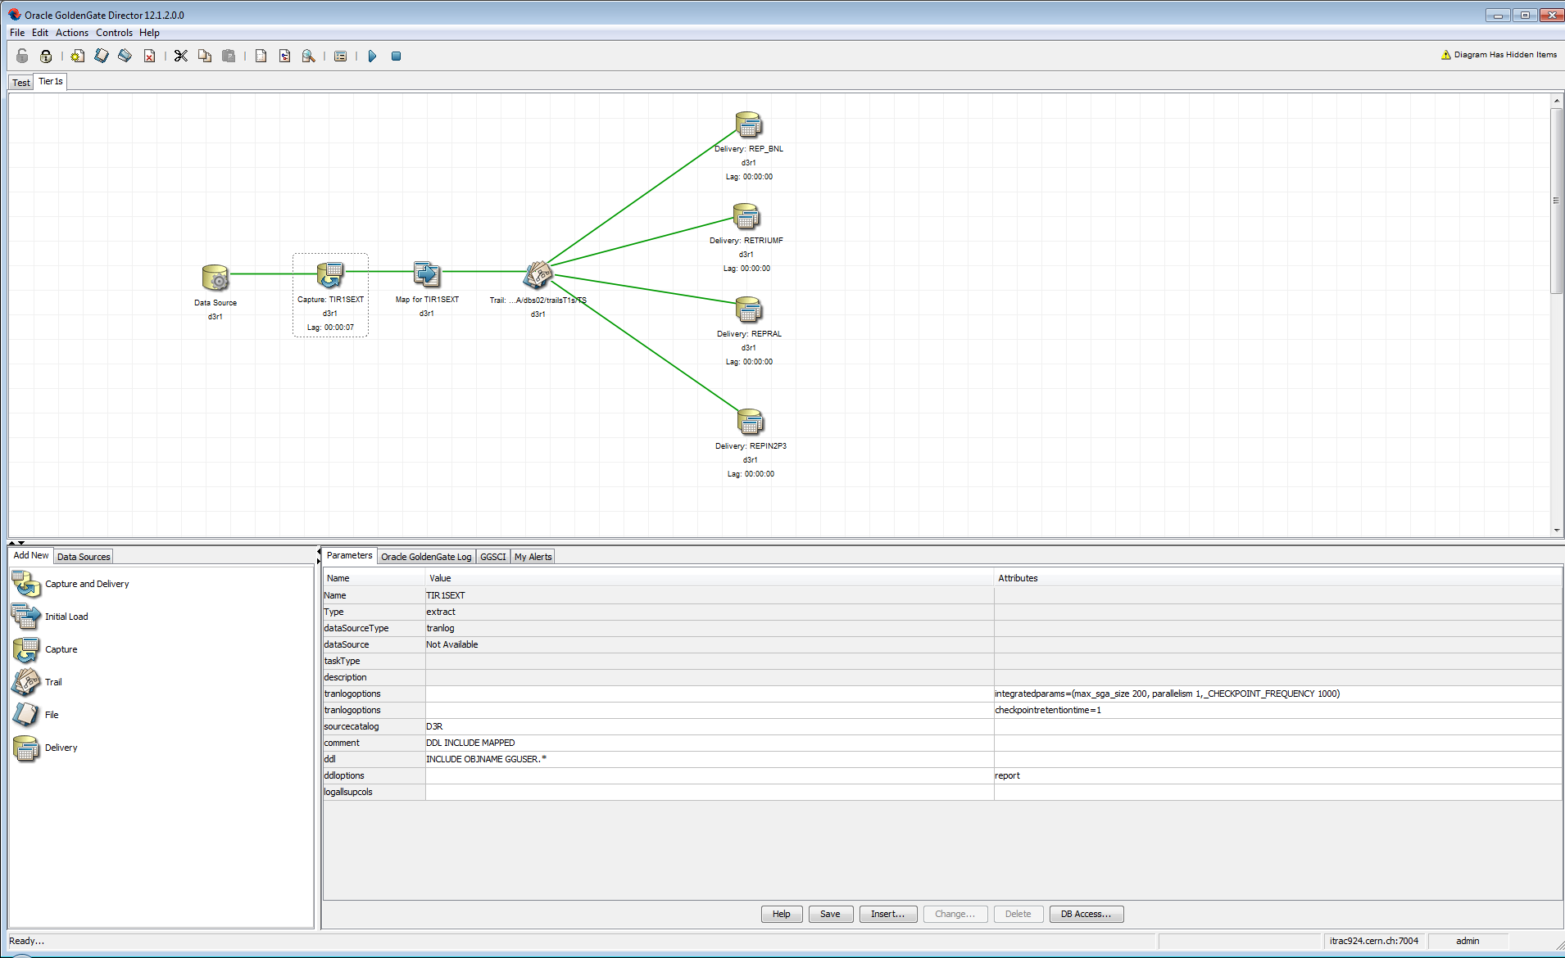
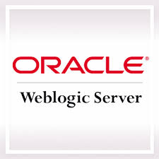

Monitoring: Oracle GoldenGate Director
Multi-tiered, client-server application that enables the configuration and management of Oracle GoldenGate instances from a remote client
OGG Director Server Domain
GGSCI
OGG Director Web
OGG Director Server Application
OGG Director Client
GGSCI
GGSCI
OGG Director Administrator
Monitor Agent
Clients
OGG Instances
OGG DIRECTOR DATABASE

Slide 21
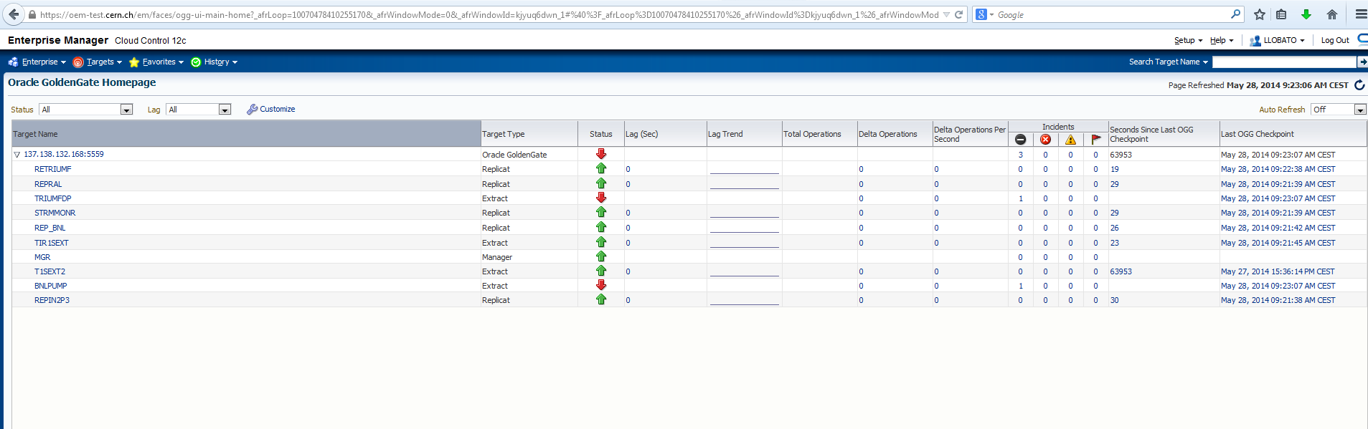
Monitoring: OGG Enterprise Manager Plug-in
For installing the plug-in:
  Enterprise Manager Cloud Control 12c Bundle Patch 1 (12.1.0.1) and later
  Oracle GoldenGate 11g Release 2 (11.2.1.0.1) and later
Management features:
  Monitor Oracle GoldenGate instances.
  Gather configuration data and track configuration changes for Oracle GoldenGate instances.
  Raise alerts and violations based on thresholds set on monitored targets and configuration data.
  Support monitoring by a remote Agent. A Local Agent is an agent running on the same host as the Oracle GoldenGate instance.

Slide 22
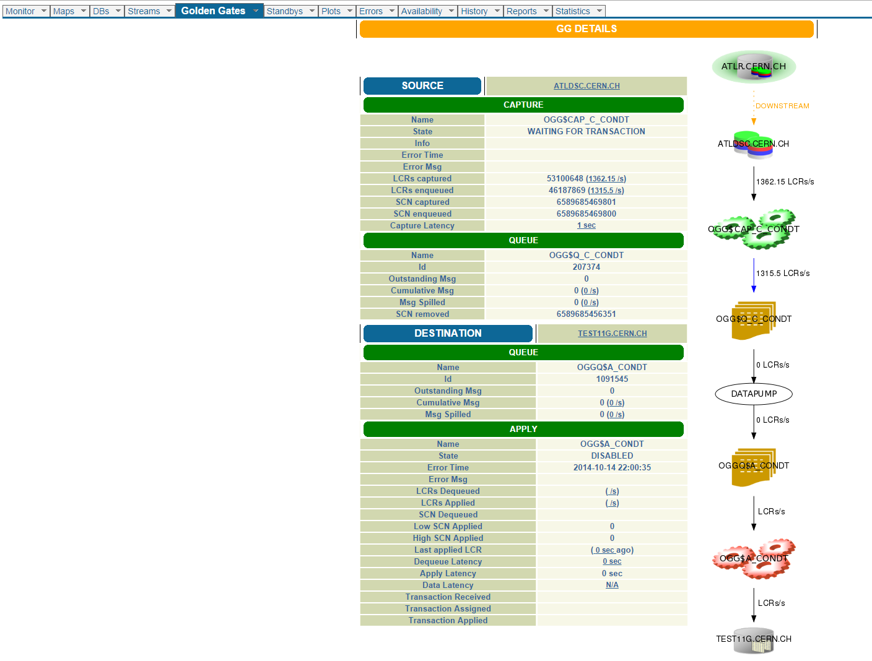
Monitoring: CERN’s Streams Monitor

Slide 23
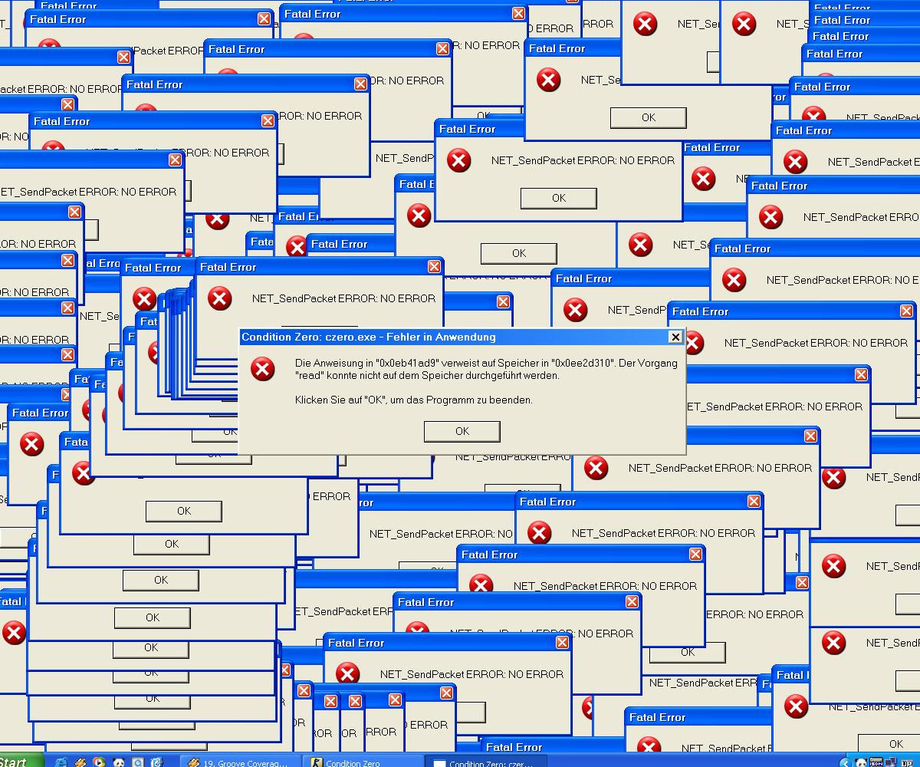
Verification
Most important after doing any operation…
VERIFICATION
Replication Technologies at WLCG - Lorena Lobato Pardavila

Slide 24
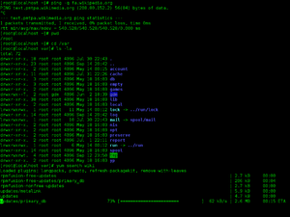

Verification: Oracle GG Veridata
Is a high-performance cross-platform data comparison tool that supports high-volume compares
Allows data consistency validation on “hot” data sets
REPOSITORY
OGG Veridata Agents
SOURCE
OGG Veridata CLI
OGG Veridata Server
TARGET
DATABASES
OGG Veridata Web
Replication Technologies at WLCG - Lorena Lobato Pardavila

Slide 25
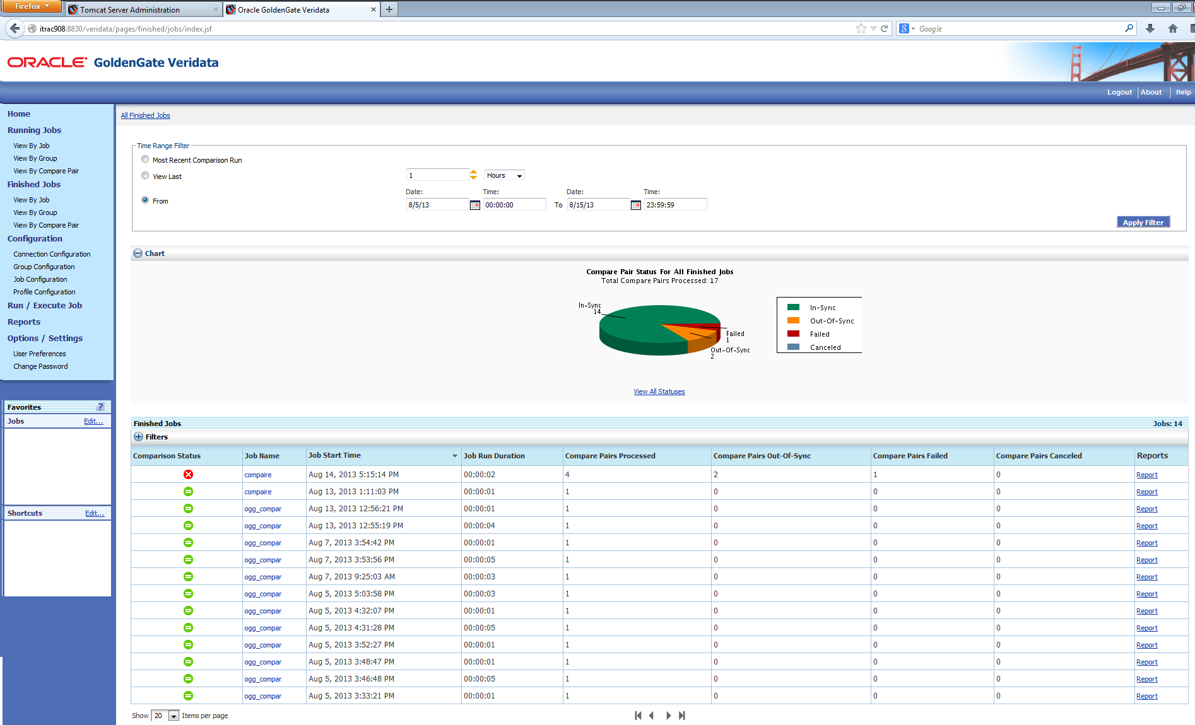
Verification: Oracle GG Veridata
Replication Technologies at WLCG - Lorena Lobato Pardavila

Slide 26
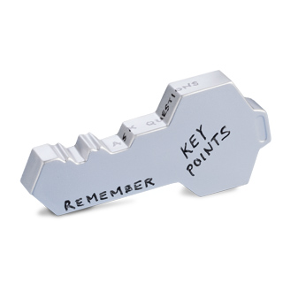
Verification: Oracle GG Veridata
Powerful tool for the data missing-synchronization identification
Along with Oracle GoldenGate, allows data real-time integration and continuous availability solutions validated data consistency
  New version requires WLS 12.1.3 and it has a ability to repair/fix out of sync data
Stores OOS(Out-of-Sync) reports in binary, XML or both
Agents can connect remotely, not needed installation in target databases
200GB production data have been compared in an ATLAS environment with a speed of 16.86 MB/sec
Replication Technologies at WLCG - Lorena Lobato Pardavila
Notes:
After migration, verify data consistency measured by Oracle GG Veridata
Veridata is a potential and solid data comparison solution
More than 120 schemas inspected between CERN and Tier1s
+1.87 TB of data checked
+34,888 of tables were processed

Slide 27


Questions?
      Thank you! / Merci! / Спасибо!
      More info: lorena.lobato@cern.ch
Replication Technologies at WLCG - Lorena Lobato Pardavila

