Slide 1
ORACLE GOLDENGATE AT CERN
Lorena Lobato Pardavila, CERN IT-DB
Oracle GoldenGate 12c Event
Baden, 28th April 2015

Slide 2
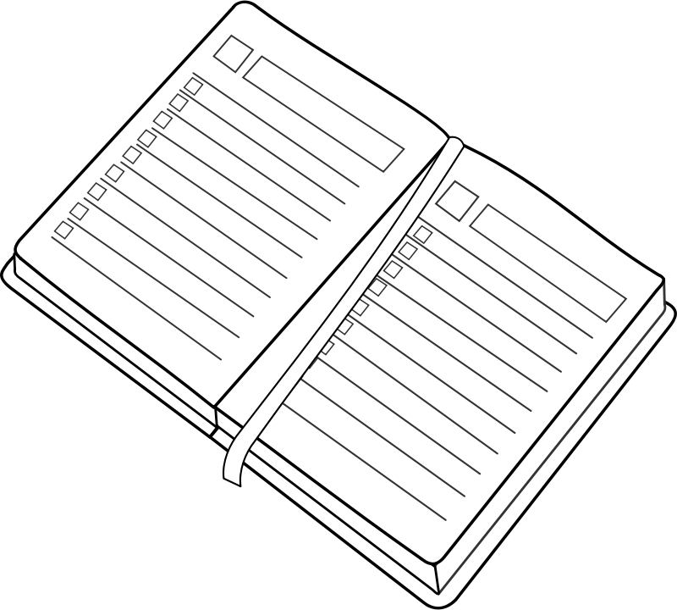
Outline
Data Replication in IT DB services
Deployment
Monitoring
Problems
Verification
Conclusions

Slide 3
What IT-DB group does?

Slide 4
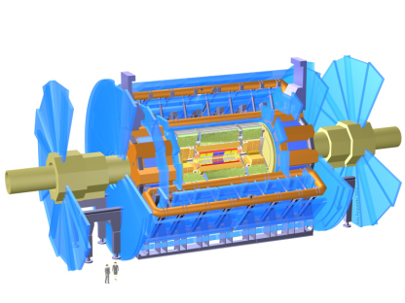
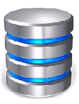
Data replication for online DBs
Key component of online-offline DB model for experiments database services
Controls and aquisition system archives (PVSS)
Conditions data
Archiving
Replication
Online
Database
Offline
Database

Slide 5
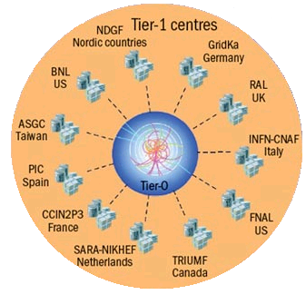
Data replication for WLCG
World wide data distribution for WLCG
Conditions data to T1s (ATLAS, LHCb – in past)
(In past) LHCb LFC data to T1s
Consolidation of data at T0
ATLAS Metadata Interface
Muon calibration data (ATLAS)
Replication
Offline
Databases
Atlas conditions are replication
to a subset of Tier-1 sites

Slide 6
ATLAS DB Replication Topology
Online
Database
RAL
(UK)
Downstream
Capture
Database
Conditions
Offline
Database
GOLDENGATE
Conditions
GOLDENGATE
Conditions
STREAMS
IN2P3
(FRANCE)
REDO
GOLDENGATE
PVSS
GOLDENGATE
STREAMS
Conditions
GOLDENGATE
TRIUMF
(CANADA)
UMICH
(USA)
ROME
(ITALY)
IN2P3
(FRANCE)
MUNICH
(GERMANY)

Slide 7
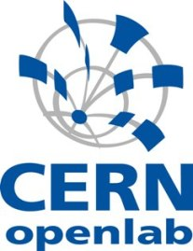
Replication Technologies Timeline
2004
2008
2010
2012
2014
Online – Offline Offline – T1s
Offline – T1s
Oracle Streams evaluation
Oracle Streams in production
Oracle Streams in production
Oracle Streams in production
GoldenGate in production
GoldenGate evaluation
GoldenGate evaluation
Active Data Guard evaluation
Active Data Guard in production
Active Data Guard evaluation
Active Data Guard in production
Initial functional and
performance tests
Oracle buys/adopts
GoldenGate
Deployment of
Oracle 11g at CERN
and T1s
New technology
available in Oracle 11g

Slide 8
Outline
Data Replication in IT DB services
Deployment
Monitoring
Problems
Verification
Conclusions

Slide 9
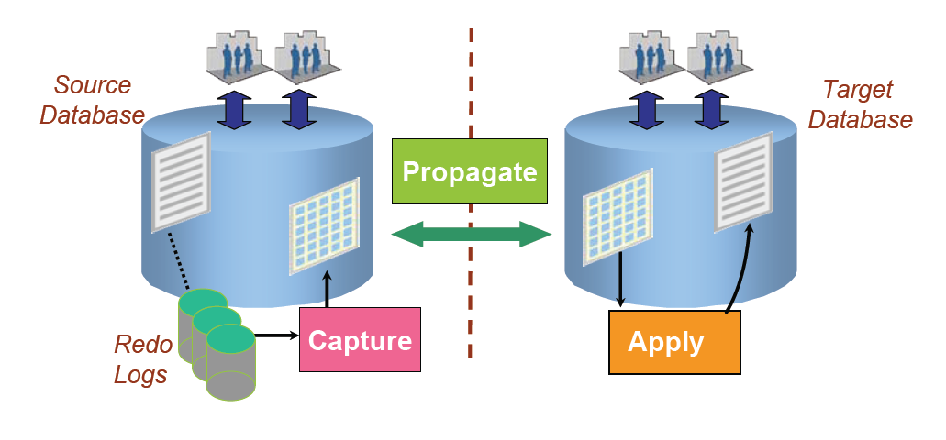
Oracle Streams
First implementation of replication
Online – Offline replication
Offline – T1s replication

Slide 10
Oracle GoldenGate
Source Database
Target Database
Redo Logs
Extract
Replicat
DataPump
Trail Files
Trail Files

Slide 11
Oracle GoldenGate
+ improved version of Streams
better performance
lower footprint on the source database
more functionalities, data types and features
+ destination DB can be at a different version than source
+ replication granularity is at schema-level
+ installation can be centralized
- additional binaries has to be installed
- coherency of entire data set is not ensured

Slide 12
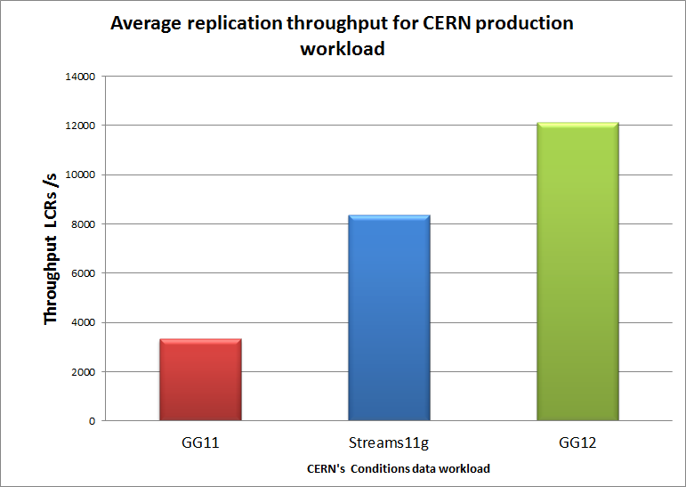
Evaluation - performance
IMPROVEMENT
In 2013:
-> new version of GoldenGate (12c) beats
Streams
Notes:
Workload Description
- 5 days of ATLAS conditions data
- 675GB of redo volume
- 250k of transactions
- 18.9 M of row changes (LCRs)

Slide 13
Deployment
Migration Streams -> GoldenGate completed Q3 2014
Script streams2ogg provided by Oracle to convert the processes
Any major issue during the migration process

Slide 14
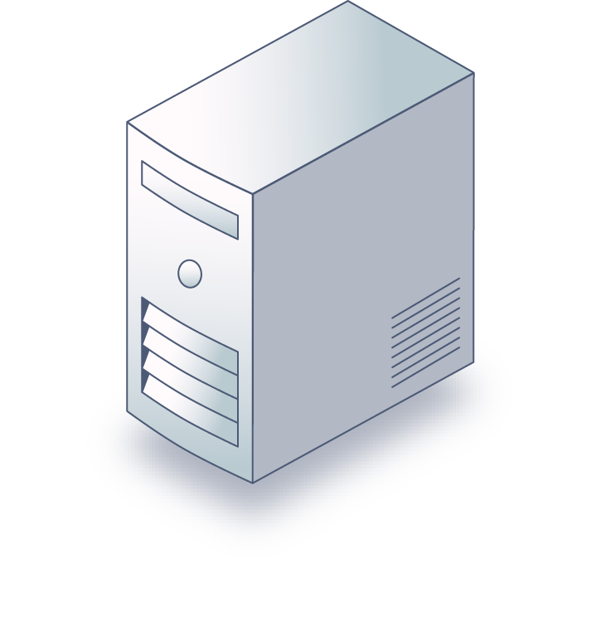
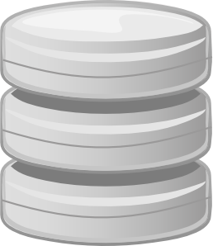
Deployment
Centralised configuration at CERN
Replica databases
GoldenGate processes
Monitoring XAG agents
Source databases
Central GG servers
Source databases
A’
A
A”
B
B’
C
NAS storage
with configuration and trail files
C’
15/10/2014

Slide 15
Outline
Data Replication in IT DB services
Deployment
Monitoring
Problems
Verification
Conclusions

Slide 16
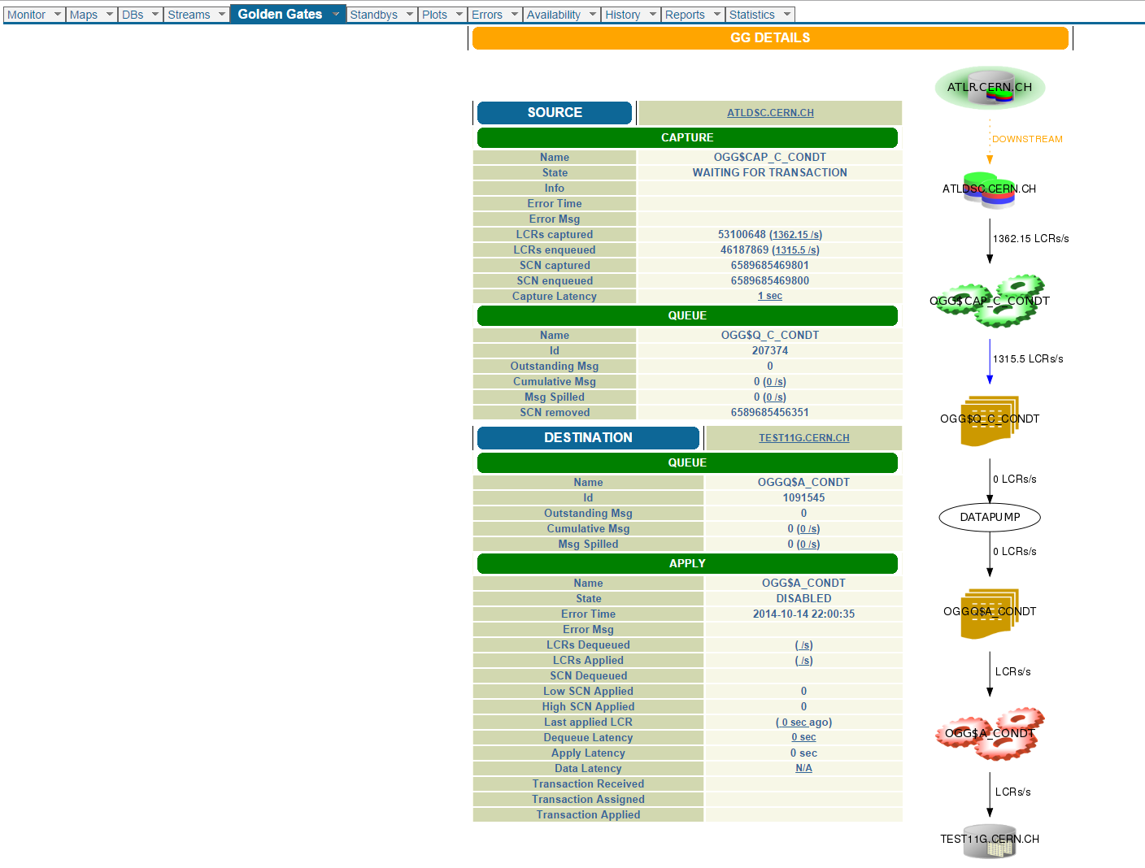
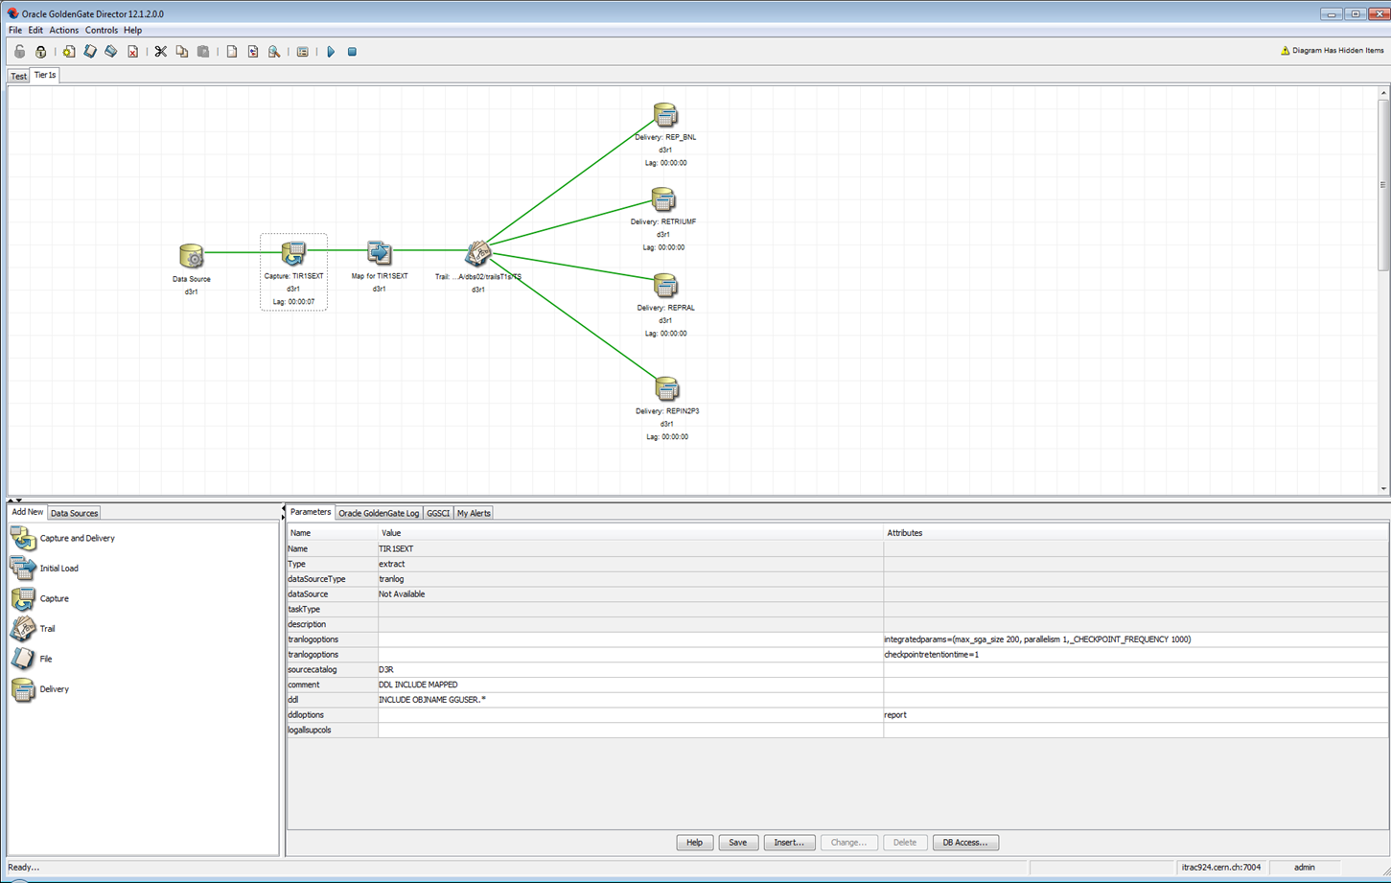
Monitoring
In-database monitoring
Status and statistics available in db views
GoldenGate statistics in AWR
available since RDBMS 12.1
GoldenGate performance advisory (SPADV for GG) and Health Check report
CERN’s Streams Monitor
Software monitoring
Oracle GoldenGate Director
OGG Enterprise Manager plugin

Slide 17
Outline
Data Replication in IT DB services
Deployment
Monitoring
Problems
Verification
Conclusions

Slide 18
Problems
Trails files automatic deletion is not working in OGG configuration without DataPump
Network problems
Christmas incident
net.core.rmem_max = 16777216 net.core.wmem_max = 16777216 net.ipv4.tcp_rmem = 4096 87380 16777216 net.ipv4.tcp_wmem = 4096 65536 16777216

Slide 19
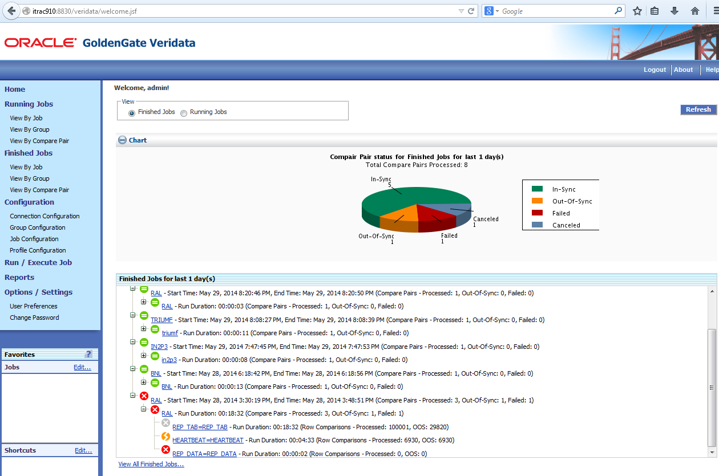
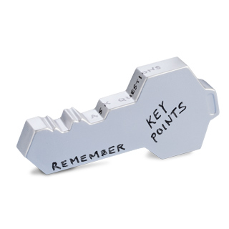
Verification:Oracle GG Veridata
Powerful tool for the data missing-synchronization identification
It has the ability to repair/fix out of sync data
Agents can connect remotely, not needed installation in target databases
200GB production data have been compared in an ATLAS environment with a speed of 16.86 MB/sec

Slide 20
Conclusions
Database replication is key technology to enable distribution of conditions data across T0 (and T1s)
Complex: different requirements, different topologies
Technology evolution:
Oracle Streams (initial solution) was replaced by Golden Gate (T0 and T1s)
The change improved availability and performance of the data replication services

Slide 21
Acknowledgments
Collaboration has been key for the success of this project.
Experiments
Many thanks to the experiments DB coordinators and experts
ATLAS: Gancho Dimitrov
Tier 1 DBAs and database experts
Osman Aidel, Carmine Cioffi, Andrew Wong, Carlos Gamboa
Oracle (via the Openlab partnership)
Patricia McElroy, Jagdev Dhillon, Greg Doherty, Monica Marinucci
CERN IT-DB group
Especially: Eva Dafonte Perez, Zbigniew Baranowski

Slide 22
Questions?
Thank you!
CONTACT
Work: lorena.lobato@cern.ch
Personal: lobato.pardavila.lorena@gmail.com
Twitter: @lobatopardavila

