Slide 1
Brocade Flow Optimizer
CERN openlab
15/10/2015
Layer 123
SDN & OpenFlow World Congress
Stefan Stancu

Slide 2
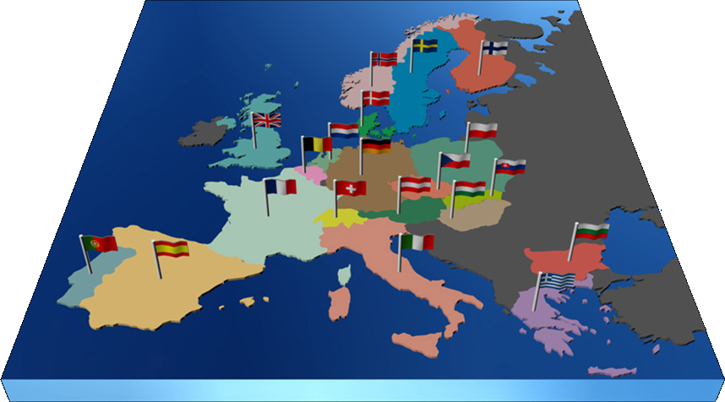
CERN
The largest particle physics laboratory in the world
Annual budget
~ 1.000 MCHF (1.000 MUSD)
External funding
for experiments
People
2.424 Staff
783 Fellows & assoc.
288 Students
10.388 Users
2.000 External Firm
21 Member States
Austria, Belgium, Bulgaria, Czech Republic, Denmark, Finland, France, Germany, Greece, Hungary, Israel, Italy, Netherlands, Norway, Poland, Portugal, Slovak Republic, Spain, Sweden, Switzerland, United Kingdom
+ Candidates: Romania, Serbia
Seven Observers
European Commission, USA, Russian Federation,
India, Japan, Turkey, UNESCO

Slide 3

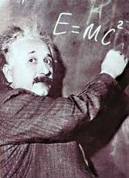
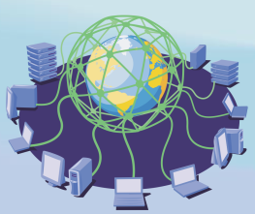

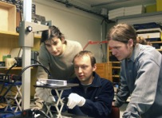
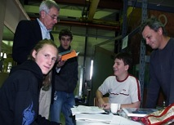
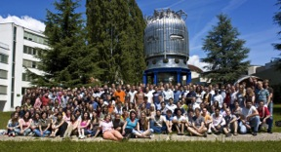
CERN’s Mission
Push the frontiers of knowledge
E.g. the secrets of the Big Bang …what was the matter like
within the first moments of the Universe’s existence?
Develop new technologies
for accelerators and detectors
Information technology - the Web and the GRID
Medicine - diagnosis and therapy
Train scientists and engineers of tomorrow
Unite people from different countries and cultures

Slide 4
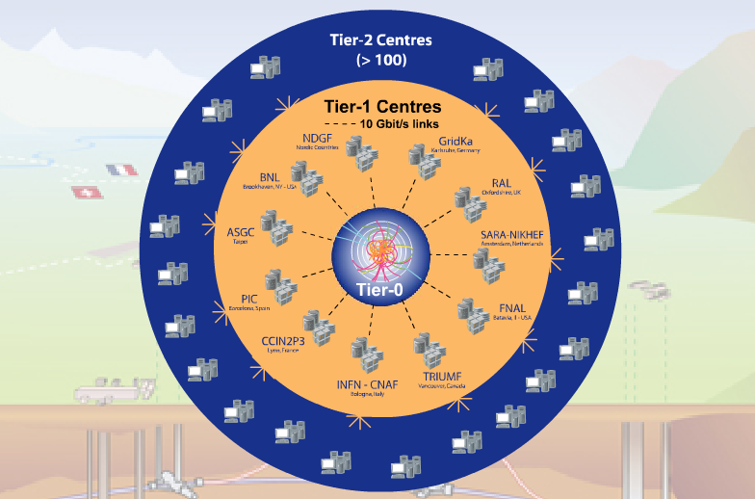
Worldwide LHC computing grid
Tier 2 centers
Tier-0 (CERN):
  Data recording
  Initial data reconstruction
  Data distribution
Tier-1 (11 centers):
Permanent storage
Re-processing
Analysis
Tier-2 (~ 200 centers):
Simulation
End-user analysis

Slide 5







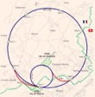










CERN network infrastructure
Core
EXT
LCG
B513-B-RBRML-1
B513-B-RBRML-2
E600GVA1.USLHCNET.ORG
E600GVA2.USLHCNET.ORG
E513-X-MFTE6-1
World Health Organization
Computer Center
Firewall
E513-E-RBRXL-1
E513-E-RCI65-3
Vault
L513-V-RBRMX-1
L513-B-RBRMX-1
GPN
Computer Center
G513-E-FCISA-1
E513-E-RBRXL-2
Internet
L513-V-RBRMX-2
R513-B-RBRML-1
R513-C-RBRML-1
G513-E-RCI76-1
Vault
R513-V-RBRML-1
R513-C-RBRML-2
90x
G513-E-RCI76-2
L513-C-RBRMX-1
L513-B-RBRMX-2
55x
R513-V-SHPZML-1
R513-B-RBRML-2
10x
Farms
R513-C-SHPZM-3
Meyrin area
Prevessin area
TN
L513-C-RBRMX-2
L513-B-RBRMX-3
G513-E-FCISA-2
T212-1-RCA86-1
T354-R-RCA86-1
T376-R-RCA80-1
T513-T-RCA86-1
T874-R-RCA86-1
T874-R-RCA86-3
X 450
(300 main room
150 vault)
513-CCR
RT3
BT2
RT4
BT3
RT14
BT13
RT13
BT12
10-1
40-S2
376-R
513-C
874-R
887-R
BT1
RT2
BT16
RT17
L513-C-RBRMX-3
T513-B-RCA86-1
BT14
T2173-R-RCA80-1
LHC
area
2-S
513-CCR
BT15
T874-B-RCA86-1
RT15
or
T513-T-RCA80-2
Prevessin area
Rxxx-x-RHPZM-1
Rxxx-x-RHPYM-1
BT4
BT5
BT6
BT7
BT8
BT9
BT10
BT11
L513-C-RBRMX-4
874-CCC
RT16
RT5
RT6
RT7
RT8
RT9
RT10
RT11
RT12
100x
T874-R-RCA80-2
T2175-R-RCA86-1
TT1
TT2
TT3
TT4
TT5
TT6
TT7
T2275-R-RCA86-1
T2375-R-RCA86-1
T2475-R-RCA86-1
TT8
1000x
LHC area
20x
T2575-R-RCA86-1
T2675-R-RCA86-1
T2775-R-RCA86-1
T2875-R-RCA86-1
5x
30x
Minor Starpoints 100x
CNIC
350x
L513-E-RBRML-1
L513-E-RBRML-2
LCG
GPN
CERN sites
AG
AG
AG
ATCN
15x
15x
TN
Control
15x
15x
Control
10x
Control
10x
TN
10x
TN
10x
TN
AG
CDR
AG
CDR
AG
AG
CDR
AG
8x
AG
HLT
AG
CDR
Tiers'1
DAQ
ATLAS
25x
DAQ
ALICE
90x
DAQ
CMS
DAQ
LHCB
90x
Gigabit
10 Gigabit
Multi Gigabit
Multi 10 Gigabit

Slide 6
CERN Computing Environment
Dynamic
  Constantly evolving and expanding
  Rapidly changing user requirements
  Distributed systems, VM services
Heterogeneous
  Several independent networks (7+):
  Different requirements
  Diverse user groups
High traffic
  Constant high input from accelerator detectors (~100 Tbyte/s for ATLAS)
  Real-time online filtering and offline grid processing (~30 Pbyte/year, permanent storage)
24/7 Service Availability
  Operational maintenance flexibility
  Scalability and load sharing
  Almost no maintenance windows

Slide 8
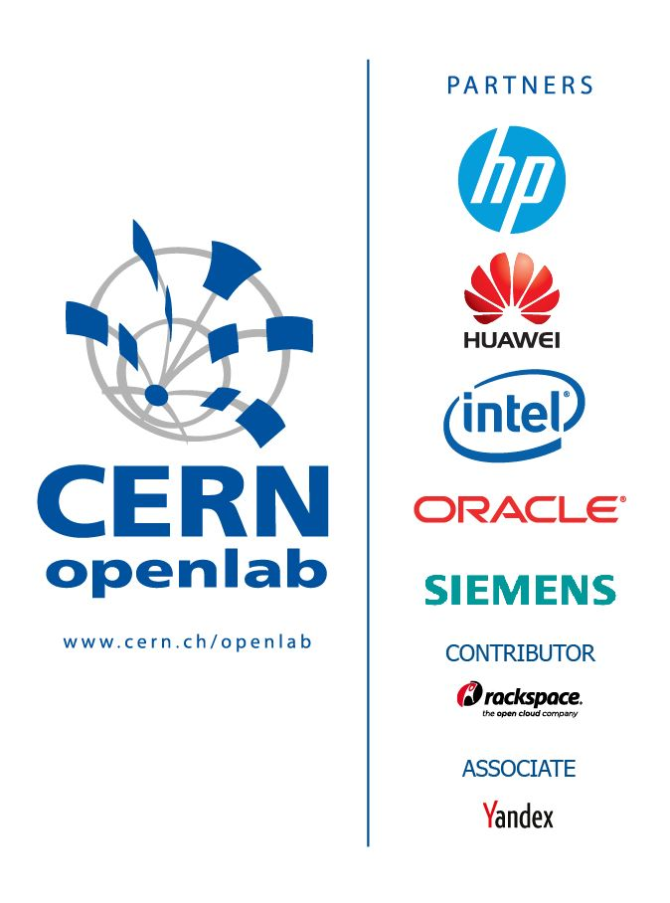





CERN openlab in a Nutshell
PARTNERS
A science – industry partnership to drive R&D and innovation with over a decade of success
Evaluate state-of-the-art technologies in a challenging environment and improve them
Test in a research environment today what will be used in many business sectors tomorrow
Train next generation of engineers/employees
Disseminate results and outreach to new audiences
CONTRIBUTORS
ASSOCIATES
RESEARCH

Slide 9
CERN openlab challenges
2014 openlab whitepaper networks and connectivity use cases:
  Ability to migrate public IP address between sites
  Cross-site, on-demand VLANs
  Intelligent bandwidth optimisation
    Legitimate large flows that require programmable load balancing for efficient capacity utilization
    Nice fit for SDN → Brocade’s Flow Optimizer
  Latency-tolerant wide-area NFS
  Layer-3 roaming across Wi-Fi and mobile telephony data services
  Intelligent, self-adjusting and self-healing Wi-Fi networks
  Wireless networks for data acquisition
  Secure, high-bandwidth mobile communication technology

Slide 10
CERN’s interest in SDN
CERN openlab is an environment optimal for research and collaboration
CERN is interested in SDN for increasing network performance and agility:
  Intelligent bandwidth optimization
  Ability to send specific data to specific locations
    Proactive Bandwidth Monitoring
    DDoS mitigation
    Policy based Flow Mirroring

Slide 11
Use case 1:
Intelligent Dynamic Policy Based Routing
Internet traffic (non-physics)
accidentally arriving via “physics” network.
Two distinct external networks
  Internet
  LHC dedicated (physics data)
Use Brocade Flow Optimizer to ensure that:
  Physics data stays on the physics network
  Internet data stays on the campus network
physics data
Brocade Flow Optimizer
Open
Daylight

Slide 12
Use case 2: Firewall offload
Use Brocade Flow Optimizer to:
Identify top talkers
The user can decide what to do with such flows:
  Discard (e.g. DDoS attack)
  Bypass Firewall (know trusted traffic)
  Don’t touch (neutral internet traffic)
Twofold optimization
  Offload firewall (expensive resource) from handling high amounts of trusted traffic
  Higher bandwidth for physics research traffic
Brocade Flow Optimizer
Open
Daylight

Slide 13
Use case 3: IDS traffic mirroring
Use OpenFlow technology
  OpenFlow gives high flexibility for specific fields to be matched for traffic flows
Use Brocade Flow Optimizer for scalable and flexible flow mirroring
  distributed mirroring
    traffic matching IP=***0 → mirror to port 1 (IDS - 1)
    traffic matching IP=***1 → mirror to port 2 (IDS - 2)
  don't mirror trusted traffic
    traffic matching trusted IP → “forward normal”
Brocade Flow Optimizer
Open
Daylight

Slide 14
Brocade Flow Optimizer – openlab Project
CERN openlab – Brocade collaboration
  Brocade is a contributor member of CERN openlab
  Started in summer 2015
Lab environment for development
  OpenDaylight controller
  Brocade Flow Optimizer
  Brocade OpenFlow enabled switches/routers
    ICX Campus LAN switches at CERN
    Access to Brocade lab with MLX Series Core Routers
Goal
  Enhance and generalize the Brocade Flow Optimizer architecture

Slide 15
Conclusion
CERN requirements push the limit
Apply new techniques and technologies
Joint development in rapid cycles
Test prototypes in CERN environment
High service availability
SDN / OpenFlow
Brocade Flow Optimizer project
Brocade switches lab setup
Produce advanced products and services
CERN openlab
A public-private partnership between
the research community and industry

