Slide 1
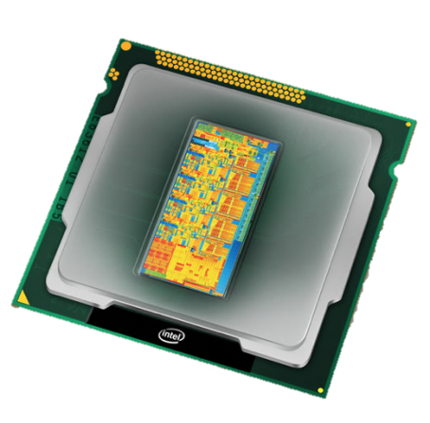

An evaluation of the Intel Xeon E5 Processor Series
Zurich Launch Event
8 March 2012
Sverre Jarp, CERN openlab CTO
Technical team: A.Lazzaro, J.Leduc, A.Nowak

Slide 2

Mont Blanc (4,808m)
Geneva (pop. 190’000)
Lake Geneva (310m deep)

Slide 3
Intense data pressure creates strong demand for computing
Raw data: a few petabytes per second
Tens of petabytes stored per year
250’000 IA computing cores
A rigorous selection process enables us to find that one interesting event in 10 trillion (10¹³)

Slide 4
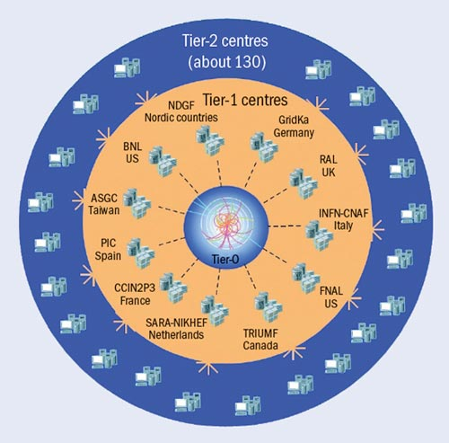
The Worldwide LHC Computing Grid
Tier-0 (CERN): data recording, reconstruction and distribution
nearly 160 sites
~250’000 cores
Tier-1: permanent storage, re-processing,
analysis
173 PB of storage
> 1 million jobs/day
Tier-2: Simulation,
end-user analysis
10 Gb links

Slide 5

The CERN openlab
A unique research partnership of CERN and the industry
Objective: The advancement of cutting-edge computing solutions to be used by the worldwide LHC community
Partners support manpower and equipment in dedicated competence centers
openlab delivers published research and evaluations based on partners’ solutions – in a very challenging setting
Created robust hands-on training program in various computing topics, including international computing schools; summer student programme
Past involvement: Enterasys Networks, IBM, Voltaire, F-secure, Stonesoft, EDS; New contributor: Huawei
Just started phase IV: 2012-2014
http://cern.ch/openlab

Slide 6
Benchmarking: A complex affair
In modern servers, at least the following elements need to be controlled:
  Hardware:
    Processor generation
    Socket count
    Core count
    CPU frequency
    Turbo boost
    SMT
    Cache sizes
    Memory size and type
    Power configuration
  Software:
    Operating System version
    Compiler version and flags

Slide 7
Xeon E5 in some detail
Advanced Vector eXtensions (AVX)
  256 bit registers which can hold 4 doubles/8 floats
  AVX instruction set
More execution units
  Two load units, for instance
Enhanced Hyper-threading and Turbo-boost technology
Larger on-die L3 cache
Integrated PCI Express 3.0 I/O

Slide 8
Our Xeon E5 testing
System tested:
  Beta-level white box; Dual-socket server.
  Xeon E5-2680 @ 2.7 GHz, 8 cores, 130W TDP
    32 GB memory (1333 MHz)
    C1 stepping
  Code name: “Sandy Bridge EP”
Benchmarks used:
  HEPSPEC
  HEPSPEC/W
  MT-Geant4
  MLfit

Slide 9
HEPSPEC
Throughput test from SPEC 2006
  All the C++ jobs (INT as well as FP); As many copies as cores
  Scientific Linux CERN (SLC) 5.7/gcc 4.1.2/64-bit mode/Turbo off/SMT on
  Compared to 6-core “Westmere-EP” Xeon X5670 (@2.93 GHz)
    Frequency-scaled
Using only the “real” cores:
Speed-up per core: 1.2x
Core count: 1.33x
Total: 1.6x
SMT gain (for both): 1.23x

Slide 10
Energy efficiency
For CERN and most W-LCG sites, energy efficiency is paramount
  Our centres have (more or less) a fixed amount of electric energy
  Ideally, we would like to double the throughput/watt from generation to generation
  This was relatively easy when core count increased geometrically:
    1 → 2 → 4
  Recently, however, it has been increasing arithmetically:
    4 (Xeon 5500) → 6 (Xeon 5600) → 8 (Xeon E5-2600)

Slide 11
HEPSPEC/Watt
Great news: Bigger jump than foreseen in energy efficiency!
  Now reaching 1 HEPSPEC/W which is 1.7x compared to Xeon X5670
    Xeon E5 options: SLC 5.7, 64-bit mode, SMT on, Turbo on
    Xeon 5600 options: SLC 5.4
Xeon E5-2600
Bigger is better!
Xeon 5600
STOP PRESS: With SLC 6 (gcc 4.4.6) we further lower the power consumption by 5% and increase the HEPSPEC results by 3%: 1.083x in total !

Slide 12
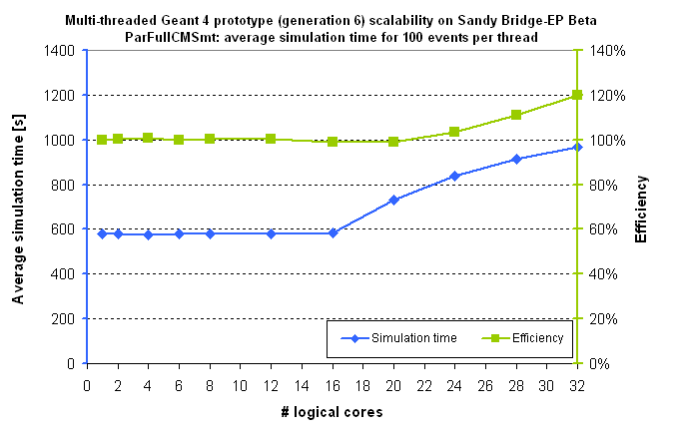
MT Geant4
  SLC 5.7, gcc 4.3.3, pinning of threads
Our favourite benchmark for testing weak scaling:
A threaded version of CERN’s detector simulation program
  Speed-up compared to previous generation (L5640@2.26GHz):
    Both with Turbo-off, SMT-on (L5640 frequency-adjusted): 1.46x
  Xeon E5-2600 SMT speed-up: 1.25x

Slide 13
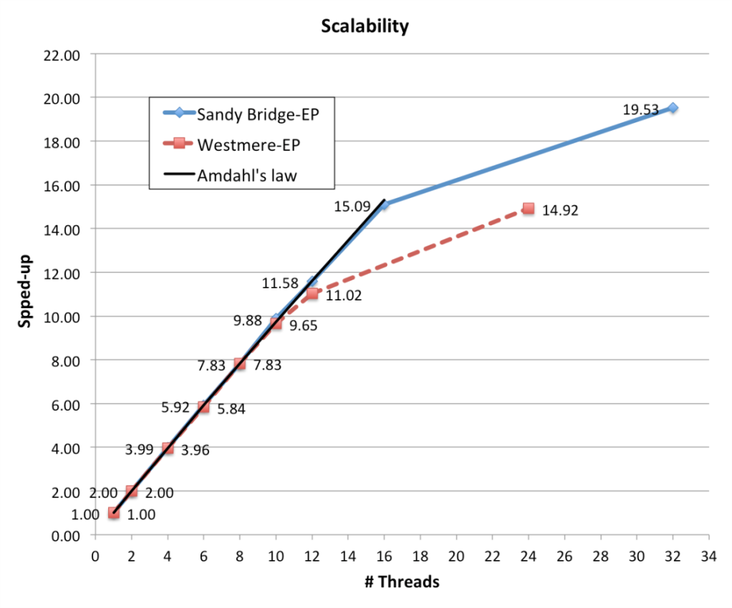
MLFit
  SLC 6.2, icc 12.1.0, pinning of threads
Our favourite benchmark for testing strong scaling:
A threaded/vectorised data analysis program
  Single core (Turbo off, using SSE): 1.19x
  Single core, moving to AVX: 1.12x
  All the “real” cores w/SSE: (1.33 * 1.19) 1.59x
  All the “real” cores & AVX: (1.59 *1.12) 1.78x
1.33x
  Xeon E5-2600 SMT speed-up: 1.29x

Slide 14
Conclusion
The Intel Xeon E5 Processor Series confirms Intel’s desire to improve both absolute performance and performance per watt
CERN and W-LCG will appreciate both
  In particular, the HEPSPEC/W value
  Now reaching 1 HEPSPEC/W which is 1.7x compared to previous generation (Xeon X5670)
A full openlab evaluation report will be published at launch time
  http://www.cern.ch/openlab
  The Xeon X5670 report is available since April 2010

