Slide 1


High Throughput Computing Collaboration A CERN openlab / Intel collaboration
Niko Neufeld, CERN/PH-Department
niko.neufeld@cern.ch

Slide 2
HTCC in a nutshell
Apply upcoming Intel technologies in an Online / Trigger & DAQ context
Application domains: L1-trigger, data acquisition and event-building, accelerator-assisted processing for high-level trigger

Slide 3
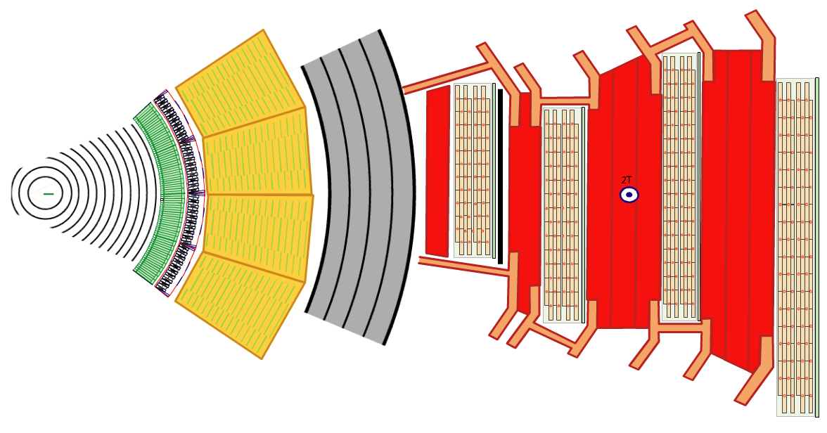
40 million collisions / second: the raw data challenge at the LHC
15 million sensors
Giving a new value 40.000.000 / second
= ~15 * 1,000,000 * 40 * 1,000,000 bytes
= ~ 600 TB/sec
(16 / 24 hrs / 120 days a year)
can (afford to) store about O(1) GB/s
Notes:
Each LHC experiment (detector) consists of millions of sensors. The particles created by the LHC will create a signal in these sensors. A new signal will be available in every sensor 40.000.000 / second, because this is how often a new collision will be produced in the LHC
The detector can be thought of as a giant 3-D, ultra-high-speed camera, which takes a snapshot of the collision 40.000.000 times a second. Compare this to a contemporary high-resolution digital camera: At 10 Megapixels, the raw picture will have 3 x 10.000.000 = approximately 30 Megabytes. The 3 comes from the 3 primary colours which will be measured for each of the 10.000.000 pixels. This enormous size is the reason why only professional photographers store the picture in raw format. For hobby use the pictures are on the fly compressed.
The cameras which are the LHC experiments face the additional challenge that they have to “take a picture” 40.000.000 a second. And the picture is too complicated to be simply compressed.
600 Terabytes correspond to a 100 m high stack of standard DVD (1/3 of the height of the Eiffel Tower)

Slide 4
Defeating the odds
Thresholding and tight encoding
Real-time selection based on partial information
Final selection using full information of the collisions
Selection systems are called “Triggers” in high energy physics

Slide 5
Challenge #1 First Level Triggering

Slide 6
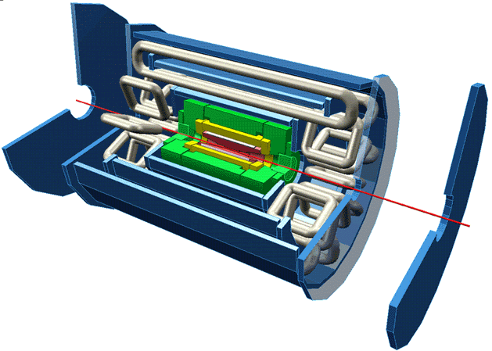
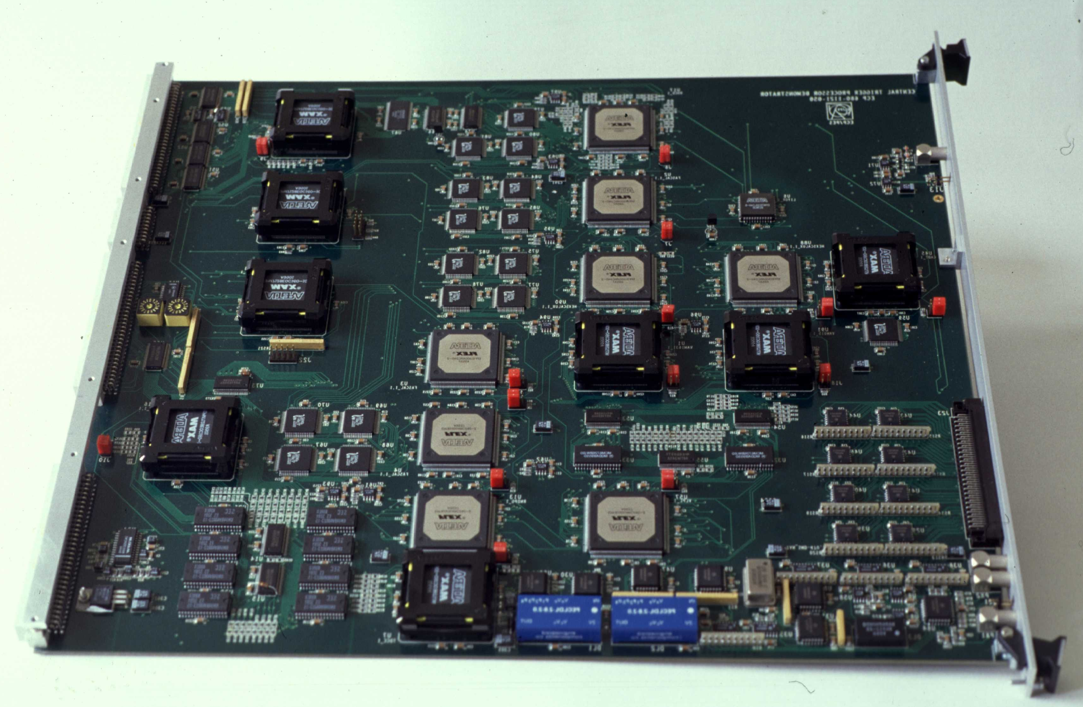
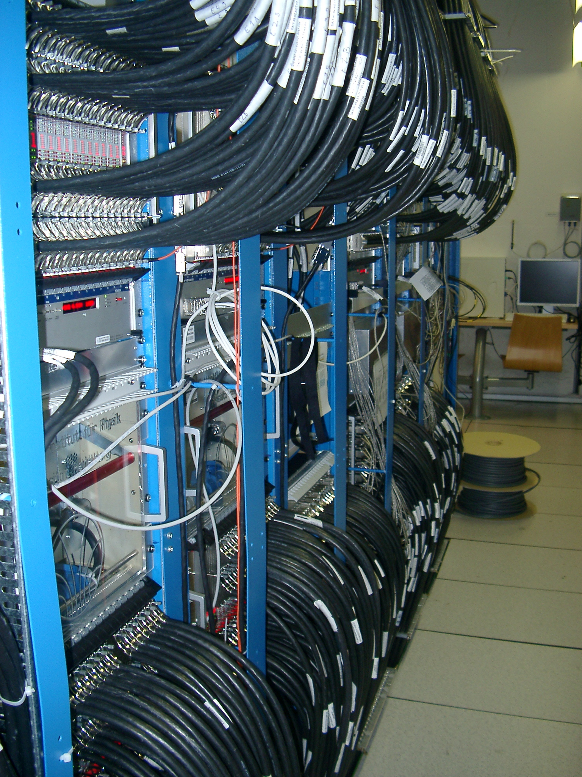
Selection based on partial information
A combination of (radiation hard) ASICs and FPGAs process data of “simple” sub-systems with “few” O(10000) channels in real-time
Other channels need to buffer data on the detector
this works only well for “simple” selection criteria
long-term maintenance issues with custom hardware and low-level firmware
crude algorithms miss a lot of interesting collisions
Notes:
No single computer or electronical system can process the enormous amount of data produced in the LHC experiments.
A divide and conquer approach is used.
The many regions of the large LHC experiments are treated separately and in parallel. Sophisticated custom-built electronics (top right-hand picture from ATLAS) is connected to a small part of the detector. From there it reads out the collision data in this region only but 40 Million times a second. Many, many such electronics modules are needed to cover the huge LHC detectors. The bottom left picture shows a small part of the trigger electronics of ATLAS, where in each column there are 40 modules as shown above.
Since the information is limited, because it only comes from a small segment, only a preliminary decision can be taken. The filtering can only tell the difference between collisions which look quite different to the electronics (to the naked eye they still look the same, of course).
The number of collisions retained after this step is still enormous: between 100.000 and 1.000.000 every second. But the filtering, which is needed to select the interesting events out of these 100.000 needs to be much more sophisticated.

Slide 7
FPGA/Xeon Concept
Intel has announced plans for the first Xeon with coherent FPGA concept providing new capabilities
We want to explore this to:
Move from firmware to software
Custom hardware → commodity
Rationale: HEP has a long tradition of using FPGAs for fast, online, processing
Need real-time characteristics:
algorithms must decide in O(10) microseconds or force default decisions
(even detectors without real-time constraints will profit)

Slide 8
HTCC and the Xeon/FPGA concept
Port existing (Altera ☺) FPGA based LHCb Muon trigger to Xeon/FPGA
Currently uses 4 crates with > 400 Stratix II FPGAs →move to a small number of FPGA enhanced Xeon-servers
Study ultra-fast track reconstruction techniques for 40 MHz tracking (“track-trigger”)
Collaboration with Intel DCG IPAG -EU
Data Center Group, Innovation Pathfinding Architecture Group-EU

Slide 9
Challenge #2 Data Acquisition

Slide 10
Working with full collision data event-building
Detector
Pieces of collision data spread out over 10000 links received by O(100) readout-units
All pieces must be brought together into one of thousands compute units → requires very fast, large switching network
Compute units running complex filter algorithms
10000 x
Readout Units
~ 1000 x
DAQ network
~ 3000 x
Compute Units

Slide 11
Future LHC DAQs in numbers
 | Data-size / collision [kB] | Rate of collisions requiring full processing [kHz] | Required # of 100 Gbit/s links | Aggregated bandwidth | From
ALICE | 20000 | 50 | 120 | 10 Tbit/s | 2019
ATLAS | 4000 | 500 | 300 | 20 Tbit/s | 2022
CMS | 4000 | 1000 | 500 | 40 Tbit/s | 2022
LHCb | 100 | 40000 | 500 | 40 Tbit/s | 2019

Slide 12

HTCC and data acquisition
Explore Intel’s new OmniPath interconnect to build the next generation data acquisition systems
Build small demonstrator DAQ
Use CPU-fabric integration to minimise transport overheads
Use OmniPath to integrate Xeon, Xeon/Phi and Xeon/FPGA concept in optimal proportions as compute units
Work out flexible concept
Study smooth integration with Ethernet (“the right link for the right task”)

Slide 13
Challenge #3 High Level Trigger

Slide 14
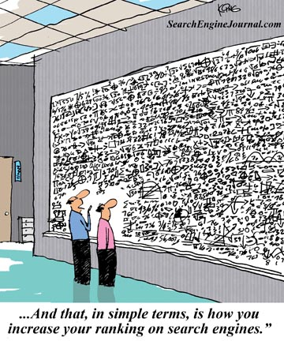
High Level Trigger
Pack the knowledge of tens of thousands of physicists and decades of research into a huge sophisticated algorithm
Several 100.000 lines of code
Takes (only!) a few 10 - 100 milliseconds per collision
“And this, in simple terms, is how we find the Higgs Boson”
Notes:
To find the Higgs Boson or other rare events among the remaining 100.000 or so collisions we need the collected knowledge of the physicists working at LHC. All this physics knowledge brought together over generations is incorporated in huge, highly sophisticated computer programs, which despite their size take only a fraction of a second to run on a modern computer.
These programs will select the most promising collisions. The selected collisions will be written to permanent storage and kept for further analysis by physicists.
Despite the speed of the algorithms a huge number of computers is required to perform this selection, because so many collisions need to be decided upon every second.

Slide 15
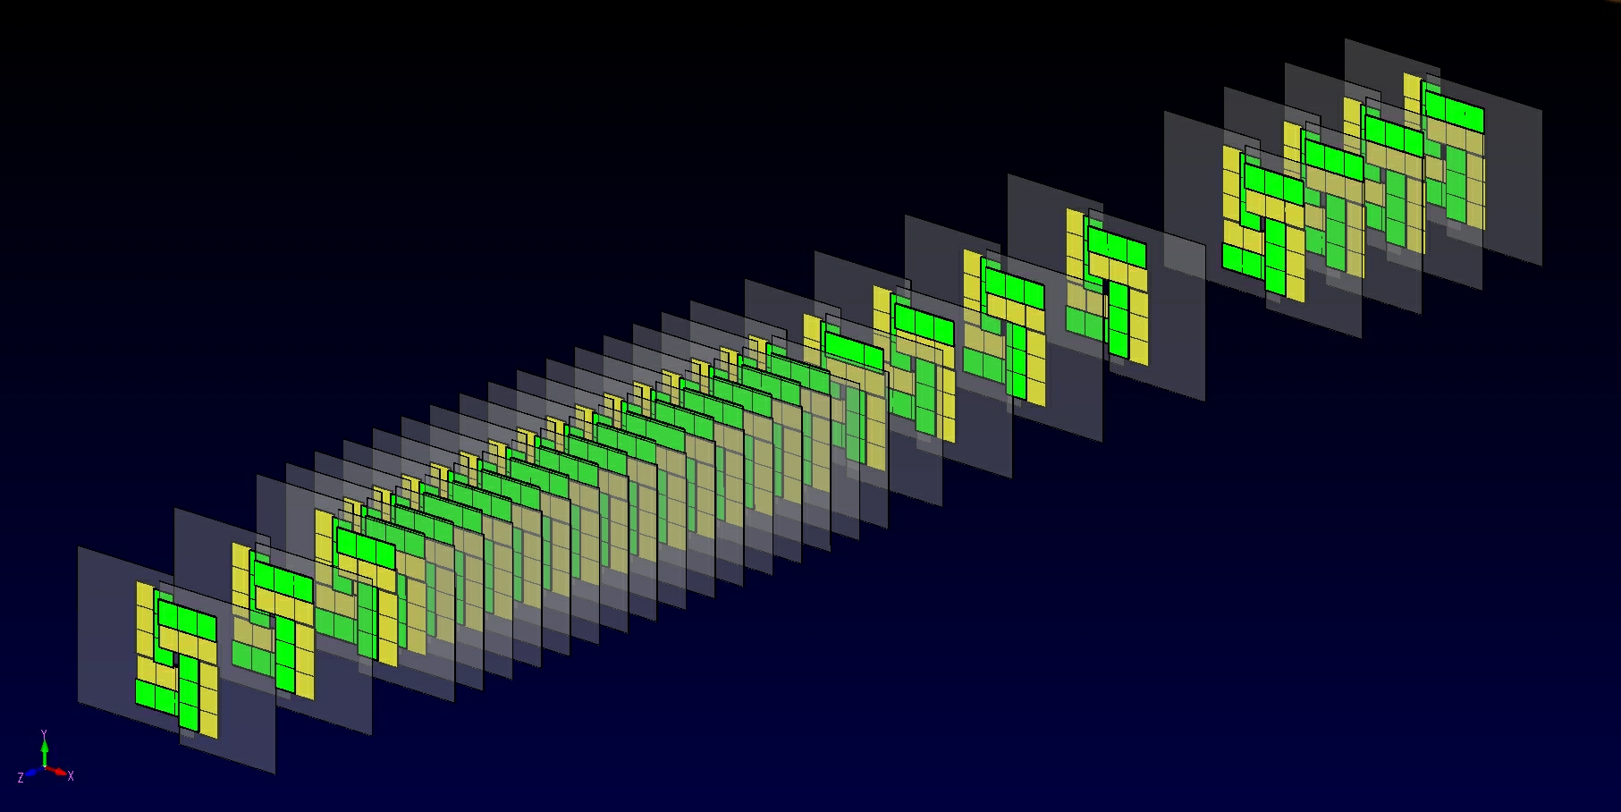
Pattern finding - tracks

Slide 16
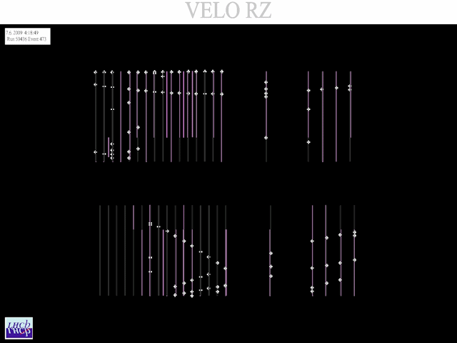
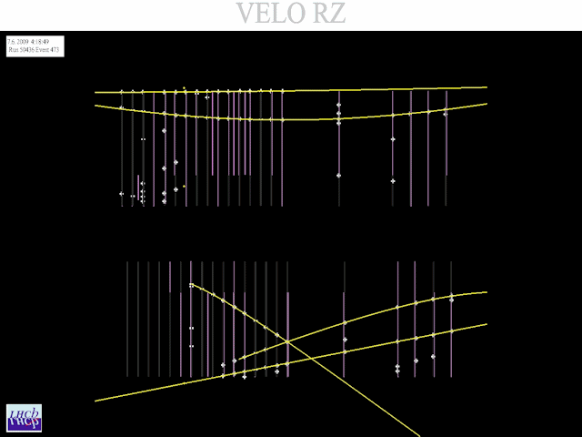


Same in 2 dimensions
Can be much more complicated: lots of tracks / rings, curved / spiral trajectories, spurious measurements and various other imperfections

Slide 17
HTCC and the High Level Trigger
Complex algorithms
Hot spots difficult to identify → cannot be accelerated by optimising 2 -3 kernels alone
Classical algorithms very “sequential”, parallel versions need to be developed and their correctness (same physics!) needs to be demonstrated
Lot of throughput necessary → high memory bandwidth, strong I/O
There is a lot of potential for parallelism, but the SIMT-kind (GPGPU-like) is challenging for many of our problems
HTCC will use next generation Xeon/Phi (KNL) and port critical online applications as demonstrators:
LHCb track reconstruction (“Hough Transformation & Kalman Filtering”)
Particle identification using RICH detectors

Slide 18
Summary
The LHC experiments need to reduce 100 TB/s to ~ 25 PB/ year
Today this is achieved with massive use of custom ASICs and in-house built FPGA-boards and x86 computing power
Finding new physics requires massive increase of processing power, much more flexible algorithms in software and much faster interconnects
The CERN/Intel HTC Collaboration will explore Intel’s Xeon/FPGA concept, Xeon/Phi and OmniPath technologies for building future LHC TDAQ systems

