Slide 1
ICHEC Presentation
Srikanth Sridharan
9/2/2015
ESR2: Reconfigurable Computing and FPGAs
ICE-DIP

Slide 2
The ICE-DIP Project

Slide 3
Background
The Proposed upgrades to Large Hadron Collider(LHC) envisages 100x increase in data rate
Some experiments want to capture 100% of that data, which is currently not possible
Traditional and Current computing systems inadequate to meet these needs

Slide 4
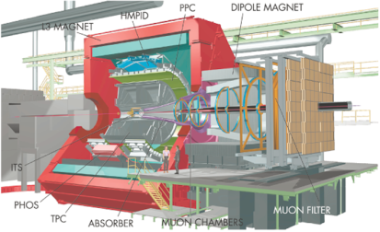
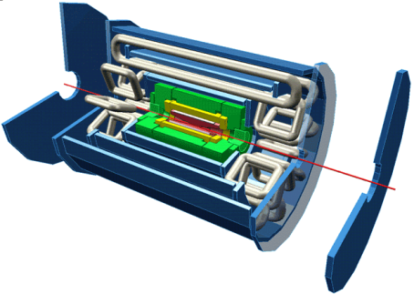
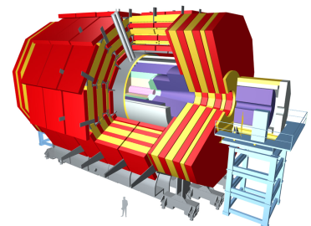
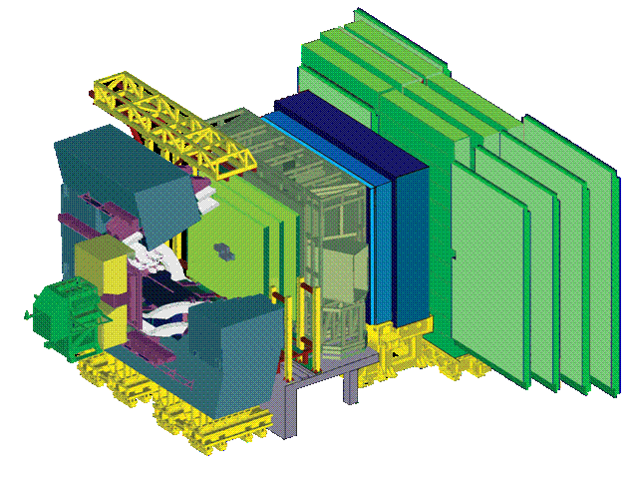
Readout Links of LHC Experiments
 | DDL | Optical 200 MB/s ≈ 400 links Full duplex: Controls FE (commands, Pedestals, Calibration data) Receiver card interfaces to PC | yes
 | SLINK | Optical: 160 MB/s ≈ 1600 Links Receiver card interfaces to PC. | yes
 | SLINK 64 | LVDS: 200 MB/s (max. 15m) ≈ 500 links Peak throughput 400 MB/s to absorb fluctuations Receiver card interfaces to commercial NIC (Myrinet) | yes
 | Glink (GOL) | Optical 200 MB/s ≈ 4000 links Receiver card interfaces to custom-built Ethernet NIC (4 x 1 Gbit/s over copper) | (no)
Flow Control
Material from N. Neufeld - ISOTDAQ (Intro to Trigger & DAQ) 01/2014
Notes:
Note that all these links are in the Gigabit / s class – in fact they are faster (about a factor 2). This trend is (unfortunately) broken with the GBT link, which is only 3.2 Gbit/s (net) as compared to the typical network link of the 201x (10 Gigabit/s) (exception ALICE DDL3)

Slide 5
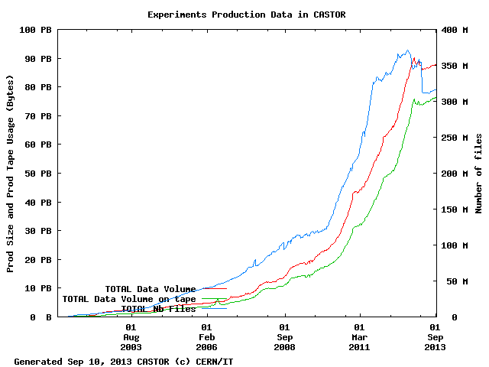
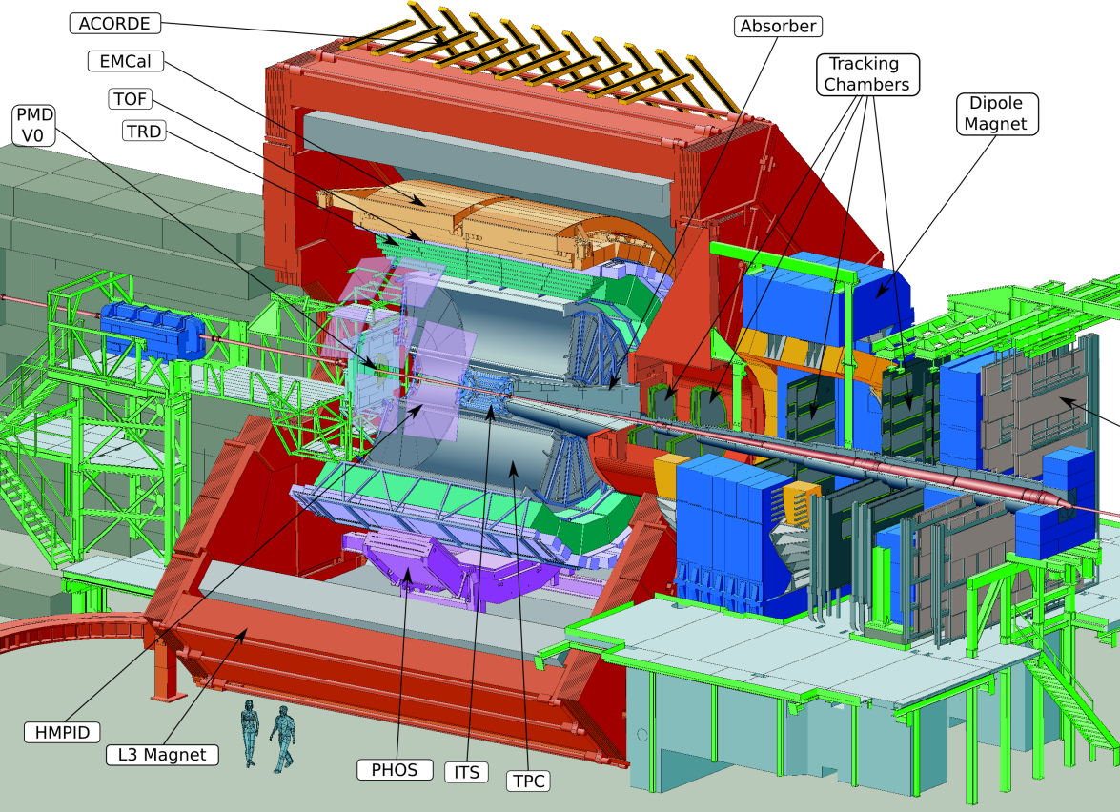
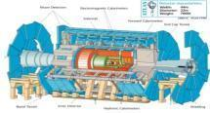
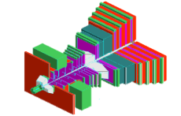
Big Science: lots of data !
 | Beam Type | Recording (Mass Storage) (GB/s) | Data Archived Total/Yr (PB)
ALICE | Pb-Pb | Design: 1.25 2009-2013: 4.00 2015: 10.00 | 2.3
ATLAS | pp | Design: 100 | 6.0
CMS | pp | Design: 100 | 3.0
LHCb | pp | Design: 40 | 1.0
5

Slide 6
Focus Areas
Working on the domain of FPGAs and Reconfigurable Computing
Specific focus areas within the domain
Data Acquisition on FPGAs
Accelerating High Energy Physics Algorithms
CPU-FPGA Hardware Integration
Programming models for CPU-FPGAs

Slide 7
Technical work 1/2
Work done so far
Dynamically Adaptive Header Generator and Front-End Source Emulator for a 100Gbps FPGA based DAQ
OpenCL implementation for Acceleration of L0 Muon Trigger algorithm and RICH detector algorithm
OpenCL implementation of the Dynamically Adaptive Header Generator

Slide 8
Technical work 2/2
Current work
OpenCL implementation of Hough transform on FPGA and Xeon Phi
Proposal selected for Altera’s Innovate Europe program
Future work
Explore Xeon CPU and FPGA integration through a QPI interface using an emulation platform

Slide 9
Conclusion
Potential Areas fo collaboration
Evaluation of Xilinx OpenCL flow
Comparison of Xilinx vs Altera implementation
Thank You!

