Slide 1
Big Data
Power and Responsibility
HEPTech, Budapest, 30 March 2015
Alberto Di Meglio
CERN openlab Head
DOI: 10.5281/zenodo.16480 License: CC-BY-SA

Slide 2

What is Big Data?
Velocity
Volume
Variety
Variability
Veracity
Value
5
The Vs definition
3
4
6

Slide 3
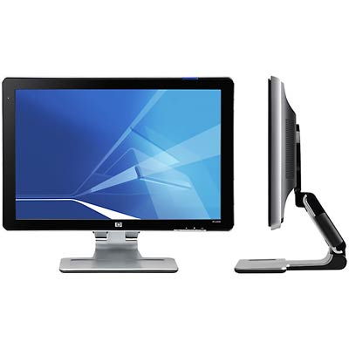
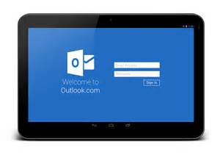
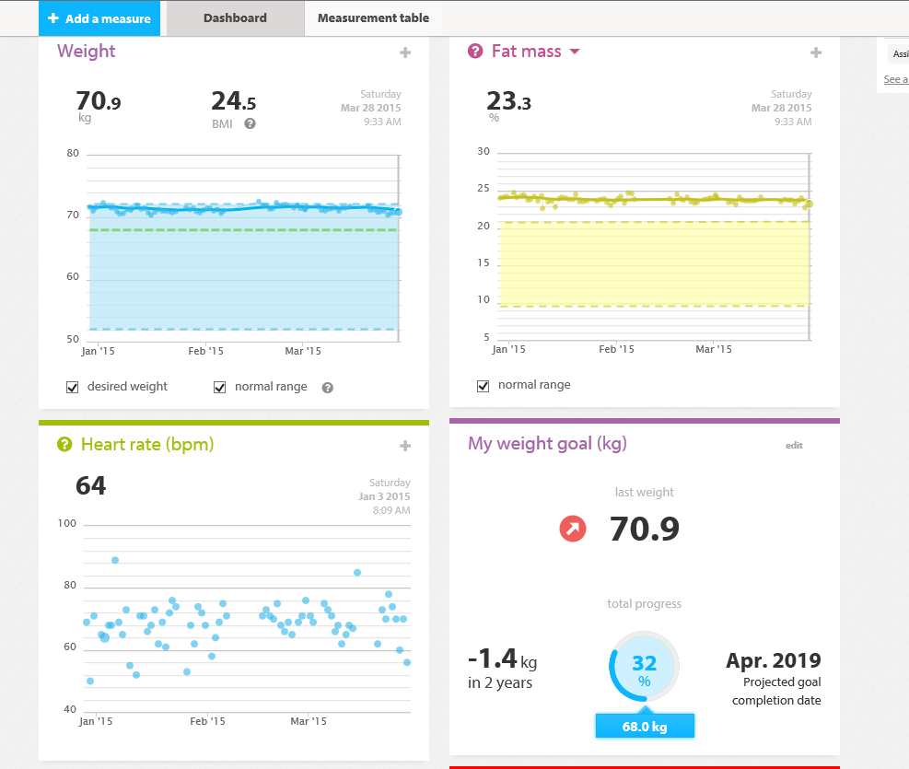
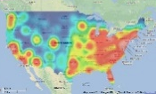
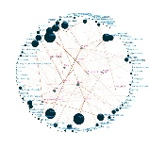
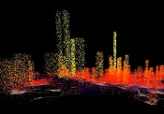
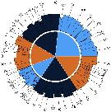
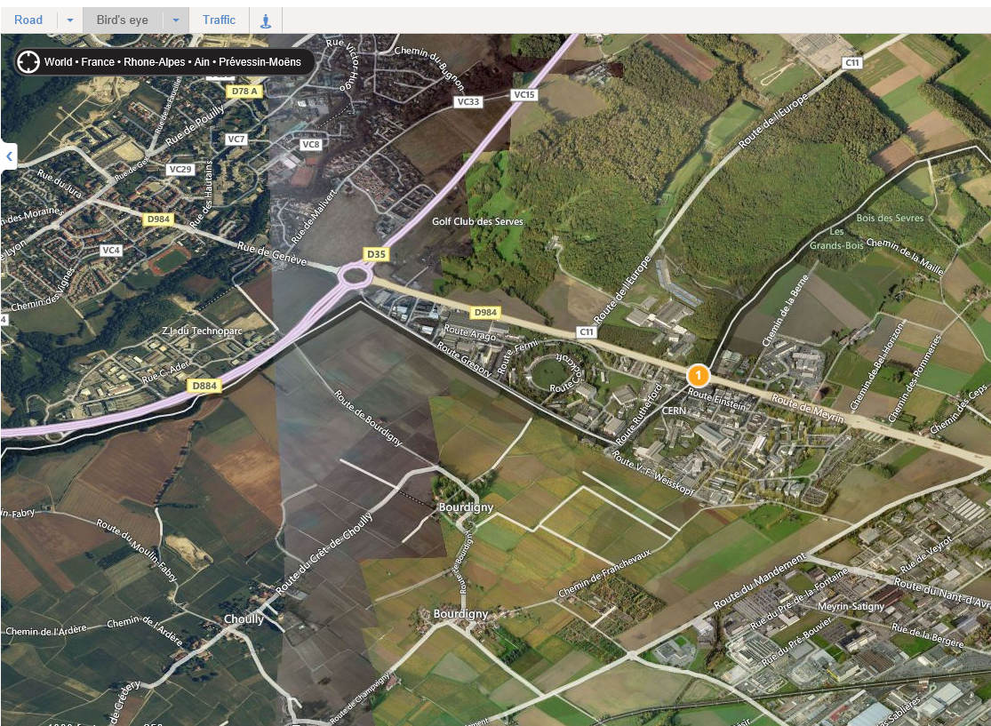

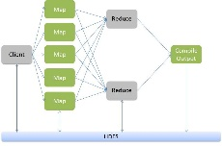

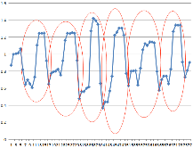
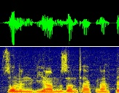


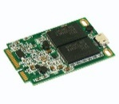
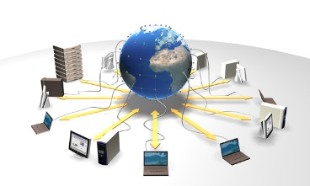
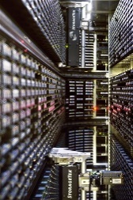
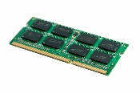
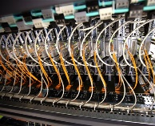

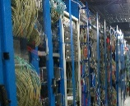
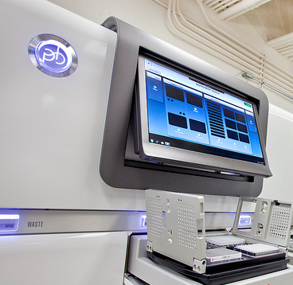

Bigger+Faster+Smarter
Information
Information
Applications designed
for “big data”
Software
Data visualization,
representation
Value
Veracity
Variability
Variety
Volume
Velocity
Data analysis
and analytics platforms
Pattern recognition,
machine learning, predictive analytics
Platform
Large storage (disks, tapes, memory)
Distributed Computing and Data Grids, Clouds, HPC, Crowd Computing
Infrastructure
Fast data acquisition systems
Flexible networks

Slide 4
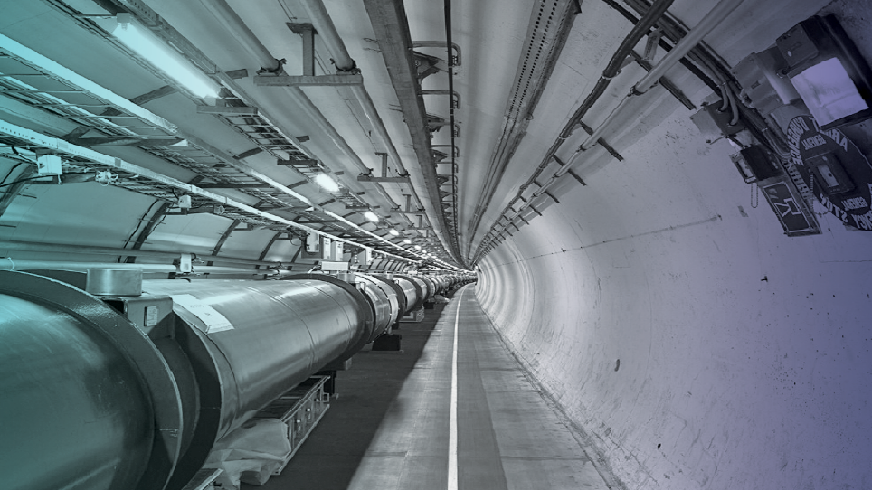
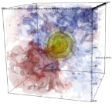
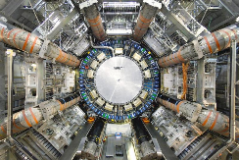
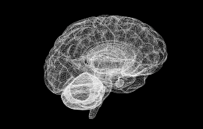
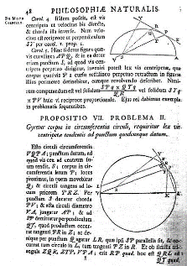
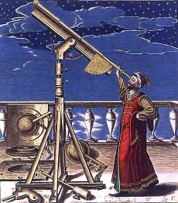
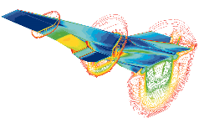
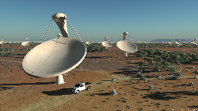
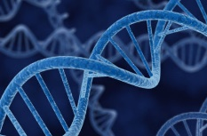
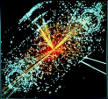
Data-Driven Research
Image © CERN
4000 years
500 years
~50 years
Today
1 – Empirical
observations
2 - Generalization
Theoretical models
3 - Simulations
Computational
sciences
4 - Data-driven
science
eScience
Data preservation
- Raw data
- Processed data
- Publications

Slide 5
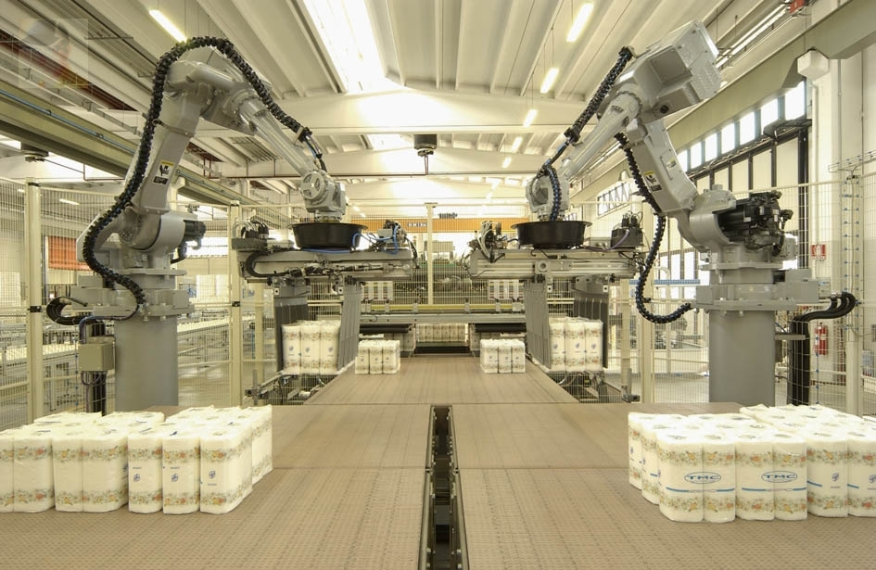

Industry, Commerce, Administration
Manufacturing Processes
Quality Assurance
Control Systems
eGovernment
Transport
Utilities
eCommerce
Real Estate
Finance
Insurance
Service Provision
Social Networks
Business Intelligence

Slide 6
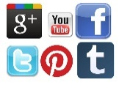

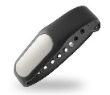
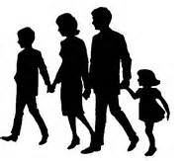




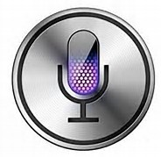

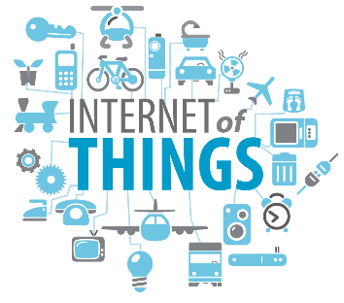
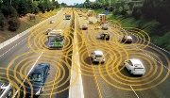
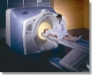
Everyday Life
Social networks
Games
Fitness devices and apps
Home automation
Personal Identities and Profiles
Smart cities
Personal Assistants
Smart objects (cars, etc.)
Personalized medicine

Slide 7
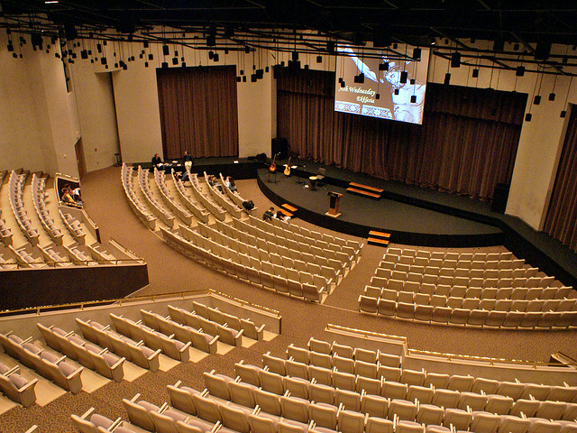
Education
Multicore CPU programming, graphical processors (GPU),
multithreaded
software
Data analysis technologies,
tools,
data visualization,
monitoring, security, etc.
Applications of physics to medical research (hadron therapy, etc.),
simulation
software
Software & Computing Engineers
Data Scientists
Multidisciplinary applications

Slide 8

Fair Use of Data
Ownership and access rights
  With producer or service provider?
Privacy and confidentiality
  Separation of data and metadata
  Policies and laws
Economics
  Data consumerisation
  Micropayments economy
“Digital information is just
people in disguise”

Slide 9
Predicting Conditions and Behaviours?
Consumers orientation
  Detailed knowledge of individual habits and tastes and what affects them
Insurance risk assessment
  Insurance policy modulated to individual risk of getting ill
Predictive policing
  If I know that you will ALMOST CERTAINLY commit a crime, should I restrain you now?
« Il vaut mieux hasarder de sauver un coupable que de condamner un innocent »
(“It is better to risk sparing a guilty person than to condemn an innocent one”)
Voltaire, Zadig ou La Destinée, 1747

Slide 10
Power and Responsibility
Big data and the technologies around it bring the promise of scientific discoveries, efficient processes, reduced environmental impact, more comfortable lives
But we might face difficult discussions around what makes us what we are, our free will, liberty of choice
“With great power comes great responsibility”

Slide 11
Themes of this Conference
HEPTech, where Research meets Industry
  A program of talks by experts from research and industry
Explore the many aspects of Big Data
  In a (sort of) logical order
  Fast paced, but with time for discussion and questions

Slide 12

Thank you
and
enjoy the conference!

