Slide 2

A Tale of Two File Systems: data storage for Physics at CERN and a deep dive into Oracle ASM.
Luca Canali, CERN
Enkitec E4, Dallas, June 2014

Slide 3
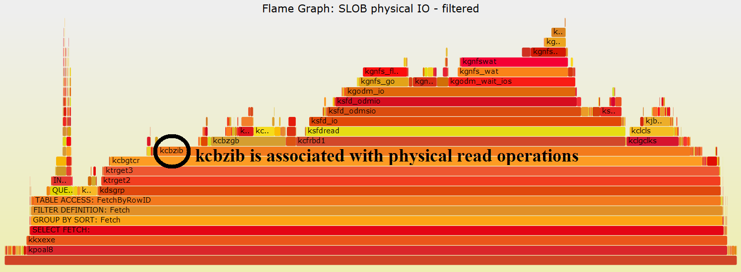
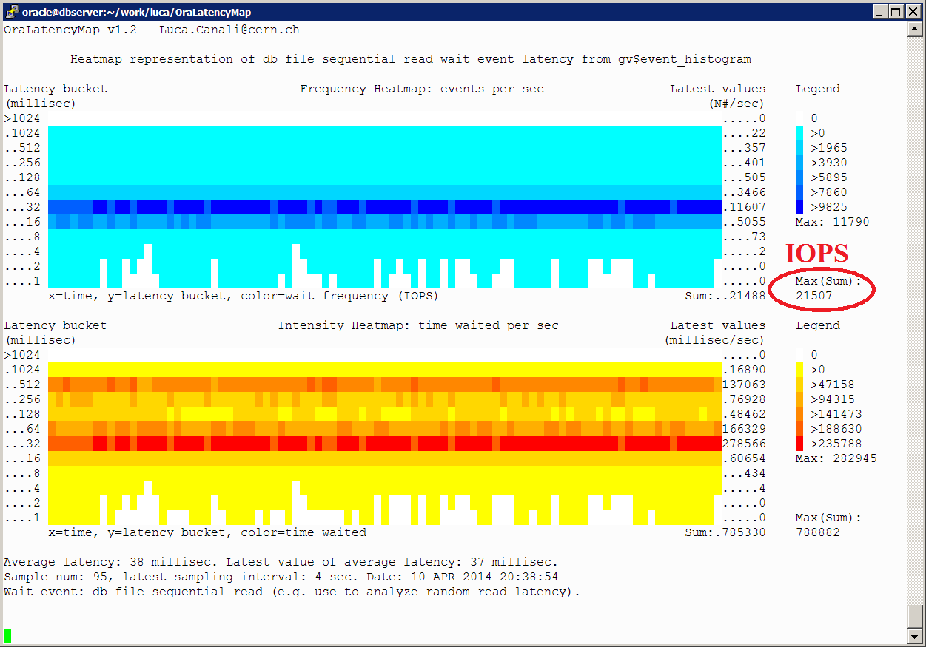
About Me
Senior DBA and team lead at CERN IT
  Joined CERN in 2005
  Working with Oracle RDBMS since 2000
Passionate to learn and share knowledge, how to get most value from database technology
@LucaCanaliDB

Slide 4
Outline
Introduction to CERN
LHC Data Storage and Analysis
Oracle Databases at CERN
ASM deep dive
Conclusions

Slide 5

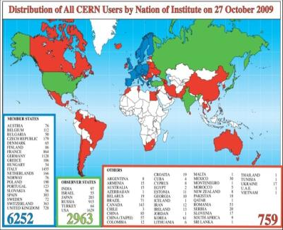
CERN
CERN - European Laboratory for Particle Physics
Founded in 1954 by 12 countries for fundamental physics research in a post-war Europe
Today 21 member states + world-wide collaborations
  About ~1000 MCHF yearly budget
  2’300 CERN personnel + 10’000 users from 110 countries

Slide 6
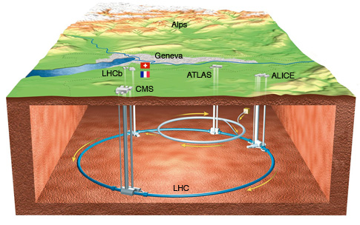
LHC
Large Hadron Collider (LHC)
  World’s largest and most powerful particle accelerator
  27km ring of superconducting magnets
  Currently undergoing upgrades, restart in 2015

Slide 7
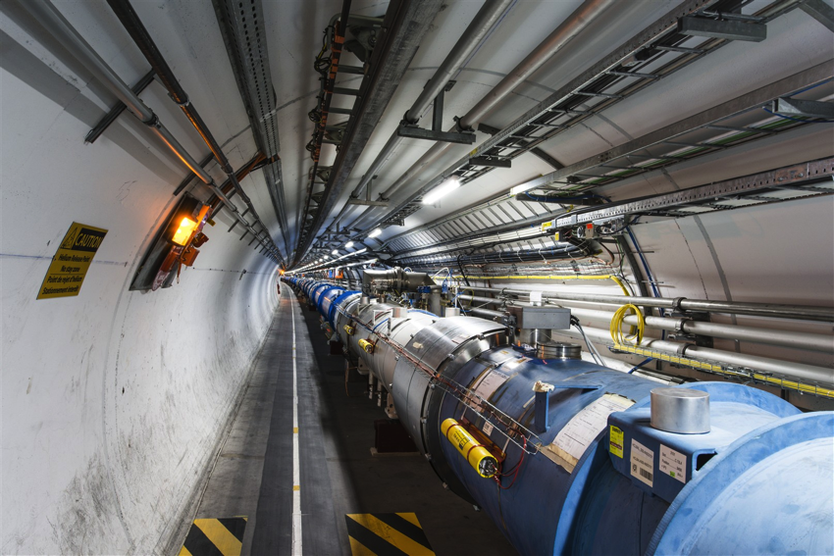
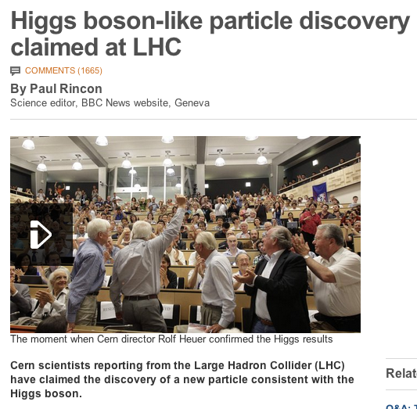
From particle
to article..
How do you get from this
to this
Notes:
New particle discovery: see also CMS and Atlas announcement on July 4th 2012.

Slide 8

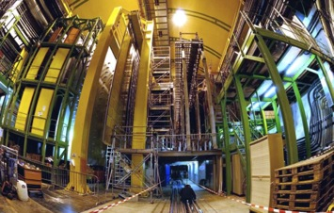
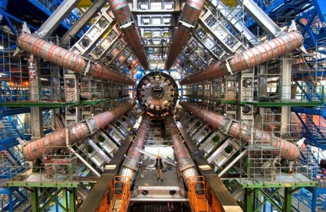
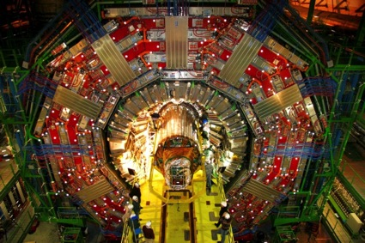
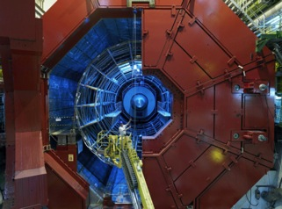
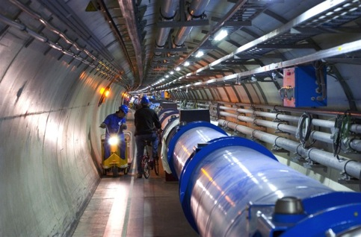

LHC and Detectors
pp, B-Physics, CP Violation
(matter-antimatter symmetry)
LHCb
CMS
ATLAS
General Purpose,
proton-proton, heavy ions
Discovery of new physics:
Higgs, SuperSymmetry
Exploration of a new energy frontier
in p-p and Pb-Pb collisions
ALICE
LHC ring:
27 km circumference
Heavy ions, pp
(state of matter of early universe)
Notes:
8

Slide 9
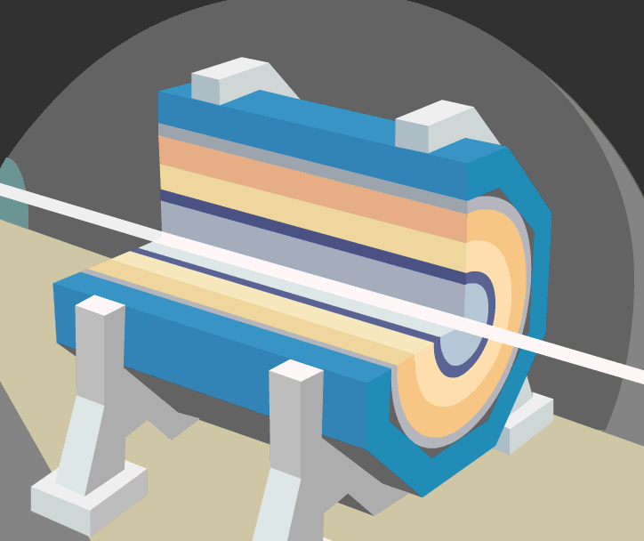
A collision at LHC

Slide 10
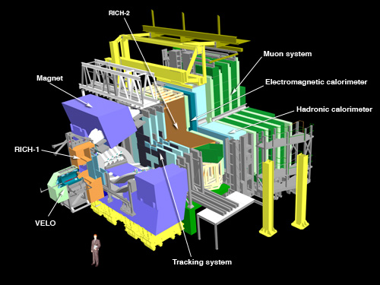
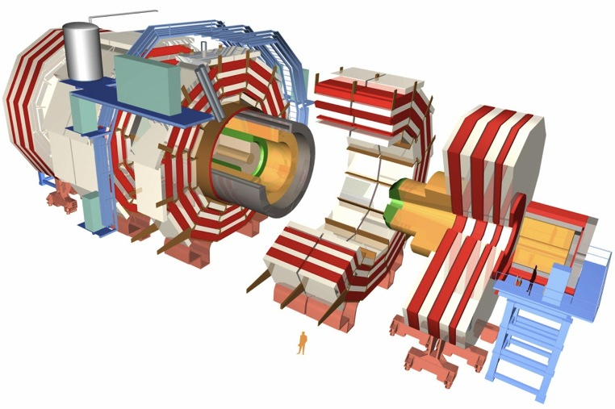
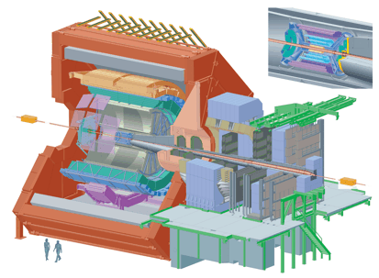
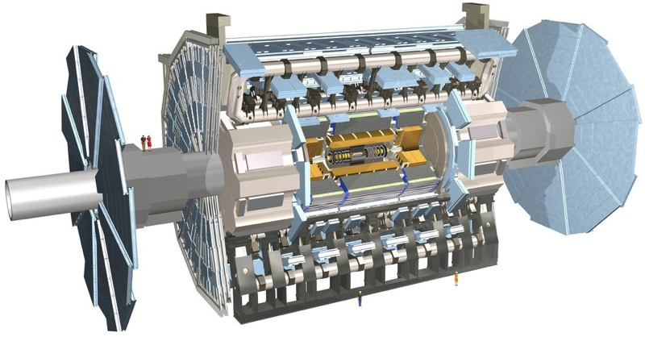
150 million sensors deliver data …
… 40 million times per second

Slide 11
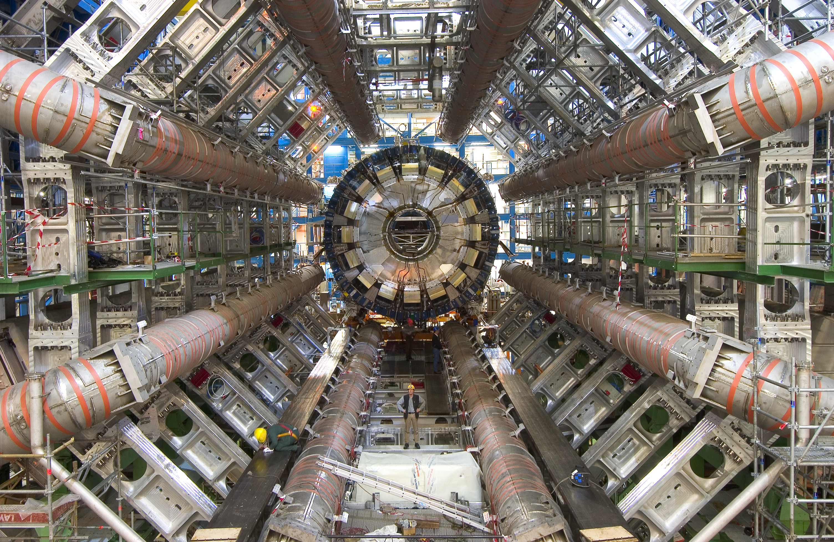
The “ATLAS” experiment during construction
7000 tons, 150 million sensors, 1 petabyte/s

Slide 12
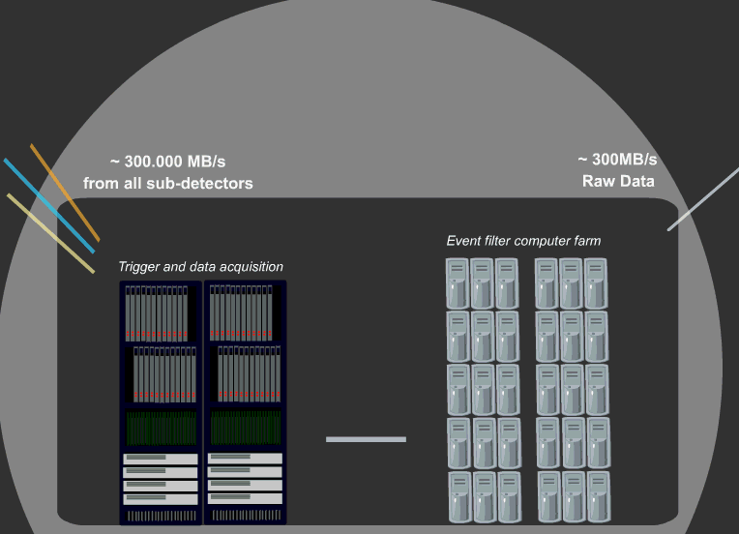
The Data Acquisition

Slide 13
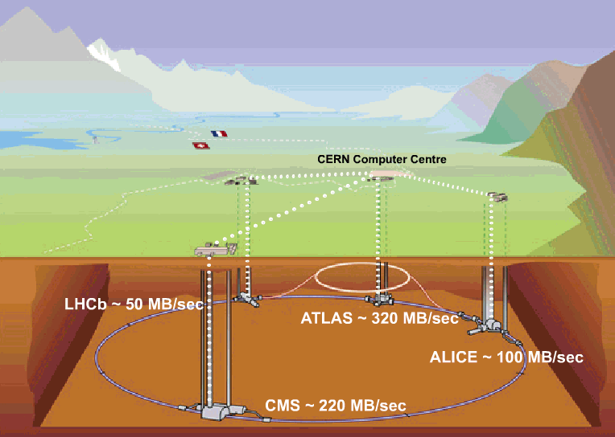
Acquisition, First pass reconstruction, Storage & Distribution
2011: 4-6 GB/sec
2011: 400-500 MB/sec
1.25 GB/sec (ions)

Slide 14
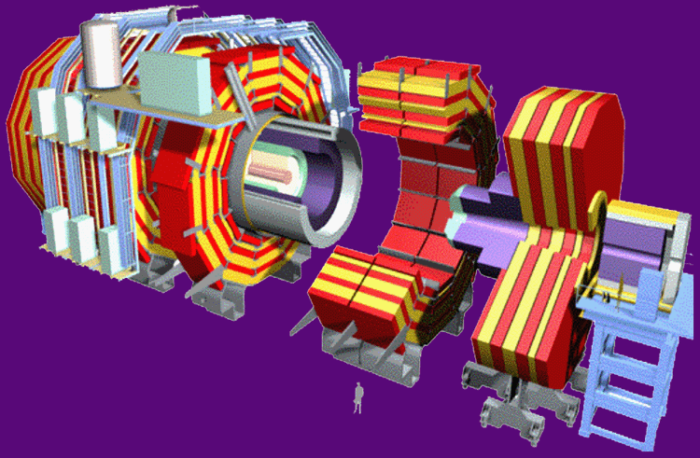
Data Flow – online
Detector
150 million electronics channels
1 PBytes/s
Fast response electronics,
FPGA, embedded processors,
very close to the detector
Level 1 Filter and Selection
Constraints:
Budget
Physics objectives
Downstream data flow pressure
150 GBytes/s
High Level Filter and Selection
O(1000) servers for processing,
Gbit Ethernet Network
0.6 GBytes/s
N x 10 Gbit links to
the computer centre
CERN computer centre

Slide 15
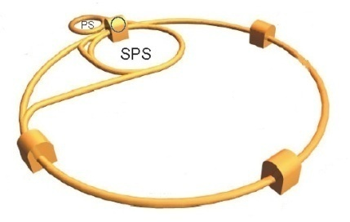

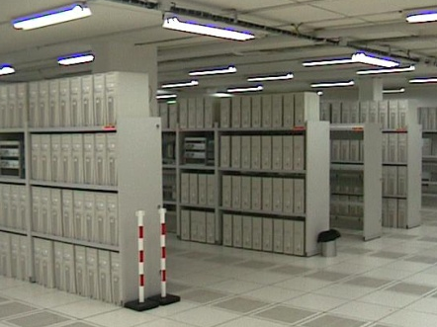

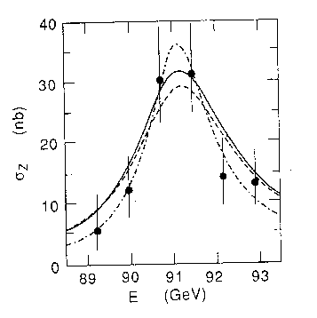


Data Flow – offline
1000 million
events/s
LHC
4 detectors
Filter and
first selection
1…4 GB/s
Create sub-samples
World-wide analysis
Physics
Explanation of nature
10 GB/s
3 GB/s
Store on disk and tape
Export copies

Slide 16
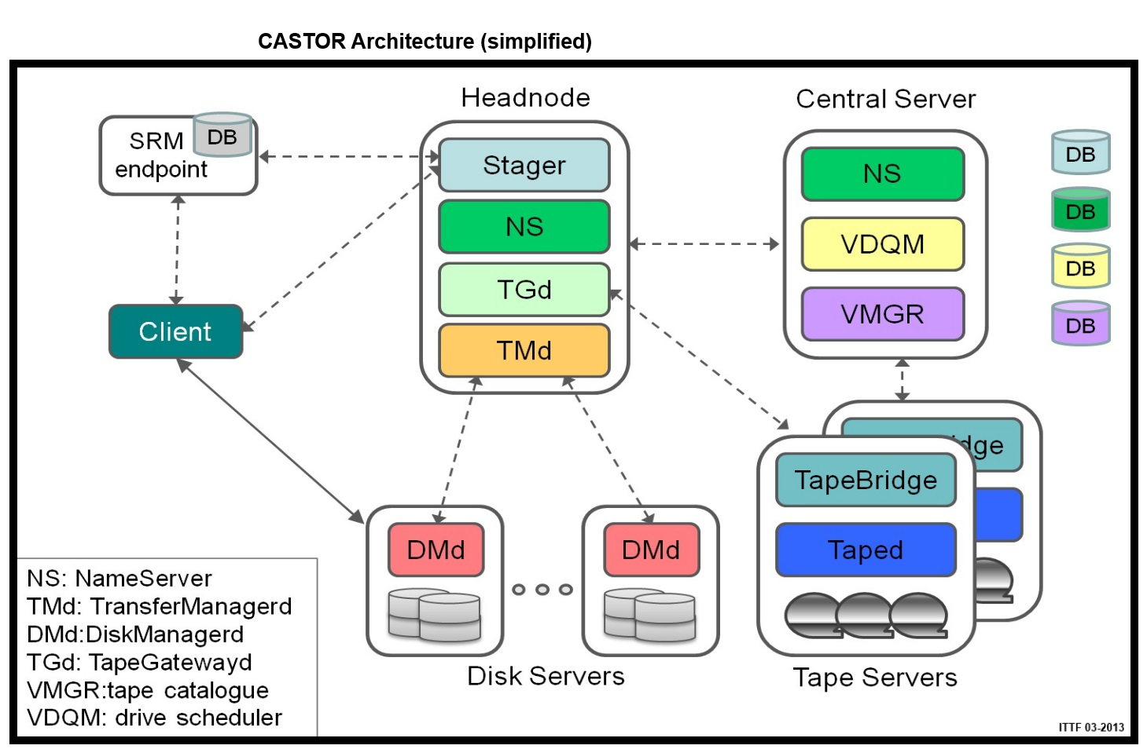

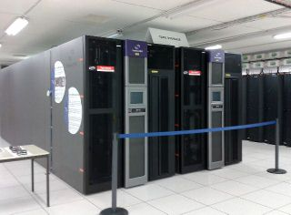
Data Storage – CASTOR
Notes:
See http://castor.web.cern.ch/ for updates
Home
The CERN Advanced STORage manager (CASTOR) is a hierarchical storage (i.e. has disk and tape) management system which was developed at CERN for managing physics data files - enormous data volume, (petabytes). Files can be stored, listed, retrieved and remotely accessed using CASTOR command-line tools or user applications that were developed using the CASTOR API. CASTOR provides a set of access protocols such as RFIO (Remote File IO), ROOT (deprecated 03 February 2014), XROOT and GridFTP.
The design is based on a component architecture (Architecture diagram) using a central database in-order to safeguard the state changes of the CASTOR components. The access to disk pools is controlled by the Stager; the directory structure is kept by the Name Server. The tape access (writes and recalls) is controlled by the Tape Infrastructure.
The 5 major functional modules are:
Stager - this disk pool manager allocates and reclaims space; it also controls client access and oversees the disk pool local catalogue
Name Server - this CASTOR name space (files and directories) includes the corresponding file metadata (size, dates, checksum, ownership and ACLs (Access Control List), tape copy information). Command-line tools modelled along Unix tools enables the manipulation of the name space (e.g. nsls corresponds to ls, etc...)
Tape Infrastructure - under certain conditions CASTOR saves files onto tape in order to provide data safety and to manage data storage that is larger than the available disks. At CERN, the high capacity tape units that are used are Oracle StorageTek (photo) T10000C (5 TB) and IBM TS1140 (4 TB). Cartridges are housed in tape libraries, and access to them is fully automatized. The libraries used by CASTOR in production are 4 x Oracle SL8500 and 3 x IBM TS3500. The current total tape archive capacity is ~100 PB (January 2013). The CASTOR Volume Manager database contains information about each tape's characteristics, capacity and status. The Name Server database contains information about the files (sometimes referred to as segments) on a tape:
ownership
permission details
file offset location on tape
User commands are available to display information in both the Name Server and Volume Manager databases.
The mounting of cartridges to and from tape drives is managed by the Volume Drive Queue Manager (VDQM) in conjunction with library control software specific to each model of tape library.
The cost of storage per terabyte on tape is a lot less than that on hard disk, and it has the advantage of not consuming electricity when tapes are not being accessed. However, access times on tape are longer, in the order of minutes rather than seconds.
Client - this allows the user to upload, download, access and manage CASTOR data
Storage Resource Management - allows for data access in a computing Grid via the SRM protocol. It interacts with CASTOR on behalf of a user or other services (such as FTS, the File Transfer System used by the LHC community to export data).

Slide 17
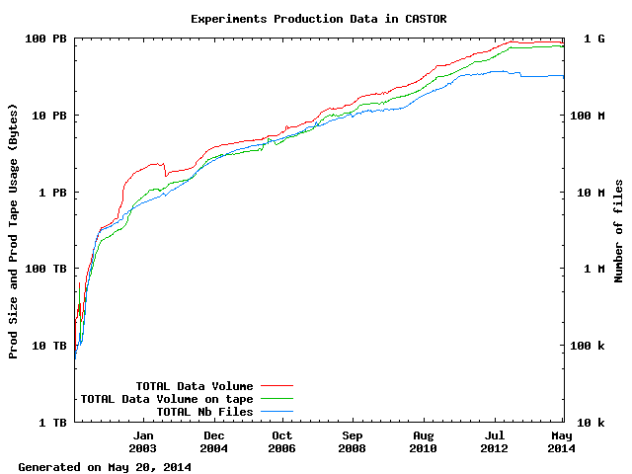
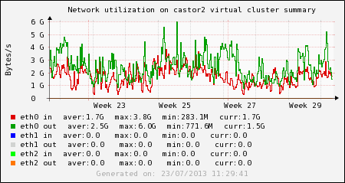
Data Storage – CASTOR
Data: ~ 100 PB
Files: ~ 300 M
Example of activity (Jul 2013):
In: avg 1.7 GB/s, peak 4.2 GB/s
Out: avg 2.5 GB/s, peak 6.0 GB/s

Slide 18
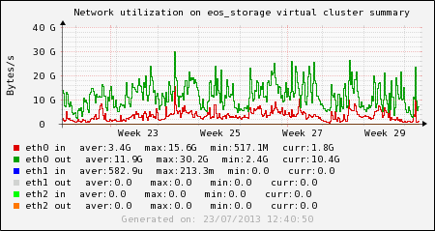
Data Storage - EOS
Disk-only storage for analysis use case
  Optimized for concurrency
  Multi-replica on different diskservers (JBODs)
20PB, 158M files, ~1100 diskservers
  Data: Xavier Espinal, CHEP conference, Oct 2013
Example of activity (Jul 2013):
In: avg 3.4 GB/s, peak 16.6 GB/s
Out: avg 11.9 GB/s, peak 30.6 GB/s
  Credits: EOS project, http://eos.cern.ch/
Notes:
EOS is a disk-based service providing a low latency storage infrastructure for physics users. EOS provides a highly-scalable hierarchical namespace implementation. Data access is provided by the XROOT protocol.
The main target area for the service are physics data analysis use often cases characterized by many concurrent users, a significant fraction random data access and a large file open rate.
For user authentication EOS supports Kerberos (for local access) and X.509 certificates for grid access. To ease experiment workflow integration SRM as well as gridftp access are provided. EOS further supports the XROOT third-party copy mechanism from/to other XROOT enabled storage services at CERN.

Slide 19
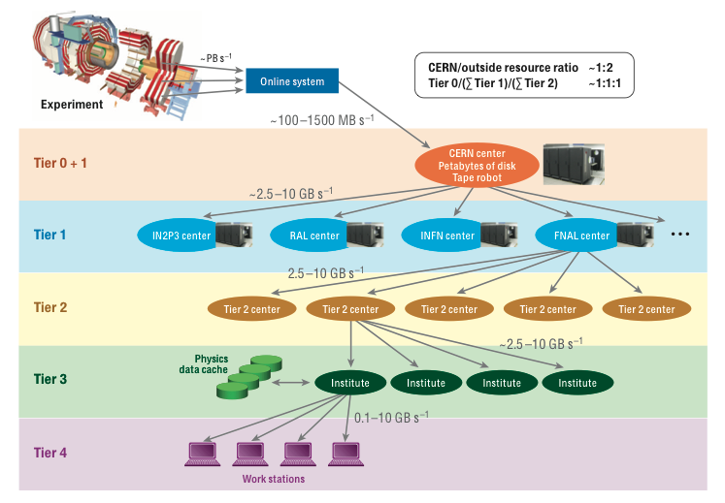
Original Computing model
Notes:
Original model was strictly hierarchical

Slide 20
WLCG: Worldwide LHC Computing Grid
Tier 0 (CERN)
  Data recording
  Initial data reconstruction
  Data distribution
Tier 1 (11 + KISTI,Korea in progress)
  Permanent storage
  Re-processing
  Analysis
  10 Gbit/s links
  Tier 2 (~150 centres)
  Simulation
  End-user analysis
  Overall
  ~160 sites, 39 countries
  300,000 cores
  200 PB of storage
  2 million jobs/day
Tier-2 sites
(about 150)
Tier-1 sites
- - - - 10 Gbit/s links
Notes:
The Tier 0 centre at CERN stores the primary copy of all the data. A second copy is distributed between the 11 so-called Tier 1 centres. These are large computer centres in different geographical regions of the world, that also have a responsibility for long term guardianship of the data. The data is sent from CERN to the Tier 1s in real time over dedicated network connections.
In order to keep up with the data coming from the experiments this transfer must be capable of running at around 1.3 GB/s continuously. This is equivalent to a full DVD every 3 seconds.
The Tier 1 sites also provide the second level of data processing and produce data sets which can be used to perform the physics analysis. These data sets are sent from the Tier 1 sites to the around 130 Tier 2 sites.
A Tier 2 is typically a university department or physics laboratories and are located all over the world in most of the countries that participate in the LHC experiments. Often, Tier 2s are associated to a Tier 1 site in their region. It is at the Tier 2s that the real physics analysis is performed.

Slide 21

From experiment to discovery
data acquisition
event
data taking
analysis
event
analysis
reconstruction
analysis objects
(extracted per physics topic)
event
reconstruction
raw data
ntuple1
ntuple2
simulated raw data
generation→simulation→digitization
event
summary
data
ntupleN
event
simulation
interactive
physics analysis
(thousands of users!)
Global computing resources to store, distribute and analyse LHC data are provided by the Worldwide LHC Computing Grid (WLCG)

Slide 22
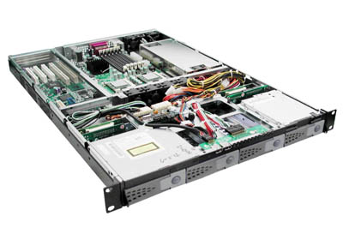

Job Data and Control Flow (1)
Here is my program and I want to
analyze the ATLAS data from the
special run on June 16th 14:45h
or all data with detector signature X
Processing nodes (CPU servers)
‘Batch’ system to decide
where is free computing
time
Management software
Data management system
where is the data and how
to transfer to the program
Database system
Translate the user request into physical location
and provide meta-data (e.g. calibration data) to the program
Disk storage

Slide 23

Job Data and Control Flow (2)
CERN installation
From: Physics computing - Helge Meinhard, 2013
Users
Repositories
- code
- metadata
- …….
Interactive
Data processing
batch
Bookkeeping
Data base
Tape storage
Disk storage
CASTOR
Hierarchical Mass Storage Management System (HSM)

Slide 24
Data and Algorithms
HEP data are organized as Events (particle collisions)
Simulation, Reconstruction and Analysis programs process “one event at a time”
Events are fairly independent → embarrassingly parallel problem
RAW
Triggered events
recorded by DAQ
Detector digitisation
~2 MB/event
ESD/RECO
Pseudo-physical information:
Clusters, track candidates
Reconstructed
information
~100 kB/event
AOD
Physical information:
Transverse momentum,
Association of particles, jets,
id of particles
Analysis
information
~10 kB/event
TAG
Classification
information
Relevant information
for fast event selection
~1 kB/event
From: Ian.Bird@cern.ch / August 2012

Slide 25
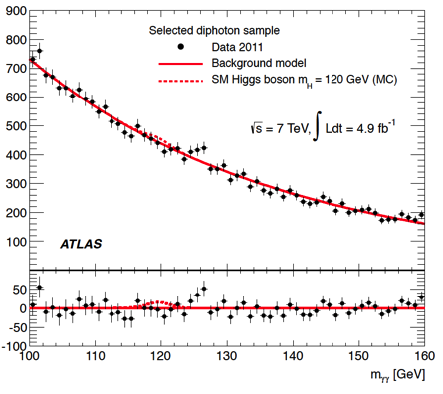

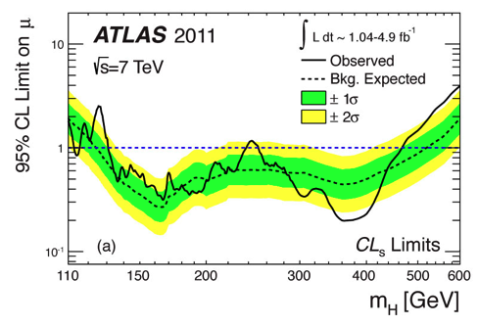
Data Analysis
Huge quantity of data collected, but most of events are simply reflecting well-known physics processes
  New physics effects expected in a tiny fraction of the total events: few tens
Crucial to have a good discrimination between interesting events and the rest, i.e. different species
  Data analysis techniques play a crucial role in this “fight”
Credit: A.Lazzaro

Slide 26
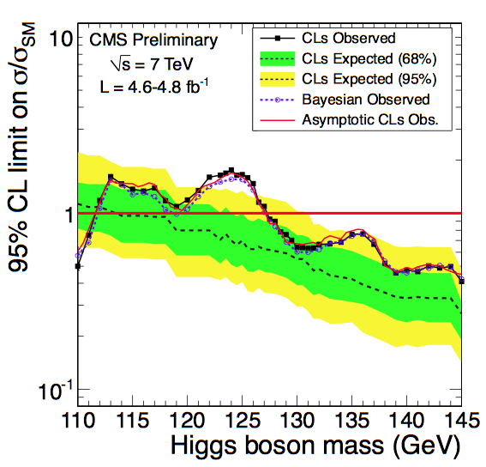
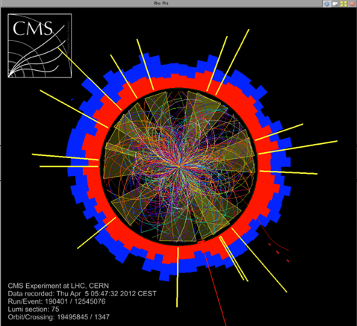
ROOT Object-Oriented toolkit
Data Analysis toolkit
  Written in C++ (millions of lines)
  Open source
  Integrated interpreter
  File formats
  I/O handling, graphics, plotting, math, histogram binning, event display, geometric navigation
  Powerful fitting (RooFit) and statistical (RooStats) packages on top
  In use by all HEP experiments
Credit: F.Rademakers

Slide 27

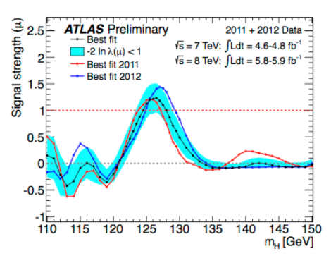
Data Analysis in Practice
LHC Physics Analysis is done with ROOT
Dedicated C++ framework developed by the High Energy Physics community, http://root.cern.ch
Provides tools for plotting/fitting/statistic analysis etc.
ROOT-ntuples are centrally produced by physics groups from previously reconstructed event summary data
Each physics group determines specific content of ntuple
Physics objects to include
Level of detail to be stored per physics object
Event filter and/or pre-analysis steps
ntuple1
event
summary
data
ntuple2
ntupleN

Slide 28
Data Analysis in Practice
Analysis is typically I/O intensive and runs on many files
analysis
event
analysis
Small datasets→ copy data and run analysis locally
Large datasets:→use the LHC Computing Grid
Grid computing tools split the analysis job in multiple jobs each running on a subset of the data
Each sub-job is sent to Grid site where input files are available
Results produced by sub-jobs are summed
Bored waiting days for all grid-jobs to finish→
Filter data and produce private mini-ntuples
analysis objects
(extracted per physics topic)
ntuple1
ntuple2
ntupleN
interactive
physics analysis
(thousands of users!)
An Openlab Project: Can we replace the ntuple analysis with a model where data is analysed inside a centrally accessible Oracle database?

Slide 29
Recap
Data is crucial for High Energy Physics
  Currently 100PB of LHC-related data at CERN
  Tape for archive + Disk filesystem for analysis
GRID processing
  Embarrassingly parallel problems
  It’s an international distributed effort
  Various processes of data reduction/filtering to increase efficiency of storage and analysis
Future
  Heading towards the Exabyte scale!
  Challenges to increase data rates, storage size and computing efficiency

Slide 30
Outline
Introduction to CERN
LHC Data Storage and Analysis
Oracle Databases at CERN
ASM deep dive
Conclusions

Slide 31
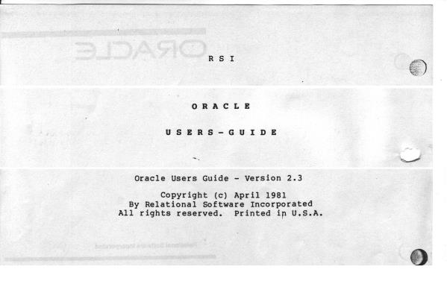
Oracle at CERN
Since 1982
(accelerator
controls)
More recent:
use for Physics
Source: N. Segura Chinchilla, CERN

Slide 32

CERN’s Databases
~100 Oracle databases, most of them RAC
  Mostly NAS storage plus some SAN with ASM
  ~500 TB of data files for production DBs in total
Examples of critical production DBs:
  LHC logging database ~170 TB, expected growth up to ~70 TB / year
  13 production experiments’ databases ~10-20 TB in each
  Read-only copies (Active Data Guard)

Slide 33
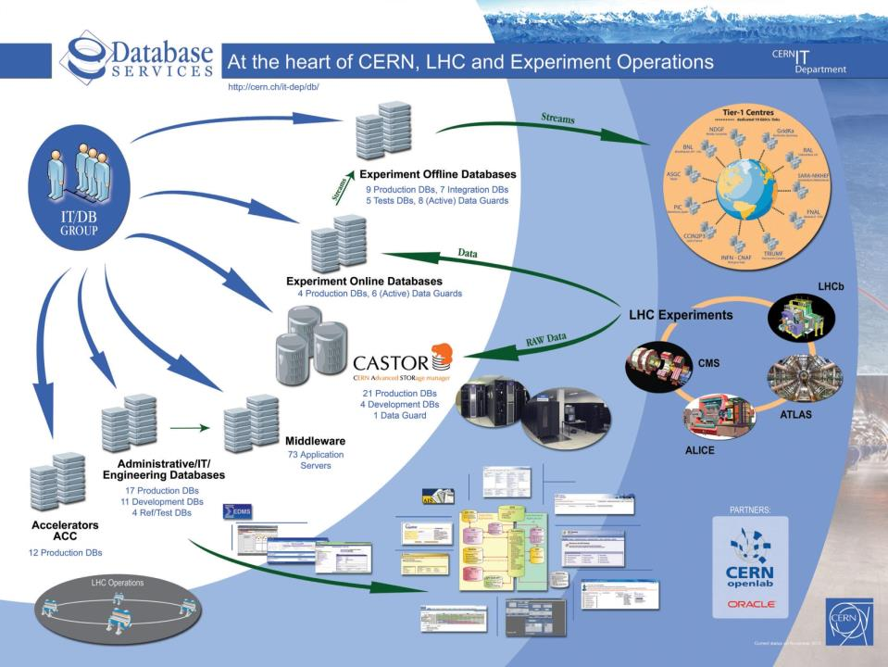

Slide 34
ASM and Our Experience
Used to build RAC on commodity HW
  Normal redundancy (scale out)
  Goals of increasing performance and reducing cost
  Commodity HW -> ASM is the cluster filesystem
Why investigating the internals?
  New technology, at the time we started (10gR1)
    understand the stability and performance
    Result: white paper on ASM internals studies in 2006

Slide 35



ASM for a Clustered Architecture
Oracle architecture of redundant low-cost components
Servers
SAN
Storage
Notes:
Work from 2006:
This is the architecture deployed at CERN for the Physics DBs, more on https://twiki.cern.ch/twiki/pub/PSSGroup/HAandPerf/Architecture_description.pdf

Slide 36
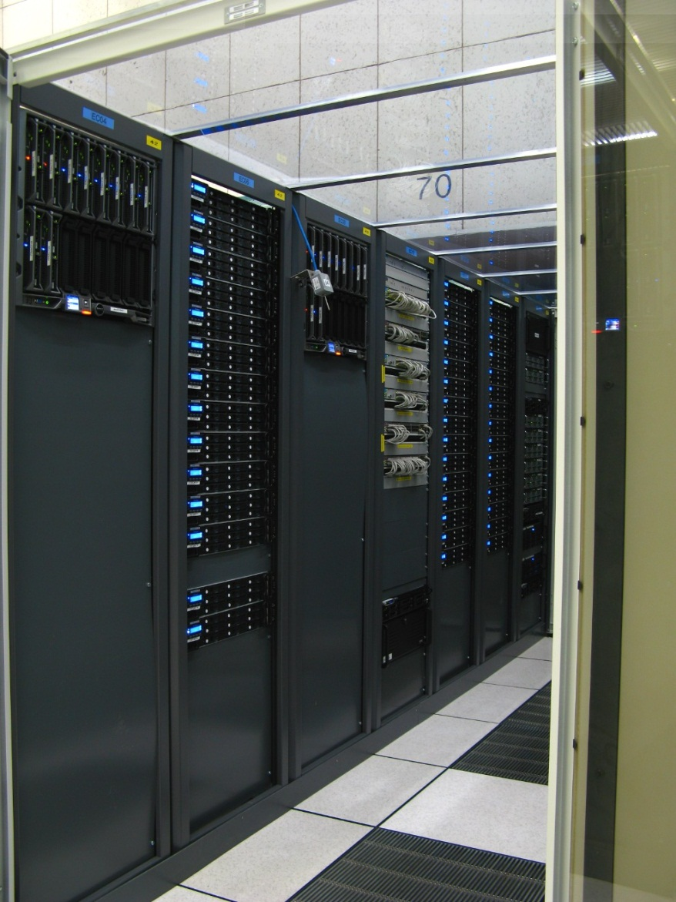

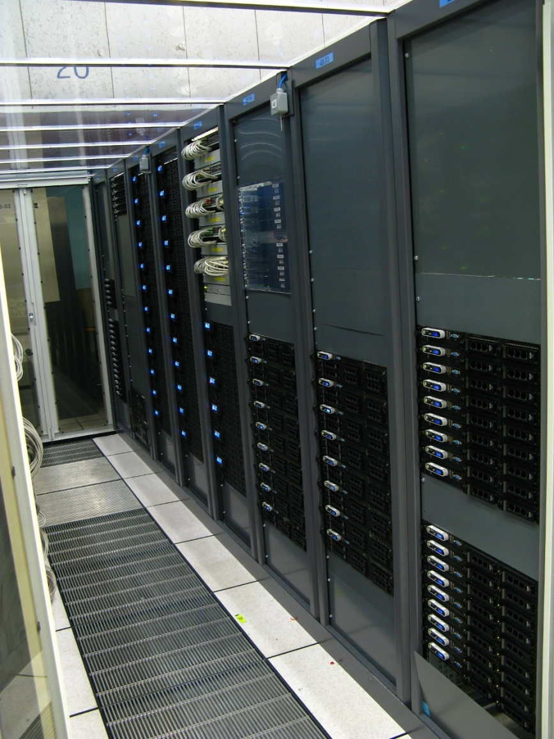
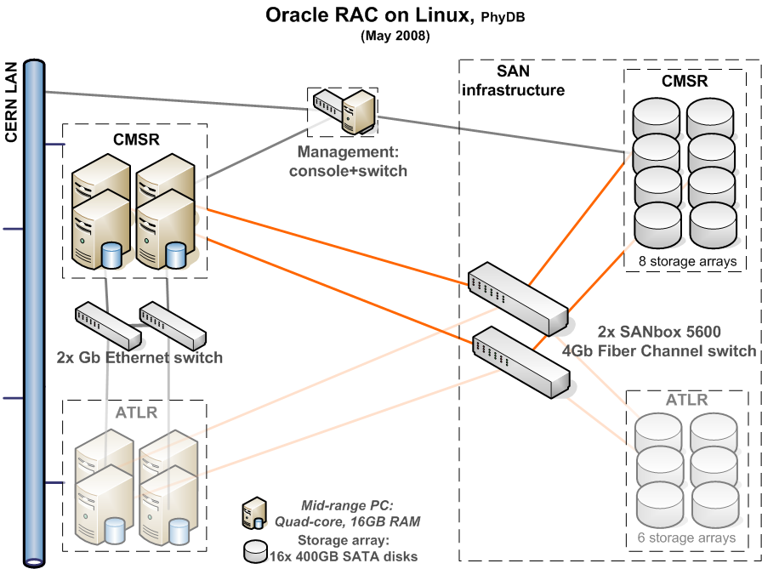
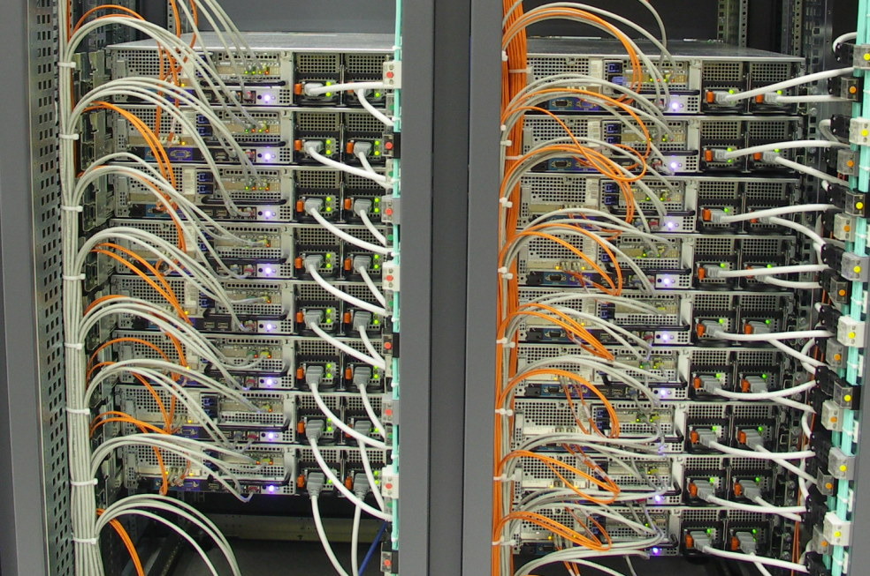
ASM Normal Redundancy
Dual-CPU quad-core blade servers, 24GB memory, Intel Nehalem low power; 2.26GHz clock
Redundant power, mirrored local disks, 4 NIC (2 private/ 2 public), dual HBAs, “RAID 1+0 like” with ASM
L
Notes:
More recent HW uses Nehalem processors and 24 GB of RAM

Slide 37

Automatic Storage Management
ASM (Automatic Storage Management)
  Oracle’s cluster file system and volume manager for Oracle databases
  HA: fault tolerant, online storage reorganization/addition
  Performance: stripe and mirroring everything
  Commodity HW: Physics databases at CERN use ASM normal redundancy (similar to RAID 1+0 across multiple disks and storage arrays)
Failgroup1
Failgroup2
Failgroup3
Failgroup4
DATA_DiskGroup
RECOVERY_DiskGroup

Slide 38
ASM Is not a Black Box
ASM is implemented as an Oracle instance
  Familiar operations for the DBA
  Configured with SQL commands
  Info in V$ views
  Logs in udump and bdump
  Some ‘secret’ details hidden in X$TABLES and ‘underscore’ parameters
ASM internals
  Topics is vast. Here we will focus internals of storage and ignore volumes and ACFS internals

Slide 39
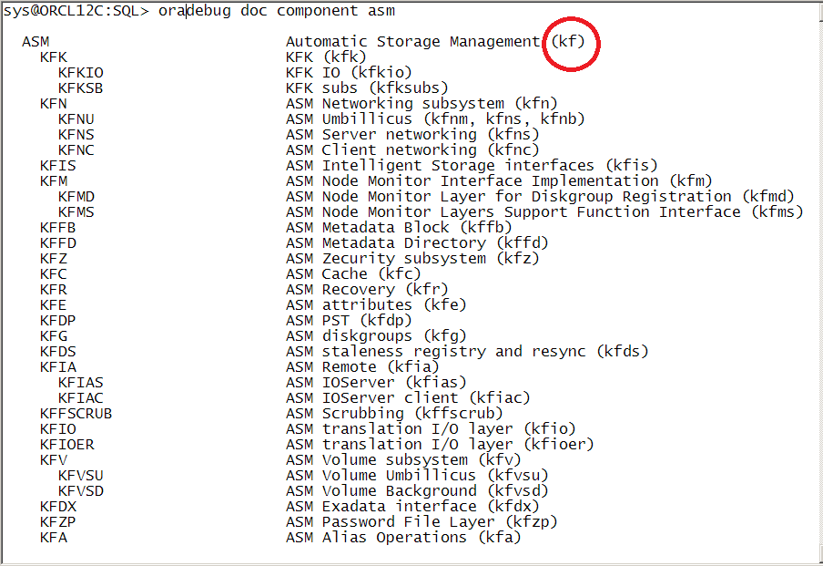
ASM – Oracle Kernel Functions
First rule of ASM internals investigations
  look for the KF prefix!

Slide 40
ASM – V$ views and X$ tables
More ASM internals:
  Documented: GV$views
  Undocumented: X$ tables (more than 60 X$KF.. tables in 12c)
select * from v$fixed_table where name like 'X$KF%';
select * from v$fixed_view_definition where view_name like 'GV$ASM%';

Slide 41
ASM – Instance Parameters
More ASM internals:
  Instance parameters: a handful
  Undocumented: _asm parameters (more than 100 in 12c)
select a.ksppinm "Parameter", c.ksppstvl "Instance Value", a.KSPPDESC
from x$ksppi a, x$ksppsv c
where a.indx = c.indx
and a.ksppinm like '%asm%'
order by a.ksppinm;

Slide 42
Selected V$ Views and X$ Tables
View Name | X$ Table | Description
V$ASM_DISKGROUP | X$KFGRP | performs disk discovery and lists diskgroups
V$ASM_DISK | X$KFDSK, X$KFKID | performs disk discovery, lists disks and their usage metrics
V$ASM_FILE | X$KFFIL | lists ASM files, including metadata
V$ASM_ALIAS | X$KFALS | lists ASM aliases, files and directories
V$ASM_TEMPLATE | X$KFTMTA | ASM templates and their properties
V$ASM_CLIENT | X$KFNCL | lists DB instances connected to ASM
V$ASM_OPERATION | X$KFGMG | lists current rebalancing operations
N.A. | X$KFFOF | reports the list of open files (lsof)
N.A. | X$KFDPARTNER | lists disk-to-partner relationships
N.A. | X$KFFXP | extent map table for all ASM files
N.A. | X$KFDAT | allocation table for all ASM disks
Notes:
A longer list at https://twiki.cern.ch/twiki/bin/view/PDBService/ASM_Internals
View Name X$ Table name Description
V$ASM_DISKGROUP X$KFGRP performs disk discovery and lists diskgroups
V$ASM_DISKGROUP_STAT X$KFGRP_STAT diskgroup stats without disk discovery
V$ASM_DISK X$KFDSK, X$KFKID performs disk discovery, lists disks and their usage metrics
V$ASM_DISK_STAT X$KFDSK_STAT, X$KFKID lists disks and their usage metrics
V$ASM_FILE X$KFFIL lists ASM files, including metadata/asmdisk files
V$ASM_ALIAS X$KFALS lists ASM aliases, files and directories
V$ASM_TEMPLATE X$KFTMTA lists the available templates and their properties
V$ASM_CLIENT X$KFNCL lists DB instances connected to ASM
V$ASM_OPERATION X$KFGMG lists rebalancing operations
N.A. X$KFKLIB available libraries, includes asmlib path
N.A. X$KFDPARTNER lists disk-to-partner relationships
N.A. X$KFFXP extent map table for all ASM files
N.A. X$KFDAT extent list for all ASM disks
N.A. X$KFBH describes the ASM cache (buffer cache of ASM in blocks of 4K (_asm_blksize)
N.A. X$KFCCE a linked list of ASM blocks. to be further investigated
Additional in 11g:
View Name X$ Table name Description
V$ASM_ATTRIBUTE X$KFENV ASM attributes, the X$ table shows also 'hidden' attributes
V$ASM_DISK_IOSTAT X$KFNSDSKIOST I/O statistics
N.A. X$KFDFS
N.A. X$KFDDD
N.A. X$KFGBRB
N.A. X$KFMDGRP
N.A. X$KFCLLE
N.A. X$KFVOL
N.A. X$KFVOLSTAT
N.A. X$KFVOFS
N.A. X$KFVOFSV

Slide 43
More Selected V$ Views and X$ Tables
View Name | X$ Table | Description
N.A. | X$KFFOF | reports the list of open files. it is the source for lsof in asmcmd
N.A. | X$KFKLSOD | reports the list of open devices. it is the source for lsod in asmcmd
V$ASM_ATTRIBUTE | X$KFENV | ASM DG attributes. Data stored in file #9 of each DG Notes: the X$ table shows also 'hidden' attributes. Example: '_extent_counts‘
N.A. | X$KFZPBLK | info on the password files in asm
More info: https://twiki.cern.ch/twiki/bin/view/PDBService/ASM_Internals
Notes:
Example to turn off variable extents
alter diskgroup set attribute '_extent_counts'='214748367 0 0';

Slide 44
ASM Parameters
Underscore instance parameters
  Typically don’t need tuning
  _asm_ausize and _asm_stripesize
    May need tuning for VLDB in 10g
New in 11g, diskgroup attributes
  V$ASM_ATTRIBUTE, examples:
    disk_repair_time, au_size, _extent_counts, _extent_sizes
  X$KFENV shows ‘underscore’ attributes
Notes:
Query to display underscore parameters
select a.ksppinm "Parameter", c.ksppstvl "Instance Value" from x$ksppi a, x$ksppcv b, x$ksppsv c where a.indx = b.indx and a.indx = c.indx and ksppinm like '%asm%' order by a.ksppinm;

Slide 45
ASM Storage Basics
ASM Disks are divided in Allocation Units (AU)
  Default size 1 MB (_asm_ausize) (4 MB in Exadata)
  Tunable diskgroup attribute in 11g
ASM files are built as a series of extents
  Extents are mapped to AUs using a file extent map
  When using ‘normal redundancy’, 2 mirrored extents are allocated, each on a different failgroup
  RDBMS read operations access the primary extent of a mirrored couple (unless there is an IO error)
    Notable exceptions: use of asm_preferred_read_failure_groups (11g) and 12c new feature of even reads
  In 10g the ASM extent size = AU size
    This has changed since 11g (variable extents)
Notes:
11g implements variable extent size for extent#>20000 (similar to the automatic extent size management in the DB)

Slide 46
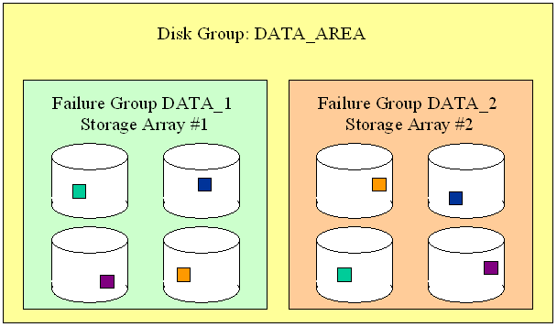
Files, Extents, and Failure Groups
Files and
extent
pointers
Failgroups
and ASM
mirroring

Slide 47
ASM Metadata Walkthrough
Three examples follow of how to read data directly from ASM.
Motivations:
  Build confidence in the technology, i.e. ‘get a feeling’ of how ASM works
  Toolkit: it may turn out useful one day to troubleshoot a production issue.

Slide 48
Example 1: Direct File Access 1/2
Goal: Reading ASM files with OS tools, using metadata information from X$ tables
Example: find the 2 mirrored extents of the RDBMS spfile
sys@+ASM1> select GROUP_KFFXP Group#, DISK_KFFXP Disk#, AU_KFFXP AU#, XNUM_KFFXP Extent# from X$KFFXP where number_kffxp=(select file_number from v$asm_alias where name='spfiletest1.ora');
GROUP# DISK# AU# EXTENT#
---------- ---------- ---------- ----------
1 16 17528 0
1 4 14838 0

Slide 49
Example 1: Direct File Access 2/2
Find the disk path
sys@+ASM1> select disk_number,path from
v$asm_disk where GROUP_NUMBER=1 and disk_number
in (16,4);
DISK_NUMBER PATH
----------- ------------------------------------
4 /dev/mapper/mystor1_1p1
16 /dev/mapper/mystor2_6p1
Read data from disk using ‘dd’
dd if=/dev/mapper/mystor2_6p1 bs=1024k
count=1 skip=17528 |strings
Notes:
Device mapper multipathing is used under Linux
Block devices are given a name /dev/mapper/mystor.. to reflect the storage array name
The name is a symbolic link (handled by device mapper) to /dev/dm-xxx (device mapper block device)
Device names and device mapper configurations are set up with /etc/multipath.conf

Slide 50
X$KFFXP – notable columns
Column Name | Description
NUMBER_KFFXP | ASM file number. Join with v$asm_file and v$asm_alias
COMPOUND_KFFXP | File identifier. Join with compound_index in v$asm_file
INCARN_KFFXP | File incarnation id. Join with incarnation in v$asm_file
XNUM_KFFXP | ASM file extent number (mirrored extent pairs have the same extent value)
PXN_KFFXP | Progressive file extent number
GROUP_KFFXP | ASM disk group number. Join with v$asm_disk and v$asm_diskgroup
DISK_KFFXP | ASM disk number. Join with v$asm_disk
AU_KFFXP | Relative position of the allocation unit from the beginning of the disk.
LXN_KFFXP | 0->primary extent,1->mirror extent, 2->2nd mirror copy (high redundancy and metadata)
SIZE_KFFXP | 11g, integer value which marks the size of the extent in AU size units.
Notes:
‘File extent pointer’ X$ table. This is the author interpretation of the table based on investigation of actual instances.
X$KFFXP Column Name Description
ADDR x$ table address/identifier
INDX row unique identifier
INST_ID instance number (RAC)
NUMBER_KFFXP ASM file number. Join with v$asm_file and v$asm_alias
COMPOUND_KFFXP File identifier. Join with compound_index in v$asm_file
INCARN_KFFXP File incarnation id. Join with incarnation in v$asm_file
PXN_KFFXP Progressive file extent number
XNUM_KFFXP ASM file extent number (mirrored AU have the same extent value)
GROUP_KFFXP ASM disk group number. Join with v$asm_disk and v$asm_diskgroup
DISK_KFFXP Disk number where the extent is allocated. Join with v$asm_disk
AU_KFFXP Relative position of the allocation unit from the beginning of the disk. The allocation unit size (1 MB) in v$asm_diskgroup
LXN_KFFXP 0->primary extent, ->mirror extent, 2->2nd mirror copy (high redundancy and metadata)
FLAGS_KFFXP N.K.
CHK_KFFXP N.K.
SIZE_KFFXP 11g, to support variable size AU, integer value which marks the size of the extent in AU size units.
extent sizes are determined by the diskgroup parameter _extent_sizes, default value='1 4 16' and the extent sizes by _extent_counts, default= 20000 20000 214748367

Slide 51
Example 2: A Different Way
A different metadata table to reach the same goal of reading ASM files directly from OS:
sys@+ASM1> select GROUP_KFDAT Group# ,NUMBER_KFDAT Disk#, AUNUM_KFDAT AU# from X$KFDAT where fnum_kfdat=(select file_number from v$asm_alias where name='spfiletest1.ora');
GROUP# DISK# AU#
---------- ---------- ----------
1 4 14838
1 16 17528
Notes:
This is much slower that reading X$KFFXP since it scans all the disks’ allocation tables

Slide 52
X$KFDAT – Selected Columns
Column Name (subset) | Description
GROUP_KFDAT | Diskgroup number, join with v$asm_diskgroup
NUMBER_KFDAT | Disk number, join with v$asm_disk
COMPOUND_KFDAT | Disk compund_index, join with v$asm_disk
AUNUM_KFDAT | Disk allocation unit (relative position from the beginning of the disk), join with x$kffxp.au_kffxp
V_KFDAT | Flag: V=this Allocation Unit is used; F=AU is free
FNUM_KFDAT | File number, join with v$asm_file
XNUM_KFDAT | Progressive file extent number join with x$kffxp.pxn_kffxp
Notes:
‘Disk allocation table’ X$ table. This is the author interpretation of the table based on investigation of actual instances.
X$KFDAT Column Name Description
ADDR x$ table address/identifier
INDX row unique identifier
INST_ID instance number (RAC)
GROUP_KFDAT diskgroup number, join with v$asm_diskgroup
NUMBER_KFDAT disk number, join with v$asm_disk
COMPOUND_KFDAT disk compund_index, join with v$asm_disk
AUNUM_KFDAT Disk allocation unit (relative position from the beginning of the disk), join with x$kffxp.au_kffxp
V_KFDAT V=this Allocation Unit is used; F=AU is free
FNUM_KFDAT file number, join with v$asm_file
I_KFDAT N.K.
XNUM_KFDAT progressive file extent number join with x$kffxp.pxn_kffxp
RAW_KFDAT raw format encoding of the disk,and file extent information

Slide 53
ASMCMD
Metadata in 12c asmcmd
ASMCMD> mapextent '+ORCL_MYTEST/ORCL/DATAFILE/mytest.256.844901607' 1
Disk_Num AU Extent_Size
1 107 1
0 107 1
ASMCMD> mapau
usage: mapau [--suppressheader] <dg number> <disk number> <au>
help: help mapau
ASMCMD> mapau 1 1 107
File_Num Extent Extent_Set
261 1273 636

Slide 54
ASMCMD and DBMS_DISKGROUP
asmcmd is written in perl
  Opportunity to see how the commands are implemented
ls –l $GRID_HOME/lib/asmcmd*
  17 files in 12.1.0.1
More info on dbms_diskgroup
  Strings $ORACLE_HOME/bin/oracle|grep -i dbms_diskgroup
  find $ORA_CRS_HOME -name asmcmd*|xargs grep -i dbms_diskgroup

Slide 55
DBMS_DISKGROUP
Procedure Name | Parameters
dbms_diskgroup.open | (:fileName, :openMode, :fileType, :blkSz, :hdl,:plkSz, :fileSz)
dbms_diskgroup.read | (:handle,:offset,:length,:buffer,:reason,:mirr)
dbms_diskgroup.write | (:handle,:offset,:length,:buffer,:reason)
dbms_diskgroup.createfile | (:fileName, :fileType, :blkSz, :fileSz, :hdl, :plkSz, :fileGenName)
dbms_diskgroup.close | (:hdl)
dbms_diskgroup.commitfile | (:handle)
dbms_diskgroup.resizefile | (:handle,:fsz)
dbms_diskgroup.remap | (:gnum, :fnum, :virt_extent_num)
dbms_diskgroup.getfileattr | (:fileName, :fileType, :fileSz, :blkSz)
… | …

Slide 56
Yet Another Way to Read From ASM
Using the internal package dbms_diskgroup
declare
fileType varchar2(50); fileName varchar2(50);
fileSz number; blkSz number; hdl number; plkSz number;
data_buf raw(4096);
begin
fileName := '+ORCL_DATADG1/ORCL/spfileORCL.ora';
dbms_diskgroup.getfileattr(fileName,fileType,fileSz, blkSz);
dbms_diskgroup.open(fileName,'r',fileType,blkSz, hdl,plkSz, fileSz);
dbms_diskgroup.read(hdl,1,blkSz,data_buf);
dbms_output.put_line(data_buf);
end;
/

Slide 57
DBMS_DISKGROUP, 12.1.0.1
dbms_diskgroup.abortfile(:handle)
dbms_diskgroup.addcreds(:osuname,:clusid,:uname,:passwd);
dbms_diskgroup.asmcopy (:src_path, :dst_name, :spfile_number,:fileType, :blkSz, :spfile_number2,:spfile_type, :client_mode)
dbms_diskgroup.checkfile (v_AsmFileName,v_FileType,v_lbks, v_offstart,v_FileSize)
dbms_diskgroup.close (:handle);
dbms_diskgroup.commitfile (:handle);
dbms_diskgroup.copy ('', '', '', :src_path, :src_ftyp, :src_blksz,:src_fsiz, '','','', :dst_path, 1)
dbms_diskgroup.createclientcluster (:clname, :direct_access)
dbms_diskgroup.createdir(:NAME);
dbms_diskgroup.createfile(:NAME,:type,:lblksize,:fsz,:handle,:pblksz,:genfname);
dbms_diskgroup.dropdir(:DIRNAME)
dbms_diskgroup.dropfile(:NAME,:type);
dbms_diskgroup.getfileattr (:src_path, :fileType, :fileSz, :blkSz)
dbms_diskgroup.getfileattr(:NAME,:type,:fsz,:lblksize, 1,:hideerr);
dbms_diskgroup.getfilephyblksize (:fileName, :flag, :pblksize)
dbms_diskgroup.gethdlattr(:handle,:attr,:nval,:sval);
dbms_diskgroup.gpnpsetsp(:spfile_path)
dbms_diskgroup.mapau (:gnum, :disk, :au, :file, :extent, :xsn)
dbms_diskgroup.mapextent(:NAME,:xsn,:mapcount,:extsize,:disk1,:au1,:disk2,:au2,:disk3,:au3);
dbms_diskgroup.mkdir (:DIRNAME)
dbms_diskgroup.open(:NAME,:fmode,:type,:lblksize,:handle,:pblksz,:fsz);
dbms_diskgroup.openpwfile(:NAME,:lblksize,:fsz,:handle,:pblksz,:fmode,:genfname,:dbname);
dbms_diskgroup.patchfile (v_AsmFilename,v_filetype,v_lbks,v_offstart,0,v_numblks,v_FsFilename,v_filetype,1,1)
dbms_diskgroup.read(:handle,:offset,:length,:buffer,:reason,:mirr);
dbms_diskgroup.remap (:gnum, :fnum, :vxn)
dbms_diskgroup.renamefile(:NAME,:tname,:type,:genfname);
dbms_diskgroup.resizefile(:handle,:fsz);
dbms_diskgroup.write(:handle,:offset,:length,:buffer,:reason);

Slide 58
Generating Lost Write Issues in Test
Read/Write a single block from Oracle data files:
  ASM: example for block number 132
    Read:
    Write:
    asmblk_edit is based on DBMS_DISKGROUP
    Download from: http://cern.ch/canali/resources.htm
./asmblk_edit -r -s 132
-a +TEST_DATADG1/test/datafile/testlostwritetbs.4138.831900273
-f blk132.dmp
./asmblk_edit -w -s 132
-a +TEST_DATADG1/test/datafile/testlostwritetbs.4138.831900273
-f blk132.dmp

Slide 59
Strace and ASM 1/3
Goal: understand strace output when using ASM storage
Example:
pread(256,"#33\0@\"..., 8192, 473128960)=8192
This is a read operation of 8KB from FD 256 at offset 473128960
What is the segment name, type, file# and block# ?

Slide 60
Strace and ASM 2/3
From /proc/<pid>/fd I find that FD=256 is
  /dev/mapper/mystor4_1p1
This is disk 20 of D.G.=1 (from v$asm_disk)
From x$kffxp find the ASM file# and extent#:
  Note: offset 473128960 = 451 MB + 27 *8KB
sys@+ASM1>select number_kffxp, XNUM_KFFXP,size_kffxp from x$kffxp where group_kffxp=1 and disk_kffxp=20 and au_kffxp=451;
NUMBER_KFFXP XNUM_KFFXP SIZE_KFFXP
------------ ------------ ----------
268 17 1
Notes:
In Oracle 12c we can simply use asmcmd:
mapau 1 20 451

Slide 61
Strace and ASM 3/3
From v$asm_alias I find the file alias for file 268: USERS.268.612033477
From v$datafile view I find the RDBMS file#: 9
From dba extents finally find the owner and segment name relative to the original I/O operation:
sys@ORCL>select owner,segment_name,segment_type from dba_extents where FILE_ID=9 and 27+17*1024*1024/8192 between block_id and block_id+blocks;
OWNER SEGMENT_NAME SEGMENT_TYPE
----- ------------ ------------
SCOTT EMP TABLE

Slide 62

Investigation of Fine Striping
An application: finding the layout of fine-striped files
  Explored using strace of an oracle session executing ‘alter system dump logfile ..’
  Result: round robin distribution over 8 x 1MB extents
    Note: since 11gR2 Oracle by default does not use fine striping for online logs
…
…
…
…
…
…
…
…
…
…
…
…
…
…
…
…
B0
B1
B2
B3
B4
B5
B6
B7
AU = 1MB
…
…
…
…
…
…
…
…
…
…
…
…
…
…
…
…
A0
A1
A2
A3
A4
A5
A6
A7
Fine striping size = 128KB (1MB/8)

Slide 63
Metadata Files
ASM diskgroups contain ‘hidden files’
  Most of them not listed in V$ASM_FILE
  Details are available in X$KFFIL
  Example (12c):
GROUP# FILE# FILESIZE_AFTER_MIRR RAW_FILE_SIZE
-------------- -------------- ------------------- --------------
1 1 2097152 6291456
1 2 1048576 3145728
1 3 88080384 267386880
1 4 8331264 25165824
1 5 1048576 3145728
1 6 1048576 3145728
1 7 1048576 3145728
1 8 1048576 3145728
1 9 1048576 3145728
1 12 1048576 3145728
1 13 1048576 3145728
1 253 1536 2097152
1 254 2097152 6291456
1 255 165974016 336592896
Notes:
select group_kffil group#, number_kffil file#, filsiz_kffil filesize_after_mirr, filspc_kffil raw_file_size from x$kffil where number_kffil <256;
Metadata files have 3-way mirroring

Slide 64
ASM Metadata 1/2
File#0, AU=0: disk header (disk name, etc), Allocation Table (AT) and Free Space Table (FST)
File#0, AU=1: Partner Status Table (PST)
File#1: File Directory (files and their extent pointers)
  Files with more than 60 extents have also indirect pointers
File#2: Disk Directory
File#3: Active Change Directory (ACD)
  The ACD is analogous to a redo log, where changes to the metadata are logged.
  Size=42MB * number of instances
Sources:
Oracle Automatic Storage Management, Oracle Press Nov 2007, N. Vengurlekar, M. Vallath, R.Long
asmsupportguy.blogspot.com (Bane Radulovic)
Notes:
A note on File#1 and file extent pointers:
The extent information available in X$KFFXP is
In File#1 for the first 60 extents (short files)
Extent# > 60 make use of indirect pointers
Indirect pointers are allocated in files
Direct investigation:
Using X$KFFXP count the extents allocated for:
create tablespace test1 datafile size 30712k;
60 extents (normal redundancy)
create tablespace test2 datafile size 30713k;
65 extents (normal redundancy)
The extra extents are indirect pointers

Slide 65
ASM Metadata 2/2
File#4: Continuing Operation Directory (COD).
  The COD is analogous to an undo tablespace. It maintains the state of active ASM operations such as disk or datafile drop/add. The COD log record is either committed or rolled back based on the success of the operation.
File#5: Template directory
File#6: Alias directory
11g, File#9: Attribute Directory
11g, File#12 Staleness directory created when needed to track offline disks
12c, File#13: ASM password directory
11g, File#254: and registry, created when needed to track offline disks

Slide 66
ASM special files
11gR2 File#253 (visible in v$asm_file) -> ASM spfile
11gR2 File#255 (visible in v$asm_file) -> OCR registry
11gR2, File#1048572 (Hex=FFFFC), not a real file#, only appears in X$KFDAT, it's the voting disk in ASM (11gR2 and 12c)
File#256
  first user file, typically the first one created in the diskgroup. Often it’s the DB control file. In 12c it can be the DB password file (new 12c feature of DB password file in ASM).

Slide 67
X$KFDPARTNER
Column Name (subset) | Description
GRP | Diskgroup number, join with v$asm_diskgroup
DISK | Disk number, join with v$asm_disk
NUMBER_KFDPARTNER | partner disk number, i.e. disk-to-partner (1-N) relationship
DISKFGNUM | failgroup number of the disk
PARTNERFGNUM_KFDPARTNER | failgroup number of the partner disk
Disks are partners when they have mirror copies of one or more extents

Slide 68
Why Disk Partners
ASM limits the number of disk partners
  Reduce impact of multiple disk failures
  Limit is: _asm_partner_target_disk_part (default 8 in recent versions)
  _asm_partner_target_fg_rel (target maximum number of failure group relationships for repartnering, default 4)
Configuration:
  Best use 3 or more failgroups for normal redundancy diskgroups
  Probability that 2 disks contain mirrored data decreases with increasing number of disks

Slide 69
ASM Rebalancing and VLDB
Performance of rebalancing is important for VLDB
An ASM instance can use parallel slaves
  RBAL coordinates the rebalancing operations
  ARBx processes pick up ‘chunks’ of work. By default they log their activity in udump
Does rebalancing scale?
  In 10g serialization limited scalability
  Improved performance of rebalance in each version
    Notable 11gR2 resolved issue of excessive repartnering
Notes:
Gmon is also involved at the beginning and the end of the rebalancing operation to take and release the diskgroup lock

Slide 70
Fast Mirror Resync
ASM 10g does not allow to temporarily offline disks
  A transient error in a storage array can cause several hours of rebalancing to drop and later add back disks
  It is a limiting factor for scheduled maintenances
11g and 12c -> ‘fast mirror resync’
    Redundant storage can be put offline for maintenance
    Changes are accumulated in the staleness registry (file#12 and file#254)
    Changes are applied when the storage is back online
Unscheduled disk issues -> disk go offline
  Regulated by diskgroup parameters: disk_repair_time, default to 3.6 h
    new in 12c failgroup_repair_time defaults to 24.0 h

Slide 71
ASM and Primary Extent Corruption
When unavailable or corrupt data is found
  ASM will read data from mirror
  ASM will try to fix the wrong data and write to ASM
    For example writing back corrected data does not seem to be done when I/O is direct read (e.g. backup)
Example (corruption generated with dd), from alert log:
Corrupt block relative dba: 0x000021ff (file 11, block 8703)
Completely zero block found during multiblock buffer read
Reading datafile '+ORCL_DATADG/ORCL/DATAFILE/mytest.259.848360345' for corruption at rdba: 0x000021ff (file 11, block 8703)
Read datafile mirror ' ORCL_DATADG_0000' (file 11, block 8703) found same corrupt data (no logical check)
Read datafile mirror ‘ORCL_DATADG_0001' (file 11, block 8703) found valid data
Hex dump of (file 11, block 8703) in trace file {…}
Repaired corruption at (file 11, block 8703)

Slide 72
Silent Corruption
Search for silently corrupted secondary extents
PL/SQL script based on: dbms_diskgroup.checkfile
  Undocumented, a script used to be in MOS
  See also notes in this slide
amdu -dis '/dev/mapper/myLUN*p1' -compare -extract ORCL_DATADG1.267 -noextract
RDBMS: alter system dump datafile .. block ..
  Oracle will read both mirrors and report in alert log
Notes:
Script using checkfile:
-- checkfile_ASM, a script to check if mirror extents in ASM files do not have corruption/lost writes
-- Luca Feb 2013
-- Note the script borrows several ideas from MOS note How to dump or extract a raw block from a file stored in ASM diskgroup [ID 603962.1]
-- The usage of dbms_diskgroup.checkfile is trial and error. MOS note Note 387001.1 is supposed to describe it but it is not visible.
-- Usage: input file name to check
-- with some simple modifications this script can be changed to check all files in batch
-- warning, do not use in prod, still in development, dbms_diskgroup.checkfile maybe not safe
set serveroutput on
declare
v_AsmFilename varchar2(4000);
v_offstart number;
v_numblks number;
v_filetype number;
v_filesize number;
v_lbks number;
v_typename varchar2(4000);
v_pblksize number;
v_handle number;
begin
dbms_output.enable(500000);
v_AsmFilename := '&ASM_File_Name';
v_offstart := 1;
dbms_diskgroup.getfileattr(v_AsmFilename,v_filetype,v_filesize,v_lbks);
dbms_diskgroup.open(v_AsmFilename,'r',v_filetype,v_lbks,v_handle,v_pblksize,v_filesize);
dbms_diskgroup.close(v_handle);
select decode(v_filetype,1,'Control File',2,'Data File',3,'Online Log File',4,'Archive Log',5,'Trace File',6,'Temporary File',
7,'Not Used',8,'Not Used',9,'Backup Piece',10,'Incremental Backup Piece',11,'Archive Backup Piece',12,'Data File Copy',
13,'Spfile',14,'Disaster Recovery Configuration',15,'Storage Manager Disk',16,'Change Tracking File',17,'Flashback Log File',
18,'DataPump Dump File',19,'Cross Platform Converted File',20,'Autobackup',21,'Any OS file',22,'Block Dump File',
23,'CSS Voting File',24,'CRS') into v_typename from dual;
dbms_output.put_line('File: '||v_AsmFilename); dbms_output.new_line;
dbms_output.put_line('Type: '||v_filetype||' '||v_typename); dbms_output.new_line;
dbms_output.put_line('Size (in logical blocks): '||v_filesize); dbms_output.new_line;
dbms_output.put_line('Logical Block Size: '||v_lbks); dbms_output.new_line;
dbms_output.put_line('Physical Block Size: '||v_pblksize); dbms_output.new_line;
dbms_diskgroup.checkfile(v_AsmFilename,v_filetype,v_lbks,v_offstart,v_filesize);
-- check output in alert
end;
/
Example from alert log when dumping a data block with corrupted mirror
Start check mirror blocks file#:+ORCL_DATADG1/ORCL/DATAFILE/users2.309.840124245 minblk 524291 maxblk 524291
ksfdrfms:Mirror Read file=+ORCL_DATADG1/ORCL/DATAFILE/users2.309.840124245 fob=0x550c90d18 bufp=0x2acf2dbdd400 blkno=524291 nbytes=8192
ksfdafReadMirror: Read success from mirror side=1 logical extent number=0 disk=ORCL_DATADG1_0011 path=/dev/mapper/myLUN4_4p1
Mirror I/O done from ASM disk /dev/mapper/myLUN4_4p1
ksfdrnms:Mirror Read file=+ORCL_DATADG1/ORCL/DATAFILE/users2.309.840124245 fob=0x550c90d18 bufp=0x2acf2dbdf600 nbytes=8192
ksfdafReadMirror: Read success from mirror side=2 logical extent number=1 disk=ORCL_DATADG1_0001 path=/dev/mapper/myLUN3_2p1
Block 524291: Differences found between mirror sides 1 and 2

Slide 73
AMDU
ASM Metadata Dump Utility
  Introduced with 11g, can be used in 10g too.
Allows to dump ASM contents without opening diskgroups
Can read from dropped disks
Can find corrupted blocks
Can check ASM file mirror consistency
Get started:
  amdu –help
  amdu creates an output directory and populates it with
    report.txt, map files, image files

Slide 74
AMDU - Examples
# Extracts file 267 from ASM diskgroup ORCL_DATADG1
# Note: works as asmcmd cp but also on dismounted disk groups!
$ amdu -dis '/dev/mapper/myLUN*p1' -extract ORCL_DATADG1.267
# Compares primary and mirror extents in normal redundancy disk groups
# Useful to check for potential corruption issues
# results in the report.txt file
$ amdu -dis '/dev/mapper/myLUN*p1' -compare -extract ORCL_DATADG1.267 -noextract
# Dump contents of a given diskgroup and does not create image file
# The .map file reports on all files found (column number 5 prefixed by the letter F)
$ amdu -dis '/dev/mapper/myLUN*p1' -noimage -dump ORCL_DATADG1
See also: https://twiki.cern.ch/twiki/bin/view/PDBService/ASM_utilities

Slide 75
KFED
KFED=Kernel Files metadata EDitor
  Reference: ASM tools used by Support : KFOD, KFED, AMDU (Doc ID 1485597.1)
  kfed can be used to read and write ASM metadata. In particular disk headers and ASM (hidden) metadata files.
  kfed in write mode is a powerful but potentially dangerous tool

Slide 76
KFED - examples
# reads the disk header to stdout
$ kfed op=read dev=/dev/mapper/myLUN1_p1
# reads the metadata of a specified AU and block into file /tmp/a
$ kfed op=read dev=/dev/mapper/myLUN1_p1 aunum=3 blknum=3 text=/tmp/a
# writes from /tmp/a into the specified AU and block
# the checksum is computed and written together with data
# !! Careful, writing into ASM metadata is unsupported !!
$ kfed op=write dev=/dev/mapper/myLUN1_p1 aunum=3 blknum=3 text=/tmp/a

Slide 77
Playing with Metadata - Examples
Example 1: Recover an accidentally dropped diskgroup
Option 1: recover files with AMDU
  amdu -dis '/dev/mapper/MYLUN*p1' -former -extract ORCL_DATADG.256
Option 2: edit metadata with KFED an make the disk(s) visible again
$ kfed read /dev/mapper/MYLUN1_p1 aunum=0 blknum=0 text=dumpfile_MYLUN1_p1
Manual edit of the local copy of the header block:
$ vi dumpfile_MYLUN1_p1
replace the line:
kfdhdb.hdrsts: 4 ; 0x027: KFDHDR_FORMER
with:
kfdhdb.hdrsts: 3 ; 0x027: KFDHDR_MEMBER
Write the modified block header
$ kfed write /dev/mapper/MYLUN1_p1 aunum=0 blknum=0 text=dumpfile_MYLUN1_p1
Notes:
Repeat the procedure for all disks of the diskgroup
Obvious note: writing into disks with KFED should be done with assistance of support

Slide 78
Example
How to change an ASM diskgroup parameter on a dismounted disk group
ASM diskgroup parameters are in the (hidden) file #9
Find AUs that contain that information
  can be up to 3 mirrored copies in a normal redundancy diskgroup with 3 or more failgroups
Read current value into a flat file, update the file and write the updated file with checksum using KFED
  Repeat for all mirrored extents
Dismount and mount diskgroup to see change
  query v$asm_attribute to see the new value

Slide 79
Example - Editing File #9 for Test
select DISK_KFFXP,AU_KFFXP,LXN_KFFXP,SIZE_KFFXP from x$kffxp where NUMBER_KFFXP=9 and GROUP_KFFXP=2;
kfed read /dev/mapper/myLUNp1 aunum=28 blknum=9 text=…
kfede[0].name: smart_scan_capable ; 0x034: length=18
kfede[0].value: FALSE ; 0x074: length=5
kfede[0].length: 5 ; 0x174: 0x0005
#edit the file text=… with the new values
kfede[0].name: smart_scan_capable ; 0x034: length=18
kfede[0].value: TRUE ; 0x074: length=4
kfede[0].length: 4 ; 0x174: 0x0004
kfed write /dev/mapper/myLUNp1 aunum=28 blknum=9 text=…
Notes:
After changing 'cell.smart_scan_capable'='TRUE‘ on ‘normal’ storage, HCC will be allowed, however one needs to turn off cell offloading
alter system set cell_offload_processing=FALSE scope=both sid='*';
Note: all this is unsupported and only provided for sand-box experimenting

Slide 80
Example
How to rename an ASM disk
In 12c a new feature allows to rename disks:
alter diskgroup .. mount restricted
alter diskgroup rename disk '...' to 'new path';
In 11g (unsupported!) this can be used
  KFED to update disk directory file #2 and disk headers (see details in slide comments)
  update -> kfddde[0].dskname: NEWNAME ; 0x038: length=7
Notes:
-- disk rename in 11g
-- Luca, Apr 2014
-- note you should rather use 12c ASM
--
-- in 12c is just:
-- alter diskgroup .. mount restricted
-- alter diskgropu rename disk '...' to 'new path';
--
1) Identify all the mirror extents of ASM file N.2 for the relevant diskgroup (i.e. the disk directory). Example:
select disk_kffxp,au_kffxp, path from x$kffxp x,v$asm_disk_stat v
where x.group_kffxp=2 and number_kffxp=2
and x.group_kffxp=v.group_number and x. disk_kffxp=v.disk_number
order by x.pxn_kffxp;
2) dismount the diskgroup
3) Read the first copy of the disk header and update it with the new disk name and length. Example:
kfed read /dev/mapper/disk1name_p1 aunum=0 blknum=0 text=disk1name_p1_au0blk0
make a backup copy of the file disk1name_p1_au0blk0
vi disk1name_1p1_au0blk0
update -> kfddde[0].dskname: NEWNAME ; 0x038: length=7
kfed write /dev/mapper/disk1name_p1 aunum=0 blknum=0 text=disk1name_1p1_au0blk0
Note: it does not seem to be necessary to update the other copies of the disk header, ASM seems to take care of that when we will mount the diskgroup.
4) Use kfed to read, modify and then write the new disk name in the relevant entry of the directory.
This is similar to point N.3 with the notable minor differences that:
- From step (1) above we know in which aunum and disk we will find the directory but not necessarily in which blknum. It's just a matter of trying blknum=0, then blknum=1, etc. It won't take long.
- For diskgroups in normal or high redundancy it's advisable to update all the mirror copies.
5) mount the diskgroup, monitor the ASM alert log and hope for the best :)
6) Some tips to recover from errors:
- dismount the diskgroup
- copy back the previous values of the modified blocks with using from the backup files
- mount the diskgroup
- the affected disks will probably be offline, online them back.

Slide 81
New 12c Features for ASM
Notable: Flex ASM, disk header replication, even read, disk replace command, rebalance enhancements, resync enhancements, increased storage limits,etc
ASM diskgroup scrubbing
    Aimed at finding and fixing corruption issues
    Current experience: need more investigations possibly on 12.1.0.2 when it’s out
Notable 12c RDBMS feature
  Datafile online move, can help for many online storage operations, including fixing mirror corruption
Notes:
See also on MOS Bug 13799671 : NEED FOR AUTOMATED ASM MIRROR CONSISTENCY CHECK ROUTINE

Slide 82
Conclusions
Basic knowledge of ASM internals
  helps to build confidence in the technology
KFED and AMDU to access metadata
  Powerful tools, worth having some examples handy in case of need.
Upgrades of ASM/Clusterware to 12c
  Stable for us so far also with 11g RDBMS
RDBMS and ‘scalable seuquential-access multi-PB filesystems’
  Coexist and complement each other

Slide 83
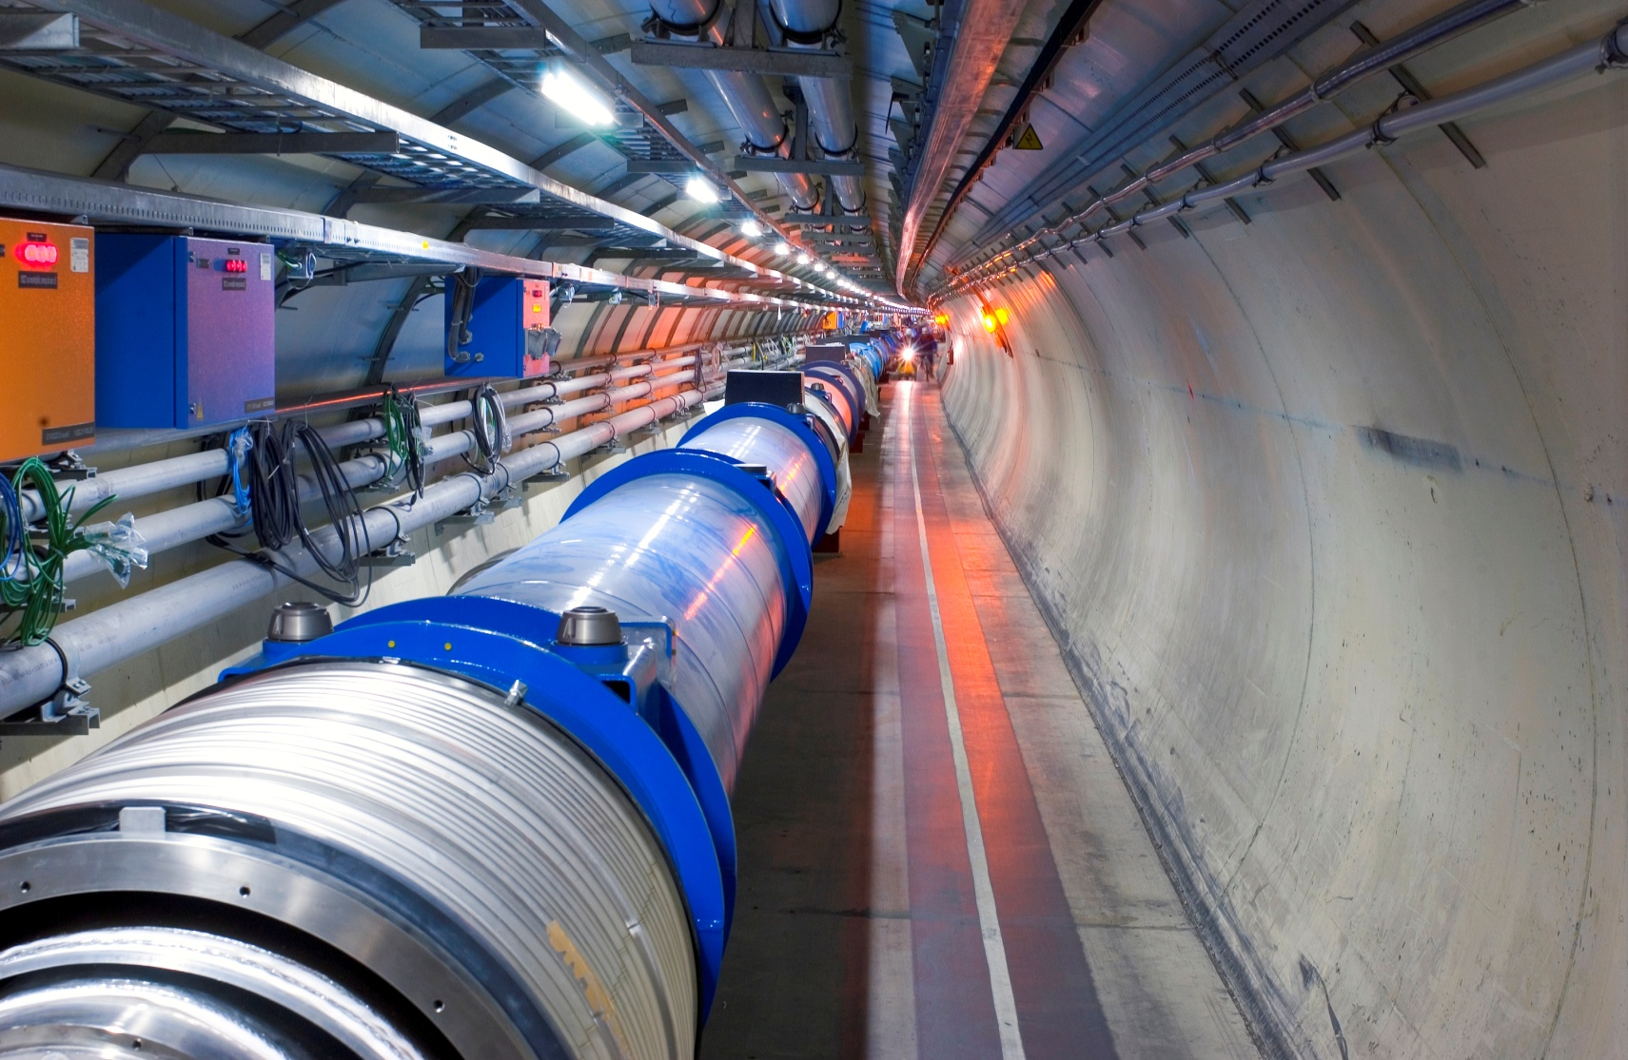
Acknowledgements and Contacts
CERN Colleagues and in particular the Database Services Group
  http://cern.ch/DB
Thanks to Enkitec
  Kerry and Tanel
Contacts and material
  Luca.Canali@cern.ch
  http://cern.ch/canali

