Slide 1
Database Performance Tuning with EM12c
Anton Topurov
IT Department – DB Group

Slide 2
Agenda
Database Performance Tuning
Enterprise Manager 11
Enterprise Manager 12
Conclusions

Slide 3
Database DB Time
Total time spent inside database calls by active foreground sessions
Fundamental measure of Oracle performance throughput
Includes CPU time, IO time and non-idle wait time
Database Time is total time spent by user processes either actively working or actively waiting in a database call.

Slide 4
Active Sessions
Active
In a database call
Contributing to DB Time
Average Activity of a Session
Active Time ÷ Elapsed Time
Average Active Sessions
Total of average activity across all sessions
Total DB Time ÷ Elapsed Time
Notes:
<<DEBA>> Let’s explore some of the fundamental concepts that we have used to define the DB time methodology.

Slide 5
Average Active Sessions
How many fully active sessions required to generate observed DB Time?
Fundamental database performance metric
Time-normalized DB Time and thus comparable
Proportional to load on the database
Responds directly to performance problems
Across systems
Across time periods

Slide 6
Performance Tuning in EM 11

Slide 7
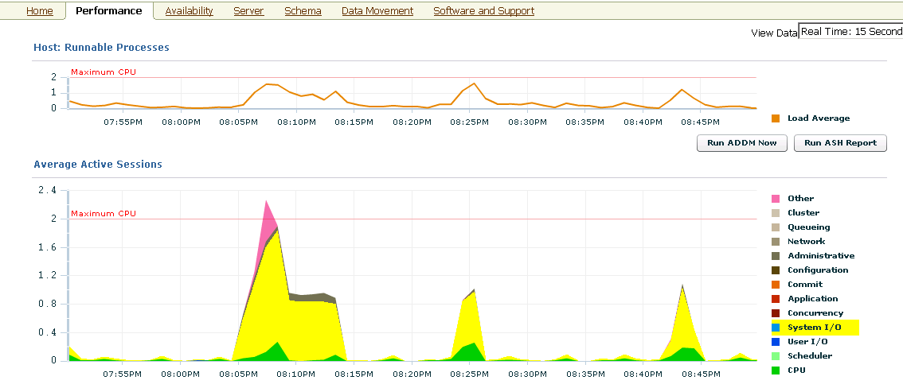
Performance Page

Slide 8
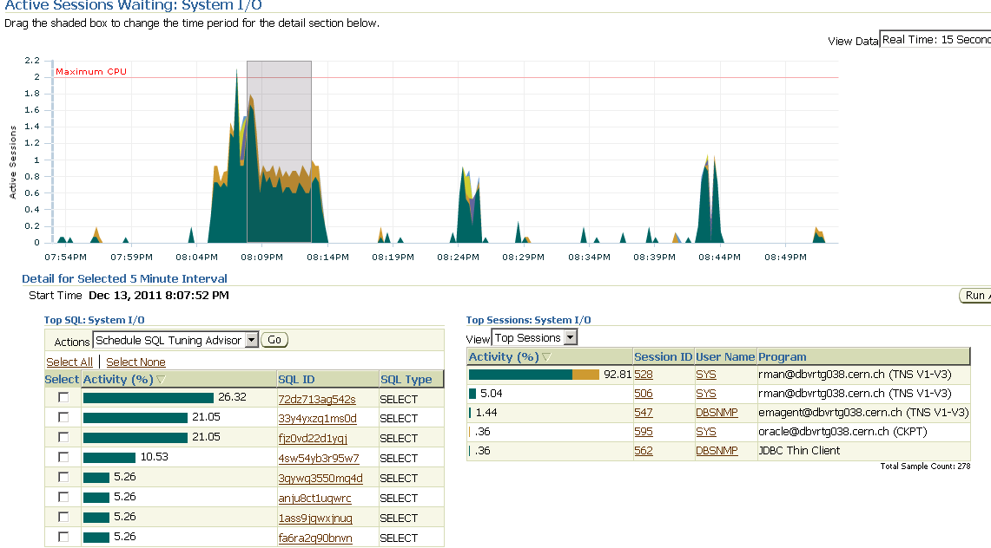
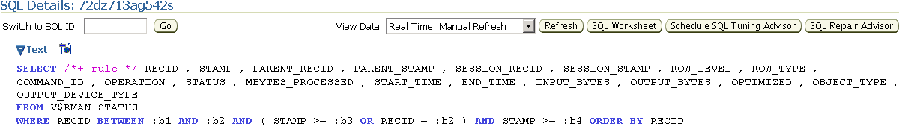
Drill down to root cause

Slide 9
Performance Tuning in EM 12

Slide 10
New features EM12c
ASH Analytics
  Active Session History Based
  Fine Grained filtering
Active Reports
  Interactive reports without connection to EM
  Save or send
Emergency Monitoring
  When database is hanged
  Get data directly from the host

Slide 11
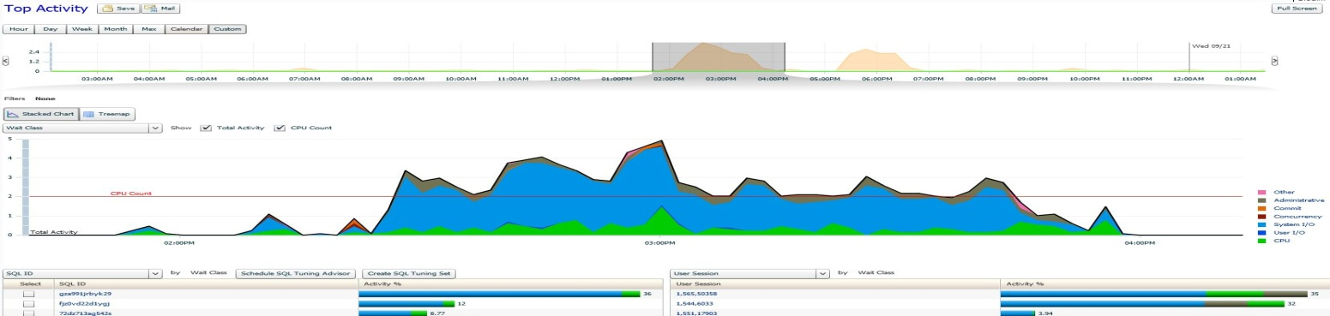
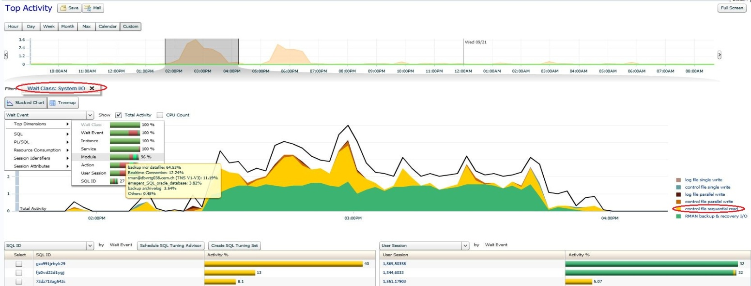
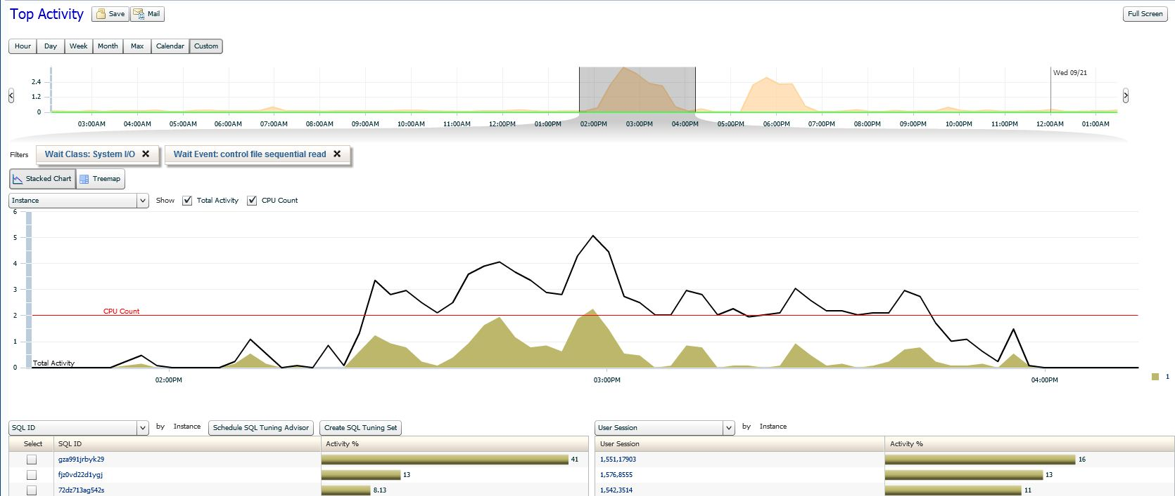
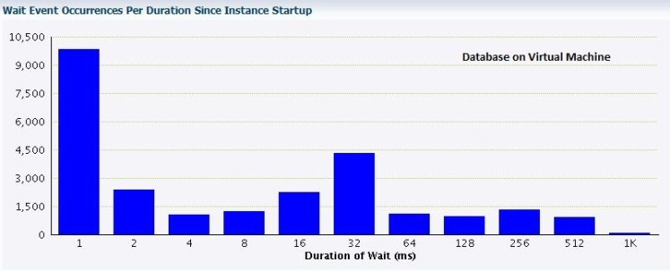
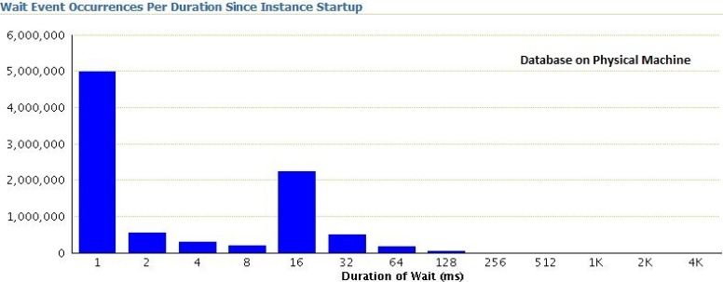
Case Study # 1: Slow response time due to high I/O
ASH Analytics
Wait Class
Add Filter
Wait Event
Sliced the data on RMAN I/O
Drilling down to corresponding wait event and histograms
Slow network speed due to MTU 1500 on OVM
Histogram
Notes:
We have noticed that backups on our test database machine are running significantly slower then on the dev machine.
Obviously the size and the content of these databases is almost the same. Therefore we decided to investigate with EM.
First of all, we have selected the time window, corresponding to the duration of the backup action.
As you can see, we see a lot of System I/O related RMAN events.
In order to drill down we filter on system IO, and see immediately what wait events contribute most to our problem:
Control file sequential read and RMAN Backup and Recovery IO.
Comparing the the Dev database, we saw that Control File Sequental Read takes much longer, then on DEV, which we can see on the histograms of the wait event. Therefore our next step was to check the network performance to the IO subsistem, which showed that VM-based networking was much slower due to not using Jumbo frames.

Slide 12
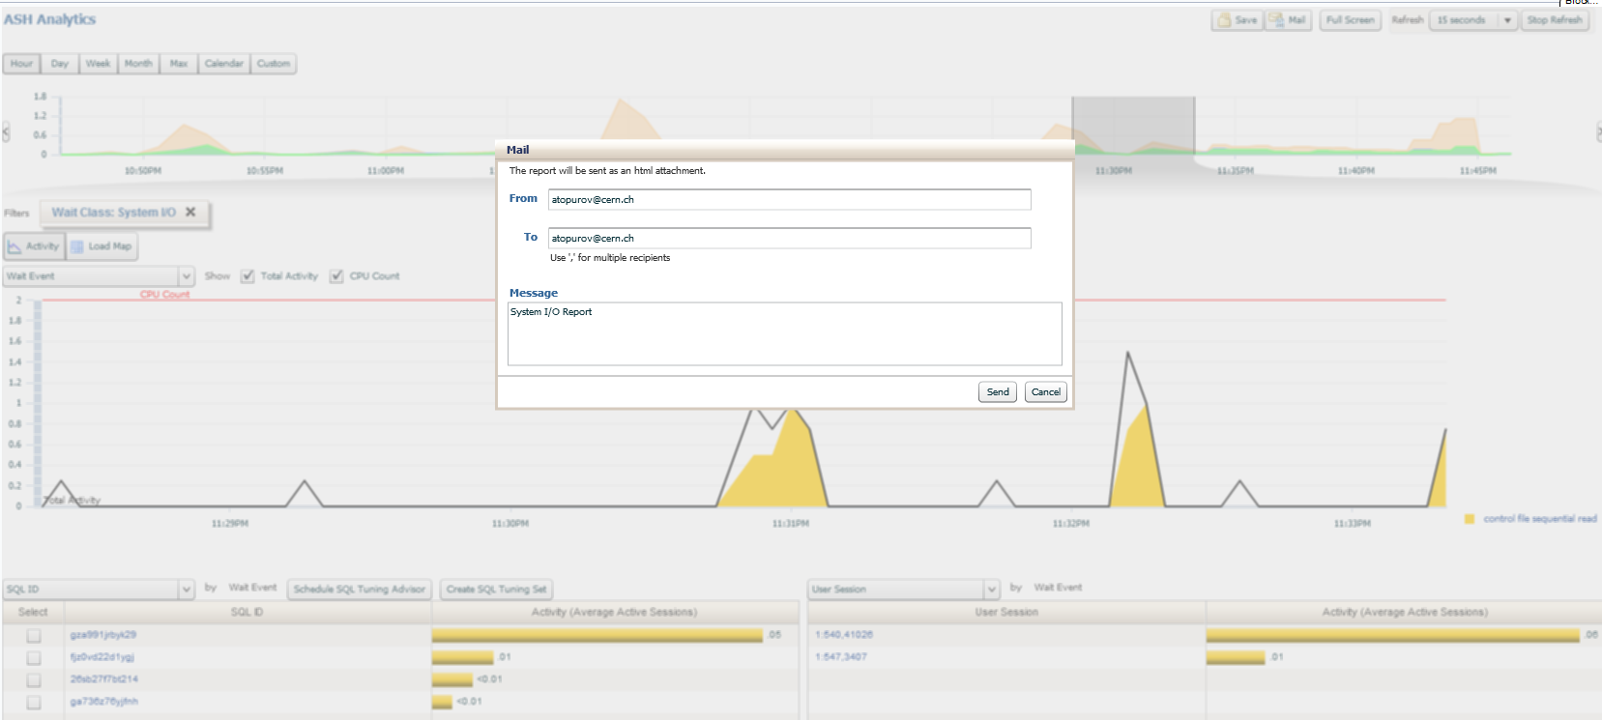
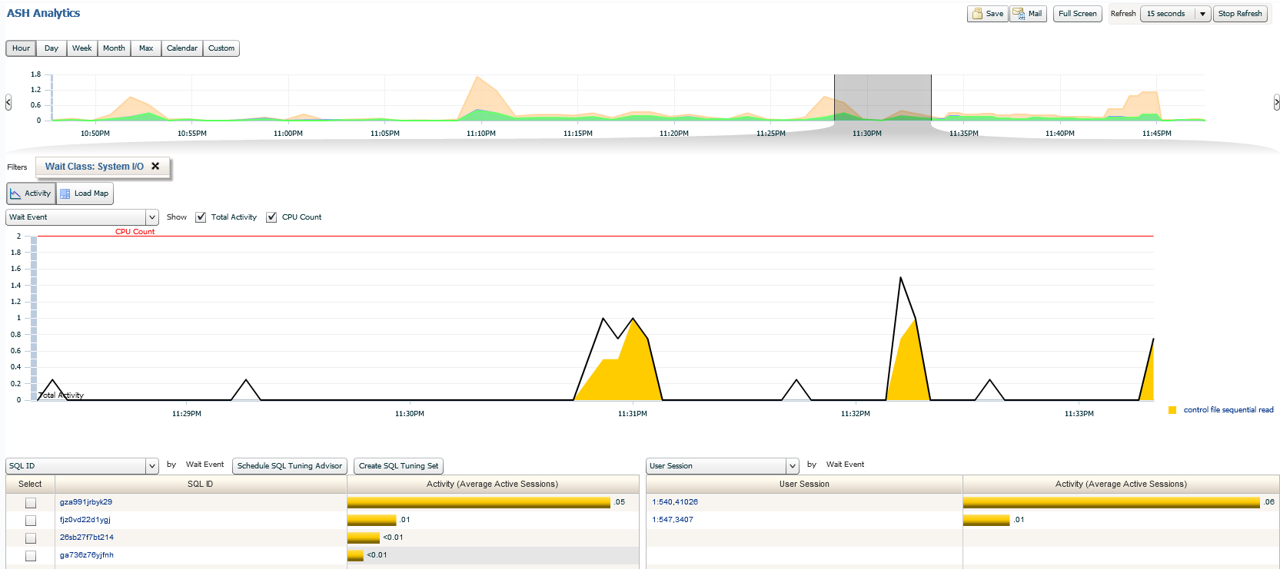

Slide 13
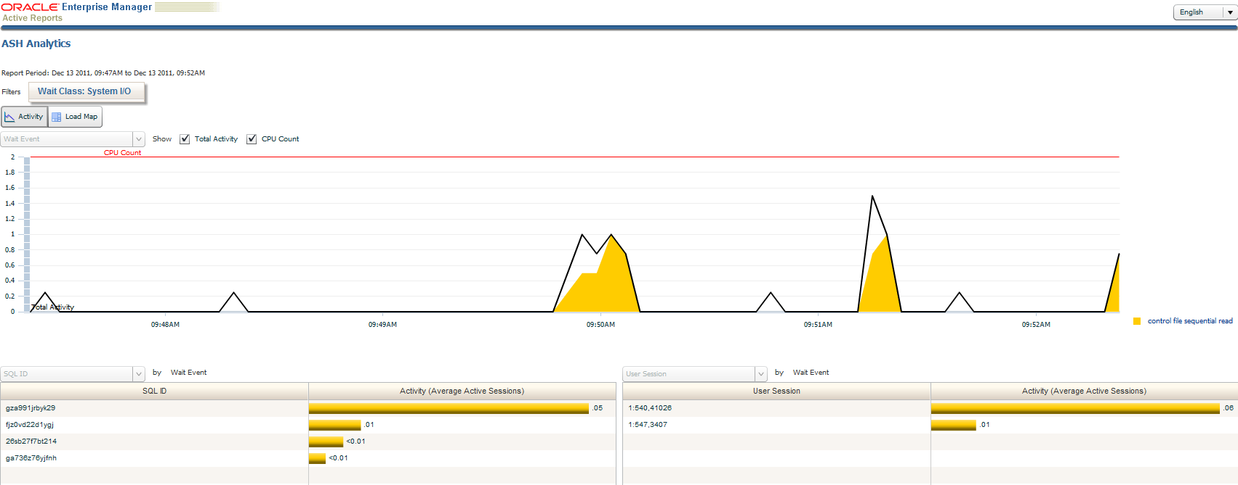

Slide 14
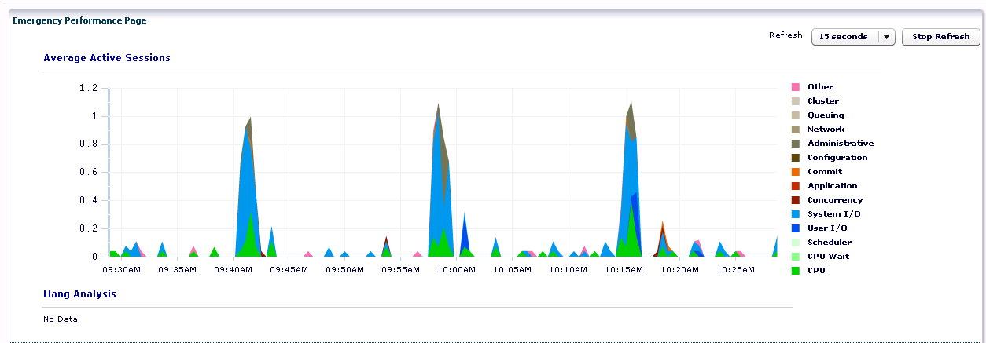
Emergency Monitoring
Uses host credentials
  Gets info directly from the host

Slide 15
Conclusions
More performance features
  Visualization on focus
Greater level of flexibility
  More filtering dimensions
  Flexible duration timelines
Emergency tools
  Can be used when nothing else helps
All user friendly

Slide 16
Questions?

Slide 17
Thank you!

Slide 18
