Slide 2

CERN Big Data Analytics as a Service Infrastructure:
Challenges and Desired Features
Manuel Martín Márquez
Notes:
Introduce myself: 8 years data engineering, data analytics (make sense)

Slide 3


CERN
CERN - European Laboratory for Particle Physics
Founded in 1954 by 12 Countries for fundamental physics research in a post-war Europe
    Major milestone in the post-World War II recovery/reconstruction process

Slide 4
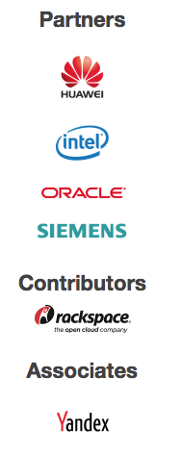
CERN openlab
Public-private partnership between CERN and leading ICT companies
Accelerate cutting-edge solutions to be used by the worldwide LHC community
Train the next generation of top engineers and scientists.

Slide 5























CERN openlab

Slide 6
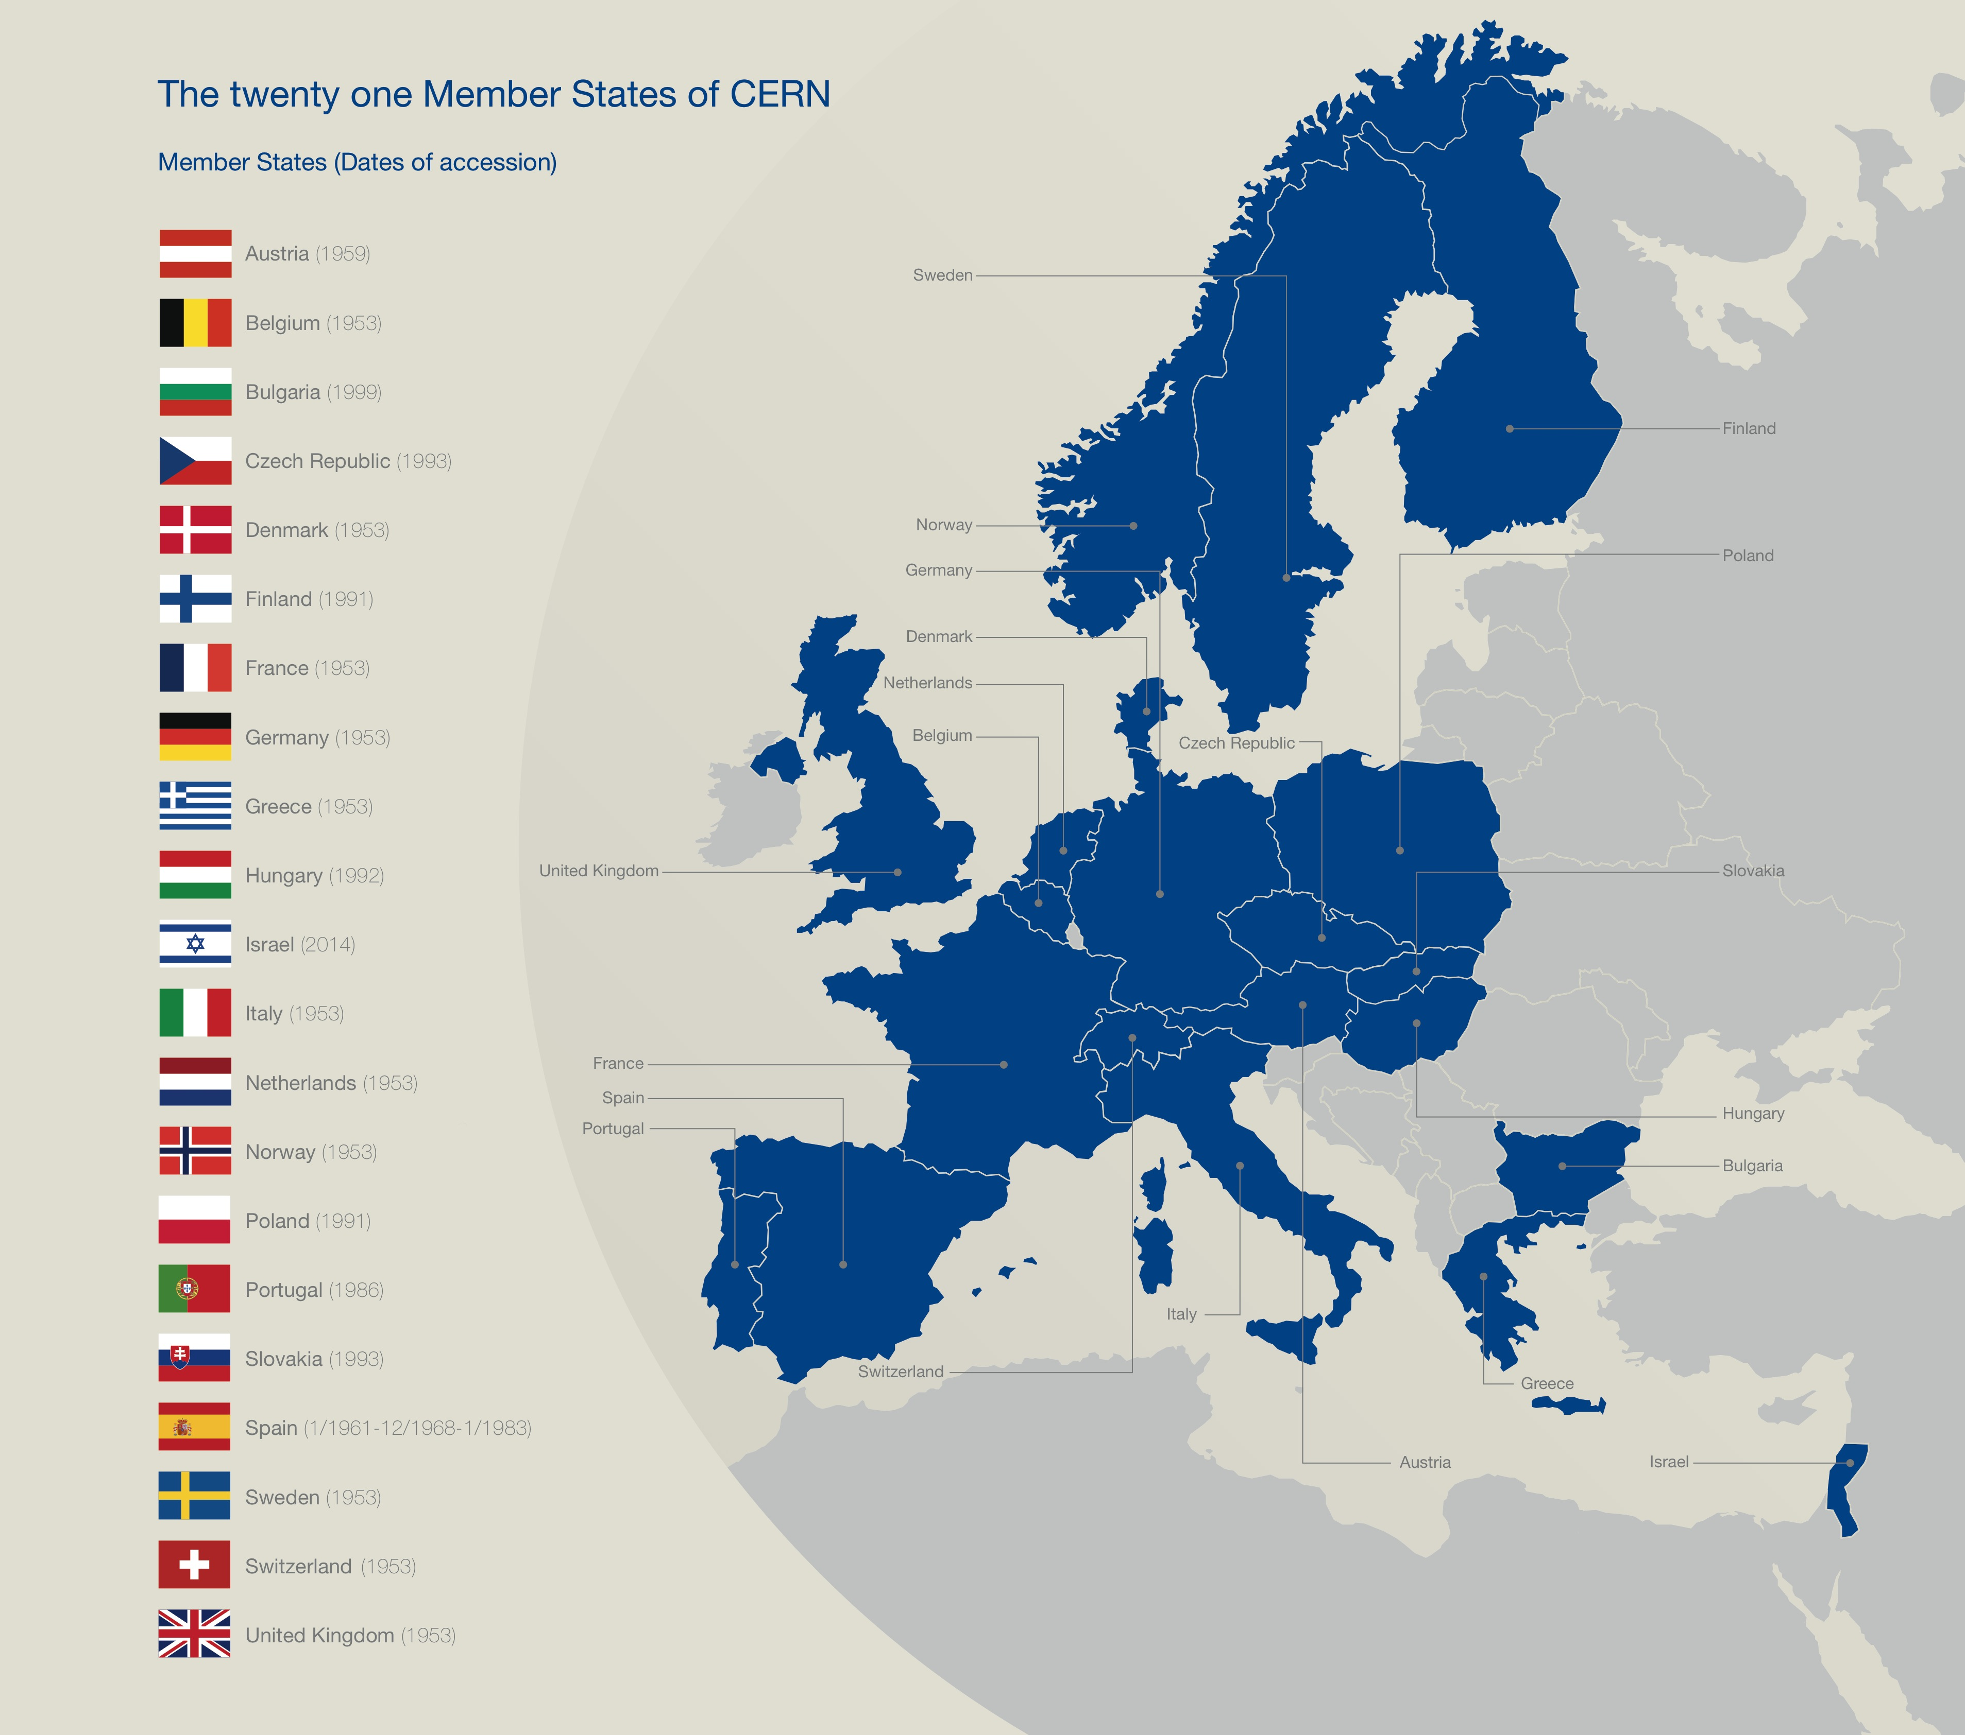

Slide 7
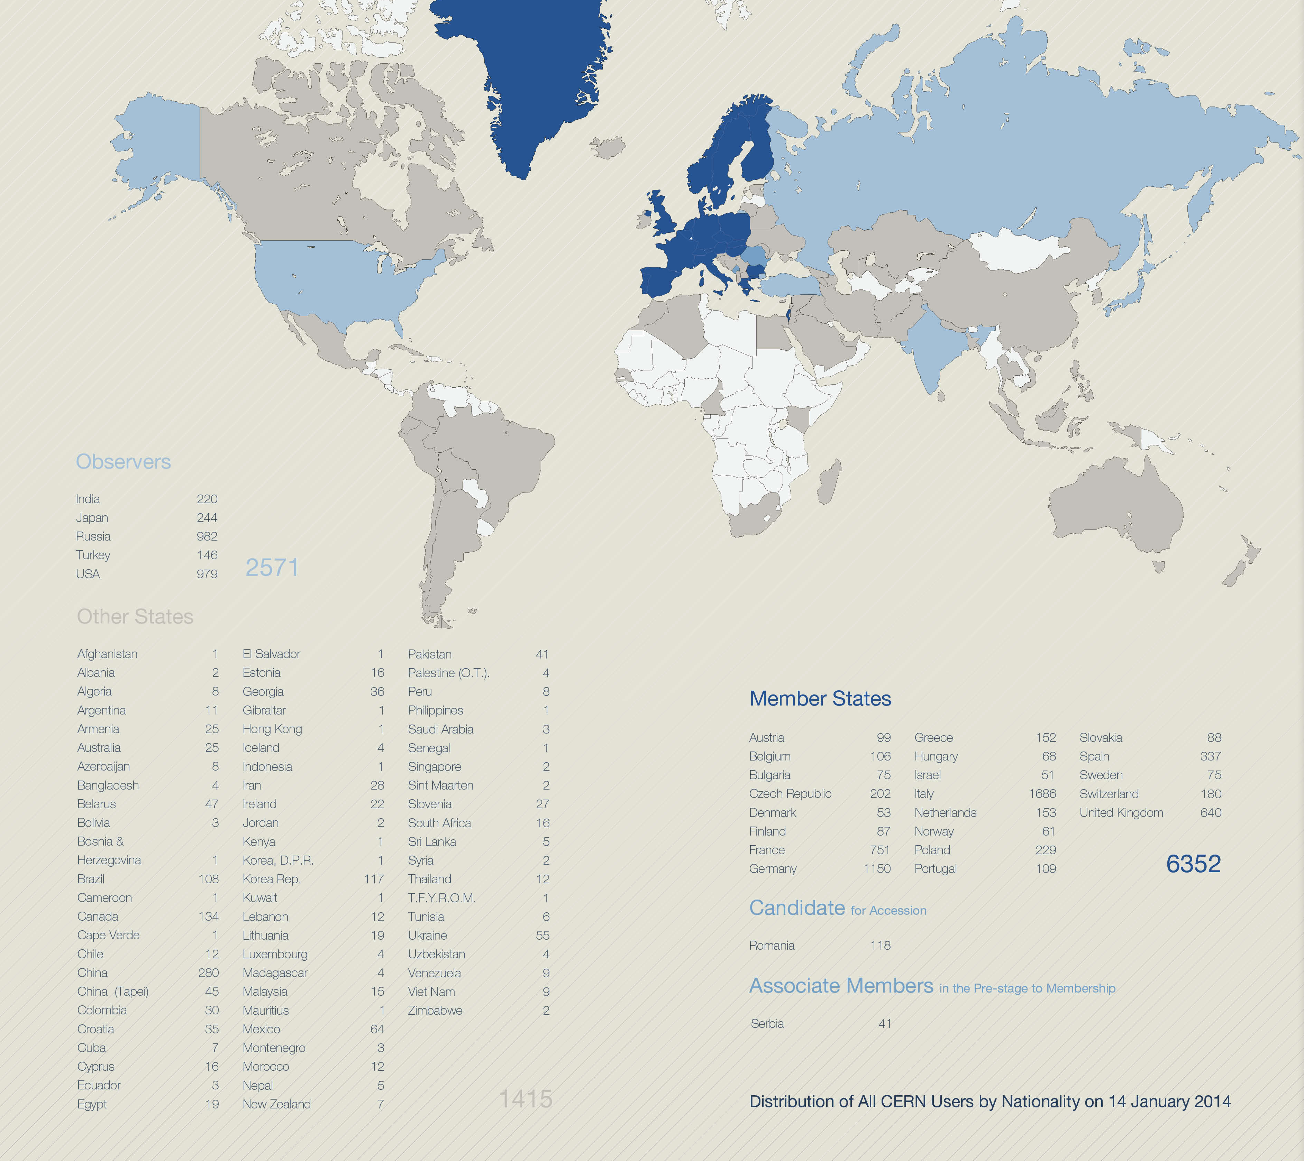
A World-Wide Collaboration

Slide 8
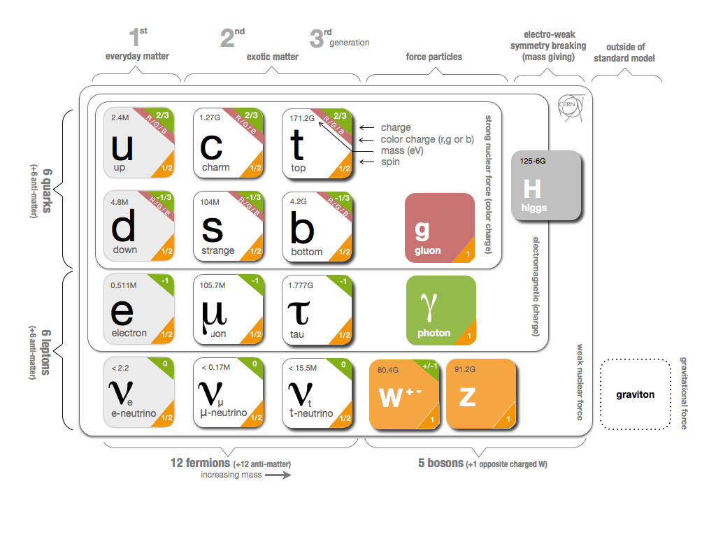
Fundamental Research
Why do particles have mass?

Slide 9
Fundamental Research
Why is there no antimatter left in the Universe?
  Nature should be symmetrical
What was matter like during the first second of the Universe, right after the "Big Bang"?
  A journey towards the beginning of the Universe gives us deeper insight.

Slide 10
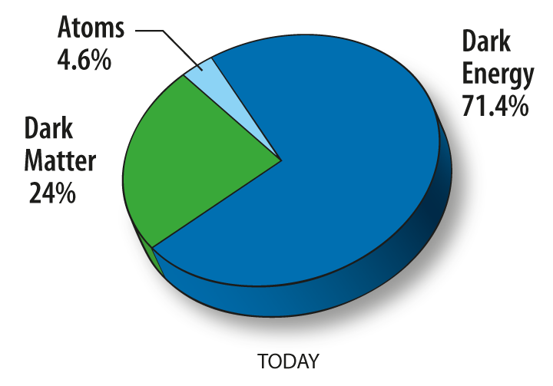
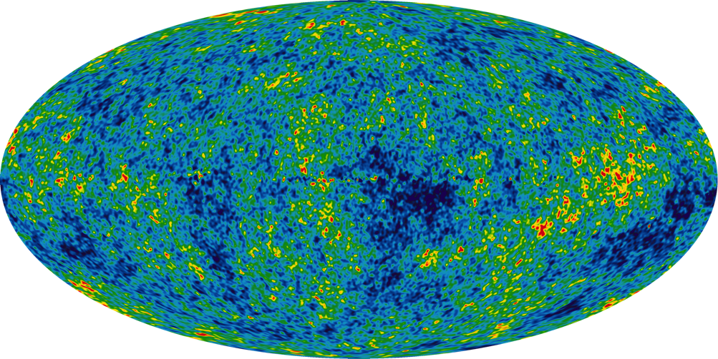
Fundamental Research
What is 95% of the Universe made of?

Slide 11
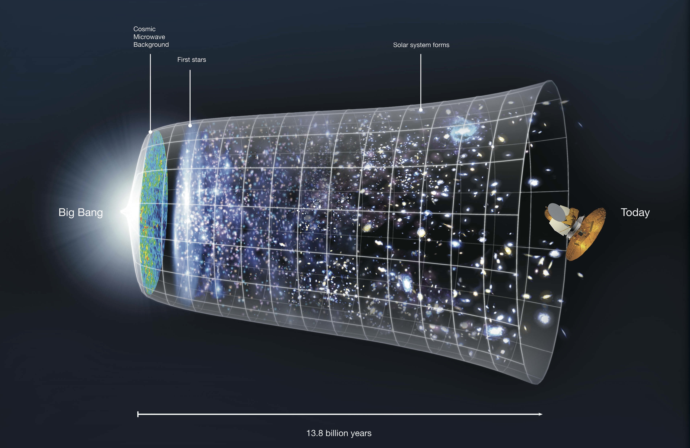

Slide 12

The Large Hadron Collider (LHC)
Largest machine in the world
27km, 6000+ superconducting magnets
Fastest racetrack on Earth
Protons circulate 11245 times/s (99.9999991% the speed of light)
Emptiest place in the solar system
High vacuum inside the magnets
Hottest spot in the galaxy
During Lead ion collisions create temperatures 100 000x hotter than the heart of the sun;

Slide 13
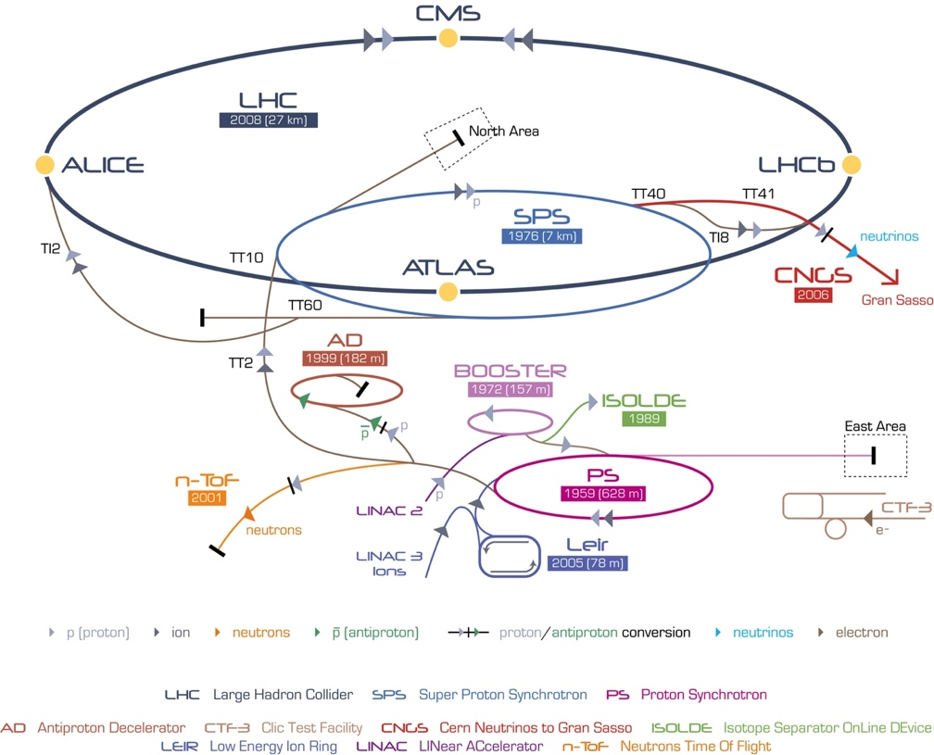
CERN’s Accelerator Complex

Slide 14
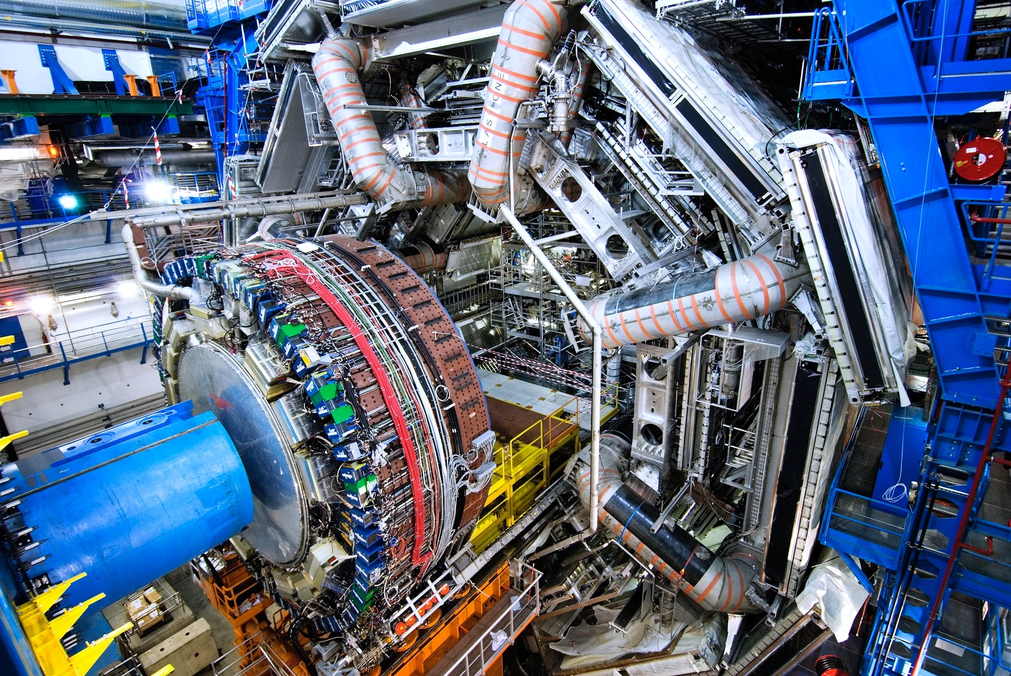
ATLAS Detector
150 Million of sensor
Control and detection sensors
Massive 3D camera
Capturing 40+ million collisions per second
Data rate TB per second

Slide 15
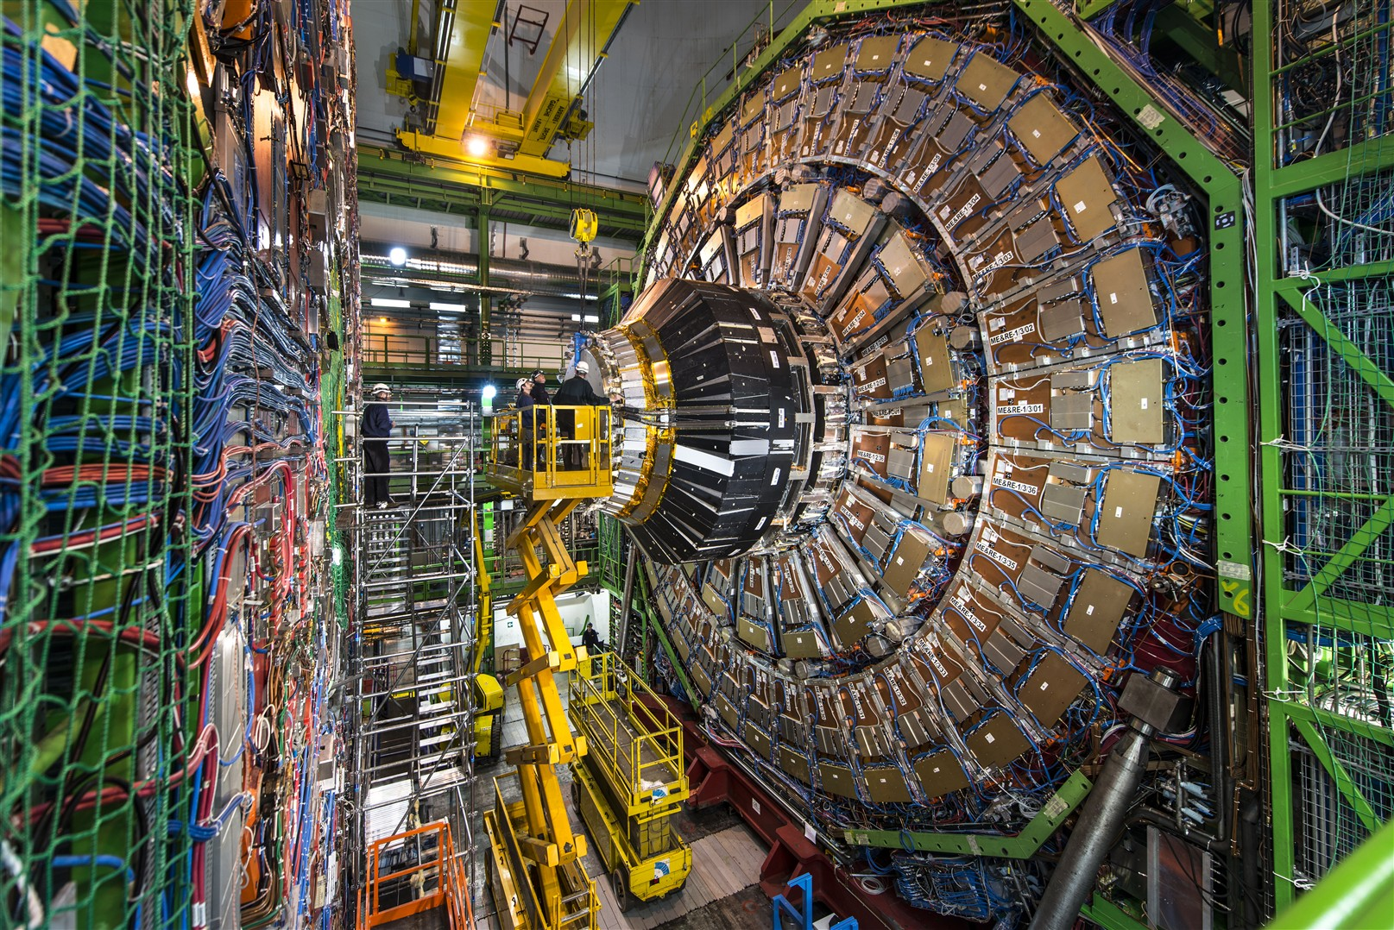
CMS Detector
Raw Data
Was a detector element hint?
How much energy?
What time?
Reconstructed Data
Particle Type
Origin
Momentum of tracks (4 vectors)
Energy in cluster (jets)
Calibration Information

Slide 16
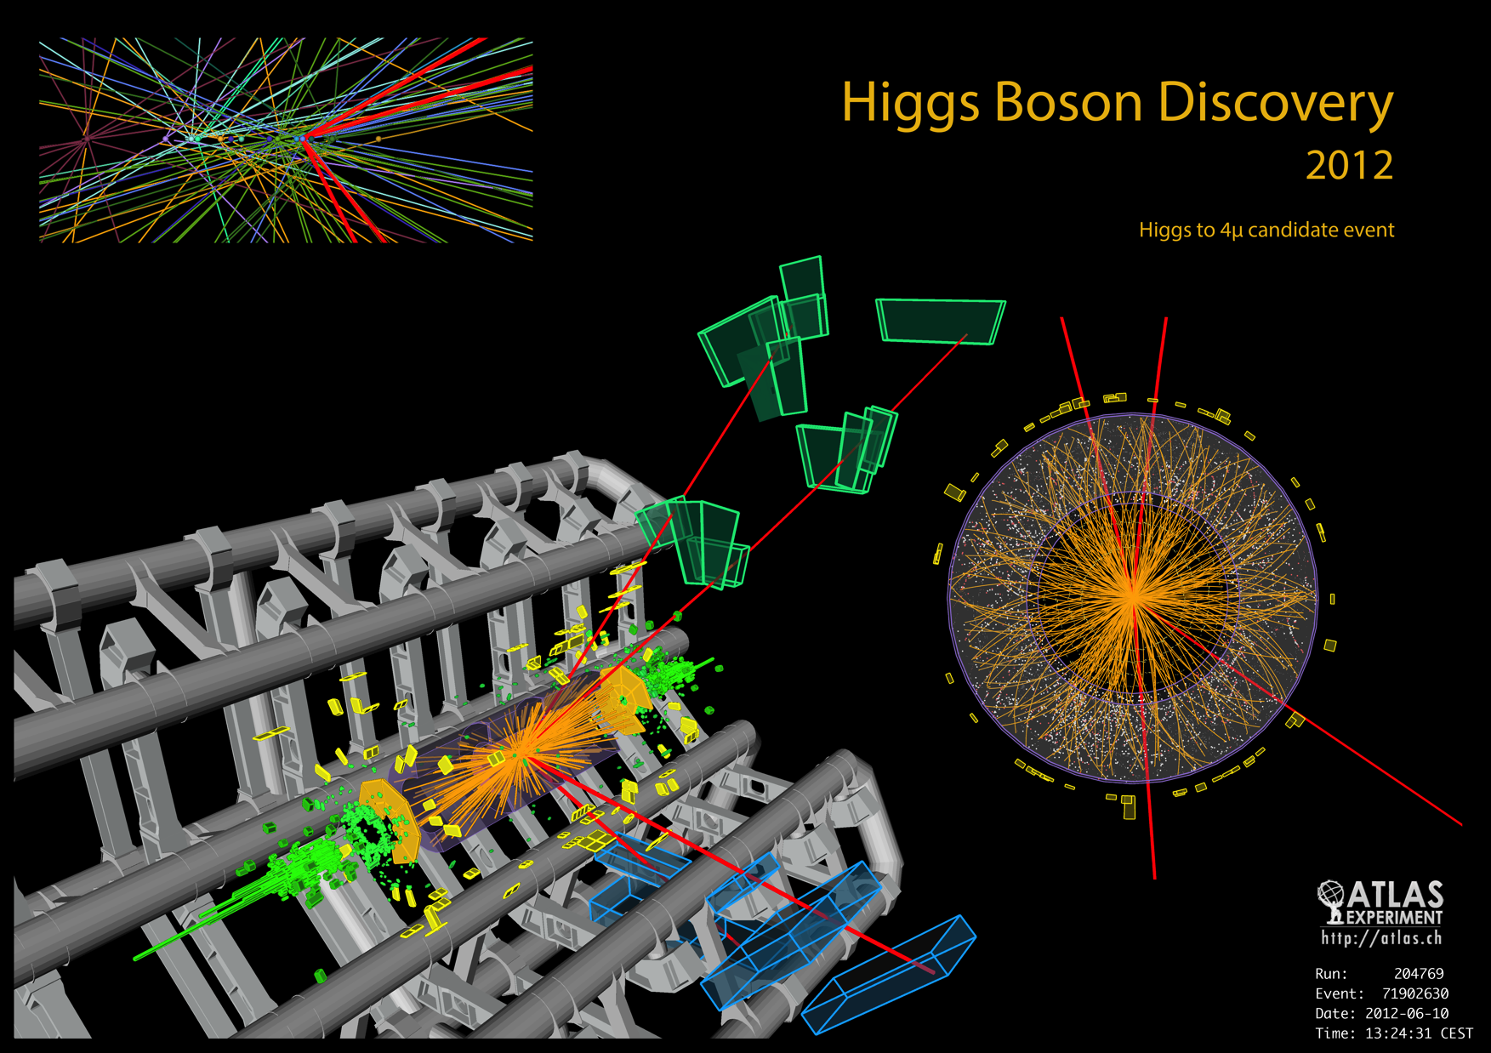

Slide 17
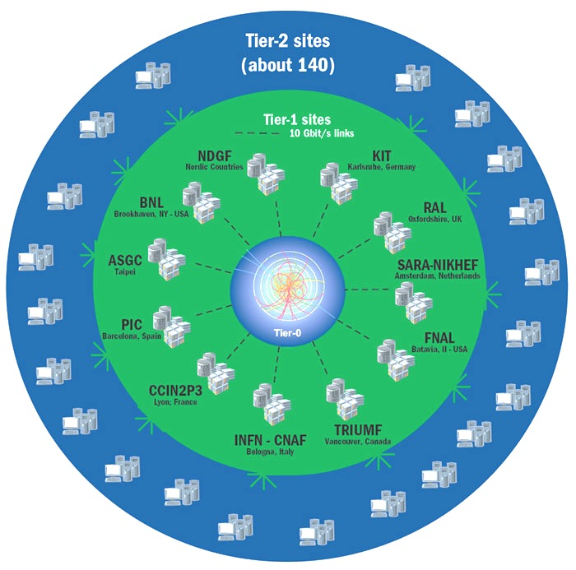

Worldwide LHC Computing Grid
Provides Global computing resources
  Store, distribution and analysis
Physics Analysis using ROOT
  Dedicated analysis framework
  Plotting, fitting, statistics and analysis

Slide 18
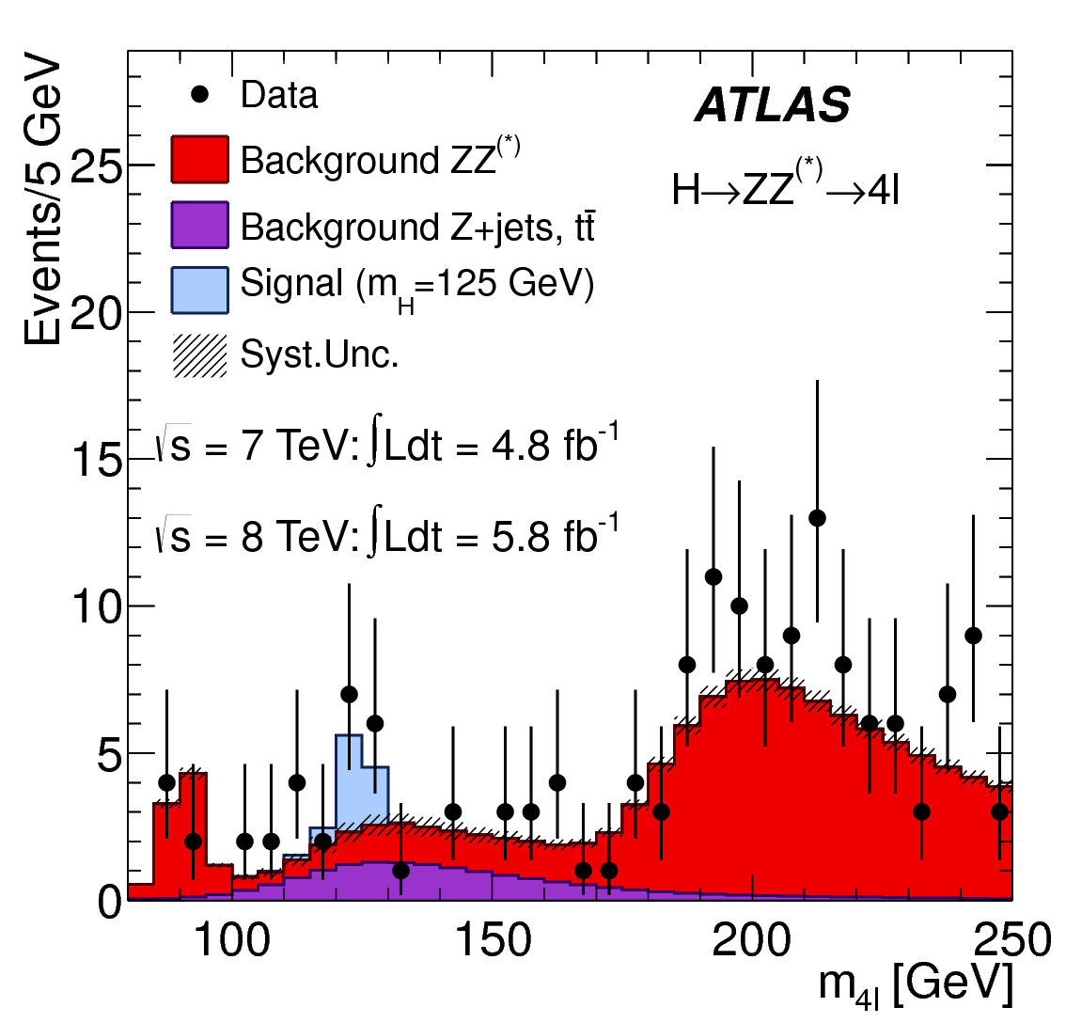
Grid Data Analysis in Practice
Small Datasets
  Copy files and run locally
Large Datasets
  Split the analysis in multiple jobs
  Jobs sent to Grid

Slide 19
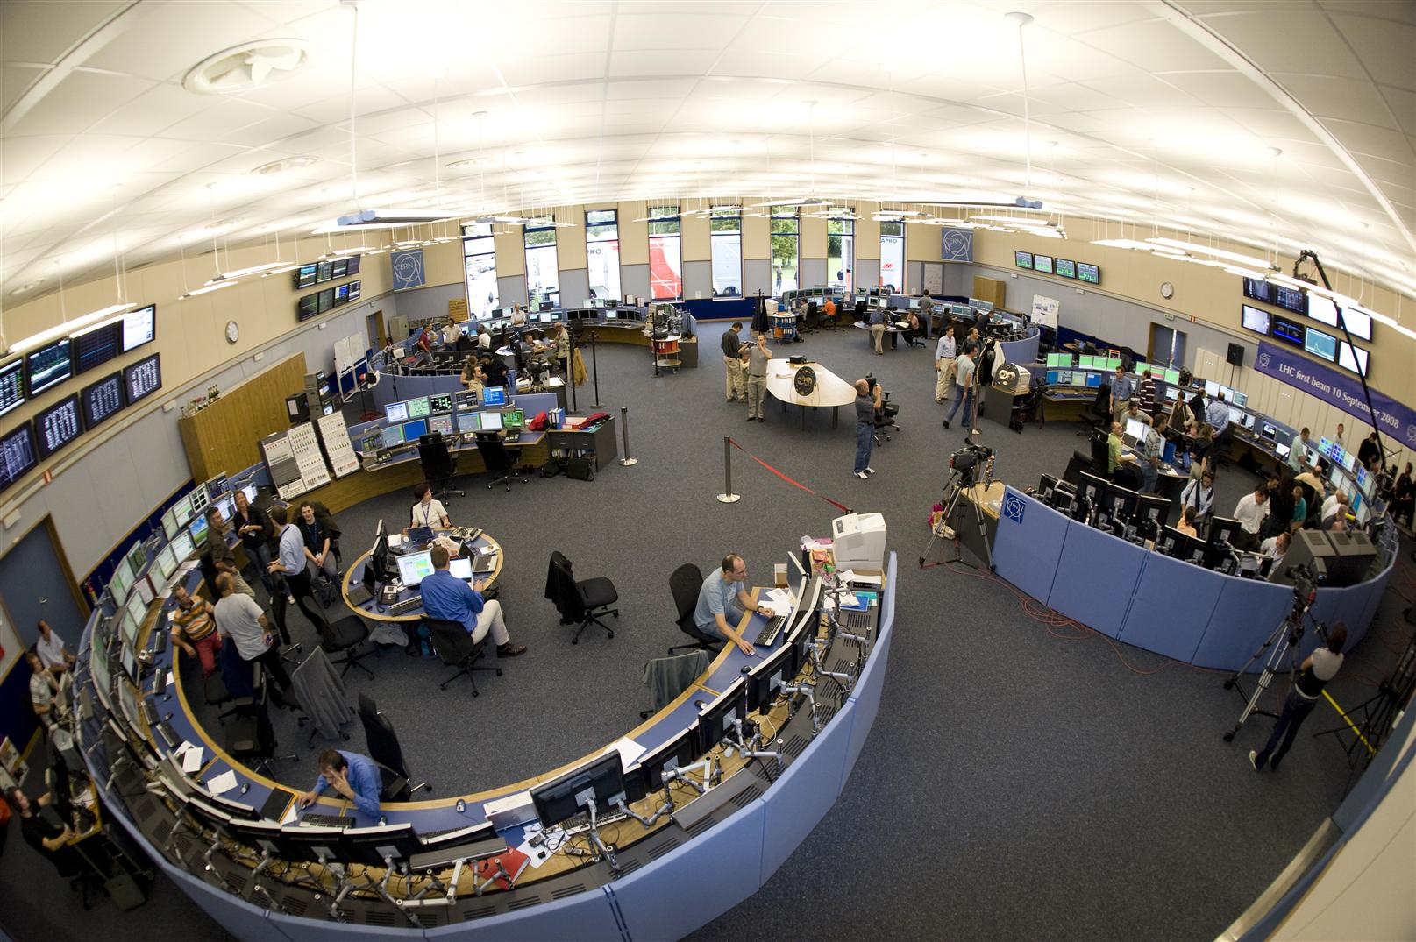
CERN Control Systems
Control and operations
Million of sensors, large number of control devices, front-end equipment, etc.
Many critical systems: Cryogenics, Vacuums, Machine Protection, etc.

Slide 20
The Challenge
LHC Availability – Estimated VS Observed

Slide 21
The Challenge
LHC Corrective Intervention: 3087 / year

Slide 22
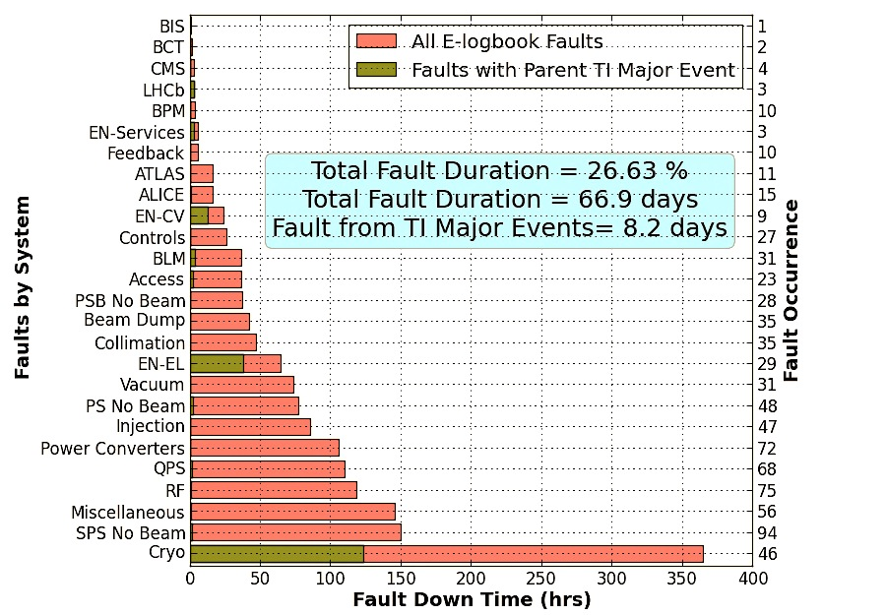
The Challenge
Fault Drivers

Slide 23
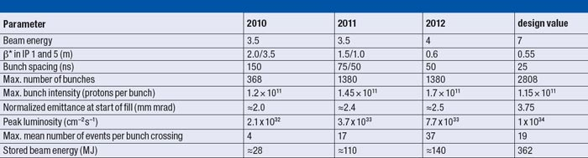
The Challenge
A look into the near Future
  LHC run 2 (2015)
2015

Slide 24
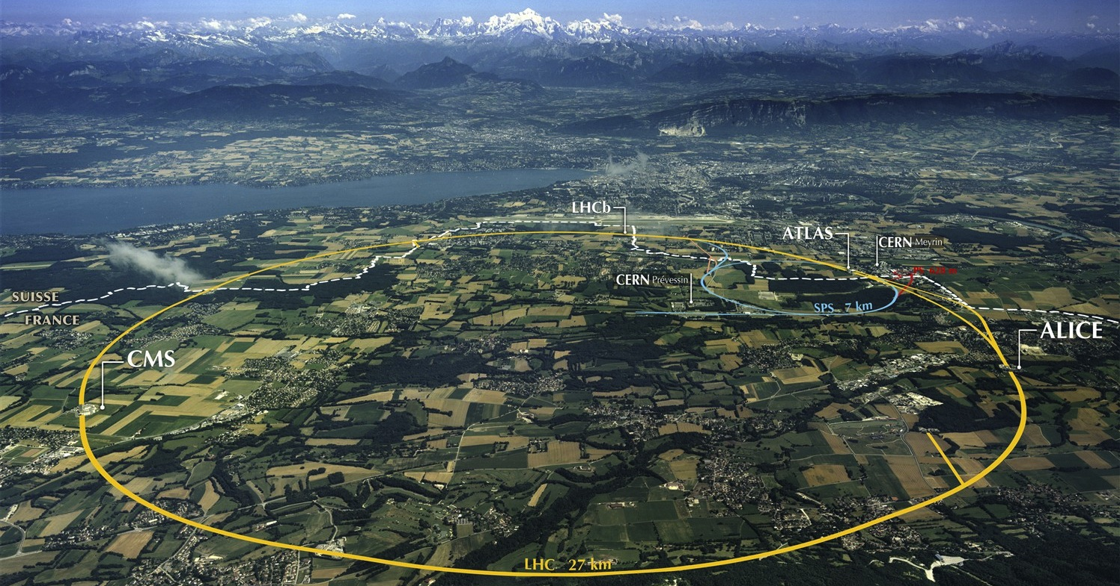

Post-LHC accelerator projects
80-100 km
Notes:
CERN

Slide 25
Data Analytics Challenges
Profit from our data investment
  Extracting knowledge.
Optimize our systems is mandatory
  Reducing and predicting faults and corrective interventions
  Increase the availability and operations efficiency
Control and Monitoring Systems
  Proactive
  Predictive
  Intelligent

Slide 26
DA Technology Aspects:
Near-real-time processing
  GBs per second – Low Latency (order of second)
  Integrate pre-existing human knowledge and inferred from analytics
  Important factors to considered
    Scalability
    Fault-tolerance
    Guarantee all data is processed

Slide 27
DA Technology Aspects:
Batch Processing
  Different Domains
  Highly heterogeneous data nature
  Support wide range of DA tools and programming languages
Data Repositories
  Store large amount of data (Hundreds of TBs)
  Integrate with existing repositories

Slide 28
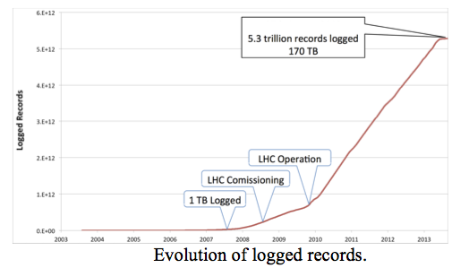
DA Technology Aspects:
CERN Accelerator Logging Service (1 million signals)
  Cryogenics temperatures,
  Magnetic field strengths, Power dissipation, Vacuum Pressures,
  Beam intensities and positions…etc…
About 5 million daily/average data requests
Throughput over 100TB/Year, 300TB in 2015

Slide 29
DA Educational Aspects:
Data analysis platforms,
statistics, mathematics,
data visualization,
monitoring, security,
etc.
General
  New professional profile
CERN
  Many domains of expertise involved
    Vacuum, cryogenics, power converters
  Engineering and Control teams
    Need to work close to data scientists
Data Scientists

Slide 30



DA as a Service:
Integration
  Use open and well-defined standards
    Real-time Analysis
    Batch Processing
    Data Repositories
  Offer solution to other data analytics need in other institutions
    ESA, Human Brain Project, etc.

