Slide 1
Next Generation Operating Systems
Zeljko Susnjar, Cisco CTG
June 2015
Notes:
Why should Cisco care about Operating System (R)evolution?
Maybe first because it is a USD14B (Gartner) market that is core to Cisco’s business
How does this fit our mandate?
Long term
BD Investment theme
Thought leadership
Disruption long term..

Slide 2
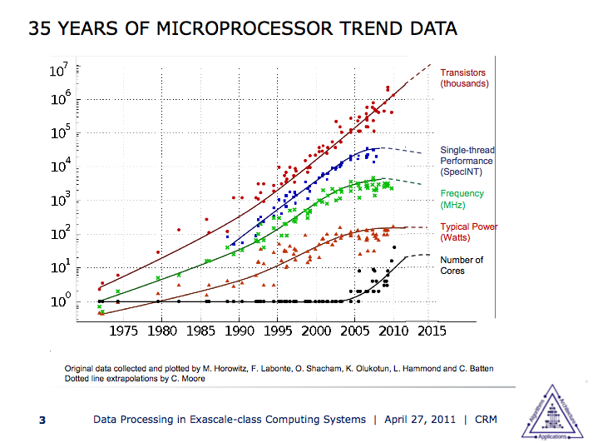
The end of CPU scaling
Future computing challenges
Power efficiency
Performance == parallelism
Notes:
The key effect of Dennard scaling was that as transistors got smaller the power density was constant –if there was a reduction in a transistor’s linear size by 2, the power it used fell by 4 (with voltage and current both halving).

Slide 3
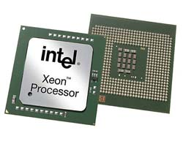
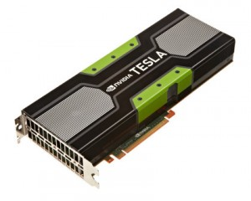
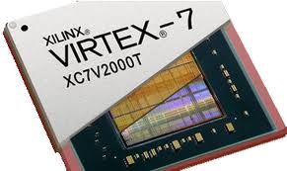
Paradox of the computing industry
System software has not evolved at the same pace as HW
Multiple applications
Multiple applications
Time-sharing OS
Spatial computing platform
Single core CPU
Massively multicore CPU
FPGA
GPU
CPU
CPU

Slide 4



Server Virtualization is at a generational shift
Virtual machine
Virtual machine
APIs and interfaces for containers management
App
App
App
App
Container
Container
App
App
App
App
Operating System
Operating System
Hypervisor
Operating System
Hardware
Hardware
Hypervisors are still good, but have pitfalls
Application containers are the future of virtualization
Flexible, multi-OS, application isolation / security
Optimizations, IO handling, expensive license fees
No hypervisor overhead, performance, fine grained resource control
Linux ABI, security and app isolation

Slide 5
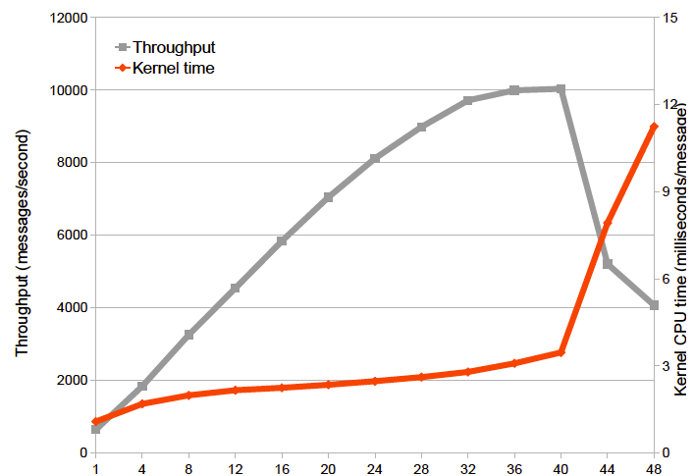
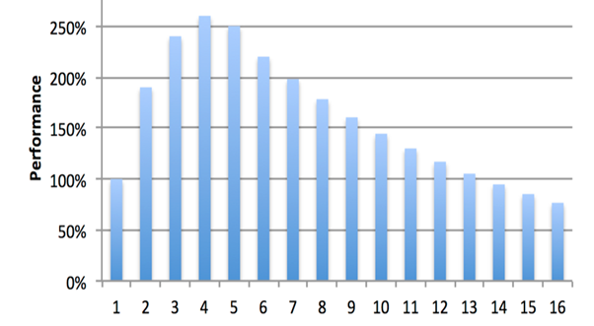
OS constraints are hard to overcome with current design
Containers are built on Operating system
CPU
L1 cache
4 cycles
L2 cache
12 cycles
L3 cache 30 cycles
DRAM
300 cycles
Number of cores
Number of cores
Packet scalability
  Kernel stack too complicated
  User mode networking stack like PF_RING/DPDK write your own driver
CPU Cores scalability
  Many task on one core → one task on many cores
  Monolithic architecture based on time sharing
Memory scalability
  CPU cache too small
  Cache misses due to scattered data in the memory

Slide 6
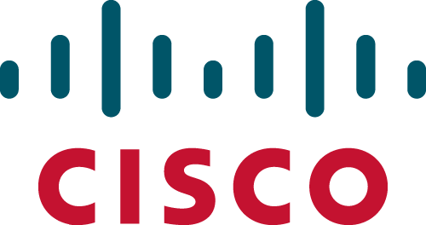

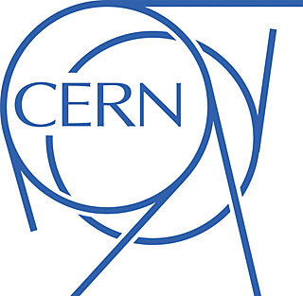
Solving the problem at the lowest level of abstraction
Next-Gen Computing: Redesign of Operating System for energy efficient and linear scalable computing platform
New architectural concept, greatly enhancing application performance in modern datacenters and fundamentally addressing the following challenges:
Application’s parallelization driven by rapidly growing number of CPU cores per socket
Efficient use of heterogeneous resources
Data center wide system consistency
Advantages of OS control/data plane separation
Greater scale-up bundled with smarter NIC processing
Reduce CPU kernel overhead
Higher network throughput by using multiple cores
App
App
App
App
App
Ctrl Plane
Data plane
Hardware
Hardware
Hardware
Hardware
Notes:
Keep data structures per core. Then on aggregation read all the counters.
Atomics. Instructions supported by the CPU that can called from C. Guaranteed to be atomic, never conflict. Expensive, so don’t want to use for everything.
Lock-free data structures. Accessible by threads that never stop and wait for each other. Don’t do it yourself. It’s very complex to work across different architectures.
Threading model. Pipelined vs worker thread model. It’s not just synchronization that’s the problem, but how your threads are architected.
Processor affinity. Tell the OS to use the first two cores. Then set where your threads run on which cores. You can also do the same thing with interrupts. So you own these CPUs and Linux doesn’t.
Kernel
Access control
Resource broker
Namespace
Applications
Low-level API to HW
IO handling
Hardware
IO scheduling
App multiplexing
Protection functions

Slide 8

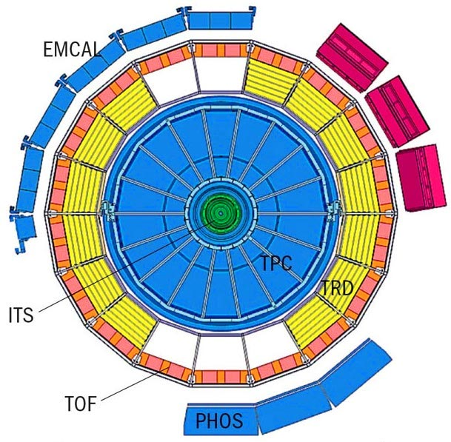

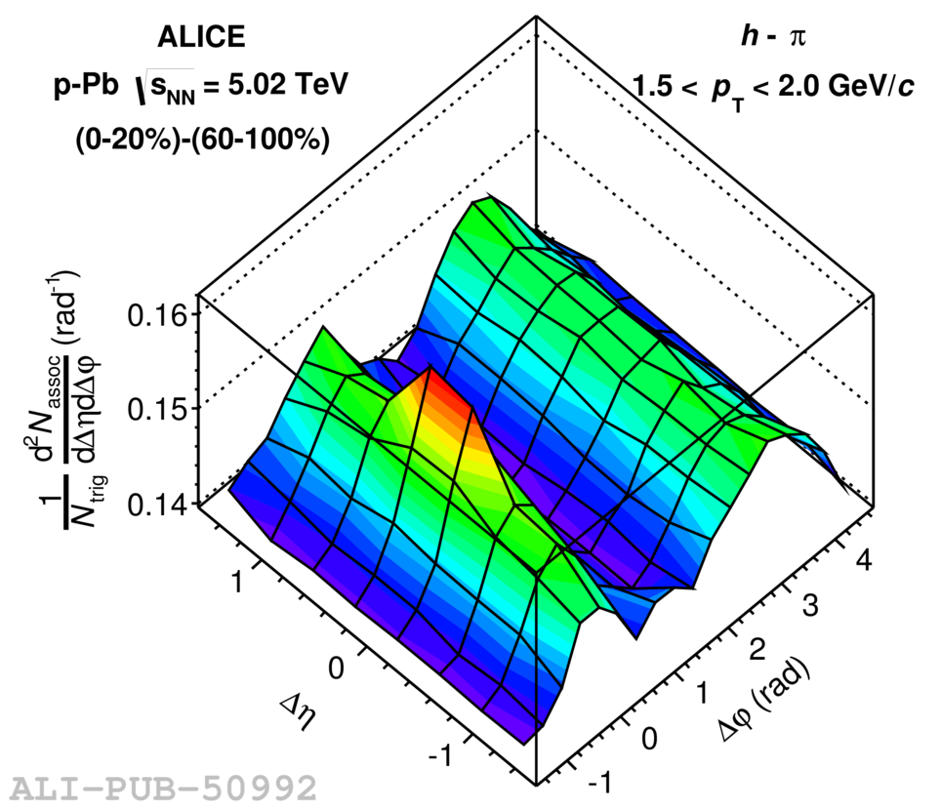
CERN Challenge: The Alice computing requirements
Detector upgrade for Run 3 (2020)
100 increase in event rate
1TB/s raw data rate
From Detector Readout to Analysis:
What is the “optimal” computing architecture?

Slide 9

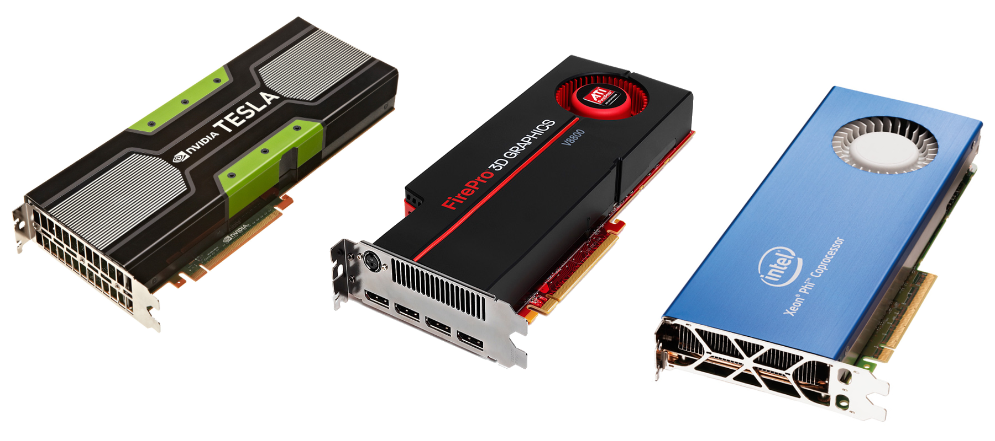
O2 facility:
Highly specialized heterogeneous computing platform
463 FPGAs
  Detector readout and fast cluster finder
100’000 CPU cores
  To compress 1.1 TB/s data stream by overall factor 14
5000 GPUs
  To speed up the reconstruction
50 PB of disk
--------------------------------------------------------
Considerable computing capacity that will be used for Online and Offline tasks

Slide 10

Data Plane Computing System
DPCS: Openlab project investigating applicability of modern OS concepts in the ALICE O2 environment
  Data Plane OS concept
  I/O Virtualization
  Multicore scaling
  Heterogeneous compute

Slide 12
Data flow in O2 facility
Detectors electronics
~ 8000 optical links
Read-out farm: 250 servers
with FPGA acceleration
Processing farm: 1500 servers with GPU acceleration
Storage system
68 storage units
with 34 data servers
Data of all interaction - continuous mode
1.1 TB/s
Computing farm
Online data volume reduction by
factor 14 (20 for the TPC data)
Compressed data
90 GB/s
Data storage for 1 year
of compressed data (60 PB)
Compressed data
Reconstructed events
Asynchronous event reconstruction
A few hours after data taking

