Slide 2
Endeca Information Discovery for the Monitoring & Control of the LHC
Manuel Martín Márquez

Slide 3
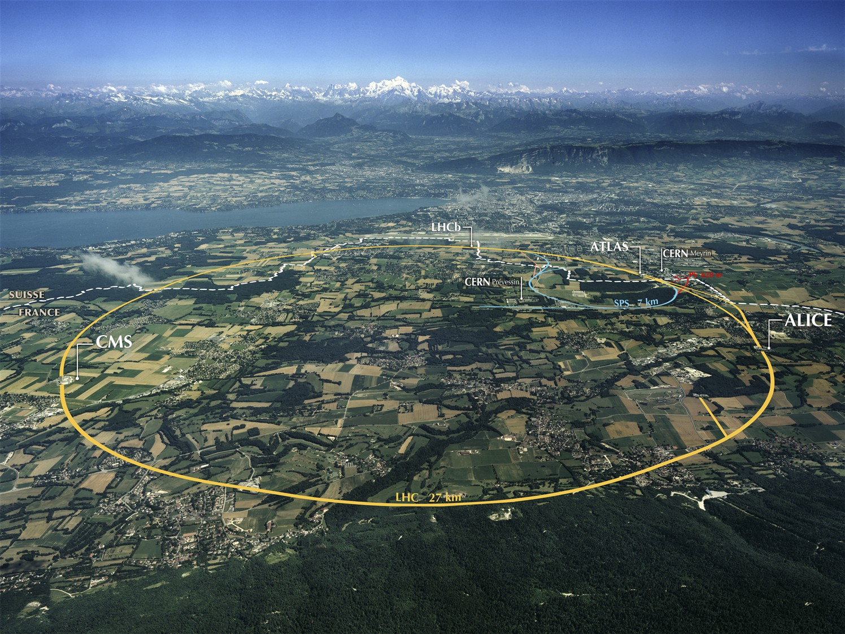
The Large Hadron Collider (LHC)
Largest machine in the world
27km, 6000+ superconducting magnets
Fastest racetrack on Earth
Protons circulate 11245 times/s (99.9999991% the speed of light)
Emptiest place in the solar system
High vacuum inside the magnets
Hottest spot in the galaxy
During Lead ion collisions create temperatures 100 000x hotter than the heart of the sun;

Slide 4
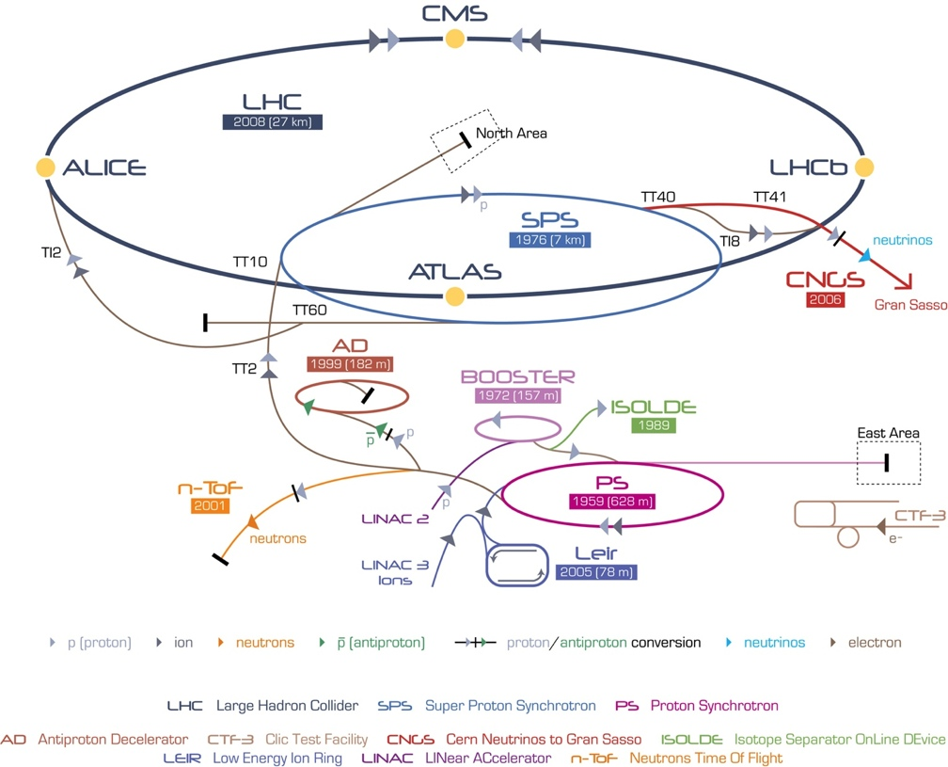
CERN Accelerator Complex

Slide 5
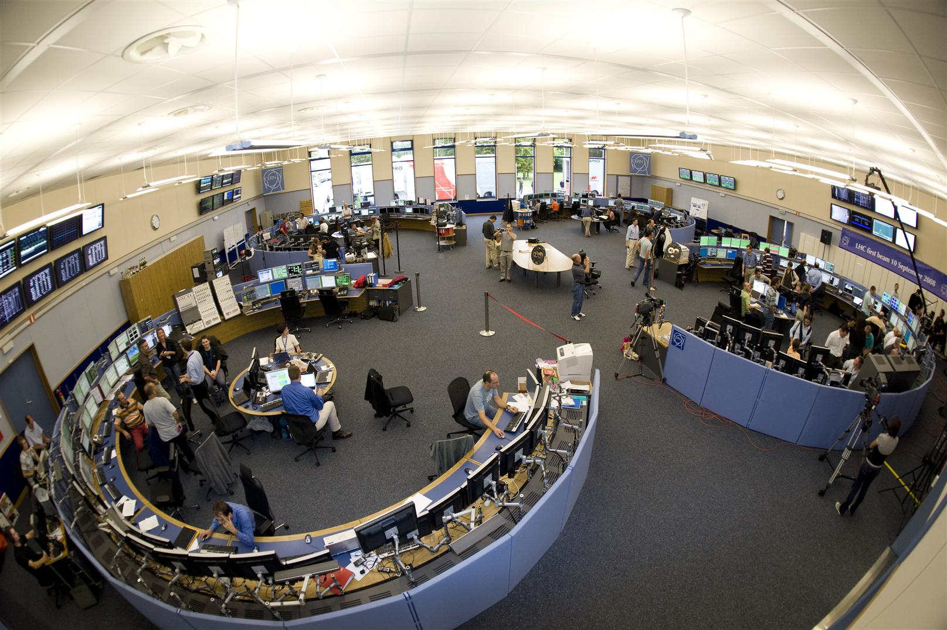
CERN Control Centre
CERN Accelerator Complex is unique installation
Therefore, we have to face unique challenges
Control and Operations
Million of sensors, large number of control devices, front-end equipment, etc.
Many critical systems: Cryogenics, Vacuums, Machine Protection, etc.

Slide 6
Data Analytics Challenges
Control and Monitoring Systems
Proactive
Predictive
Intelligent
Optimize our systems is mandatory
Reducing and predicting faults and corrective interventions
Increase the availability and operations efficiency
Profit from our data investment
Knowledge Extraction
Information Discovery

Slide 7
Data Analytics Challenges

Slide 8
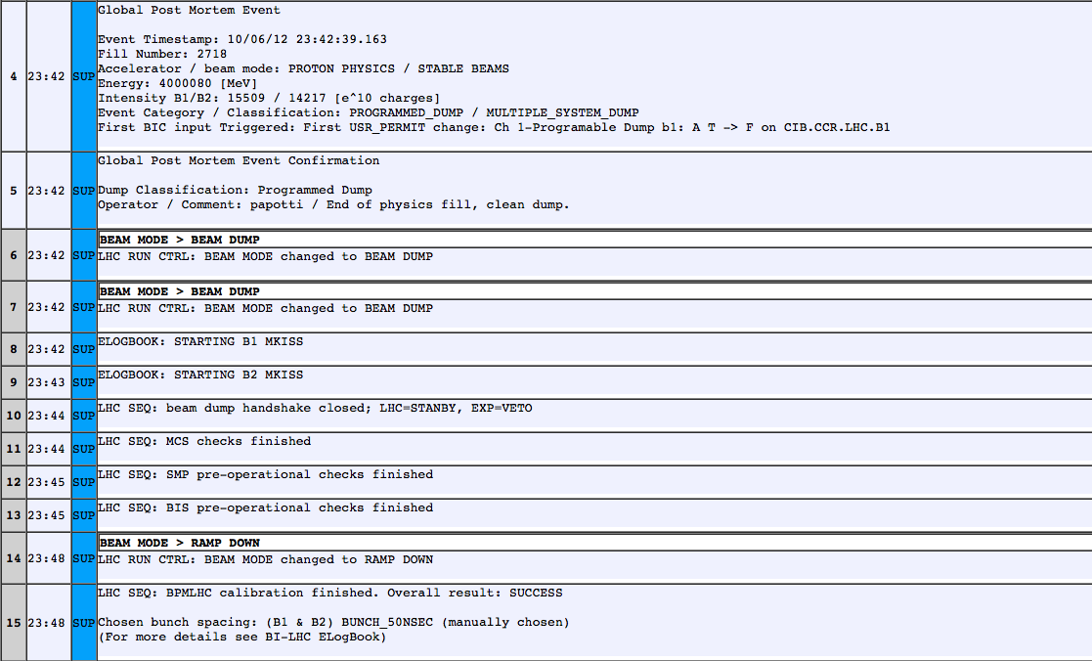
Endeca Information Discovery
Better LHC Operations
Events Analysis
Correlate Information
Fault Tracking System
Operational Modes
Operational Issues
Control Equipment

Slide 9
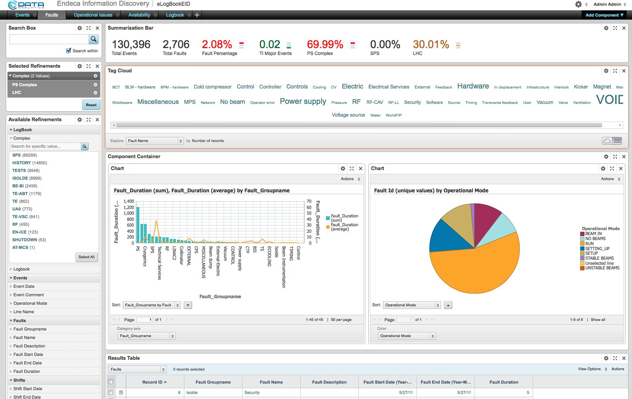
Endeca Information Discovery
Information Discovery for improving the Accelerator Complex Operations
Integrating Data Sources
Electronic Logbook
Control Configuration DB
JIRA (Jason)

Slide 10
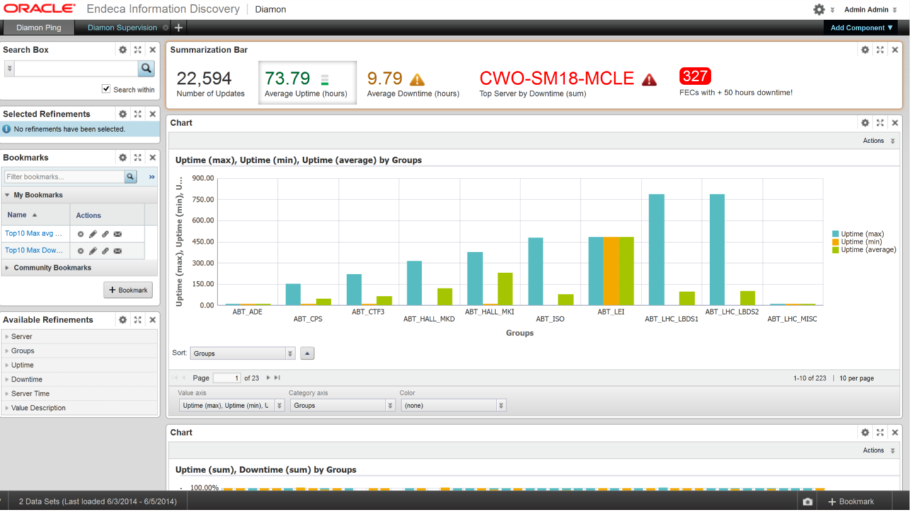
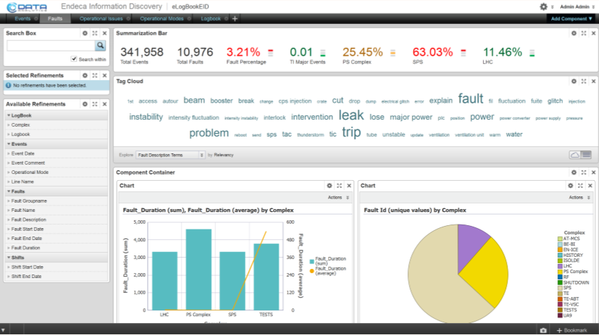
Information Discovery as a Service
Controls and Operations
System Configuration Logging and Monitoring Engineering
IT
Endeca Studio
(user group dedicated)
Provisioning Service
Logs
HR
DIAMON
System Administrators
LanDB
Wide Range of Data Sources
HR Surveys
Accelerator Operators
xx/xx/2014
First Name and Family Name – CERN openlab
10

