Slide 1

TIM BELL
Clouds and Research Collide at CERN
Infrastructure Manager, CERN :: @noggin143

Slide 2

CLOUDS AND
RESEARCH COLLIDE
AT CERN

Slide 3
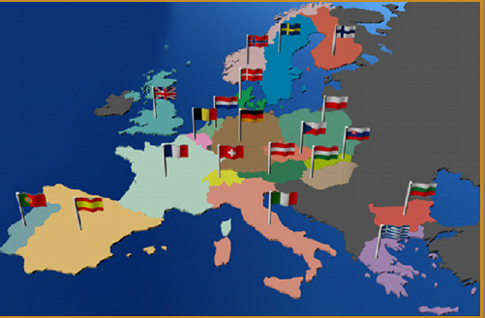
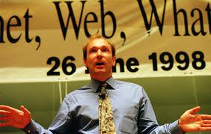
About CERN
CERN is the European Organization
for Nuclear Research in Geneva
  Particle accelerators and other infrastructure
  for high energy physics (HEP) research
  Worldwide community
    21 member states (+ 2 incoming members)
    Observers: Turkey, Russia, Japan, USA, India
    About 2300 staff
    >10’000 users (about 5’000 on-site)
    Budget (2014) ~1000 MCHF
Birthplace of the World Wide Web

Slide 4
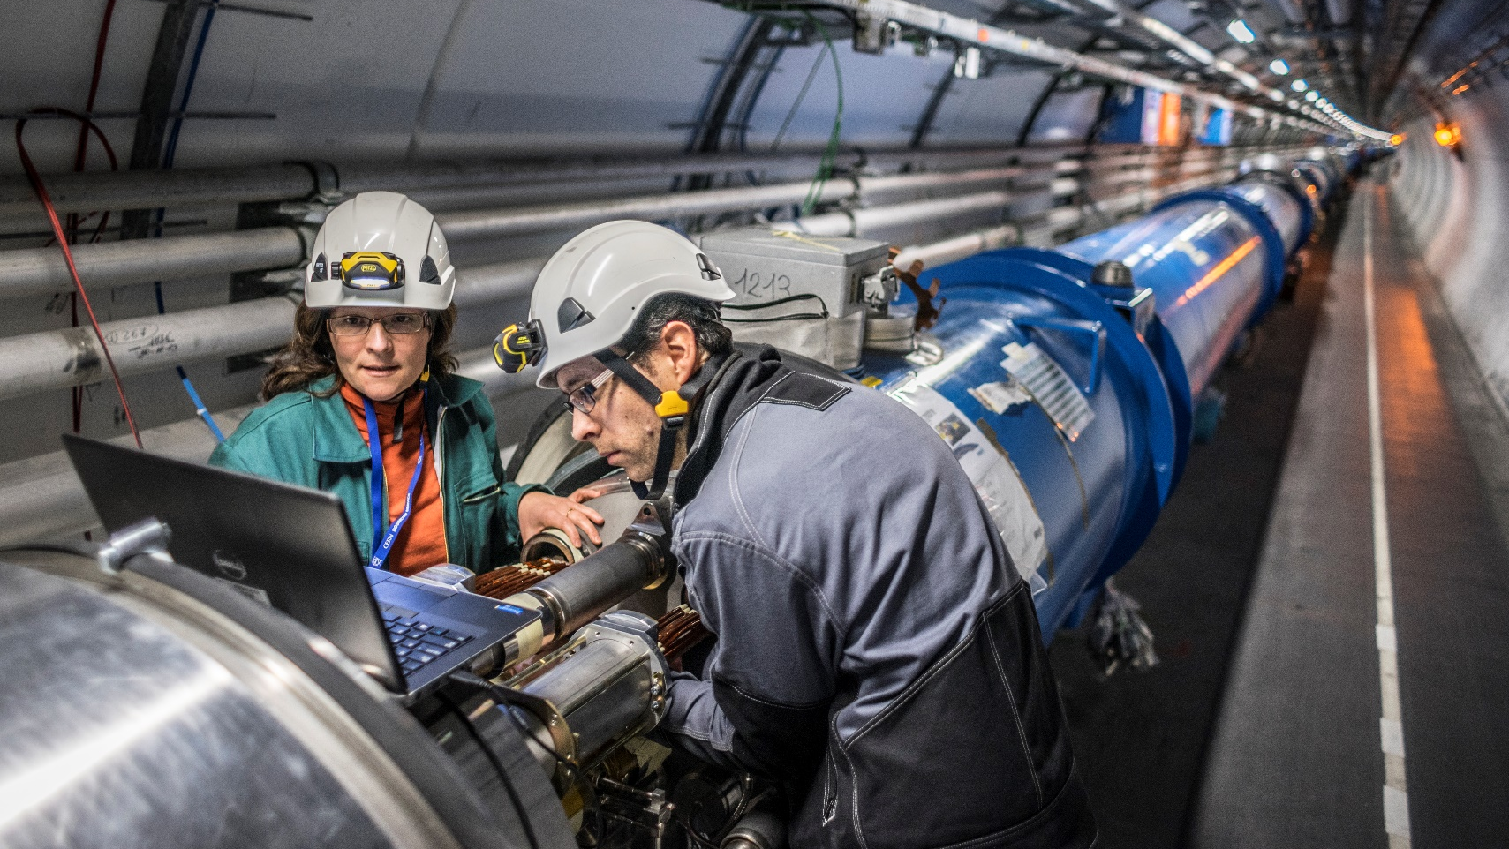
Notes:
Over 1,600 magnets lowered down shafts and cooled to -271 C to become superconducting. Two beam pipes, vacuum 10 times less than the moon

Slide 5


Slide 6
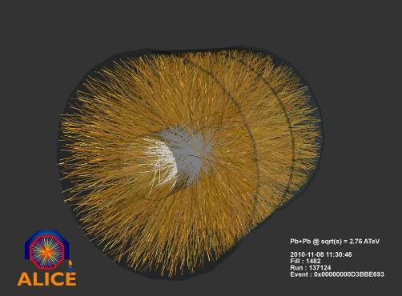
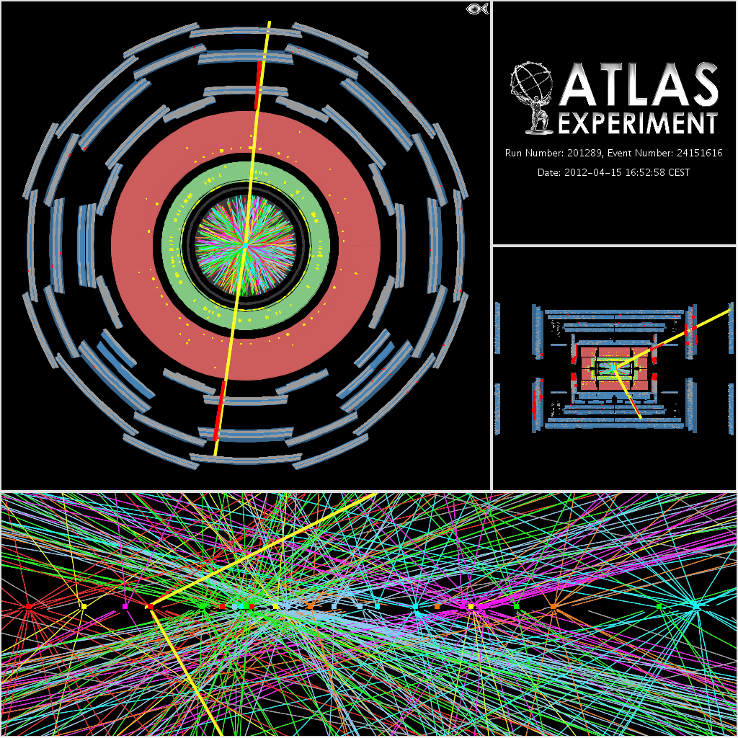
COLLISIONS

Slide 7
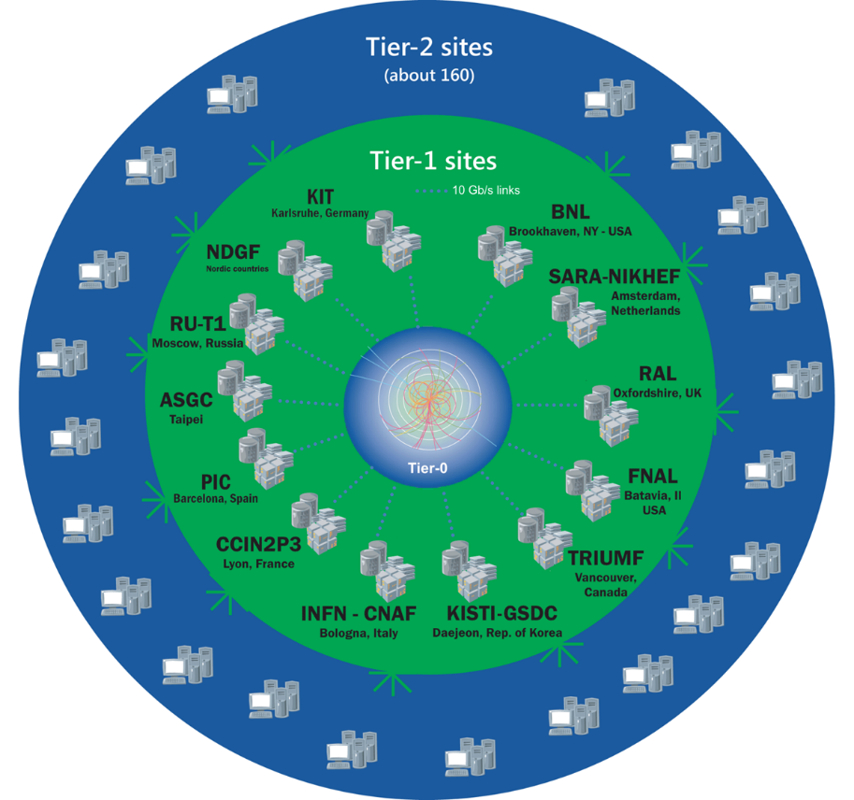
The Worldwide LHC Computing Grid
TIER-0 (CERN):
data recording, reconstruction and distribution
nearly 170 sites,
40 countries
~350’000 cores
TIER-1:
permanent storage,
re-processing,
analysis
500 PB of storage
> 2 million jobs/day
TIER-2:
Simulation,
end-user analysis
10-100 Gb links

Slide 8
LHC Data Growth
Expecting to record 400PB/year by 2023
Compute needs expected to be around 50x current levels if budget available
PB per year
2010 2015 2018 2023

Slide 9
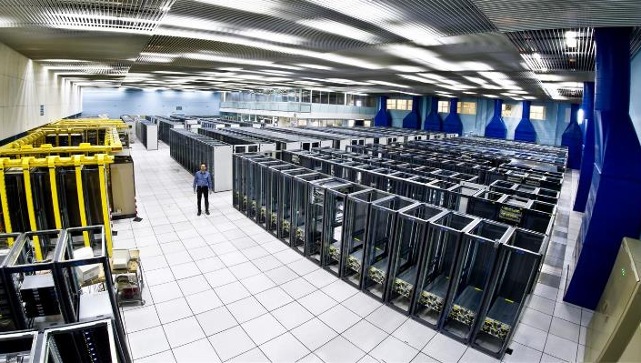
THE CERN MEYRIN
DATA CENTRE
http://goo.gl/maps/K5SoG
Notes:
Recording and analysing the data takes a lot of computing power.
The CERN computer centre was built in the 1970s for mainframes and crays. Now running at 3.5MW of power, it houses 11,000 servers but is at the limit of cooling and electrical power. It is also a tourist attraction with over 80,000 visitors last year!
As you can see, racks are only partially empty in view of the limits on cooling.

Slide 10
Public Procurement Cycle
Step | Time (Days) | Elapsed (Days)
User expresses requirement |  | 0
Market Survey prepared | 15 | 15
Market Survey for possible vendors | 30 | 45
Specifications prepared | 15 | 60
Vendor responses | 30 | 90
Test systems evaluated | 30 | 120
Offers adjudicated | 10 | 130
Finance committee | 30 | 160
Hardware delivered | 90 | 250
Burn in and acceptance | 30 days typical with 380 worst case | 280
Total |  | 280+ Days
Notes:
However, CERN is a publically funded body with strict purchasing rules to make sure that the contributions from our contributing countries are also provided back to the member states, our hardware purchases should be distributed to each of the countries in ratio of their contributions.,
So, we have a public procurement cycle that takes 280 days in the best case… we define the specifications 6 months before we actually have the h/w available and that is in the best case. Worst case, we find issues when the servers are delivered. We’ve had cases such as swapping out 7,000 disk drives where you stop tracking by the drive but measure it by the pallet of disks.
With these constraints, we needed to find an approach that allows us to be flexible for the physicists while still being compliant with the rules.

Slide 11
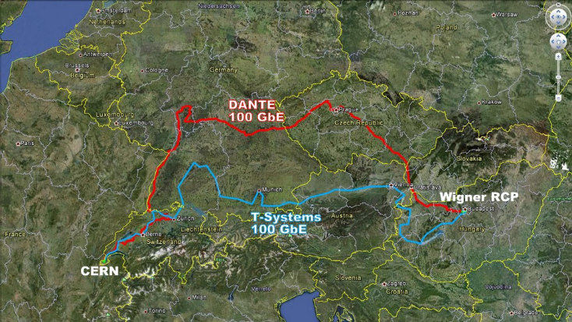

Slide 12

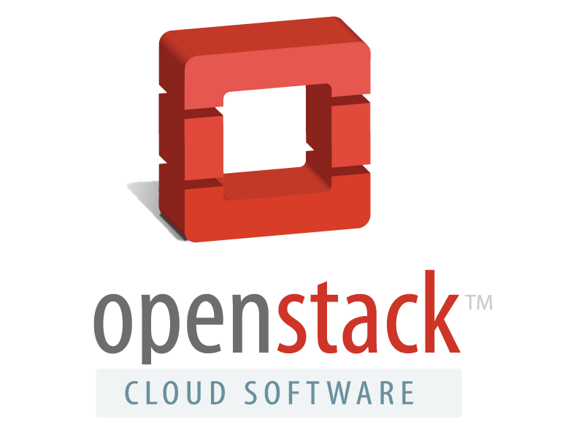








CERN Tool Chain

Slide 13
OpenStack Private Cloud Status
4 OpenStack clouds at CERN
  Largest is ~120,000 cores in ~5,000 servers
  3 other instances with 45,000 cores total
  1,100 active users
Running OpenStack Juno
  3PB Ceph block storage for attached volumes
All non-CERN specific code is contributed back to the community
Notes:
Already 4 independent clouds – federation is now being studied
Rackspace inside CERN openlab
Cells is a key technology to scale

Slide 14
Upstream OpenStack on its own does not give you a cloud
Packaging
Integration
Burn In
SLA
Monitoring
Metering and chargeback
Autoscaling
Monitoring and alerting
Remediation
Cloud is a service!
High availability
Config management
Scale out
Log processing
Infra
onboarding
Capacity planning
Metrics
OpenStack APIs
CI
Network design
Upgrades
Cloud monitoring
Builds
Net/info
sec
SLA
Alerting
Incident resolution
Customer support
User experience
Source: eBay

Slide 15
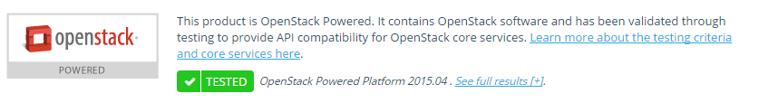
Marketplace Options
Build your own
  High level of programming
  skills needed
  Complete the service circles
Use a distribution
  Good linux admin skills
  License costs
Use a public cloud or hosted private cloud
  Quick start
  Varying pricing models available, check for “OpenStack powered”

Slide 16
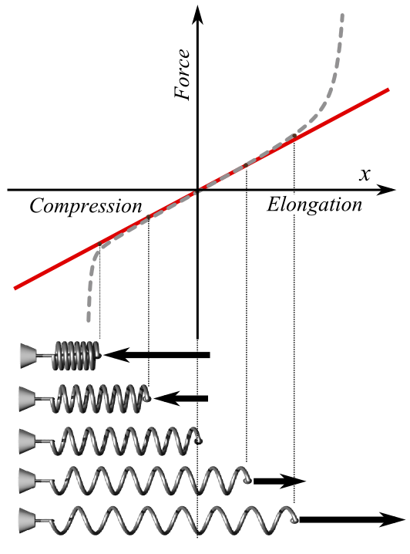
Hooke’s Law for Cultural Change
Under load, an organization can extend proportional to external force
Too much stretching leads to permanent deformation
Notes:
Even in a research oriented environment like CERN, we’ve found tensions between the needs of different services. Hostnames, software version pinning, automatic updates at weekends, ... There are no easy answers especially in an organisation with a culture of academic freedom.

Slide 17
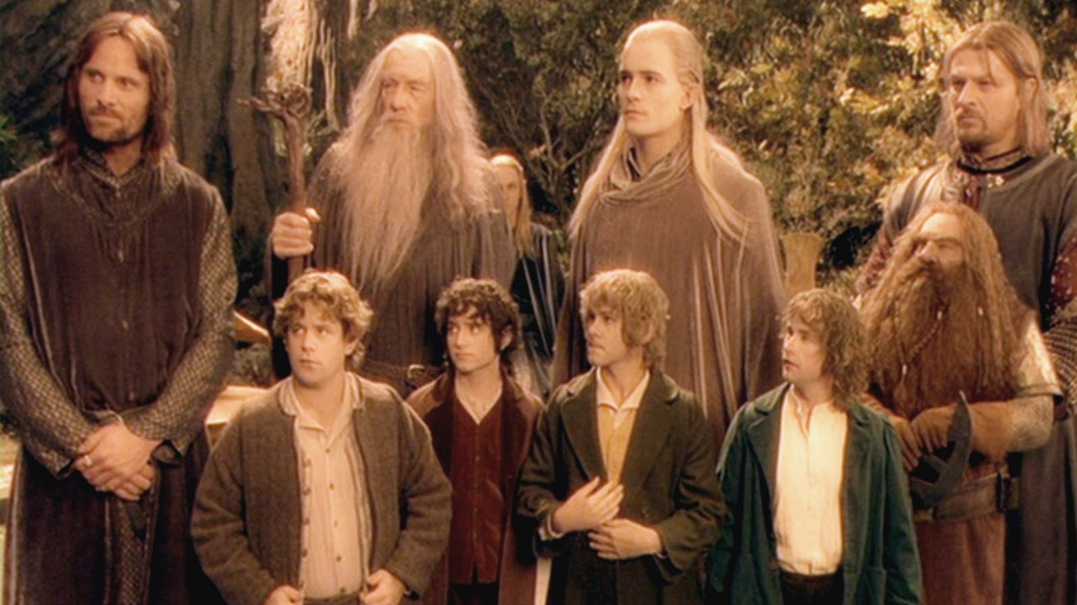
THE AGILE EXPERIENCE
Notes:
So, we assembled a team made up of experienced service managers and new students. By freezing developments on legacy projects, we were able to make resources available but only as long as we could rapidly implement new functions. Many of the staff had to do their ‘day’ jobs as well as work on the new implementations. Several effects
- Newcomers often had experience of the tools from university
People learnt very rapidly by following mailing lists, going to conferences and interacting with the community. Contributions such as contributing to the governance, use cases and testing in addition to standard development contributions.
Short term staff saw major improvements in their post-CERN job prospects as they left with very relevant skills

Slide 18




CULTURAL BARRIERS
Notes:
The agile approach is a major cultural change which is an ongoing process. To illustrate this, there are some characteristics which I show extreme examples of to watch out from Tolkein…. Luckily, we never had characters like this at CERN:
Don’t be hasty, let’s go slowly… transformations such as this cannot be done in a reasonable time by incremental change
Move away from silos… top to bottom from application to hardware managed by a single team to a layered model with shared budget and resources.
Knowledge management responsibilities change. The guru who wrote the tool and trains others on how to use it is replaced by the outside community in which people participate. Everything can appear to be research if you start with a blank piece of paper.
The server or application manager of ‘precious’ applications that need special handling and care has to be understood… some cases are inevitable but many reflect non-technical aspects of the application or server management and may justify changes of process

Slide 19
CERN Openlab in a Nutshell
A science – industry partnership to drive R&D
and innovation with over a decade of success
Evaluate state-of-the-art technologies in a challenging environment and improve them
Test in a research environment today what will
be used in many business sectors tomorrow
Train next generation of engineers/employees
Disseminate results and outreach to new audiences

Slide 20







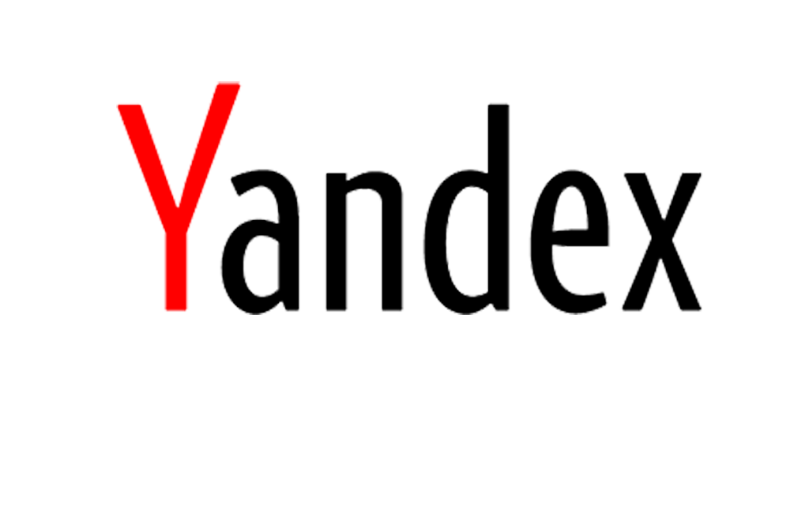


Phase V Members
PARTNERS
CONTRIBUTORS
ASSOCIATES
RESEARCH

Slide 21
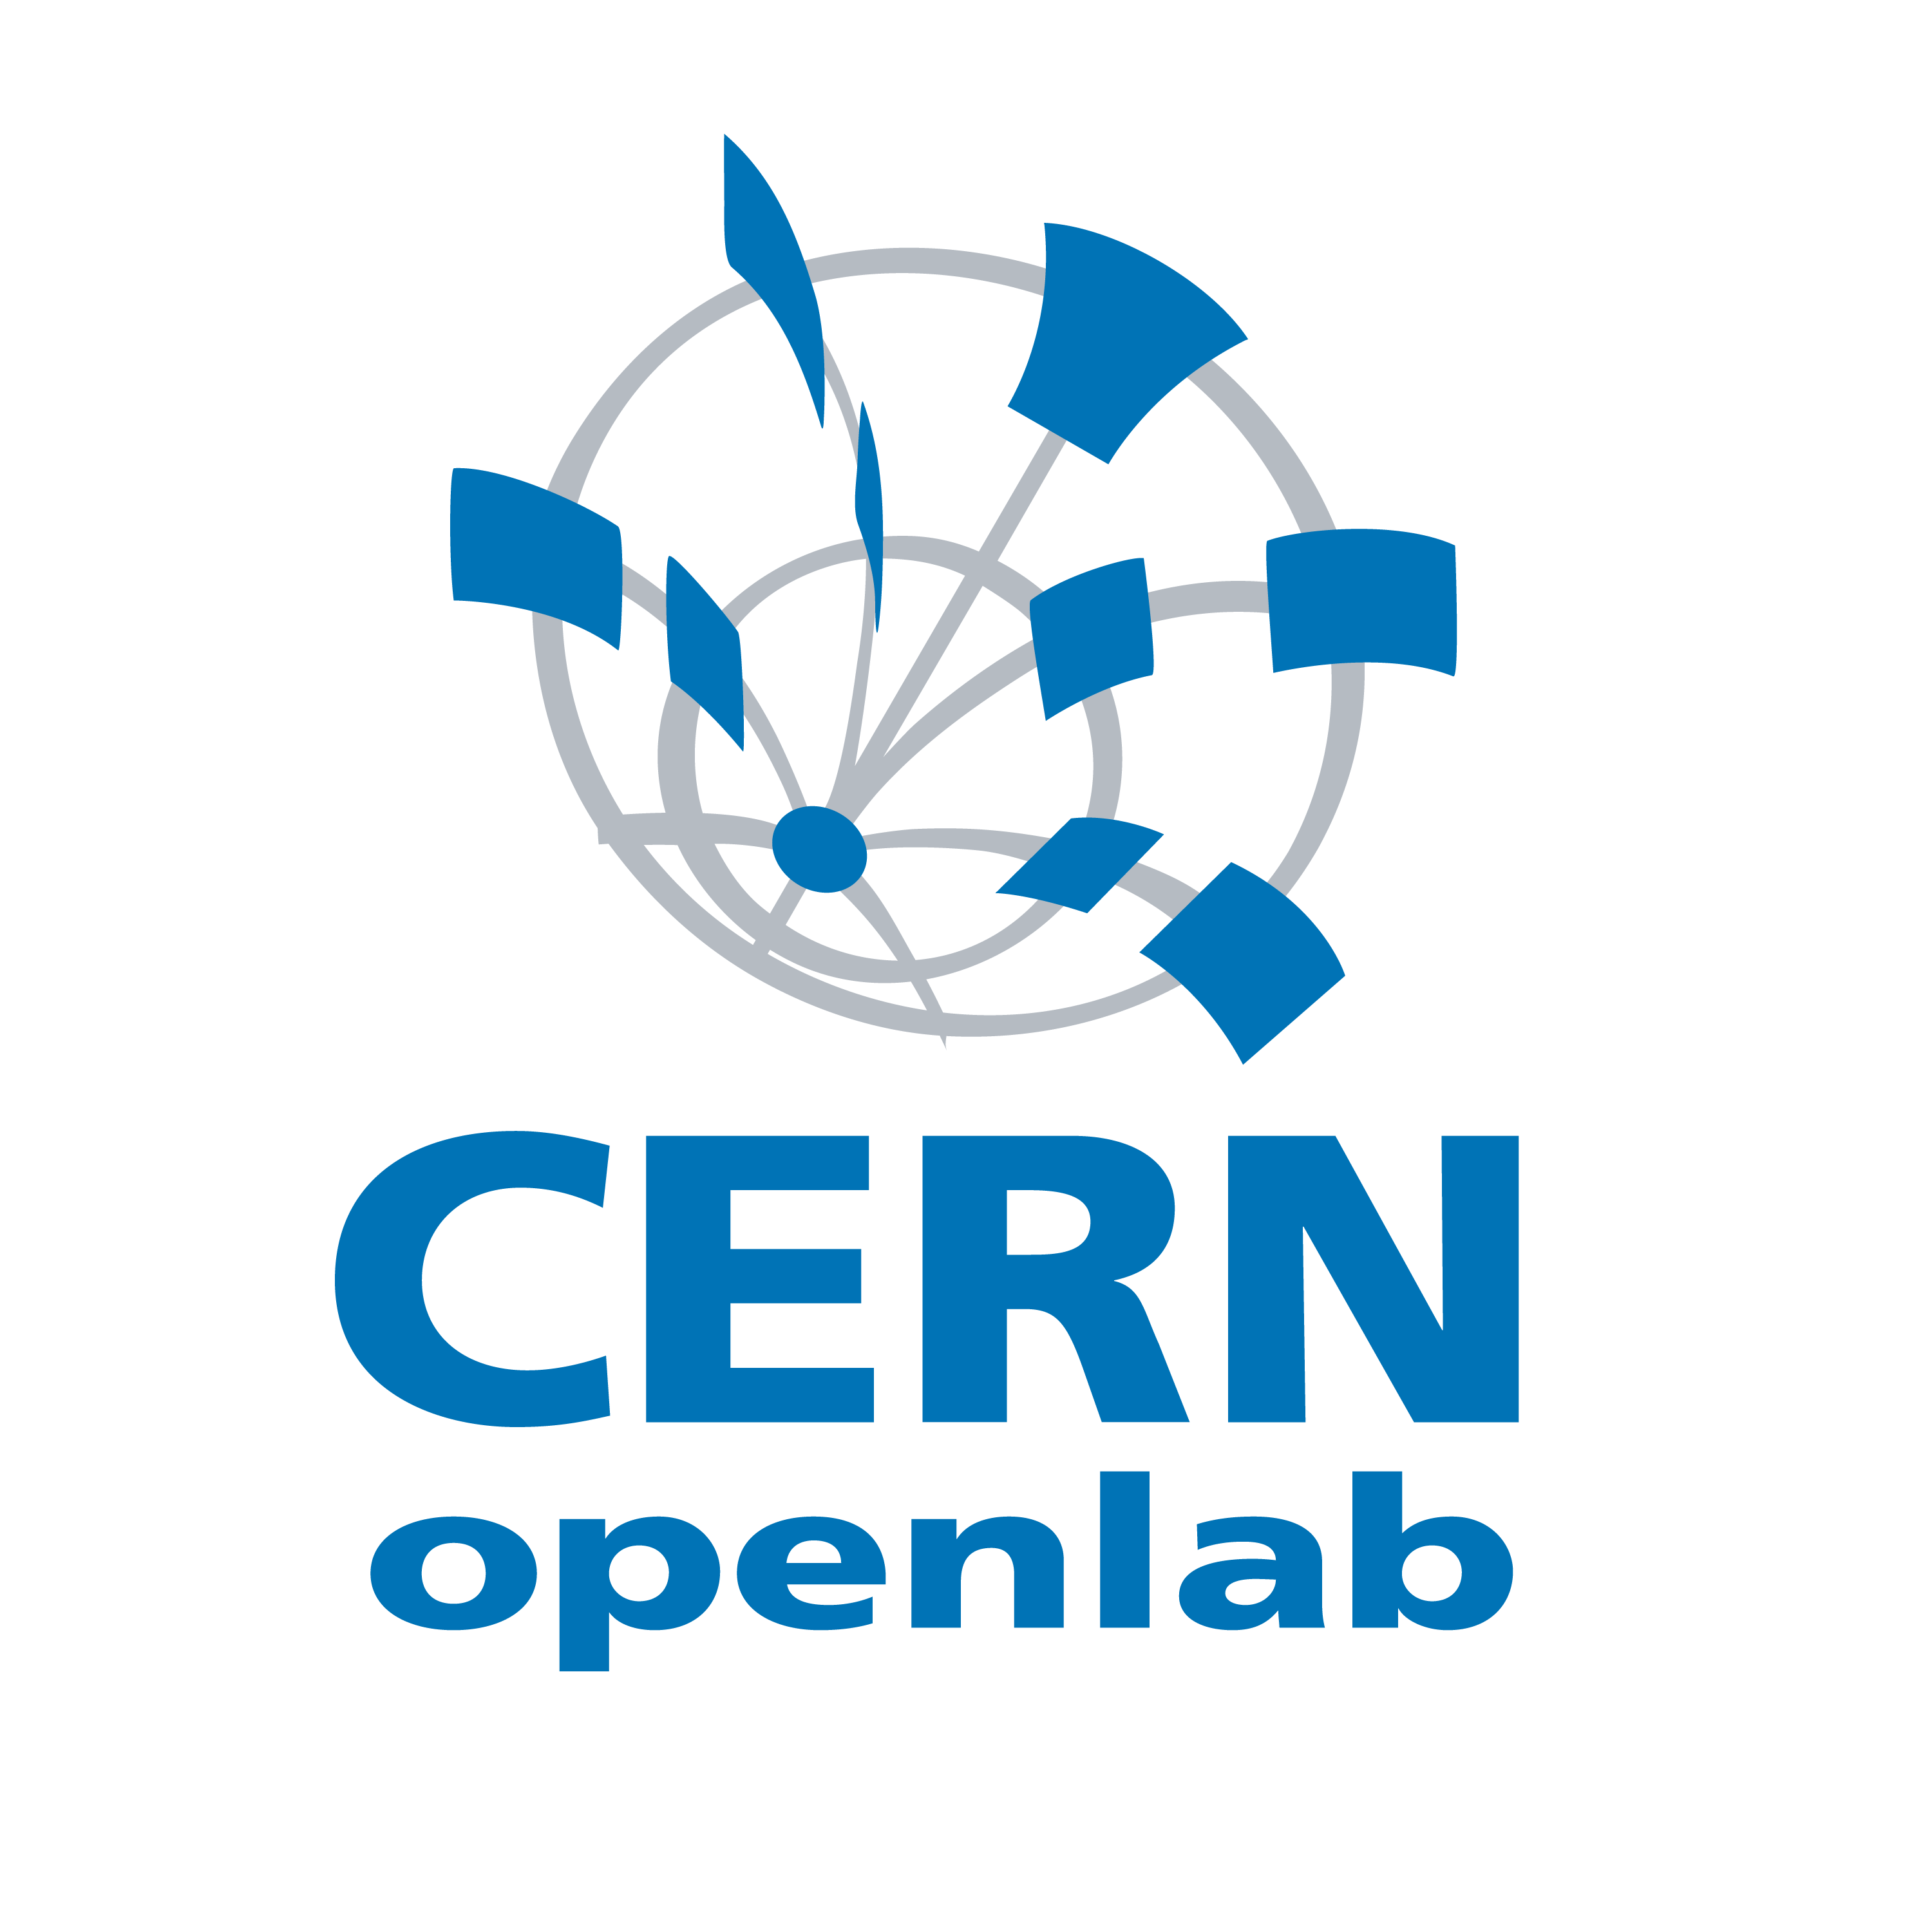
Onwards the Federated Clouds
Many Others
on Their Way
Public Cloud such
as Rackspace
NecTAR
Australia
Brookhaven
National Labs
IN2P3
Lyon
ALICE Trigger
12K cores
CERN Private Cloud
120K cores
ATLAS Trigger
28K cores
CMS Trigger
12K cores
Notes:
The trigger farms are those servers nearest the accelerator which are not needed while the accelerator is shut down till 2015
Public clouds are interesting for burst load (such as coming up to a conference) or when price drops such as spot market
Private clouds allow universities and other research labs to collaborate in processing the LHC data

Slide 22
Openlab Past Activities
Developed OpenStack identity federation
  Demo’d between CERN and Rackspace
  at the Paris summit
Validated Rackspace private and public
clouds for physics simulation workloads
  Performance and reliability comparable
  with private cloud

Slide 23
Openlab Ongoing Activities
Expand federation functionality
  Images
  Orchestration
Expand workloads
  Reconstruction (High I/O and network)
  Bare-metal testing
  Exploit federation

Slide 24
Summary
OpenStack clouds are in production at scale for High Energy Physics
Cultural change to an Agile approach has required time and patience
but is paying off
CERN’s computing challenges and collaboration with Rackspace
has fostered sustainable innovation
Many options for future computing models according
to budget and needs

Slide 25
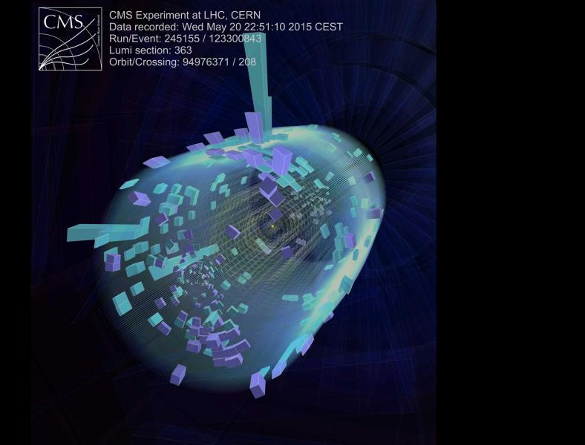
For Further Information ?
Technical details at http://openstack-in-production.blogspot.fr
CERN code is upstream or at http://github.com/
cernops

Slide 26
Backup Slides

Slide 27
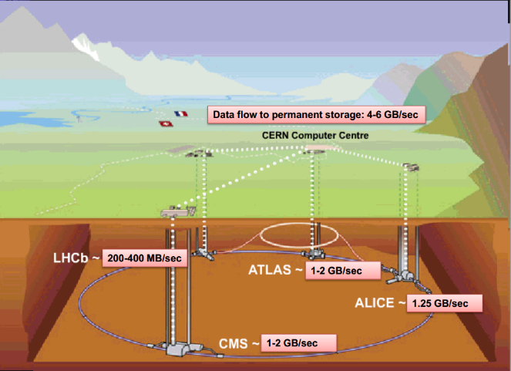

Slide 28
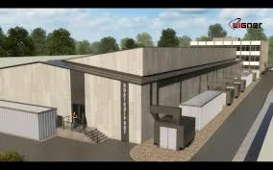
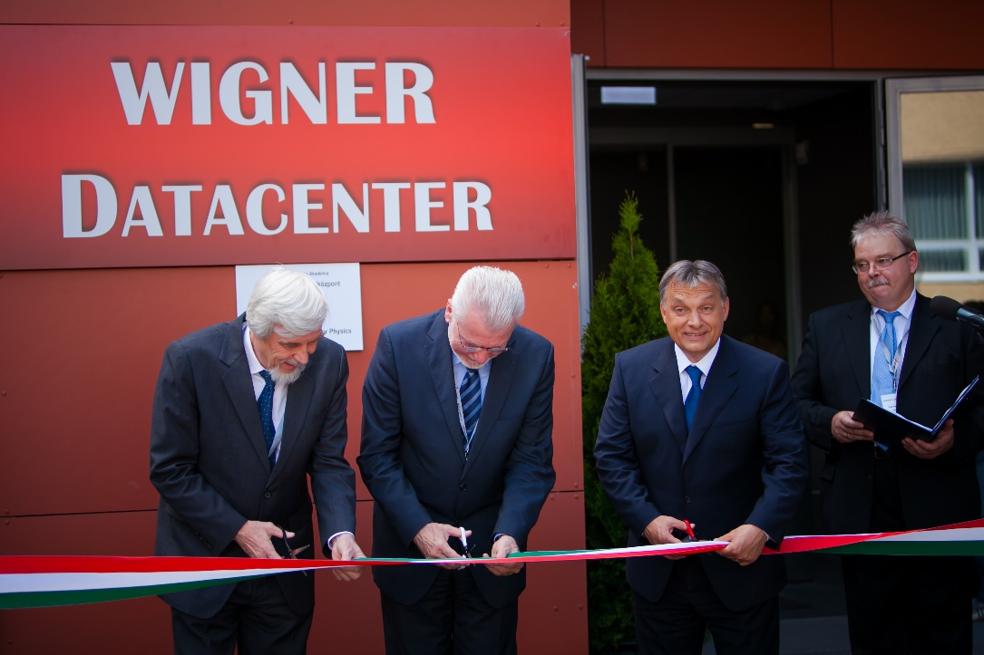
New Data Centre in Budapest
Notes:
We asked our 20 member states to make us an offer for server hosting using public procurement. 27 proposals and Wigner centre in Budapest, Hungary was chosen. This allows us to envisage sufficient computing and online storage for the run from 2015.

Slide 29
Cultural Transformations
Technology change needs cultural change
Speed
  Are we going too fast ?
Budget
  Cloud quota allocation rather than CHF
Skills inversion
  Legacy skills value is reduced
Hardware ownership
  No longer a physical box to check

Slide 30
Good News, Bad News
Additional data centre in Budapest now online
Increasing use of facilities as data rates increase
But…
Staff numbers are fixed, no more people
Materials budget decreasing, no more money
Legacy tools are high maintenance and brittle
User expectations are for fast self-service
Notes:
With the new data centre in Budapast, we could now look at address the upcoming data increases but there were a number of constraints.
In the current economic climate, CERN cannot be asking for additional staff to run the computer systems.
At the same time, the budget for hardware is also under restrictions. The prices are coming down gradually so we can get more for the same but we need to find ways to maximise the efficicency of the hardware.
Our tools for management were written in 2000s, consist of 100,000 of lines of perl over 10 years, often by students, and in need of maintenance. Changes such as IPv6 or new operating systems would require major effort just to keep up.
Finally, the users are expected a more responsive central IT service… their expectations are set by the services they use at home, you don’t have to fill out a ticket to get a dropbox account so why should you need to at work ?

Slide 31
Innovation Dilemma
How can we avoid the sustainability trap ?
  Define requirements
  No solution available that meets those requirements
  Develop our own new solution
  Accumulate technical debt
How can we learn from others and share ?
  Find compatible open source communities
  Contribute back where there is missing functionality
  Stay mainstream
Are CERN computing needs really special ?
Notes:
We came up with a number of guiding principles…
We took an approach that CERN was not special. Culturally, for a research organisation this is a big challenge. Many continue to feel that our requirements would be best met by starting again from scratch but with the modern requirements.
In the past, we had extensive written procedures for sysadmins to execute with lots of small tools to run, These were error prone and often the guys did not read the latest ones before they performed the operation. We needed to find ways to scale the productivity the team to match the additional servers.
One of the highest people cost items was the tooling. We had previously been constructing requirements lists, with detailed must-have needs for acceptance. Instead, we asked ourselves how come the other big centres could run using these open source tools yet we had special requirements. Often, the root cause was that we did not understand the best approach to use the tools rather than that we were special.
The maintenance of our tools was high. The skills and experienced staff were taking up more and more of their time with the custom code so we took an approach of deploy rather than develop.
This meant finding the open source tools that made sense for us, trying them out. Where we found something that was missing, we challenged it again and again. Finally, we would develop in collaboration with the community generalised solutikons for the problems that can eb maintained by the community afterwards. Long term forking is not sustainable.

Slide 32

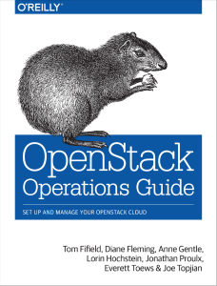
O’Reilly Consideration
Notes:
So how did we choose our tools ? There were the technical requirements are a significant factor but there is also the need to look at the community ecosystem.
Open source on its own is not enough.. Our fragile legacy tools were open source but were lacking a community. Typical example of this is the O’Reilly books.. Once the O’Reilly book is out, the tool is worth a good look.
Furthermore, it greatly helps to train new staff… you can buy them a copy and let them work it through to learn rather than needing to be guru mentored.

Slide 33
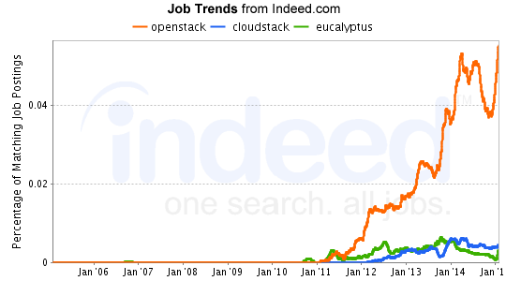
Job Trends Consideration
Notes:
CERN staff are generally on short term contracts, 2-5 years and come from all over the member states.
They come to CERN, often out of university or their 1st jobs. We look for potential rather than specific skills in the current tools.
After a time at CERN, they leave with expert skills and experience in our tools which is a great help for finding future job opportunities and ensuring motivation to the end of their contracts.

Slide 34
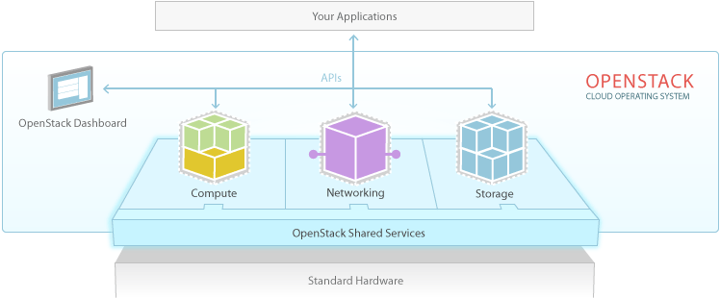
OpenStack Cloud Platform
Notes:
Add Heat (Cloud Formation templates)

Slide 35
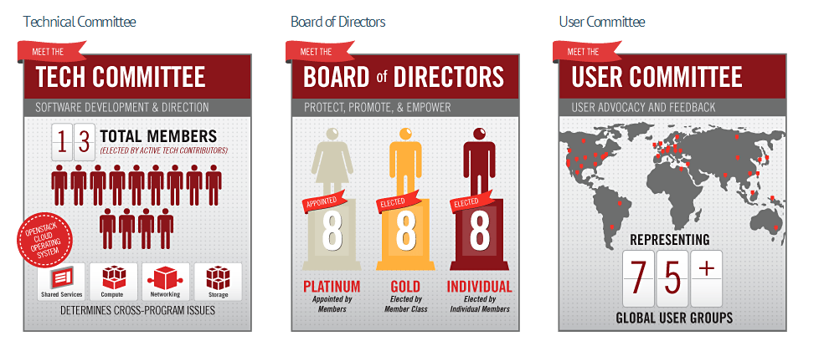
OpenStack Governance

Slide 36
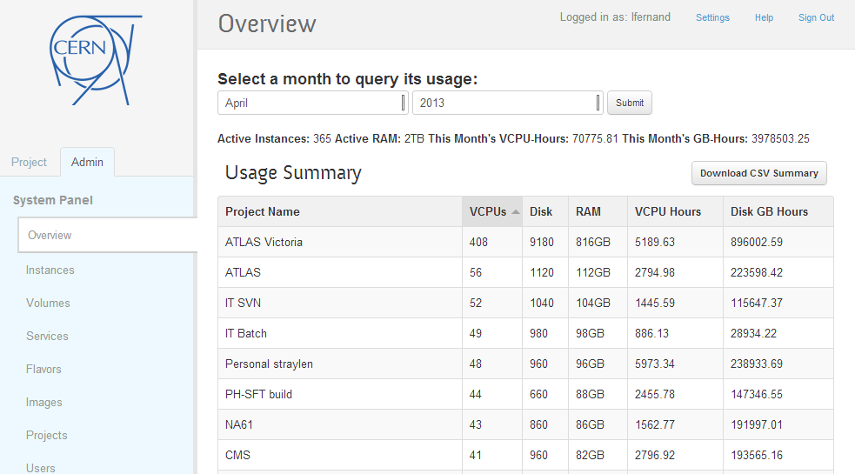

Slide 37
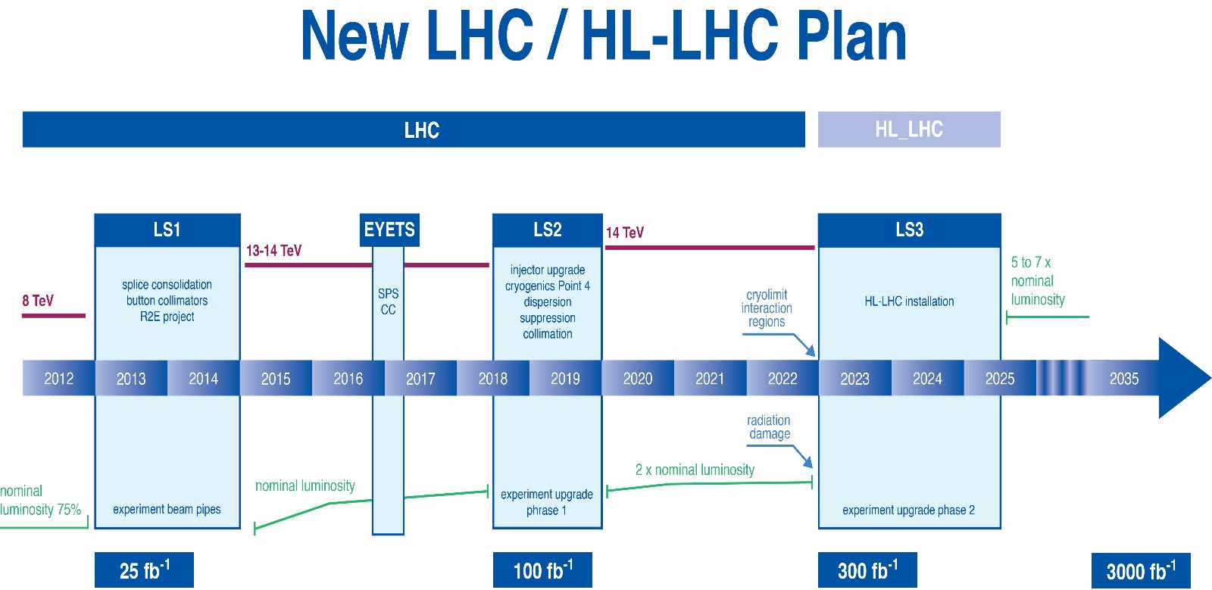
The LHC timeline
L.Rossi
L=1.6x10³⁴
Pile-up~30-45
L=2-3x10³⁴
Pile-up~50-80
L=5x10³⁴
Pile-up~ 130-200
L~7x10³³
Pile-up~20-35

Slide 38
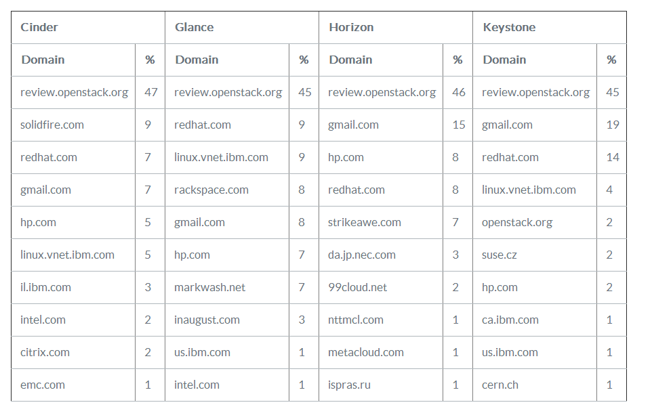
http://www.eucalyptus.com/blog/2013/04/02/cy13-q1-community-analysis-%E2%80%94-openstack-vs-opennebula-vs-eucalyptus-vs-cloudstack

Slide 39
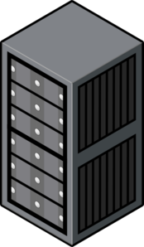


Scaling Architecture Overview
Child Cell
Geneva, Switzerland
controllers
compute-nodes
Load Balancer
Geneva, Switzerland
Top Cell - controllers
Geneva, Switzerland
Child Cell
Budapest, Hungary
controllers
compute-nodes
Notes:
HA Proxy load balancers to ensure high availability
Redundant controllers for compute nodes
Cells used by the largest sites such as Rackspace and NeCTAR – more than 1000 hypervisors is the recommended configuration

Slide 40
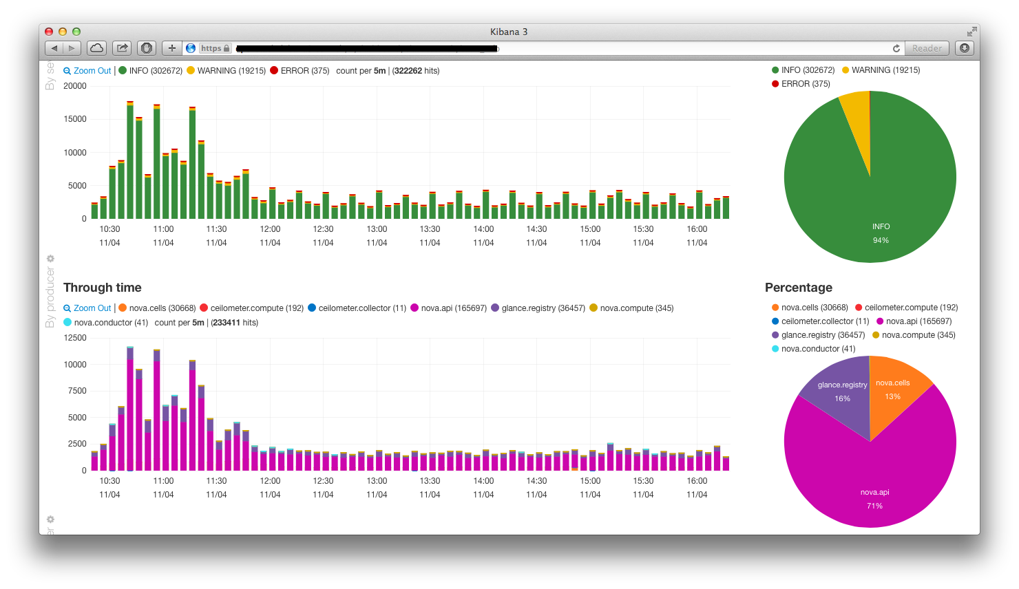
Monitoring - Kibana

Slide 41
Architecture Components
Top Cell
Children Cells
Controller
Controller
Compute node
rabbitmq
- Nova api
- Nova consoleauth
- Nova novncproxy
- Nova cells
rabbitmq
- Nova api
- Nova conductor
- Nova scheduler
- Nova network
- Nova cells
- Nova compute
- HDFS
- Ceilometer agent-compute
- Elastic Search
- Flume
- Kibana
- Glance api
- Glance registry
- Glance api
- Ceilometer api
- Stacktach
- Ceilometer agent-central
- Ceilometer collector
- Cinder api
- Cinder volume
- Cinder scheduler
- Ceph
- Keystone
- Keystone
- Flume
- MySQL
- Horizon
- MongoDB
- Flume
Notes:
Child cells have their own keystone in view of load from ceilometer
Requires care to set up and test

Slide 42

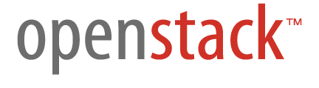
Block Storage
Ceph & NetApp
CERN Accounting
CERN Network Database
Ceilometer
Cinder
Account mgmt system
Network
Compute
Keystone
Scheduler
Microsoft Active Directory
Nova
Horizon
Glance
Database Services
Notes:
Account Management Automation
CERN legacy network database
No Neutron yet

Slide 43

Academic
Other market sectors
Big Science
Small and Medium Scale Science
Government
Manufacturing
Oil & gas, etc.
Helix Nebula
Broker(s)
Network Commercial/GEANT
EGI Fed Cloud
Atos
Cloud
Sigma
T-
Systems
Interoute
Front-end
Front-end
Front-end
Front-end
Front-end
Front-end
Publicly funded
Commercial

